Slide 1
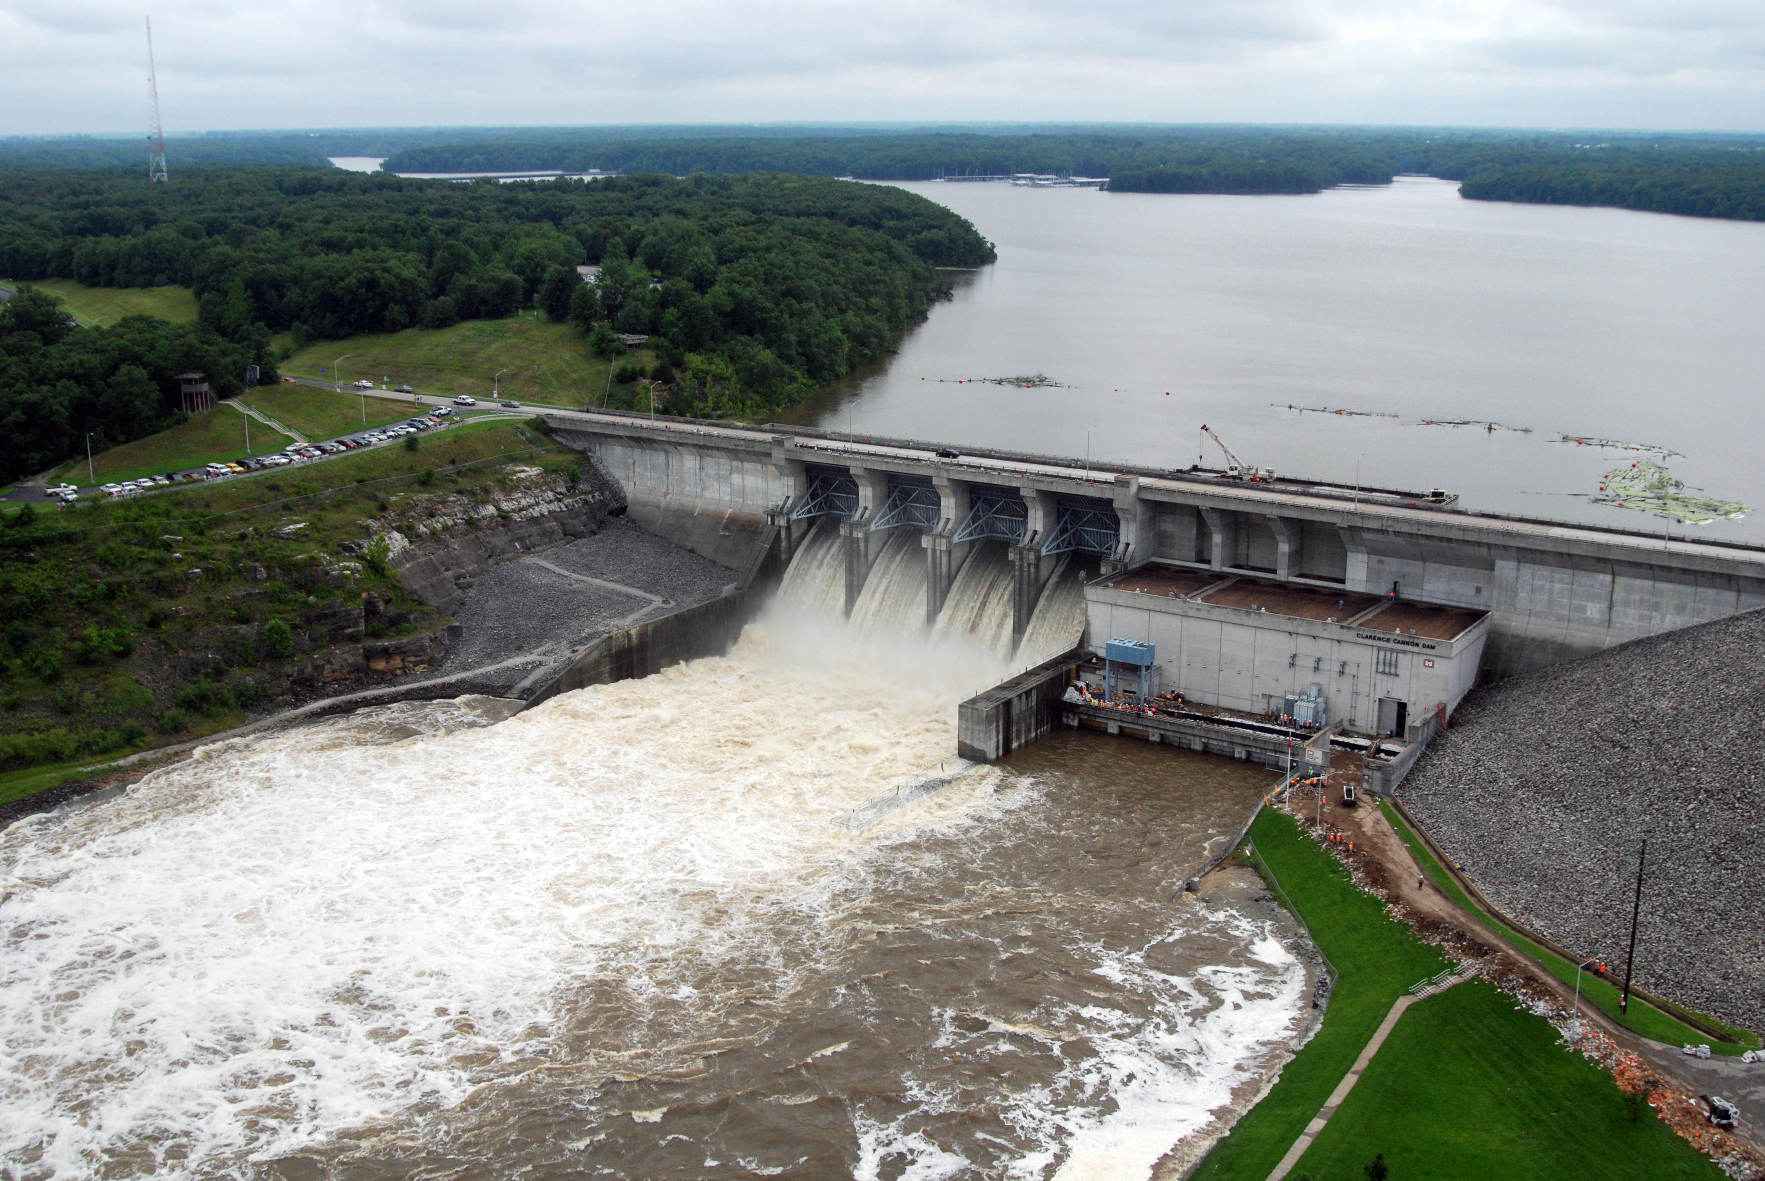
Implementing Release Rules
Reservoir Modeling with HEC-ResSim

Slide 2
Outline
Set the stage
Where and how to find operational constraints for a reservoir
How to define operational constraints as HEC-ResSim rules, and input them
  Create basic at-site rules

Slide 3
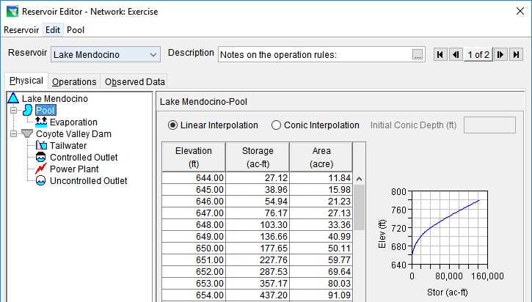
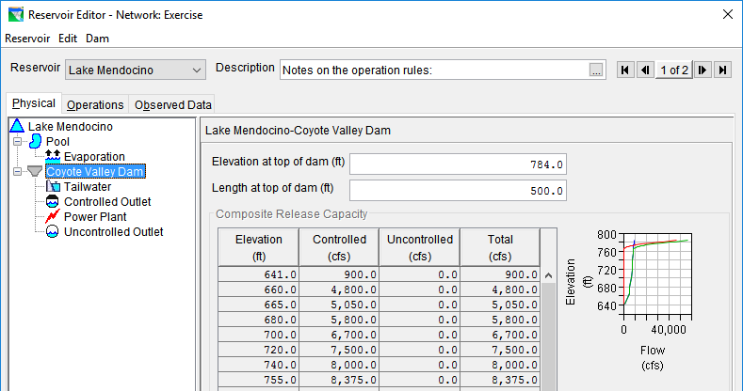
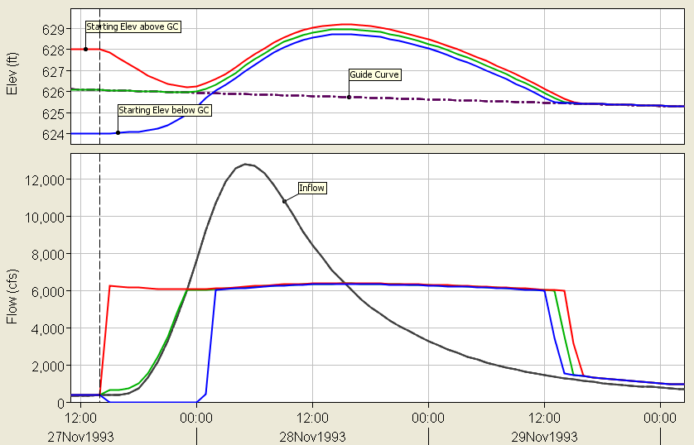
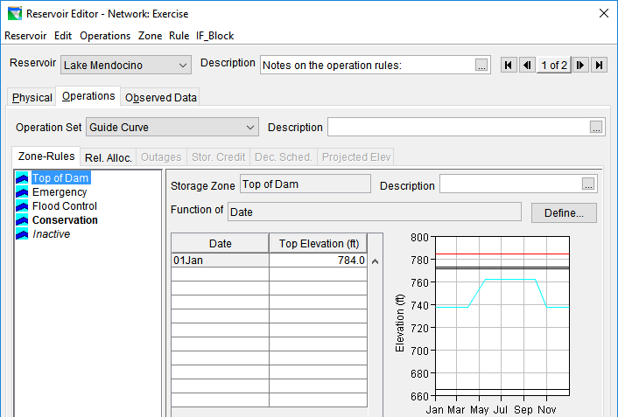
Thus Far
physical release constraint

Slide 4
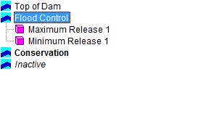
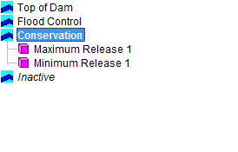
Thus Far….
Allowable Range of Releases & Release Decision

Slide 5
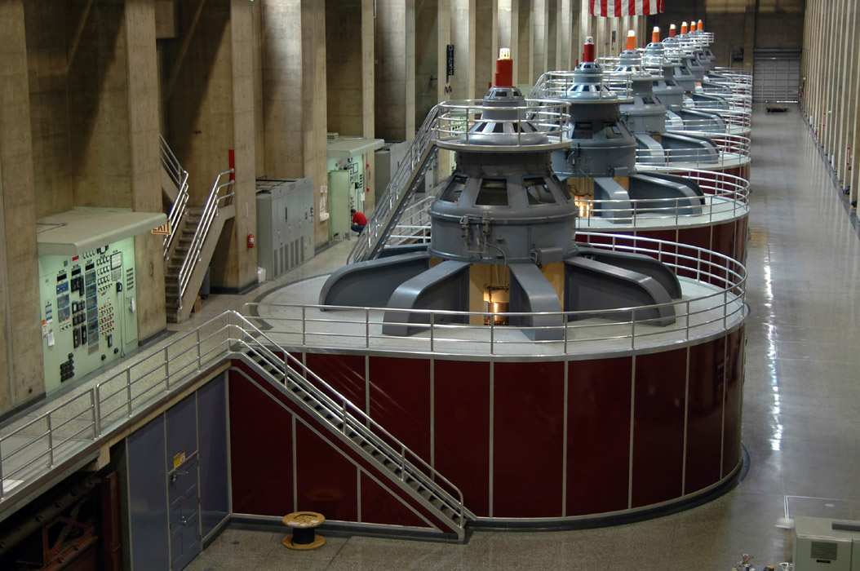

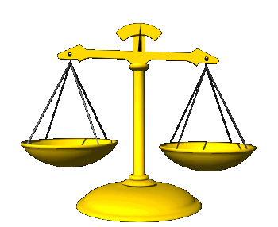

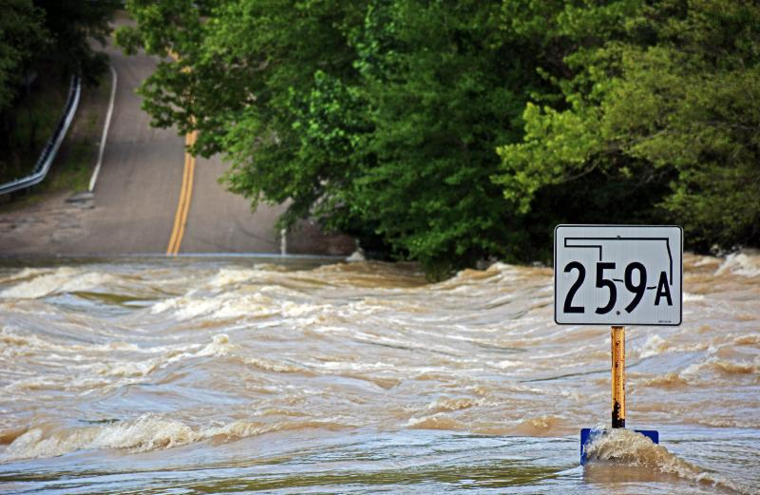
Objectives, and Operational Constraints

Slide 6
Where to Find
Operational Constraints

Slide 7
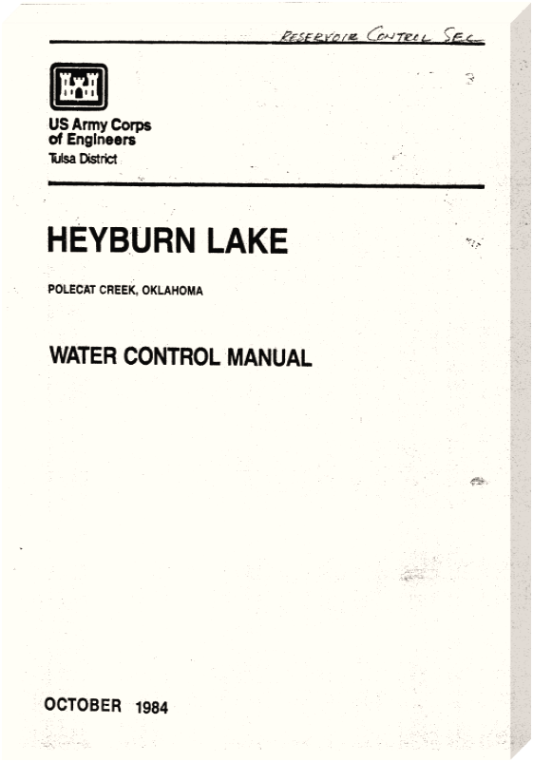
Sources for Operational Constraints
A good ol’ Water Control Manual
  Best source for operational constraints
No water control manual?
  Contact the operating agency
  Contact state water resources agency
Polecat:
“Despite their common name, polecats are more closely related to dogs than to cats.” -wikipedia

Slide 8
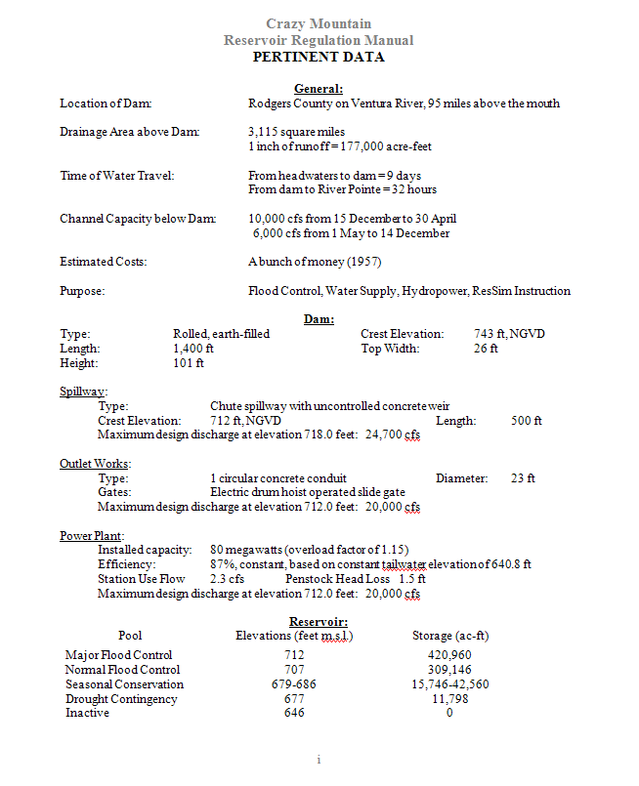
Pertinent Data
Become familiar with characteristics of the reservoir
Reservoir’s purpose and operating constraints
Keywords and phrases:
  Project Purposes
  Pool Levels
  Channel Capacity

Slide 9
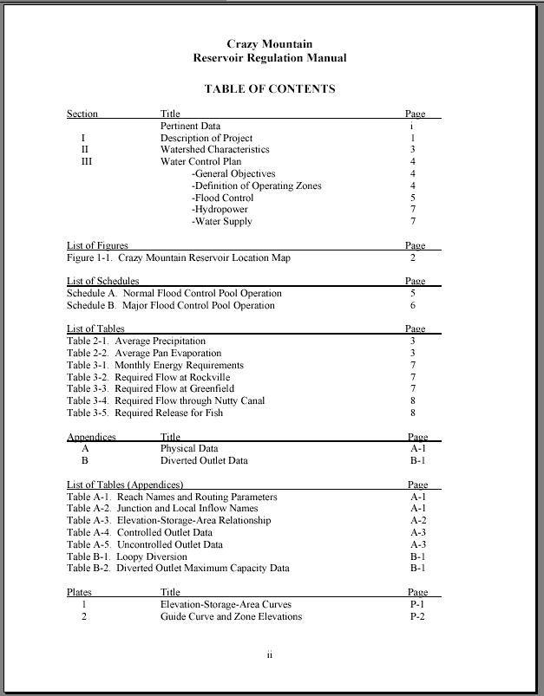
Table of Contents
Look at the table of Contents:
  Lists of Figures, Tables
  Plates and Exhibits
Keywords and phrases:
  Water Control Plan
  Instructions to Operators
  Operating Zones
  Operating Constraints
  Hydropower

Slide 10
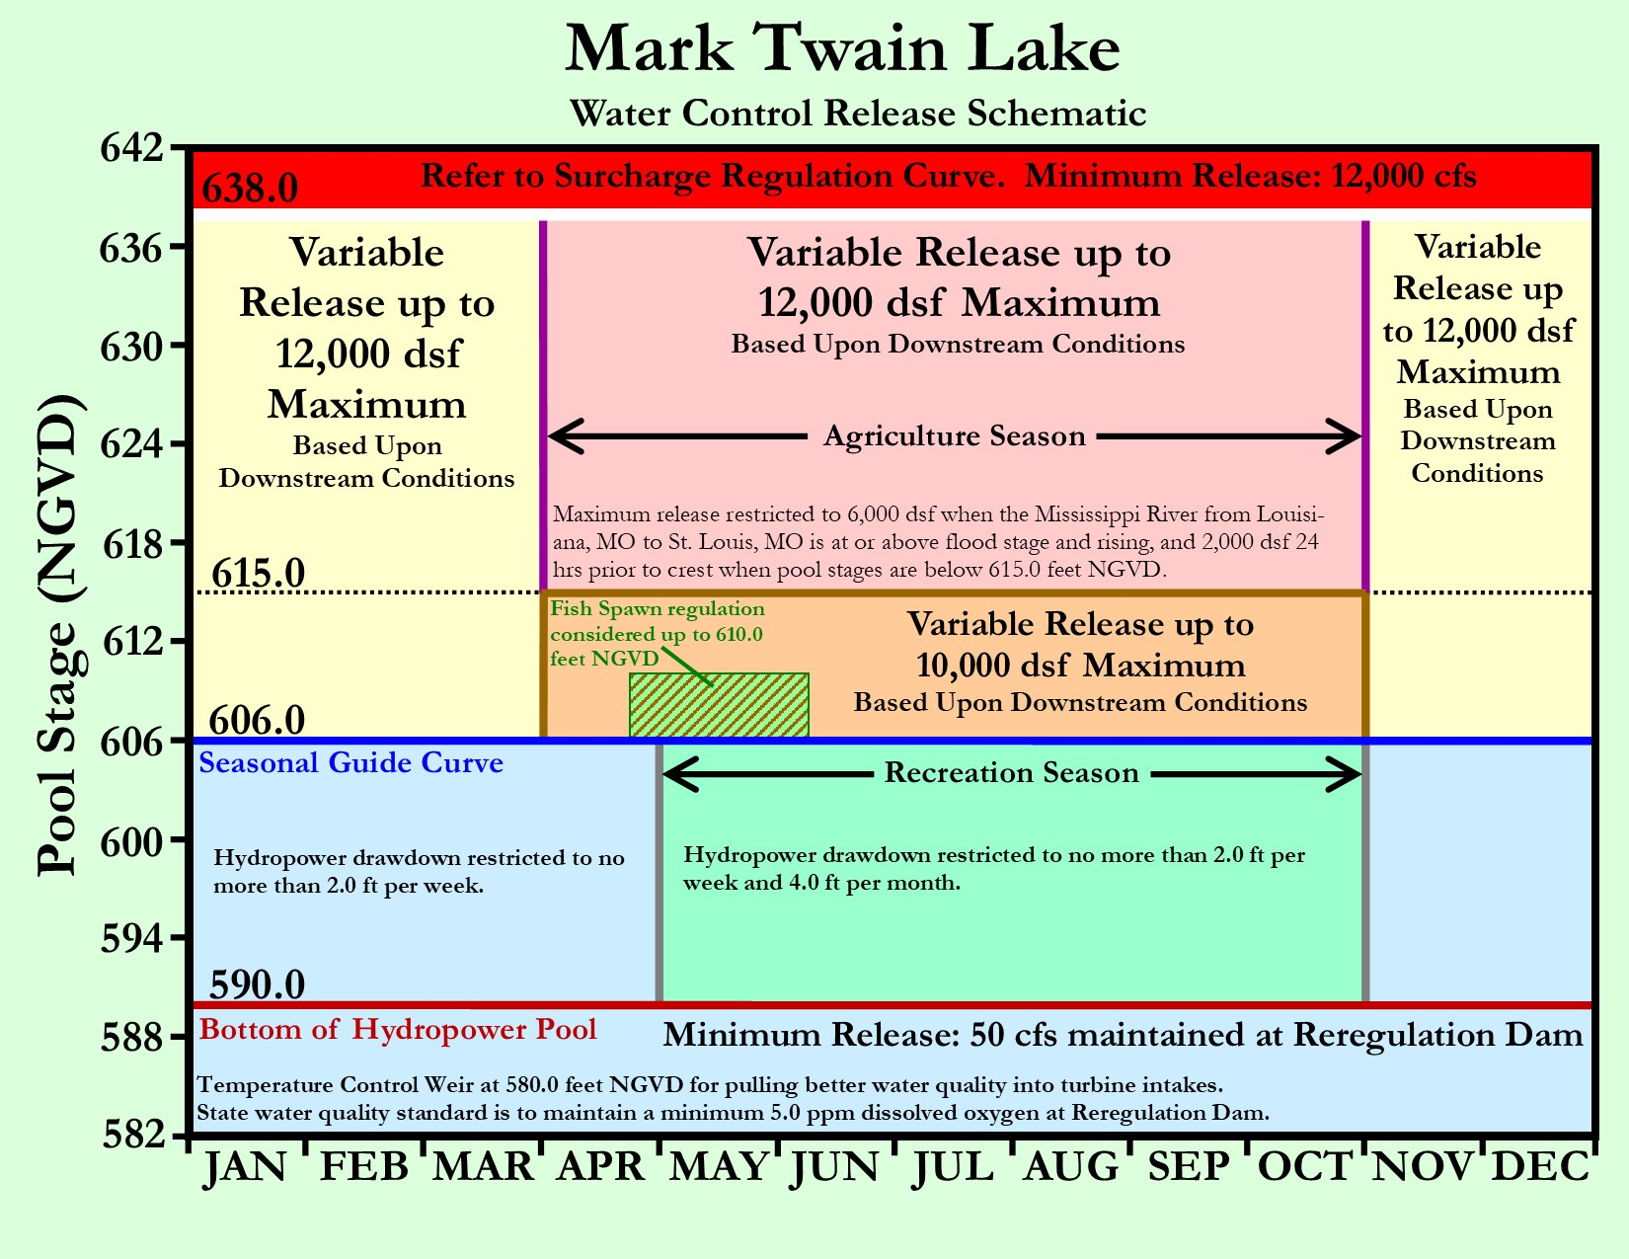
Plates

Slide 11
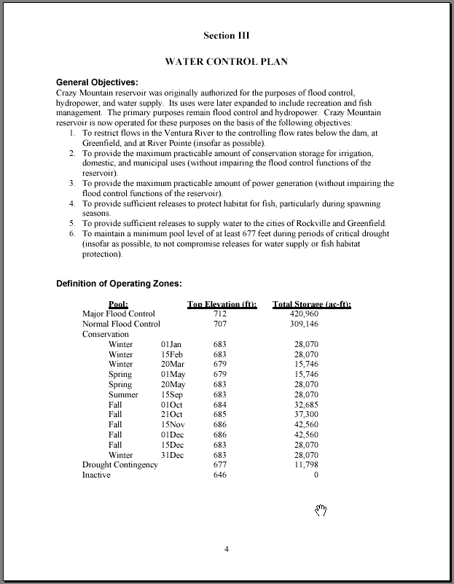
Water Control Plan
Read the plan CAREFULLY
Look for descriptions of requirements the reservoir must meet
Look for pool levels that will define your operating zones
Tables are great
  Some constraints are only mentioned in the text !

Slide 12
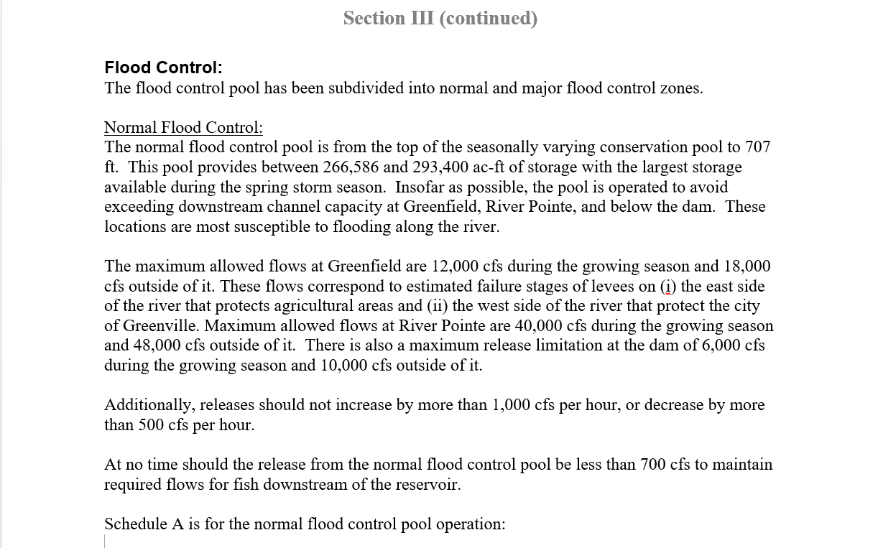
Operational Constraints
Downstream Constraint (Maximum)
At-site Release Constraint (Maximum)
At-site Rate of Change Constraint (Increase/Decrease)

Slide 13
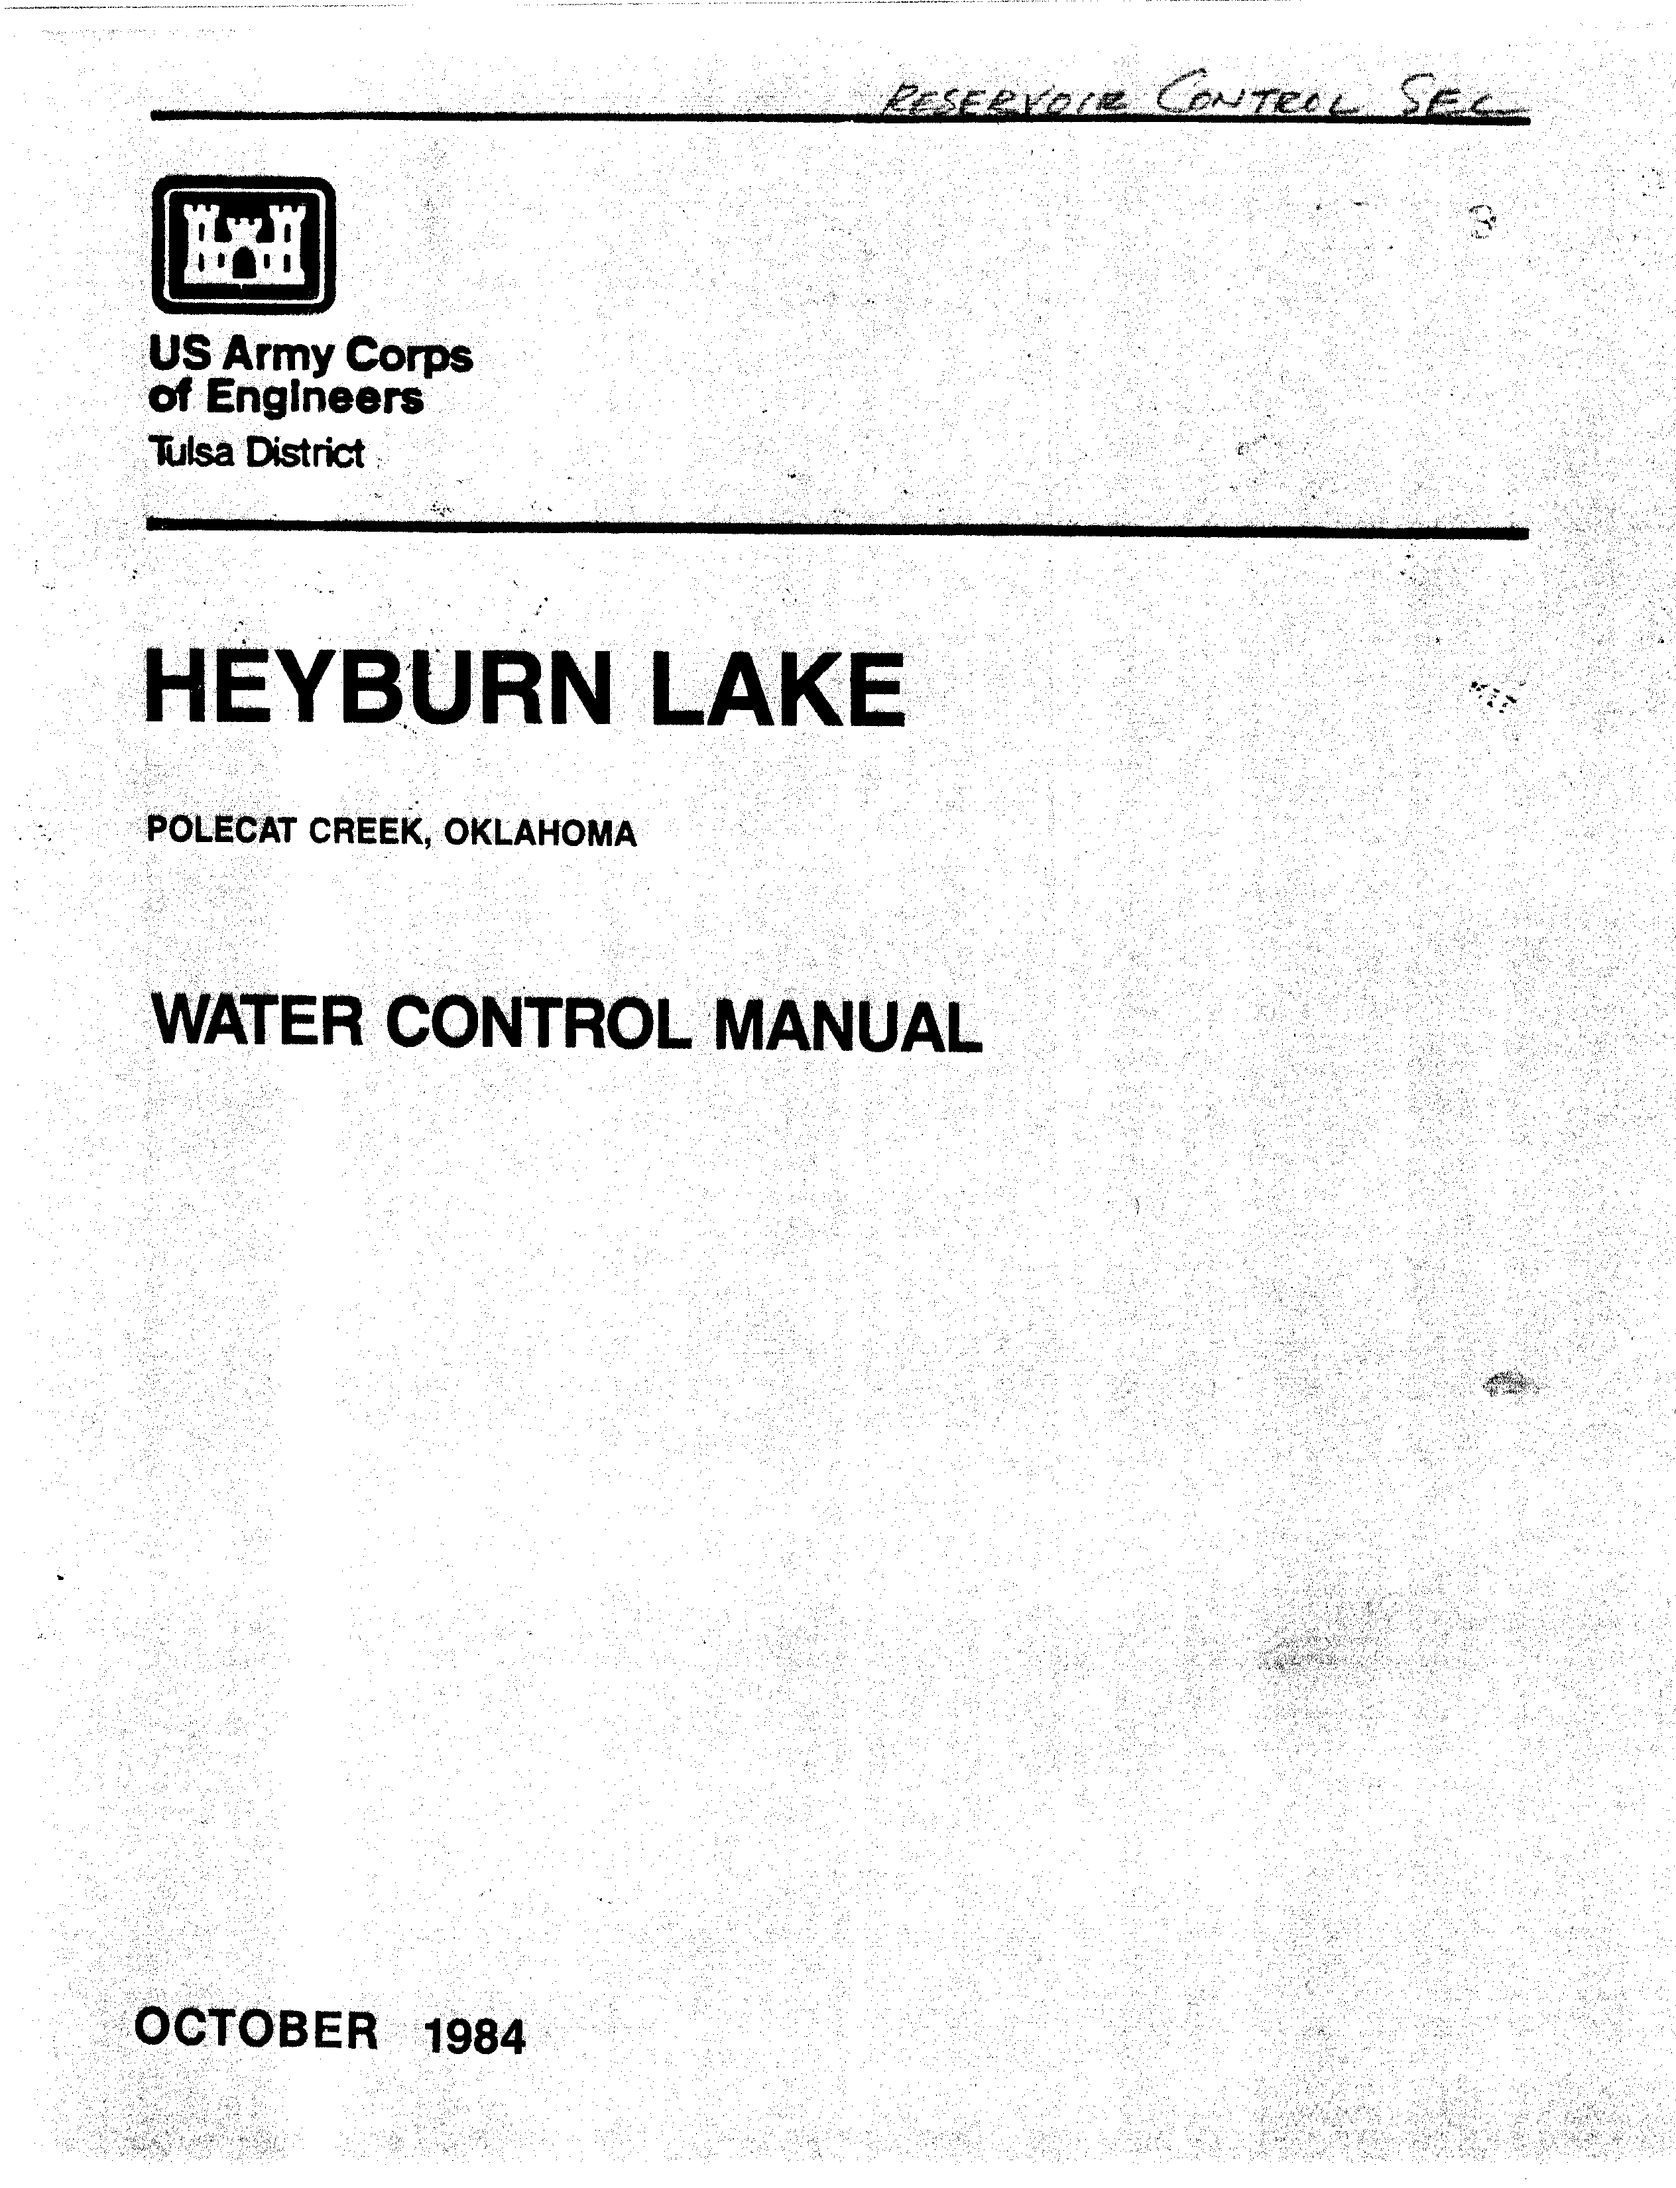
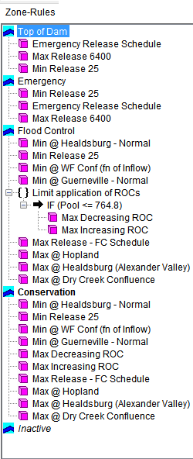
Next, Convert to Operational Rules

Slide 14
Turning Operating Constraints into
HEC-ResSim Operating Rules

Slide 15
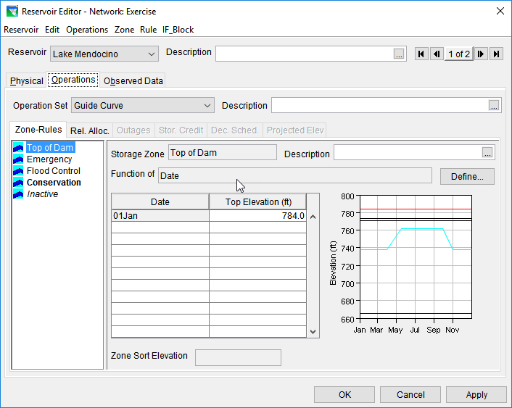
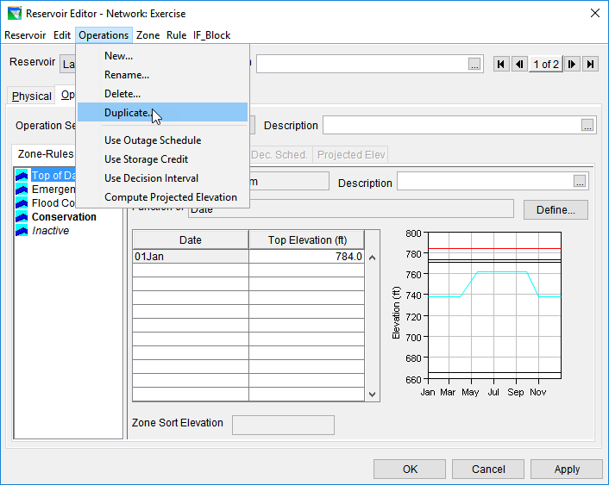
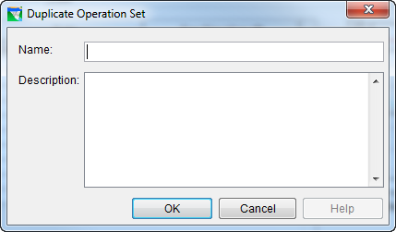
Create a New Operation Set
Operations Set: The set of zones and rules that describe a water control plan
  Instead of creating from scratch, use Duplicate…

Slide 16
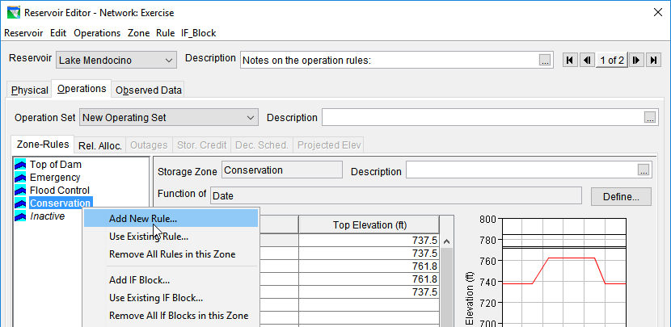
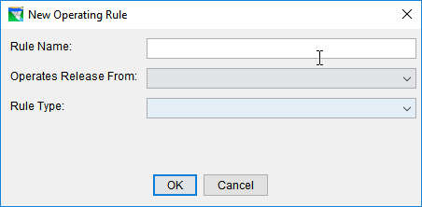
Creating a Rule
Right click a Zone to add the rule to
  This is the zone in which the rule will apply
Select Add New Rule… from the Rule Menu
1
2

Slide 17
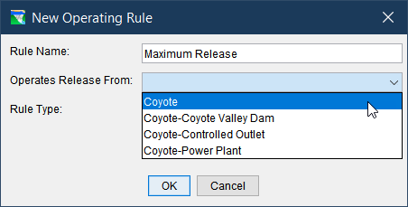
Creating a Rule: Release From
Select the reservoir element the rule will affect
  The pool (labeled as the reservoir itself)
  The dam
  An outlet group
  A specific outlet
3

Slide 18
Elements of a Reservoir Element
Inflow Junction
Reservoir
Pool
Outlets
Dam
Dam Tailwater
Outflow Junction

Slide 19

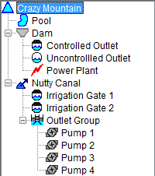
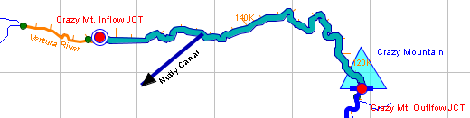
Elements of a Reservoir
The Physical tab helps visualize the elements within a reservoir

Slide 20
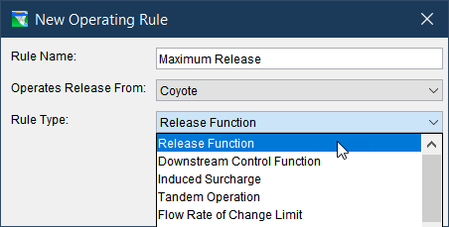
Creating a Rule: Rule Type
Select the rule type
  Many different rule types to select
    Some elements can’t use certain rule types
    Drop down will update based on element
4

Slide 21
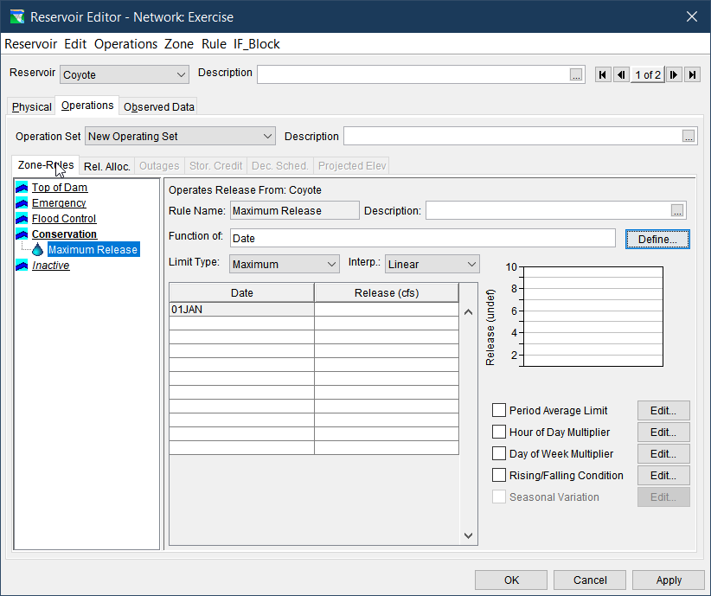
10000

Slide 22
Defining Rate of Change Rules

Slide 23
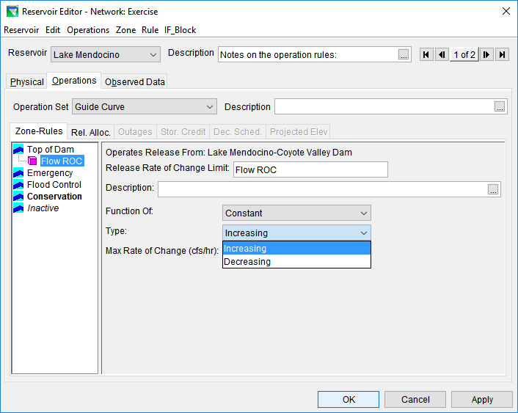
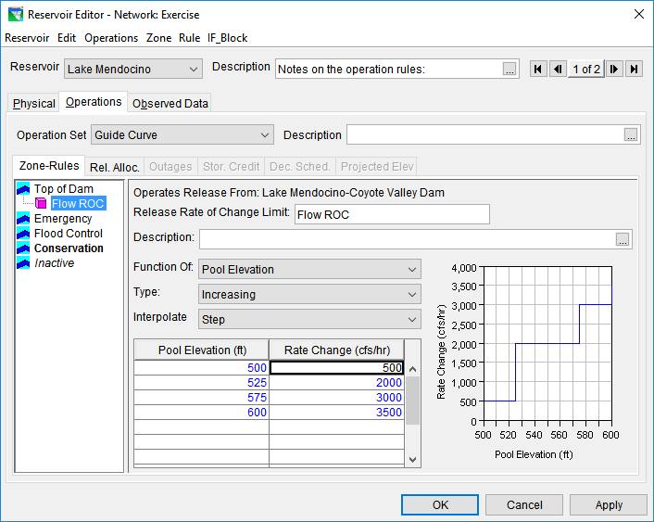
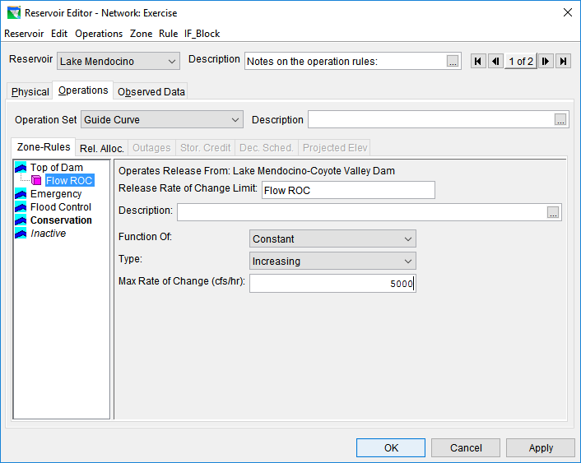
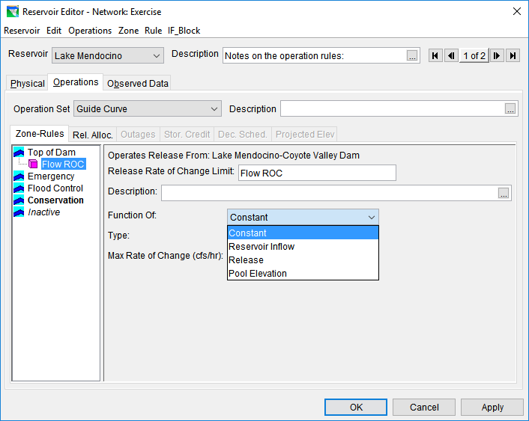
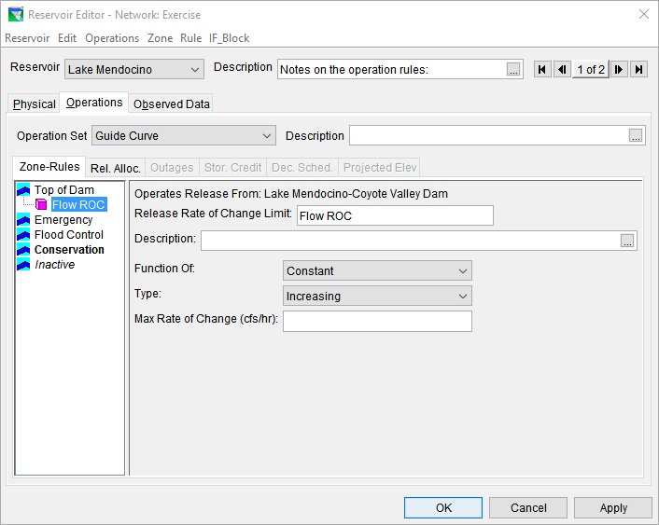

Flow Rate of Change Rules
Limits the rate of change (cfs/hr) of releases from one time step to the next
Evaluated instantaneously

Slide 24

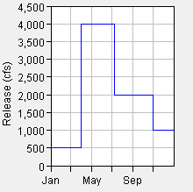
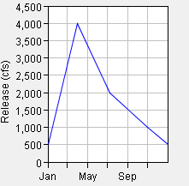
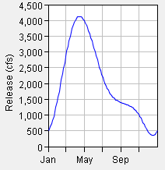
Interpolation Options
Step
Linear
Cubic

Slide 25
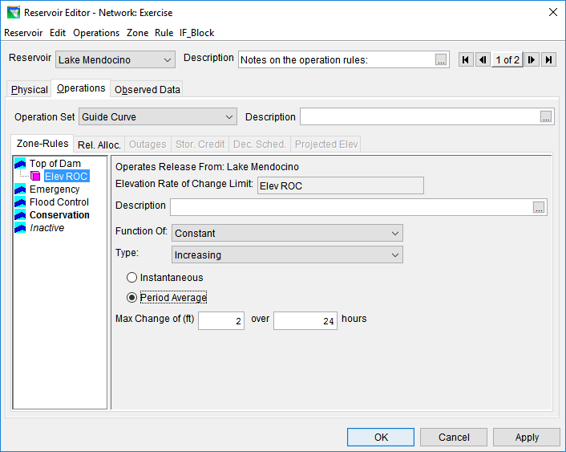
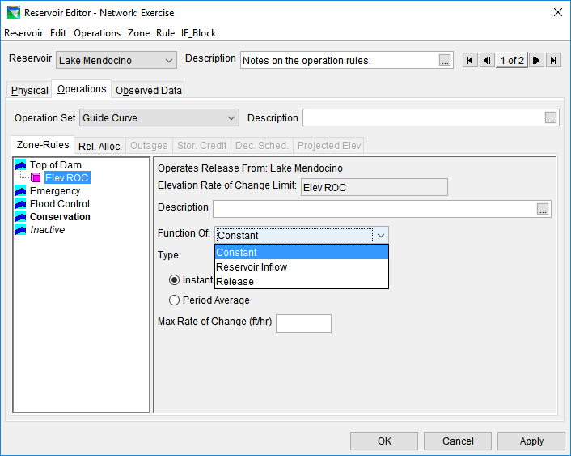
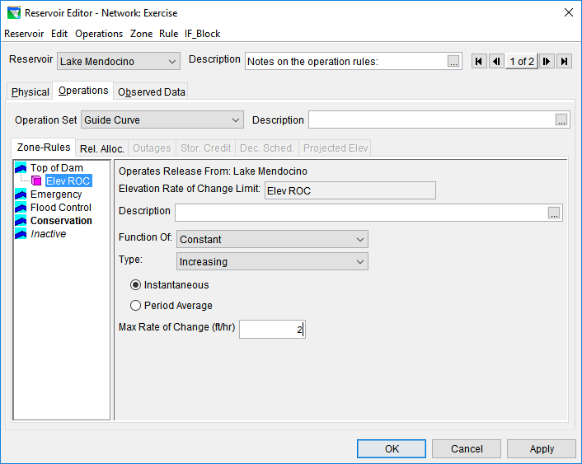
Elevation Rate of Change Rules
Limits the rate of change (ft/hr) of reservoir elevation
Instantaneous or Period Average

Slide 26
Defining Release Function Rules

Slide 27
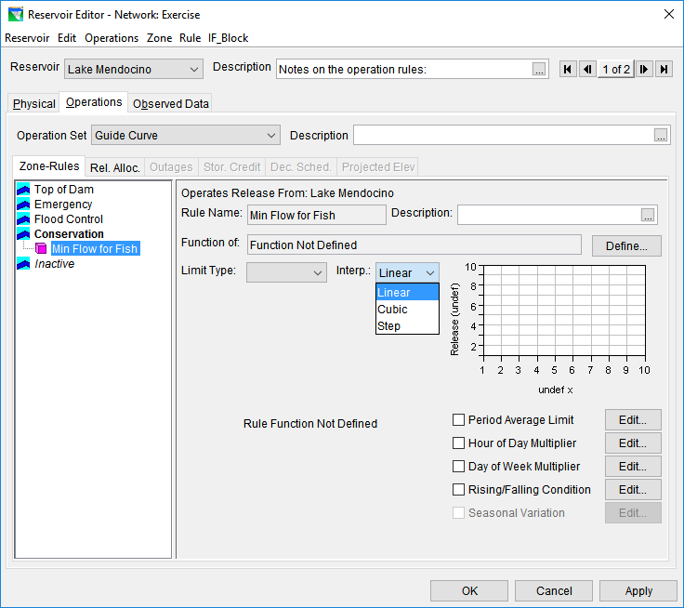
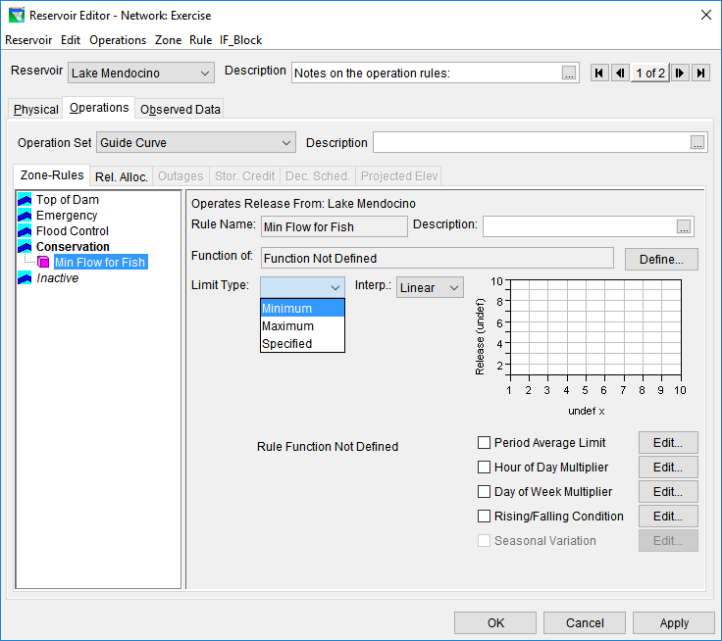
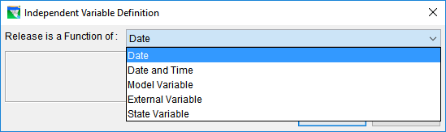
Release Function Rules
Sets releases as a function of a variable
powerful and flexible rule

Slide 28
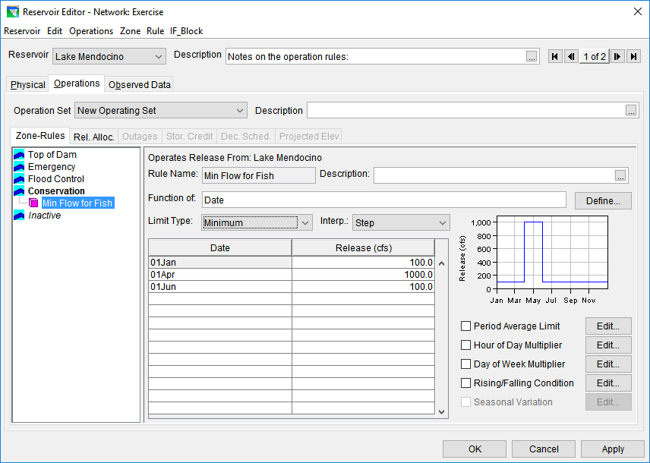
Function of: Date and Date&Time

Slide 29
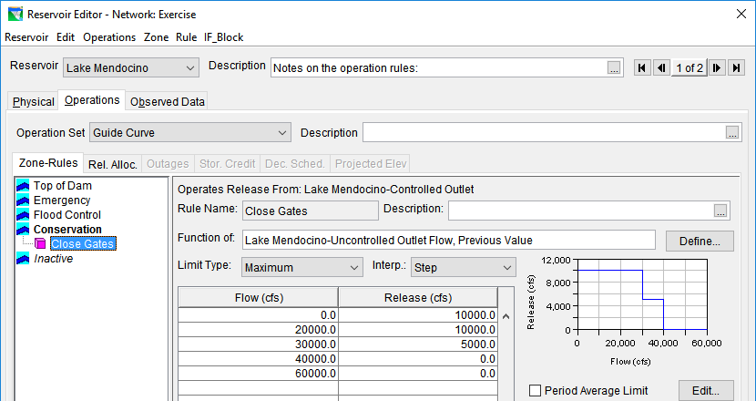
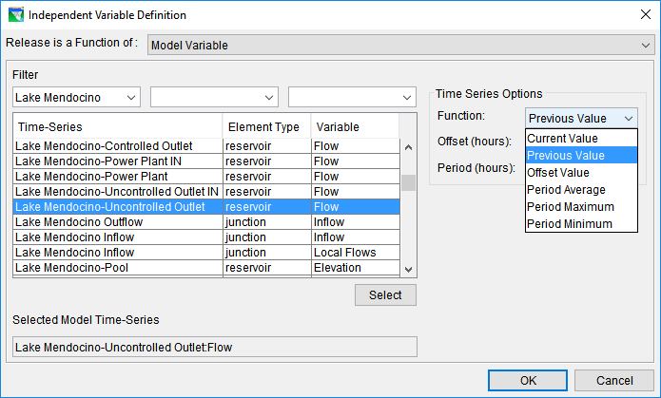
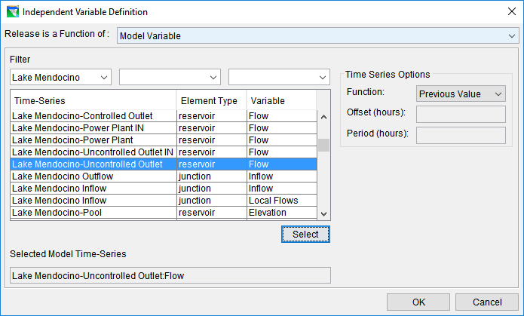
Function of: Model Variable
Makes releases based on the current value of a time series
  One the model computes, or model input

Slide 30
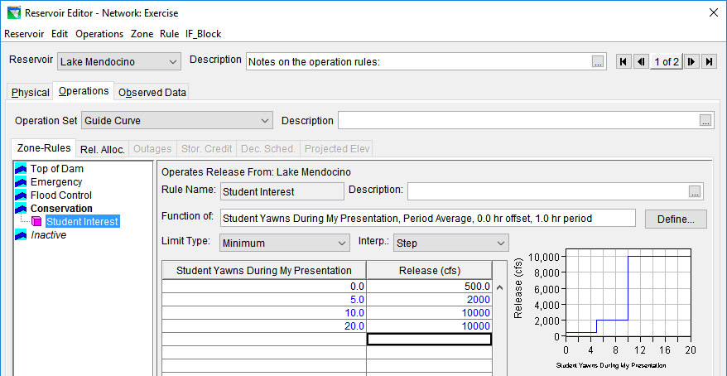
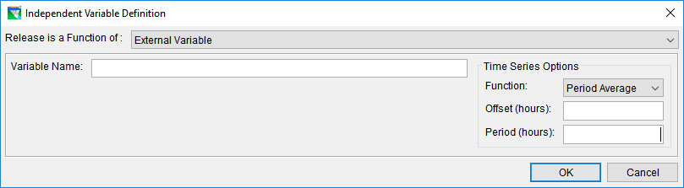
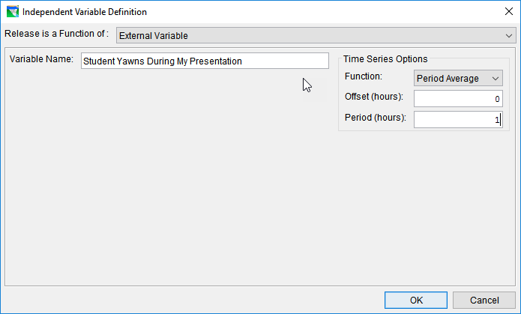
Function of: External Variable
Makes releases based on the current value of a user-defined time series external to the model

Slide 31
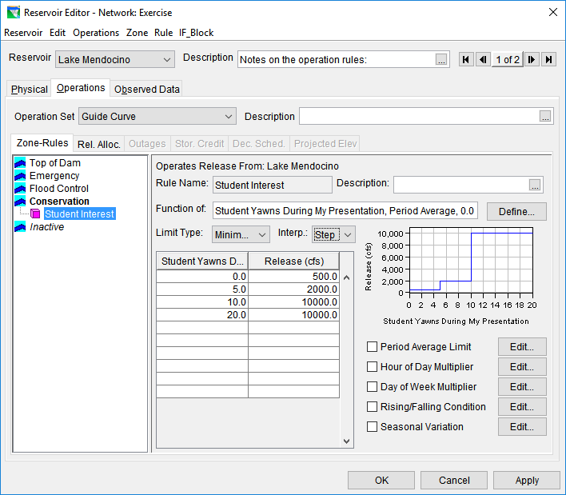
Additional Modifiers

Slide 32

Period Average Limit
Sets the rule to meet a target, but averaged over a period
Period
  None
  Daily
  Weekly
Starting Day of Period
  For weekly only, set the start day of the week
Daily Pattern
  Acts as a weighting pattern for meeting the flow requirement

Slide 33


Hour of Day & Day of Week Multipliers
Applies a multiplier to the release for specific days of the week, or hours of the day
Can effectively turn off a rule with a 0.0 multiplier

Slide 34




Rising/Falling Condition
Sets the rule to only be applied during a rising or falling condition
  Averaging Period
    Hours over which the condition will be determined
  Tolerance
    The amount by which the beginning and end of the period can differ and still be considered constant

Slide 35


Seasonal Variation
Sets the rule to behave differently throughout the year
  Adds date columns to the
  existing tables
  Obviously, won’t work with
  a function of
  date rule

Slide 36
Take-home Points
The Water Control Manual can provide most of the information needed to model the reservoir operations
At-Site Rules limit the reservoir release explicitly
The Release Function Rule can be utilized to describe many operational constraints:
  Channel Capacity
  Water Supply
  Environmental Support
  Explicit (Specified) Releases
  Etc.

Slide 37
Definitions
Physical Constraint – Outlet maximum discharge capacity and rate of increase or decrease constraints
Operational Constraint – A regulation. A requirement defined in the Water Control Plan. A limit on the release.
At-Site Constraint – An operational constraint specified for the reservoir itself or one of its outlets; not a downstream constraint.

Slide 38
More Definitions
Operational Zone – A portion or range of the reservoir pool for which certain constraints have been specified.
Operation Rule – The ResSim data input form used to specify an operational constraint, so that the constraint can be simulated.
Operation Set – The collection of zones and rules that describe a water control plan

