Slide 1
Routing Methods within HEC-ResSim
Mike Bartles, P.E.
USACE, Institute for Water Resources, Hydrologic Engineering Center
Notes:
Introduce reach routing methods within HEC-ResSim
A good bit of the material within this lecture was originally developed by Gary Brunner while he was at HEC
When I teach this material as part of the Basic HMS course, we usually allot 3 to 4 hours for three lectures and a workshop. However, I only have 45 minutes within this class. So, I needed to chop out A LOT of material. That being said, if you’re interested and want to hear more of me talking about this subject, I have included a bunch of links to videos and HMS materials that delve more deeply into the subject.

Slide 2
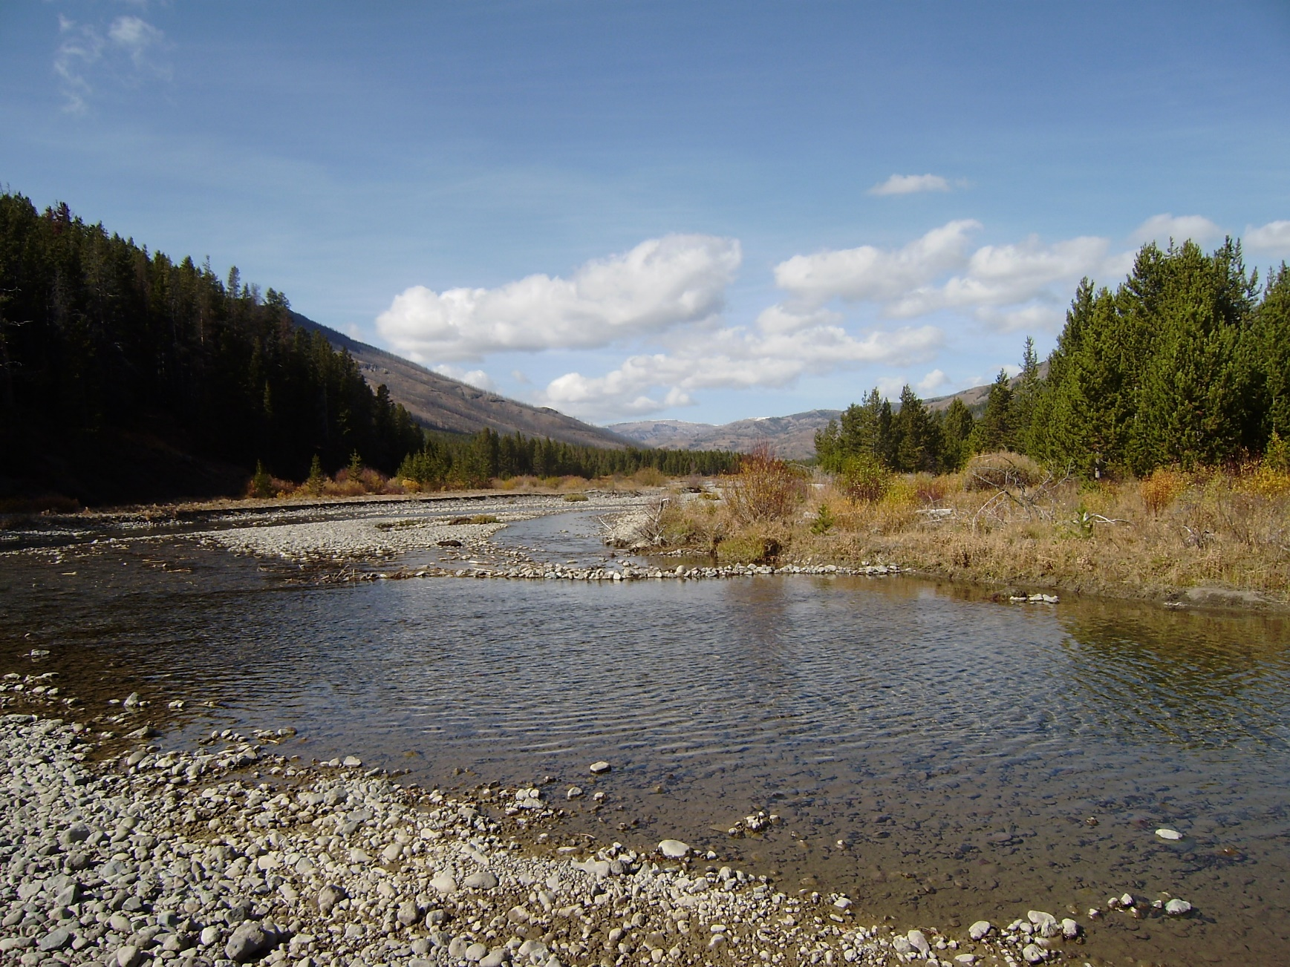
Objectives
Provide an overview of open channel flow processes and common applications.
Discuss how hydrologic routing differs from hydraulic routing.
Describe channel routing within HEC-ResSim
Show the available reach routing methods and
Highlight a few methods in more detail
  Parameter estimation
  Advantages and Disadvantages
Calibration Techniques
2
Notes:
This lecture is meant to serve as an introduction to channel routing. It will not be an exhaustive, detailed look at everything that is contained within HEC-ResSim.
Just a heads up: we will spend a bit of time looking at equations in the beginning. It’s important to look at the equations to understand how hydrologic routing differs from hydraulic routing.
Afterwards, we’ll talk about the various ways in which reach routing can be simulated within HEC-ResSim.
We’ll also discuss parameter estimation and pros/cons of each method
Finally, we’ll briefly discuss calibration techniques.

Slide 3

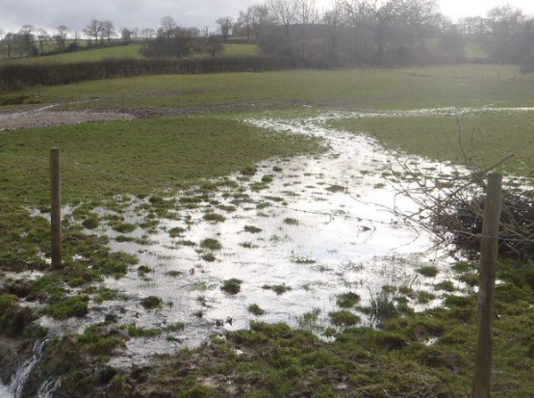
Overland vs Open Channel Flow
3
Notes:
Overland flow is shown in the left-hand image.
In general, depths are shallower in this flow regime.
Simulating the movement of water in this manner is typically done using unit hydrograph theory within subbasin elements in HEC-HMS or some other hydrologic modeling application.
As depths increase, the predominant flow regime begins to transition to open channel flow, as shown in the right-hand image.
At this point, open channel flow approximations are used to represent translation and attenuation effects as flood waves move downstream.
We’re going to be discussing the simulation of water moving in the right-hand image within this lecture.

Slide 4
Reach Routing
4
Notes:
Open channel flow modeling or reach routing, as it’s referred to within HEC-ResSim, is an approach that is used to predict the temporal and spatial variations of a hydrograph as it moves through a river or stream.
The effects of storage and flow resistance are reflected by changes in the hydrograph shape and timing as the flood wave moves from upstream to downstream.
The figure shown here demonstrates the major changes that can occur as a hydrograph moves through a reach.
Specifically, the blue inflow hydrograph is translated or shifted in time and the peak inflow is reduced or attenuated to produce the pink outflow hydrograph.

Slide 5
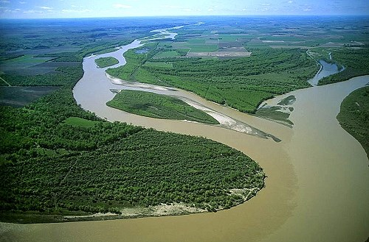
Hydraulic and Hydrologic Routing
Hydraulic Routing
  Based on Solutions of Partial Differential Eqns.
  St. Venant equations (Dynamic Wave Eqns.)
    Continuity Equation
    Momentum Equation
Hydrologic Routing
  Continuity Equation
  Momentum Equation or Storage-Discharge Relationship
5
Notes:
In general, routing techniques may be classified into two categories: hydraulic routing and hydrologic routing.
Hydraulic routing techniques are based on the solution of partial differential equations which govern unsteady, open channel flow.
These equations are often referred to as the St. Venant or Dynamic Wave equations.
Hydrologic routing routines employ the continuity equation and either simplified forms of momentum equation or very simplified relationships between storage within the reach and discharge at the outlet as a replacement for the momentum equation.

Slide 6
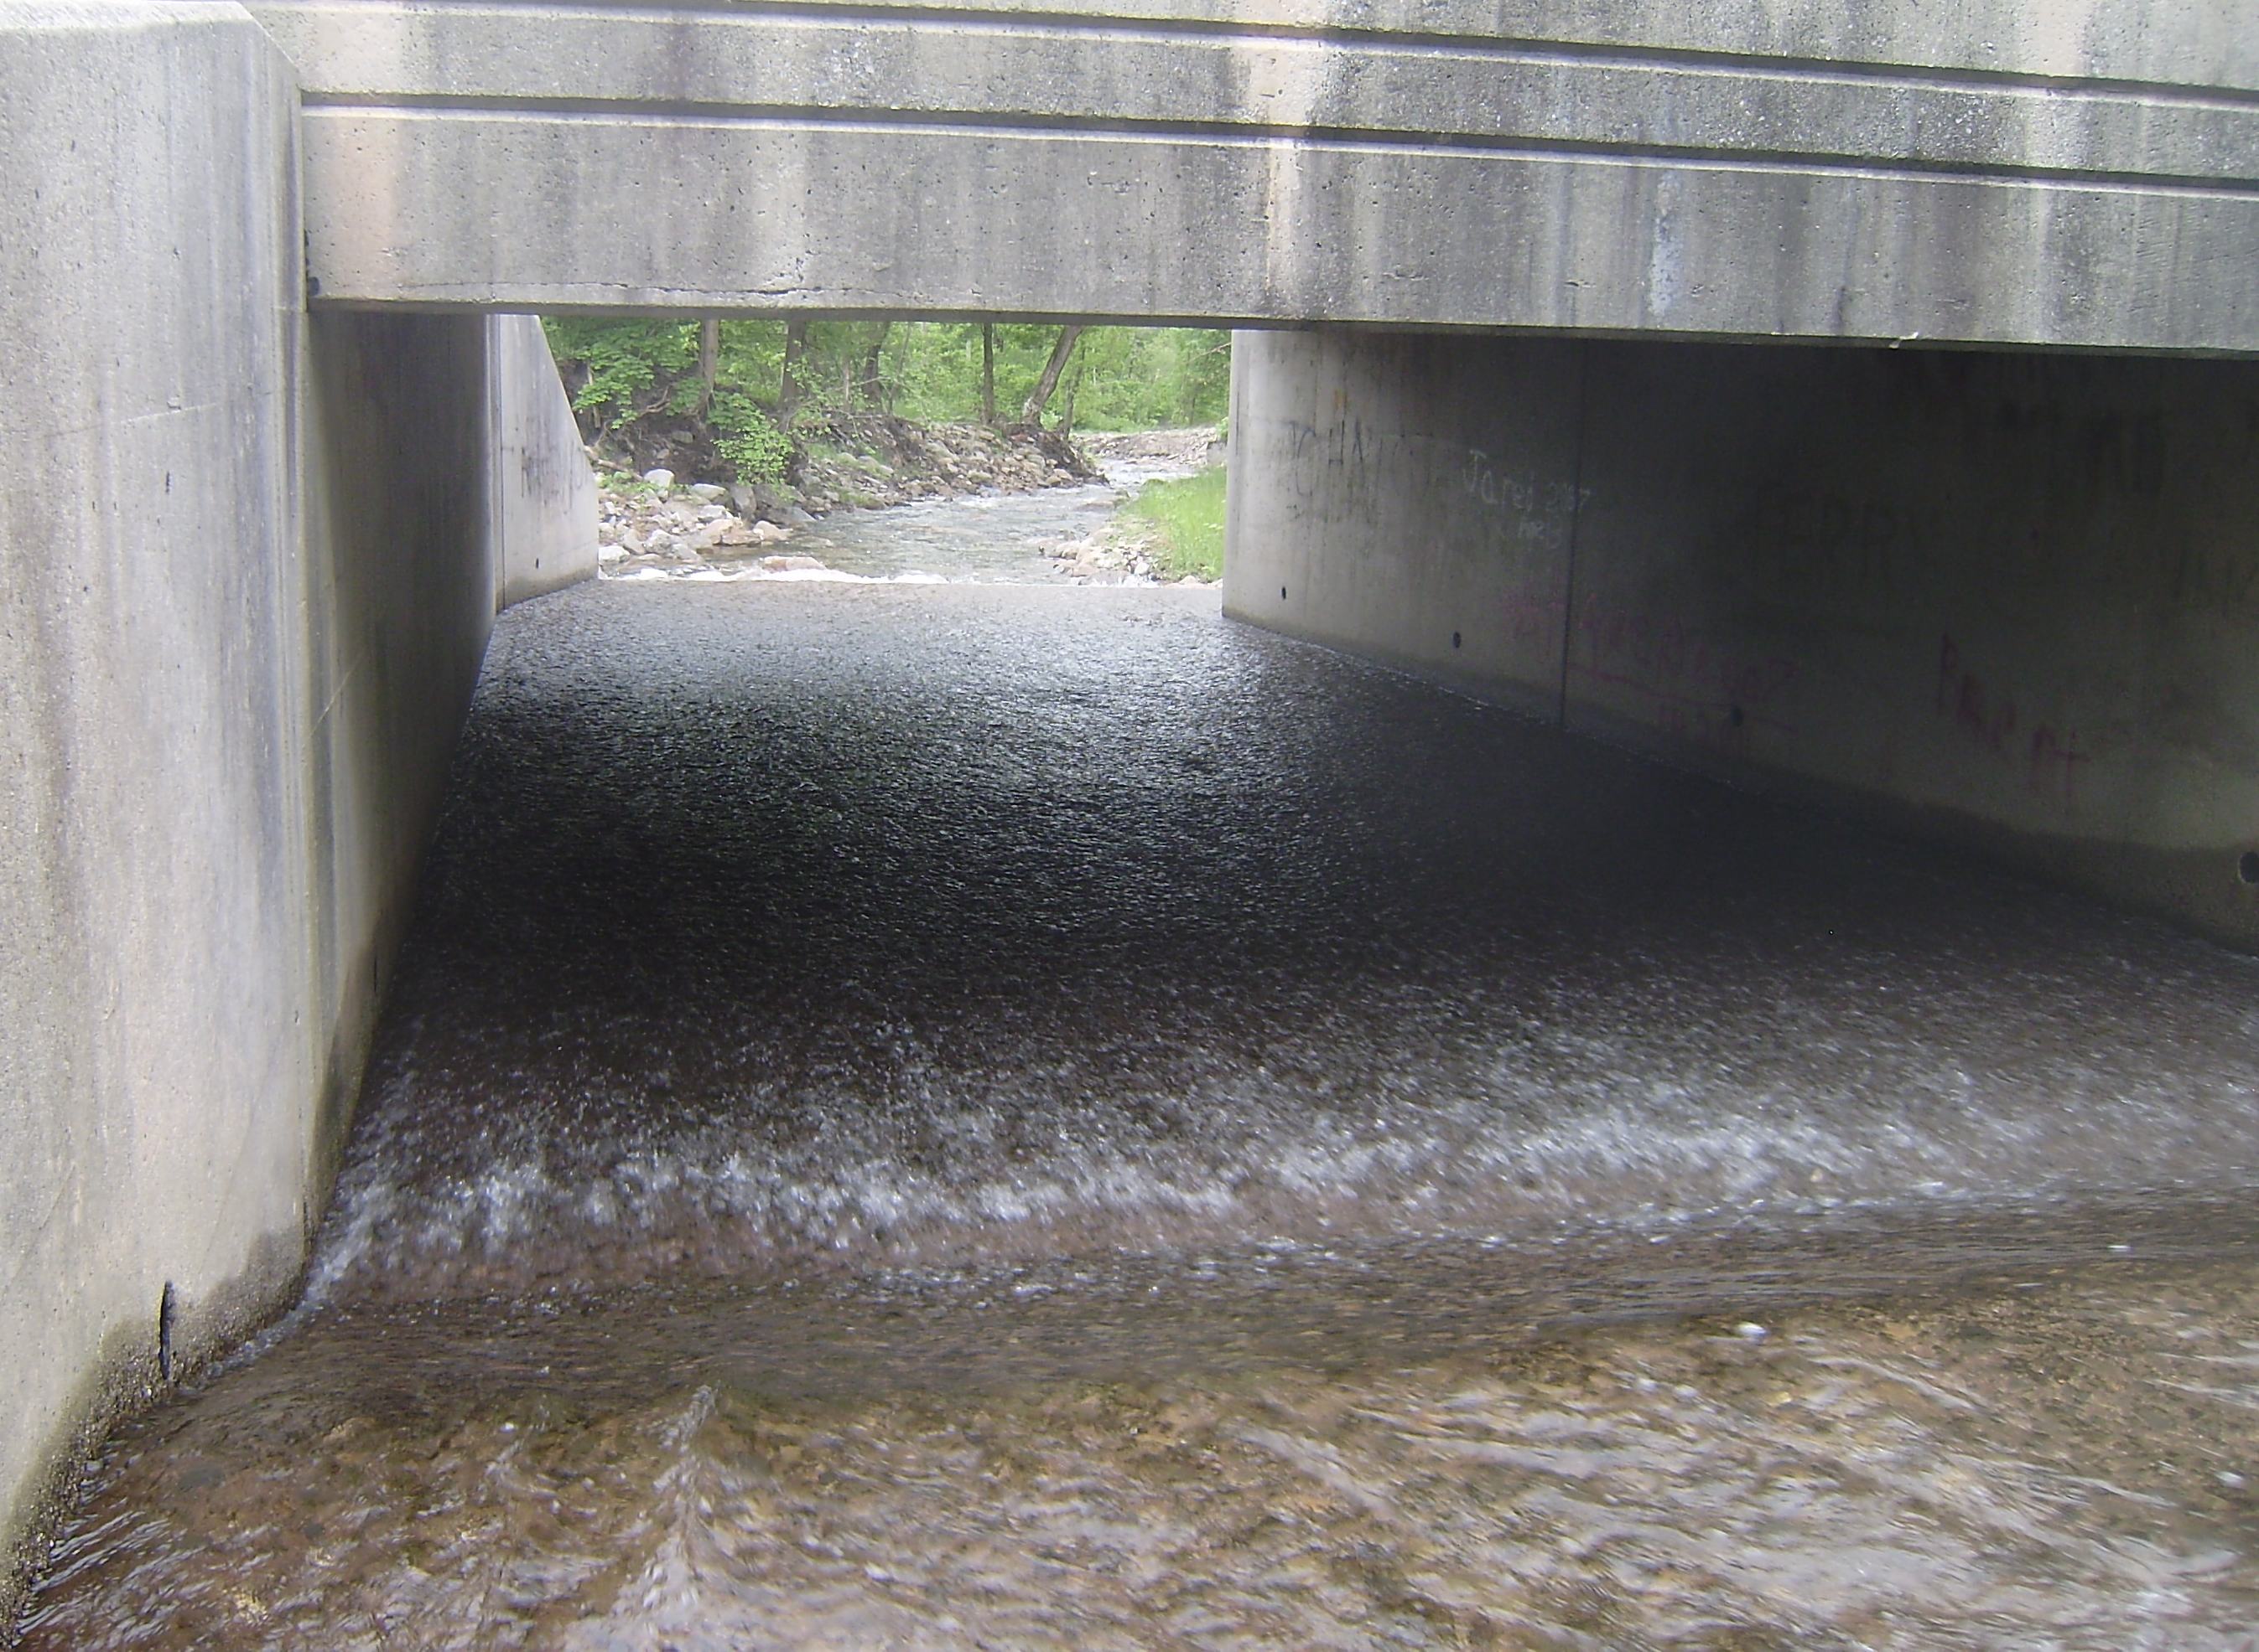
St. Venant Equations
  Continuity
  Momentum
6
Notes:
The equations that describe one-dimensional unsteady flow in an open channel consist of a continuity equation and a momentum equation, as shown here.
The solution of these equations defines the propagation of a flood wave with respect to distance along the channel and time.
Solved together with the proper boundary conditions, these equations are the St Venant or Dynamic Wave equations.
The routing methods that are available within HEC-ResSim all simplify the continuity and/or momentum equations. However, they do so to varying degrees. In general, the more terms that are preserved in the specific method, the more accurate the method will be. However, the more terms that are preserved, the more parameters that must be specified and the more complicated the method.

Slide 7
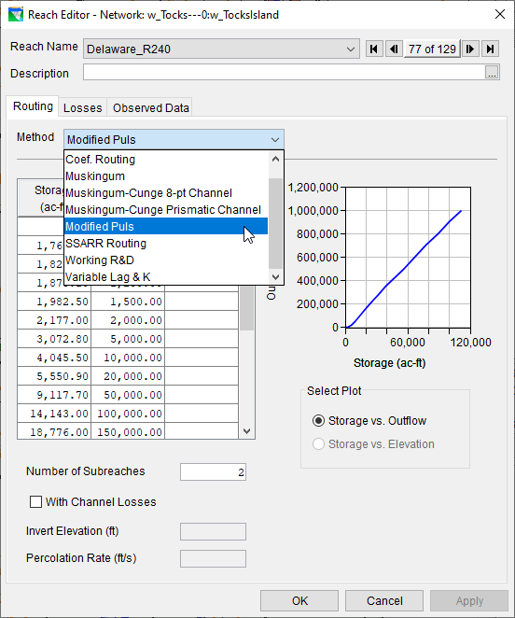
Available Routing Methods
Coefficient
Muskingum
Muskingum-Cunge
  8-pt Channel
  Prismatic Channel
Modified Puls
SSARR
Working R&D
Variable Lag and K
7
Notes:
There are seven hydrologic routing methods available for use within HEC-ResSim
Each one of these approaches uses different approximations of the continuity and momentum equations
We’ll discuss the highlighted methods in more detail
I don’t recommend using the other four, non-highlighted methods. But, they are included within the software.

Slide 8
Muskingum Method
Developed to accommodate the looped relationship between storage and outflow that exists in rivers
Relationship between storage and discharge at the outlet is not a unique relationship, it is looped
For a more in-depth discussion of this method, see: https://youtu.be/AhifqyHKliY
Example Application
8
Notes:
Routing in natural rivers is complicated by the fact that storage in a river reach is not a function of outflow alone.
That’s because the water surface in a channel, during the passage of a flood wave, is not uniform.
The storage and water surface slope within a river reach, for a given outflow, can be greater during the rising stages of a flood wave than during the falling stages, or vice versa.
Therefore, the relationship between storage and discharge at the outlet of a channel is not a unique relationship.
Rather it is a looped relationship, as shown in the figure on right.
The Muskingum method was developed to accommodate this looped relationship.

Slide 9
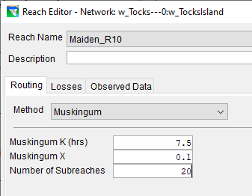
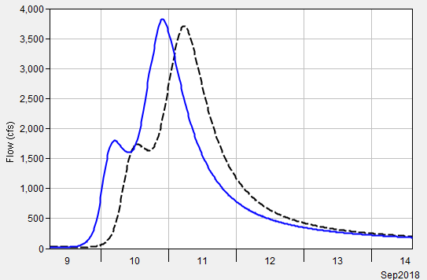
Muskingum Method – Example
Inflow
Outflow
9
Notes:
This method requires three parameters: K, X and number of subreaches.
K, X, and number of subreaches are constant throughout time. So, this method cannot simulate variable translation and attenuation.
This example shows how an inflow hydrograph, shown in blue, is translated and attenuated to produce the outflow hydrograph shown in black.
The inflow hydrograph is translated in time by 7.5 hours, which is controlled by, and equivalent to, the K parameter.
The peak of the inflow hydrograph is reduced by 120 cfs, which is controlled by the X parameter and number of subreaches.

Slide 10
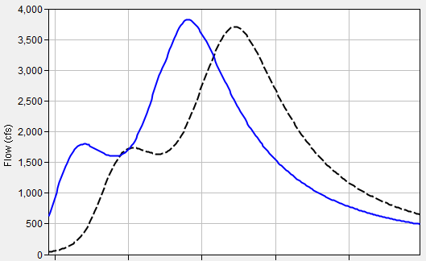
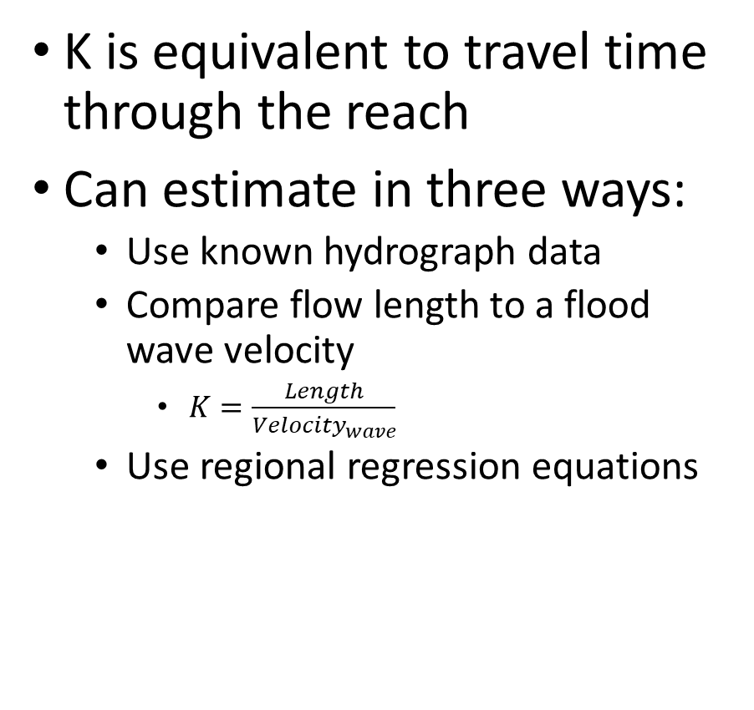
Parameter Estimation – K
K is equivalent to travel time through the reach
Can estimate in three ways:
  Use known hydrograph data
  Compare flow length to a flood wave velocity
    $K=\frac{Length}{{Velocity}_{wave}}$
  Use regional regression equations
Inflow
Outflow
10
Notes:
When estimating an appropriate K, three approaches can be used.
The first approach uses observed data at the start and end of the reach to directly compute the travel time. This approach is depicted in the right-hand image. You can use the elapsed time between centroid of areas of the two hydrographs, between the hydrograph peaks, or between midpoints of the rising limbs. However, it’s usually a rare occurrence that observed data is available at both the upstream and downstream end of the reach, so this approach isn’t too common.
The second approach to estimate K uses a computed flood wave velocity and flow length to infer a travel time. This approach is more commonly used and we’ll explore more on the next slide.
Finally, regression equations relating parameters like slope, roughness, and length are available in some regions that can be used to infer this parameter.

Slide 11
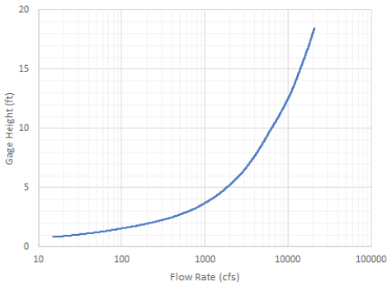
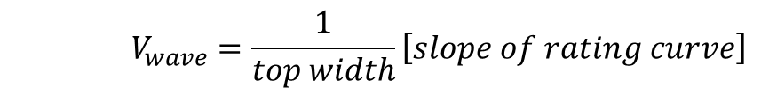
Parameter Estimation – K
Compare flow length to a flood wave velocity
  Manning’s Equation
  Kleitz – Seddon Law
    Flood wave velocity can be approximated from the channel and rating curve
α
    $$V_{wave}=\frac{1}{top width}\left[slope of rating curve\right]$$
11
Notes:
A value for K can be estimated as the travel time of the flood wave through the routing reach.
The flood wave velocity can be estimated using Manning’s equation or the Kleitz-Seddon Law.
The Kleitz-Seddon law allows you to approximate flood wave velocity from a stage-flow rating curve at representative location for the routing reach.
This method requires you to estimate the slope of the rating curve and the top width, both at a flow rate of interest.
In the image to the right, the flow rate of interest is 10,000 cfs (animate).
The slope at this point can then be estimated (animate).
The top width must also be estimated for the flow rate of interest using aerial photos, field surveys, or backwater calculations.

Slide 12
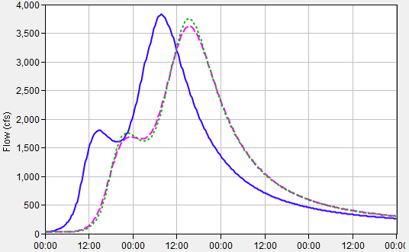
Parameter Estimation – X
Affects attenuation
Dimensionless coefficient
Lacks a strong physical meaning
Limited to bound 0.0 to 0.5
  When X = 0:
    Storage is only a function of outflow
    Maximum attenuation
  When X = 0.5:
    Equal weight to inflow and outflow
    No attenuation; only translation
Start with 0.25 and calibrate
Inflow
Outflow; X = 0.4
Outflow; X = 0.1
12
Notes:
X is a dimensionless coefficient that controls attenuation.
As I mentioned before, since attenuation is numerical when using this method, this parameter lacks a strong physical meaning and can’t be easily estimated from physical characteristics of the reach.
X must be between 0 and 0.5.
When X=0.0, storage becomes solely a function of outflow. This results in the maximum amount of attenuation.
When X=0.5, storage is equally weighted between inflow and outflow and no attenuation will be simulated.
Typically, I set X equal to 0.25 and then calibrate using observed data.

Slide 13
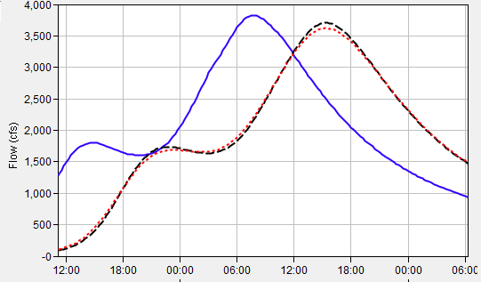
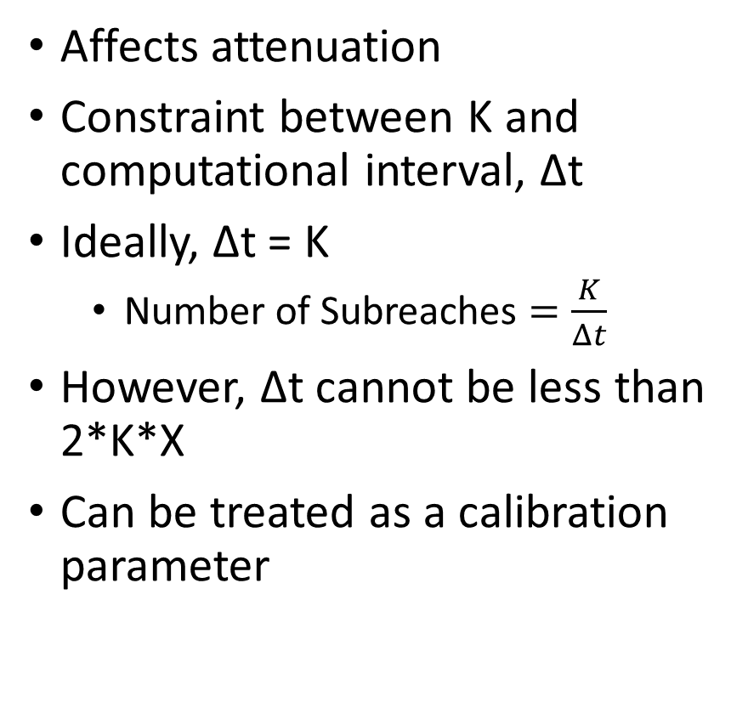
Parameter Estimation – No. Subreaches
Affects attenuation
Constraint between K and computational interval, Δt
Ideally, Δt = K
  Number of Subreaches $=\frac{K}{Δt}$
However, Δt cannot be less than 2*K*X
Can be treated as a calibration parameter
Inflow
Outflow; # subreaches = 20
Outflow; # subreaches = 10
13
Notes:
The Muskingum routing method has a constraint related to the relationship between the parameter K and the computation interval.
Ideally, the two should be equal, but the computation interval should not be less than 2 * K * X to avoid instabilities.
A long routing reach should be subdivided into sub reaches so that the travel time through each sub reach is approximately equal to the routing computation interval.
This assumes that factors such as channel geometry and roughness have been taken into consideration when estimating K.
To initially estimate this parameter, divide your estimate of K by the computational time interval.
However, this parameter also acts to produce attenuation, so it can be modified during calibration.

Slide 14
Muskingum Method
Advantages
"Mature" method that has been used successfully in thousands of studies throughout the U.S.
Easy to set up and use.
Method is parsimonious; it includes only a few parameters necessary to explain the variation of runoff volume.
Disadvantages
Method may be too simple to accurately predict flood wave translation and attenuation.
Only appropriate for use in moderately steep streams (bed slopes > 2 ft/mi).
Cannot simulate variable translation and attenuation.
Cannot simulate backwater effects or impacts of hydraulic structures.
14
Notes:
The main advantage of this method is that it’s simple! Because it’s simple, it’s been successfully used all over the world for numerous types of applications.
Also, this method is parsimonious in that a small number of variables (or parameters) are used to explain something which allows for easy investigation of model uncertainty.
However, the primary disadvantage of this method is also that it’s simple.
This method also cannot simulate variable translation and attenuation affects; you only get one go by defining a constant K, X, and number of subreaches for a simulation.

Slide 15
Muskingum-Cunge Method
Builds upon the Muskingum method
  Within the Muskingum method, the X parameter (i.e. attenuation) is not physically based
Cunge set numerical diffusion equal to physical diffusion
  This allowed for parameters to be physically-based as well as improving accuracy and applicability
For a more in-depth discussion of this method, see: https://youtu.be/aUdExHpePOY
Example Application
15
Notes:
When using the Muskingum method, attenuation is achieved through numerical diffusion rather than physical.
Cunge improved upon the original Muskingum method by setting this numerical diffusion to a physical estimate of diffusion.
The resultant “Muskingum-Cunge” method, as it’s now referred to, has parameters that can be estimated from physical characteristics of the channel, allows for variable translation and diffusion, compares well with full unsteady flow equations over a wide range of flow situations, and is independent of the simulation time step.
This was a big leap forward and major improvement over the Muskingum method!

Slide 16
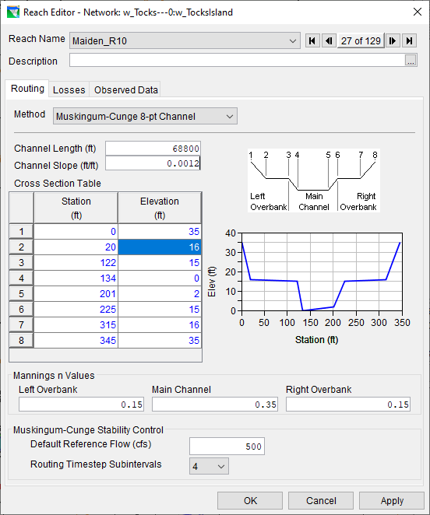
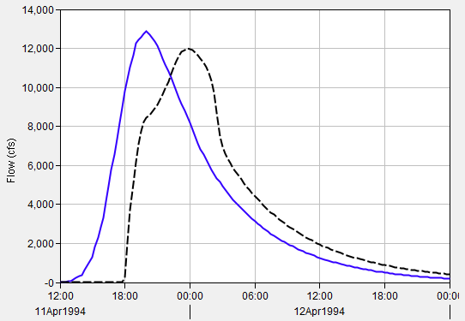
Muskingum-Cunge Method – Example
Inflow
Outflow
16
Notes:
This method requires multiple parameters: length, friction slope, manning’s roughness, an index flow, and a cross section shape and parameters.
This example shows how an inflow hydrograph, shown in blue, is translated and attenuated to produce the outflow hydrograph shown in black.
The inflow hydrograph is translated in time by a varying amount. Translation isn’t uniform and depends upon the inflow hydrograph and the physical characteristics of the reach in question.
The inflow hydrograph is also attenuated. Similarly, the amount of attenuation depends upon the inflow hydrograph and the physical characteristics of the reach.

Slide 17
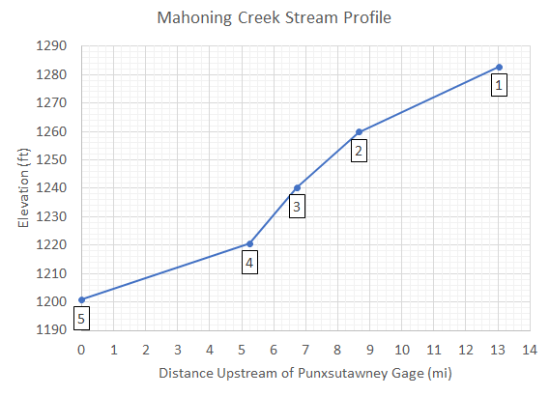
Parameter Estimation – Reach Length and Friction Slope
Compute reach characteristics
  Parameters | Characteristics | Reach
Friction slope can be initially estimated using bed slope
  If slope varies significantly, it may be necessary to use multiple reaches with different slopes
17
Notes:
Both reach length and friction slope can be estimated directly within HEC-HMS if you have associated a terrain data set with your basin model and your reaches are georeferenced.
When estimating an initial friction slope, I usually equate to the bed slope.
However, if the slope is expected to vary significantly, it may be necessary to use multiple reaches with different slopes instead of just one. This is the case for the image to the right. Three different reaches, each with different slopes, are likely most appropriate for use in this example.

Slide 18
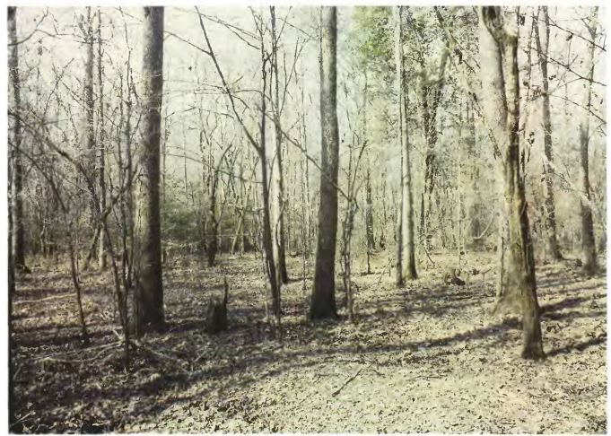
Parameter Estimation – Manning’s Roughness
Average value for the whole reach
Estimate using “reference” streams or through calibration
Bayou de Loutre near Farmerville, LA
Computed roughness: n = 0.11
Depth of flow: 3.6 ft
18
Notes:
The Manning's n roughness coefficient should be set as the average value for the whole reach.
This value can be estimated using “reference” streams with established roughness coefficients or through calibration.
As an example, the image to the right is of a floodplain in Louisiana with a computed Manning’s n of 0.11.

Slide 19
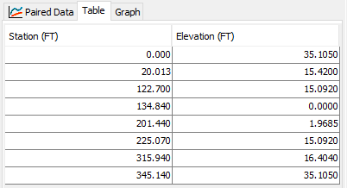
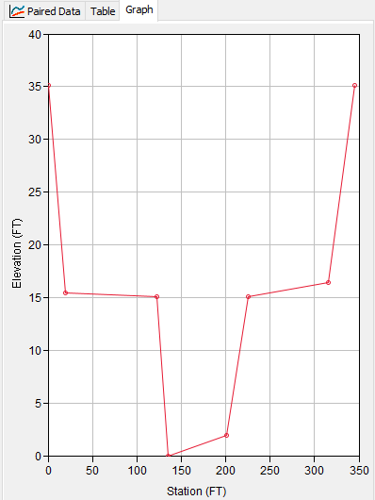
Parameter Estimation – Cross Section Shape
Three shapes:
  Eight point
  Trapezoidal
  Circular
Estimate parameters using GIS information
When using Eight Point shape:
  Bank points are always the 3rd and 6th points
  Left/Channel/Right Manning’s roughness changes at these points
19
Notes:
HEC-ResSim allows you to specify the required cross section information in three ways: eight point, trapezoidal/prismatic, and circular
I personally prefer to use the 8 point cross section shape.
Depending upon the chosen shape, additional information will have to be entered to describe the cross-section shape.
All the required parameters can be estimated using GIS information.
In the example shown here, I took a field-surveyed cross section and simplified it to just eight points, which can be done fairly rapidly.

Slide 20
Muskingum-Cunge Method
Advantages
Similar to advantages of the Muskingum method.
Predicted values are in accordance with open channel flow theory.
Parameters can be estimated using measurable channel characteristics.
Can use cross-section shapes that include overbank areas.
Good for ungaged reaches.
Disadvantages
Only appropriate for use in moderately steep streams (bed slopes > 2 ft/mi).
Cannot simulate backwater effects or impacts of hydraulic structures.
Method is less parsimonious than Muskingum; it requires many more parameters.
20
Notes:
A major advantage of this method is that the predicted values are in accordance with open channel flow theory.
Also, you can simulate variable translation and attenuation.
Finally, the required parameters can be estimated using physically measurable characteristics.
However, this method is less parsimonious than simpler methods in that more parameters are required.
It also cannot simulate backwater effects and is only appropriate for use in streams with slopes greater than 2 ft/mi and situations with slow rising hydrographs.

Slide 21
Modified Puls Method
A unique relationship between storage and outflow of a reservoir (or channel) can be developed
Solves the continuity equation over a time step (dt). Written as:
Two unknowns O₂ and S₂
Use storage-discharge curve to solve
Example Application
21
Notes:
The equation defining storage routing, based on the principle of conservation of mass, can be written in approximate form for a routing interval dt.
The subscripts "1" and "2" denote the beginning and end of the routing interval.
The known values in this equation are the inflow hydrograph, and the storage and discharge at the beginning of the routing interval.
The unknown values are the storage and discharge at the end of the routing interval.
With two unknowns (O2 and S2) remaining, another relationship is required to obtain a solution.
The storage-outflow relationship is normally used as the second relationship needed to solve. How that relationship is derived is what distinguishes various storage routing methods.

Slide 22
Modified Puls Method
Relationship between storage and discharge at the outlet is not a unique relationship, it is looped (hysteresis)
22
Notes:
Routing in natural rivers is complicated by the fact that storage in a river reach is not a function of outflow alone.
The water surface in a channel, during the passing of a flood wave, is not uniform.
The storage and water surface slope within a river reach, for a given outflow, can be greater during the rising stages of a flood wave than during the falling (figures on left), or vice versa.
Therefore, the relationship between storage and discharge at the outlet of a channel is not a unique relationship, rather it is a looped relationship (figure on right above).

Slide 23
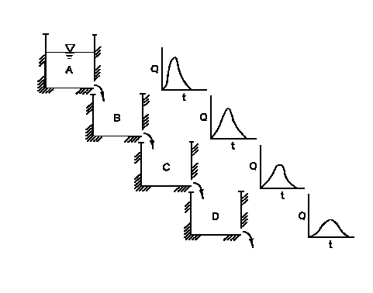
Modified Puls Method
Model the reach as a cascade of level pools
23
Notes:
In order to apply the Modified Puls method to a channel routing problem, the storage within the river reach is approximated with a series of cascading reservoirs.
Each reservoir is assumed to have a level pool, and therefore a unique storage-discharge relationship.
The cascading reservoir approach can approximate the looped storage-outflow effect when evaluating the river reach as a whole.
The rising and falling flood wave is simulated with different storage levels in the cascade of reservoirs, thus producing a looped storage-outflow function for the total river reach.
This is depicted graphically in the figure above.

Slide 24
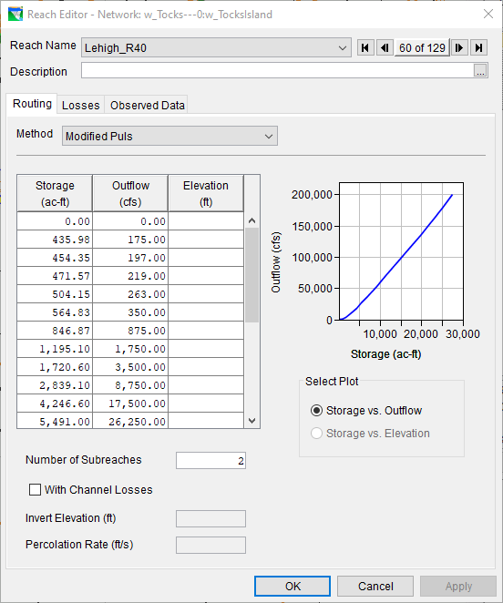
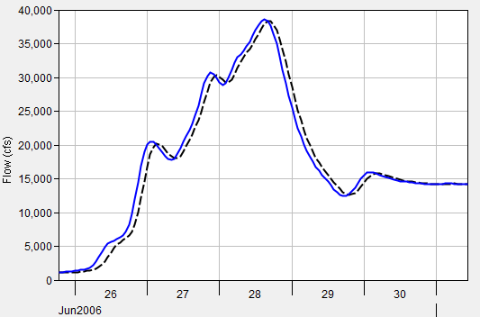
Modified Puls Method – Example
Inflow
Outflow
24
Notes:
This method requires relatively few parameters: a storage-outflow relationship and the number of subreaches.
This example shows how an inflow hydrograph, shown in blue, is translated and attenuated to produce the outflow hydrograph shown in black.
Similar to the Muskingum-Cunge method, the inflow hydrograph is translated in time and attenuated by a varying amount.
Translation and attenuation aren’t uniform and depend upon the inflow hydrograph and the parameters of the reach in question.

Slide 25
Parameter Estimation – Storage-Outflow Curves
Steady-flow profile computations (Best)
  Using an HEC-RAS Model to Create Storage-Discharge Curves for Mod-Puls Reaches in HEC-HMS
Observed water surface profiles
Normal-depth computations
Observed inflow and outflow hydrographs
Optimization (calibration) techniques using observed inflow and outflow hydrographs
25
Notes:
Storage-outflow curves can be created in multiple ways
The preferred way is to use a series of steady flow simulations to compute volumes within a given reach that correspond to a single discharge value.

Slide 26
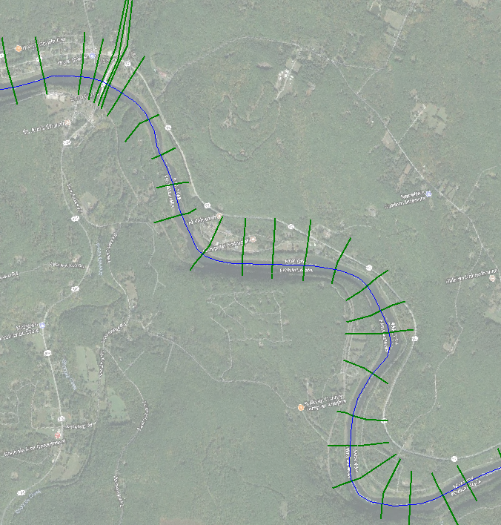
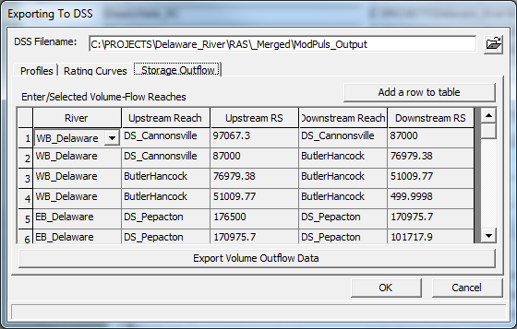
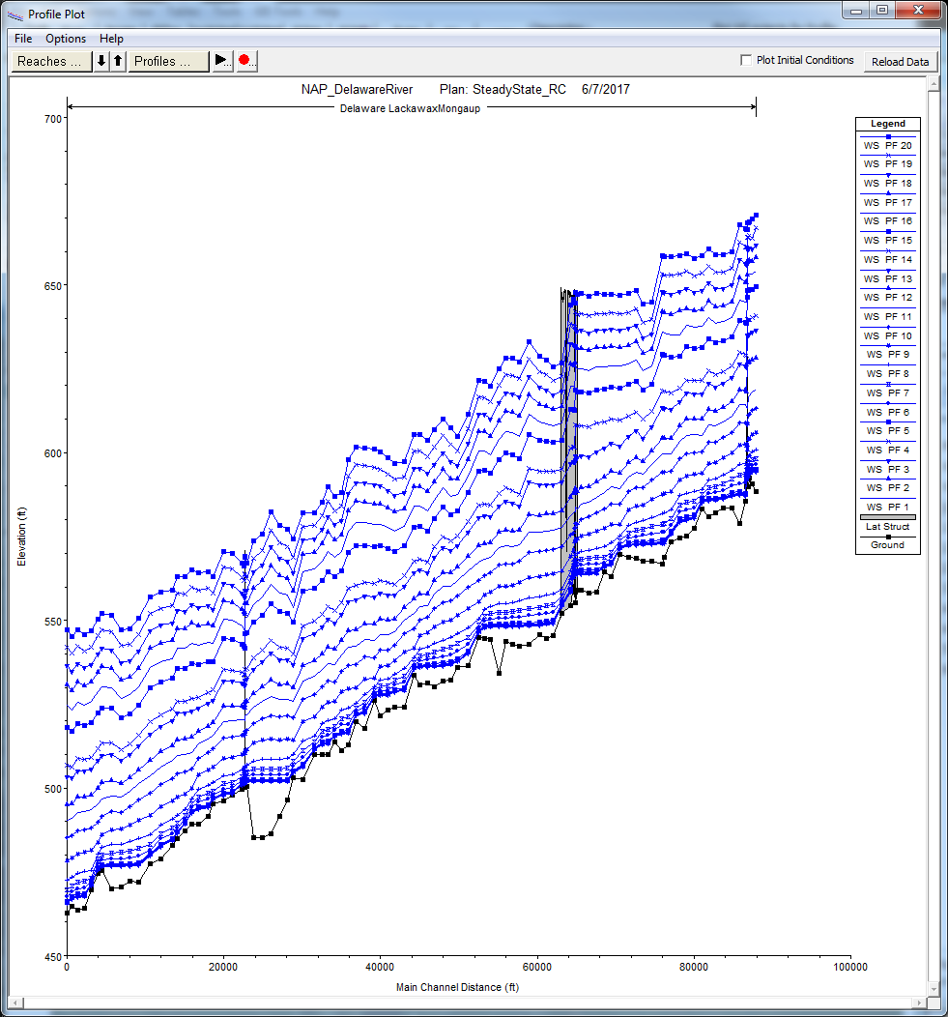
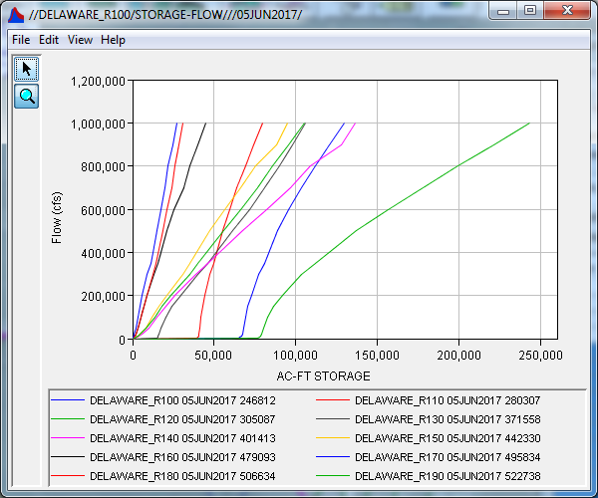
Parameter Estimation – Storage-Outflow Curves
Example from steady flow profiles
26
Notes:
A calibrated steady state hydraulic model (e.g. HEC-RAS) can be used to calculate multiple water surface profiles for the reach of interest for the range of discharges and depths that are expected to be simulated.
From these water surface profiles, the storage within the reach(es) of interest is automatically calculated for each steady state discharge
The resultant storage-outflow relationships are then written to DSS for use by both HEC-HMS and HEC-ResSim (ResSim requires you to manually copy/paste these relationships into the software)

Slide 27
Modified Puls Method
Advantages
Can simulate backwater effects and impacts of hydraulic structures.
Can be used to produce accurate results within flat streams (bed slopes < 2 ft/mi).
Disadvantages
Requires hydraulic simulations to derive accurate storage vs. outflow relationships; consequently, this method can be difficult to parameterize and calibrate.
27
Notes:
The biggest advantages to this method is that, if careful attention is paid to the development of the storage-outflow relationships, accurate results can be obtained in the presence of backwater effects and flat streams. This makes this method unique in the realm of hydrologic routing.
However, this method requires storage-outflow relationships, which are typically derived from a hydraulic model. This can be time consuming, but it’s worth it.

Slide 28
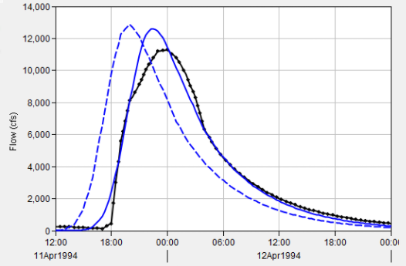
Calibration Techniques
For all hydrologic routing methods:
  First, match rising limb of hydrograph
  Then, match peak discharge
  Finally, iterate to match rising limb, peak, and receding limb as best as possible
Use multiple statistical metrics
  Nash-Sutcliffe Efficiency
  Ratio of the Root Mean Square Error to the Standard Deviation
  Percent Bias
  R²
Inflow
Outflow
Obs. Flow
28
Notes:
When calibrating routing methods, I like to start by modifying my initial estimates to best match the rising limb of the observed hydrograph.
Then, I modify appropriate parameters in an attempt to match the observed peak flow rate.
Finally, iterate to match the rising limb, peak, and receding limb as best as possible
In this example, observed flow is shown in black and computed flow is shown in solid blue.
I’ve matched the rising limb decently well, but my computed peak discharge is too high. So, if I were using the Muskingum method, I’d decrease my X parameter and/or number of subreaches. If I were using the Muskingum-Cunge method, I’d increase my roughness coefficients.
Remember to use multiple statistical metrics to gauge whether your model is accurate like NSE, RSR, PBIAS, and R². Don’t just use the ol’ eyeball test!

Slide 29
Review
Discuss how hydrologic routing differs from hydraulic routing due to simplifications
Seven hydrologic routing methods are available within HEC-ResSim
Detailed the Muskingum, Muskingum-Cunge, and Modified Puls methods
  Presented parameter estimation techniques and advantages/disadvantages for each method
Briefly discussed calibration techniques
29

