Slide 1
Advanced Topics -
Compute Blocking
Evan Heisman, PE

Slide 2
Outline
How ResSim Computes
Examples of Operational Dependencies
What are compute blocks?
How can you find them?
Why should you care about them?
How to influence them?

Slide 3
How ResSim computes
ResSim computes through several loops:
  Time blocks
    Compute passes
      Compute blocks
        Timesteps
          Elements, in hydrologic order

Slide 4
How ResSim computes
ResSim computes through several loops:
  Time blocks
    Compute passes
      Compute blocks
        Timesteps
          Elements, in hydrologic order
Time Blocks: Computes are split across time to fit into memory – this can cause problems with scripts

Slide 5
How ResSim computes
ResSim computes through several loops:
  Time blocks
    Compute passes
      Compute blocks
        Timesteps
          Elements, in hydrologic order
ResSim applies rules over several compute passes, starting with at-site rules (1), adding scripted rules (2), downstream control (3), and finally system operations (4).

Slide 6
How ResSim computes
ResSim computes through several loops:
  Time blocks
    Compute passes
      Compute blocks
        Timesteps
          Elements, in hydrologic order
Compute Blocks:
Links together elements that must compute together, ResSim computes each compute block across the Time Window, upstream to downstream.

Slide 7
How ResSim computes
ResSim computes through several loops:
  Time blocks
    Compute passes
      Compute blocks
        Timesteps
          Elements, in hydrologic order
Timesteps: Within a compute block, ResSim computes one timestep at a time for every element, upstream to downstream.

Slide 8
How ResSim computes
ResSim computes through several loops:
  Time blocks
    Compute passes
      Compute blocks
        Timesteps
          Elements, in hydrologic order
Elements: Every junction, reach, reservoir, outlet, outlet group, diversion (etc.) is an element.

Slide 9
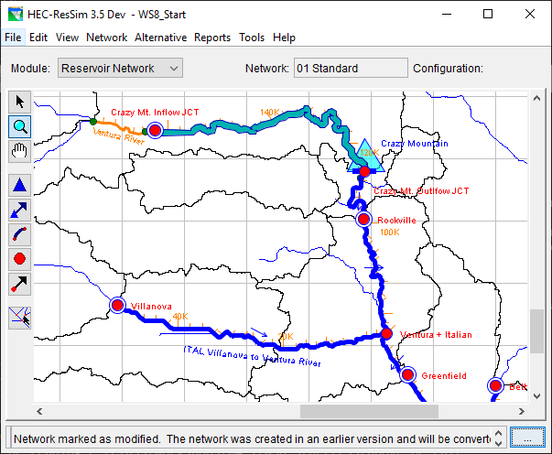
How ResSim computes
Notes:
This slide shows the Crazy Mountain watershed with the dam and several points downstream, the purpose is to show a simple ResSim model where each element gets its own compute block.

Slide 10
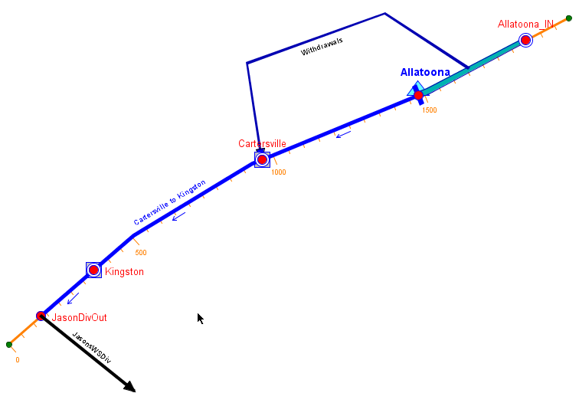
Example of an Operational Dependency
Local Downstream Control
Notes:
Now this model has some elements that create compute blocks – diversion and downstream control points.

Slide 11
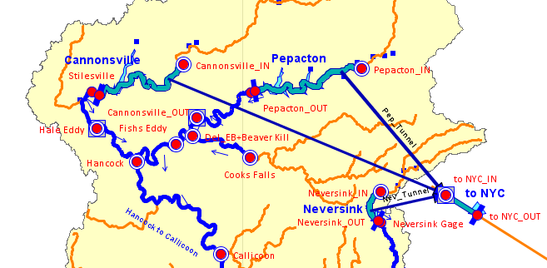
Example of an Operational Dependency
Local & System Downstream Control
Notes:
Look at this system, what is “downstream”?

Slide 12
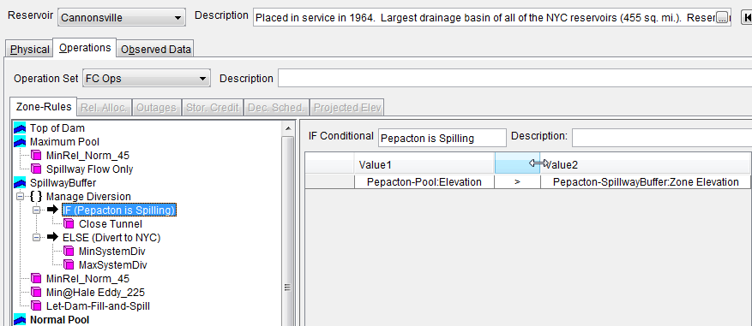
Example of an Operational Dependency
What’s happening at another reservoir…
Notes:
Operational dependency – information the reservoir needs to know to make it’s decision. What might be some examples?
Are they always upstream? Are there feeback loops that might mean an operation will change the value it is calculated from?
Think about the flow of information as well as the flow of water when you’re modeling reservoir systems. What elements need to know about the others?
ResSim will try to link these together into a compute block… but it can’t know about the ones inside of scripts.

Slide 13
Terminology
Operational Dependency
  A location and parameter that must be considered when making release decisions.
  Examples
    Downstream Control
    Current Flow/Stage at a Gage
    Current state of another reservoir
    What else?

Slide 14
How to identify dependencies…
Do any of your reservoirs operate for a requirement or limit at a location outside of the project?
Do you have any diversions?
Do you have any “complex” ratings?
Do you have any scripts?
  If so, do any of your scripts require a model variable that is not computed by the reservoir or diversion that uses the script?

Slide 15
Terminology
Compute Block*
  The set of model elements that must be computed together, timestep by timestep, in order for the reservoir to estimate the state of the dependency and thus make a release decision.
  * Called Iteration Blocks in the compute log.

Slide 16
What is included in compute blocks..
The (operational) element that has the dependency
  Reservoir
  Diversion
  Junction?
The location of the dependency
Everything in between…

Slide 17
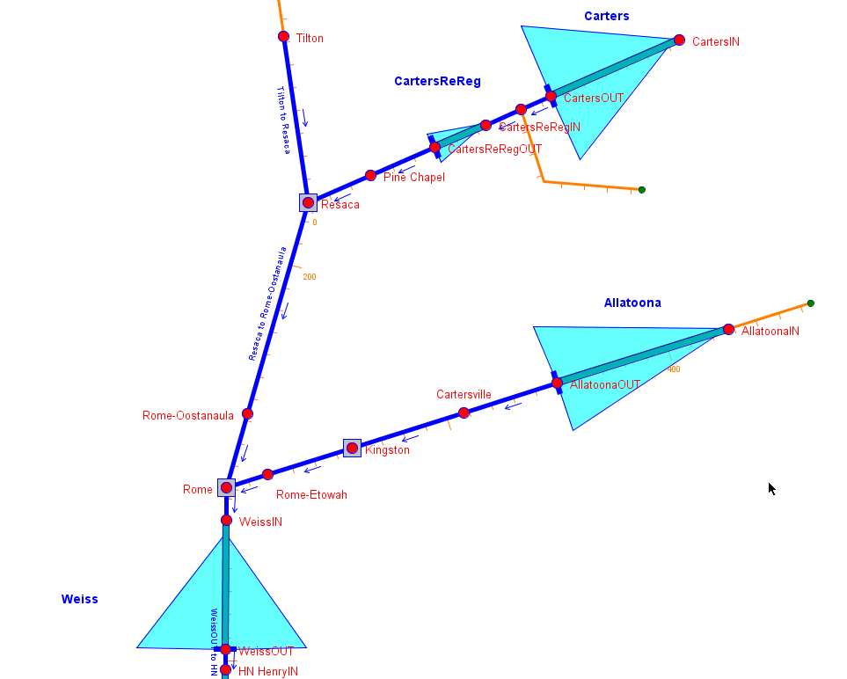
Notes:
This image is trying to show a couple of ways that a compute block will be formed.

Slide 18
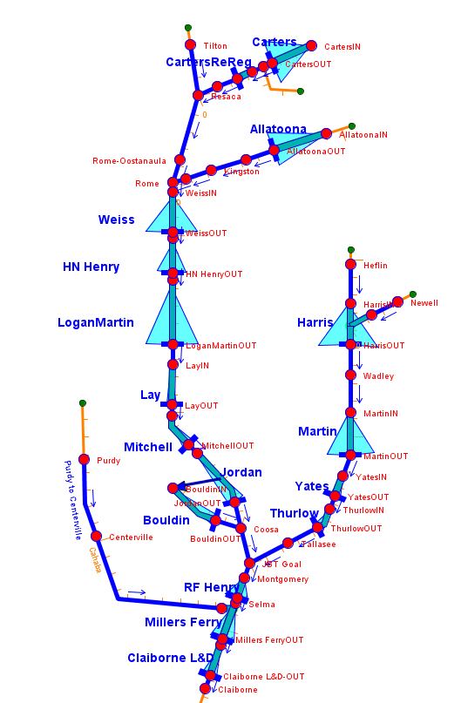
Notes:
Here’s a bigger view of the same watershed – with more compute blocks.

Slide 19
How ResSim identifies them...
ResSim processes through the native model features to find dependencies. It looks at:
  Release Rules
  Downstream Control Rules
  If-Block Conditional Expressions
  Zones
  Diversion connections and functions
  Ratings
What’s missing?
Notes:
What’s missing? Scripts – ResSim cannot ask your script what it depends on! We’ll talk about how to deal with this in a moment.

Slide 20
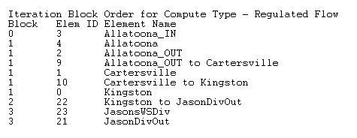
Finding ResSim’s Compute Blocks…
View the compute log…
  Go to the bottom of the log then scroll up until you find this table:
Compute block #s

Slide 21
Why should you care…
An If blocks or rule may not function properly and you cannot figure out why…
A State Variable or scripted rule doesn’t get valid values in one or more of the time series it accesses
Beware of “current elevation”, “current outflow”, or other current values downstream of the dam! These are values from the previous compute pass. But ResSim won’t stop you from using them!

Slide 22
What to do about it
Apply a modeling technique to force ResSim to include your dependency into the compute block you identify.
  Dummy Rule is the most common
  Other techniques are also available…

Slide 23
Advanced Topics -
Modeling Techniques

Slide 24
Terminology
What is a Modeling Technique?
It is a nicer name for a “work around” / ‘hack’ / ‘kludge’ – the name you’ll use in a report or to your supervisor.
Okay, what are those?
“A Work Around is something a modeler does to get the modeling software to behave in a desired manner. It is often used to deal with (work around) a software bug or deficiency.”
These aren’t a sign of a bad ResSim model!

Slide 25
Known Uses for Modeling Techniques
To force the compute blocking logic to include elements it otherwise wouldn’t.
To bring external time series into the model so that a script doesn’t have to (an “external” dependency).
To compute a state variable that is a dependency to other state variables.
Others…

Slide 26
How to influence the Compute Blocks…
Use an existing modeling feature to inform the compute blocking logic:
  A release rule
  A downstream control rule
  A zone
  An If Block
  A diversion

Slide 27
Influencing Compute Blocks…
If the ONLY purpose of the additional rule, zone, etc, is to influence the compute blocking, then it should be designed to have NO OTHER IMPACTS.
  Minimum flow rule = 0
  Zone below inactive
  If test that is always false (without an else)
  Diversion = 0

Slide 28
Influencing Compute Blocks…
“Dummy Rules” are rules that are used to influence or aid the ResSim decision logic without directly affecting the “allowable range”.
  Influence is attained by making the rule’s “function of” the location and/or parameter of interest.
  No effect is attained by specifying the “function” (lookup table) as a minimum flow which always evaluates to a value less than or equal to 0.0.

Slide 29
Types of Modeling Techniques
Dummy Rules
  Compute Blocks, State Variables, Time Series
Dummy Zones
  Compute Blocks, State Variables, Time Series
Dummy Diversions
  Compute Blocks, State Variables, Time Series
Dummy Junctions
  Time Series
And even Dummy Reservoirs!

Slide 30
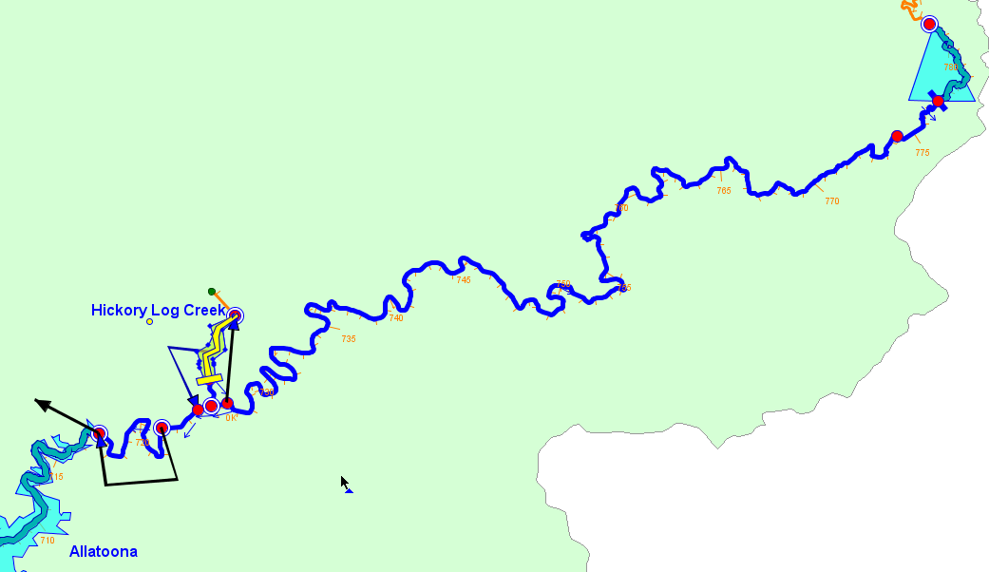
Dummy_abv_Dawsonville
A dummy reservoir was used to:
  Launch a State Variable
  Force a Compute Block
  Bring in a bunch of external time series

Slide 31
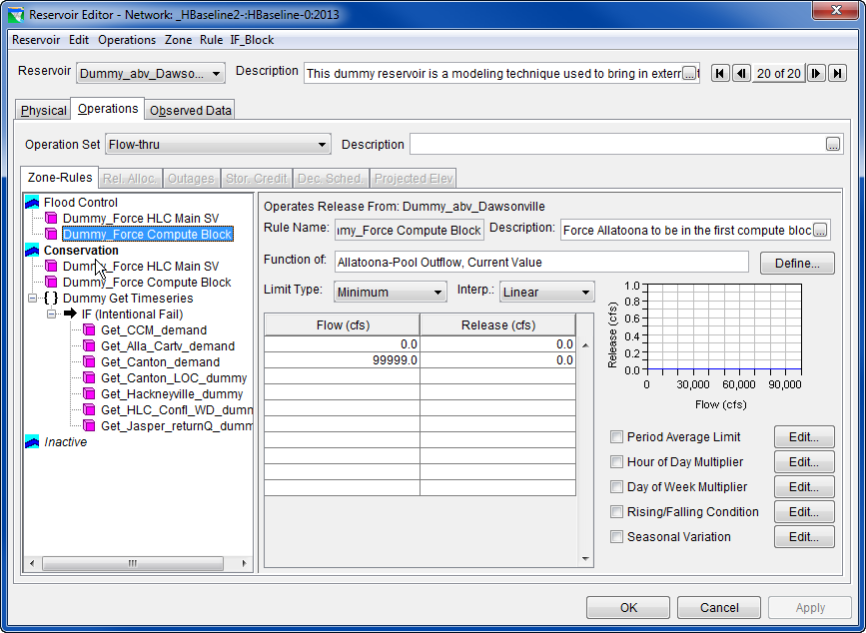

Slide 32
Modeling Challenges

Slide 33
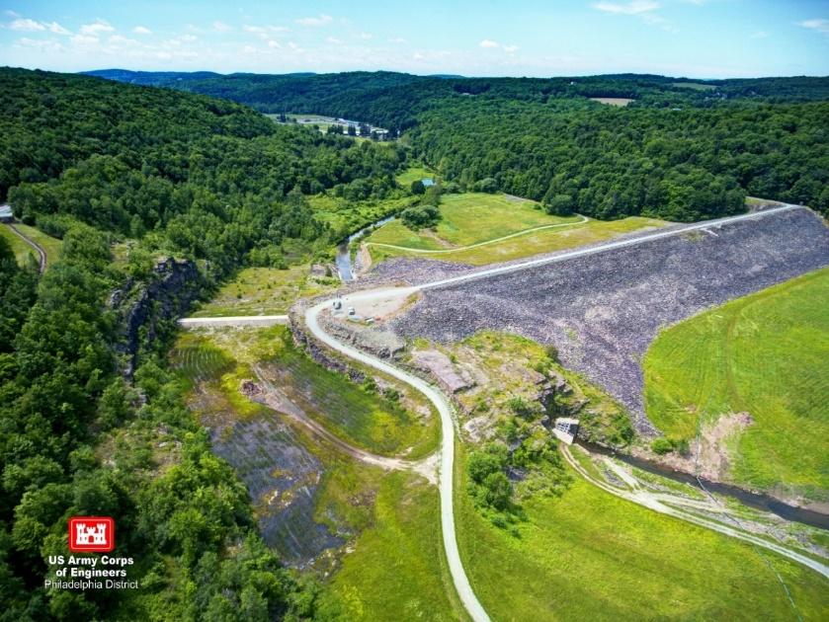
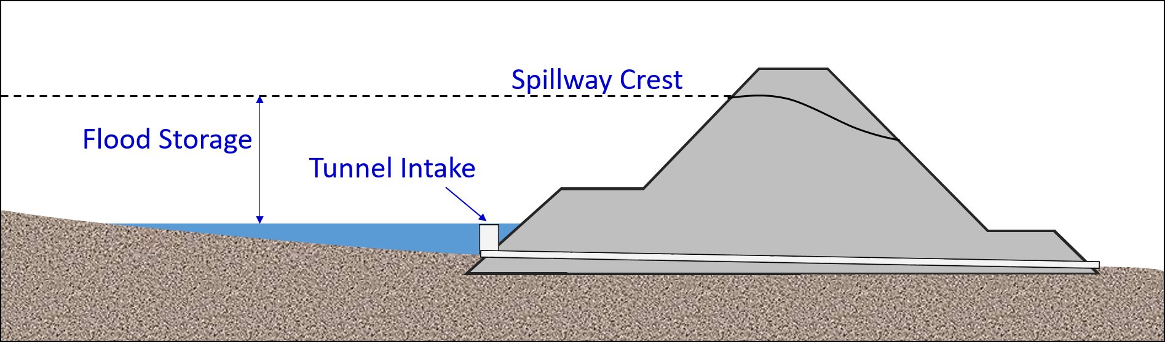
The Challenge: A Dry Dam
Jadwin Dam
Flood Control Only
Passive operations outside flood events
Dry dam, no permanent pool
Notes:
Delaware River System
Lackawaxen River Basin
Dyberry Creek

Slide 34
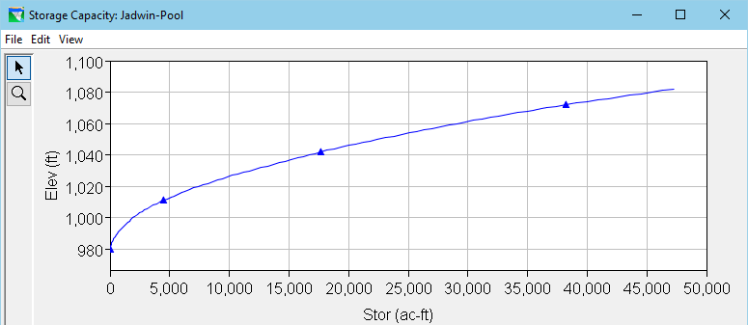
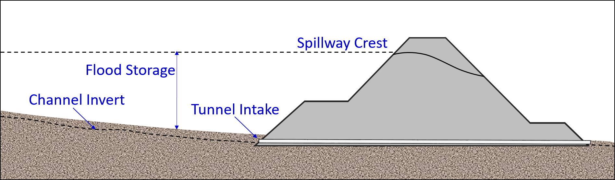
Why was Jadwin a Challenge?
Tunnel Invert = 974’
Pool data starts at 980’
Computed pool elevation won’t track with historic record.
No “normal pool”
Notes:
No permanent pool
Un-gated Tunnel, invert = 974’
Storage table does not include river channel, starts at 980’
Model results won’t track with historic pool record
Discovery - Pool gage located in the river channel

Slide 35
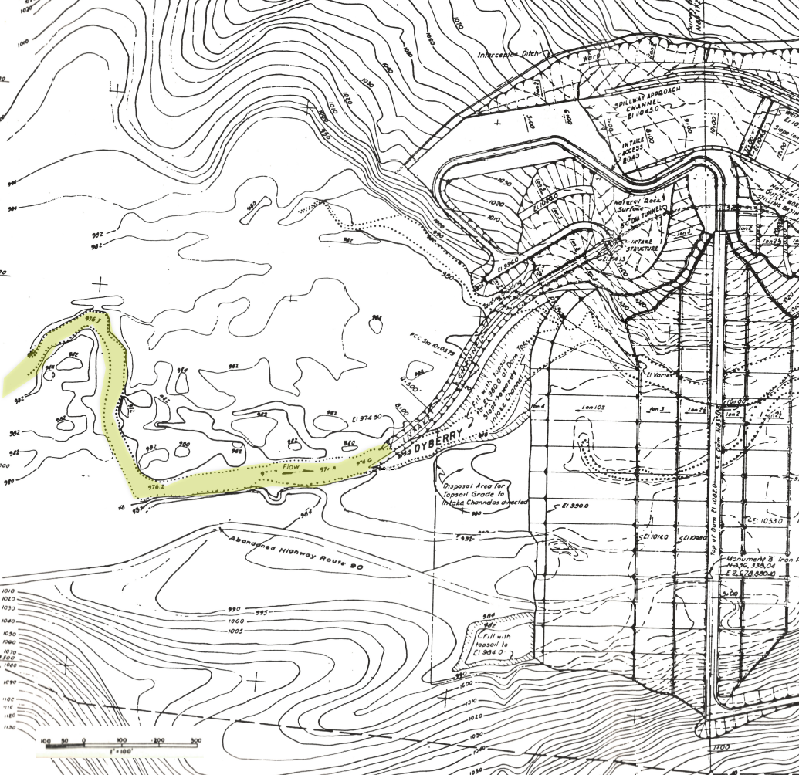
The Solution…
Estimate…
  Volume of Wedge
  Length
  Width
  Add the “new” volume to the storage table.
Guide Curve at Invert
No Inactive Zone
Notes:
The wedge represents the volume of the channel up to the point where the existing storage table starts.
Thus, the length is how far back the channel goes before the invert is at the zero storage elevation.
The width and height are the approximate channel shape at or near the intake.
The volume should be computed in slices so that the stage can be reasonably compared to the gage record for in-channel flows (before the reservoir actually starts to fill).
If a rating curve exists for the gage, consider using it to back calculate the volume…

Slide 36
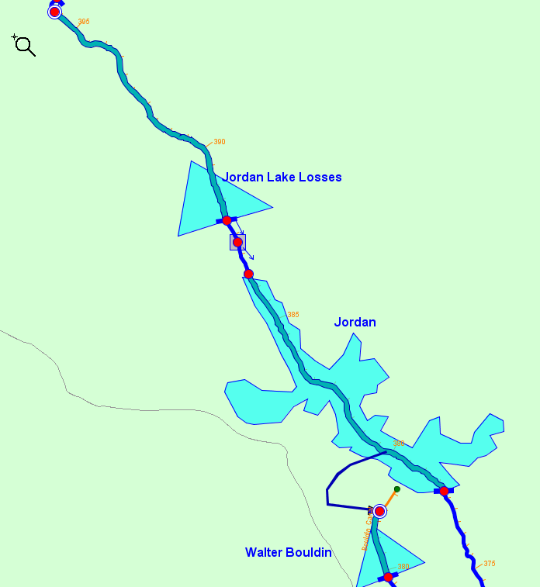
Compute Net Inflow
Upstream reservoirs operate for net inflow to Jordan-Bouldin. To determine the net inflow, a dummy reservoir was used to represent the combined pool of the pair and their associated evaporation.

Slide 37
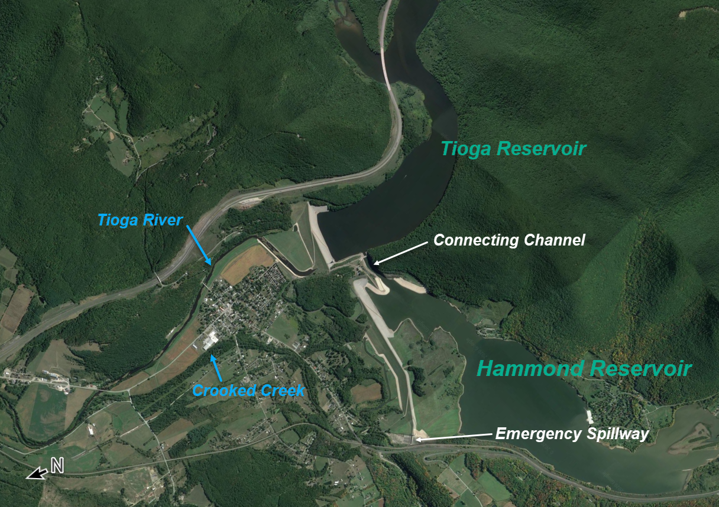
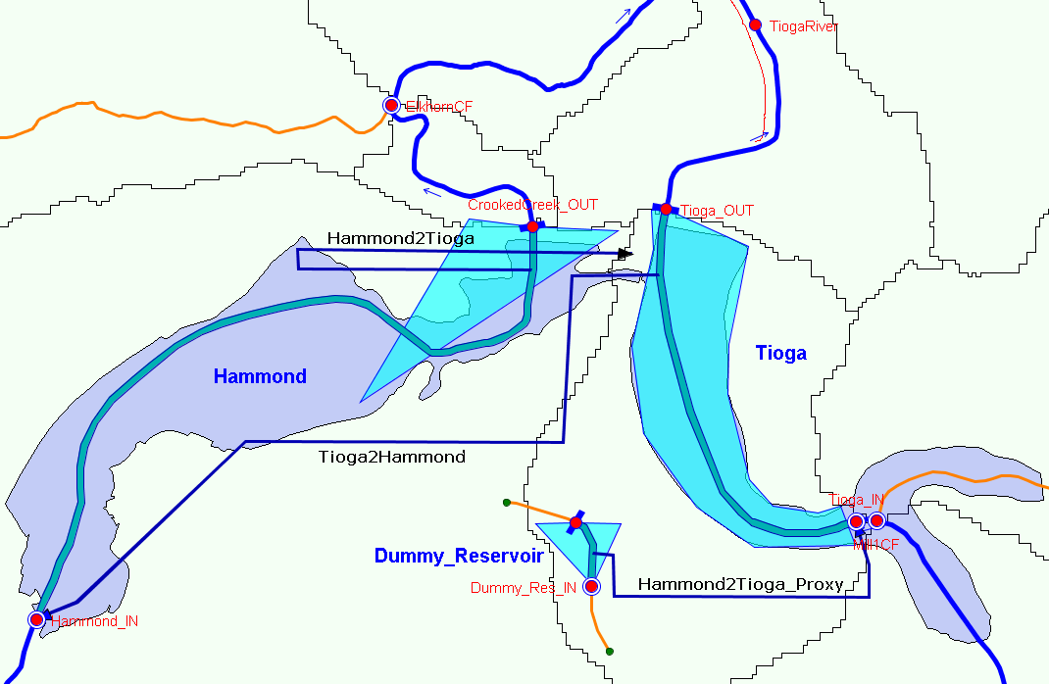
The Challenge: A Connecting Channel between two Reservoirs
Tioga & Hammond Reservoirs
3 Diverted Outlets
1 Dummy reservoir
3 State Variables
  1 Scripted
  2 Scriptless
Notes:
Low ph (acidic conditions) associated with coal mine drainage in the headwaters of the Tioga River has been a major cause of poor water quality in that river.
One reason for building the Hammond dam, was to provide relatively neutral water to mix with the Tioga reservoir water to increase the ph level of the Tioga River downstream of these waterbodies.
Why is this a challenge? Bi-Directional Flow - The connecting channel can flow in both directions between the reservoirs.
ResSim can only handle dendritic networks.

Slide 38

Questions…

