Slide 1
Scripting HEC-ResSim

Slide 2
Topics
Scripts Executed During Simulations
State Variable Scripts
Scripted Rule Scripts
Scripts Executed Outside Simulations
Static Scripts
Jython

Slide 3
Two Categories of Scripts – 1 of 2
Scripts executed during simulations
These scripts can:
Compute and store the state of some (concrete or abstract) portion of the model at each simulation time step
Compute a flow limit (minimum, maximum, or specified) at each simulation time step
These scripts cannot:
Know when they execute in relation to other scripts

Slide 4
Two Categories of Scripts – 2 of 2
Scripts executed outside simulations
These scripts can:
Pre-process data for simulations
Run simulations (some or all alternatives)
Post-process data from simulations, generate plots, reports, etc…
These scripts cannot:
Interact with a running simulation

Slide 5
Scripts Executed During Simulations
There are two types of HEC-ResSim scripts that are executed during simulations
State Variable Scripts
Scripts that set the value of a state variable, which can be used by rules and IF-THEN-ELSE blocks to specify flow constraints
A model variable represents the state of some element of the network with a value at each time step of the simulation (thus, a time series)
A state variable is a model variable-like time series whose values are computed by a script instead of the static rule-based logic; it doesn’t necessarily represent the state of a single element
Scripted Rules
Scripts that directly specify flow constraints

Slide 6
Scripts Executed During Simulations
Common Properties of State Variable and Scripted Rule Scripts
Scripts are executed at every iteration of every timestep
Computation at any time step may depend on any model variables at previous time steps, and may depend on other State Variables at the current or previous timestep
The main scripts must “return” a value.
Notes:
Scripts that depend on other State Variables at the same time step must manually ensure they have been executed before the current script

Slide 7
Model Variables vs. State Variables
Represent the state of single elements within a ResSim model.
Standard output of a ResSim model.
Globally accessible Time Series objects that belong to the network.
Not associated with a specific network element, so can represent complex or abstract concepts involving one or more model elements – such as basin wetness, system drought state, etc.
Defined by the modeler.
Globally accessible Time Series objects that belong to the network.

Slide 8
More about State Variables
HEC-ResSim computes a state variable by executing a Jython script for that variable at every time step throughout the simulation period.
The script can access model variables and other state variables for the current and prior time steps.
Scripts that depend on other State Variables at the same time step must be manually ensured to be executed after the script they depend upon
The script can also perform any function available to Jython to compute the variable.
Care must be taken not to perform lengthy tasks (e.g. disk or network access) because of the number of times the script is executed!
Notes:
Jython is a Java implementation of the Python programming language and provides the common basis for ResSim, DssVue, and CWMS scripting.
State Variable definition scripts do not return anything. They must “set” the value of the TimeSeries object for the current time step, or have set it in an earlier time step. The script may optionally set values into the future (through the end of the computation time window).

Slide 9
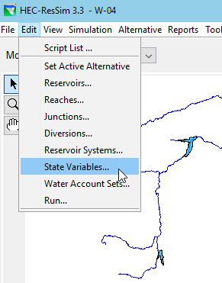
Creating a New State Variable
To create a new State Variable script:
Edit menu, State Variables…
The State Variable Editor will open.
State Variable menu, New…
Enter a name and an optional description, Click OK.
Enter a parameter (DSS C Part) in the Parameter Name field.
Select the parameter type from the Parameter Type list.
Edit the script text as desired.
Press the Compile Script button to check for syntax errors.
Fix any errors and repeat this step.
Save the script by selecting Save from the State Variable menu or by pressing Ctrl-S.

Slide 10
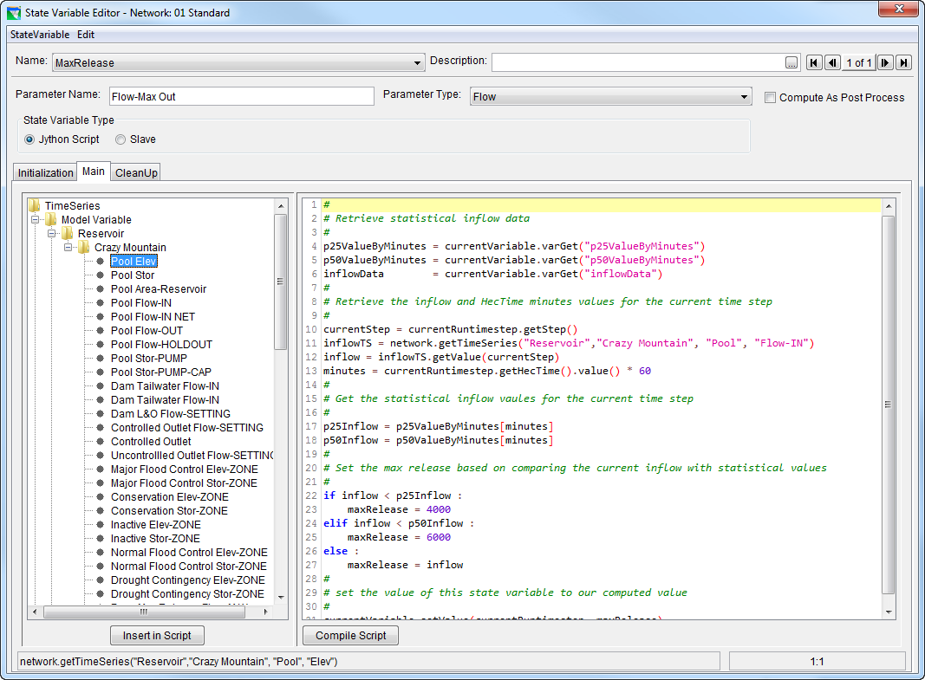
The State Variable Editor
State Variable Selector
Script Tabs
API Tree
Edit Pane
API Preview
Cursor Position

Slide 11
Using the State Variable API Tree
Selecting a node (not a folder) in the API Tree causes the API insertion text for the selected node to be displayed in the API preview bar.
Double-clicking on a node in the API Tree causes its API text to be inserted at the current cursor position in the Edit Pane.
The same can be accomplished by selecting a node in the API and then selecting the Insert in Script button under the API Pane.
Dragging a node in the API Pane to some position in the Editor Pane causes its API text to be inserted at that location in the Editor Pane.

Slide 12
Scripted Rules…
Are Release Function Rules defined by a script
Are evaluated with the other rules in the rule stack
Allow the modeler to define a more complex or abstract rule than the standard rule set allows
Have an init function (initRuleScript) and a main function. (runRuleScript)
A value for the rule limit must be defined and set in the script.

Slide 13
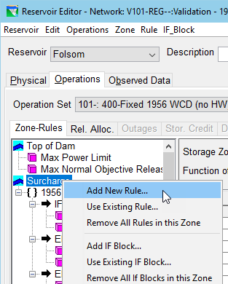
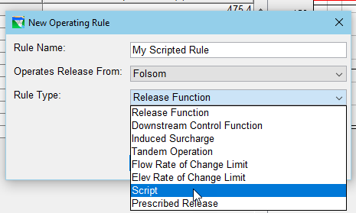
Creating a Scripted Rule
To create a Scripted Rule:
Open the Reservoir Editor, Operations tab
In the Zone-Rules tree on the Zone-Rules tab, right-click the desired zone and select Add New Rule… from the context menu.
Give the rule a name, select the release element
Select Script for the Rule Type.
Press the OK button.
The Scripted Rule Editor appears in the rule’s Edit pane. It is very similar to the State Variable Editor.

Slide 14
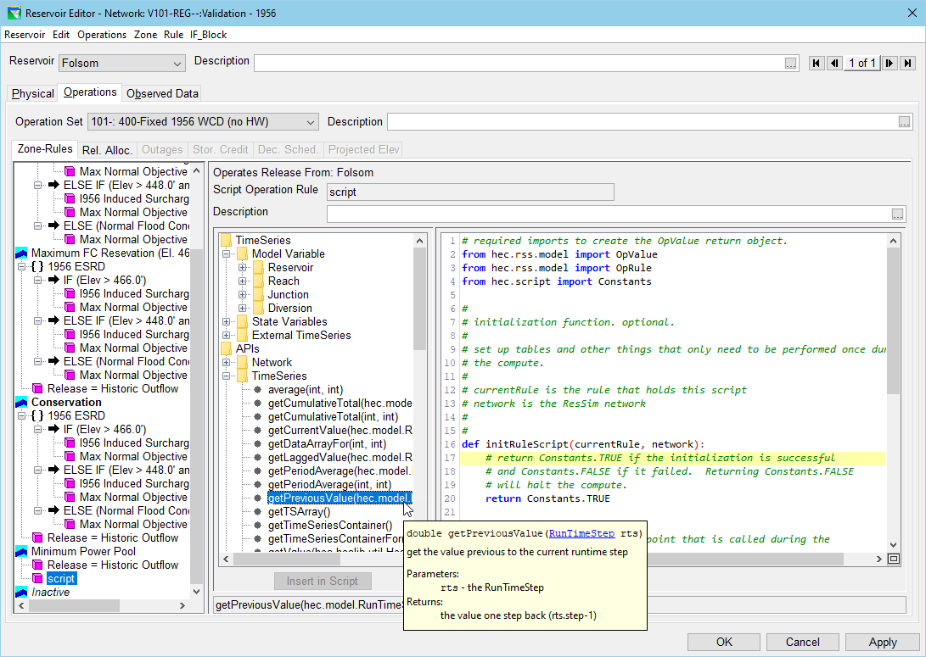
Scripted Rule Editor
API Tree
Edit Pane
API Preview

Slide 15
Scripts Executed Outside Simulations
There is only one type of script executed outside simulations, which we call static scripts or utility scripts.
ResSim Static scripts resemble HEC-DSSVue scripts:
They can be executed from the Script Selector, Script Pane, or Script Editor.
They are created, edited, and tested in the Script Editor.
Their location in the Tree Pane of the Script Editor corresponds to a file in your user profile’s AppData area on disc.
ResSim Static scripts go beyond HEC-DSSVue scripts:
Script location in the Tree Pane determines script visibility.
Scripts can have knowledge of the current module and current simulation.

Slide 16
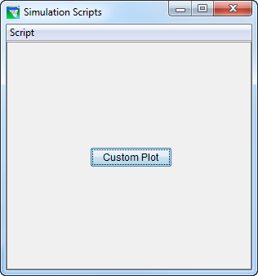
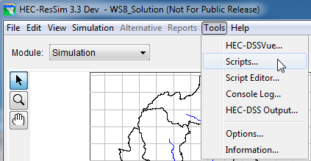
The Script Selector
The Script Selector is accessed by the Tools→Scripts menu item in any module.
The Script Selector is titled according to the current module.
Execute a script by pressing its button.

Slide 17
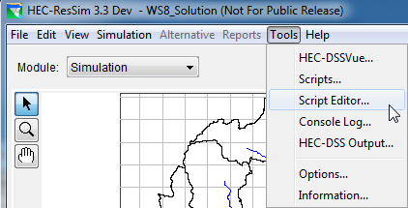
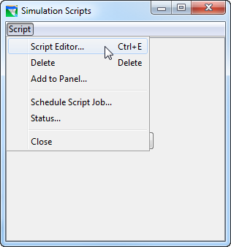
Accessing the Script Editor
The Script Editor is accessed by the Tools→Script Editor… menu item on the HEC-ResSim menu bar, or by Script→Script Editor menu item on the Script Selector.

Slide 18
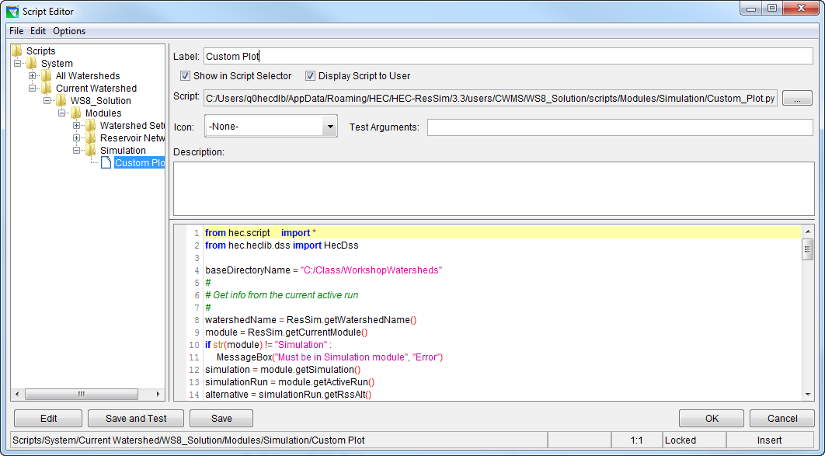
The Script Editor
Tree Pane
Script Name
Visibility Switches
File Name
Description Pane
Icon Selector
Pre-Defined Variables
Editor Pane
Edit/Save/Test Buttons
Dismissal Buttons
Location & Mode Indicators

Slide 19
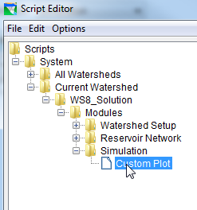
Static Script Visibility
For a static script to be visible:
its position in the Tree Pane:
must be in the All Watersheds folder or Current Watershed folder
must be in Modules folder or folder corresponding to the current module
its Show in Script Selector switch must be checked to be visible in the Script Selector
its Display Script to User switch must be checked to be visible in the script pane

Slide 20
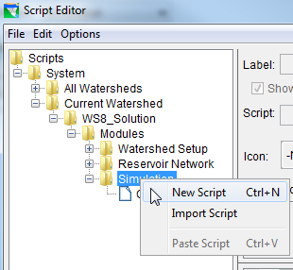
Creating a New Static Script
To create a new static script:
right-click on one of the folders under either the All Watersheds or Current Watershed:
Modules
Watershed Setup
Reservoir Network
Simulation
select New Script from the context menu
enter a name in the Label field
enter the script text in the Editor Pane
press the Save or Save and Test button

Slide 21
Editing Existing Static Scripts
To edit an existing Static Script, do one of the following:
double-click on its entry in the Tree Pane
right-click on its entry in the Tree Pane and select Edit Script from the context menu
select its entry in the Tree Pane and do one of the following:
select File→Open from the menu bar
press Ctrl-O
press the Edit button

Slide 22
Testing Existing Static Scripts
To test an existing Static Script from the Script Editor, select its entry in the Tree Pane and do one of the following:
select File→Test from the menu bar
press the Save and Test button

Slide 23
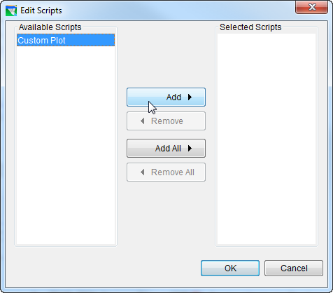
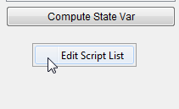
Adding Scripts to the Control Panel
To add a script to the simulation module script pane:
right-click in the scripts area
select Edit Script List from the context menu
use the Edit Scripts dialog to move desired scripts to the Selected list

Slide 24
The hec.script package
These hec.script package contains some “wrapper” classes that simplify some common functions for the scripter. Just identify the classes you need on an include statement in your script such as:
from hec.script include ResSim, MessageBox
For example, the ResSim class, a subclass of ClientAppWrapper provides the following functions:
isWatershedOpened()
getWatershed()
getWatershedName()
openWatershed(watershedName)
closeWatershed()
getCurrentModule()
Also Available is MessageBox

Slide 25

What is Jython?
http://jython.org
Jython is a Java-based implementation of the Python programming language. This means:
You learn the Python language to learn Jython.
Jython code can work seamlessly with Java code.
Anybody programming experience will pick it up quickly.
Others can quickly become effective by mimicking examples.

Slide 26

What is Python?
http://python.org
Python is a programming language that is
interpreted
open source
object oriented
and has
simple syntax
high level dynamic data types

Slide 27


Some Books Available

Slide 28
Review
Scripts Executed During Simulations
State Variable Scripts
Scripted Rule Scripts
Scripts Executed Outside Simulations
Static Scripts
Jython

