Slide 1
Scripting HEC-ResSim with Jython
Debugging Techniques

Slide 2
Topics
Jython Exceptions
Know Your Error Types
Reading Exception Traces
Print It Out
Assert Your Assumptions
Exception Handling

Slide 3
Jython Exceptions
(a.k.a. Error messages)
Jython Exceptions -
  are errors that occur in Jython code, such as:
    referencing a non-existent item,
    trying to modify an immutable object,
    etc…
  occur at a specific code level and will propagate up to higher levels until they are handled.
    Function calls introduce a lower level of code until they complete.
    The highest level of code is the Jython interpreter.
  are handled by the Jython interpreter by printing an error message about the exception.
    If the interpreter is not in interactive mode, it will terminate once it has printed the error message.

Slide 4
Know Your Error Types
Error Type | Reason for Error
AttributeError | Tried to access a non-existent item in a module or class.
IOError | Error opening, creating, reading, or writing a file.
ImportError | Cannot find the specified module for importing.
IndexError | Sequence subscript is out of range.
NameError | Tried to access a non-existent variable*.
SyntaxError | Invalid Jython code. The error is often on the line before the one indicated.
TypeError | Attempted operation using invalid data type.
UnboundLocalError | Tried to access an undefined variable*.
ValueError | Attempted operation using correct data type, but invalid value.
ZeroDivisionError | Attempted to divide by zero or perform modulo zero.
*The variable in an UnboundLocalError has been defined by at least one code path, but not the code path taken when the error was encountered.

Slide 5
Jython Exception Type Hierarchy
SystemExit
KeyboardInterrupt
Exception
StandardError
  ArithmeticError
    FloatingPointError
    OverflowError
    ZeroDivisionError
  AssertionError
  AttributeError
  EnvironmentError
    IOError
    OSError
  EOFError
  ImportError
  LookupError
    IndexError
    KeyError
  MemoryError
  NameError
    UnboundLocalError
  RuntimeError
    NotImplementedError
  SyntaxError
    IndentationError
    TabError
  SystemError
  TypeError
  ValueError
    UnicodeError
Warning
  DeprecationWarning
  RuntimeWarning
  SyntaxWarning
  UserWarning

Slide 6
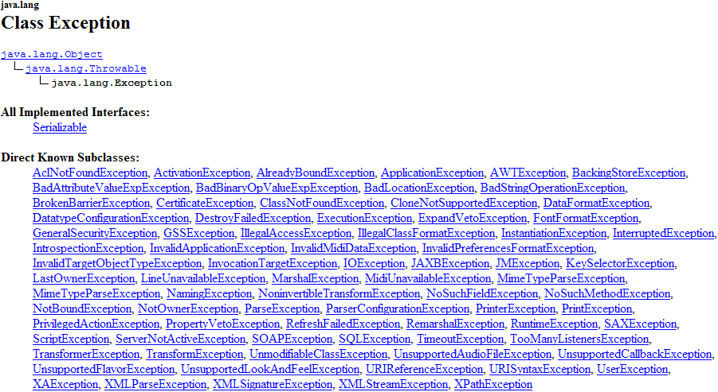
Java Exception Types

Slide 7
Reading Exception Traces
When Jython encounters an error in compiling or executing a script it prints an exception trace (aka Traceback) that includes:
  A call stack
    represents the state of the script when the error occurred
    is the hierarchy of module entries and function calls, including file names and line numbers
    bottom line is the actual location of the error
  The error type
  Any available error information

Slide 8
Exception Trace Example 1
Traceback (innermost last):
File "test2.py", line 9, in ?
File "test2.py", line 6, in main
File "T:\\test1.py", line 16, in ?
File "T:\\test1.py", line 11, in func
AttributeError: class 'org.python.modules.math' has no attribute 'Fmod'
Call Stack (file, line, function)
Error Location
Error Type
Error Information
If an exception occurs in a script for a state variable or scripted rule within HEC-ResSim, the exception trace will be in the console and compute logs. And, you may get a message box, too.
The quickest way to locate the exception trace is to scroll to the bottom of the log and then scroll up to locate the error.

Slide 9
Exception Trace Example 2
Traceback (innermost last):
File "test2.py", line 9, in ?
File "test2.py", line 6, in main
File "T:\\test1.py", line 17, in ?
File "T:\\test1.py", line 11, in func
File "C:\Java\jython-2.1\Lib\shutil.py", line 73, in copy2
File "C:\Java\jython-2.1\Lib\shutil.py", line 29, in copyfile
IOError: File not found - 'T:\another_module.py (The filename, directory
name, or volume label syntax is incorrect)
Error Location is shutil.py, line 29 in function copyfile.
Location in script that caused the error is test1.py, line 11 in function func.

Slide 10
Print It Out
Often the most useful debugging technique is the least sophisticated: - print statements
print statements output to the console/console log.
But, inside state variable and rule scripts, you can ALSO write information to the compute log and compute window using:
  network.printMessage(message) [prints in black]
  network.printErrorMessage(message) [prints in red]
  network.printWarningMessage(message) [prints in orange]
  network.printLogMessage(message)
  Note:
    printMessage – prints only to the compute log and window
    printLogMessage – prints only to the compute log

Slide 11
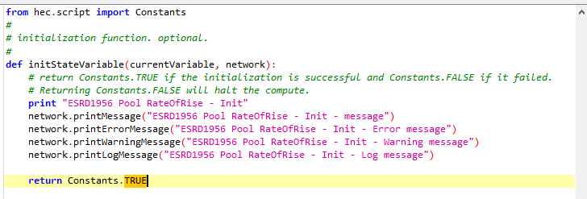
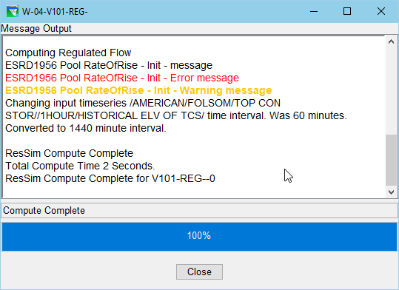
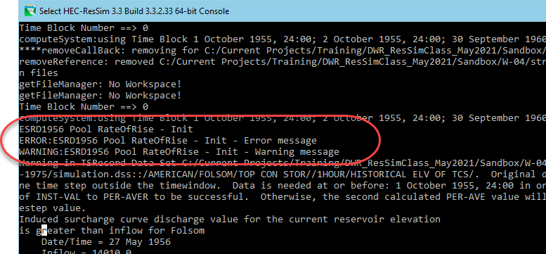
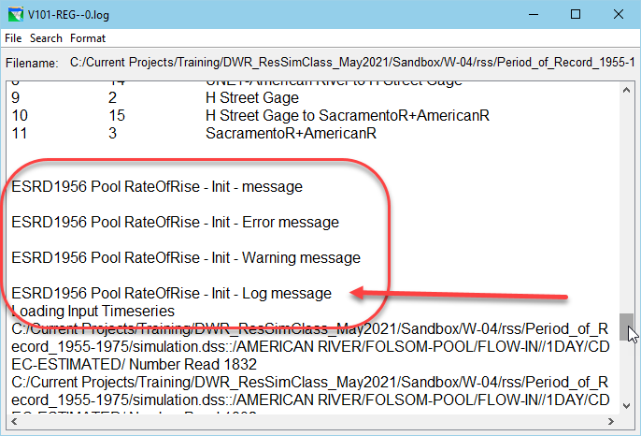
Print It Out - Examples
State Variable Init. Script
Compute Window
Console/
Console Log
Compute Log

Slide 12

Use of a “debug” variable
from hec.script import MessageBox, Constants
debug = Constants.TRUE
# setup my variables
a = 1
b = 2
# do stuff
if debug:
  msg = “A= %d, B = %d” % (a, b)
  MessageBox.showInformation(msg)
# do more stuff
currentVariable.setValue(currentRuntimestep, a+b)

Slide 13
Assert Your Assumptions
Assertions document the conditions you consider to be valid in your script. These are another form of print statements!
assert statement syntax:
  assert condition [,message]
The assert statement:
  Evaluates condition.
  Raises an AssertionError if condition is false.
    If specified, message will be printed by the AssertionError handler
  Is equivalent to
    if not condition : raise AssertionError[,message]

Slide 14
Assertion Example
### BAD ###
x = 6
y = 10
# x should be >= 0
# y should be in range 2..5
z = some_function(x, y)
### GOOD ###
x = 6
y = 10
assert x >= 0, "x out of range"
assert 2 <= y <= 5, "y out of range"
z = some_function(x, y)
Traceback (most recent call last):
File "<myexample>", line 5, in <module>
AssertionError: y is out of range
Assertions don’t prevent errors, but they force errors to be explicit at the point they are tested.
Otherwise, the errors may cause the script be behave badly or abort in an unexpected location that is difficult to debug.

Slide 15
Assert Your Assumptions
Constants.UNDEFINED - A classic assumption when writing state variable and scripted rule scripts is that the data you are retrieving from your model variables is defined; i.e. that there are values in there!!!
Too often, this is not the case.
If you want the program to stop when this condition is encountered, you can use assertions to test this assumption:
from hec.script import Constants
#
# Get pool elevation for the current time step
elevTs = network.getTimeSeries("Reservoir","Folsom", "Pool", "Elev")
elevNow = elevTs.getCurrentValue(currentRuntimestep)
assert elevNow <> Constants.UNDEFINED
# Use pool elevation to determine storage…

Slide 16
Exception Handling – try/except
Exception handling statements allow exceptions to be handled in a specified way.
Required header clauses
  try :
    Suite is executed.
    If an exception is encountered:
      Control is transferred to the appropriate except clause, if present, when the exception is encountered.
      If no appropriate except clause is present, the exception is propagated up to the next higher code level.
    If no exception is encountered:
      Control is transferred to the else clause if present.
      If there is no else clause, control is transferred to the first statement beyond the try/except statement.
  except [exception_type[, target]]:
    At least one except clause is required; more are permitted…

Slide 17
Exception Handling – except…
Optional header clauses
  except [exception_type[, target]]:
    At least one except clause is required; more are permitted.
    If exception_type is specified, any exception of exception_type or its sub-types that occurs in the suite of the try: clause will be “caught” or “handled” by the suite.
      If target is specified, it is a variable name that will receive the exception object being handled, allowing inspection of the exception details.
    If exception_type is not specified, any exception will be handled by the suite unless handled by a previous clause.
    If two except: clauses specify exception_type and one exception_type is a sub-type of the other, the clause with the sub-type must be listed first to be effective.

Slide 18
except Clause Ordering
  The first except: clause to match an exception type handles the exception.
  If two except: clauses specify exception_type and one exception_type is a sub-type of the other, the clause with the sub-type must be listed first to be effective.
  An except: clause without an exception_type, if present, must always be the last one.
#wrong try: suite except type: suite except sub-type: suite except: suite | #wrong try: suite except: suite except type: suite except sub-type: suite | #right try: suite except sub-type: suite except type: suite except: suite

Slide 19
Exception Handling – else & finally
Optional header clauses
  else:
    If the else: clause is specified, its suite is executed if no exception was encountered in the suite of the try: clause.
  finally:
    If the finally: clause is specified, its suite is executed regardless of whether an exception occurred.
    Executes after the suites of any except: or else: clauses.
    Does not handle an exception. Will propagate any unhandled exception after its suite is executed.
    Very useful for making sure resources are released (e.g., closing database connections, etc…)

Slide 20
Exception Handler - Framework
try :
# do some things here that might cause an exception, e.g.
raise valueError(“a sample value error”)
except ExceptionType as eMsg:
# handle all Jython exceptions except SystemExit
# and KeyboardInterrupt in this suite
print str(eMsg)
except ExceptionType, eMsg:
# older version, deprecated; similar to above.
except java.lang.Throwable as jexc:
# handle all Java exceptions in this suite
else:
# do any special “no exception” processing in this suite
finally:
# do any special “cleanup” processing in this suite

Slide 21
Exception Handler - Example
# Code without an exception handler
>>> x = 10
>>> z = x / y
Traceback (most recent call last):
File "<stdin>", line 1, in <module>
NameError: name 'y' is not defined
# The same code with an exception handling block
>>> x = 10
>>> try:
... z = x / y
... except NameError, err:
... print "One of the variables was undefined: ", err
...
One of the variables was undefined: name 'y' is not defined

Slide 22
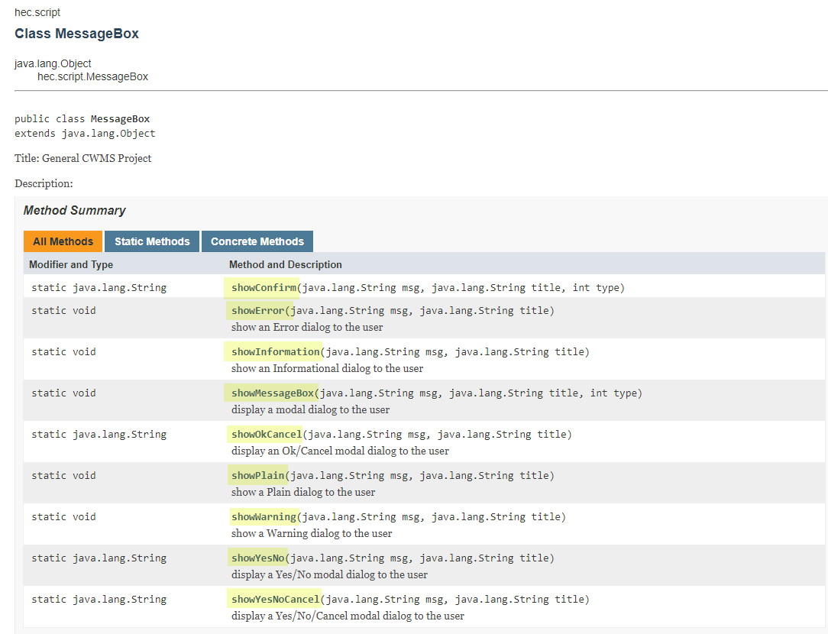

Slide 23
Useful Exception Dialogs
It is often difficult to separate the error output from other output of a script.
Using dialogs such as hec.script.MessageBox to display error information can be useful.
Put the contents of a script into a function definition (usually called main). Then at the bottom of the script you can have a the following exception handler:

Slide 24
Example - Exception Handler for Python Exceptions
try :
main()
except Exception, e:
# code to handle Python-style exceptions
import sys
import traceback
import StringIO
import hec
classname = e.__class__.__name__
message = " ".join(e.args)
tracebuf = StringIO.StringIO()
traceback.print_exc(None, tracebuf)
tracestr = tracebuf.getvalue()
tracebuf.close()
html = "<html>" + message + "<hr>" + tracestr
print
print "ERROR :"
print "ERROR : %s" % classname
for line in message.split("\n") : print "ERROR : %s" % line
print "ERROR :"
for line in tracestr.split("\n") : print "ERROR : %s" % line
print "ERROR :"
hec.script.MessageBox.showError(html, "%s : %s" % (classname, sys.argv[0]))

Slide 25
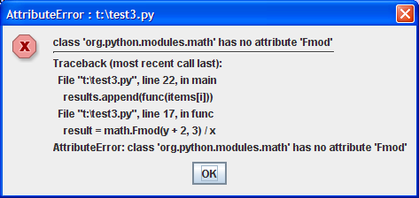
Python Exception
Handler Dialog Box

Slide 26
Example - Exception Handler for Java Exceptions
except java.lang.Exception, e:
import sys
import traceback
import StringIO
import hec
classname = e.__class__.__name__
message = e.getMessage()
tracebuf = StringIO.StringIO()
traceback.print_exc(None, tracebuf)
tracestr = "\n".join(tracebuf.getvalue().strip().split("\n")[:-1])
tracebuf.close()
sw = java.io.StringWriter()
pw = java.io.PrintWriter(sw)
e.printStackTrace(pw)
pw.flush()
tracestr += "\n" + sw.toString()
html = "<html>" + message + "<hr>" + tracestr
print
print "ERROR :"
print "ERROR : %s" % classname
for line in message.split("\n") : print "ERROR : %s" % line
print "ERROR :"
for line in tracestr.split("\n") : print "ERROR : %s" % line
print "ERROR :"
hec.script.MessageBox.showError(html, "%s : %s" % (classname, sys.argv[0]))

Slide 27
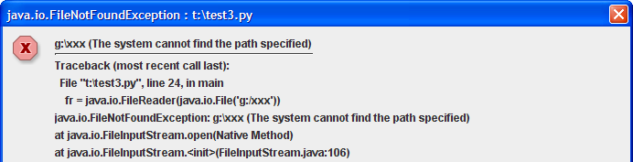
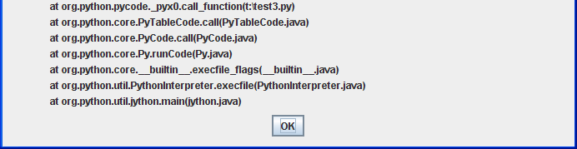
Java Exception Handler Dialog Box

Slide 28
Review
Jython Error are Exceptions
Know Your Error Types – e.g., what’s a NameError?
By default, Jython Errors generate Exception Tracebacks…
Print It Out – print & network.printMessage()…
Assert Your Assumptions – generate your own errors
Exception Handling – write your own code to “handle” exceptions.

