Slide 1
Using Balanced Hydrograph Analysis to better define Graphical Flow-Frequency Analysis
Chanel Mueller, PE (MN)
USACE St. Paul District
25 May 2017

Slide 2
Presentation Outline
Brief Overview of Flow Frequency Analysis
Graphical versus Analytical Analysis
Record Extension: MOVE.3
Volume Frequency Analysis
Balanced Hydrographs
Synthetic Event Analysis

Slide 3
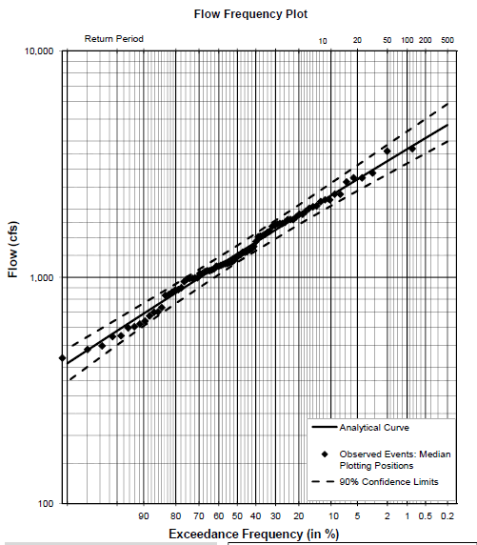
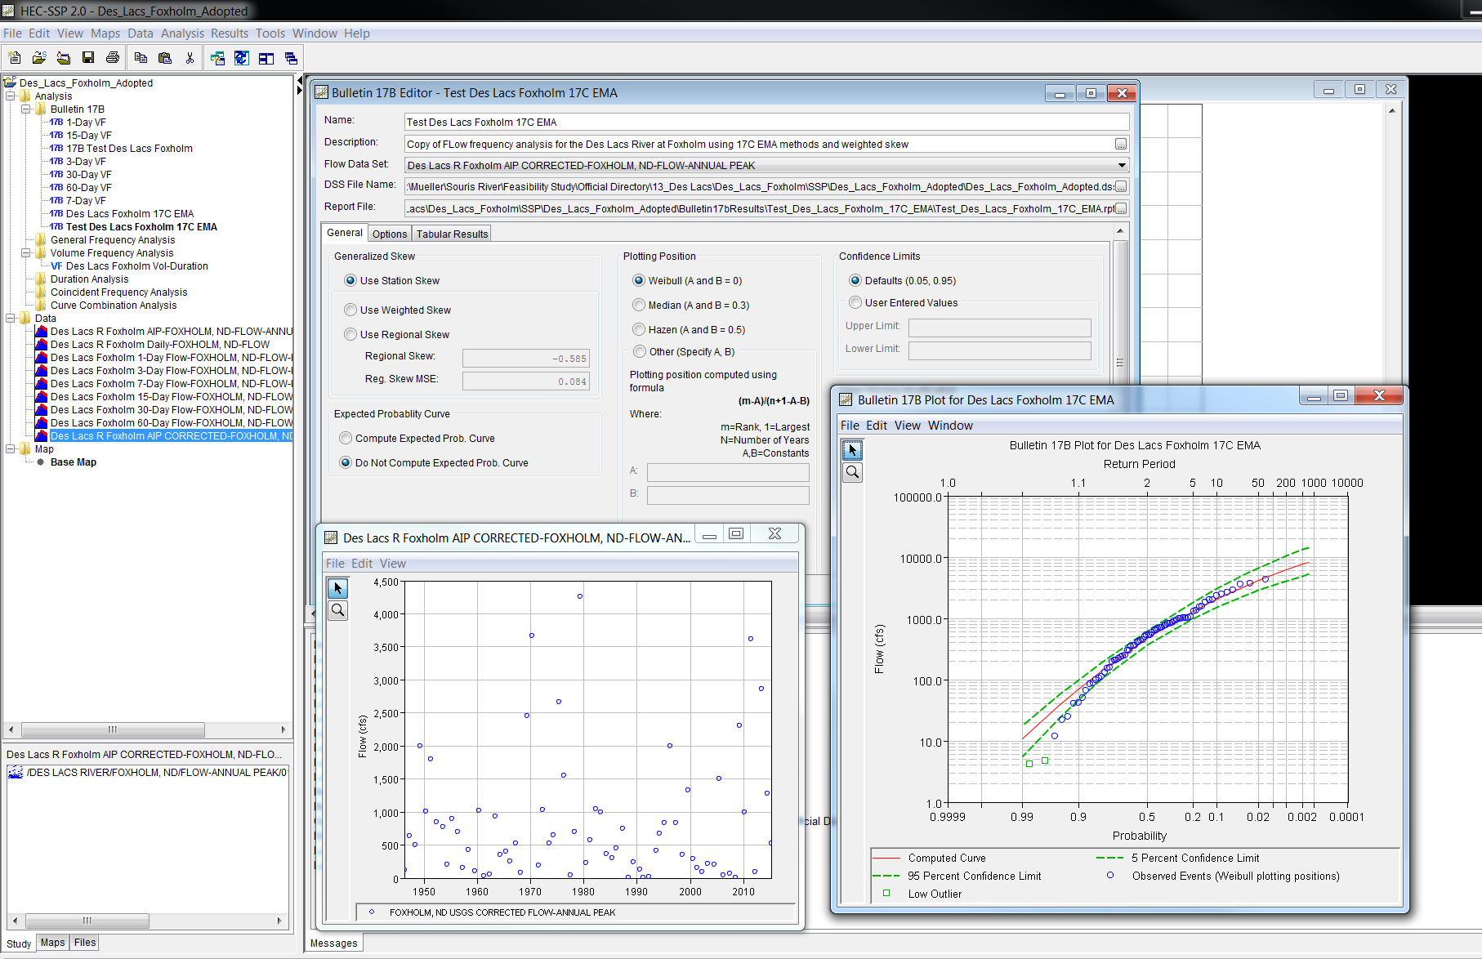
What is Flow-Frequency Analysis?
Flow versus Exceedance Probability
Characterization of Flood Risk
Using Past as Representation of future
Applications:
  Floodplain Mapping
  Watershed Management
  Design
HEC-SSP v2.1
  http://www.hec.usace.army.mil/
Notes:
Reliable estimation of peak streamflow is an essential element of water resources planning
A flow-frequency relationship is a relationship between flow magnitude and exceedance probability that gives you insight into the likelihood of a given discharge occurring. They are used to predict flood risk for sites along a river.
The results of flow-frequency analysis are needed for Risk Management, floodplain mapping, watershed management, and to aid in the design of dams, bridges, culverts and flood risk management projects
It is a probability distribution for the largest flow in any year
USACE software for Computing Flow-frequency Analysis: Hydrologic Engineering Center’s Statistical Software Package v2.1 (HEC-SSP) – nonproprietary software available at: http://www.hec.usace.army.mil/software/hec-ssp/

Slide 4
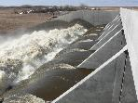
Graphical vs. Analytical Analysis
Analytical Analysis: When possible apply a statistical distribution
  Expected Moments Algorithm (EMA) or Log Pearson Type III (LP3)
  Why?
    Smooth fit
    Reproducible
    Widely Accepted
    Extrapolation to Extremes
Graphical Analysis: Data cannot be adequately described by a analytical distribution
    Urbanization
    Regulation
    Breakout Flows
USACE guidance:
  EM 1110-2-1417 Flood Runoff Analysis
  EM 1110-2-1415 Hydrologic Frequency Analysis
Analytical LP3 Fit to Unregulated Peaks
Dam Limits Flow to 1,000 cfs
1,000 cfs
Graphical Fit to Regulated Peaks
Notes:
In general if there is not an identifiable reason for carrying out a graphical analysis an analytical curve should be generated. The USACE recommend carrying out analytical flow-frequency analysis in accordance to Bulletin 17B- we are currently transitioning to Bulletin 17C.
I would default to applying an analytical distribution unless you strongly feel that the model is not a good representation of the data or is not providing a conservative estimate of flood values of interest (falls well below 1% event for FIS studies) because applying an analytical distribution gives you automatic insight into the extremes, is reproducible and is the most widely accepted method for generating flow-frequency analysis
The statistical model that you select whether that be LP3 or EMA must be able to represent the data you are analyzing
EM 1110-2-1417
"A frequency distribution is selected because it models well the data that are observed [...] the reliability of frequency estimates depends on how well the proposed model represents the parent population. The fit can be tested indirectly with a simple graphical comparison of the fitted model and the sample”
EM 1110-2-1415
Analytical Distributions should not be applied where the sample cannot be adequately fitted by a statistical model like Log Pearson Type III. Situations where an analytical distribution is typically not appropriate:
Downstream of a Significant Reservoir Project
Downstream of a Significant natural, Breakout Flow Area
Downstream of a Highly Urban Area
In these cases you have to use a graphical distribution
Graphical analysis involves fitting a curve by hand to observed data plotted on probability paper.

Slide 5
Challenge: How do You Define the Extremes for Graphical Flow Frequency Analysis?
34 years of Available Peak Flow Data
2%, 50-year Event
Notes:
-Most USGS streamflow gage sites have less than 100 years of annual peak flow data available.
-We are interested in defining flow-frequencies for events with probabilities of exceedance of 1% and less.
-This requires the flow-frequency relationship to be extrapolated beyond the plotting positions associated with historic peak flow data
- In this case Because you have less than 50-years of records at this site (34 years) you don’t have a definitive way of drawing the upper end of the flow frequency curve above the 2% or 50-yr Event
The unregulated flow-frequency curve, along with limiting topographic features can be used to help inform how to extend the frequency distribution- but in general it is very difficult to definitely define the flow-frequency curve beyond the historic data points.
The rest of this presentation will be dedicated to describing how a synthetic balanced hydrograph approach can be used to aid in the extrapolation of graphical flow-frequency curves beyond the observed, peak streamflow data series

Slide 6
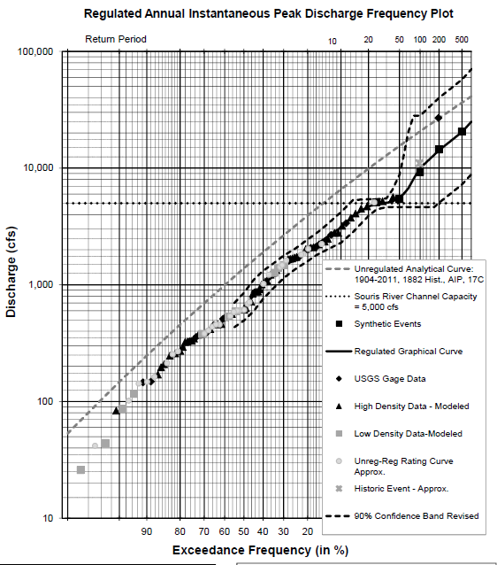

Record Extension
Augment Historic Plotting Positions
Maintenance of Variance Equations (MOVE)
  Bulletin 17C: MOVE.3
  Vogel & Stedinger
Unbiased Estimate of Mean & Variance → maintains variability vs. simple linear regression
Advantages over two station comparison…
  Does not rely on the assumption of normality skew (G) ≠ 0
  Provides additional data not just an adjusted statistical distribution
$$\hat{y_{i}}=a^{′}+b \left(x_{i}−x_{2}\right)$$
y_{i}̂ = Estimated flow at the short record site
a’ = Intercept of regression line
b = Slope of regression line
x_{i} = Observed flow at long term site in year “i”
x ̅₂ = Mean of the long term station for the non-overlapping period
Citation: Vogel, Richard M., and Stedinger, Jery R.; "Minimum variance streamflow record augmentation procedures." Water Resources Research 21.5 (1985): 715-723
Notes:
To help define the upper end of your frequency curve, the first thing you can do is seek out ways to augment the data series to which your fitting a graphical flow-frequency relationship
Bulletin 17C recommends this be done using the MOVE.3 technique. The MOVE.3 technique is a statistical method for estimating missing flows from the record at a short term station by comparing the short term flow record to the long term flow record. This extension technique can be applied to sites with a strong statistical correlation of flows within hydrologically similar watersheds.
The MOVE.3 technique produces a nearly unbiased estimate of mean and variance. MOVE.3 is primarily applied in support of water resources planning and management models, as well as for reservoir design and operation. The equation presented below summarizes the MOVE.3 regression used to estimate missing flows at short record stations if there is a long term station nearby. Additional details can be found in the Bulletin 17C guidelines and a description of the method by Vogel and Stedinger
Some advantages of MOVE.3 over two station comparison – which was the extension technique recommended by Bulletin 17B are that MOVE.3 actually augments the data series to which you are fitting the statistical distribution so you can use it for graphical analysis. MOVE.3 does not rely on the assumption of normality like the two station comparison method so you can apply it more readily to skewed datasets. Lastly, the MOVE equations are better than a simple linear regression for example because a simple linear regression will not maintain the variability in the flow record

Slide 7
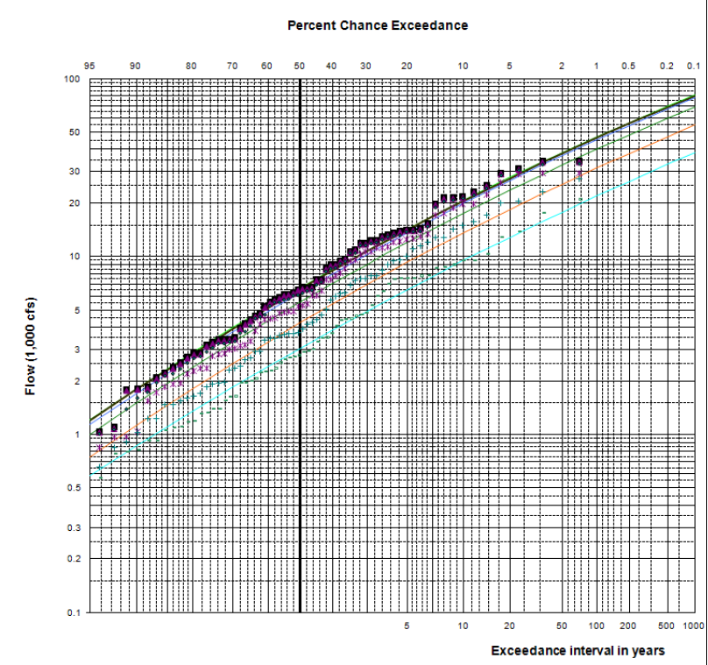
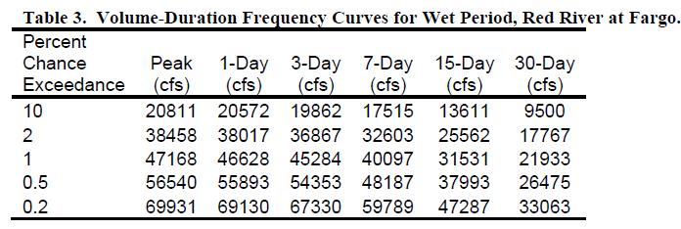
Synthetic Event Analysis:
Step 1 Unregulated Volume Frequency analysis
Define Unregulated Daily Flow Record
Carryout Unregulated Volume Frequency Analysis
Apply Statistical Frequency Analysis
  Log Pearson Type III
  Expected Moments Algorithm
HEC-SSP v. 2.1 Volume Frequency Editor
3-Day 10% Volume 3 x 19,862 – 59,586 sfd
Notes:
The first step is to develop an unregulated record for your period of analysis at your point of interest. If your point of interest is just downstream of a reservoir this would be the reservoir inflow record which can be determined by reverse routing flows through the reservoir. If the site is downstream a hydrologic routing model and local flow records must be developed between the source of regulation and your point of interest and the reservoir inflow record must be routed and combined downstream to your point of interest.
This allows you to generate a unregulated volume frequency analysis.
You can determine the volumes in second foot days associated with a given recurrence interval and a given duration by multiplying the duration by the average maximum flow over that duration determined by the frequency curve
second-foot day
(hydrology) The volume of water represented by a flow of 1 cubic foot per second for 24 hours; equal to 86,400 cubic feet (approximately 2446.58 cubic meters); used extensively as a unit of runoff volume or reservoir capacity, particularly in the eastern United States.

Slide 8
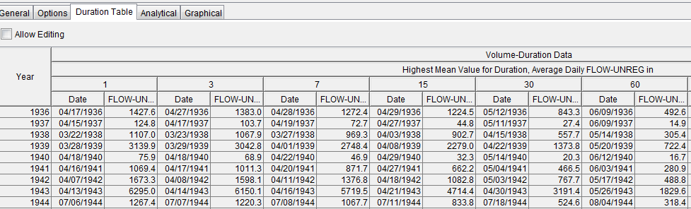
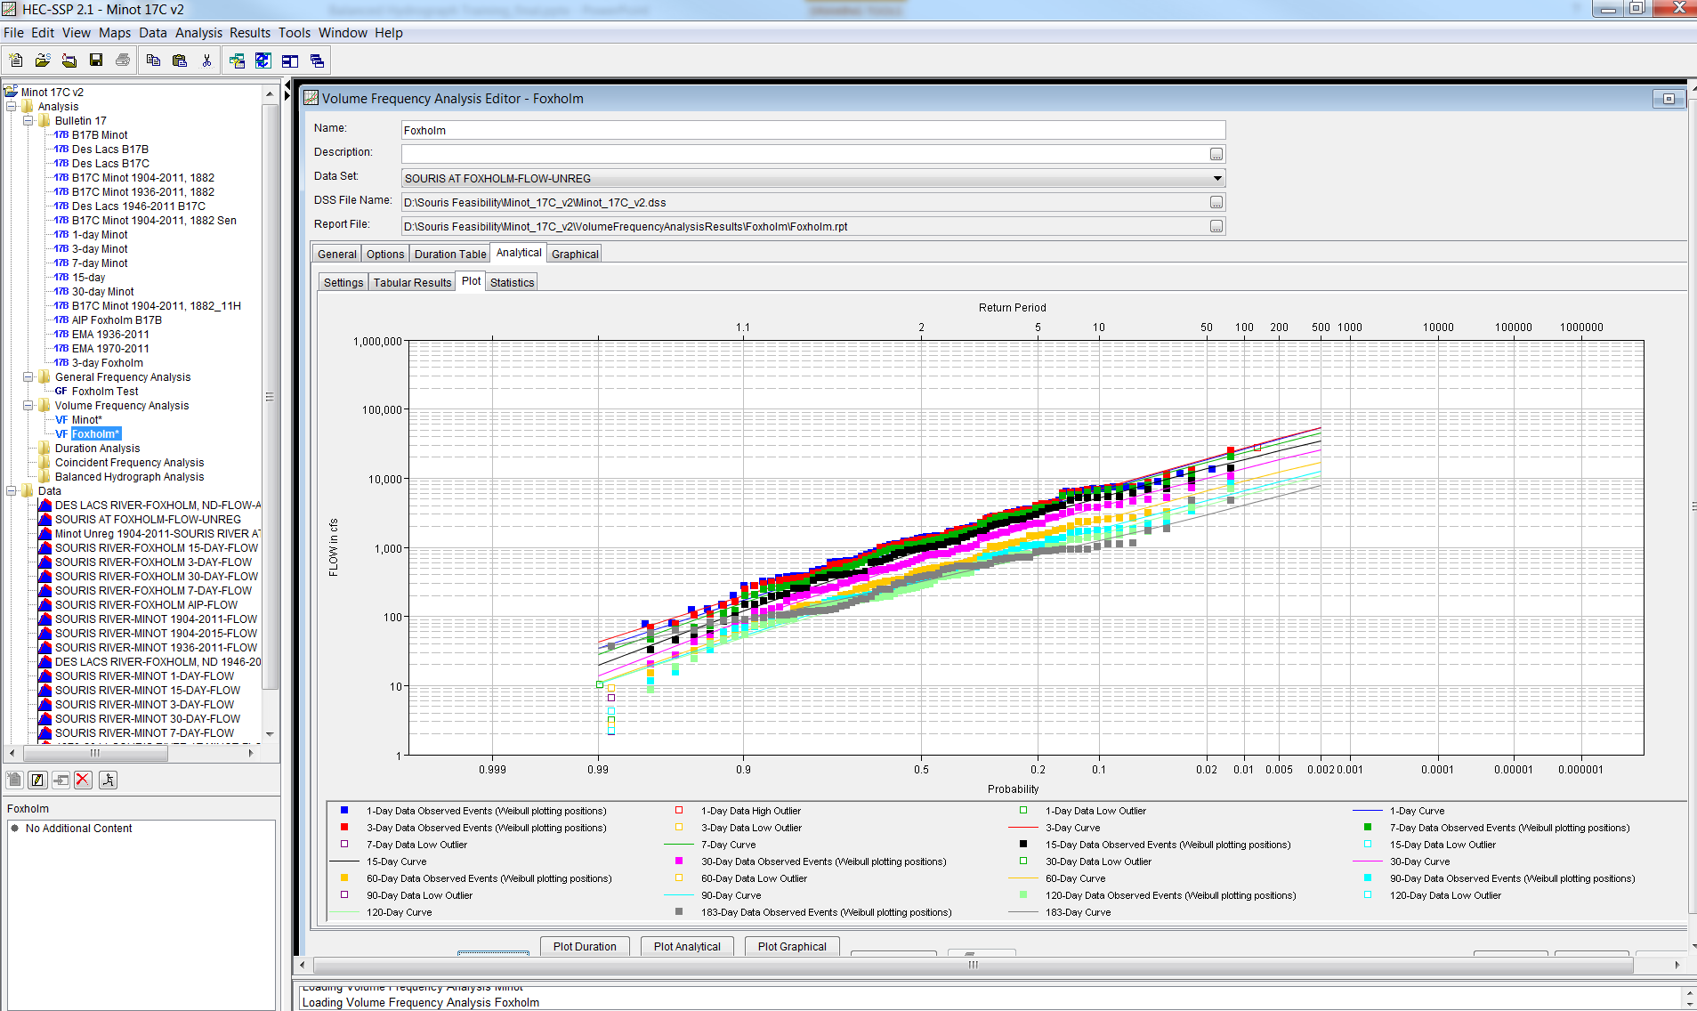
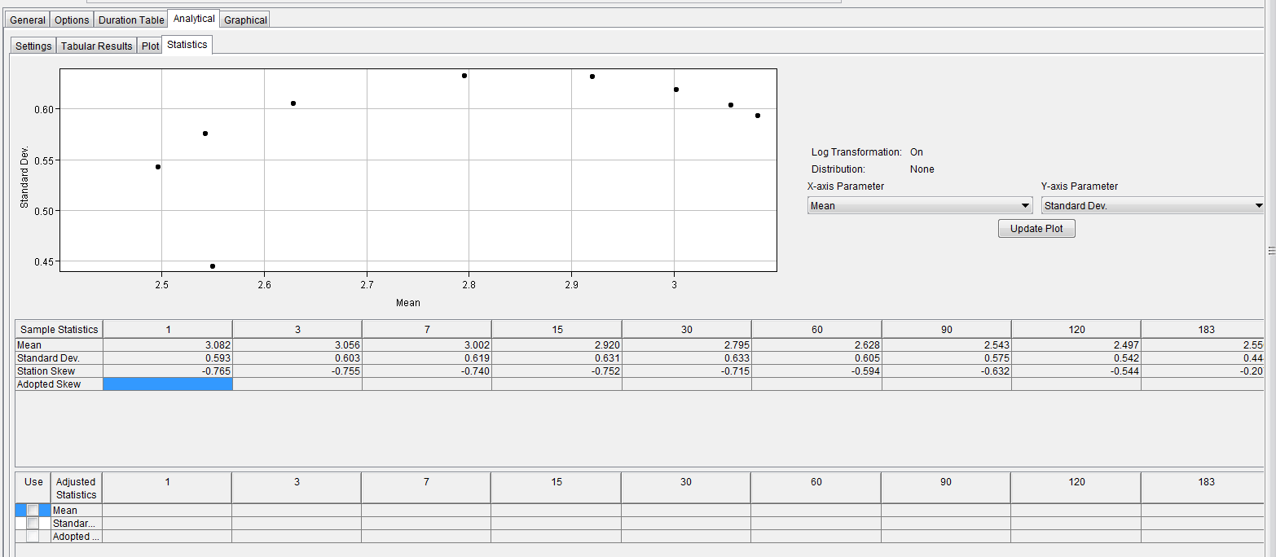
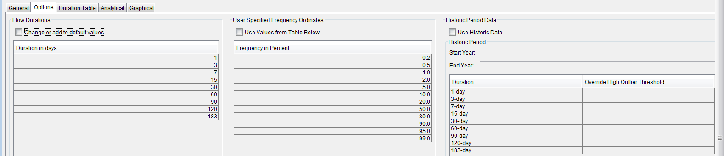
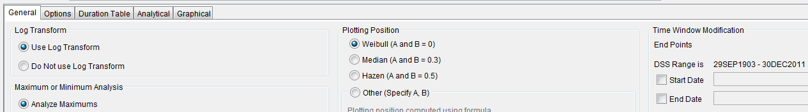
Synthetic Event Analysis:
Step 1 Unregulated Volume Frequency analysis
Duration Table
Statistics Tab
Input Unregulated Daily Flow Dataset
Options Tab
General Tab
Notes:
HEC-SSP allows you to upload input data for volume frequency analysis using the data editor. Data can be uploaded directly from the USGS, an excel file, a text file, a HEC-DSS Vue file or it can be manually entered
All data and output is stored in HEC-DSSVUE
Duration Tab = plotting positions
General Tab is where you can select your time window for analysis, whether or not you want to apply a log transform and your plotting positions
In the options tab you can select the durations and frequency for which you want to conduct the analysis
In the statistics tab you have the option to the statistical properties of the distribution you are using to model your dataset. You may want to smooth out the statics associated with the family of volume frequency curves you are generating for different durations if the curves cross.

Slide 9
Step 2: Develop Target Synthetic Hydrograph
What is a Balanced Hydrograph?
A hydrograph where incremental volumes are arranged in a consistent volume-frequency relationship for durations of interest
In other words, different duration intervals 1-day, 3-day, 7-day, etc. – produce volumes with same chance of exceedance
Based on results of volume-frequency analysis

Slide 10
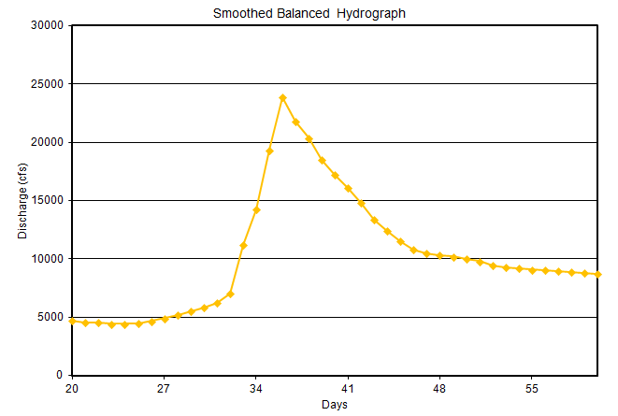
Example of a Balanced Hydrograph
The average of the maximum 3-days of flow = 1%, 3-day Volume from the Volume-Frequency Curve
The average of the maximum 7-days of flow = 1%, 7-day Volume from the Volume-Frequency Curve

Slide 11
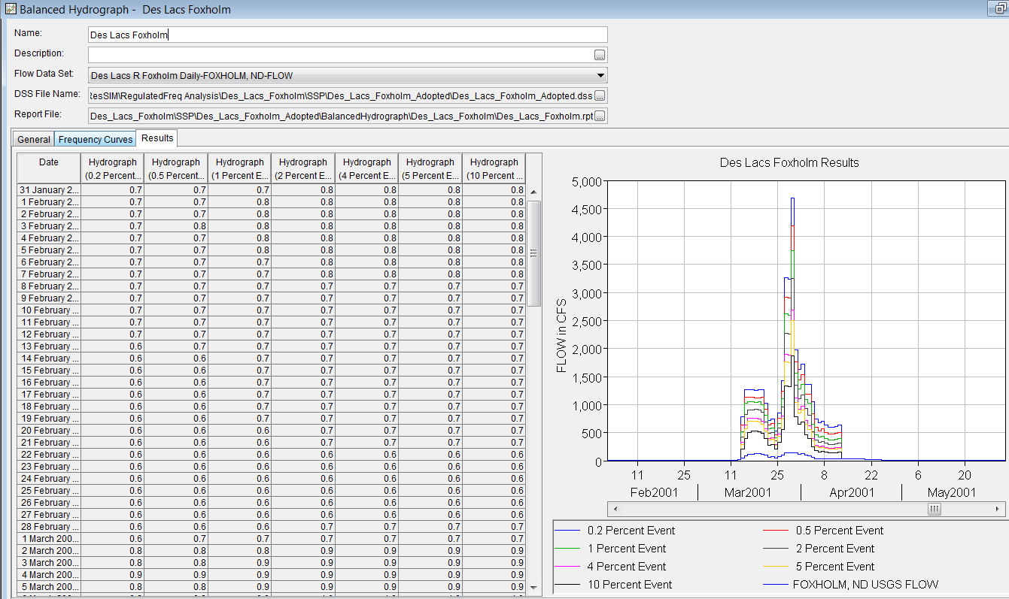
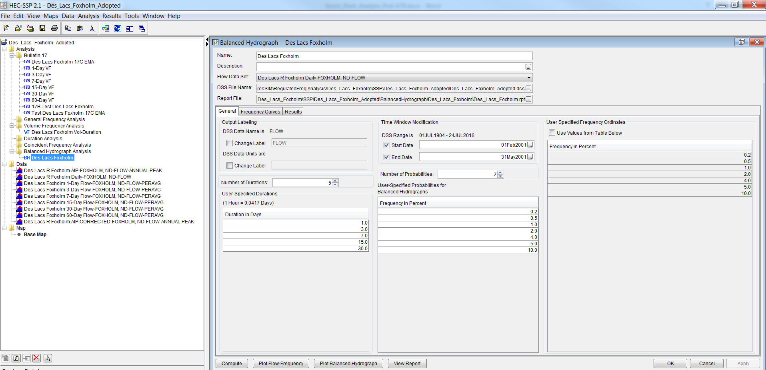
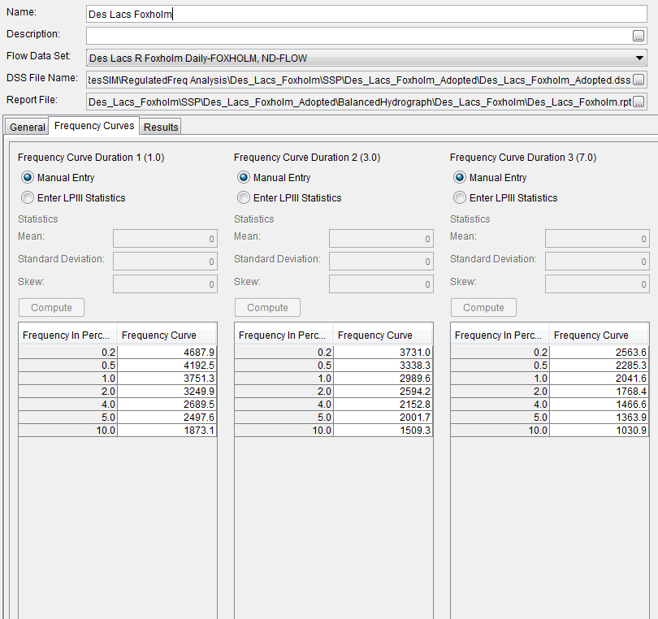
Balanced Hydrographs in HEC-SSP
Results
Input Volume Frequency Curve Results
Volume-Frequency Curve Data
Insert start & end date for pattern hydrograph
Input Durations of Interest
Specify for which probabilities you want to generate balanced hydrographs
Input observed, pattern hydrograph

Slide 12
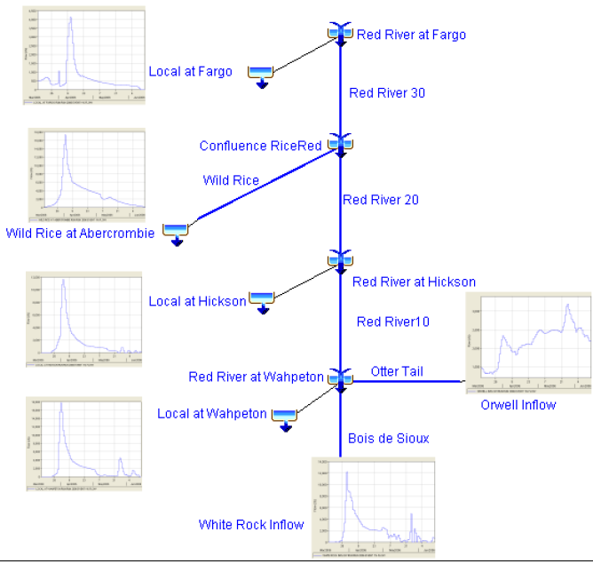
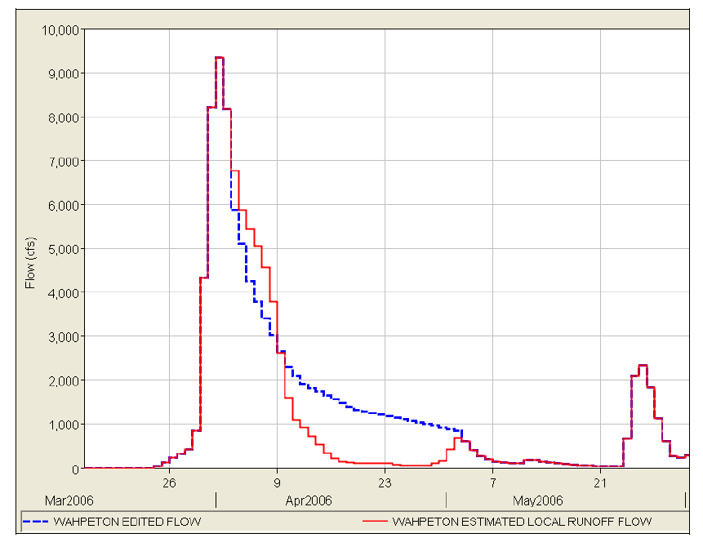
Synthetic Event Analysis
Downstream Point of Interest Where you Want to generate frequency Analysis
3. Use Unregulated Routing Model to Route & Combine Input Hydrographs
Flow Direction
4. Compare Resulting Hydrograph at Downstream Point of Interest to Volume-Frequency based balanced hydrograph for given recurrence interval
Unregulated Routing Model
2. Ratio Up & Make Minor Changes to Pattern Input Hydrographs
Select Pattern Observed Event Collect Input hydrographs U/S Point of Interest based on Obs. data
  Local Flow Hydrographs
  Inflows to Reservoirs
  Tributary Contributions
Notes:
Using the hydrologic routing model you developed and the local flow record you develop to generate the unregulated record you can develop a suite of inflow hydrographs for each recurrence interval that when routed and combined downstream match the volumes generated by your unregulated volume frequency analysis at your downstream point of interest.
Use at least 3 events as pattern events to generate these balanced, by volume hydrographs downstream.
Look for unimodal events, try to ensure that the events you select represent the flow distributions that could potentially be expected for an extreme event. Look at the largest events in the basin. For example in this case Bois de Sioux dominated vs Otter Tail dominated vs equal distribution of flow
Sensitive to pattern event you select
Display spreadsheet you use to develop a match

Slide 13
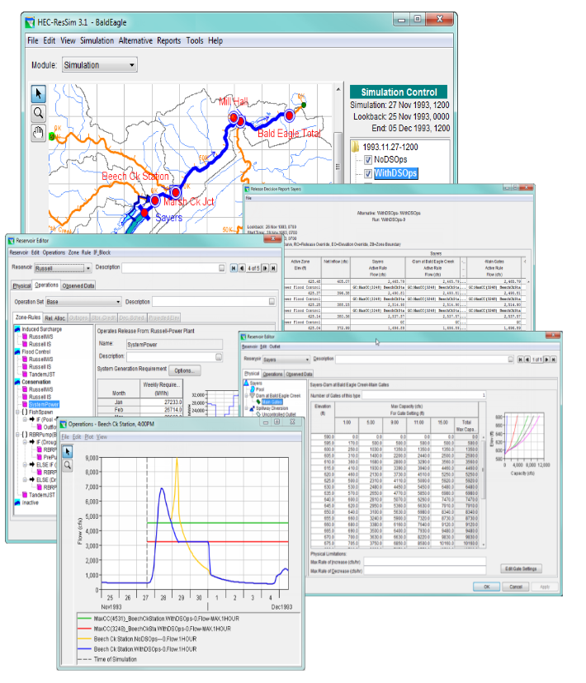
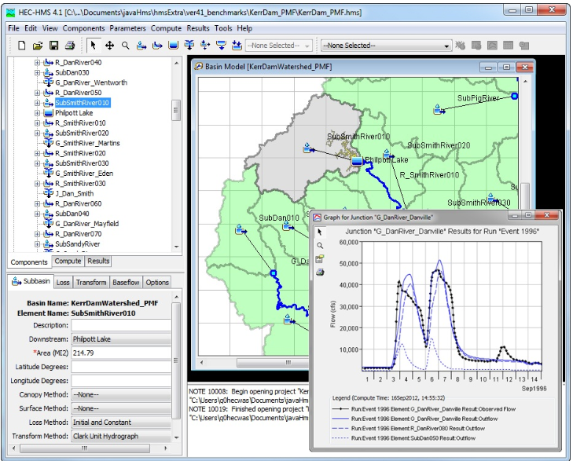
What Tools Do we have Available for Hydrologic Routing & Reservoir Simulation?
Hydrologic Modeling System (HEC-HMS)
Reservoir System Simulation (HEC-ResSIM)
To Ratio up Inflows:
  Simulation Editor in HEC-HMS
  HEC-ResSIM Alternative editor
Notes:
You can use the inflow Multiplier option in ResSim or the Ratio option in HMS to ratio up inflow and local flow hydrographs uniformly
In the alternative editor in HEC-ResSIM
In the simulation runs editor in HMS

Slide 14
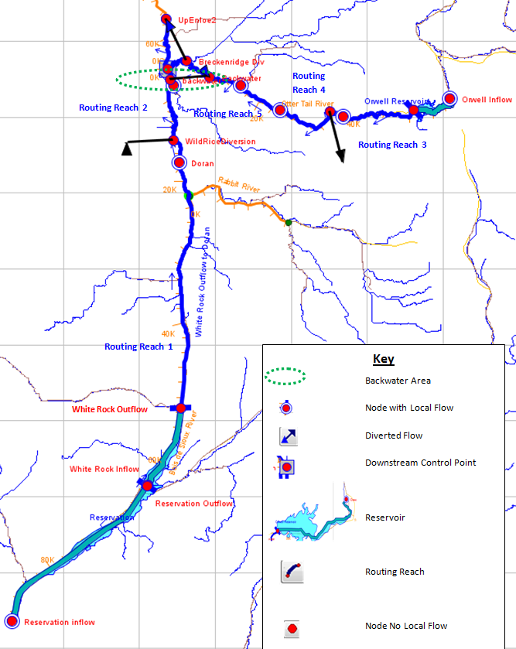
Regulated Synthetic Event Analysis
Apply Reservoir Model
Notable Assumptions
  Unregulated inputs = Regulated Inputs
  Pattern Event
Input hydrographs are not Coincident Hydrographs
Reservoir System Simulation (HEC-ResSIM)
Notes:
Route the Input hydrographs representative of a given recurrence interval through a regulated HEC-ResSIM model
Determine:
The resulting Regulated peak at downstream point of interest = Synthetic Regulated Peak flow at recurrence interval used to anchor the annual instantaneous peak flow frequency curve
The resulting highest 3-day, 7-day,15-day and 30-day average flow from the resulting hydrograph to anchor the volume frequency curves Based on the Assumption that the Input hydrographs for the unregulated condition are equivalent to the Input hydrographs for the regulated condition
Input hydrograph for a given probability of exceedence are the same for the unregulated and regulated condition
The pattern events used represent the hydrologic response to a given synthetic event
Note that Input hydrographs do not represent coincident peaks on Tributaries

Slide 15
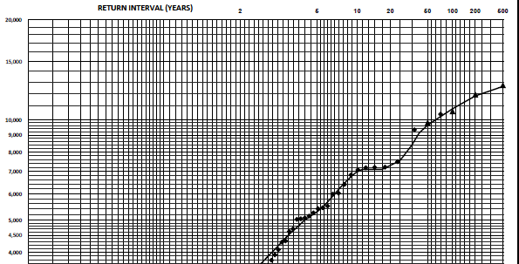
Synthetic Event Analysis
Annual Instantaneous Peak Flow-Frequency Analysis
Synthetic Event Are Used to anchor the upper end of the graphical flow-frequency curve
Extends the graphical curve beyond plotting positions based on historic data

Slide 16
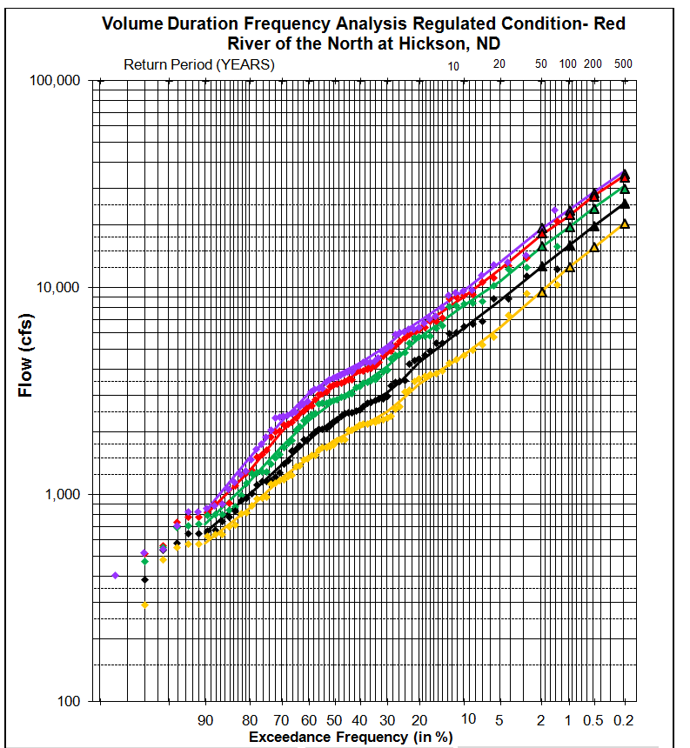

Volume Frequency Analysis

Slide 17
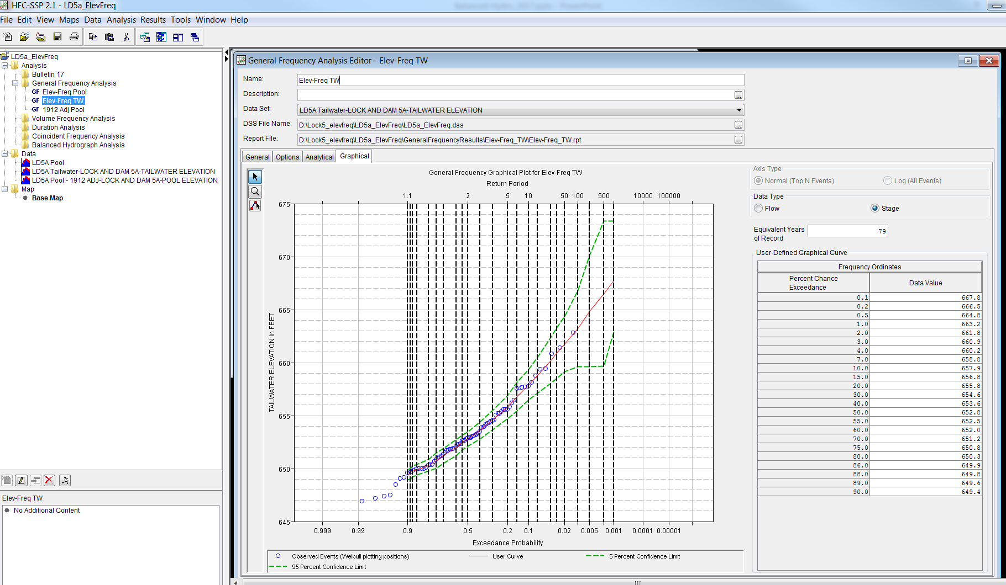
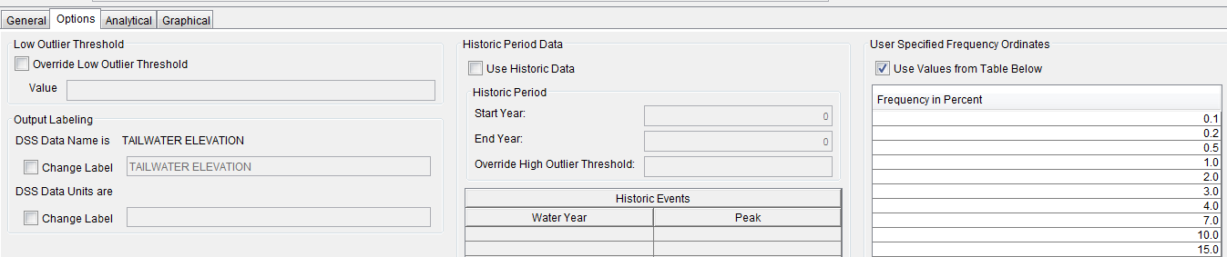
Graphical Flow-Frequency Analysis in HEC-SSP
General Frequency Analysis
Graphical Tab
Upload Data for Plotting Positions
Options Tab
Develop Smoothed Curve Outside of SSP
Enter Curve in HEC-SSP
  Add Plotting Position Data
  Equivalent Period of Record
Computes Confidence Limits
  Order Statistics Approach
Equivalent Period of Record & User Generated Curve
Notes:
Options Tab allows you to enter the frequency ordinates you want to use to define your curve

Slide 18
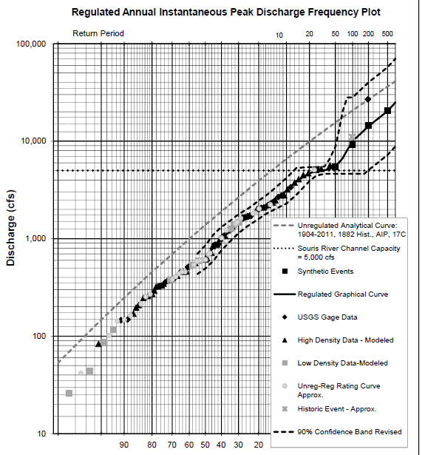
One Method to Define Graphical Frequency Curve
?

Slide 19

Questions/Comments?
My question is: I wonder what he thinks of hydrology?...

