Slide 1
Frequency Analysis Enhancements within HEC-SSP
Matt Fleming, P.E.
Mike Bartles, P.E.
Hydrologic Engineering Center
May 2019

Slide 2

Topics
History
Status
  Distribution Fitting Analysis Example
  Training Courses
Future
  Improved User Experience
  Correlation Analysis
  Maximum Likelihood Estimation
  B17 Moving Window
Garrison Dam – June 2011

Slide 3
History
HEC-SSP started development in FY2005
Version 1.0 released in August 2008
…
Version 2.2 released in Summer 2019
  New Mixed Population Analysis
  New Distribution Fitting Analysis
  Updated Bulletin 17 Analysis
  EMA added to General Frequency and Volume Frequency Analyses

Slide 4
HEC-SSP Team
TEAM MEMBERS
H&H Technology Division Lead | Matt Fleming
Lead Developer / Project Lead | Mike Bartles
Development and Application | Beth Faber
Development and Application | Greg Karlovits
Development and Application | Will Lehman
Development and Application | Haden Smith
Development and Application | John England
Development and Application | Angela Duren
Development | Mark Ackerman
Development | Paul Ely
Development | Rami Gasim
Development | Caleb DeChant
Development | Ben Chacon
Development | Stephen Ackerman

Slide 5
Partners
Risk Management Center (RMC)
Modeling, Mapping, and Consequences (MMC) Center
Water Management Implementation Support Team (WMIST)
USACE Fort Worth District
USACE Headquarters

Slide 6
Version 2.2 Features
Improved user experience for everyone
New tools to meet USACE needs
  Improved B17C/EMA implementation
  EMA w/in General Frequency Analysis
  EMA w/in Volume Frequency Analysis
  New Curve Combination Analysis
  New Mixed Population Analysis
  New Distribution Fitting Analysis

Slide 7
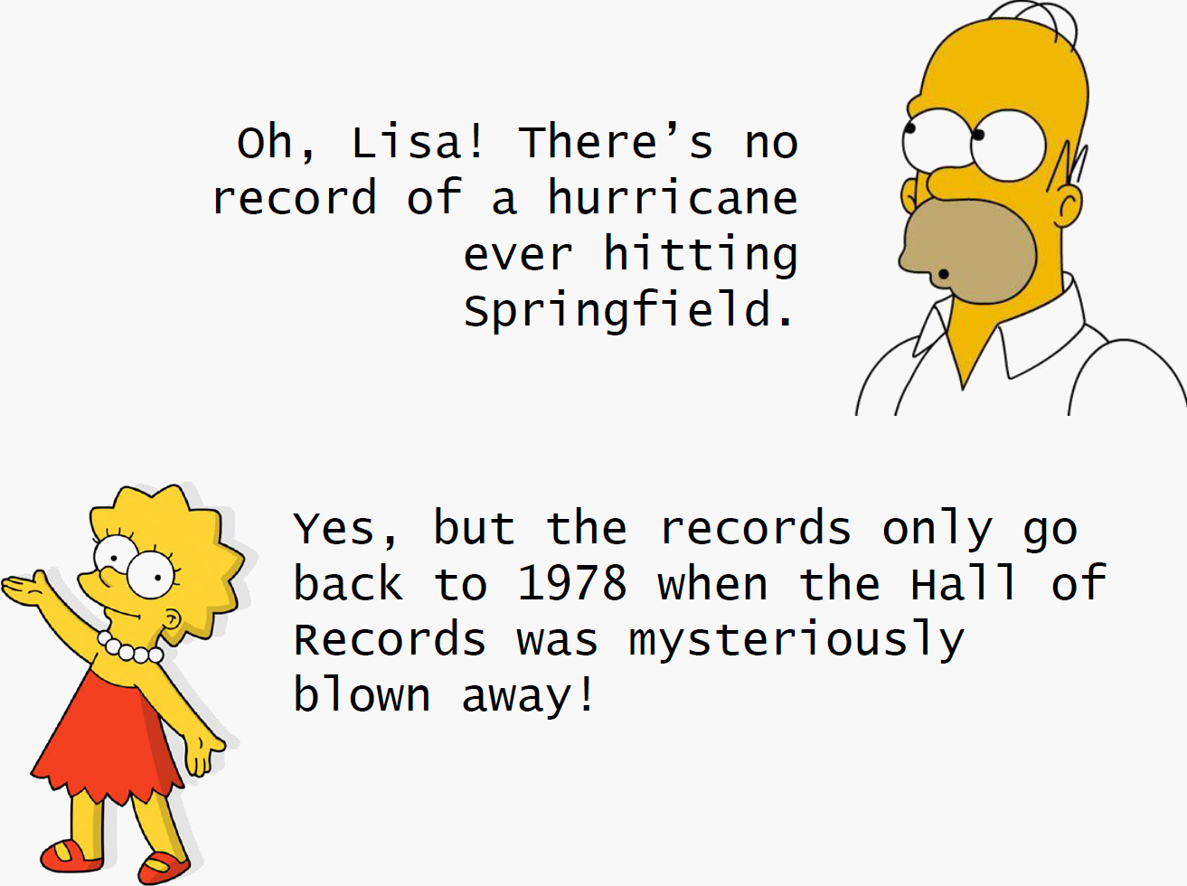

Slide 8
Distribution Fitting Analysis
What’s the likelihood of the 1-minute wind speed exceeding hurricane strength in Springfield?
Designation | 1-Minute Wind Speed (MPH)
Tropical Depression | < 38
Tropical Storm | 39-73
Category I Hurricane | 74-95
Category II Hurricane | 96-110
Category III Hurricane | 111-129
Category IV Hurricane | 130-156
Category V Hurricane | > 157

Slide 9
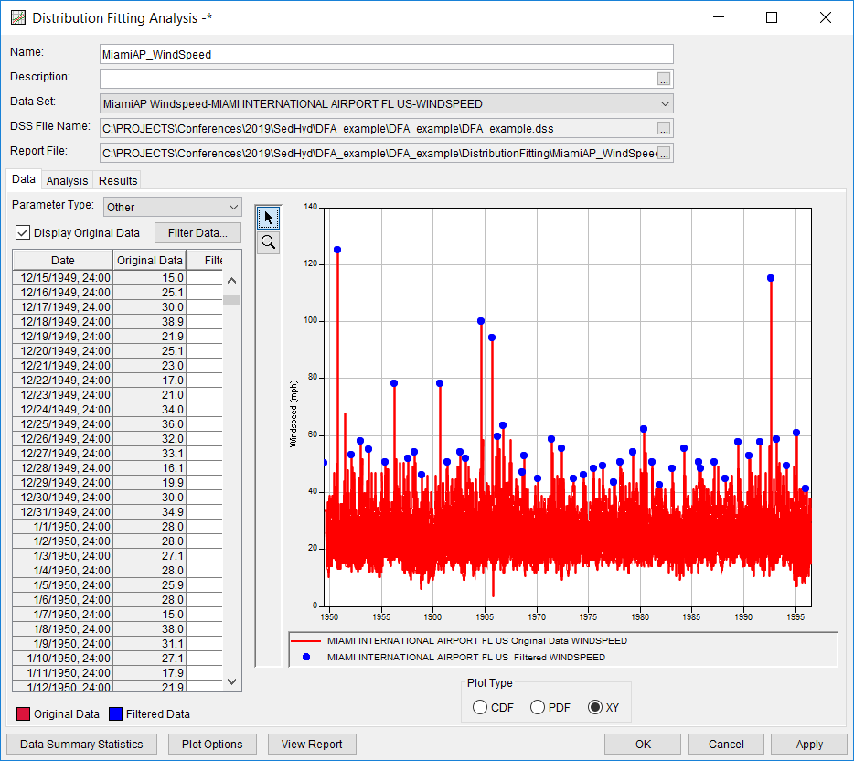
Distribution Fitting Analysis
Wind Speed Example
Step 1
  Import and filter data (e.g. extract annual maximum series)
Original Data
Peaks

Slide 10
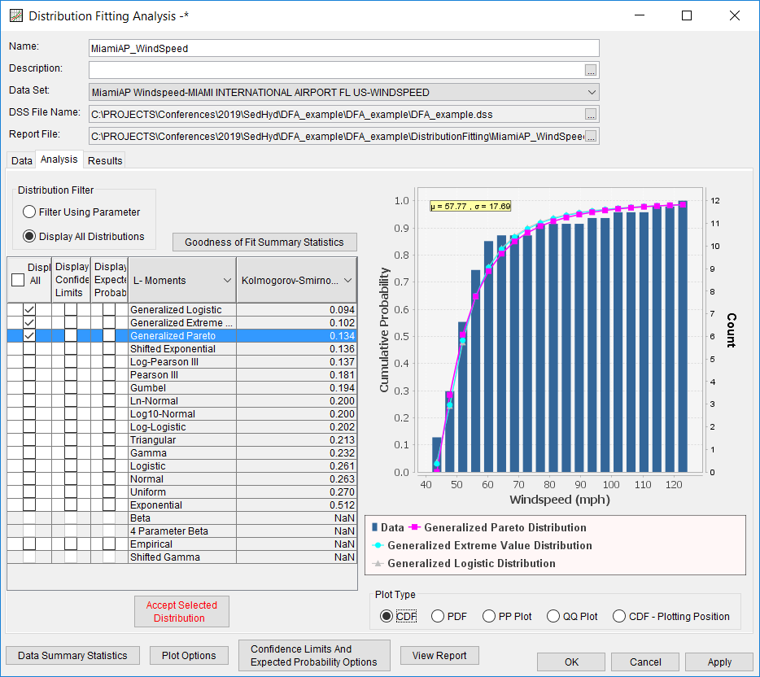
Distribution Fitting Analysis
Wind Speed Example
Step 2
  Analyze multiple distributions and fitting methods
Data
GLO | L-Moments
GEV | L-Moments
GPA | L-Moments

Slide 11
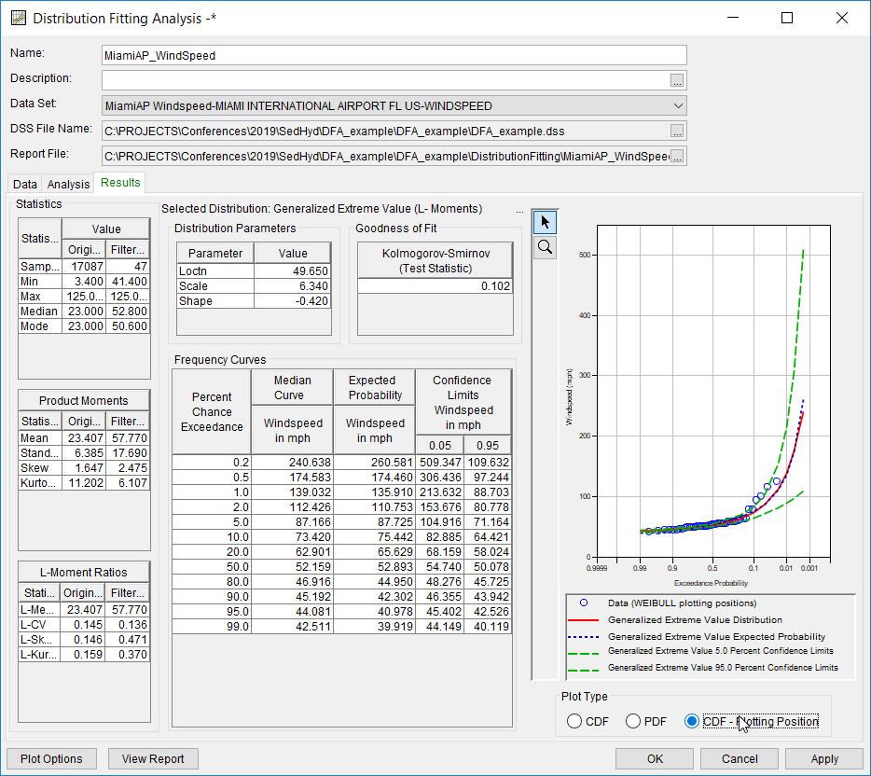
Distribution Fitting Analysis
Wind Speed Example
Step 3
  Accept a distribution and fitting method
  Compute conf. limits and exp. probability
Data
Median
5/95 Conf Limits
Exp. Probability

Slide 12
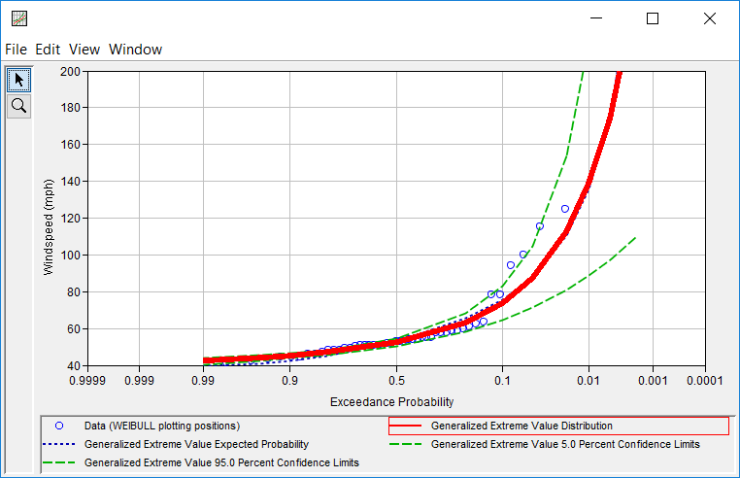
Distribution Fitting Analysis
Wind Speed Example
Category V
Category IV
Category III
Category II
Category I
10% AEP

Slide 13
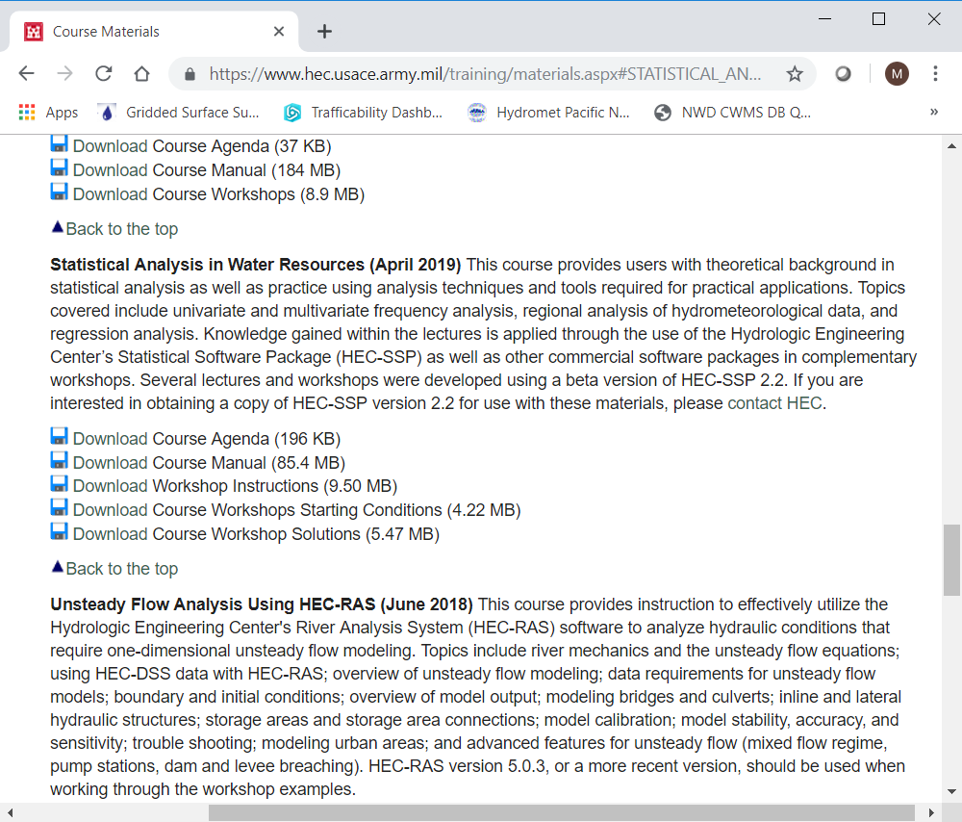
HEC Training Materials
PROSPECT training course materials posted to HEC’s website
Lectures and workshops can be downloaded
  Statistical Analysis in Water Resources (2019)
https://www.hec.usace.army.mil/training/materials.aspx

Slide 14
Future
Next planned release: version 2.3
  Planned for FY2021
Keep on improving the user experience
Continue to address bugs
Integrate new tools to meet partner needs
  Separate input/output DSS files
  Correlation Analysis
  Maximum Likelihood Estimation fitting method
  Moving / Expanding Window Bulletin 17 analysis

Slide 15
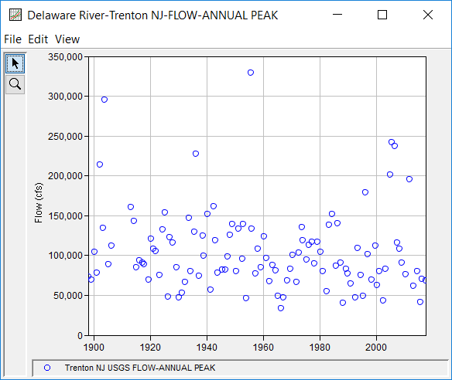
Moving / Expanding Window B17 Analysis
Delaware River at Trenton, NJ
  Little to no flooding between 1955 and 1996
  Three large floods in 2004, 2005, 2006
  Why does the 1% AEP flow rate change?

Slide 16
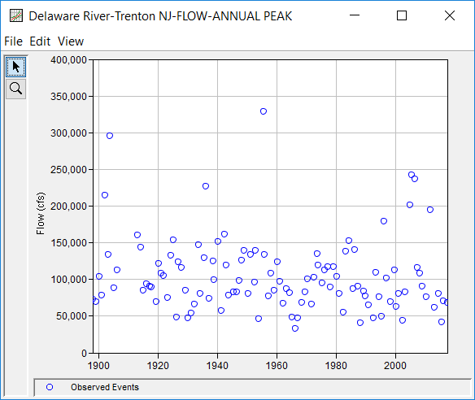
Moving / Expanding Window B17 Analysis
Data
Analysis Periods
Option 1: Moving Window
  For example, analyze 20 years at a time and incrementally move the window by 10 years

Slide 17
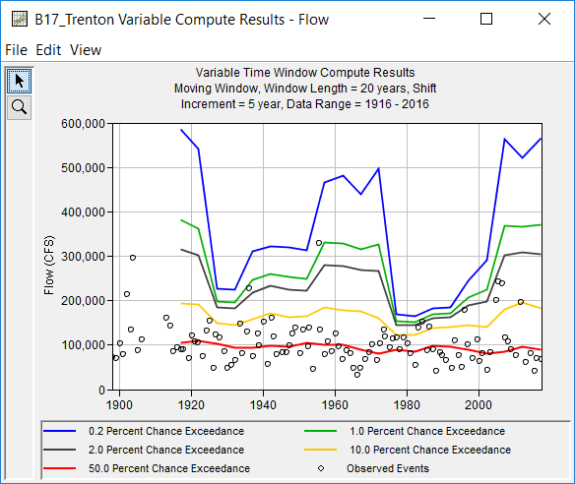
Moving / Expanding Window B17 Analysis
Data
0.2% AEP
1% AEP
2% AEP
10% AEP
50% AEP

Slide 18
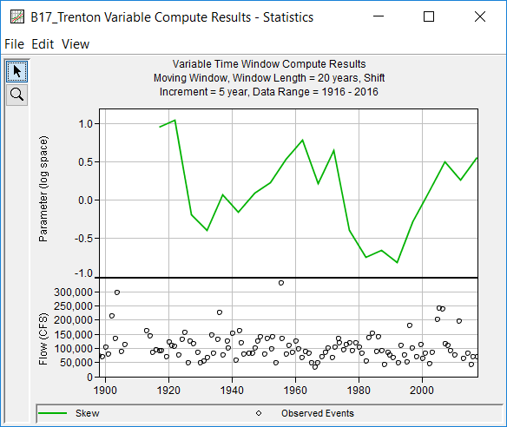
Moving / Expanding Window B17 Analysis
Data
Skew (log)
Regional Skew Estimate

Slide 19
Moving / Expanding Window B17 Analysis
Data
Analysis Periods
Option 2: Expanding Window
  For example, start with 20 years and incrementally expand the window by 5 years

Slide 20
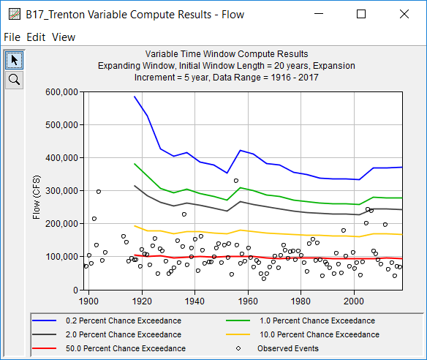
Moving / Expanding Window B17 Analysis
Data
0.2% AEP
1% AEP
2% AEP
10% AEP
50% AEP

Slide 21
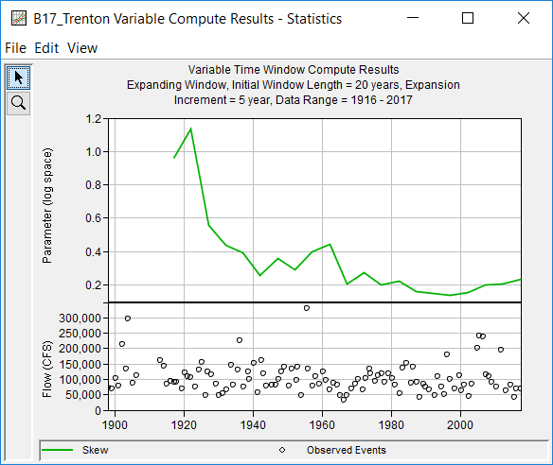
Moving / Expanding Window B17 Analysis
Data
Skew (log)
Regional Skew Estimate

Slide 22
Summary
HEC-SSP is developed primarily to meet USACE needs
Constantly improving
Looking for feedback
If you have ideas for future enhancements or questions about existing features, let us know

Slide 23
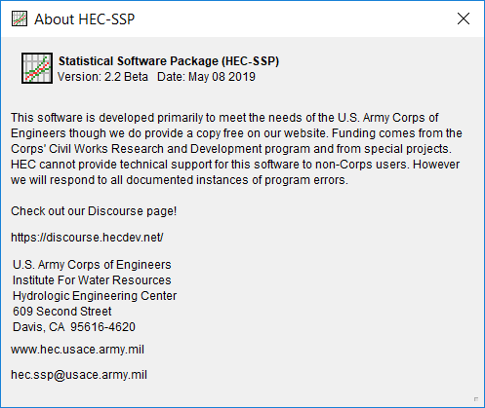
Thank you for using
HEC-SSP!
http://www.hec.usace.army.mil/software/hec-ssp/

