Slide 1
Frequency Analysis Enhancements within HEC-SSP
Mike Bartles, P.E.
Hydraulic Engineer
HEC-SSP Team Lead
Hydrologic Engineering Center
June 2018

Slide 2
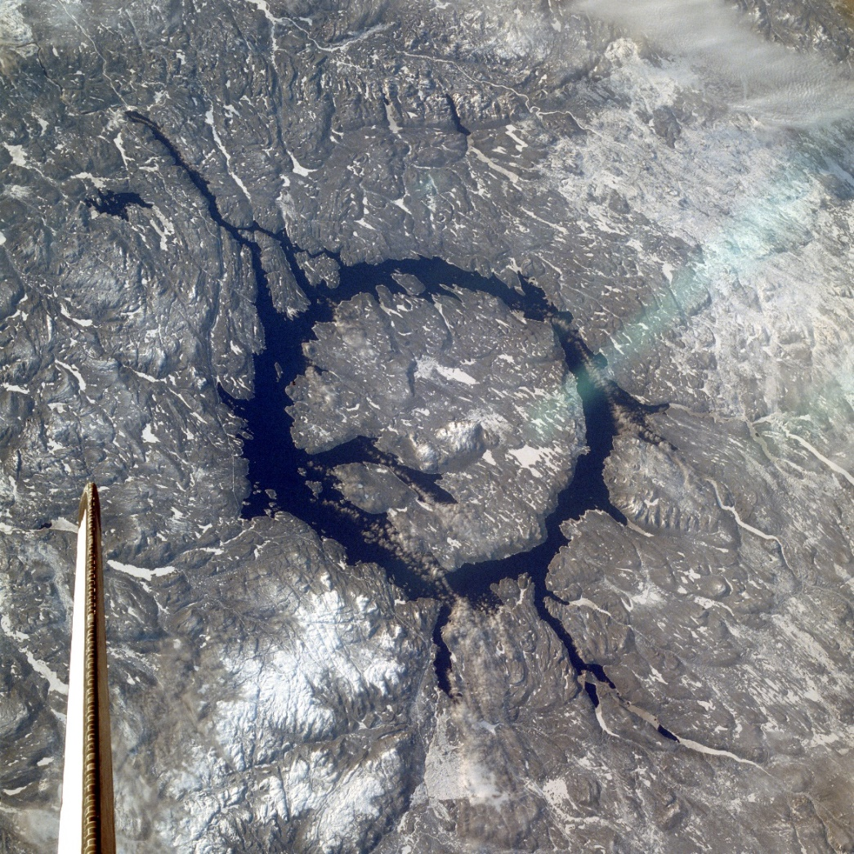
Topics
History
  Version 2.1.1 and earlier
Status
  Version 2.2
Future
  Version 2.x

Slide 3
History, Status, Future…
HEC-SSP started development in FY2005
Version 1.0 released in August 2008
…
Version 2.1.1 released January 2017
  Updated Bulletin 17 analysis with B17C procedures
  Balanced Hydrograph analysis
  Updated USGS Plugin and recompiled EMA FORTRAN code

Slide 4
History, Status, Future…
HEC-SSP Team
TEAM MEMBERS
H&H Technology Division Lead | Matt Fleming
Lead Developer / Project Lead | Mike Bartles
Development and Application | Beth Faber
Development and Application | Greg Karlovits
Development and Application | Will Lehman
Development and Application | Haden Smith
Development and Application | John England
Development and Application | Angela Duren
Development | Mark Ackerman
Development | Paul Ely
Development | Rami Gasim
Development | Caleb DeChant
Development | Ben Chacon
Development | Tevin Youn

Slide 5

History, Status, Future…
Partners
Risk Management Center (RMC)
USACE Headquarters
Modeling, Mapping, and Consequences (MMC) Center
Water Management Implementation Support Team (WMIST)
USACE Fort Worth District

Slide 6
History, Status, Future…
Version 2.2 Features
Improved user experience for everyone
  Undocked editors
  Updated background maps
  Easier data collection/input
  Linkage between analyses
  Data Filtering
New tools to meet USACE needs
  Improved B17C/EMA implementation
  New Curve Combination Analysis
  New Mixed Population Analysis
  New Distribution Fitting Analysis

Slide 7
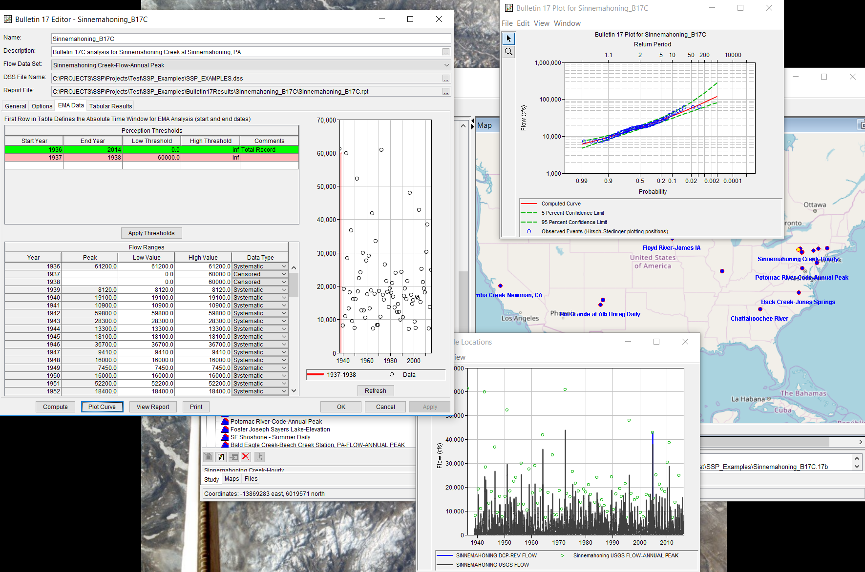
Improved User Experience
“Undocked” Editors

Slide 8
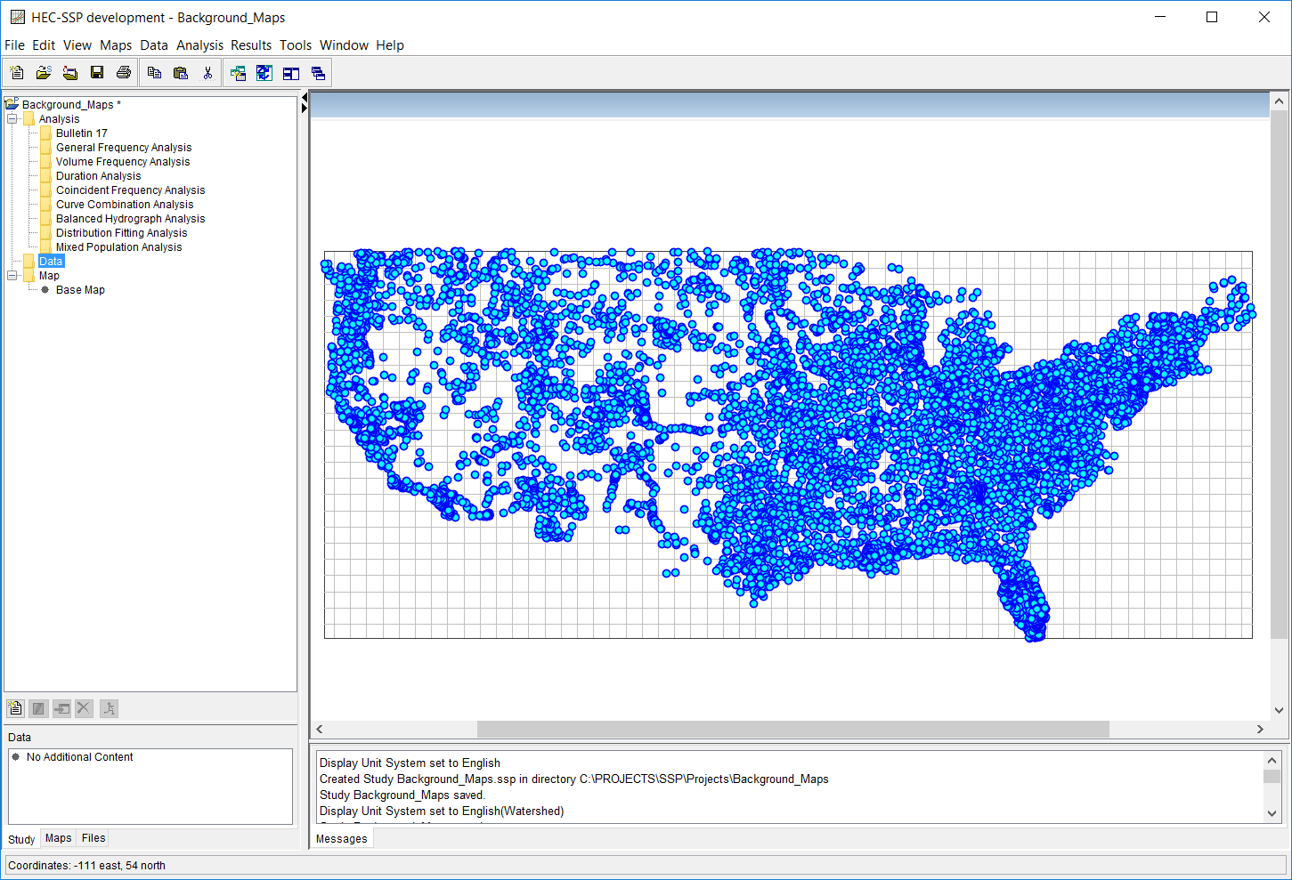
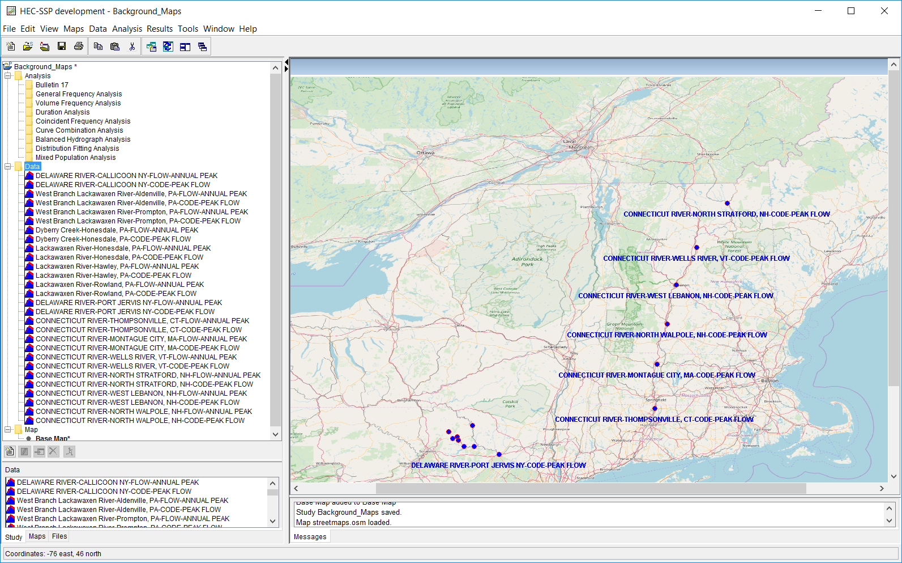
Improved User Experience
Background Maps

Slide 9
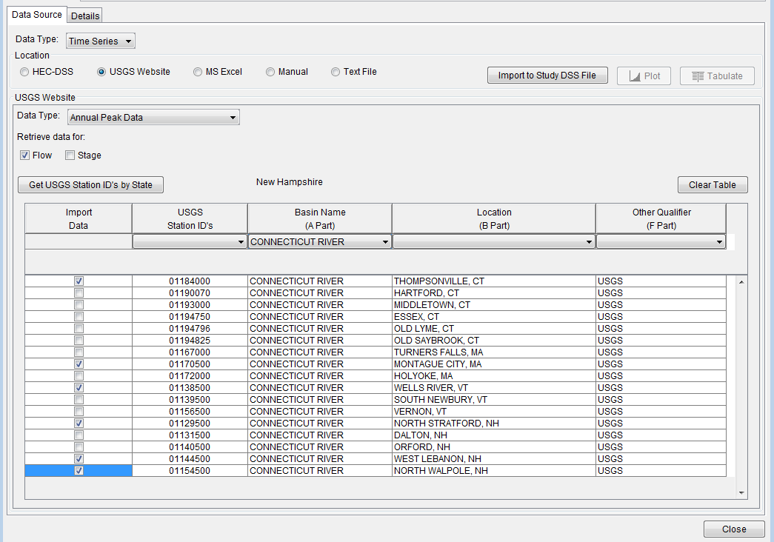
Improved User Experience
Data Importer
Notes:
Here’s an example showing how multiple gages along a river that passes through multiple states can be searched, selected, and downloaded all at once. This is especially useful for regional frequency analyses.

Slide 10
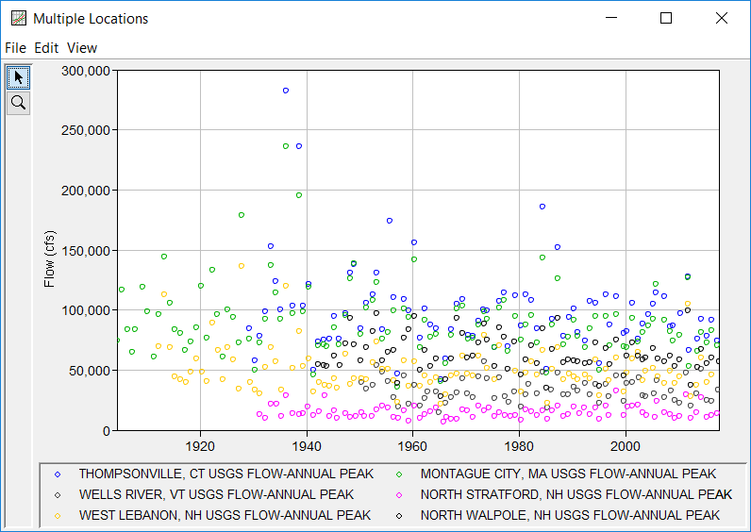
Improved User Experience
Data Visualization
Multiple data sets can be visualized in the same plot
Notes:
Here’s an example showing how multiple gages along a river that passes through multiple states can be searched, selected, and downloaded all at once. This is especially useful for regional frequency analyses.

Slide 11
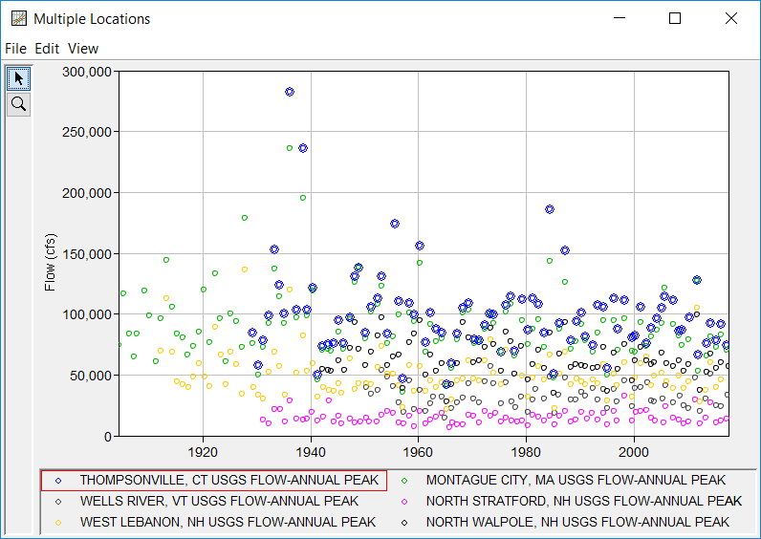
Improved User Experience
Data Visualization
Clicking on a legend item will highlight the selected curve
Notes:
Here’s an example showing how multiple gages along a river that passes through multiple states can be searched, selected, and downloaded all at once. This is especially useful for regional frequency analyses.

Slide 12
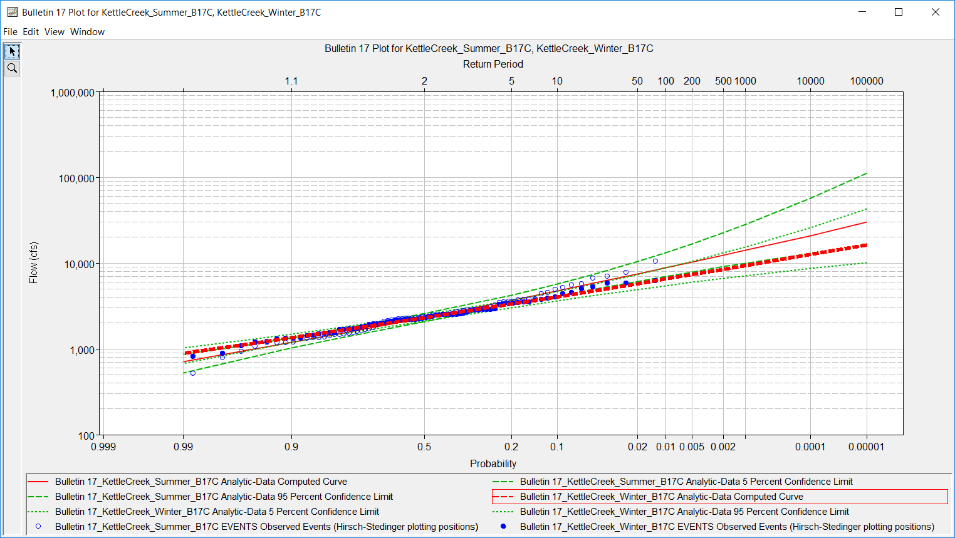
Improved User Experience
Data Visualization

Slide 13
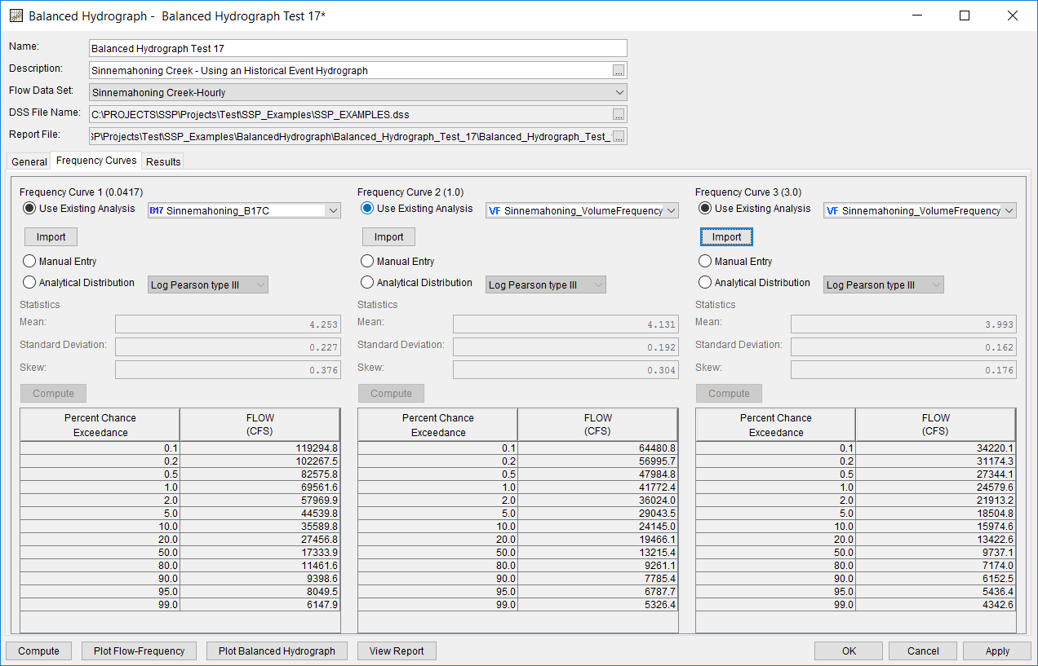
Improved User Experience
Import Results from One Analysis into Another
Inst. Peak Results
1-day VDF Results
3-day VDF Results

Slide 14
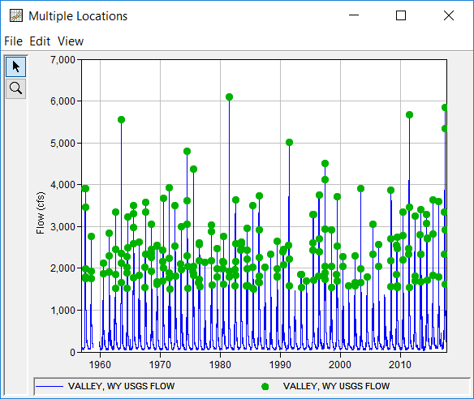
Improved User Experience
Filter Imported Data Sets
Filter Data Using:
  Absolute Time Window
    i.e. 01Oct1955 – 30Sep 2017
  Season
    i.e. 01May – 30Nov
  Min/Max Threshold
Filter to Peaks Using:
  Annual Maximum
  Peaks Over Threshold / Partial Duration
  Starting Pool Stage/Elevation
Partial Duration Series of all peaks over 1500 cfs separated by a minimum of 7 days

Slide 15
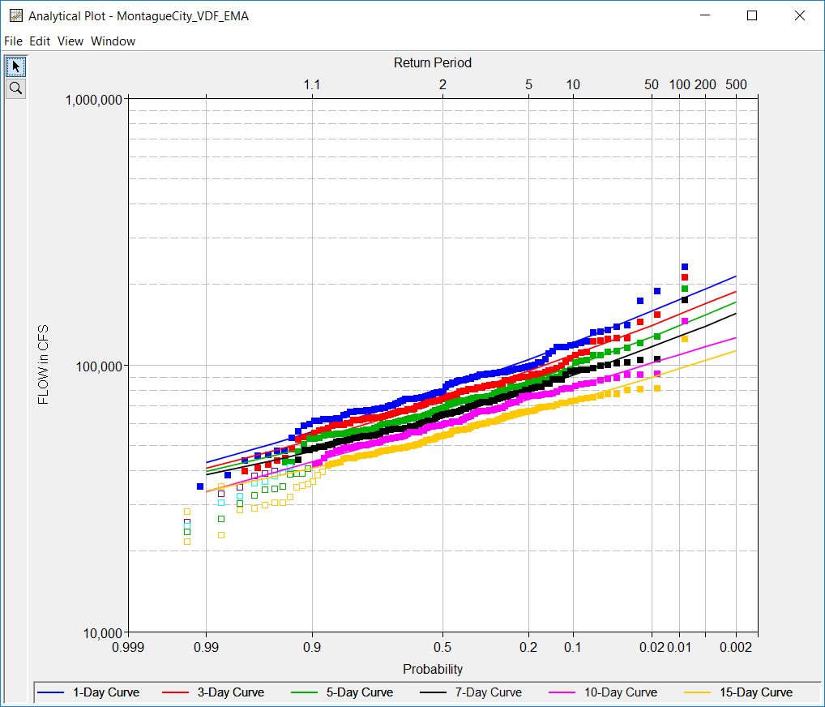
Improved Bulletin 17C Implementations
New Java Bulletin 17C code
Can now utilize Bulletin 17C procedures in General Frequency and Volume Frequency analyses:
  Expected Moments Algorithm
  Multiple Grubbs-Beck test
  Improved conf. limits
  Hirsch/Stedinger Plotting Positions

Slide 16
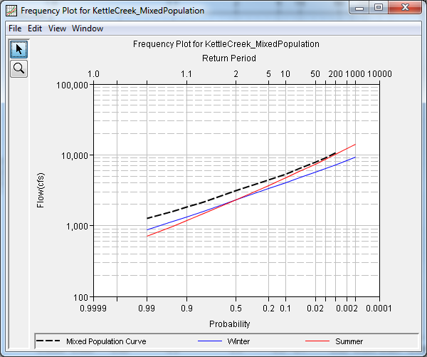
Mixed Population Analysis
Uses the Probability of Union concept to compute a frequency curve from two or more different runoff/causative mechanisms
  i.e. rainfall-only vs rain-on-snow vs snowmelt-only vs tropical storms
  resultant empirical distribution takes into account the relative probability of a flood occurring in any year due to any of the input runoff mechanisms
Results from other analyses can be imported
  Bulletin 17 and General Frequency

Slide 17
Mixed Population Analysis
Parameter | Analysis
 | Mixed | Summer | Winter
Mean | 3.561 | 3.282 | 3.507
Std. Dev. | 0.224 | 0.345 | 0.212
Skew | 0.267 | 0.192 | -0.038

Slide 18
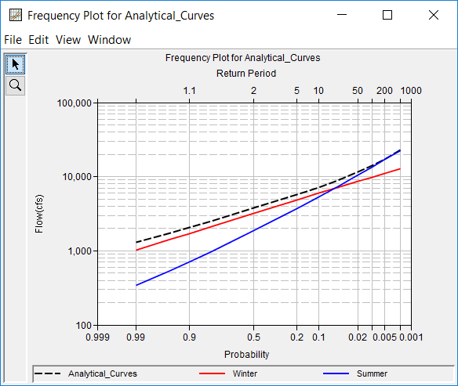
Mixed Population Analysis

Slide 19
Mixed Population Analysis

Slide 20
Distribution Fitting Analysis
What does a non-LPIII analytical distribution look like when fit to your data set of interest?
How much uncertainty when extrapolating beyond the range of observed data is due to your choice of analytical distribution?
How can you tell which distribution “fits” your observed data best?

Slide 21
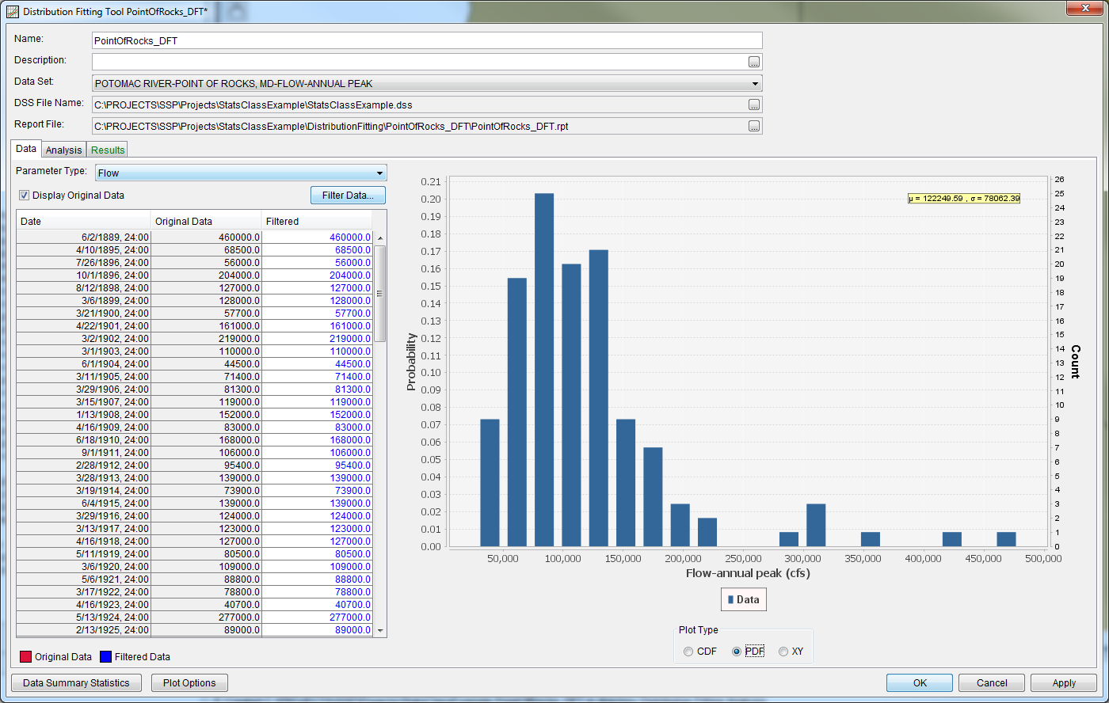
Distribution Fitting Analysis
18 analytical distributions
2 different fitting methods
IRREGULAR and REGULAR data accepted
Filter data
Can be used for flow, stage, precipitation, wind speed/direction, seasonality, etc

Slide 22
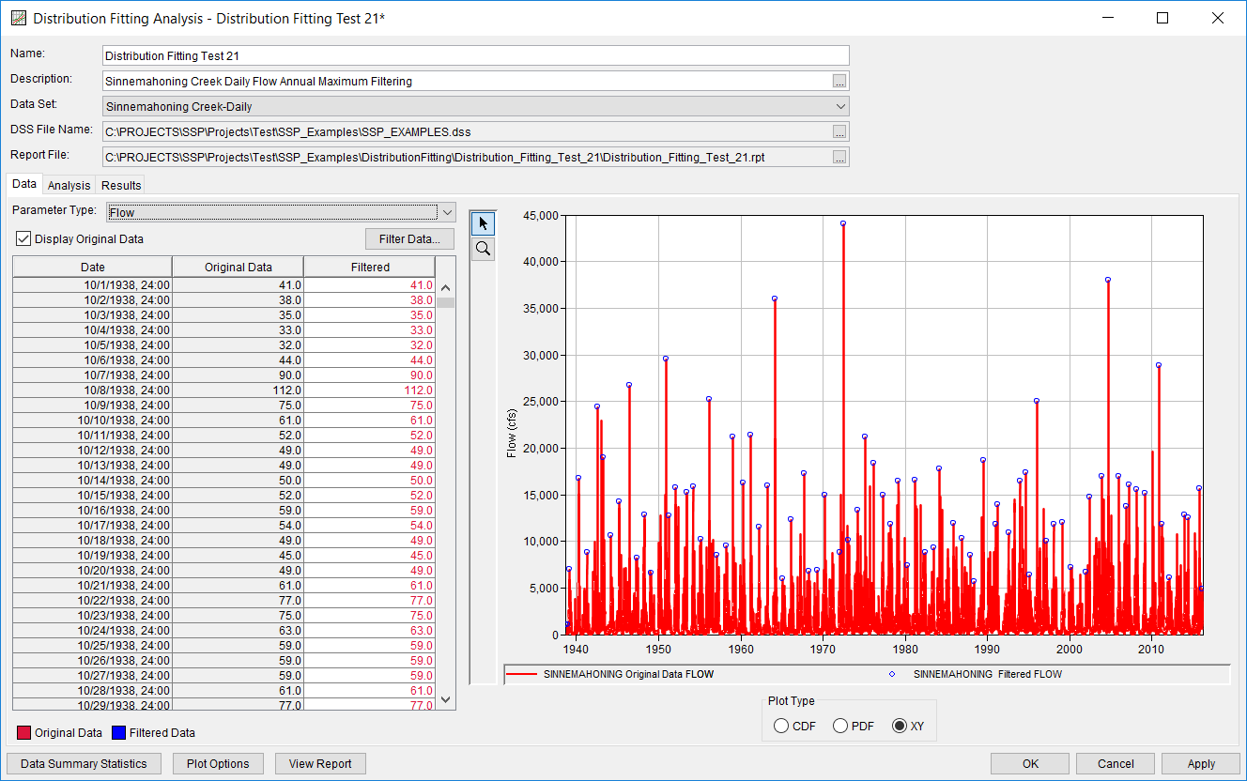
Distribution Fitting Analysis
Data Tab

Slide 23
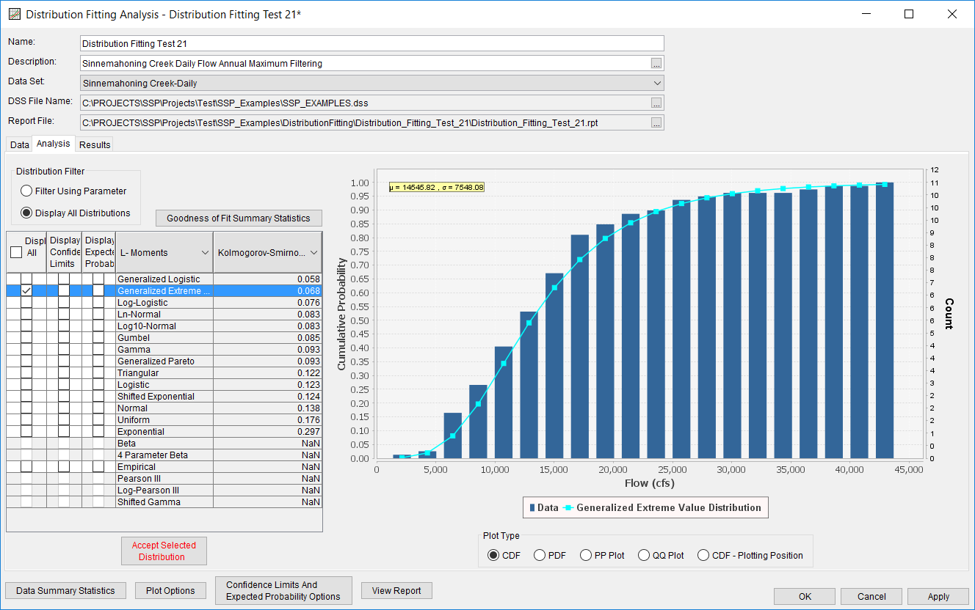
Distribution Fitting Analysis
Analysis Tab

Slide 24
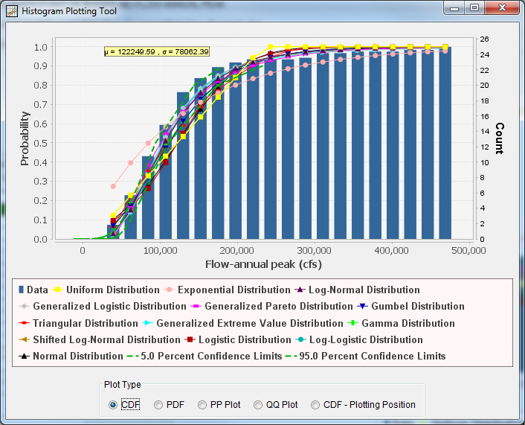
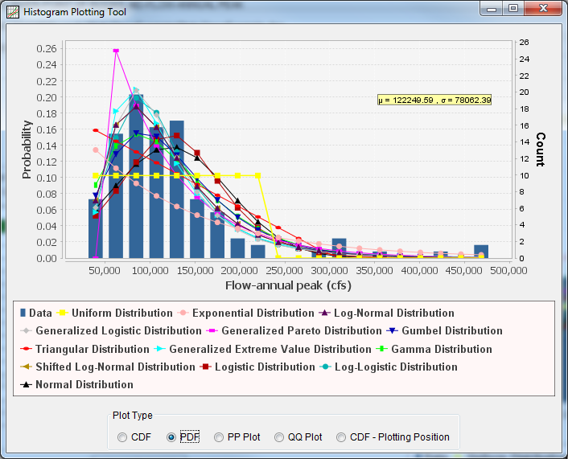
Distribution Fitting Analysis
Analysis Tab

Slide 25
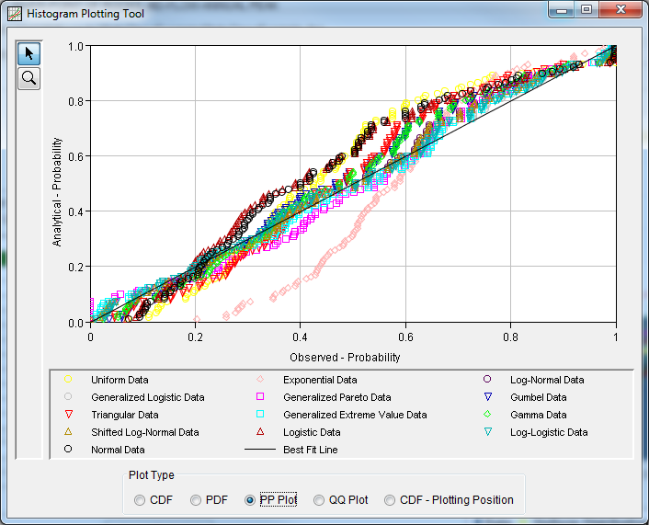
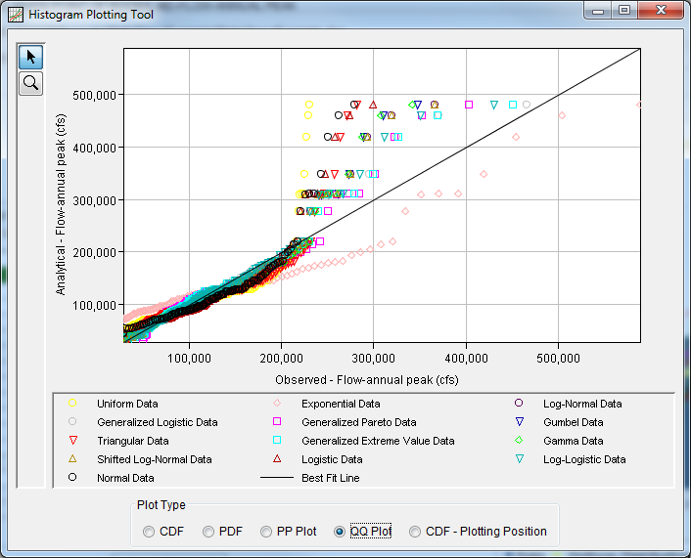
Distribution Fitting Analysis
Analysis Tab

Slide 26
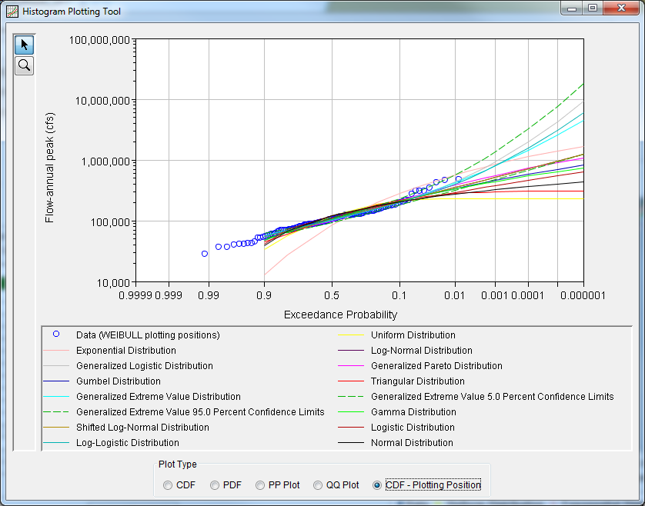
Distribution Fitting Analysis
Analysis Tab

Slide 27
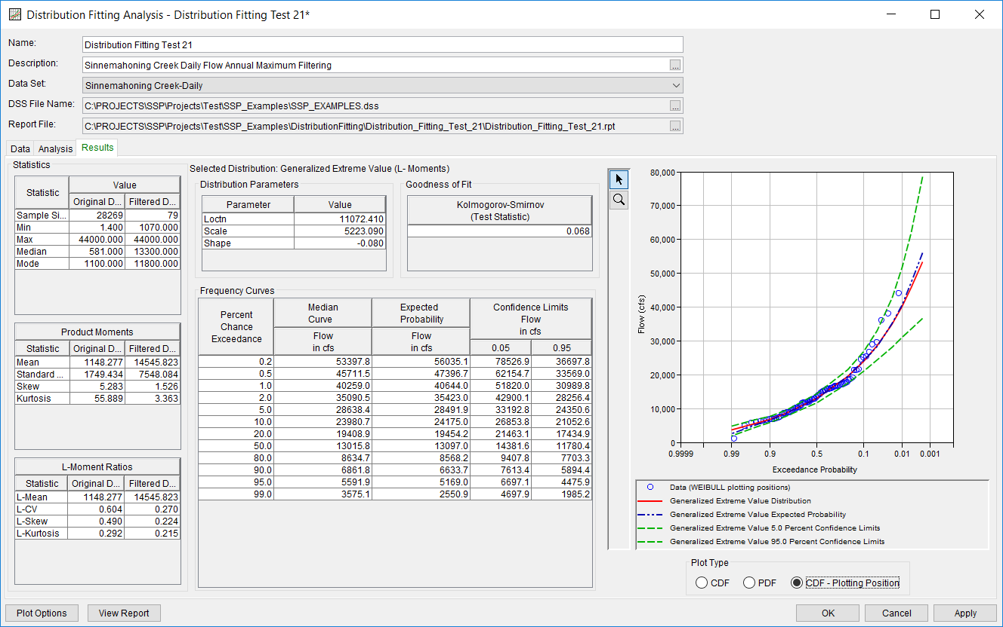
Distribution Fitting Analysis
Results Tab

Slide 28
History, Status, Future…
Version 2.x
Keep on improving the user experience
Continue to fix bugs
Continue to develop new tools to meet partner needs
  Correlation Analysis
  Maximum Likelihood Estimation fitting method

Slide 29
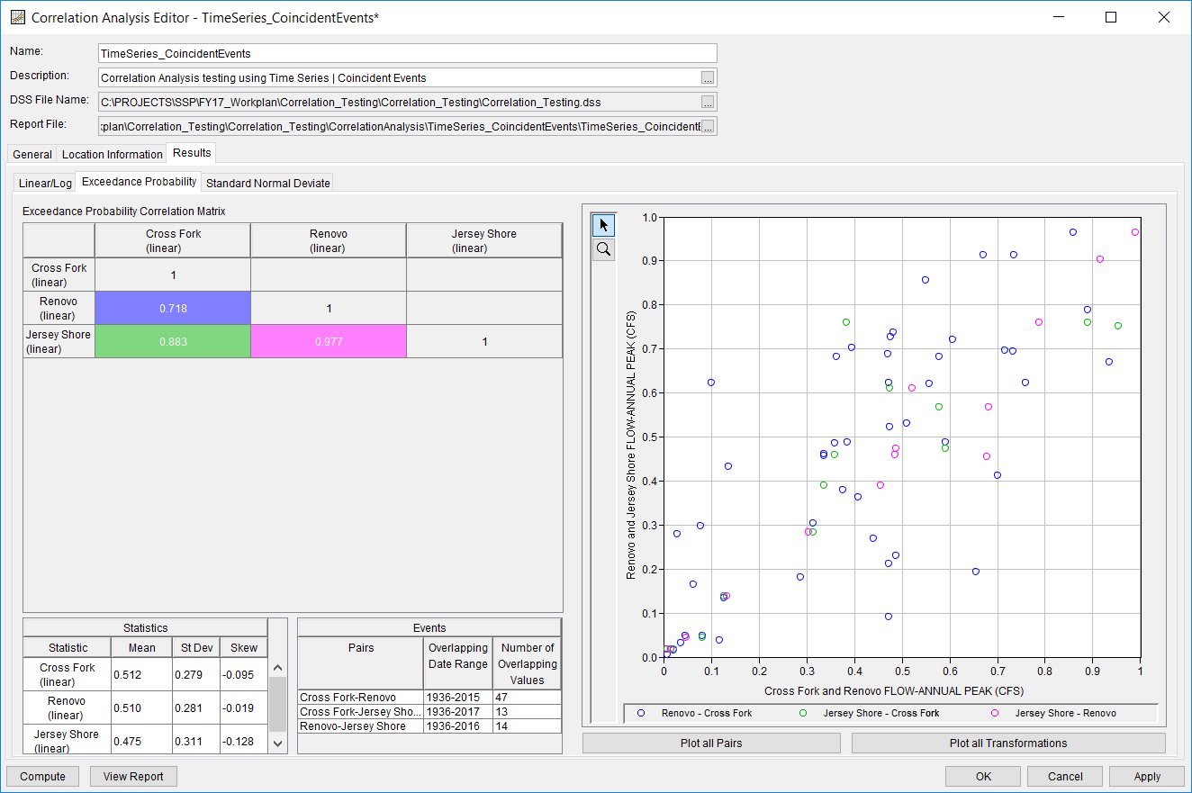
Correlation Analysis

Slide 30
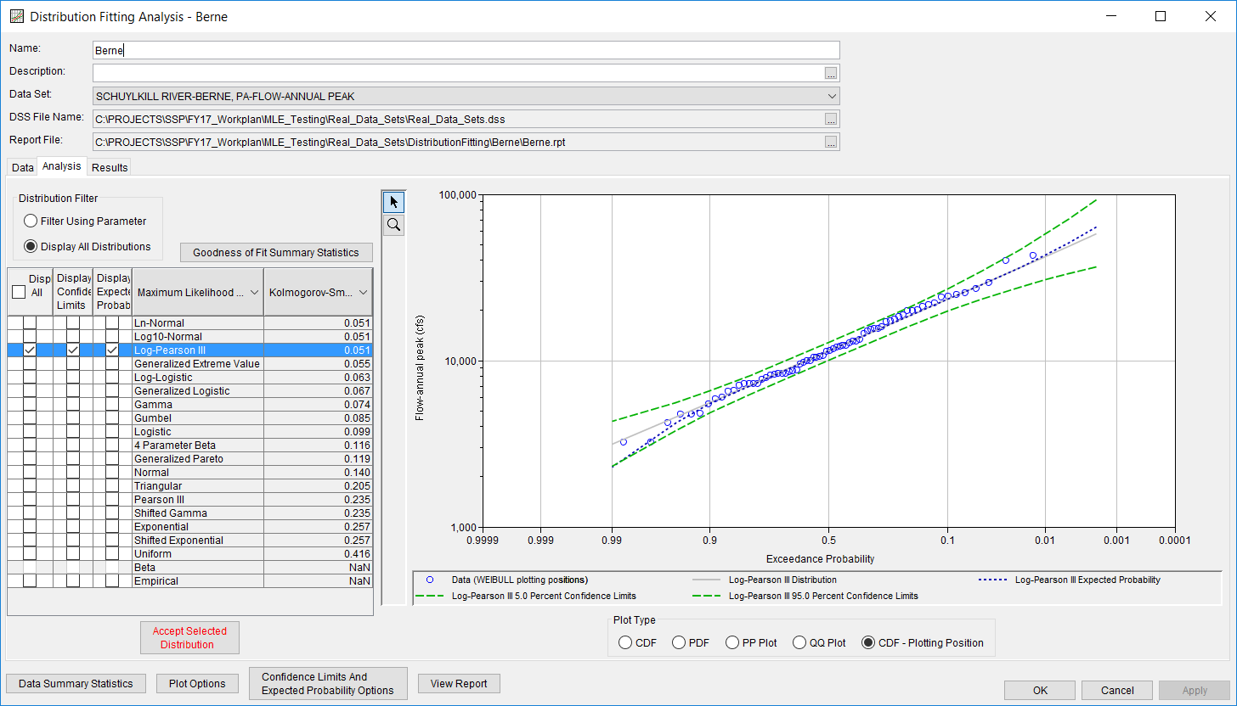
Maximum Likelihood Estimation

Slide 31
Summary
HEC-SSP currently contains nine different analysis types
Developed primarily to meet USACE needs
Constantly improving
If you have ideas for future enhancements or questions about existing features, let us know

Slide 32
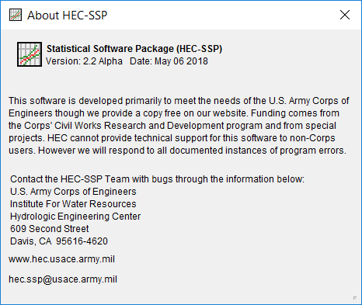
Thank you for using
HEC-SSP!
http://www.hec.usace.army.mil/software/hec-ssp/

