Slide 1
U.S. Army corps of engineers
Expected Probability
21 July 2022
Mike Bartles, P.E. – Hydrologic Engineering Center
Beth Faber, PhD, P.E. – Hydrologic Engineering Center
Dave Margo, P.E. – Risk Management Center

Slide 2
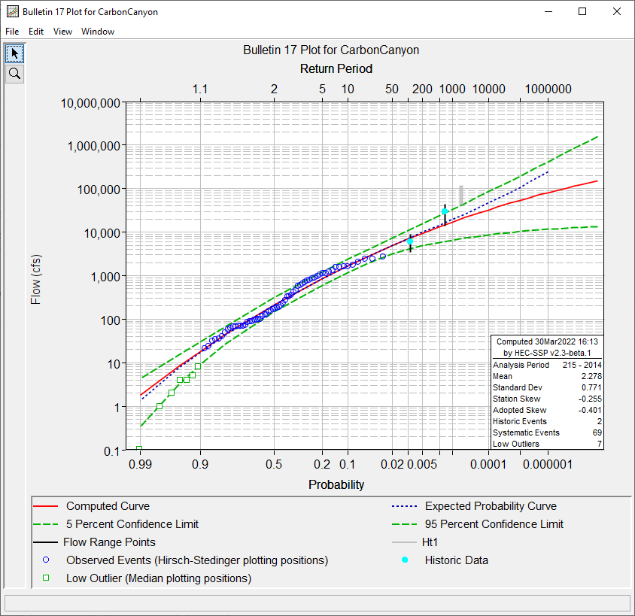
Outline
Background
How is expected probability calculated?
Demonstration
When to use / not use
Notes:
Within the presentation today:

Slide 3
What is Expected Probability
Notes:
The uncertainty in the frequency curve can also be considered in the exceedance probability of a particular flow, shown here at the estimate of the 1% flow but existing along the length of the curve. Like the distribution drawn as uncertainty in the flow quantile, the PDF is asymmetrical.

Slide 4
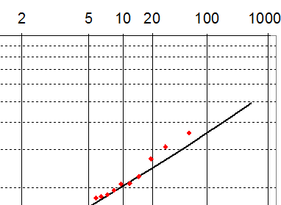
What is Expected Probability
The mean estimate of the annual exceedance probability for a given flow
Caused by asymmetry in the sampling distribution
mean
median
Notes:
In the asymmetrical PDF of uncertainty in exceedance probably of a given flow, the mean is not equal to the median. The estimated flow frequency curve is at the median of the sampling distribution, and the mean of that distribution is a larger exceedance probability at the upper tail of the distribution.
The mean of the uncertainty distribution is the unbiased estimate of the frequency curve. When considering future outcomes from the probability distribution, and using the frequency curve to perform cost benefit analysis around the country, we prefer an unbiased estimate.
The “expected probability adjustment,” shown as the dashed blue curve, moves the frequency ordinates from the median (the computed curve) to the mean of the uncertainty distribution.

Slide 5
USACE POLICY
ER 1110-2-1450, Paragraph 8 (USACE, 1994)
“Frequency-based” method
  When uncertainty is not modeled
  Corps policy is that frequency curves be adjusted to reflect expected probability
“Risk-based” method
  When uncertainty is modeled (e.g., HEC-FDA, HEC-WAT/FRA, RMC-RFA)
  Asymmetrical uncertainty is incorporated in the procedure to estimate expected value of flow, stage, AEP, damage, etc
  Expected probability adjustment not needed

Slide 6
Historical context
The expected frequency curve “can serve as a basis for computing the expected return on an investment” (Beard, 1960)
The expected flow-frequency curve is the optimal estimator in the context of flood hydrology and should be used to inform decisions (USACE, 1994)
Bulletin 17B (IACWD, 1982) provided an expected probability adjustment
Bulletin 17C (England et al, 2019) did not mention expected probability
https://agupubs.onlinelibrary.wiley.com/doi/abs/10.1029/JZ065i007p02143

Slide 7
Example
If the top of levee is equal to the computed (median) 100-year flood level, then the levee will overtop more frequently (on average) than once every 100 years. This is not good.
If the top of levee is equal to the expected 100-year flood level, then the levee will overtop (on average) once every 100 years. This is good.

Slide 8
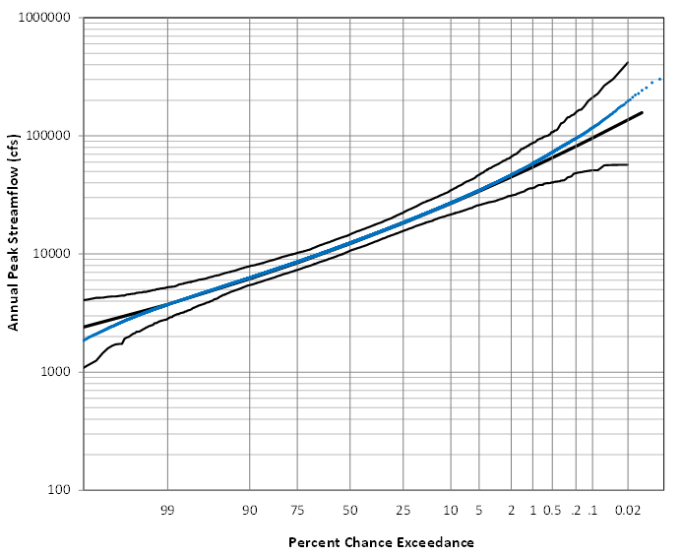
How is it Computed
Bootstrap
  Randomly sample a pre-defined number of flows (ERL), fit an LPIII, save data, repeat
  Bias!
i3 algorithm
  Invert, Interpolate, Integrate
  2nd order accurate
Exp. Prob.
Conf Limits
Median
Notes:
Image depicts conf limits and exp prob curve derived through percentile bootstrap
Results are 1st order accurate and biased!
i3 algorithm gets around the limitations of the percentile bootstrap and is 2nd order accurate
i3 algorithm:
Compute flows for the following values of CL and annual exceedance probabilities (AEP).
CL: 0.9999, 0.999, 0.99, 0.98, 0.975, 0.95, 0.925, 0.9, 0.875, 0.85, 0.825, 0.8, 0.75, 0.7, 0.65, 0.6, 0.55, 0.5, 0.45, 0.4, 0.35, 0.3, 0.25, 0.2, 0.175, 0.15, 0.125, 0.1, 0.075, 0.05, 0.025, 0.02, 0.01, 0.001, and 0.0001.
AEP: 1E-12, 2E-12, 5E-12, 1E-11, 2E-11, 5E-11, 1E-10, 2E-10, 5E-10, 0.000000001, 0.000000002, 0.000000005, 0.00000001, 0.00000002, 0.00000005, 0.0000001, 0.0000002, 0.0000005, 0.000001, 0.000002, 0.000005, 0.00001, 0.00002, 0.00005, 0.0001, 0.0002, 0.0005, 0.001, 0.002, 0.005, 0.01, 0.02, 0.05, 0.1, 0.2, 0.5, 0.8, 0.9, 0.95, and 0.99.
The wide range of CL and AEP values are needed to provide sufficient coverage for interpolation that is performed in a later step.
Calculate the standard normal Z variate for each CL and AEP that were used within Step 1.
Calculate the log10 value for each flow computed within Step 2.
Calculate the minimum and maximum log10(flow) values from Step 3.
Divide the range spanned by the min/max log10(flow) into 100 evenly spaced bins.
Linearly interpolate the values from Step 3 to calculate AEP(z) by CL(z) for each log10(flow).
Calculate the inverse standard normal Z variate for each AEP(z) and each CL(z).
Calculate the real-space flow for each log10(flow). For each, the CL is the cumulative distribution function (CDF) for AEP.
The mean (expected) value is equal to the area under the CDF. For each real-space flow, the CDF of AEP defined by the CL can be integrated to calculate the mean (expected) AEP.
Integration should be done using the trapezoidal rule.
Assume a rectangle to calculate the first and last incremental area for CL less 0.0001 and CL greater than 0.9999.
Sum the area for each real-space flow that was previously computed.
Calculate the standard normal z variate for each AEP and log10(flow) for each real-space flow.
This is necessary to linearize the data for interpolation.
Linearly interpolate the previously-computed standard normal z variates for each AEP and log10(flow) to compute the mean (expected) curve for the desired output AEP (i.e. that the user specified).
Convert the log10(flow) that make up the mean (expected) curve to real-space flows for reporting.

Slide 9
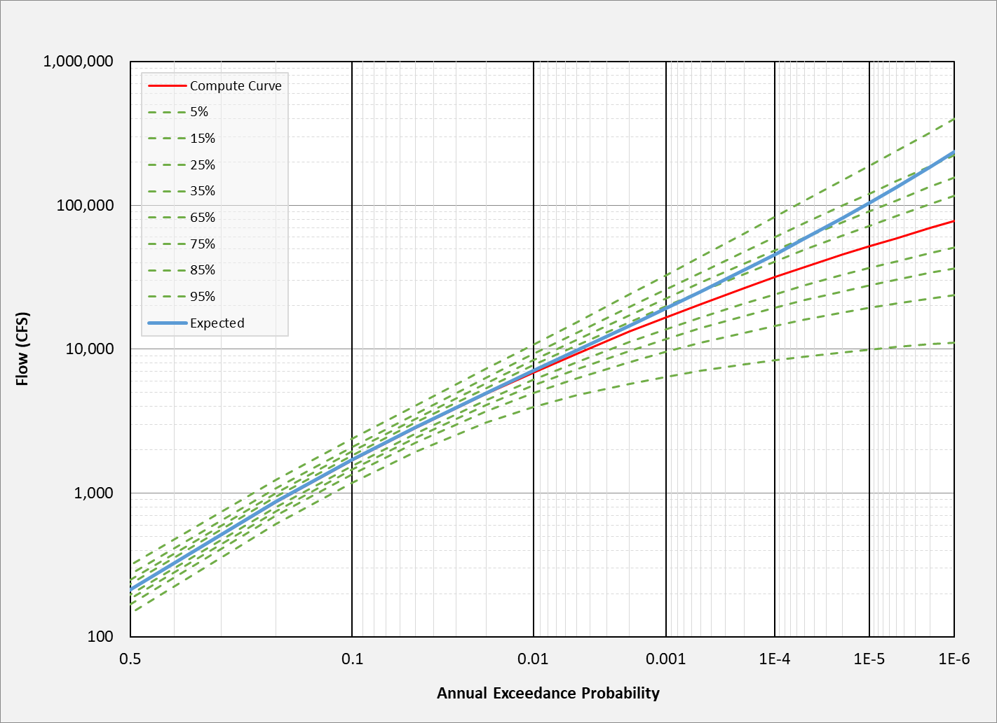
How is it Computed
*PDFs not to scale
Notes:
The i3 algorithm used w/in HEC-SSP to compute expected probability when using B17C procedures relies upon the accuracy of the confidence limits, which have been shown to be 2nd order accurate
We can compute confidence limits surrounding the median curve at various percentiles
ANIMATE
Here is an asymmetrical PDF at an AEP of interest
This information is accurate in the vertical direction. However, it’s also accurate in the horizontal direction. We can flip the confidence limits using a 45-degree line to construct asymmetrical PDFs for a corresponding flow
ANIMATE
ANIMATE
Just a note that this cartoon isn’t to scale

Slide 10
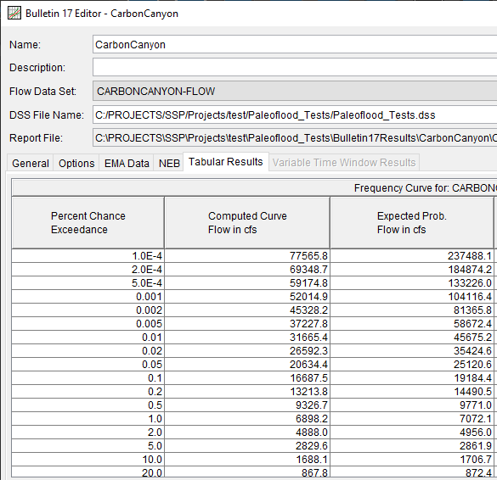
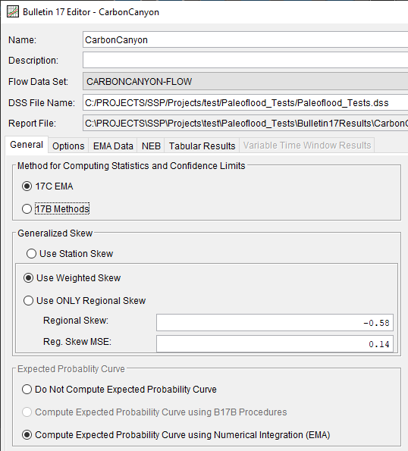
Demonstration

Slide 11
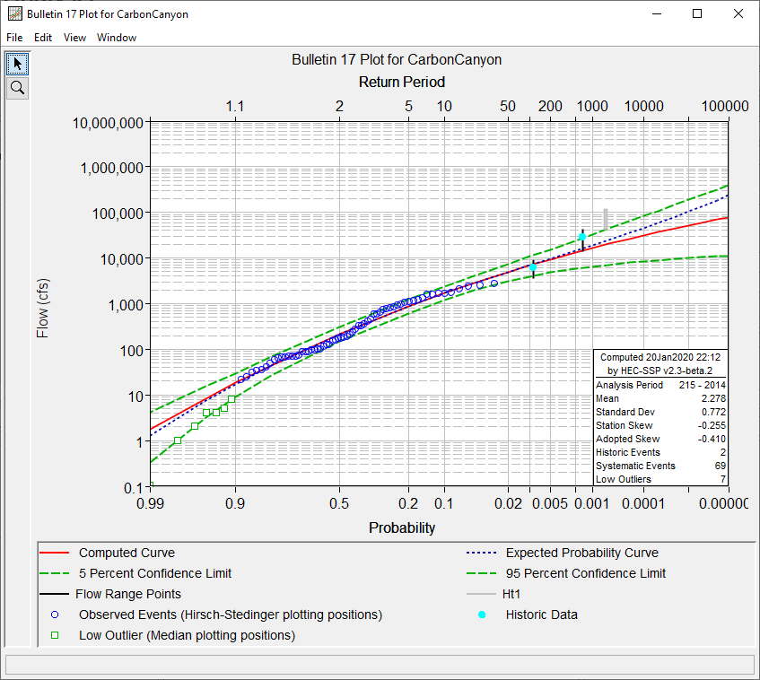
Demonstration

Slide 12
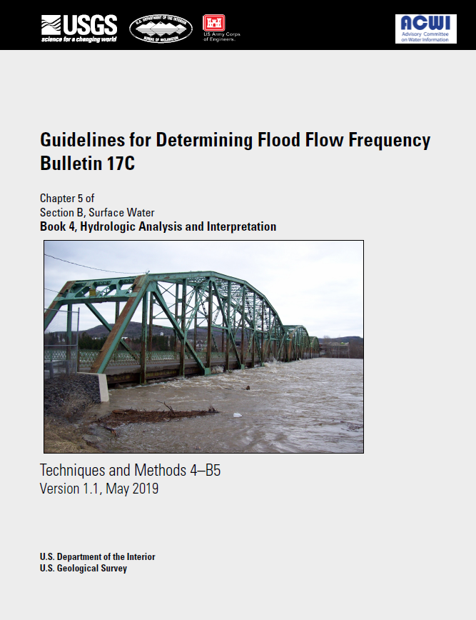
Bulletin 17C Context
Notes:
Beth to provide context of expected probability during development of Bulletin 17C

Slide 13
Conclusion
HEC-SSP v2.3 contains an expected probability adjustment that can be used with the Expected Moments Algorithm
The expected probability curve should be used when uncertainty is not carried forward into further analyses
The computed curve or parameterized distribution should be used when using HEC-FDA, HEC-WAT/FRA, and/or RMC-RFA
Notes:
Mike

Slide 14
Questions

