Slide 1
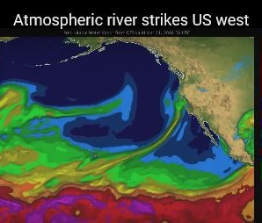
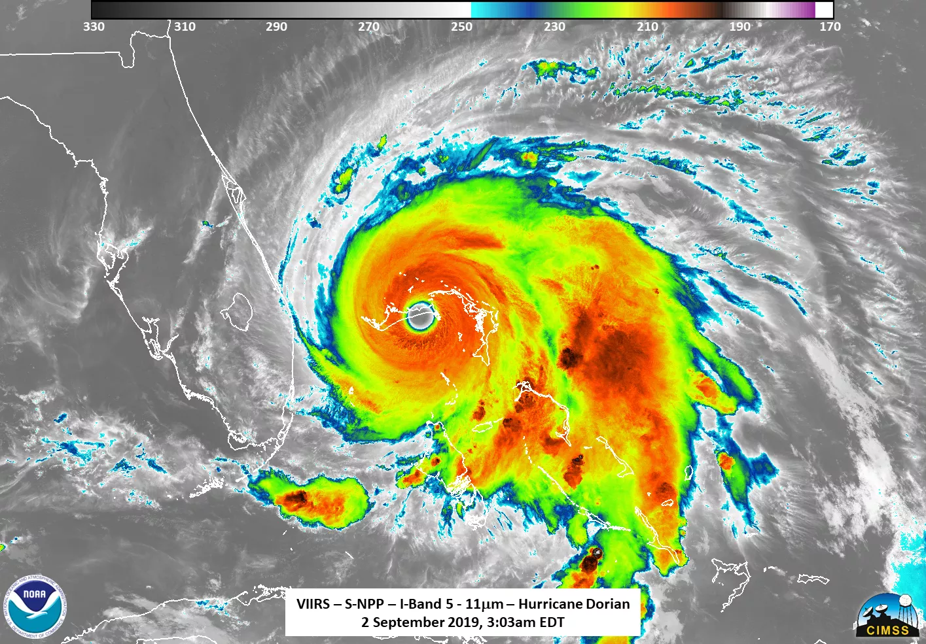
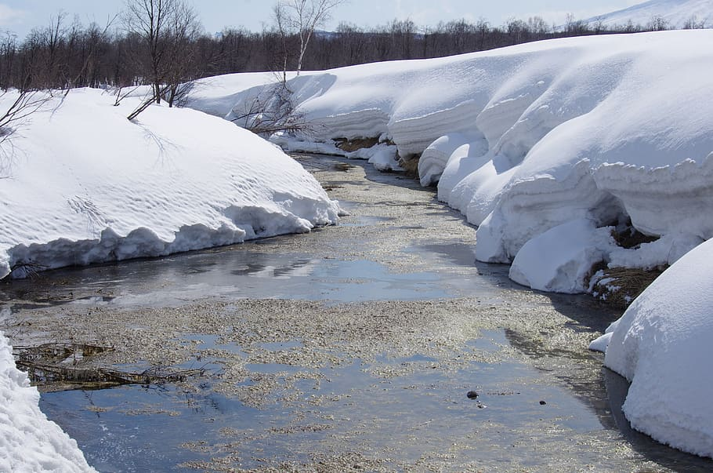

Flood Frequency Analysis and Flood Typing: An Interagency Collaborative Approach for Mixed Populations
FEMA Engineering and Mapping Community of Practice Meeting
October 3rd, 2024
This information is preliminary and is subject to revision. It is being provided to meet the need for timely best science. The information is provided on the condition that neither the U.S. Geological Survey nor the U.S. Government shall be held liable for any damages resulting from the authorized or unauthorized use of the information.

Slide 2
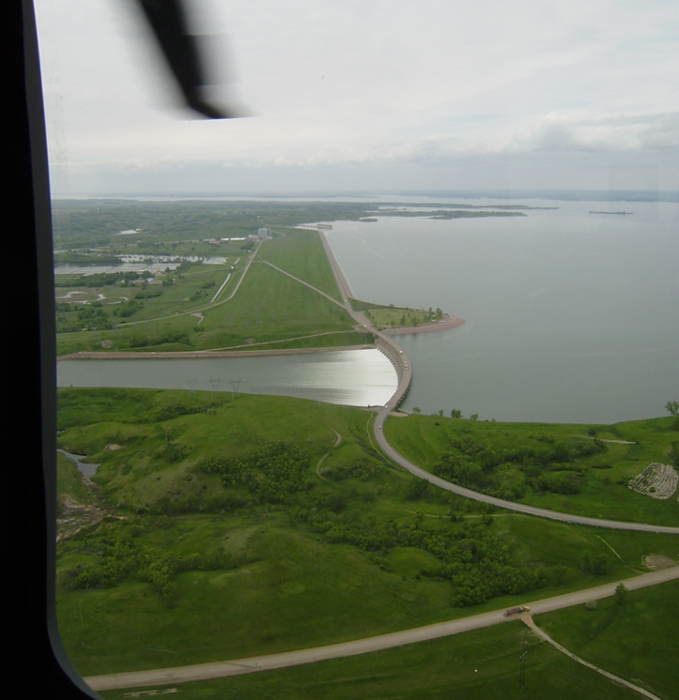
Outline
Why do we care?
Interagency work unit overview
Previous years’ efforts
Data wrangling, validation, and pipelines
Manual and semi-automated flood typing
Weather typing dashboard
Future years' efforts
Preliminary Information-Subject to Revision. Not for Citation or Distribution.

Slide 3
Why do we care?
Flow frequency analysis assumes the observations are “IID”
Independent
Identically-Distributed/homogeneous
“Identically-distributed” assumes one population creating the sample
When more than one mechanism creates floods, cannot guarantee the identically-distributed requirement
(Modified from Gotvald et al., 2012)
Preliminary Information-Subject to Revision. Not for Citation or Distribution.

Slide 4
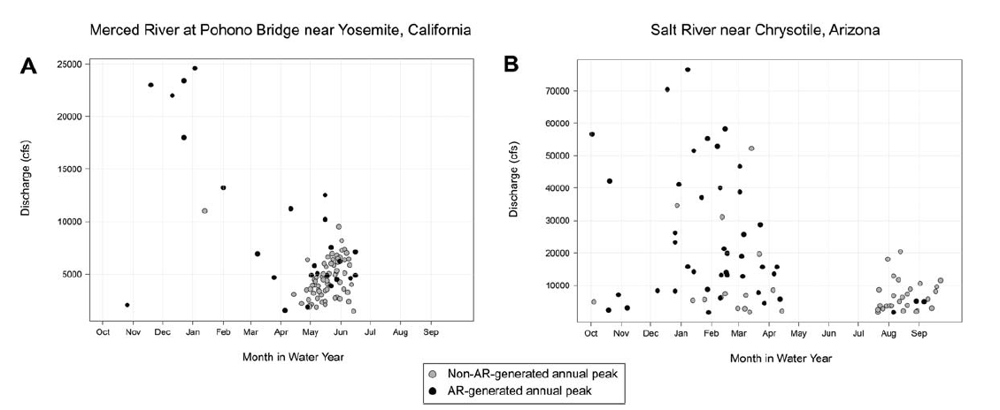
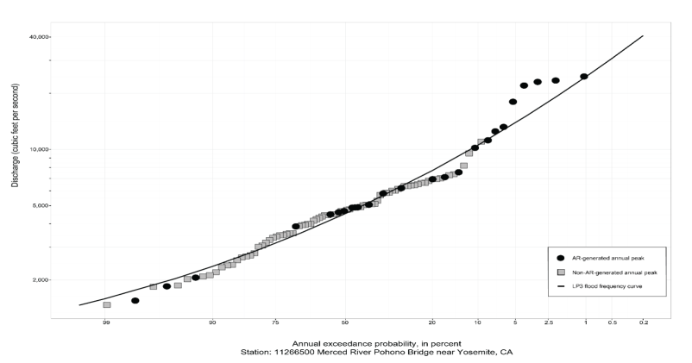
What’s taken so long?
It’s hard to classify flood types!
Further subdividing an already limited sample
We are missing the “how?”
No quantitative guidance
(Barth et.al., 2017)
Preliminary Information-Subject to Revision. Not for Citation or Distribution.

Slide 5
Interagency work unit goals
Improve mixed-population flood-frequency analysis methods
Develop and test semi-automated methods for determining flood type classifications
Develop a storage system for flood type classification information
Project future floods of different recurrence intervals considering potential changes in proportions of floods originating from different combinations of meteorological drivers and antecedent watershed conditions
Prescribe a plan for national implementation, including training of federal employees
Preliminary Information-Subject to Revision. Not for Citation or Distribution.

Slide 6
Interagency work unit collaborators
FEMA
Matt Dircksen
Christina Lindemer
David Rosa
USACE
Mike Bartles
Avital Breverman
Chris Cook
John England
Greg Karlovits
Will Lehman*
Melissa Mika
Alex Morrison
Rachelle Androwski
Brian Breaker
Kat Feingold
USGS
Stacey Archfield
Mauli Awasthi
Nancy Barth*
Robin Glas
Jory Hecht
Michelle Irizarry-Ortiz
Scott Hamshaw
Jim Lenoir
Sarah Murphy
Scott Olson
Nick Taylor
*Project Manager
Preliminary Information-Subject to Revision. Not for Citation or Distribution.

Slide 7
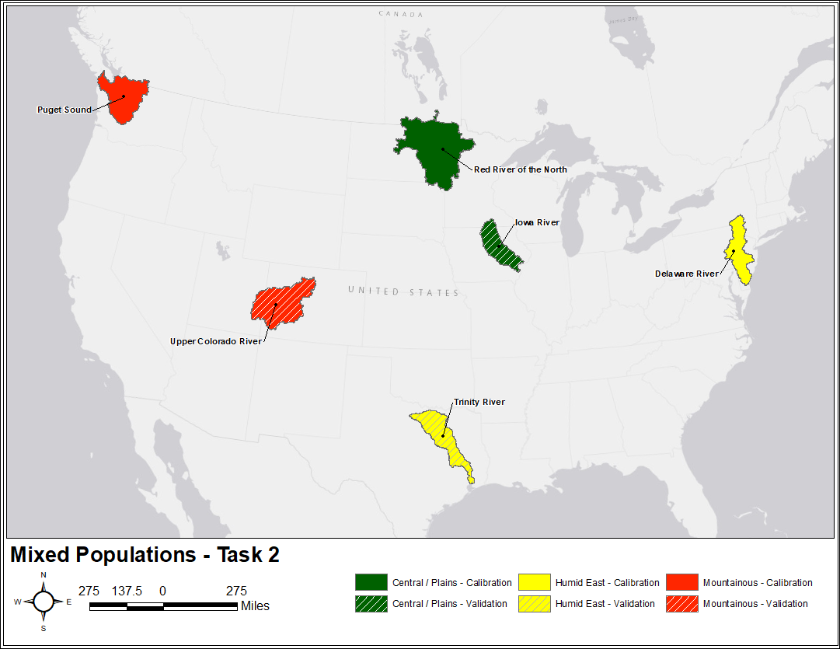
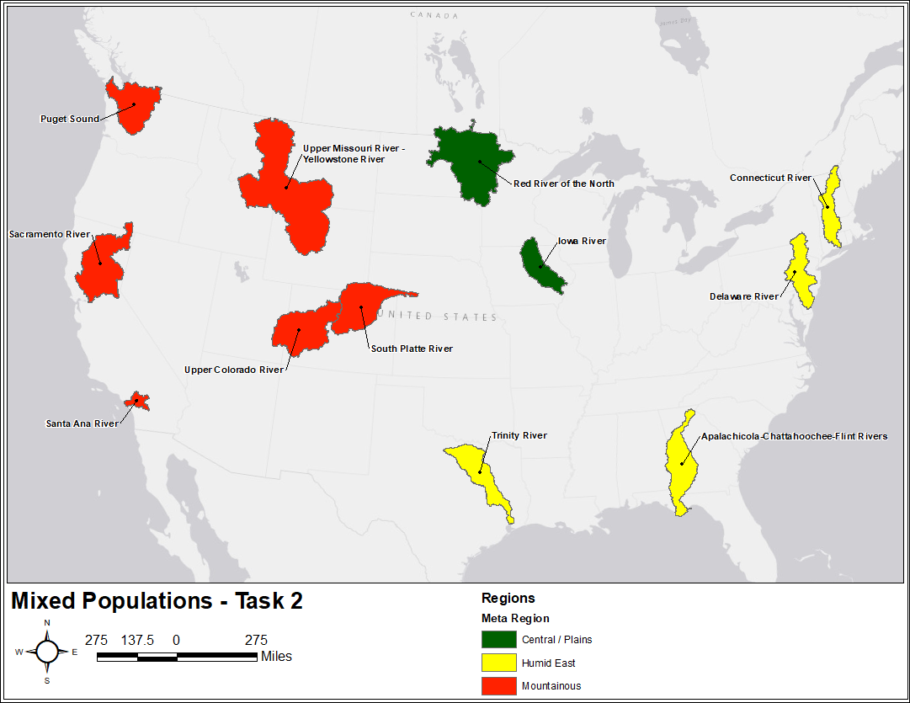
Previous years’ efforts
Within the previous year:
Performed a comprehensive literature review
Selected pilot regions (both for calibration and validation of tools and techniques)
Identified various data sources to use when identifying multiple flood mechanisms
We selected several regions to answer these questions:
Delaware River, Red River of the North, and Puget Sound as calibration regions
Trinity River, Iowa River, and Upper Colorado River as validation regions
Preliminary Information-Subject to Revision. Not for Citation or Distribution.

Slide 8
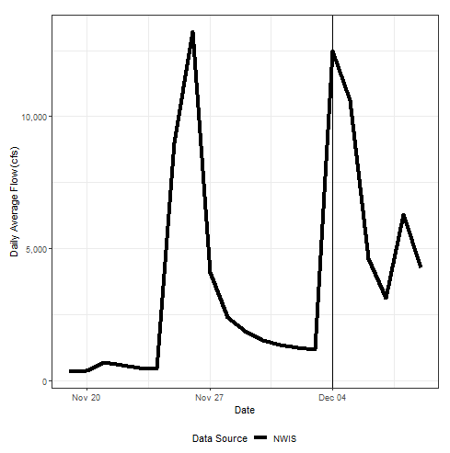

Data wrangling
Access streamflow data at USGS gages from USGS Water Data for the Nation
Instantaneous: used to get peak flow
Daily averages: used to develop time series
Plot of daily average streamflows where peak streamflow (instantaneous value) was recorded on December 4 but is muted in the daily average time series
Preliminary Information-Subject to Revision. Not for Citation or Distribution.

Slide 9
Dataset selection
Land surface data considered and selected (green/bolded) for use
Snow Water Equivalent (SWE) | Static Soil (ex. clay content) | Dynamic Soil (ex. soil moisture) | Wildfire | Ice Jams
SNODAS (2003-present) | gNATSGO | NLDAS-2 | MTBS Burned Area Boundaries | USGS NWIS
University of Arizona dataset (1981-2003) | STATSGO | WLDAS | MTBS Burn Severity Mosaic | USACE Ice Jam Database
20CRV3 (1836-1915) | SSURGO | Climate Change Initiative Soil Moisture project | LANDFIRE
NLDAS | Harmonized World Soil Database | GLEAM | USGS Combined Wildland Fire Dataset
Livneh (1915-1981) |  | SMAP | NASA RECOVER
NCEP NARR |  | MERRA-2 | Canadian National Fire Database
 |  | Climate Prediction Center global monthly soil moisture dataset | National Riparian Areas Base Map
 |  | ECMWF
 |  | ERA5-Land
 |  | ERA-Interim Land Reanalysis
 |  | Monthly Water Balance Model Soil Moisture dataset
Preliminary Information-Subject to Revision. Not for Citation or Distribution.

Slide 10
Dataset selection
Meteorological data considered and selected (green bolded) for use
 | AORC | PRISM | Livneh | 20CRV3 | TopoWx | RTMA | URMA | CONUS404 | ERA-5 | MERRA-2 | HURDAT2 | IBTrACS | EBTRK
Temperature | 1979-present | 1895-1979 | 1895-1979 | 1836-1915 | X | X | X
Atmospheric rivers |  |  |  | 1936-1940 |  |  |  |  | 1940-present | 1980-present
Convective available potential energy |  |  |  | X
Geopotential heights |  |  |  | X |  |  |  | X | X
Mean sea level pressure |  |  |  | X
Discrete storm tracks |  |  |  |  |  |  |  |  |  |  | X | X | X
Precipitation is not featured in the table because 27 datasets were considered.
Datasets also considered for atmospheric rivers include NCEP-NCAR reanalysis, NOAA Extended Reconstructed SST, ERA-Interim, CESM-LENS, and NARR methodology from Su and Smith, 2021.
Datasets also considered for geopotential heights include NCEP/NCAR, CFS-R, and NARR.
Preliminary Information-Subject to Revision. Not for Citation or Distribution.

Slide 11
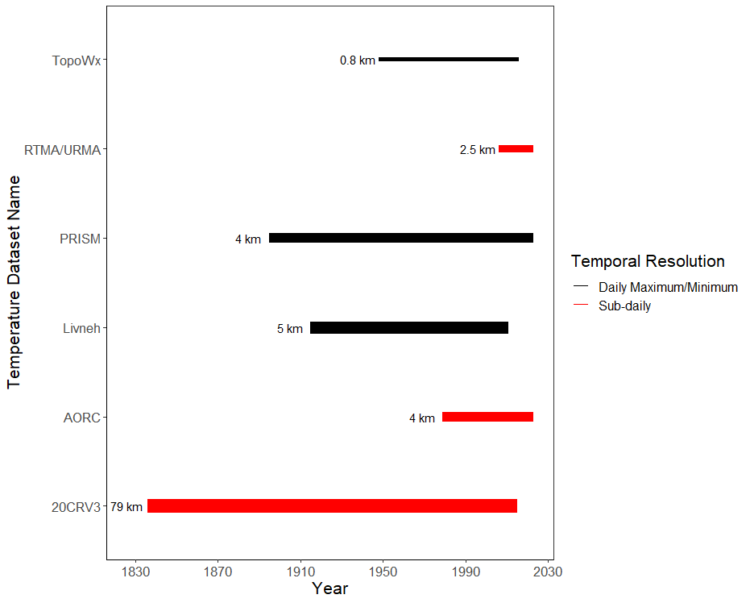
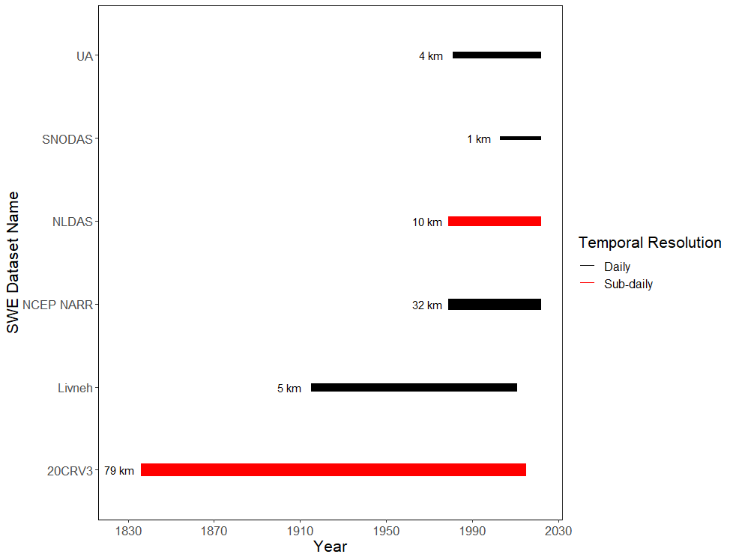
Dataset selection
Temperature
Snow Water Equivalent
2. UA: 1981-2003
1. SNODAS: 2003-present
2. PRISM & Livneh: 1895–1979
1. AORC: 1979-present
3. Livneh: 1915-1981
3. 20CRV3: 1836–1915
4. 20CRV3: 1836-1915

Slide 12
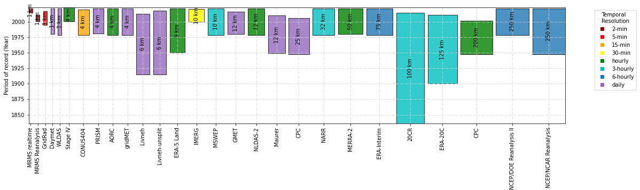
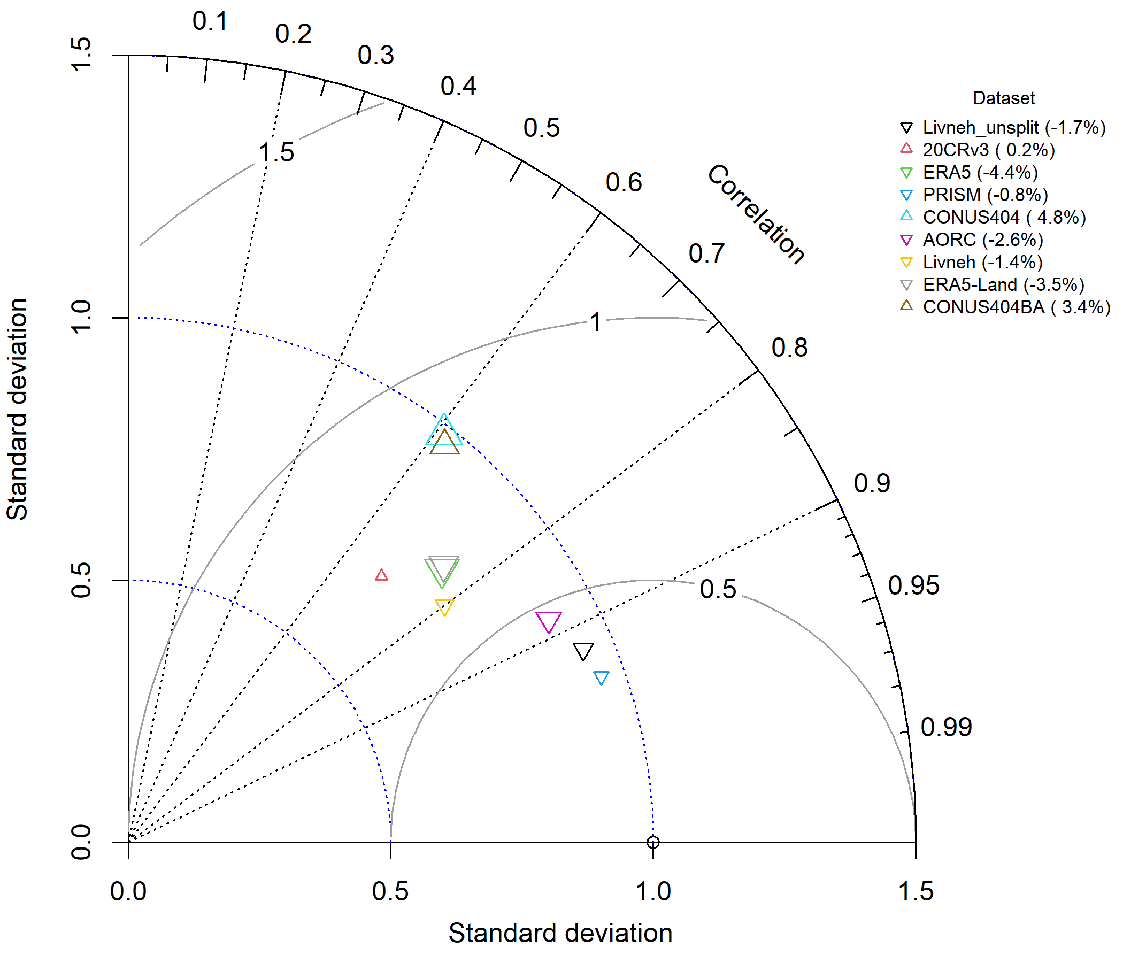

Validation of gridded precipitation data
Centered RMSD
Validated against GHCN-daily station data in each pilot region
Period: 1981–2013
All daily data (annual and by season: winter, spring, summer, fall)
Extremes of 1- to 14-day duration (top ~1% of events)
Kling-Gupta Efficiency
Correlation
Bias Ratio
Stdev Ratio
Preliminary Information-Subject to Revision. Not for Citation or Distribution.

Slide 13
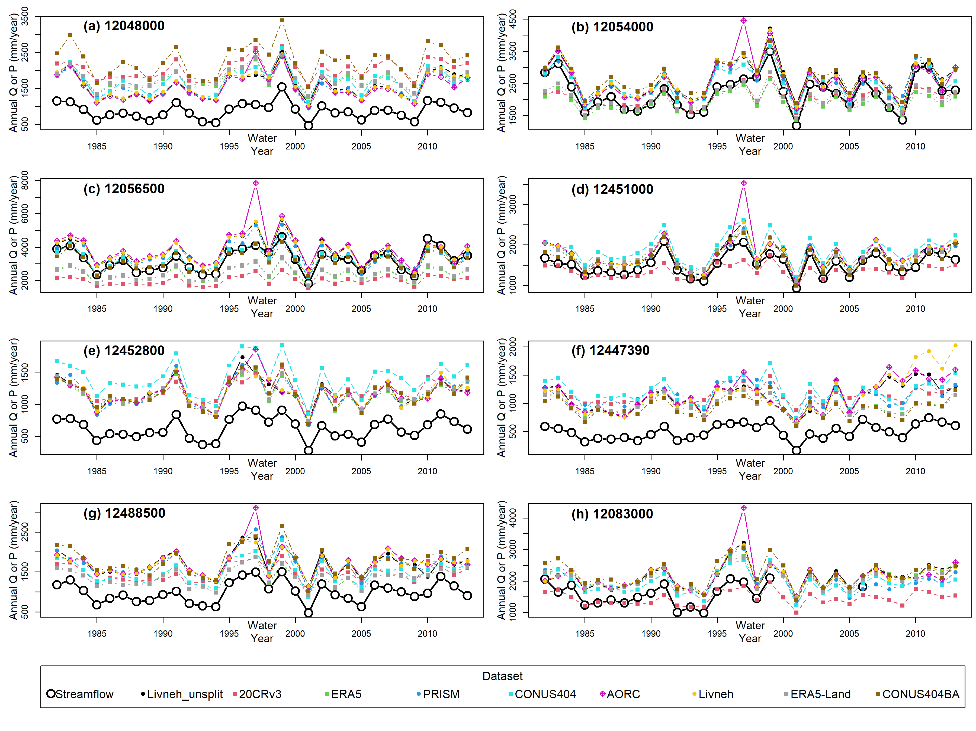
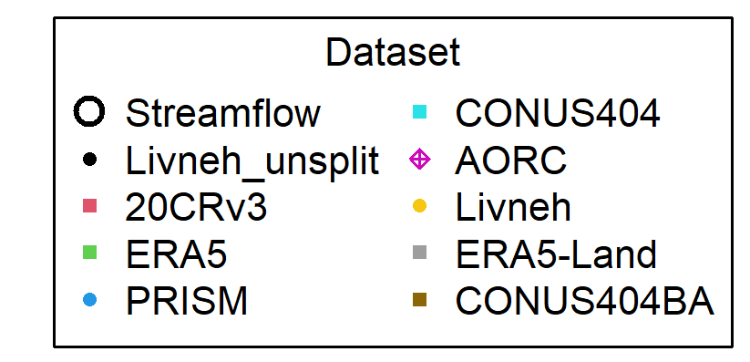
Validation of gridded precipitation data
PRISM and Livneh-unsplit best match spatiotemporal variability of station data for entire distribution of daily precipitation and multi-day extremes. Unsurprising since these datasets are developed using some of the same station data.
Reanalysis datasets have poor performance. Low skill in capturing precipitation amounts at right place and right time and coarser resolutions.
Gage- and radar-based datasets have small biases, reanalysis datasets have large + biases compared to stations especially in winter/spring in some regions. May be due to gage undercatch of snowfall! ← Unanswered question!
Comparison of water-year total precipitation vs. streamflow depth (black line, open circles) for two drainage basins in Puget Sound region with low evaporative fraction.
Preliminary Information-Subject to Revision. Not for Citation or Distribution.

Slide 14



Data pipelines for “model-ready” data
Aggregate time series of spatially-averaged weather variables for gaged watersheds
Wrangle data into “model-ready” format with consistent time index and variable names
Use of data pipeline jobs to support future up-scaling to thousands of streamgages
Gridded Data
DSS format Basin-average time series
Watershed Boundaries
HEC-Vortex
Study area site lists & peak flow dates
S3 storage of per-gage time series
Data Conversion & Upload
AWS Sagemaker python script processing jobs
Weather & Flood Typing
Cluster Analysis and Machine Learning (ML)
Mixed Populations Flood Frequency Analysis
“model-ready” data files w/ all variables
extracted sequences n-days before/after peak dates
Preliminary Information-Subject to Revision. Not for Citation or Distribution.

Slide 15
Weather typing dashboard: Motivation
An R Shiny App for holistically visualizing diverse sets of meteorologic and hydrologic data
Visualizations aid the user with weather- and flood-type categorization
INTERACTIVE
Users can quickly parse through "unwieldy" data
STANDARDIZED
Users view data wrangled the same way, reducing code inconsistencies
Preliminary Information-Subject to Revision. Not for Citation or Distribution.

Slide 16
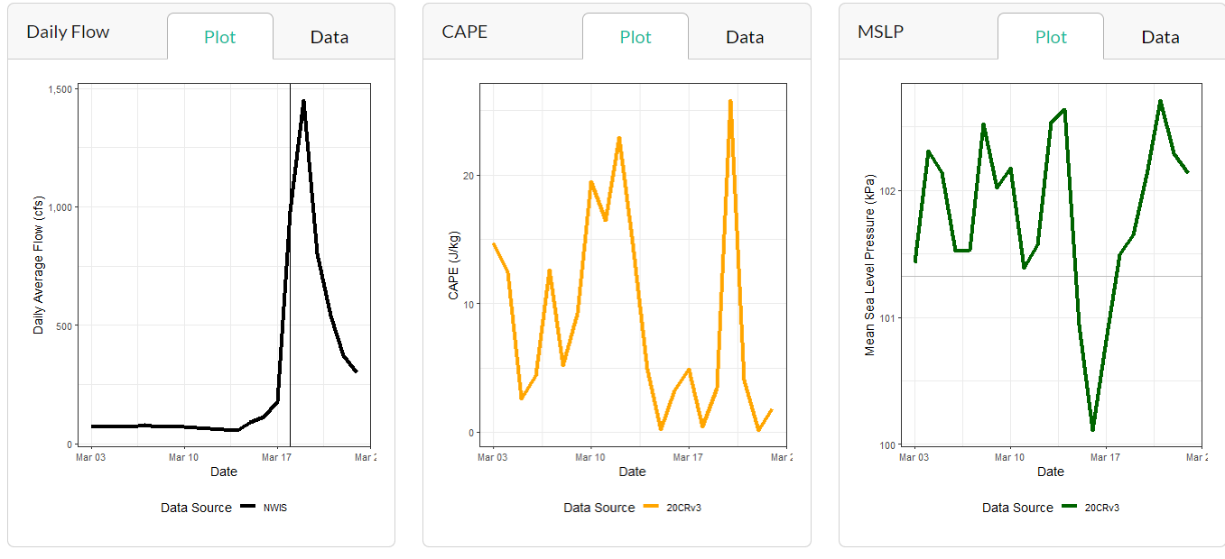
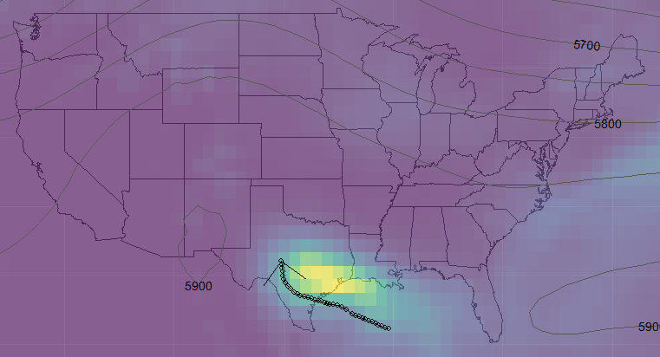
Weather typing dashboard: Data flow
Precipitation/Geopotential Overlay Tabs
Gage Time Series Tab
IBTrACS CSV (tropical storm tracks)
DSS File
sf - R interface for spatial vector data
dssrip2 - R interface for DSS files
R Object
R Object
GeoHgt NetCDF;
Precip NetCDF
dataRetrieval - R interface for NWIS data
Peak Flow Dates;
Daily Flow Values
terra - R interface for raster data
R Objects
Plots Aligned with Peak Flow Dates
Plot with Overlaid Data
Preliminary Information-Subject to Revision. Not for Citation or Distribution.

Slide 17
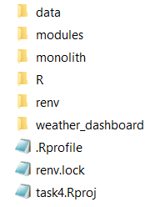
Weather typing dashboard: Collaboration
Sharing applications across agencies is difficult
The dashboard is shared as a standalone zip file on the USGS SharePoint site
renv solves some, but not all reproducibility issues
We are working to host the app on a server
Zip File Contents
Preliminary Information-Subject to Revision. Not for Citation or Distribution.

Slide 18
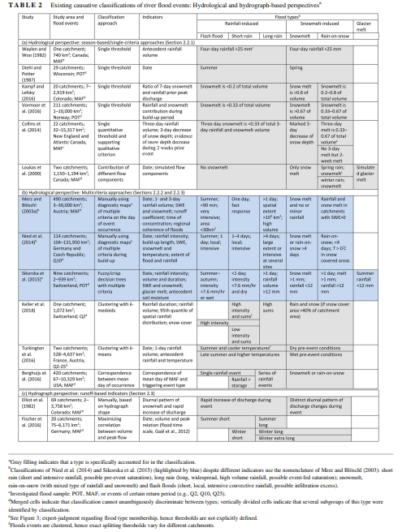
Manual flood typing
Review paper by Tarasova et al. (2019)
Existing classifications of floods:
Hydroclimatic
Hydrologic
Hydrograph-based
Classification frameworks are rarely evaluated by comparing results with detailed information from well-observed events
Flood classification frameworks should have the following characteristics:
Robust
Transferable
Adaptive
Consistent
Preliminary Information-Subject to Revision. Not for Citation or Distribution.

Slide 19
Manual flood typing
Manual flood typing
Primary Mechanism | Primary Mechanism Sub-Type | Delaware | Puget Sound | Red River of the North | Trinity | Upper Colorado | Iowa
Rain only | Cyclonic | X |  | X | X |  | X
 | Atmospheric River | X | X |  |  |  | X
 | Frontal | X | X | X | X |  | X
 | Convective |  |  | X | X |  | X
 | Tropical storm/tropical storm remnant | X |  |  |  | X
 | North American Monsoon |  |  |  |  | X
Rain-on-snow/rain and snow |  | X | X | X |  | X | X
Snowmelt only (includes glacial melt) |  |  | X |  |  | X | X
Preliminary Information-Subject to Revision. Not for Citation or Distribution.

Slide 20
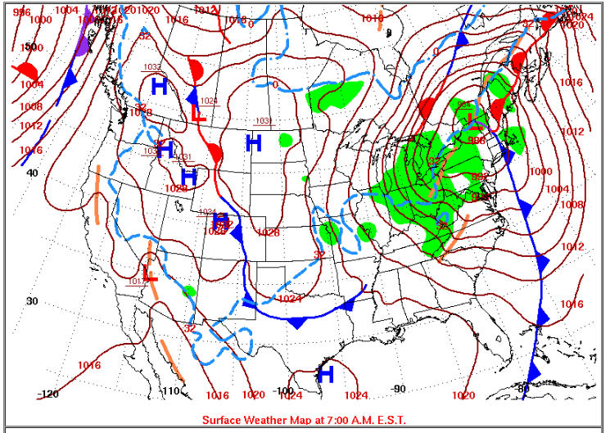
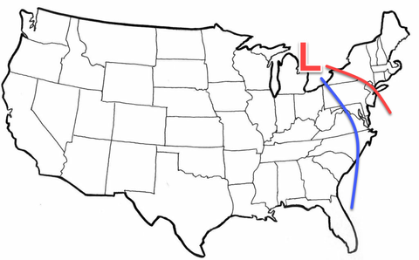
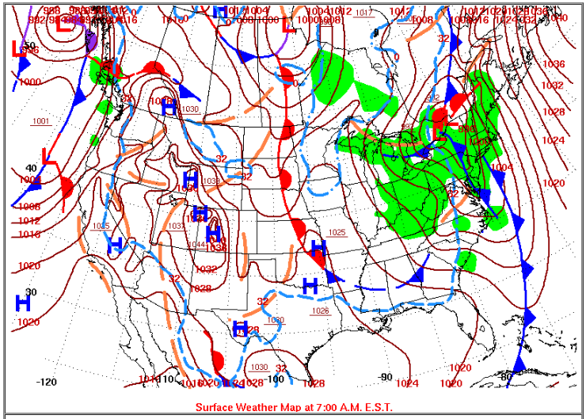
Weather typing
2/25/2016
Are there any general atmospheric patterns or setups that are indicative of a certain flood type?
Atmospheric conditions include:
Cyclonic
Atmospheric river
Frontally driven rainfall
Convectively driven rainfall
Tropical cyclone
Steady rainfall
12/25/2020
Preliminary Information-Subject to Revision. Not for Citation or Distribution.

Slide 21
Weather typing approaches
Strategy Spectrum
Analyst-Driven
Data-Driven
Primary goal: build robust training datasets
Primary roadblock: weather is complex
Preliminary Information-Subject to Revision. Not for Citation or Distribution.

Slide 22
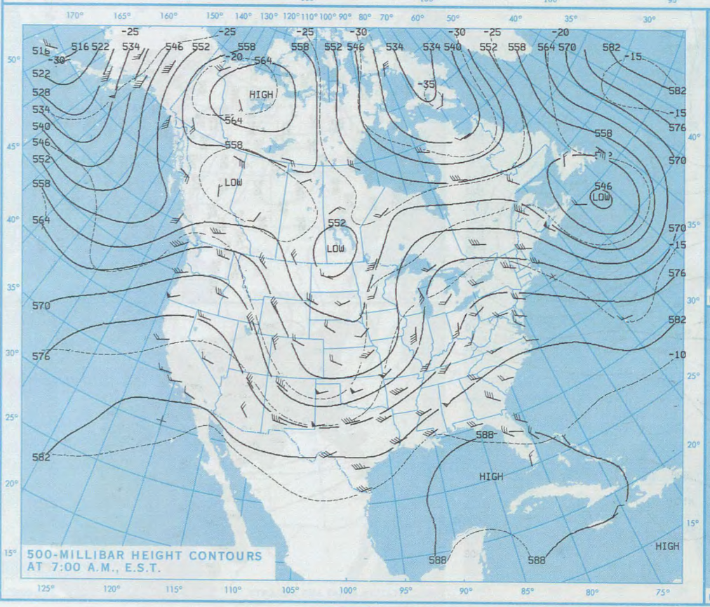
Weather typing task force
Regular meetings
Open discussions
Results sharing
Requests for help
Most importantly: capacity-building
Connect experts with learners
Preliminary Information-Subject to Revision. Not for Citation or Distribution.

Slide 23
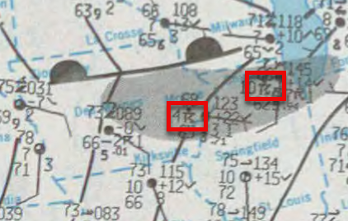
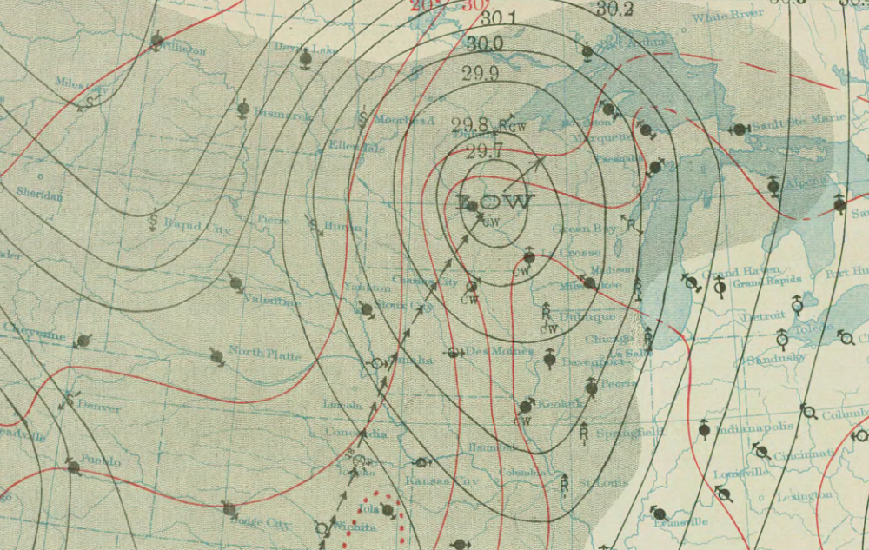
Analyst-driven weather typing
Encodes expertise
Relies on consistent, long-record product (DWM)
Synthesizes patterns
Inherently subjective
DWM 11/14/1909
Preliminary Information-Subject to Revision. Not for Citation or Distribution.

Slide 24
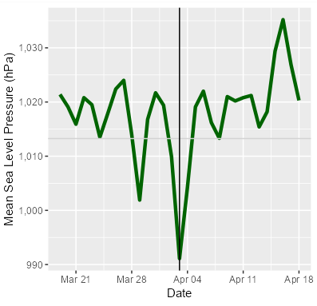
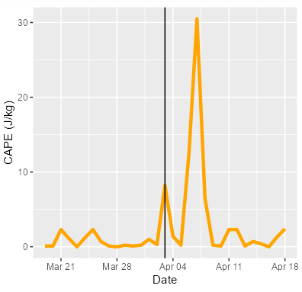
Data-driven weather typing
Cobble together best available data for POR
Use threshold values to trigger decisions
Represent processes by reducing dimension
In theory, more objective
Still needs expertise to get off the ground
Could be “too close” to the automated process
Preliminary Information-Subject to Revision. Not for Citation or Distribution.

Slide 25
Goldilocks approach
Find the strengths of both approaches
DWM: long record, consistency
Data: objectivity
Get as close to “truth” as possible and turn the automated classifiers loose
Analyze
Classify
Check Data
Refine
Preliminary Information-Subject to Revision. Not for Citation or Distribution.

Slide 26

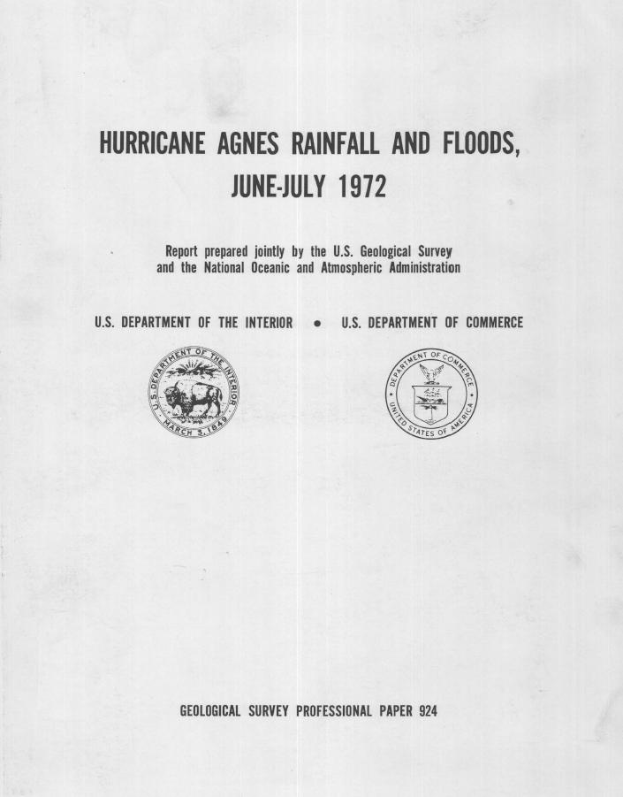
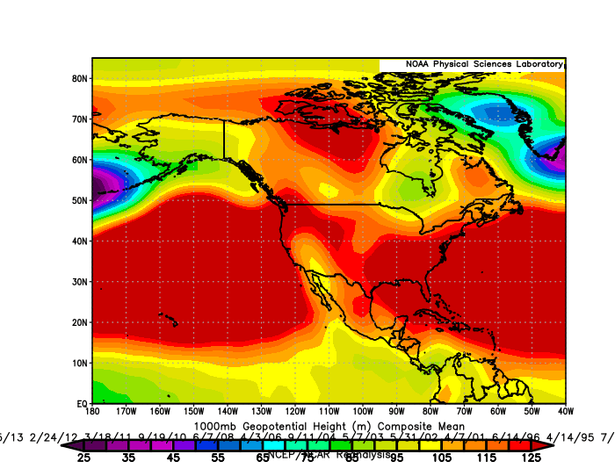
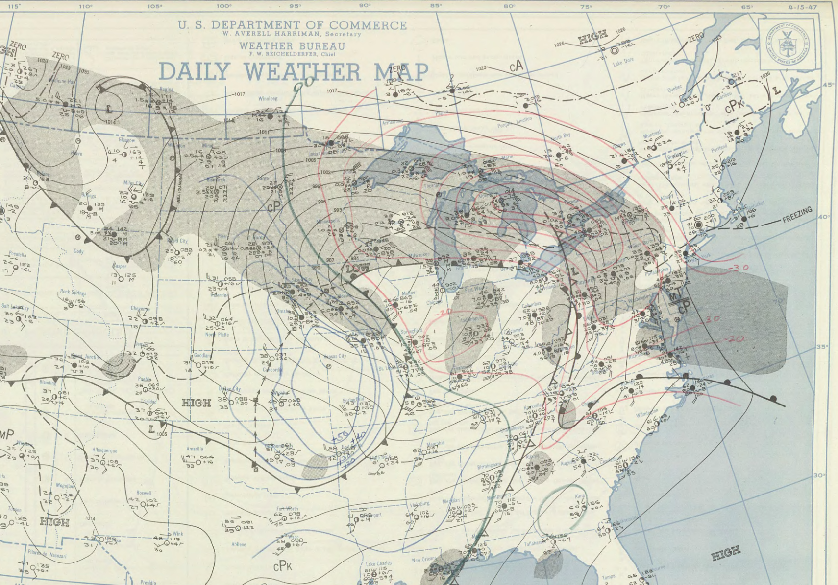
Manual flood typing
Manual flood typing was performed at 3 key gages in each pilot region
Lines of evidence:
Surface analysis maps
Weather typing dashboard
Previous flood and storm typing efforts
Post-flood reports
Monthly storm publications
Preliminary Information-Subject to Revision. Not for Citation or Distribution.

Slide 27
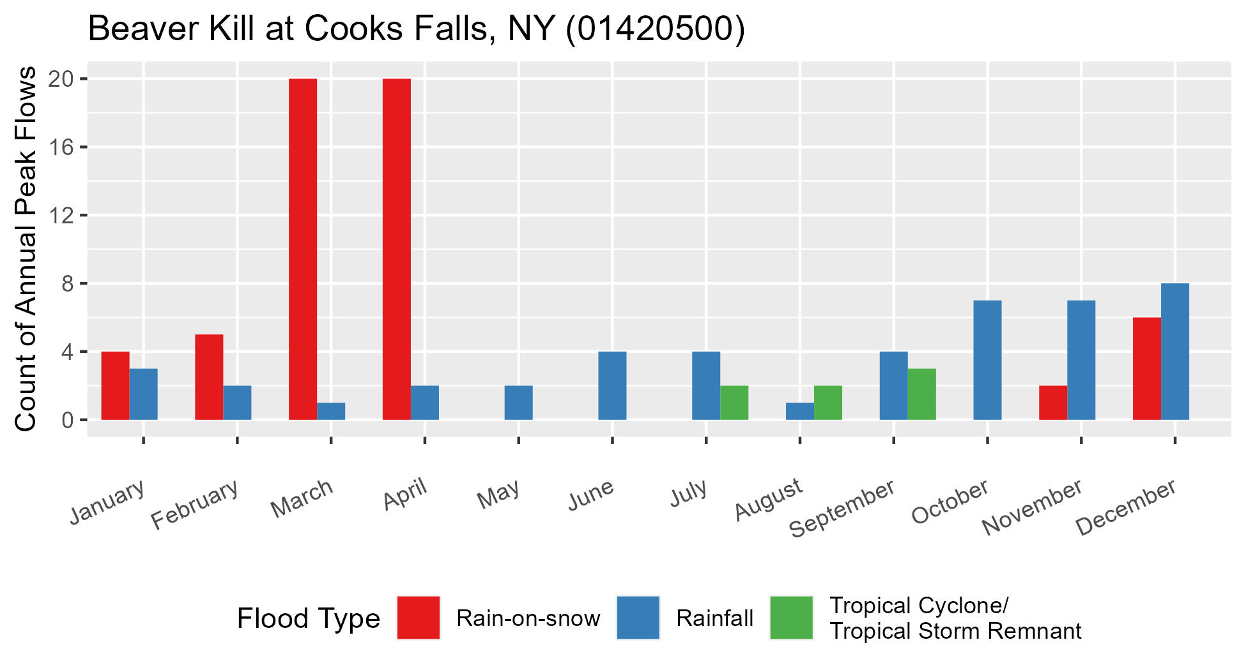
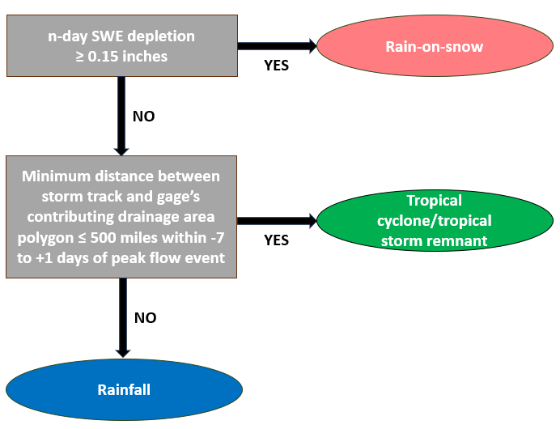
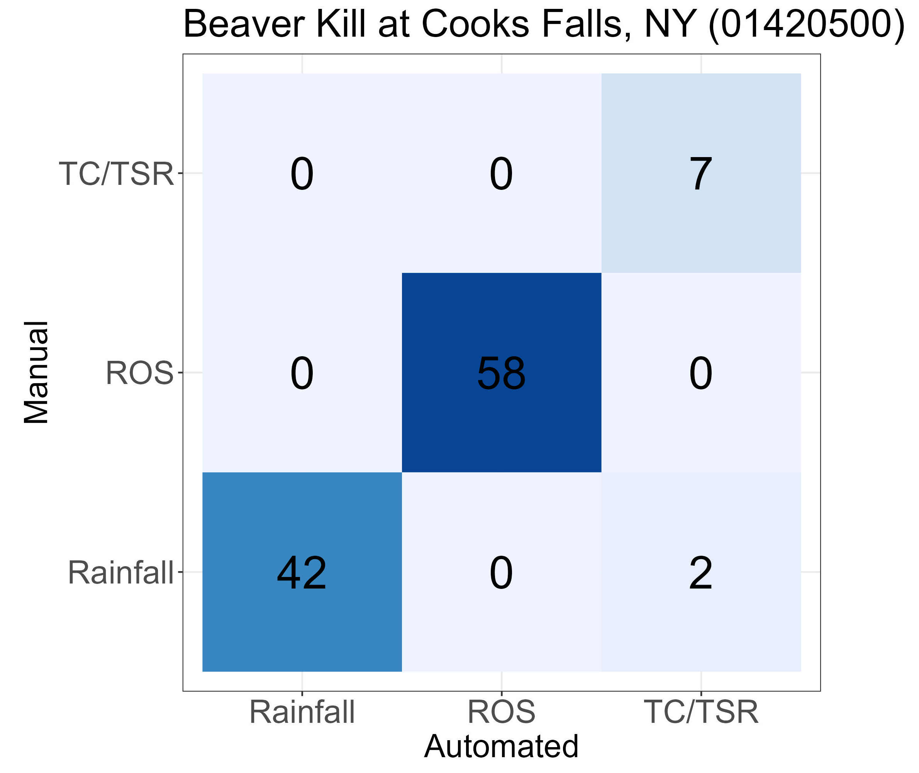
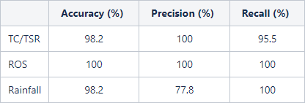
Manual and semi-automated flood typing
Preliminary Information-Subject to Revision. Not for Citation or Distribution.

Slide 28
Mixed distribution frequency models
Peaks over Threshold
Bayesian techniques
More accurate flood frequency estimates, given the flood types attributed to each peak.
Probability of Union
Multivariate approach
Baseline
GAMLSS

Slide 29
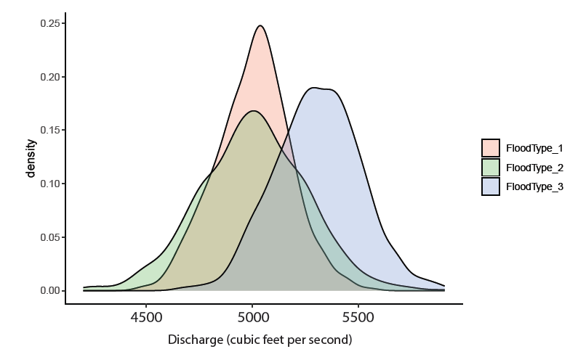
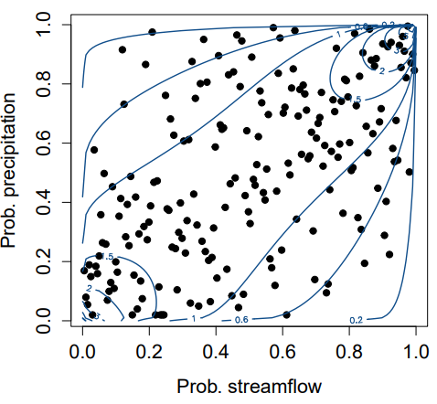
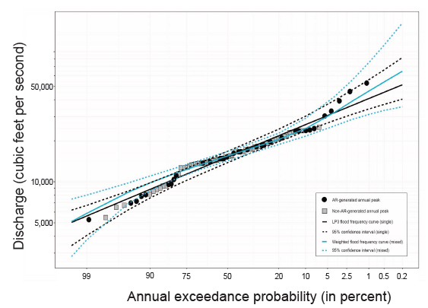
Mixed distribution frequency models:
novel approaches
Bayesian techniques
Multivariate approach
GAMLSS

Slide 30
Evaluate candidate mixed-distribution models
Now that we have better IID samples, what flood frequency analysis technique(s) do we recommend using?
Need an experiment that uses an even playing field for all possible analysis techniques
Monte Carlo to the rescue!
Chowdhury and Stedinger (1991)
Preliminary Information-Subject to Revision. Not for Citation or Distribution.

Slide 31
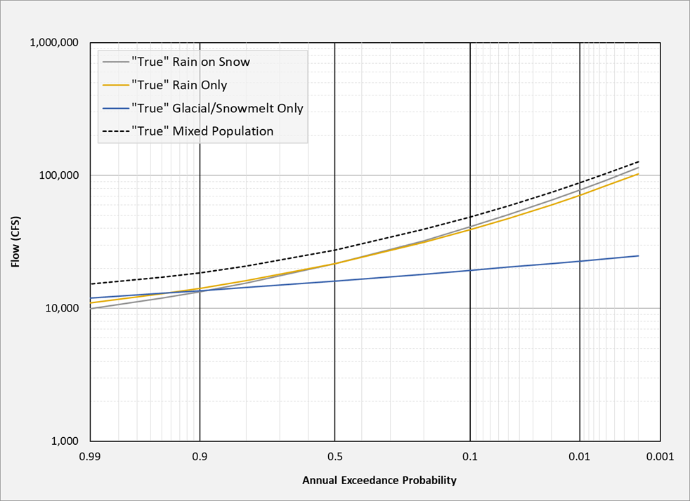
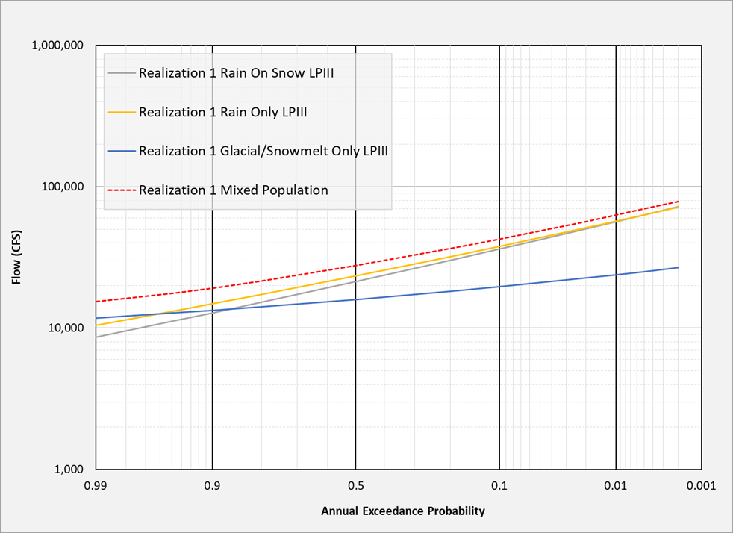
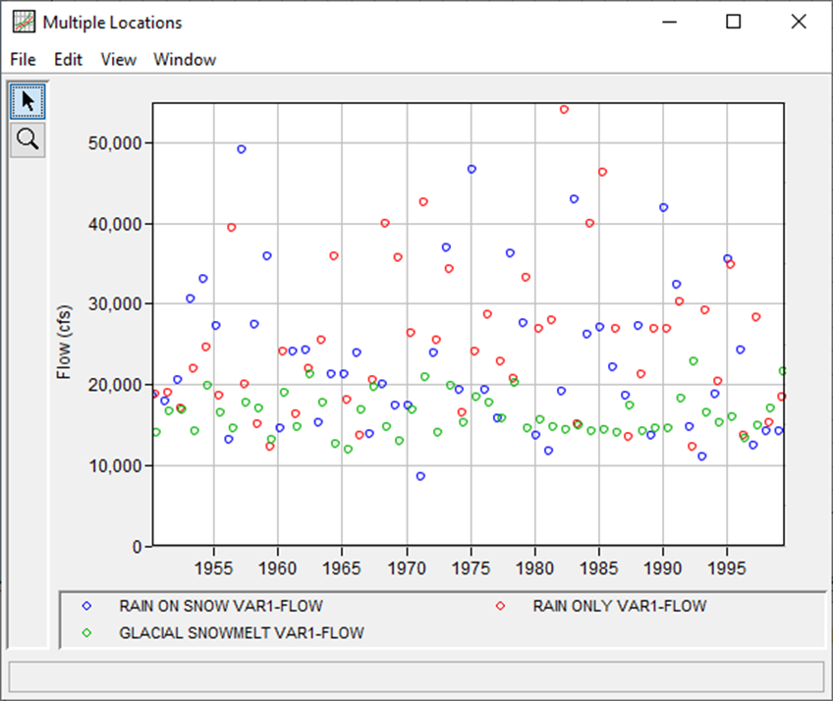
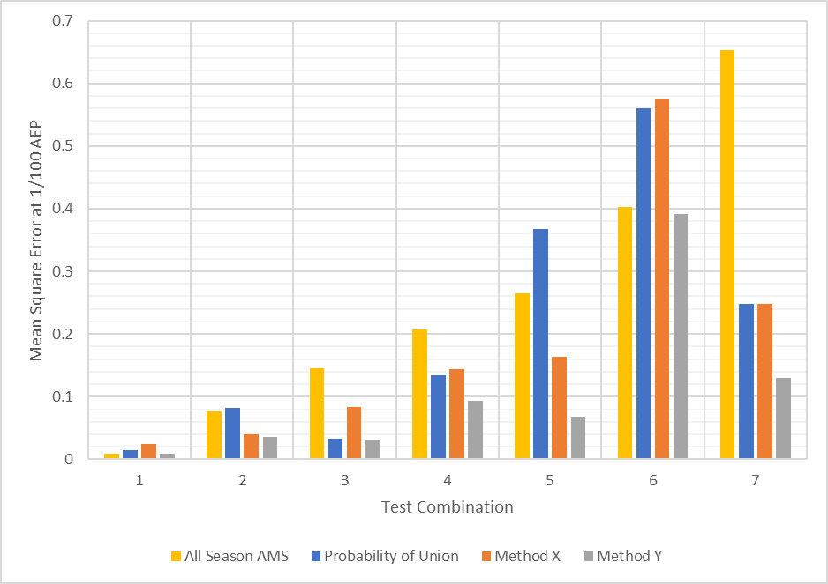
Evaluate candidate mixed-distribution models
Preliminary Information-Subject to Revision. Not for Citation or Distribution.

Slide 32
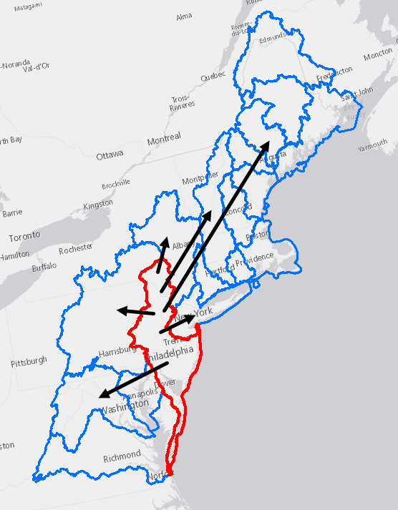
Future years' efforts
Generate estimates in pilot regions
Analyze changes in causal mechanisms over historical and future periods for pilot regions
Establish a scope-of-work for a national upscaling of mixed-populations analysis
Dissemination of results
Provide tech transfer and training materials
Preliminary Information-Subject to Revision. Not for Citation or Distribution.

Slide 33
Questions?
Thank you!
Preliminary Information-Subject to Revision. Not for Citation or Distribution.

Slide 34
Backup Slides

Slide 35
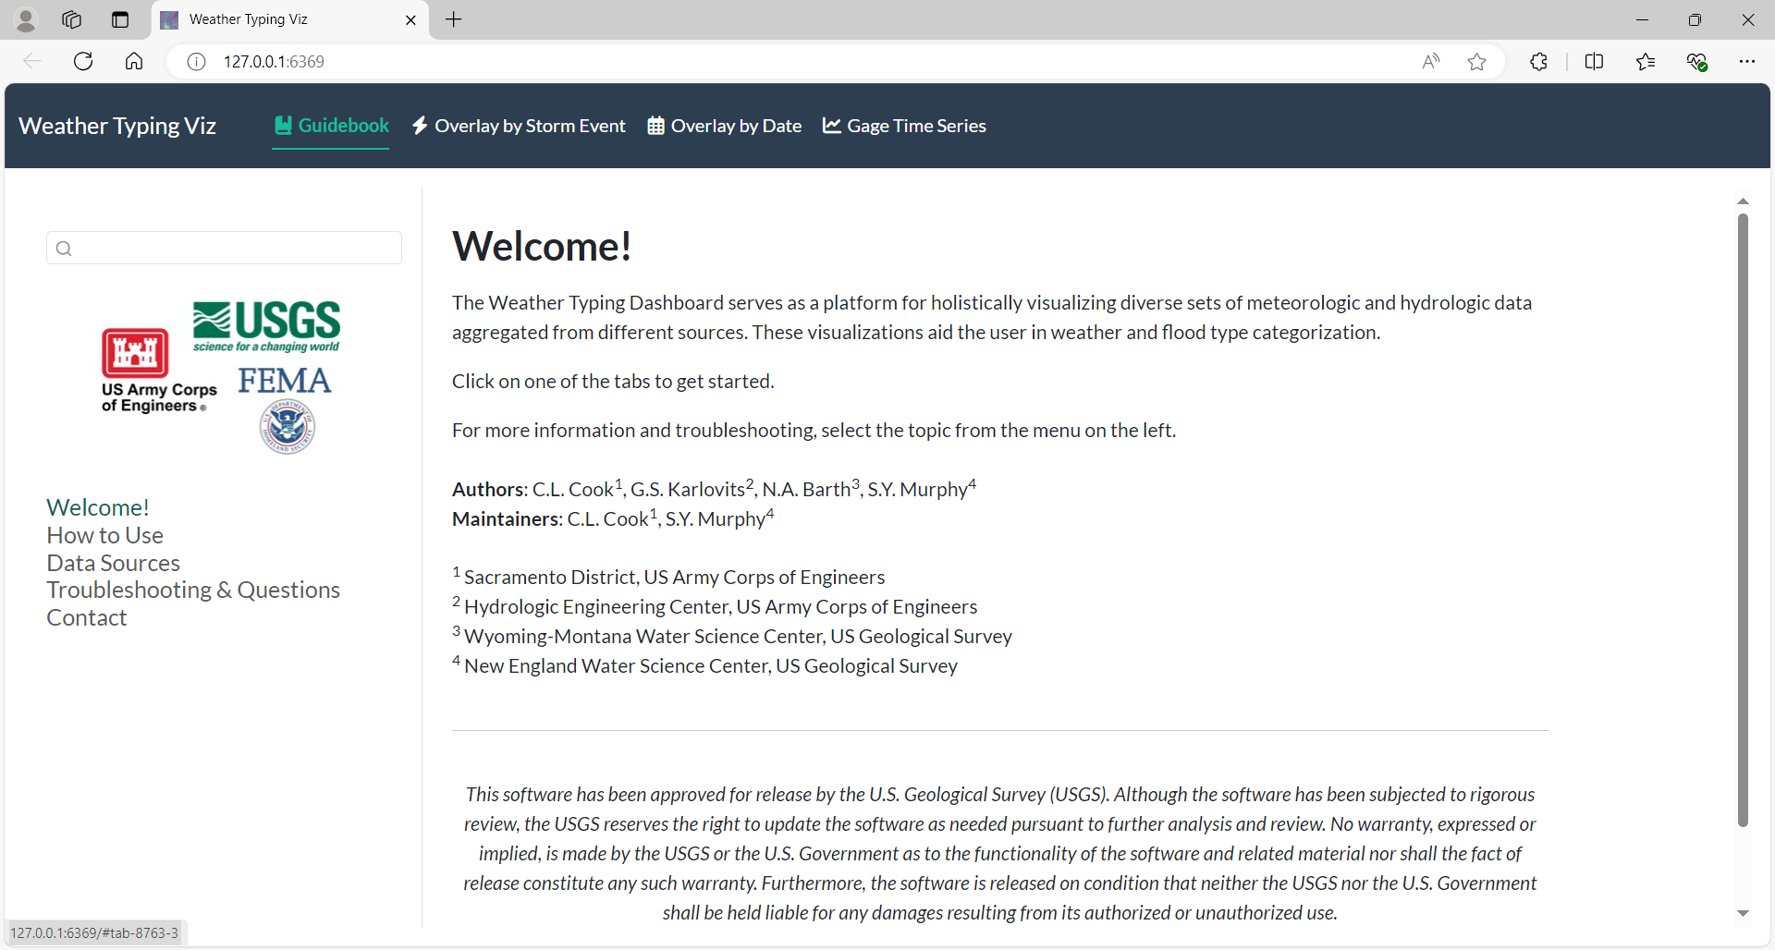

Slide 36
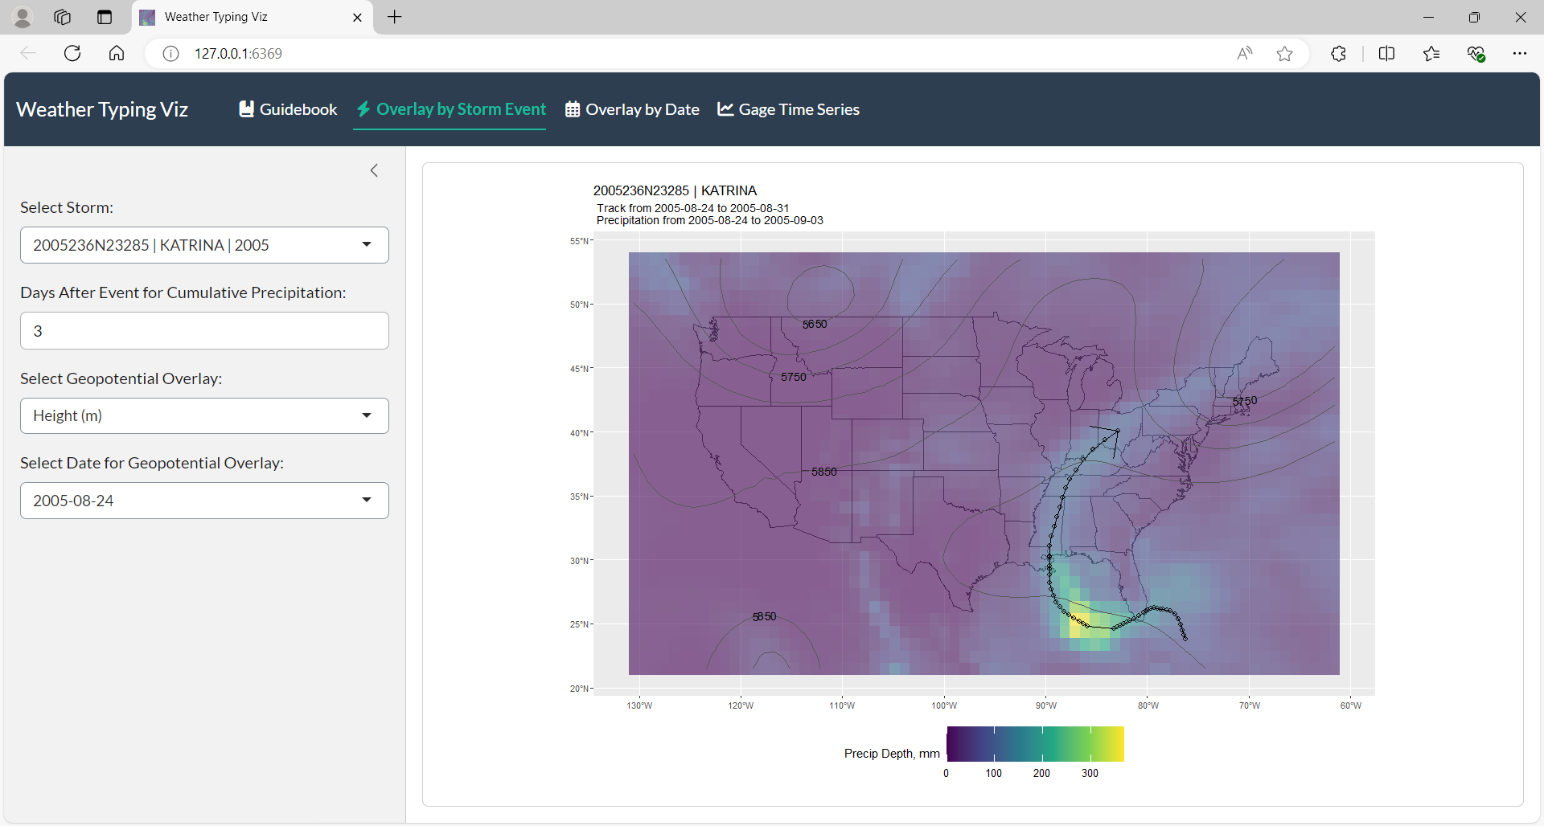

Slide 37
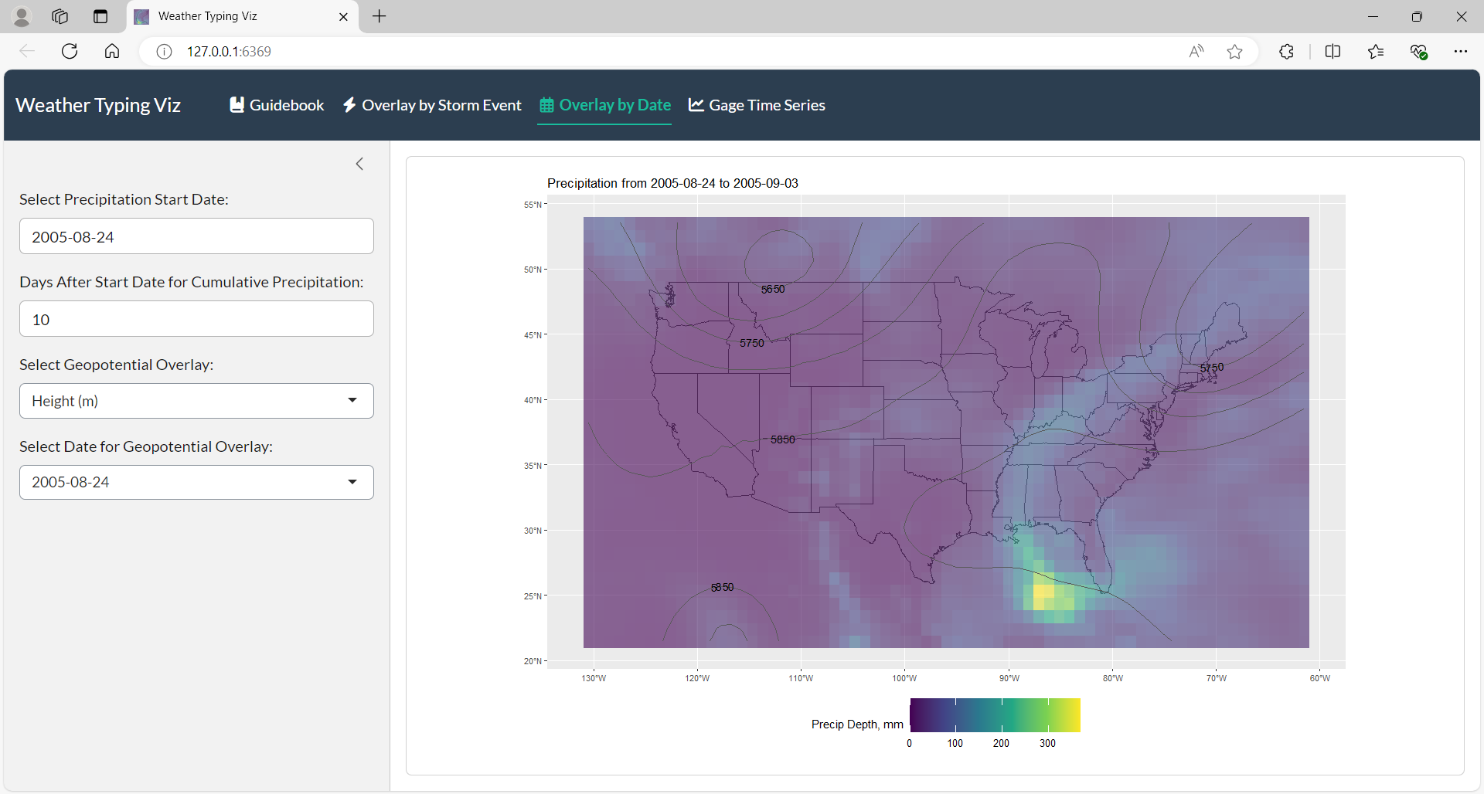

Slide 38
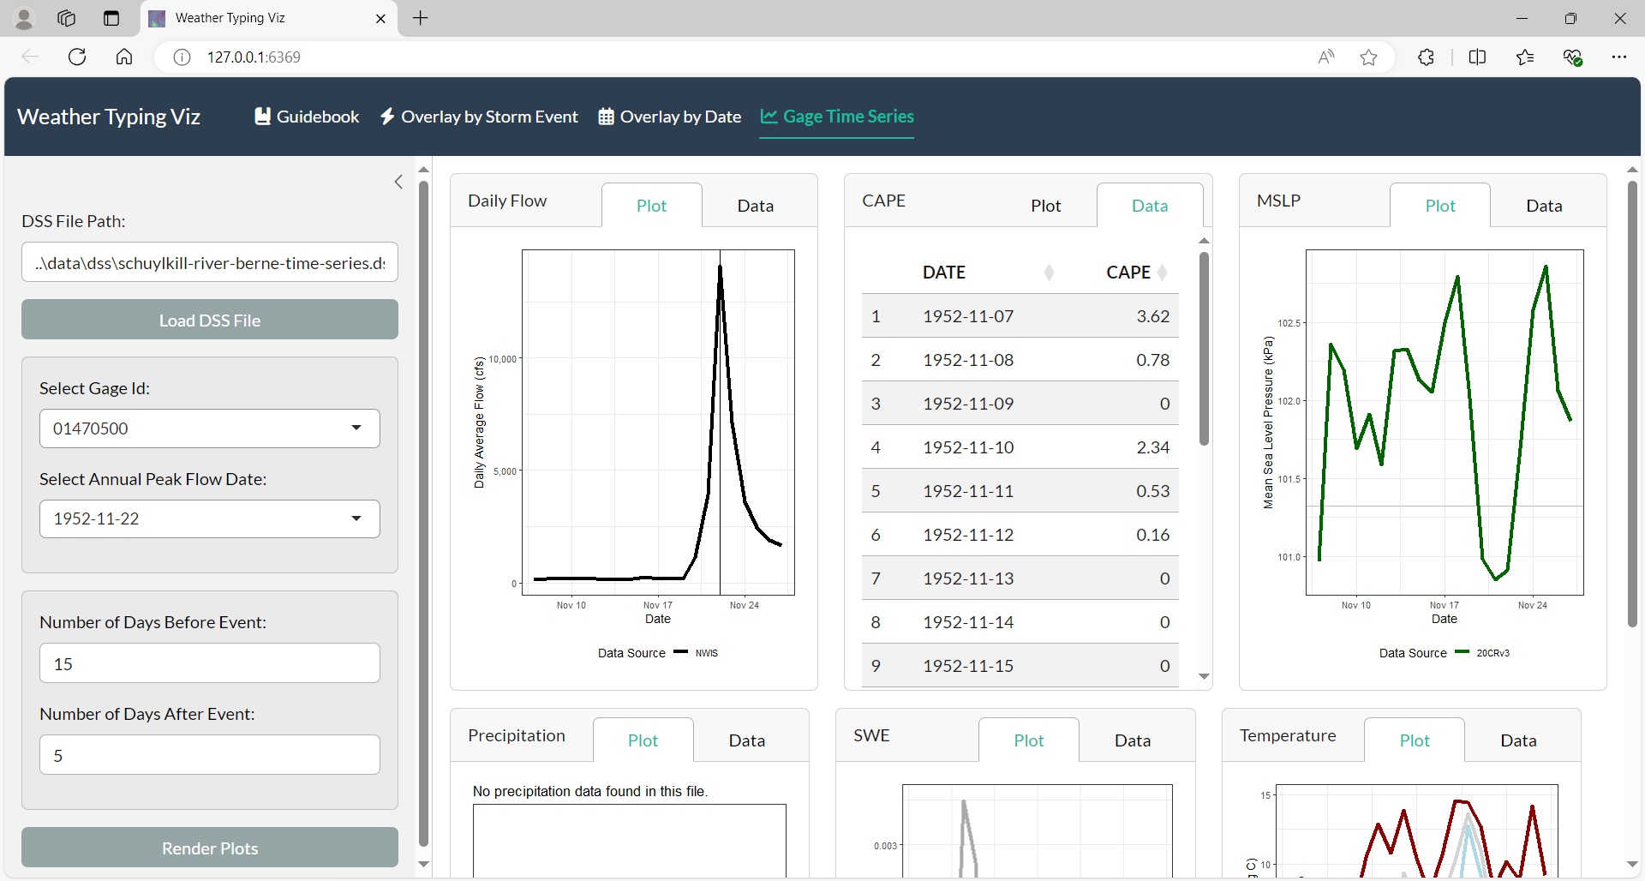

Slide 39
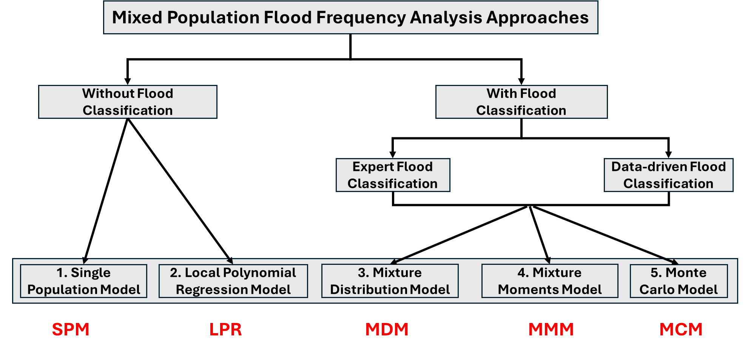

Slide 40








Data wrangling and validation
Numerous software programs and coding languages used in downloading and processing data
Work with data in various formats
Gridded vs time series
.dss, .csv, .nc, .rds, .geotiff, .shp
Data currently stored on Microsoft SharePoint and Amazon S3
Exploring long-term data storage options
Preliminary Information-Subject to Revision. Not for Citation or Distribution.

