Slide 1

Probability and Statistics Foundations
Risk-Based Analysis for Flood Risk Management Studies
Gregory Karlovits P.E., PH, CFM
USACE Hydrologic Engineering Center
Notes:
Hello everyone! I’m Greg Karlovits, from the US Army Corps of Engineers Hydrologic Engineering Center. Welcome to this course on risk-based analysis for flood risk management studies. The following series of videos is a set of 4 videos meant to provide a set of foundations for discussing and working with probability and statistics. These videos can’t replace a real college course in introductory statistics or probability theory, but they do help establish a common working knowledge base that the rest of the probability concepts in this course build off.

Slide 2

Motivation
Thing 2
Thing 1
Life is uncertain
Probability and statistics helps us make decisions under uncertainty
Notes:
We study probability and statistics because life is uncertain. Probability and statistics give us a mathematical formulation to attack uncertainty and help us make decisions. We are motivated to study these subjects to help us quantify and discuss uncertainty in a rigorous way.

Slide 3
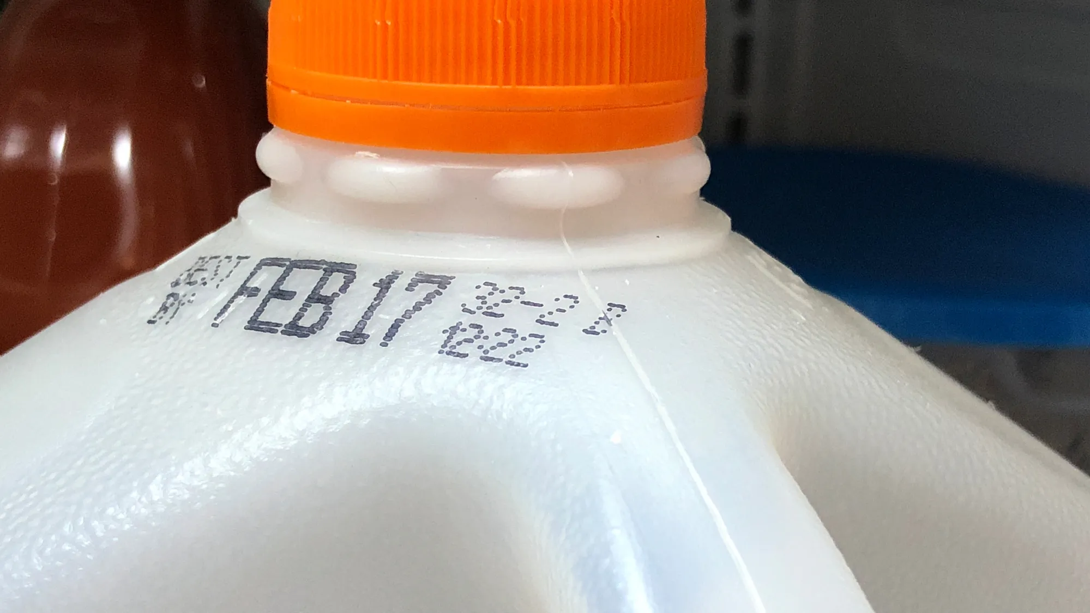
Intent
Backgrounds and freshness vary
Build a common foundation
Notes:
The intent of this lecture series is not to provide a graduate-level course covering tons of important things in statistics and probability. What this is intended to do is build a common foundation that everyone can work off in order to succeed in the rest of the course. I acknowledge that everyone’s background is different and that their freshness with statistics is certainly going to vary. The following slides should get you thinking statistically once more and get you ready for the important that follows in this class.

Slide 4
Outline
Probability and the Nature of Randomness
Events
Samples and Populations
Notes:
The lecture is broken into three sections, not counting this brief introduction.
Section 1 gets us talking the language of probability and thinking about what causes randomness.
Section 2 gives us rules for working with probability and helps us visualize random outcomes.
Section 3 helps us make sense of the data we have, and gets us thinking about where it came from.

Slide 5
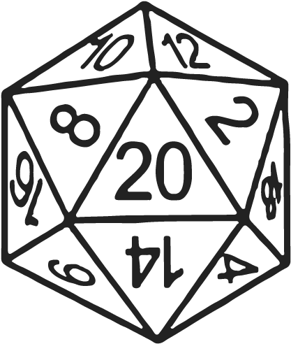
Probability and the Nature of Randomness
Risk-Based Analysis for Flood Risk Management Studies
Gregory S. Karlovits, USACE Hydrologic Engineering Center
Notes:
Welcome to section 1, in which we discuss probability and the nature of randomness. Let’s get right into it.

Slide 6
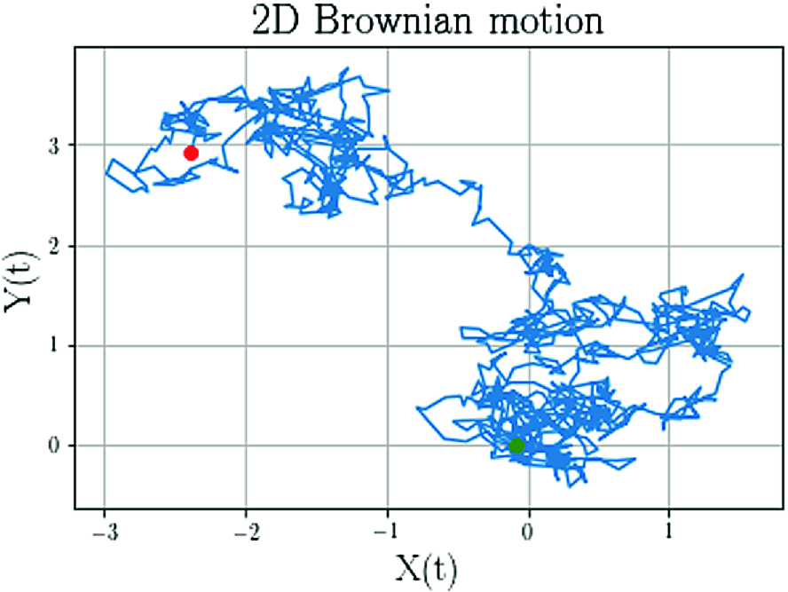
Section Outline
What is randomness?
What is probability?
Notes:
This section is going to cover, in brief, two foundational topics and establish some working definitions. The first thing to address is, what is randomness? And the second, which comes as a result of the first, is, what is probability?

Slide 7
Randomness
Unpredictable
Lack of certainty
Non-deterministic
Chaotic
Specific outcomes unknown, but patterns emerge
Notes:
What things make an outcome random? Here we are being specific about the meaning of randomness. Sometimes random is used as a synonym for arbitrary but that’s not what we’re going for here. We want to understand why an outcome we are trying to observe might be volatile, or occur in a sequence that isn’t predictable.
Anytime there is a lack of certainty on the outcome, randomness exists. The lack of certainty can be due to incomplete knowledge, or it could be due to inherent chaos in the system.
A random system is the opposite of a deterministic one. Deterministic systems are repeatable and predictable. When you do the exact same thing to a deterministic system, the outcome is the same every time. In a random system, the sequence of outcomes may be different. Each individual outcome isn’t predictable. However, when looking at a large number of outcomes, some patterns can emerge from the noise. Much of the analysis of random outcomes is an attempt to identify the pattern of behavior of a collection of these outcomes in a broad sense, instead of trying to predict the next outcome, which may be a fool’s errand.

Slide 8

Coin Flipping
Two outcomes: heads (H) and tails (T)
Outcome of next flip is unpredictable
Proportion of H/T in small number flips slightly more predictable
Proportion of H/T in huge number of flips quite predictable
Notes:
No discussion of probability would be complete without a discussion of coin flipping and dice rolling.
Looking at a coin, there are two outcomes to flipping it. If the coin is fair, then half the time it will come up heads, and the other half will come up tails. At the time of a flip, we don’t know which will come up. This implies that the flip has a random outcome.
If you flip the coin a few times, say 10 times, the proportion of heads and tails is still uncertain. But, there will be a tendency for our fair coin to start to show some of that fairness. We can still get anywhere from 0 to 10 heads in 10 flips, but getting none or 10 is pretty unlikely to happen. It’s most likely that we’ll see around 5 heads come up, since we know the coin is fair.
If we have the patience to flip the coin a huge number of times, say 10,000 times, the pattern should be very clear. The total number of heads in those trials is uncertain, but it’s very likely to be somewhere around 5,000.
These patterns emerge because these random outcomes are broad-sense predictable even if a single outcome is completely random.

Slide 9
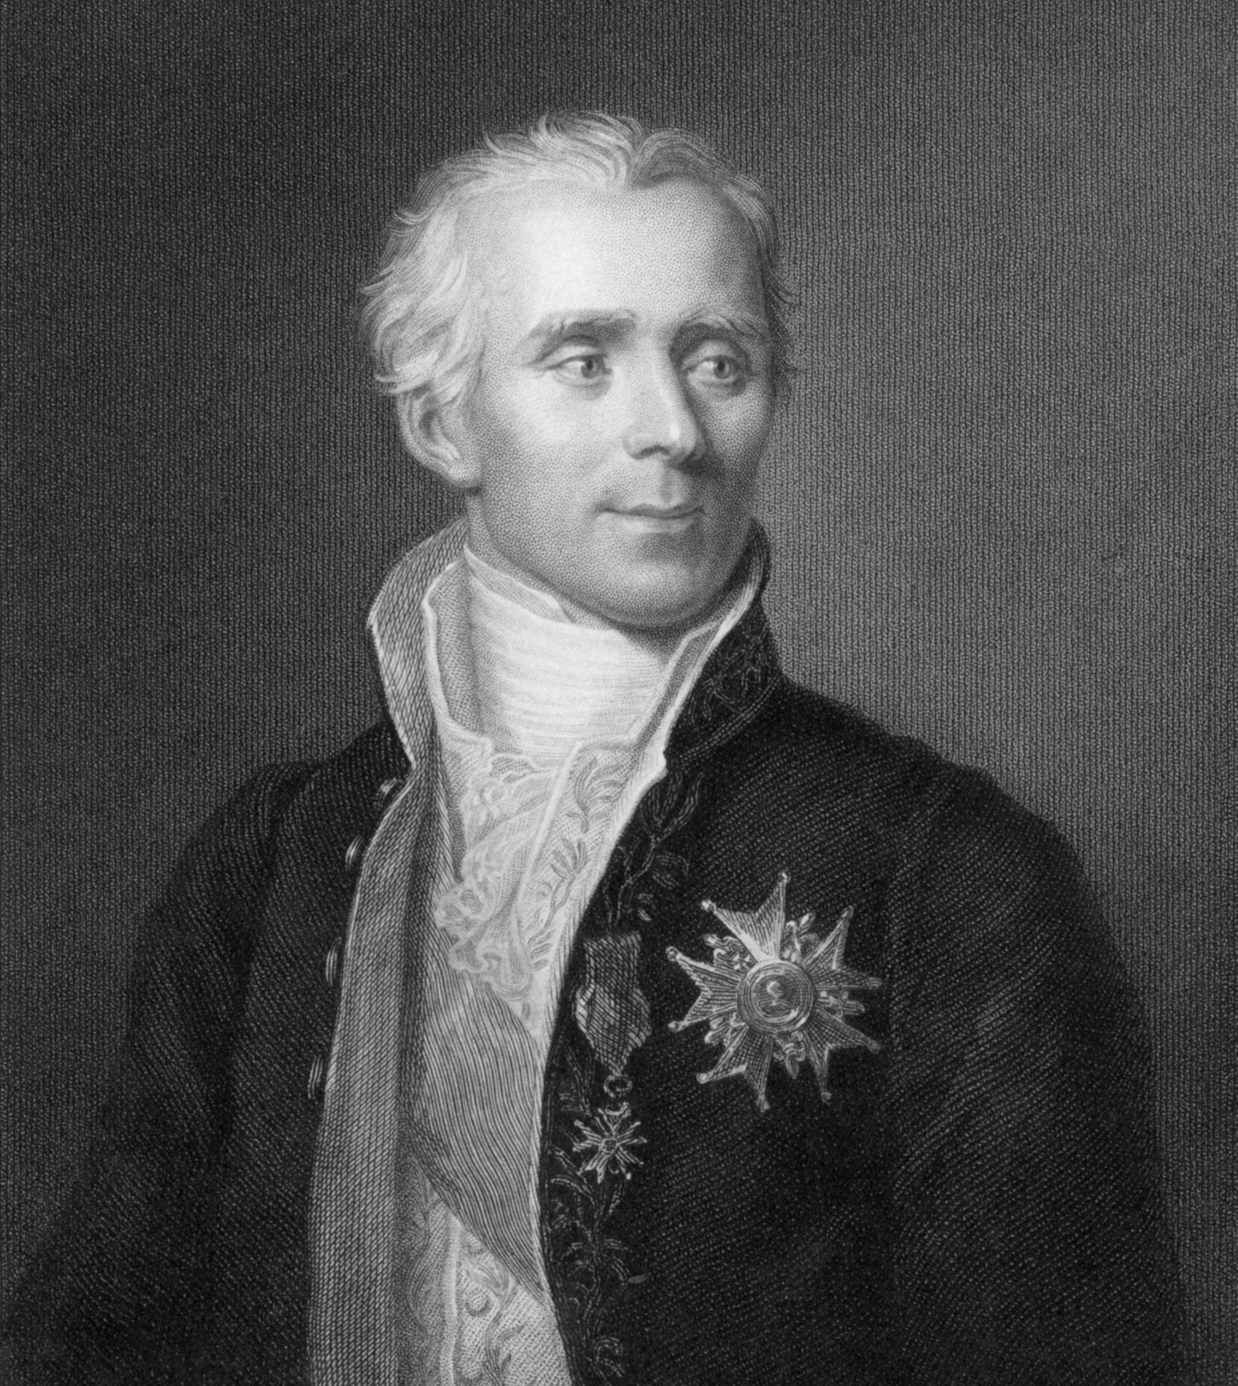
Laplace’s Demon
(x_{i}, y_{i})
m_{i}v_{i}
(x_{i}, y_{i})
m_{i}v_{i}
Notes:
So why can’t we predict the outcome of a coin flip? Certainly, with enough information, we could predict it! If you know exactly how much force was imparted to the coin at what point on its surface and at what angle, and how high above the ground the coin was flipped, and the coefficient of restitution of the floor where the coin lands, and the air density…… and I could go on but if we knew every single variable to model the physics of the coin, we could predict its outcome, right?
This idea is called causal determinism and is illustrated by a concept called Laplace’s Demon. Pierre Simon Laplace (pictured on the right) suggested that if someone (the demon) knew the precise location and momentum of every atom in the universe, that it could compute by classical mechanics all past and future values of those quantities (location and momentum).
Aside from the issues with this that arise due to thermodynamics and quantum mechanics and such, that is a limitless amount of information to consider in order to be able to treat the universe as deterministic. There’s no hard drive big enough or processor powerful enough to do all that math. Even in our coin case where the variable set is limited to a (relatively speaking, at least) small set of quantities, there are tiny influences we still fail to account for, and imperfections in the information we can consider. With all that information we might feel confident in our prediction of the coin flip, but if there is even a small lack of certainty, the coin flip is still random.

Slide 10

Sources of Uncertainty
Knowledge uncertainty “Epistemic Uncertainty”
  Sometimes reduceable by knowing more
Natural Variability “Aleatory Uncertainty”
  Outcomes are naturally random
  Too complex to ever fully understand
Notes:
If a lack of certainty implies randomness, then “uncertain” and “random” are almost synonyms. This means we can look at sources of uncertainty as causes of randomness.
There are two sources of uncertainty. The first is knowledge uncertainty – this is the uncertainty we have by not having the complete picture. We would feel more certain if we just had more data or saw more experimental trials. Knowledge uncertainty is generally thought to be reduceable by knowing more. Sometimes this type of uncertainty is referred to as “epistemic” uncertainty.
Natural variability on the other hand, cannot be reduced. These outcomes are simply by their nature random and no matter how much we observe them, we can’t narrow down their randomness. This can also arise when a system is simply too complex to understand or to model to the finest detail. Outcomes will always seem random, because we can’t account for the smallest pieces of the system to reliably predict the next outcome. They are simply subject to too much chaos. Natural variability is also sometimes called “aleatory uncertainty.”

Slide 11
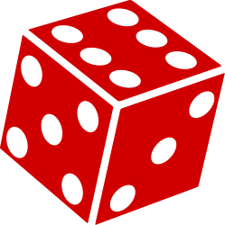



Physical Probability
Proportion of outcomes by design
Fair outcomes $→\frac{1}{n}$
Notes:
Let’s talk about an intuitive interpretation of probability called physical probability. When we flip a coin, roll a die, spin a game spinner or roulette wheel, and so on, we are creating a random outcome from a system where the chance that each outcome appears is specified by the design of the system. Most of the time we add the qualifier “fair” to these means of generating random outcomes. A fair coin is one that isn’t biased towards any particular outcome. For any coin flip the coin will either come up heads or tails. The relative likelihood of getting a heads on this flip is referred to as the probability of flipping heads. Since there are two outcomes that are equally likely on a fair coin, we get a probability of ½ for each outcome. A fair die works the same way – with six equally likely outcomes, the probability of getting any value is 1/6. The spinner for the classic kid’s game Hi-Ho Cherry-O has seven outcomes that equally split the spinner space, so the chance of landing on Bird or any other outcome is 1/7. And for American roulette wheels, there are 38 outcomes (00, and 0-36) which are equally likely, and landing in any one of the pockets has a 1/38 chance.
There are some occasions where probability simply means that a system will divide up the outcomes among several possibilities with a proportion you can determine by inspecting the system. In those situations, physical probability is useful.

Slide 12
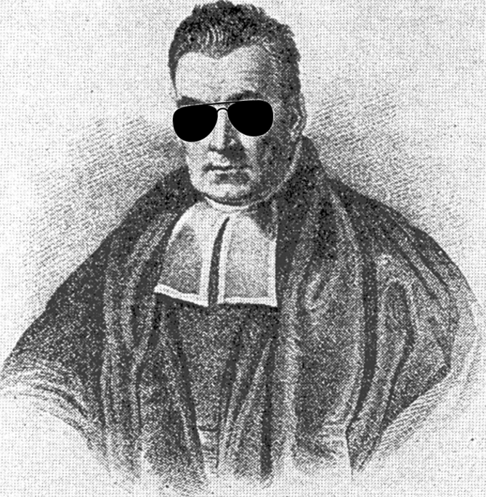


Talking About Uncertain Outcomes
Long-run probability
  $p\left(H\right)=\lim_{n→∞}{\frac{\#_{H}}{n}}$
Subjective probability
$$p\left(H\right)$$
Notes:
In our coin flip we said that the coin was “fair,” which means that heads and tails are equally likely to come up. We estimate its fairness initially by the coin’s physical properties – its shape and weight make it unbiased towards one outcome over another.
Most of our systems have probabilities that can’t be known ahead of time. This means that the physical probability definition won’t work. There are two additional definitions for probability that help us in the situations where we need a little more information in order to assess probability.
The first is the frequentist definition, which is based on the idea of long-run probability. In a sequence of coin flips approaching infinity, the number of heads divided by the number of flips is the probability of heads.
The second is the subjective definition, which is based on “reasonable expectation representing a state of knowledge or as quantification of a personal belief.” For our coin flip example, we might say “I believe the likelihood of getting a heads, on a scale of 0 to 1, with 1 representing absolute certainty, is p(H).”
While this definition doesn’t rely on an infinite sequence of coin flips, it does introduce into the calculus a reliance on personal belief or an individual’s experience. This interpretation of probability is associated with Bayesian statistics, represented by Reverend Thomas Bayes shown here on the right.
While subjective probability is very useful, this course will focus on the frequentist definition for probability.

Slide 13
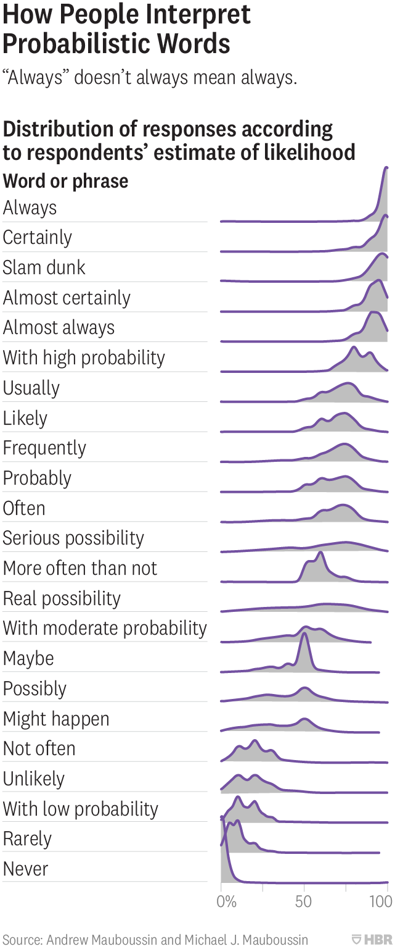
Notes:
That doesn’t mean that subjective probability isn’t valid or common. We use subjective measures of probability every day when we use probabilistic language. Here are examples of the intrinsic link between probabilistic language and likelihood. Respondents in this survey where asked how likely an outcome was, on a scale of 0-100%, based on the phrase used to describe it. For example, an event described as “always” was close to 100% likely to occur, but some respondents believe that the “always” event could have as little as 80% likelihood of occurring. Phrases like “probably”, “serious possibility”, and “real possibility”, do not elicit any sort of confidence about the likelihood of the outcome. When we use phrases like this, we encode some amount of certainty in the outcome, but the actual value of likelihood may not be clear to the speaker, the listener, or either! Whether or not we intend to, we all have aspects of subjective probability inside of us.

Slide 14
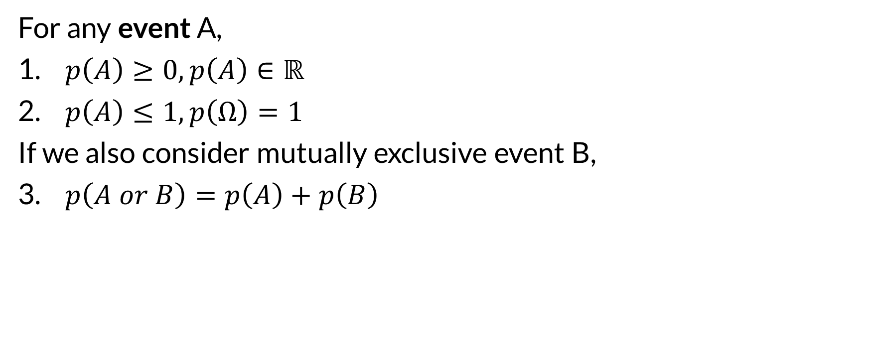

Probability Rules
For any event A,
$p\left(A\right)≥0, p\left(A\right)∈ℝ$
$p\left(A\right)≤1, p\left(Ω\right)=1$
If we also consider mutually exclusive event B,
$p\left(A or B\right)=p\left(A\right)+p\left(B\right)$
won’t happen
will happen
$$0≤p\left(A\right)≤1$$
Notes:
Regardless of how you interpret probability, these three rules – called the axioms of probability – govern how we work with probability. I will do my best to present probability topics without using set theory as much as possible.
For now, let’s use event as a synonym for outcome. If we want to assign a probability to the outcome A (for example, getting heads on a coin flip), we have to follow two rules.
First, the probability has to be a non-negative real number. It can be zero, but no negative values. It can be a decimal value, rational or irrational, but can’t be a complex number.
Second, we normalize probabilities so that they fall on the range [0, 1]. Probabilities can be equal to 1, but no greater. The probability of “something happening” is equal to one. When we get to our discussion of events in the next section, we see that this definition makes it easier for us to visualize events using a Venn diagram.
The third rule comes into play when we have more than one event to consider. If A and B are things that can’t happen at the same time, for example, getting both a heads and a tails on a coin flip, then we refer to those events as mutually exclusive. If and only if those events are mutually exclusive, then the probability of either one happening is the sum of the probability of each event. For our fair coin, the probability of getting a heads or getting a tails is equal to the probability of getting a heads plus the probability of getting a tails because these are mutually exclusive events. Since the probability of heads is ½, and the probability of tails is ½, the probability of getting either one is 1.

Slide 15
Random Variables
A numerical way of representing random outcomes
Three flavors:
  Bernoulli
  Discrete
  Continuous
Why?
  Use functions to compute the probabilities of outcomes
Notes:
Think of an equation that takes some inputs. Some of those input quantities might be uncertain, or random, and thus might take on different values. The value might change because it naturally changes, or because we don’t know enough to reliably estimate its value. The variables in that equation are random variables and have outcomes that occur with some probability.
We have already seen the first flavor of random variables. A coin flip is a Bernoulli random variable – it has two outcomes, heads and tails. In the general case, a Bernoulli random variable is a variable that can only have two states. Yes/No, Heads/Tails, and Success/Failure are three examples. We use the numbers 0 and 1 to represent the two states of a Bernoulli random variable.
The second flavor, discrete random variables, represents a collection of outcomes that are either finite, or countably infinite. The classic example is dice – a six sided die has a finite number of outcomes, specifically the integer values 1 through 6. Countable infinity is a weird concept but this can arise in random variables that can take on only integer values. They are infinite but you can count them. You’d just be counting for a really long time…
The last flavor is the one we’re generally most concerned with in water resources or economics. Continuous random variables can take on any value on an interval, including infinite intervals. When we say “any” value we mean it – the value is treated with infinite precision and theoretically carried out to decimal dust. This is because outcomes can have infinitesimal differences and still be different outcomes. In hydrology we deal with measurements of streamflow which can take on any value (sometimes including negative numbers in places where flow is reversible!)
The utility of random variables is that we can use functions to map outcomes to probabilities. In the third and fourth sections of this lecture we will discuss probability distributions which are functions that take a numerical-valued outcome and return its probability.

Slide 16
Probability and the Nature of Randomness
What is randomness?
What is probability?
Notes:
In this section we looked a brief introduction to probability and the nature of randomness. We will use this as a jumping off point in the next section to start talking about the more complex rules of probability.

Slide 17

Events
Risk-Based Analysis for Flood Risk Management Studies
Gregory S. Karlovits, USACE Hydrologic Engineering Center
Notes:
Welcome to section 2, in which we discuss events and the rules for working with probability. Let’s get right into it.

Slide 18
Section Outline
Revisiting the axioms with Venn diagrams
Mutual exclusivity and exhaustivity/partitions
Complements
General additivity
Independence
Joint, Marginal, and Conditional Probability
Notes:
The last section was a brief introduction to the concept of probability, but in this section we will gas up the heavy equipment and get excavating. First we will revisit the axioms of probability we saw in the last section and illustrate the concepts using the familiar tool of Venn diagrams. Then we will move on to a number of useful probability rules that help us define events and compute probability.

Slide 19
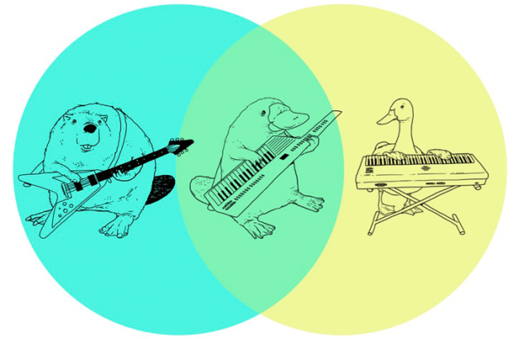
Venn Diagrams
Notes:
I’m sure folks are familiar with the general concept of Venn diagrams. We often use them to compare and contrast two things. Properties that are unique to the two things go in the outside circles, and properties common to those two things go in the overlapping portion.
Venn diagrams are useful for visualizing events as well.

Slide 20
Venn Diagrams
Ω
A
B
$$p\left(Ω\right)=1$$
$$p\left(A or B\right)=p\left(A\right)+p\left(B\right)$$
Notes:
Here is a significantly less interesting Venn diagram.
The colored circles are two events, A and B. The rectangle labeled with the omega represents all of the things that can happen. Omega is called the sample space. It is the exhaustive list of all of the things that can happen. We can use these diagrams to illustrate a number of concepts that are important for understanding events.
We discussed the three axioms of probability previously. This is an illustration that shows how two of them work.
If we set the area of each of these objects equal to their probability, this means the rectangle has an area of 1. This is because omega, our sample space, has a probability of 1 – this is the second axiom of probability. Any events we draw inside the box have to stay inside the box, they can’t be bigger than that.
This also helps us understand the third axiom, which is how probabilities can be added. We see here that events A and B have no overlap. This means they are mutually exclusive; that is, they can’t happen at the same time. As a consequence, we can compute the probability of event A or event B happening simply as the sum of their probabilities.

Slide 21
Coin Flip
Mutually exclusive and exhaustive
H
Ω
T
$$p\left(A or B\right)=p\left(A\right)+p\left(B\right)=1$$
Notes:
Returning to the outcomes of our coin flip, we know that because it’s a Bernoulli random variable that there are only two outcomes. Since something has to happen (back to our second axiom) either we get a heads or a tails, and nothing else. This means that our two outcomes fill up the sample space. A list of outcomes are called exhaustive when the list contains everything that can happen. We also know that we can’t get both a heads and a tails at the same time. This means that the outcomes are mutually exclusive, and in our diagram they have no overlap.
When a collection of outcomes are mutually exclusive and exhaustive, they are said to form a partition of the sample space.

Slide 22
Die Roll
1
Ω
2
3
4
5
6
Notes:
First off, what kind of random variable does a die roll represent, and how do you know? ….. It’s a discrete random variable, because there are a finite number of outcomes. It’s not Bernoulli because there are now more than two ways it can shake out. It’s not continuous, because we can count the number of outcomes there are. For a fair die, much like a fair coin, the outcomes are equiprobable; that is, they have the same probability.
Are rolls of a die mutually exclusive? ….. Yes they are! In one roll of a die, you can’t get both a 3 and a 5 at the same time.
Does this Venn diagram show an exhaustive listing of events? ….. Yes! The outcomes 1 through 6 are the only things that can happen, and there are no blank or empty spaces on the diagram.
Do the six outcomes represent a partition? ….. Yes again. Since the rolls are mutually exclusive, and they are exhaustive, the rolls 1 through 6 form a partition.
If this is a fair die and the outcomes are equiprobable, what does that mean the probability of rolling a 1 is? ….. It’s 1/6, because the sum of the probability of events in a partition is 1, and since they all have the same probability, it must be equally spread among the 6 outcomes.
We also know that the probability of rolling a 3 OR a 5 is equal to the probability of rolling a 3 plus the probability of rolling a 5, or 1/3, because we have the probability of two mutually exclusive events.

Slide 23
Complements
All the space in “not A”
A
Ω
A^{c}
$$p\left(A^{c}\right)=p\left(Ω\right)−p\left(A\right)=1−p\left(A\right)$$
Notes:
Complements are more than just flattery. They can make certain kinds of problems much easier.
The complement to A is written A-super-c, or A-complement. It’s any event that can occur when A doesn’t occur. In a simple case like our coin flip, the complement to heads is tails – because the only thing that can happen in “not heads” is tails. For a die roll, the complement to rolling a 1 is rolling a 2, 3, 4, 5 or a 6.
A and A-complement form a partition. This is because either A happens or it doesn’t – nothing else can happen. Also, A and not-A can’t happen at the same time.
One handy relationship results here. If you want to know the probability of A not happening is, you simply have to subtract the probability of A from 1.

Slide 24
When Events Collide – General Additivity
A and B
Ω
A
B
$$p\left(A or B\right)=p\left(A\right)+p\left(B\right)−p\left(A and B\right)$$
Notes:
Events aren’t always mutually exclusive, so if we want a general way to be able to add probabilities together, we have to deal with the overlapping area on the Venn diagram, where our platypus playing a keytar lives. Remember that the area of the rectangle labeled omega is equal to 1. The area of the events A and B are then equal to the probability of each event. When these two events overlap, we get a little lens shape in between them. The area of this space is equal to the probability of event A AND event B occurring at the same time. The equation at the bottom makes sure that we don’t double count that little lens space when we add together the probabilities.

Slide 25
Two Coins
H1
Ω
T1
Ω
H2
T2
Notes:
Let’s extend our coin flip example to the flip of two fair coins now. The figure on the left represents the outcomes from flipping our first coin, and the figure on the right represents the outcomes from our second coin. Both coins are fair, and both are Bernoulli random variables. We draw the diagrams slightly differently so that we can look at what happens when we combine the two.

Slide 26
Two Coins
H1
H2
Ω
T1
T2
$$p\left(H1 or H2\right)=p\left(H1\right)+p\left(H2\right)−p\left(H1 and H2\right)$$
Notes:
We’re going to muddy up the diagram for a second by overlaying the two. Now we see four distinct regions in here with slightly different colors. This is because in two coin flips, there are four outcomes. By flipping two coins, we’ve gone from a Bernoulli random variable to a discrete random variable for our outcomes. Looking at the diagram we get HH, TH, HT, and TT.
If we wanted to compute the probability of flipping two coins and getting a heads on either one, we can use our general adding rule. We know the probability of a heads on both coins is ½, but now since we can have overlapping events, we have to account for that overlap. The trick is in computing that right hand quantity – what is the probability of getting a heads on both the first and second coin?

Slide 27
Two Coins
Ω
HH
TH
HT
TT
$$p\left(H1 and H2\right)=p\left(H1\right)∗p(H2)$$
$$p\left(H1 or H2\right)=p\left(H1\right)+p\left(H2\right)−p\left(H1\right)∗p(H2)$$
Only because H1 and H2 are independent!
Notes:
Let’s rearrange the diagram a little bit so that the four outcomes that can result from the two coin flip are clear. Here we label the rectangle in the upper left HH because the first and the second coin were both heads, the upper right is TH because the first was tails and the second heads, and so on.
We can see how the four flips create a partition of the sample space. For both coins, heads and tails are equiprobable. So that means the width of these rectangles, which comes from the probability of getting heads or tails on the first flip, is equal to ½. The height of the rectangles works the same way – we get it from the probability of getting heads or tails on the second flip, and is also equal to ½. This means that the area of all four of these outcomes is ¼. Plugging that back into our previous equation, we find that the probability of getting a heads on either coin is 0.5 + 0.5 – 0.25 = 0.75.
We can solve this using complementation as well. Of the four equiprobable outcomes that are up there, only one doesn’t contain at least one heads – the lower right, which is TT. This means that the probability of getting at least one heads is equal to 1 minus the probability of getting no heads, which is the probability of outcome TT. This is 1 minus ¼, or 0.75.
There is an important hitch – in order for this to work, the events we’re considering have to be independent. The outcome of our first coin flip has no bearing on our second coin flip. If for example flipping a heads on our first coin made it more likely to get a heads on our second coin, these flips would NOT be independent, and these equations wouldn’t work! In our situation, when you flip the first coin, no matter what it comes up as, the second coin still has a 50-50 shot at coming up heads.

Slide 28

Independence
Joint probability of A and B
$$p\left(A and B\right)=p\left(A\right)∗p\left(B\right)$$
  iff $A⏊B$
Marginal probability of B
Marginal probability of A
Notes:
Here’s the lowdown on independence. If and only if events A and B are independent (written sometimes as A perpendicular to B) then the probability of A and B occurring is equal to the product of their individual probabilities. This statement is reversible. If the probability of A and B jointly occurring is equal to the product of their probabilities, then A and B are independent.
While we’re at it let’s add a couple important definitions. When we see the probability of A And B written, this is also called the joint probability of A and B. Anytime we talk about a variable without any other condition or information, such as the statements p(A) or p(B) in the equation here, this is referred to as the marginal probability of A or marginal probability of B. We will illustrate these next.

Slide 29
Marginal Probability
What is the probability of A occurring irrespective of what happens with B?
Ω
A
B
Notes:
This is an illustration of marginal probability on the Venn diagram. We ask the question, what is the probability of A occurring irrespective of what happens with B? This probability is the area of the red circle. Most of the time when we’re talking about the probability of some event, we’re just dealing with the simple case of marginal probability.

Slide 30

Joint Probability
What is the probability of A and B occurring together?
$$p\left(A and B\right)$$
Ω
Ω
A
A
B
B
Notes:
Now imagine that we’re concerned with the region that belongs in both A and B, so that both things have to happen. Here are a couple of interesting cases.
On the left we have two overlapping events. The probability of A and B happening at the same time is the area of that red lens in the overlap. Notice how it is smaller than the marginal probability of either A or B.
On the right we have total overlap of A and B – there is no way for B to happen if A doesn’t happen. The joint probability is then equal to the probability of the smaller of the two events, so in this case the joint probability is equal to the probability of B. This is important – remember that anytime you add variables to a joint probability statement, the joint probability can be AT LARGEST the probability of the least probable event.
Let’s look at this another way, if B happens, A is certain to happen. We can rephrase that and say that “given that B has occurred, A is certain to occur.” This is because there is no part of B outside of A: if B occurs, then A has to as well.
The statement we made: “given that B has occurred“ is a statement of conditional probability. Conditional and joint probability are tightly linked.

Slide 31

Conditional Probability
Given that B has occurred, what is the probability that A occurs?
Once we have observed that B has occurred, it becomes our “universe”
$$p\left(A | B\right)$$
A
B
Ω
A^{c}
B
A
Notes:
Conditional probability is extremely useful in statistics. Conditioning adds information. This is because we start with a statement of knowledge, generally saying “given that…” In our diagram here, we know that B has already occurred. This means that we only have to look at what happens inside of event B. We go from the diagram on the left to the one on the right. Inside of B are two events – A (which is the part that overlaps with the other circle) and A-complement, all of B that is not also in A.
The rectangles are the same size for these two figures. Notice how the area for A in red is larger than it was before – the conditional probability of A occurring, given that B has occurred, is larger than the marginal probability of A occurring. We write the conditional probability of A given B has occurred as p of A pipe B.

Slide 32

Conditional and Joint Probability
A
B
A^{c}
$$p\left(A | B\right)=\frac{p\left(A and B\right)}{p\left(B\right)}$$
  if A $⏊$ B,
  $p\left(A | B\right)=\frac{p\left(A\right)∗p\left(B\right)}{p\left(B\right)}=p\left(A\right)$
Notes:
Remember how I said conditional and joint probability are tightly linked? Their definitions are closely related. The first line gives us the means for going between conditional and joint probability of some events. This statement can be shown by the second figure from the last slide. The area of the large rectangle is equal to p(B). The rectangle B is split into two parts – the red part is the area corresponding to where A and B both occur, and the blue are is where A-complement and B both occur. This means that the area of that red rectangle represents p(A and B). Dividing that area by the area of rectangle B gives us p(A|B).
In the case where events A and B are independent, we know that the probability of A and B is equal to the product of the marginal probabilities. This leads to p(B) completely dropping out of the formula – the result is that p(A|B) is equal to p(A). What does that mean? It means that conditioning on the occurrence of B does not add any new information! Just as we said in our definition for independence, the probability of A occurring is the same regardless of what happens with B.

Slide 33

Total Probability
$P\left(B\right)=P\left(B | A\right)P\left(A\right)+P\left(B | A^{c}\right)P\left(A^{c}\right)$
  A + A^{c} forms a partition of sample space
  B can be in A, A^{c} or both (but nothing else).
A^{c}
A
B
Ω
Notes:
The Law of Total Probability, also called the Total Probability Theorem, used to play an important role in US Army Corps of Engineers guidance when doing coincident frequency analysis. It is still applied when doing these analyses, but many coincident frequency analyses have been simplified by using newer simulation techniques.
Total Probability is a way to compute the probability of an event when it might only be measurable piecewise. In this case, we are interested in the probability of event B. It can be computed by looking at how much of B is inside of A, and how much of it is outside of A, and taking a weighted average of the two. We compute the total probability of B as the probability of B given A times the probability of A, plus the probability of B given A complement times the probability of A complement.
Next I’ll show an example that illustrates this important formula.

Slide 34

Total Probability Example
I have two bags that each contain 100 marbles. In the first I have 75 red and 25 blue marbles. In the second I have 60 red and 40 blue marbles. I choose one of the bags at random (with equal probability) and then pick a marble from that bag. What is the probability that I choose a red marble?
0.75
0.6
$$p\left(red\right)=0.75∗0.5+0.6∗0.5$$
$$p\left(red\right)=0.675$$
0.5
0.5
Notes:
I have two bags that each contain 100 marbles. In the first I have 75 red and 25 blue marbles. In the second I have 60 red and 40 blue marbles. I choose one of the bags at random (with equal probability) and then pick a marble from that bag. What is the probability that I choose a red marble?
You have a 75% chance of picking a red marble given you select the first bag. You have a 60% chance of selecting a red marble if you pick the second bag. The chance of picking either bag is 0.5. This means that the probability of picking a red marble is the simple average of the two probabilities, with the result being 0.675.

Slide 35
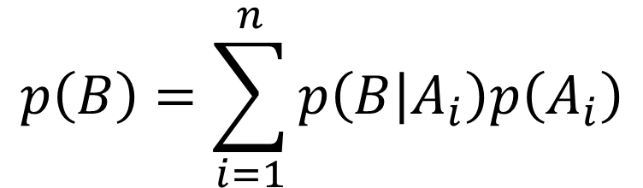
Total Probability
$$p\left(B\right)=\sum_{i=1}^{n}{p\left(B | A_{i}\right)p\left(A_{i}\right)}$$
A₁
A₂
A₃
A₄
B
Ω
Notes:
The equation extends to any number of subcases that build our example. As long as the A parts form a partition, we can compute p(B) from any number of subcases. This is the form that you will generally see in USACE guidance. This can also be used to compute the probability of some third event C, which is a function of A and B.

Slide 36

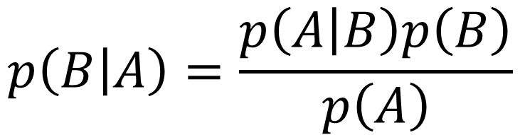
Bayes’ Theorem
$p\left(A | B\right)≠p\left(B | A\right)$ unless $p\left(A\right)=p\left(B\right)$
Reversible using Bayes’ Theorem
$$p\left(B | A\right)=\frac{p\left(A | B\right)p\left(B\right)}{p\left(A\right)}$$
Notes:
Conditional probabilities aren’t reversible – that is, p(A|B) doesn’t equal p(B|A) unless the marginal probabilities are equal. In order to reverse the condition it requires Bayes’ Theorem.
There are a lot of uses for Bayes’ Theorem. This equation established an entire field of statistics called Bayesian Statistics which is only starting to gain traction in the hydrologic sciences.

Slide 37

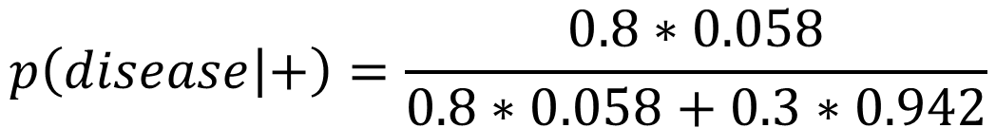
Bayes’ Theorem Example
How likely am I to have a disease, given a positive test for that result?
Sensitivity = 80%, specificity = 70%, prevalence = 5.8%.
$$p\left(disease | +\right)=\frac{p\left(+ | disease\right)p\left(disease\right)}{p\left(+ | disease\right)p\left(disease\right)+p\left(+ | no disease\right)p\left(no disease\right)}$$
$$p\left(disease | +\right)=\frac{0.8∗0.058}{0.8∗0.058+0.3∗0.942}$$
$$p\left(disease | +\right)=0.14$$
Notes:
Let’s try an example. Imagine there is a medical test that detects a specific disease. We label a positive test with the plus sign, and note the situations where the disease is or is not present with “disease” or “no disease.”
The sensitivity of the test, which defines the probability of finding the disease when it is present, is p(+|disease) and is equal to 80%.
The specificity of the test, which defines the probability of getting a negative result when there is no disease, is p(-|no disease) and is equal to 70%. To plug this term into our equation we will need the false-positive rate p(+|no disease) which is the complement of the specificity, and is 30%.
The prevalence of the disease, which defines the fraction of the population that has the disease, is p(disease), and is equal to 5.8%. We will also need the complement to this term p(no disease), which is 94.2%.
First, I am going to re-write Bayes’ Theorem expanding out the denominator using the Law of Total Probability. This will let us put our sensitivity and specificity into the equation correctly. The entire term in the denominator is just taking the marginal probability of getting a positive test, which isn’t easily known, and translating it into things we know. It comes from properties of the test, and the base rate of the disease. In this format, the math is very straightforward.
The numerator is the sensitivity times the prevalence. The denominator is the sum of the sensitivity times the prevalence and the false positive rate times the rate of no disease.
What we see is that despite a positive test in this case, the probability of having the disease is still quite small. This is because the overall probability of having the disease in the general population is quite small. Ignoring the small disease prevalence is a phenomenon called the base rate fallacy and is important to be aware of.

Slide 38
Events
Revisiting the axioms with Venn diagrams
Mutual exclusivity and exhaustivity/partitions
Complements
General additivity
Independence
Joint, Marginal, and Conditional Probability
Notes:
Alright, we got through the heavy machinery of probability. Hopefully after that you feel more comfortable with working with various kinds of events, and computing probability of events described in a number of ways. A number of these tools will be referenced later in this lecture, so if you need to go back and re-watch some of these concepts, it may be worth your time.

Slide 39
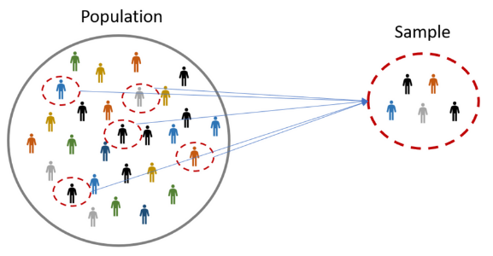
Samples and Populations
Risk-Based Analysis for Flood Risk Management Studies
Gregory S. Karlovits, USACE Hydrologic Engineering Center
Notes:
Welcome to section 3, in which we discuss samples and their relationship with populations. Let’s get right into it.

Slide 40
Section Outline
Populations vs. Samples
Inference
Estimating probability from data
Sample statistics
Inference Revisited
Notes:
In this section we will highlight the difference between treatment of a sample and a population. We will introduce the important concept of inference, and how it links samples and populations together. We will discuss estimation of probability from sample data, as well as summarizing datasets using summary statistics. And finally we will return to inference so that we can jump into our fourth and final section of the lecture.

Slide 41
Populations vs. Samples
Population
Sample
Entire group you want to draw conclusions about
May be unknowable
Parameter
Example: all annual maximum flows on the Mississippi River at Vicksburg
Part or subset of the population
Data you have or can collect
Statistic
Example: annual maximum flow observations on USGS/NWIS
Notes:
The distinction between populations and samples is crucial. Often, samples are what you have, and populations are what you want to know. The population is the entire group that you want to answer questions about. However, it may be unknowable. What you are often doing is taking a sample, which is a part or a subset of that population, and using the statistics of that sample to estimate quantities in the population, which are called parameters. An example of the difference is on the Mississippi River at Vicksburg, Mississippi. There exists some population of all annual maximum flows on the Miss at Vicksburg, but it’s an unknowable collection of flows because we can’t observe it forever. We only have a sample of annual maximum flows through the national water information system hosted by the USGS. Even though we want to answer questions about all the annual maximum flows, we only have a limited sample to work with.

Slide 42
Inference
We want to know it all
Limited by the data we have
Use data to make inferences
Population
Observation
Sample
Inference
Notes:
Inference is the art of making predictions about a population using a sample taken from that population. We want to know it all but we are limited by the data we have. Our sample is made up of representative observations of our population being studied. What we have to do is use that data to answer questions about the population. This process of asking and answering questions about the population is known as inference.

Slide 43
Inference
What is the probability that the largest flow on this river in a year is greater than 12,000 cfs?
Easy if we know what every single annual maximum flow is
Harder if we only have a limited sample
Notes:
The probability of an annual maximum flow over 12,000 cfs is a population parameter. The problem is, we can’t see every single annual maximum flow that has happened or will ever happen, so we can’t wrap our arms around the population. It would be easy to count all the flows over 12,000 cfs and divide by the total number of flows to get the probability of a flow over 12,000. However we might only have a small collection of observations because, for example, the USGS stream gage was only installed 35 years ago.

Slide 44
Less than 12,000 cfs
Greater than 12,000 cfs
25
10
Notes:
In the case where our data are limited, we can take the data we have and try to make an inference about the population. In our example we said a gage had been observing annual maximum flows on the river in question for 35 years. We can take our sample and split it – take each year that had a flow less than 12,000 cfs and put it in the bucket on the left, and take the ones greater than 12,000 cfs and put them on the right. When we do that we find there are 25 years less than, and 10 years greater than. This means in our sample, we saw that 10 out of 35 years, or about 29% of flows were greater than 12,000 cfs. Remembering our definition for probability, we recall that successes divided by the total number of trials gives us an estimate for probability. Therefore, we estimate the probability of a flow greater than 12,000 cfs being about 0.29.
We used our sample of 35 flows to make an inference about a population parameter, the probability of a flow greater than 12,000 cfs, and inferred that the population value is about 0.29.

Slide 45
Assumptions
Ω
Sample is representative
Observations are IID
  Independent
  Identically-Distributed
S
Notes:
Of course in our inference, we are making a few assumptions. The most important one is that the sample we have is representative of the population. In some circumstances it can be difficult to ascertain whether the sample is representative or not because the population is completely unknowable. For surveys, where people are polled for their opinions, the sample can be checked for representation by comparing the demographics of the respondents in the sample to the general population demographics to see how representative a sample is. For streamflow, if we have a limited record of flows, we would have to look at other variables such as climate to tell us if the period containing our sample is a good representation of the entire population.
The other major assumptions fall under the “I-ID” acronym. These assumptions have to do with the way that the observations that make up the sample were taken. We want the observations to be independent of one another – that is, that they are not dependent on each other in some way. We also want them to be identically-distributed, which is similar in nature to the representative sample assumption. Think of identical distribution as the assumption that the samples are coming from the same population.

Slide 46
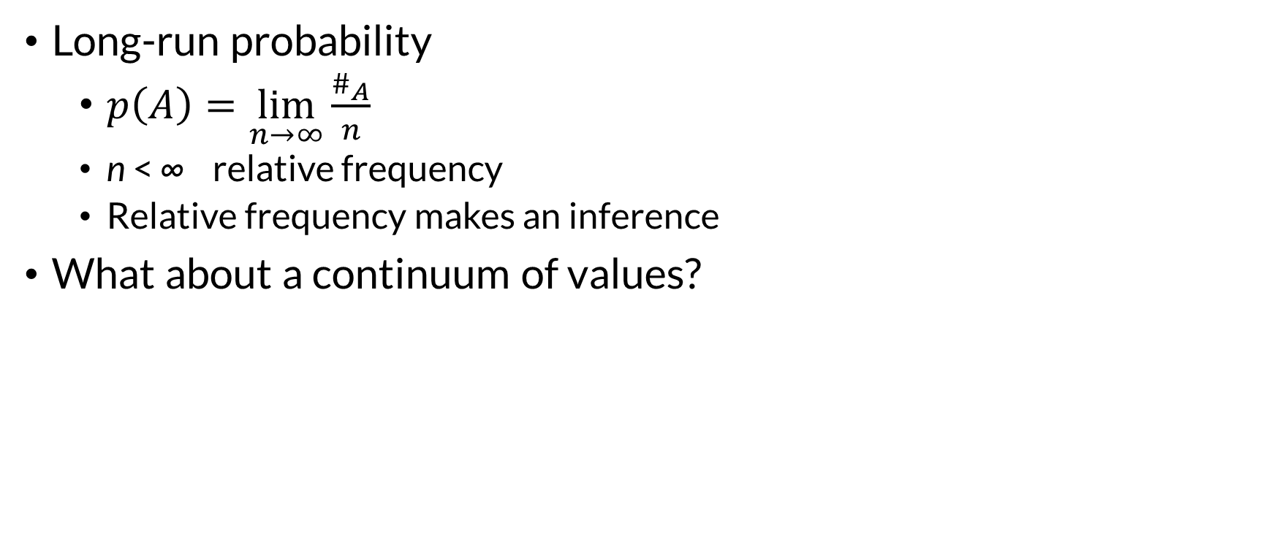
Estimating Probability from Data
Long-run probability
  $p\left(A\right)=\lim_{n→∞}{\frac{\#_{A}}{n}}$
  n < ∞ relative frequency
  Relative frequency makes an inference
What about a continuum of values?
Notes:
We rely on the definition for long-run probability to estimate probabilities from our sample data. However, this definition is dependent on a limit – that the sample size approaches infinity. In dealing with finite samples, we refer to the proportion of successes to trials as the relative frequency. It might also be called a sample proportion. Using the relative frequency to estimate the probability of an event is an example of making an inference about the unknowable population.
So far we have looked at Bernoulli random variables – an event either happens or it doesn’t, or as in our coin flips, heads and tails. Most of the time we’re not interested things that are this simple. Our random variables can often take on a larger number of values than just “yes/no” or “heads/tails.” A die roll is a simple extension of this idea.
A fair six-sided die when rolled will produce an integer value between 1 and 6. Each roll of the die is independent of the last, and we can roll a die as much as we like.

Slide 47
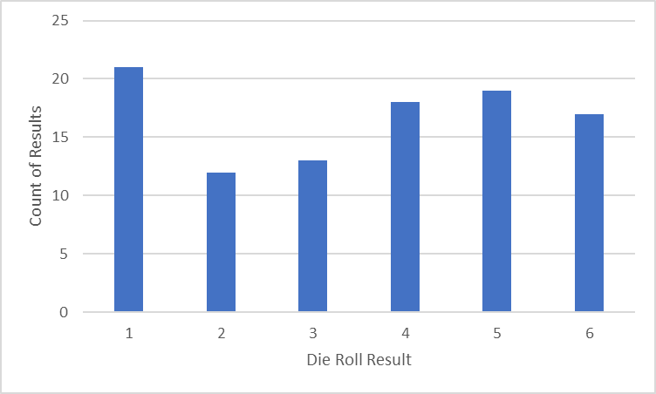
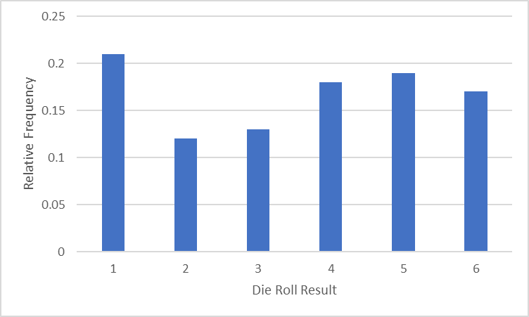
Relative Frequency
Notes:
So let’s roll a die 100 times, and tally up the number of times each face comes up. We record those outcomes in a histogram, with the height of the bar corresponding to how many times each face, 1 through 6, comes up. You can tell from the chart that 1 came up the most often and 2 came up the least. If you total up the height of the bars it will come to 100 which is our sample size.
If we want to know the relative frequency of each face, we can take the height of each bar, and divide it by our sample size of 100. On the right side, we see the scale of the bars changes where we have computed relative frequency, but the relative heights of the bars are the same.
The histogram on the right side shows the proportion of each of our outcomes in a sample. It describes how each of the outcomes is distributed within the sample. For example just over 20% of the outcomes were 1, just over 10% of the outcomes were 2, and so on.

Slide 48
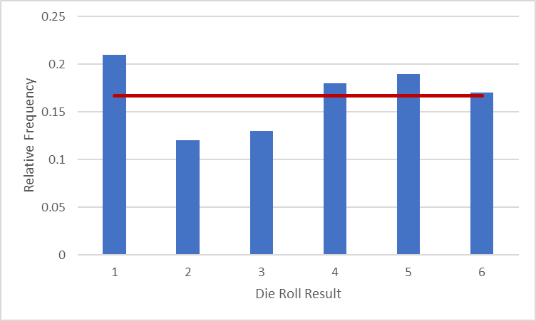
What Should We Expect?
Based on the physics of a fair die, each face = 1/6 = 0.166…
Notes:
The blue bars are the relative frequency for each of the outcomes, 1 through 6, from 100 rolls of a die. We know from physics that a fair die produces each of the outcomes with a probability of 1/6. This value is shown as the red line on the plot.
In our 100 rolls, we notice that each outcome does not occur exactly 16.6 percent of the time. In our sample, the proportion of 6s is pretty close, but 1, 2, and 3 are not as close. This discrepancy between what we expect, which is the true value, and what we got, which is the sample value, is called the sample error.

Slide 49

Why Does It Vary?
Long-run probability
  $p\left(A\right)=\lim_{n→∞}{\frac{\#_{A}}{n}}$
Smaller n, bigger sample error
Bigger sample error, less confidence in inference
Notes:
Why do our sample values vary compared to the true value?
Recall our definition for long-run probability. In a sample, we run a number of trials, which is n. In all of those trials, we count up the number of times our event A happens. Then, we divide the count of the occurrences of A by the sample size n.
Long-run probability assumes that we will get to the true value in a sample with a size that approaches infinity. When we have a small sample, we haven’t done enough to shake out the small random variations that cause the discrepancy between the sample and the true value. The smaller our sample size, the larger our sample error is. The larger the sample error, the less confidence we have when we make an inference about a population from our sample.

Slide 50
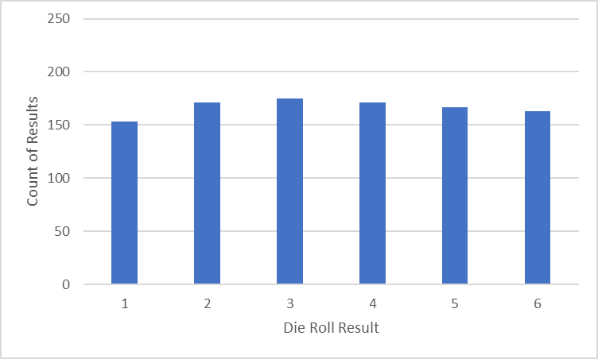
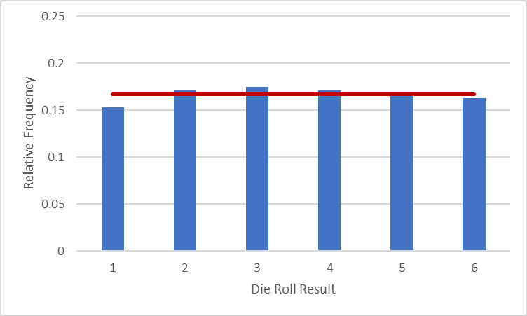
More Rolls (1,000)
Notes:
Let’s beef up the experiment a little bit. Here is a count histogram and a relative frequency histogram of 1,000 rolls of a fair six-sided die. Notice how the variability in the counts is still present, but visibly smaller than in the 100 rolls case. On the right side we see that the relative frequencies of the outcomes are all closer to our expected proportion of 1/6.

Slide 51
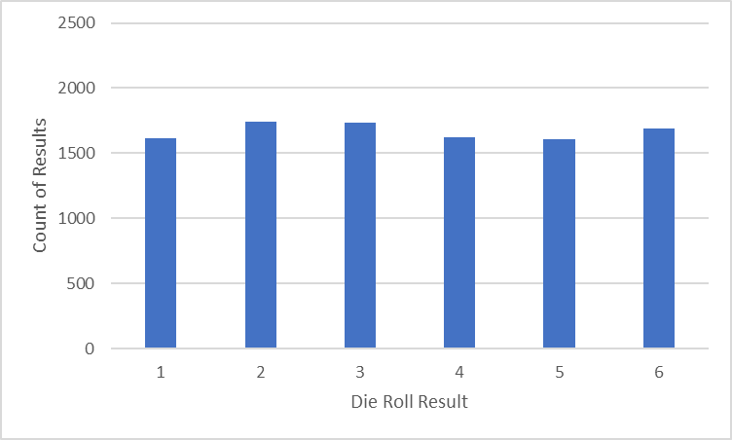
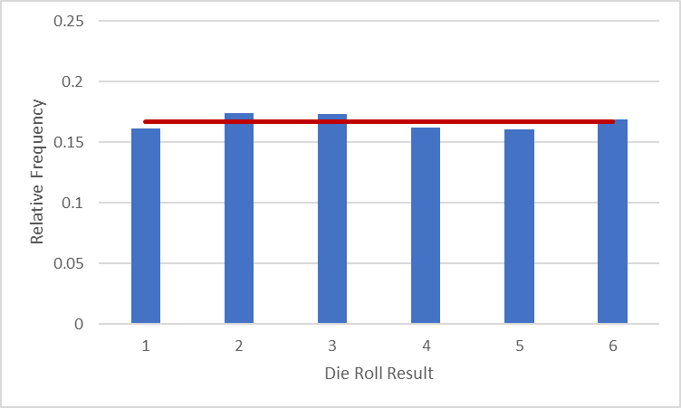
Even More Rolls (10,000)
Notes:
We continue on to 10,000 rolls of the same fair six-sided die. Luckily I don’t have to actually roll the die, and I can use computers to simulate the process. Here we see the counts on the left side, and the proportions on the right side, again with our 1/6 target drawn as a red line. Even at 10,000 rolls there’s still some variation, but it’s smaller than the 1,000 rolls histogram and much smaller than the 100 rolls histogram.

Slide 52
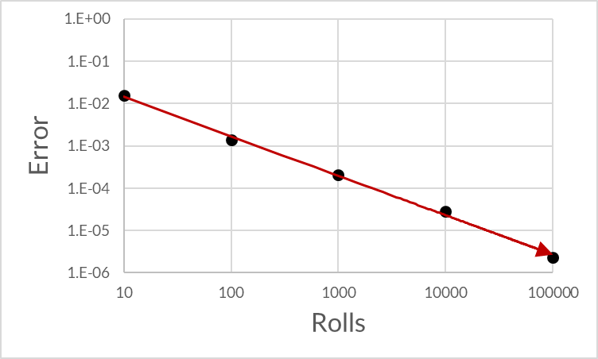
Quality of Estimate
Sample error reduces with larger sample size
Notes:
What these repeated experiments show us is that the quality of our estimate for the population distribution of values is dependent on how big our sample is. The sample error we have is expected to decrease as we have more and more samples. The plot here shows a measure of error for a series of experiments, starting with 10 rolls and going up to 100,000 rolls. The actual value of the error is unimportant; what is important is that we see that the error in estimating the proportion of outcomes decreases with increasing sample size, just as we would expect.

Slide 53
Cumulative Frequency
Relative Frequency
Cumulative Relative Frequency
Proportion of trials getting exactly the value
Estimates p(X = x)
Example:
Relative frequency of rolling a 4
Proportion of trials getting less than or equal to the value
Estimates p(X ≤ x)
Example:
Relative frequency of rolling a 4 or less
Notes:
Cumulative frequency is another way of expressing event outcomes. We build cumulative relative frequency from our typical estimates of relative frequency. While relative frequency expresses the proportion of trials that turn up exactly some value, cumulative frequency expresses the proportion of trials that turn up some specified value, or less. Relative frequency is used to estimate the population probability that a random variable takes on some specified value, which is written in this way: p of big X = little x. Cumulative relative frequency is used to estimate the probability that a random variable takes on a value that is less than or equal to a specified value, written as p of big X less than or equal to little x. The well-trod example of relative frequency is the number of times you roll a 4 out of the total number of rolls you make. A similar example for cumulative relative frequency is the proportion of rolls that are 4 or less, out of the total number of rolls you make. For dice, this means the proportion of times you roll a 1, 2, 3 or 4, out of the total number of rolls you make.

Slide 54
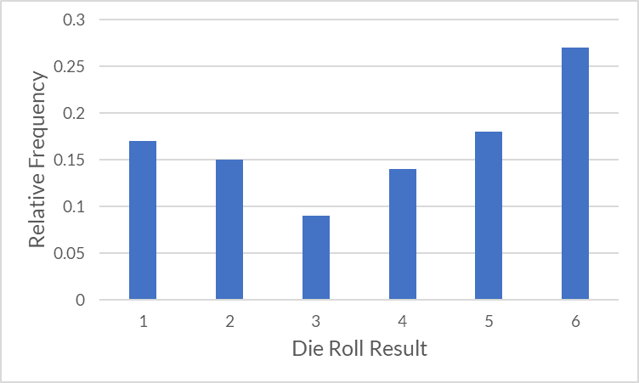
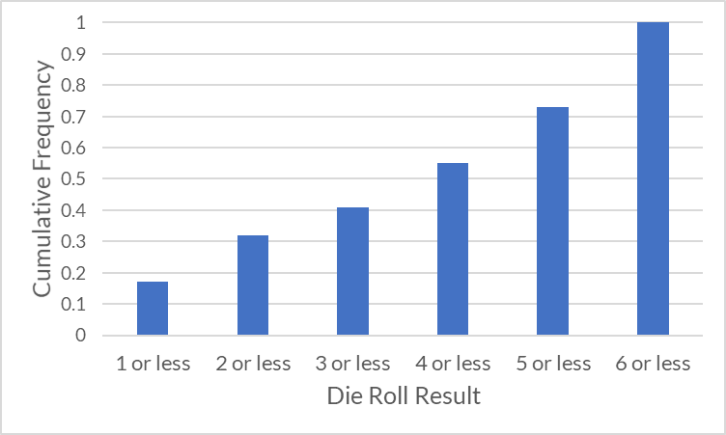
Cumulative Histogram
Relative Frequency
Cumulative Frequency
Notes:
On the left is our familiar histogram computed from 100 rolls of a fair six sided die. The height of each bar is the proportion of outcomes that had that exact roll, 1 through 6.
On the right is a cumulative frequency histogram computed from the same set of rolls. The bars represent a different event now. Each bar represents the proportion of rolls that turned up that value, or less. In other words, it accumulates from left to right. The height of the first bar on the cumulative histogram is the same as the first bar on the relative frequency histogram. However, the height of the second bar on the cumulative histogram is the sum of the heights of the first two bars of the relative frequency histogram. This is because the bar represents the outcome “2 or less” which contains the events of rolling a 1 and rolling a 2. The third bar, which has the outcome “3 or less”, contains the events of rolling a 1, a 2, or a 3. So as you move rightward on the cumulative histogram, you accumulate events. The last bar has a relative frequency of 1 – that’s because the outcome “6 or less” contains all the possible events, rolling a 1 through a 6.

Slide 55
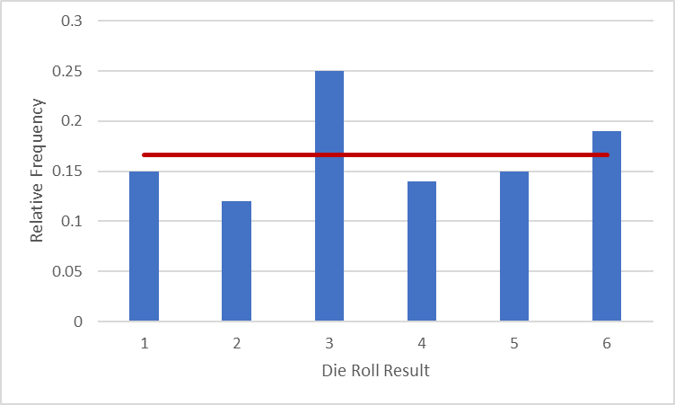
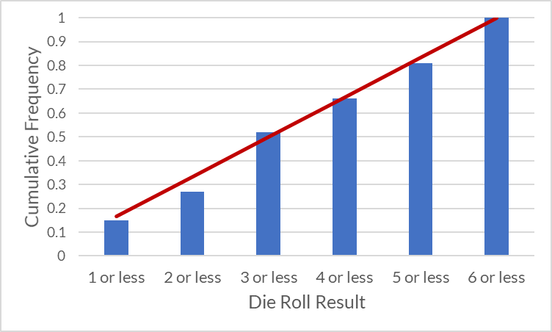
Cumulative Histogram
Relative Frequency
Cumulative Frequency
Notes:
We can compare our relative frequency histogram and cumulative frequency histograms to our expected outcomes.
The left histogram has the 1/6 ideal proportion drawn over the top with a red line.
On the right, in the same way we accumulate the heights of the bars, we can also accumulate the expected proportions.

Slide 56
Complementary Cumulative Frequency
Cumulative Relative Frequency
Complementary Cumulative Relative Frequency
Proportion of trials getting less than or equal to the value
Estimates p(X ≤ x)
Example:
Relative frequency of rolling a 4 or less
Proportion of trials getting greater than the value
Estimates p(X > x)
Example:
Relative frequency of rolling higher than 4
Remember: A^{c} is “not A”!
Notes:
Complementary cumulative frequency is a method for looking at ranges of outcomes but in a different way than the regular cumulative relative frequency. If cumulative equates to “less than or equal to”, then the complement of that is “greater than.” Cumulative relative frequency estimates the probability of a random variable being less than or equal to a value, but the complement of that is the probability of a random variable being greater than a specified value. Going back to last section’s discussion of probability rules, we know that A and its complement are mutually exclusive and exhaustive. Something that happens can either be in A or in A complement, but it can’t be in both, and it can’t be in neither. This means that the complement to “less than or equal to” has to be “greater than” and not “greater than or equal to.”
An example of cumulative relative frequency is the proportion of rolls resulting in 4 or less on a die. This contains the outcomes 1, 2, 3 and 4. The complement to that, which is the complementary cumulative relative frequency, is the relative frequency of rolling greater than 4, which has the outcomes 5 and 6.

Slide 57
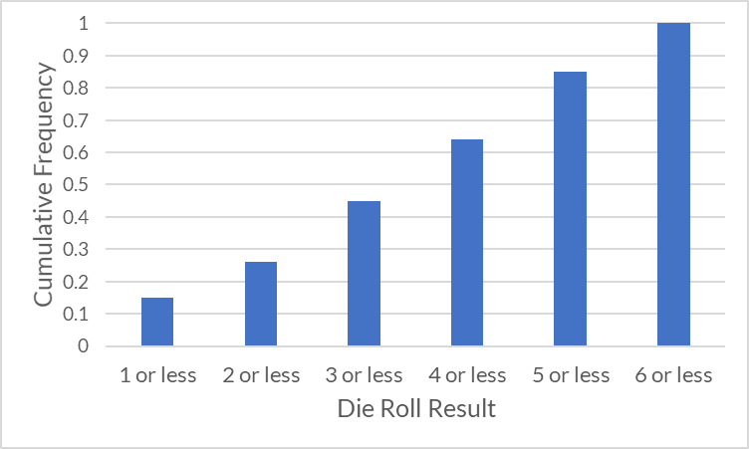
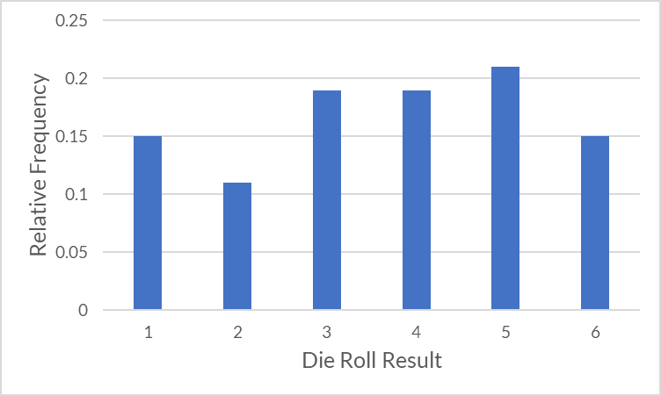
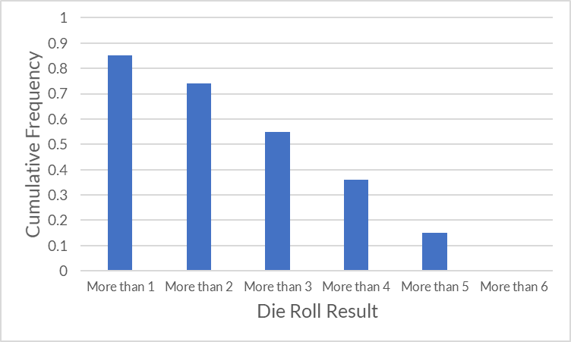
Complementary Cumulative Histogram
$$p\left(A^{c}\right)=p\left(Ω\right)−p\left(A\right)=1−p\left(A\right)$$
Notes:
Here are three views of the same sample containing 100 die rolls. On the left is the relative frequency for each of the six outcomes. In the upper right is the histogram we get when we look at the cumulative relative frequency. The first bar contains the roll of 1, the second bar is 1 and 2, the third bar is 1, 2, and 3, and so on.
The lower right histogram is the complementary cumulative histogram. The first bar contains the rolls of 2, 3, 4, 5, and 6, the second bar contains 3, 4, 5, and 6, and so on. An important feature of the two charts on the right is that the sum of the heights of the bars are equal to 1 – this is due to the definition of the complement. The first bar on the top right contains a roll of 1, and the first bar on the bottom right contains rolls of 2, 3, 4, 5, and 6. Since nothing else can happen other than those two things, the total probability between those two bars has to be 1. Notice also that the last bar in the histogram on the lower right is zero – this is because there is no way to roll higher than a 6 on a 6 sided die. The flip side of this is shown in the histogram above it – the event of “6 or less” contains the rolls 1, 2, 3, 4, 5 and 6, which is everything, so it must have a probability of 1.

Slide 58
Empirical Probability Distribution
Use our sample histogram as an estimate of the population probability distribution
Notes:
The sample histogram we’ve been creating has another name: an empirical probability distribution. Let’s break down that name. The key is that we call it empirical because it comes from experimental trials and is built using data we’ve gathered. A probability distribution is a method for telling us how much probability each of our outcomes has. So put together, we have a description of the amount of probability each of our experimental outcomes has.
We know from physics that our die produces each outcome with a probability of 1/6. This tells us how much probability each outcome gets. This is our population probability distribution.
When we get to section four of this lecture we will talk more about the role of probability distributions in inference. But for now it is good to know that our mapping of outcomes to probabilities is called a probability distribution, and we can construct one empirically using a histogram.

Slide 59
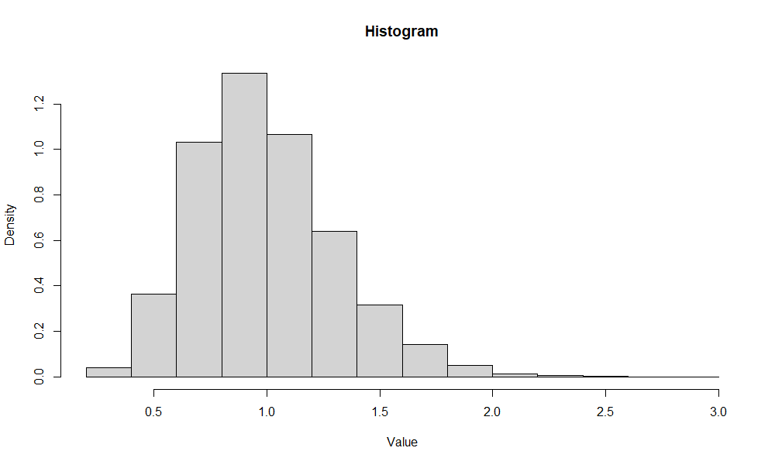
Sample Statistics
Numerical measures that describe the “shape” of a sample
Most interesting properties:
  Central tendency
  Spread/dispersion
  Symmetry
Notes:
Instead of looking at the proportion of specific outcomes in an experiment, we can start to look at properties of a sample as a whole. Often we want to summarize what a sample looks like with measurements we can compare across samples. Sample statistics are numerical measures of a sample that describe its shape. Most of the time we are interested in measuring a few specific properties. The most important is the central tendency, in other words, where the middle of the sample is. Another important property is the spread, or the dispersion of the sample, which describes how spread out data in our sample are relative to the center. Another important but less commonly used measure is a measure of symmetry, which tells us if the shape of the data tends to be the same on both sides of the center.

Slide 60
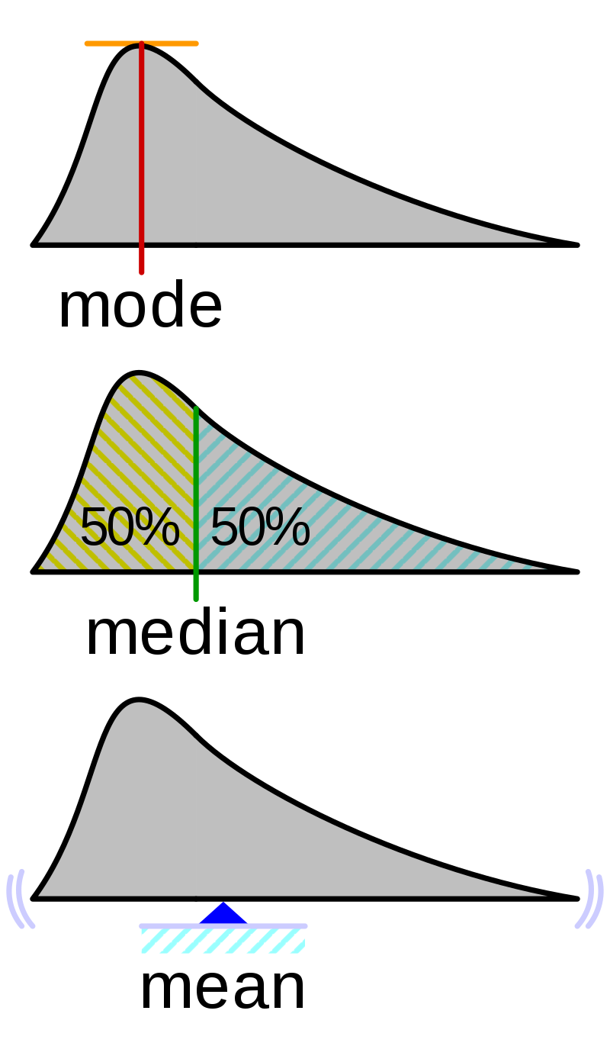
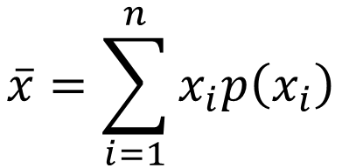
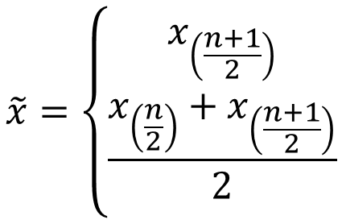
Central Tendency
Mean
$$\overline{x}=\sum_{i=1}^{n}{x_{i}p\left(x_{i}\right)}$$
$$x_{min}=x_{\left(1\right)}≤x_{\left(2\right)}≤…≤x_{\left(n\right)}=x_{max}$$
Median
$$\tilde{x}=\left\{\begin{aligned}x_{\left(\frac{n+1}{2}\right)} \\ \frac{x_{\left(\frac{n}{2}\right)}+x_{\left(\frac{n+1}{2}\right)}}{2}\end{aligned}\right.$$
n odd
n even
Mode
Most frequently-occurring value
Notes:
There are several ways to measure central tendency of a sample. The most important is the mean, but the median and mode are also important measures.
The mean is the first moment of the sample. It is also the center of mass. It is a probability-weighted average of all of the outcomes.
The median is the point where 50% of the data are on either side. For symmetrical distributions the mean and median are the same. You can compute it by sorting the data from smallest to largest, and then dividing the sample in half. If the sample size is an odd number, there will be a data point in the middle where there are the same number of observations above it as below it. This is the median. For sample sizes that are an even number, you will have two numbers in the middle. The median is the average of those numbers.
Mode is the most frequently-occurring value. For discrete data this might be pretty simple to compute. (Find the value that occurs the most often.)
For continuous data, it’s harder. You might construct a histogram of the data and find the middle value of the tallest bar. You could construct a kernel density plot and find the value corresponding to the tallest part of the density plot (like the image above.) You could fit a parametric model (i.e. a probability distribution) and get the distribution’s mode.
Data can have multiple local maxima (be multi-modal) but in general we won’t deal with data like that here.

Slide 61
Computing the Mean
Outcome | Count | Proportion | x_{i} * p(x_{i})
1 | 12 | 0.12 | 0.12
2 | 22 | 0.22 | 0.44
3 | 19 | 0.19 | 0.57
4 | 21 | 0.21 | 0.84
5 | 15 | 0.15 | 0.75
6 | 11 | 0.11 | 0.66
Sum: | 100 | 1.0 | 3.38
Mean = 3.38
Notes:
Here is an example of computing the arithmetic mean from a sample of 100 die rolls. For each outcome we multiply the value of the die roll by the fraction of the die rolls that turned up that value. Then, we add up those products. The result is in the bottom row of the last column.

Slide 62
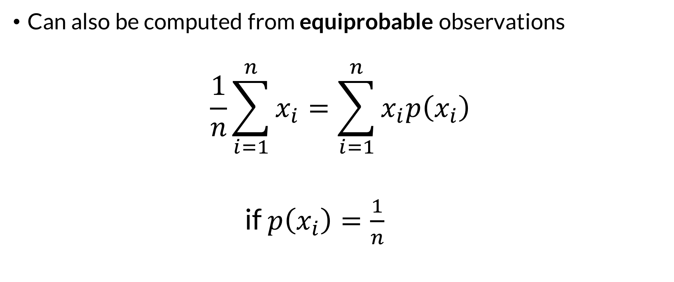
Computing the Mean
Can also be computed from equiprobable observations
$$\frac{1}{n}\sum_{i=1}^{n}{x_{i}}=\sum_{i=1}^{n}{x_{i}p\left(x_{i}\right)}$$
if $p\left(x_{i}\right)=\frac{1}{n}$
Notes:
On the last slide we computed the sample mean by looking at the proportion of each outcome in a sample. We can also compute it by looking at each data point in the sample as an equiprobable observation. Equiprobable means “same probability.” The formula shown on the left is the familiar formula for the average. Applying this formula, we would add up all 100 values we rolled on our fair six sided die, and then divide by 100.

Slide 63
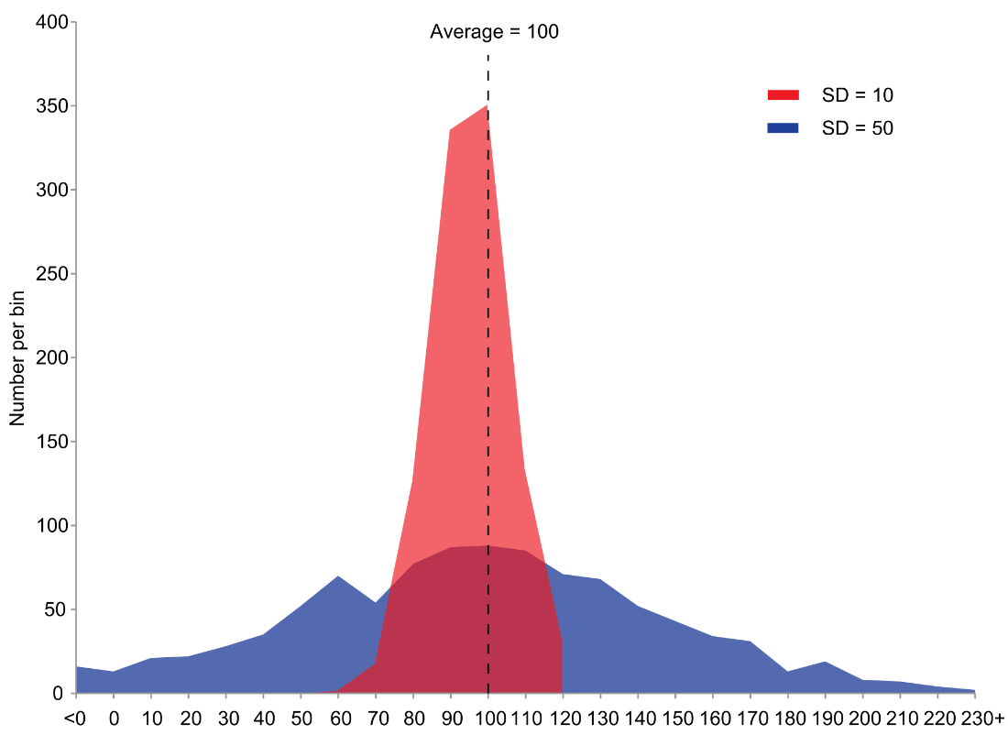
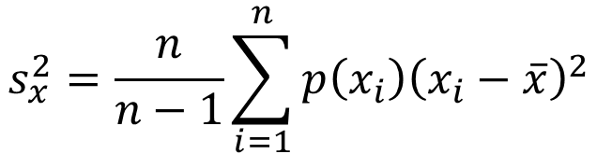
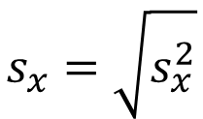
Dispersion
$$s_{x}^{2}=\frac{n}{n−1}\sum_{i=1}^{n}{{p\left(x_{i}\right)\left(x_{i}−\overline{x}\right)}^{2}}$$
Variance
Bessel’s Correction
Standard Deviation
$$s_{x}=\sqrt{s_{x}^{2}}$$
Notes:
Dispersion describes the amount of variability, or spread, in a dataset. Usually it expresses the amount of distance there is between data points in the sample.
The most common measure of dispersion is the sample variance. It is defined as the average of the squared distance of each data point from the mean of the sample. The n / n – 1 term at the beginning is referred to as Bessel’s correction, and it is important for making inferences about our population.
Also commonly used is the sample standard deviation, which is simply the square root of the sample variance. It is useful because it has the same units as the data being measured, whereas the variance has units of the square of the data units.
On the right is a histogram showing two samples with the same mean of 100. The red histogram has a standard deviation of 10, and the blue histogram has a standard deviation of 50. The blue histogram is more spread out than the red one, so it having a higher standard deviation makes sense.

Slide 64
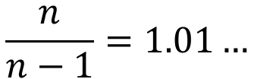
Computing Variance
Outcome | Count | Proportion | x_{i} * p(x_{i}) | (x_{i} - mean)² | p(x_{i}) * (x_{i} - mean)²
1 | 19 | 0.19 | 0.19 | 5.6169 | 1.067211
2 | 14 | 0.14 | 0.28 | 1.8769 | 0.262766
3 | 19 | 0.19 | 0.57 | 0.1369 | 0.026011
4 | 15 | 0.15 | 0.6 | 0.3969 | 0.059535
5 | 25 | 0.25 | 1.25 | 2.6569 | 0.664225
6 | 8 | 0.08 | 0.48 | 6.9169 | 0.553352
Sum: | 100 | 1 | 3.37 | -- | 2.6331
Mean = 3.37
Variance = 2.66
Standard Deviation = 1.63
$$\frac{n}{n−1}=1.01…$$
Notes:
We can compute the sample variance using the general variance formula on the last slide. Again, this is computed using the tabulated outcomes and their proportions. Note that we have to compute the sample mean first in order to get to the variance. This occurs in column 4 just like the computation we did a few slides ago. There is an additional pair of steps on the right side to get to the variance that depend on that value. The sum in the lower right has to be bias corrected, which is based on our sample size. The factor is shown in the lower left. The resulting mean of 3.37, variance of 2.66, and standard deviation of 1.63, are shown on the bottom. Remember that the standard deviation is computed as the square root of the variance.

Slide 65

Computing Variance
Can also be computed from equiprobable observations
$$s_{x}^{2}=\frac{1}{n−1}\sum_{i=1}^{n}{{\left(x_{i}−\overline{x}\right)}^{2}}$$
Standard deviation: $s_{x}=\sqrt{s_{x}^{2}}$
Bessel’s Correction
Notes:
Just like the mean, we can compute the sample variance from a collection of equiprobable data points in a sample. We still have to compute the sample mean first. Then for each observation, we subtract off the mean and square it. After adding those up, we divide by n – 1, which is the return of Bessel’s correction. This produces our sample variance.
The sample standard deviation is still just the square root of the sample variance.

Slide 66
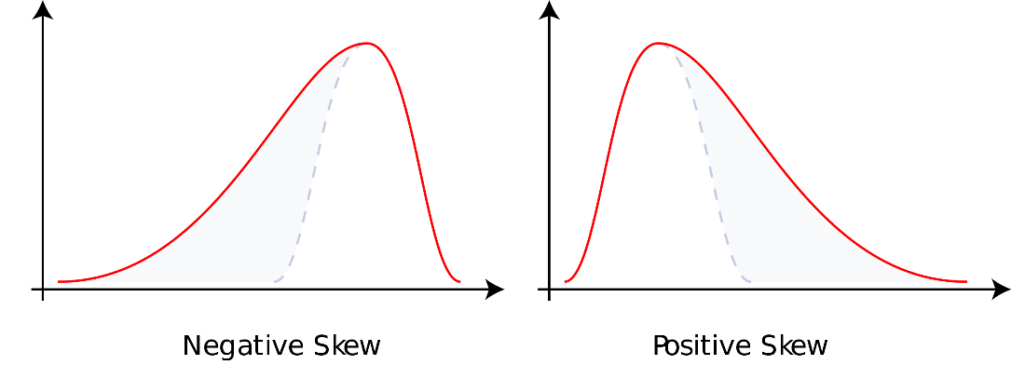
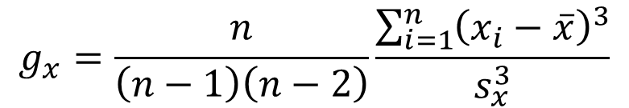
Symmetry
Coefficient of Skewness
$$g_{x}=\frac{n}{\left(n−1\right)\left(n−2\right)}\frac{\sum_{i=1}^{n}{{\left(x_{i}−\overline{x}\right)}^{3}}}{s_{x}^{3}}$$
Bias correction
Standardization
Notes:
The symmetry of a sample can be measured with a statistic called the coefficient of skewness. We look at the symmetry of the data relative to the mean of the sample. It is defined so a perfectly symmetrical sample has a skew of zero. Symmetry becomes apparent when we look at the histograms on the right. Skew values that are negative tend to have a long tail pointing towards the left. Skew values that are positive tend to have a long tail pointing towards the right. If they were symmetrical, they would look more like the dashed part of the figure.
Skew divides off a power of the variance in order to make the measurement dimensionless. It also has some business at the front end involving n which gives it better properties for inference. It is similar in principle to Bessel’s correction which is for variance.

Slide 67
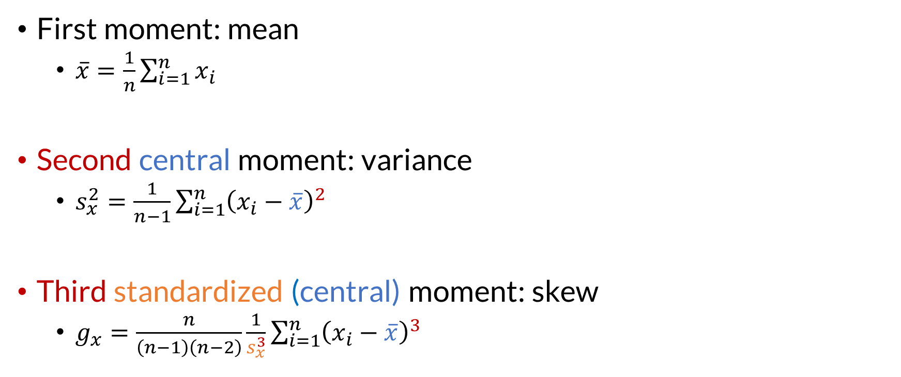
Moments
First moment: mean
  $\overline{x}=\frac{1}{n}\sum_{i=1}^{n}{x_{i}}$
Second central moment: variance
  $s_{x}^{2}=\frac{1}{n−1}\sum_{i=1}^{n}{{\left(x_{i}−\overline{x}\right)}^{2}}$
Third standardized (central) moment: skew
  $g_{x}=\frac{n}{\left(n−1\right)\left(n−2\right)}\frac{1}{s_{x}^{3}}\sum_{i=1}^{n}{{\left(x_{i}−\overline{x}\right)}^{3}}$
Notes:
The mean, variance, and coefficient of skewness fall into a category of sample statistics called moments. They get that name from similar quantities used in physics.
The mean is the first moment. Pretty straightforward.
The variance is the second central moment. It is the second moment due to the fact that we are squaring, or taking the second power of the observations. It is a central moment because we are subtracting off the mean, or centering, the variable, before doing the squaring.
The skew is the third standardized moment. It is also a central moment. It is the third moment due to the fact that we are cubing the observations. It is a central moment because we are subtracting off the mean before cubing. Finally, it is a standardized moment because we are dividing off a power of the standard deviation in order to make the measurement dimensionless.
We are taking a minute to discuss moments because they are an important part of inference that we will discuss in part four of this lecture.

Slide 68
Inference Revisited
We want to ask questions of an unknowable population
We use sample statistics to estimate population parameters
Population
Observation
Sample
s_{x}²
θ
Inference
Notes:
The diagram of inference returns. Now that we’ve worked with samples for a bit, we can start to think about how we’d use those observations to ask and answer questions about our population. One way of doing this is by assuming that our observations are representative of the population, and that we can use sample statistics as estimators for population parameters. For example, we might assume that our measurement of the sample variance is a representative measurement of the population variance.

Slide 69

Inference Revisited
Assuming a representative, IID sample:
$$\frac{\#_{A}}{n}=\hat{p\left(A\right)}$$
$$\overline{x}=\hat{μ }$$
$$s_{x}^{2}=\hat{σ^{2}}$$
$$g_{x}=\hat{γ}$$
Notes:
When we go back to our fundamental assumptions, that the sample we have is representative of the population and it was taken in a way that it is independent and identically distributed, we find that our sample statistics are estimators of population parameters. Here we use the little hat accent to indicate that something is an estimator.
First we see that our sample relative frequency is an estimator for the population probability of event A occurring. Our best guess at the true value of the probability of event A occurring based on our sample, is the relative frequency of A.
We can take this further to the moments we defined just a bit ago.
The symbol mu is used for the population mean, and mu-hat means an estimator of the population mean. We use the sample mean as an estimator of the population mean when our sample meets the assumptions. The same goes for the population variance, written as sigma-squared and for the population skewness, written as gamma.
This is going to be an important basis we use for building probability models of our population in the next section.

Slide 70
Samples and Populations
Populations vs. Samples
Inference
Estimating probability from data
Sample statistics
Inference Revisited
Notes:
We have completed our review of the distinction between populations and samples, and introduced the concept of inference. We will build off of the inference concept in the final section to build models of our populations based off of the information we have in our samples.

