Slide 1
Why Use
Partial Duration Analysis?
Partial Duration Workshop
June 2023
Gregory S. Karlovits, P.E., PH, CFM
Statistical Hydrologist
US Army Corps of Engineers
Hydrologic Engineering Center

Slide 2
Purpose
PDS has key differences from AMS analysis
What should you consider before committing to a PDS analysis?

Slide 3
Outline
Key differences between AMS and PDS
Limitations of PDS
Advantages of PDS

Slide 4
AMS and PDS Differences

Slide 5
Annual Maximum Modeling
Build a model for the largest value in each year
Federal guidance for flow (Bulletin 17C)
Data is easy to obtain and use
Departure from extreme value theory
Extra mechanics for unusual data situations
Notes:
The extra mechanics involved are to make sure the LP3 fit with method of moments can handle unusual data

Slide 6
Peaks Over Threshold
Build a model for all independent events above a threshold
Manual creation of a dataset
No Federal guidance for flow
  But, “permission” to do POT/PDS
Technique based on extreme value theory

Slide 7
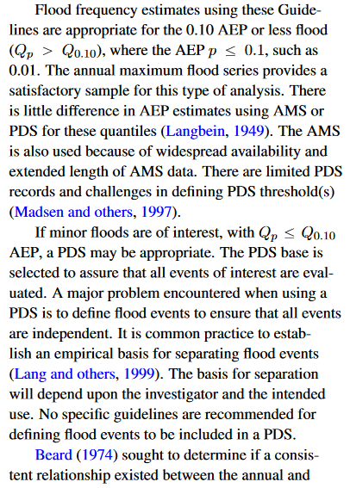
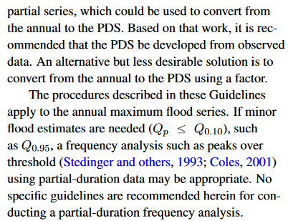
What Does Bulletin 17C Say?

Slide 8
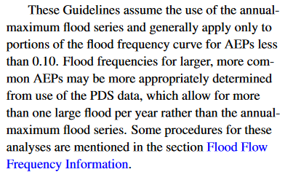

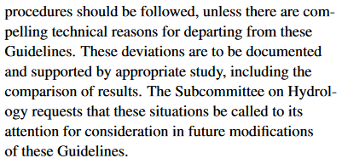
Bulletin 17C
Two situations for POT:
Estimates > 0.1 AEP
“Compelling technical reasons”
Notes:
Point 1 will be easy to illustrate and we will show the difference in the Annualization discussion. There’s very little to talk about here since the Federal guidance says to do it.
Point 2 will be a little harder since you’ll have to prove your point. We will discuss a few of these situations where at least exploring POT analysis is worth comparing to the B17C guidelines to see if it affects the answer.

Slide 9
PDS Limitations

Slide 10
Systematic Data
Instantaneous data record short and unwieldy
Daily flow records much longer
  Must estimate instantaneous from daily
    Easier to do on larger watersheds
No standard PDS data product
  Although, USGS may have archived PDS data in the past

Slide 11
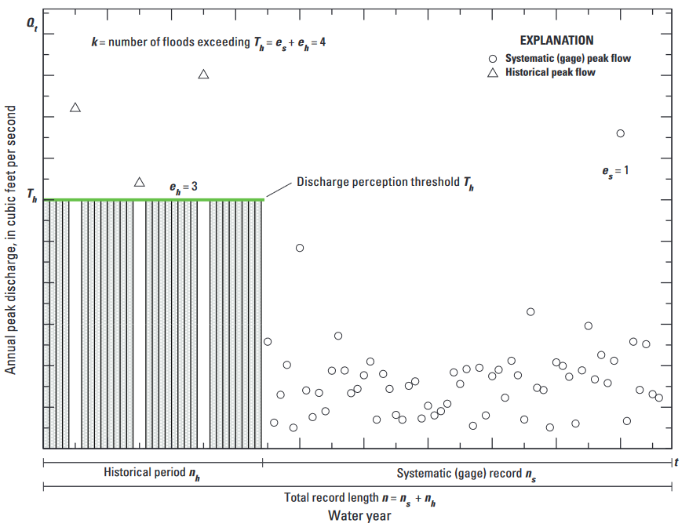
Historical and Paleoflood Data
Harder to put these data into context
“Largest flood in at least H years”
For PDS, the number of events per year in historical record is unknown

Slide 12
Subjectivity
Federal guidance promotes consistency
Creating a PDS requires two major judgments:
  Threshold choice
  Flood separation criteria
Sensitivity analysis can help mitigate this

Slide 13
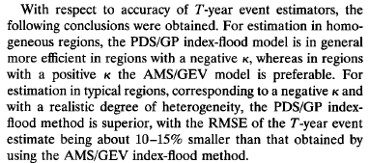
No Regional Skew Information
Not using AMS-LP3-EMA anymore
Cannot incorporate USGS regional skews
May be mitigated by larger PDS sample sizes
Performant regional methods are available
  Madsen et al. 1997b

Slide 14
No Cookbook
Love it or hate it, 17C is a recipe that generally produces reasonable results on the first attempt
Need to overcome subjective parts
Fitting method?
Model comes from EVT (use the generalized Pareto)

Slide 15
PDS Advantages

Slide 16
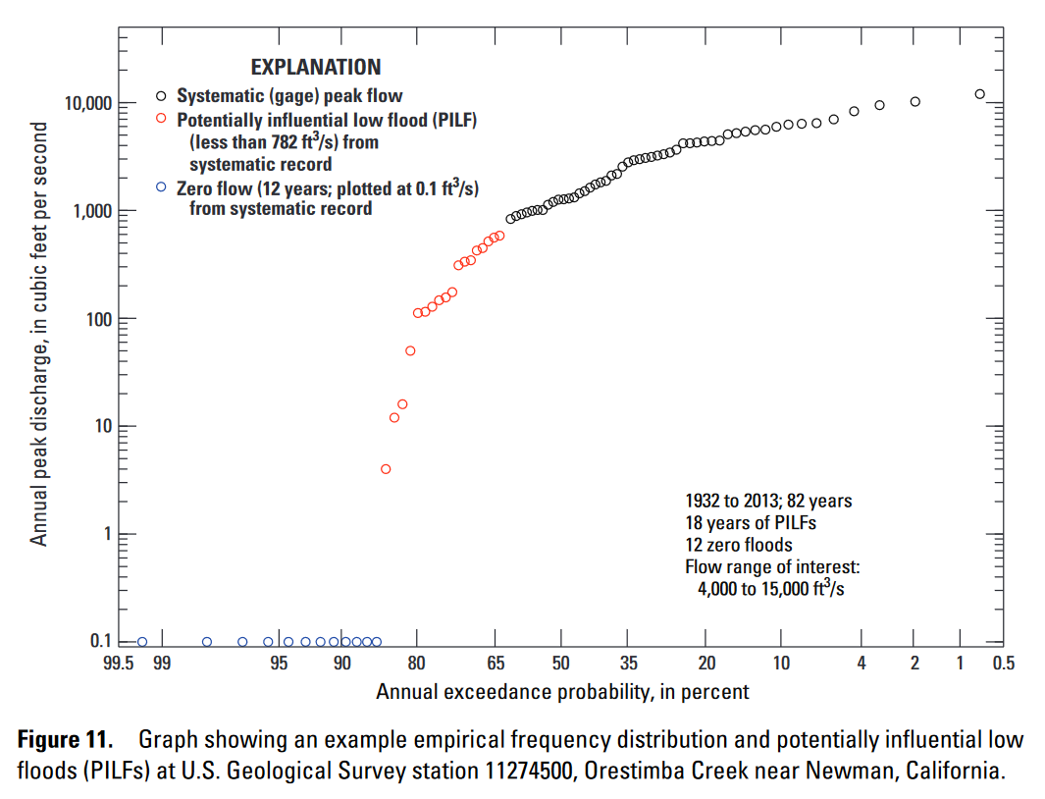
Censoring
Avoids two major issues affecting AMS:
  Potentially influential low floods
  Zero flow years

Slide 17
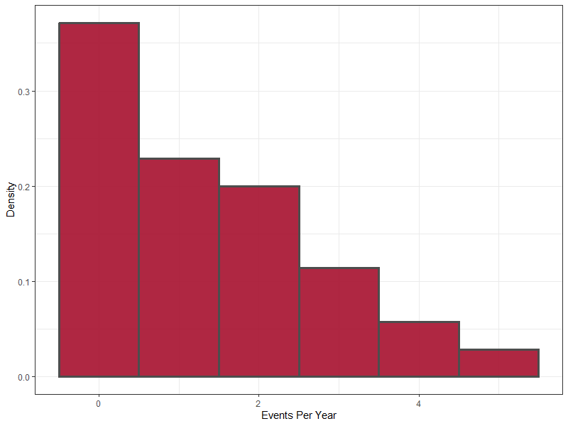
Flood Count Variability
Many years with events you wouldn’t consider floods
Many years with multiple floods
AMS performs badly in this situation

Slide 18
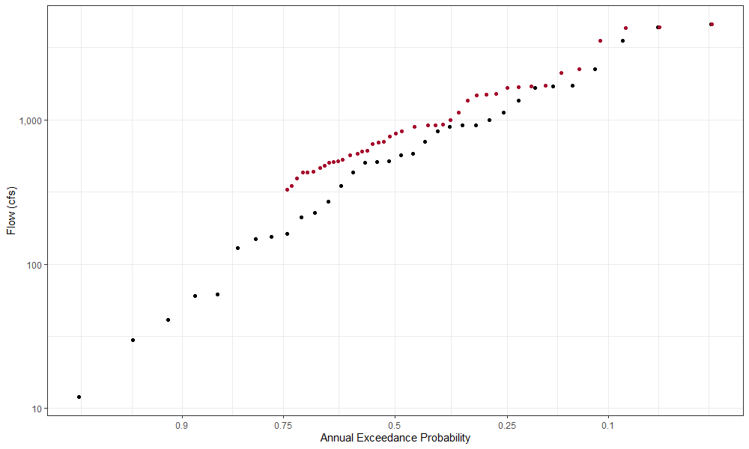
Large Flood(s) Not Included in AMS
2 of top 6 largest floods are not in the AMS!

Slide 19
Sample Sizes
Multiple true floods per year means more information
  Not mixing floods and non-floods
  Can account for significant secondary+ peaks
Can help if we need to sub-divide the sample
  Mixed populations
  Non-stationarity

Slide 20

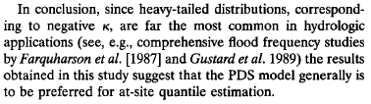

Performance
In many situations, the PDS approach is more performant
  Smaller error, tighter confidence intervals
Madsen et al. 1997a

Slide 21
Questions?

