Slide 1
Annualization
Partial Duration Workshop
June 2023
Gregory S. Karlovits, P.E., PH, CFM
Statistical Hydrologist
US Army Corps of Engineers
Hydrologic Engineering Center

Slide 2
Purpose
USACE projects revolve around annual probabilities (AEP)
Probabilities in the PDS context are not AEPs
Annualization is a procedure for getting AEPs from PDS models

Slide 3
Outline
PDS model review
Empirical annualization
Analytical annualization

Slide 4
PDS Model Review

Slide 5
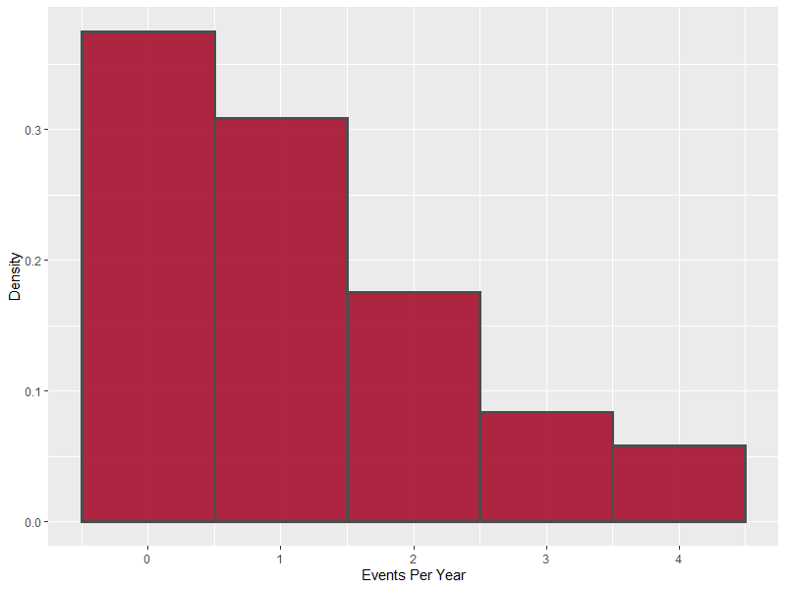
Peaks Over Threshold
Choose a high flow value as a threshold
Keep all independent flood peaks greater than the threshold
Varying number of floods per year
  0 or more
Notes:
Values above that threshold are high flow events that you’d consider a representative sample of floods.

Slide 6
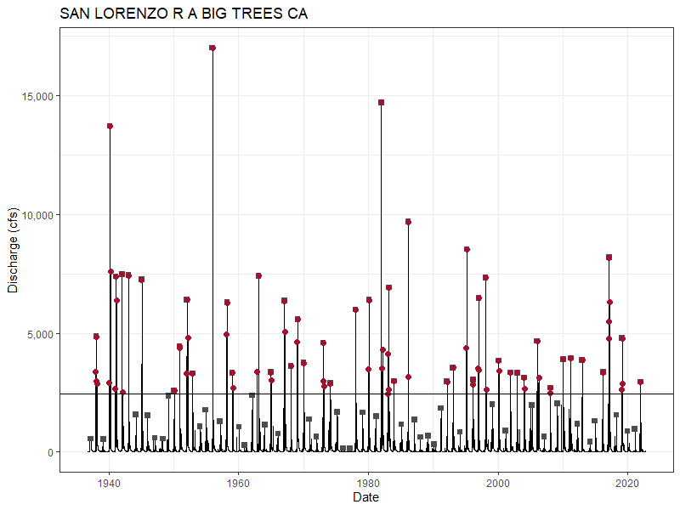
PDS vs. AMS Timeseries
Not all AMS events in PDS
Not all PDS events in AMS

Slide 7
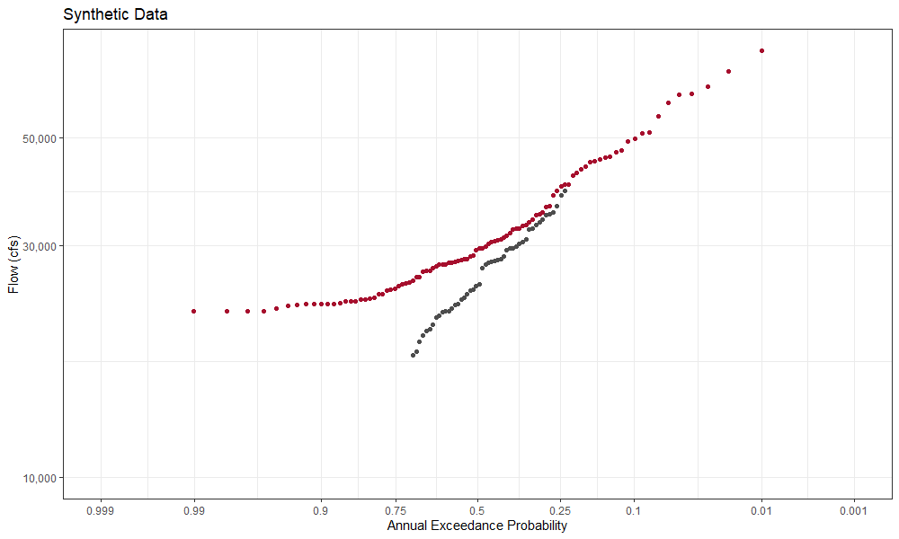

Interpreting the PDS
$$p=\frac{i}{n+1}$$
n = years in AMS
i = descending rank
Plotting positions for top N PDS events, (N is number of years):
  PDS is “average number of
  exceedances of flow Q
  in a year.”
  Note that AMS and PDS
  interpretations converge
convergence
Top N events of PDS, Weibull plotting positions
AMS says “what is the probability the largest flow in a year exceeds Q?”
AMS, Weibull plotting positions
Notes:
From Atlas 14 (regarding rainfall):
AVERAGE RECURRENCE INTERVAL (ARI; a.k.a. RETURN PERIOD, AVERAGE RETURN PERIOD) - Average time between cases of a particular precipitation magnitude for a specified duration and at a given location; the term is associated with the analysis of partial duration series. However, ARI is frequently calculated as the inverse of AEP for the annual maximum series; in this case it represents the average period between years in which a given precipitation magnitude is exceeded at least once.
The AMS is only being shown with values above the PDS threshold. 29 values are below the PDS threshold of 17,500 cfs. These data are synthetic and were generated using a model for the PDS events and a random number per year, and then the largest event of each year was kept as the annual maximum. For some years there were zero PDS events (no events that exceeded the threshold) so the resulting annual maximum must be below the threshold with an unknown value between [0, 17500].

Slide 8
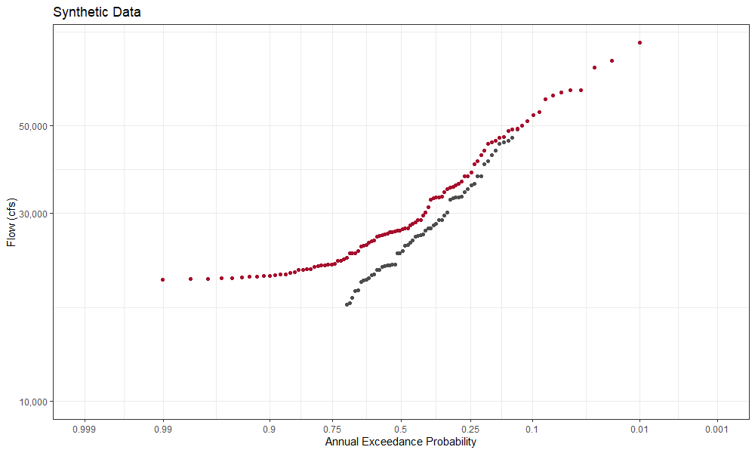
Return Period
T = 1/p
PDS accounts for the possibility of more than one exceedance in a year
AMS doesn’t care
p(Q>30k) = 0.41
Average time between exceedances = 2.44 yr
p(Q>30k) = 0.33
Average period to exceed at least once = 3.03 yr
Notes:
The distinction is only important if more than one flood in a year changes the economics. As far as I know, the USACE planning process is only concerned with the binary distinction of “yes/no flooded in a year” not “how many times flooded in a year”. This could be a consequence of the AMS-based flood frequency procedures that have been in place for a long time.
What does this mean? If a structure floods at the stage corresponding to 30,000 cfs, then probability in any given year it floods (one or more floods) is 0.33 (AEP.) This means that the average amount of time to exceed 30,000 cfs at least once is 3.03 years. However, given the possibility of flooding more than once in a year, the average amount of time between subsequent floods is 2.44 years. Notice the nuance in these definitions.

Slide 9
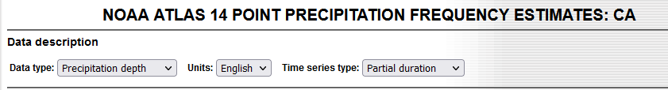
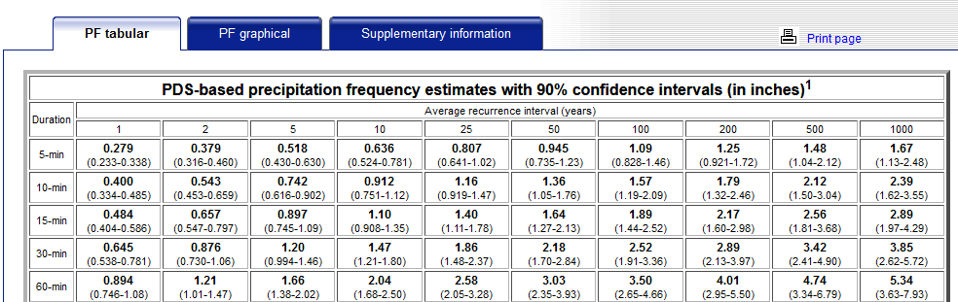
1-Year Event
Sometimes used in water quality, stormwater management
  Shown in Atlas 14 if you use the Partial Duration option
PDS event of rank N
  N^{th} largest PDS event
  in N years
On average you wait 1 year for an event of this size or larger

Slide 10
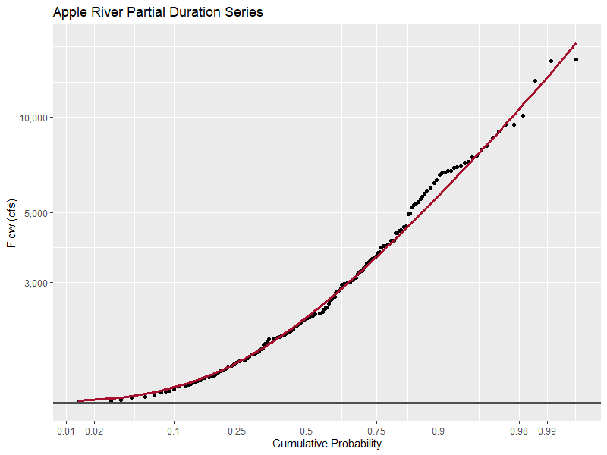
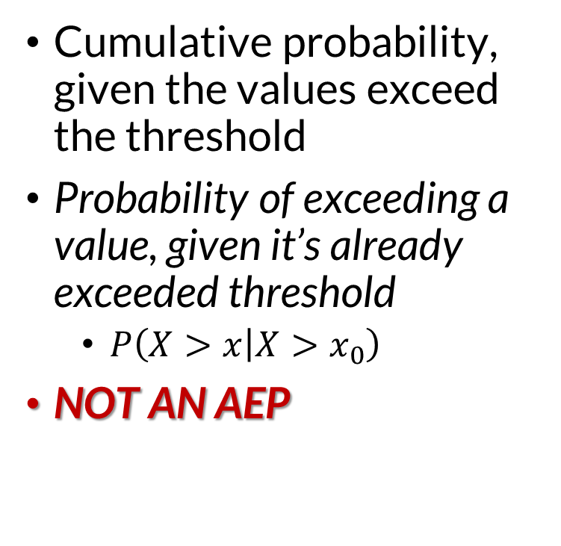

Distribution of Values
$$p=\frac{i}{n+1}$$
n = events in PDS
i = descending rank
Cumulative probability, given the values exceed the threshold
Probability of exceeding a value, given it’s already exceeded threshold
  $P\left(X>x | X>x_{0}\right)$
NOT AN AEP
GPD Fit to PDS
Weibull plotting positions
All PDS points
Threshold = 1,250 cfs

Slide 11

Interpreting the Distribution
$$p=\frac{i}{n+1}$$
n = events in PDS
i = descending rank
50% of floods that exceed 1,250 cfs are greater than 2,330 cfs
  Not 2-year flow
1% of floods that exceed 1,250 cfs are greater than 13,400 cfs
  Not 100-year flow
GPD Fit to PDS
Weibull plotting positions
All PDS points
Threshold = 1,250 cfs

Slide 12
Empirical Annualization

Slide 13
Empirical Annualization
How do we go between PDS-CDF and AMS-AEP?
Can be used without distributions
  Plotting positions
Remember!
AEP = 1-CDF
Only for AMS

Slide 14
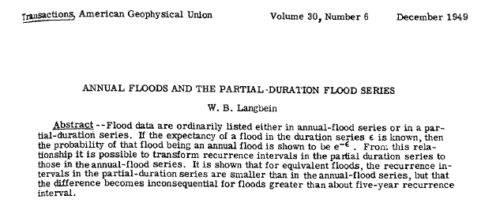
The “Langbein Adjustment”

Slide 15
Empirical Annualization
Get AEPs of interest
Convert them to PDS-CDF values
Plug them into the PDS model to get quantiles

Slide 16
Empirical Annualization
For plotting, go the reverse direction:
  Get PDS plotting positions
  Convert them to AMS-CDF values and then AEPs
  Plot them against the AMS

Slide 17

Langbein Adjustment
Given PDS-CDF $G\left(x\right)$, AMS-CDF $F\left(x\right)$, and mean rate λ:
$G\left(x\right)=\frac{\left[ln\left(F\left(x\right)\right)+λ\right]}{λ}$
$F\left(x\right)=exp\left(−λ\left[1−G\left(x\right)\right]\right)$

Slide 18
In R (lmomco Package)
Annual nonexceedance probability to PDS-CDF
  lmomco::f2fpds(p, rate = λ)
PDS-CDF to annual nonexceedance probability
  lmomco::fpds2f(p, rate = λ)

Slide 19
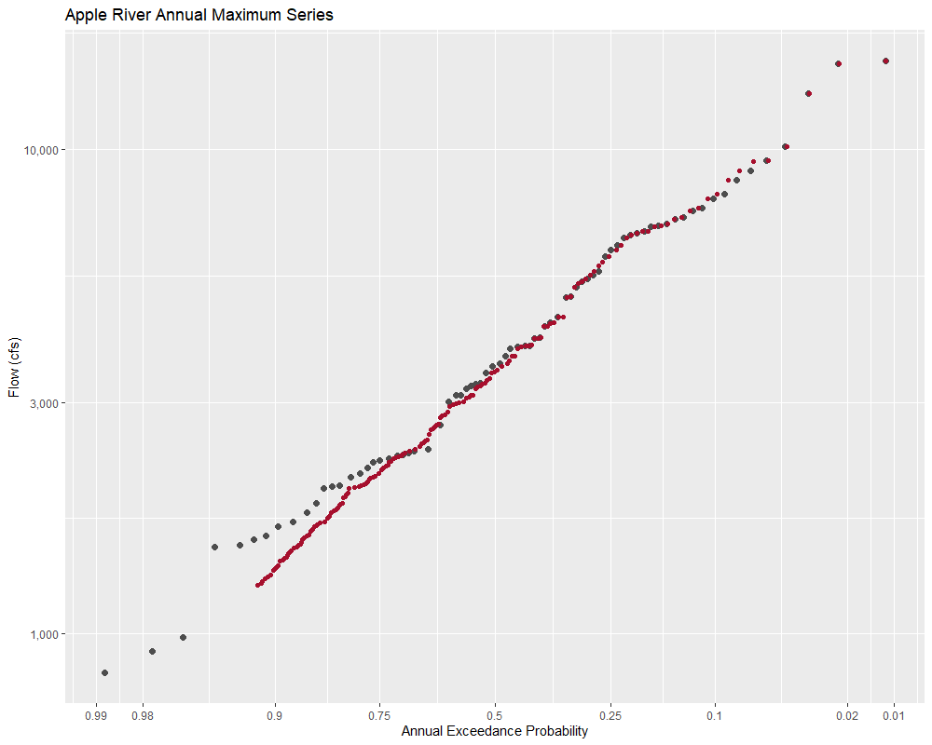
AMS
87 events
PDS
220 events
2.53 / year
PDS plotted at Weibull plotting positions then adjusted with Langbein
(red points)
AMS plotted at Weibull plotting positions
(grey points)

Slide 20
Analytical Annualization

Slide 21
Analytical Annualization
Take advantage of extreme value theory
Requires specifying distributions
  PDS modeled with generalized Pareto distribution
  Gives us an equivalent AMS model using the GEV distribution

Slide 22
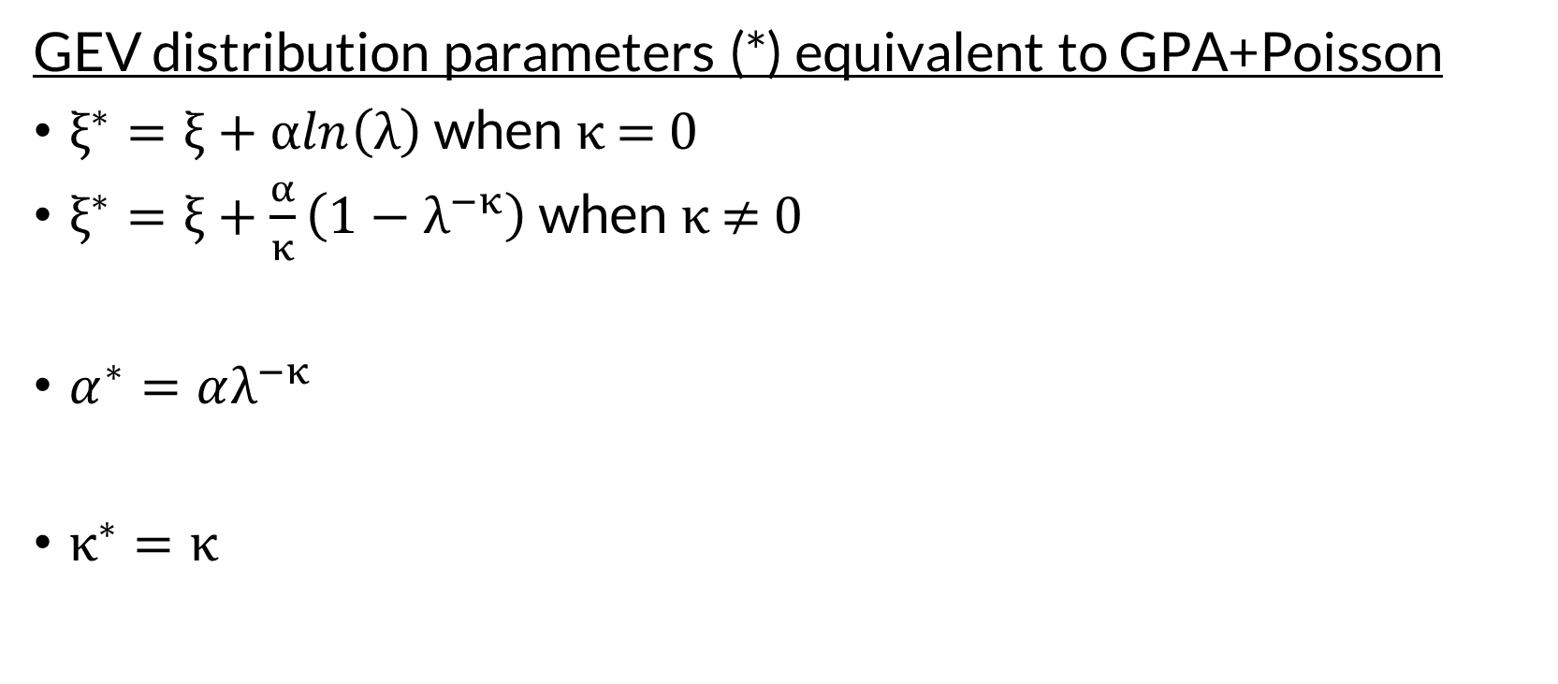
Madsen et al. 1997a (Eq. 10 and 11)
GEV distribution parameters (*) equivalent to GPA+Poisson
$ξ^{∗}=ξ+αln\left(λ\right)$ when κ = 0
$ξ^{∗}=ξ+\frac{α}{κ}\left(1−λ^{−κ}\right)$ when κ ≠ 0
$α^{∗}=αλ^{−κ}$
$κ^{∗}=κ$

Slide 23
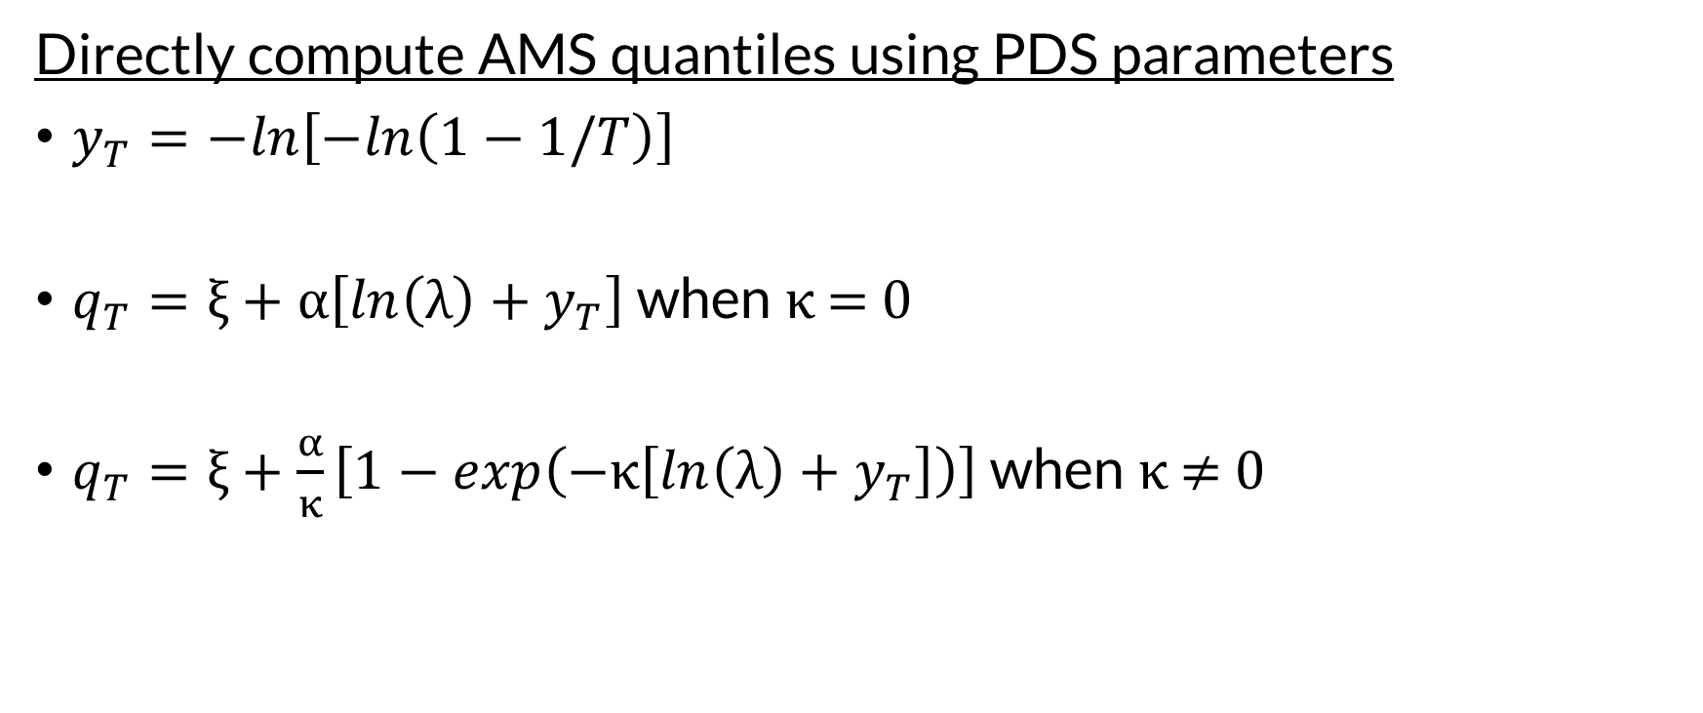
Madsen et al. 1997a (Eq. 15)
Directly compute AMS quantiles using PDS parameters
$y_{T}=−ln\left[−ln\left(1−1/T\right)\right]$
$q_{T}=ξ+α\left[ln\left(λ\right)+y_{T}\right]$ when κ = 0
$q_{T}=ξ+\frac{α}{κ}\left[1−exp\left(−κ\left[ln\left(λ\right)+y_{T}\right]\right)\right]$ when κ ≠ 0
T = average return interval (e.g. 100)

Slide 24
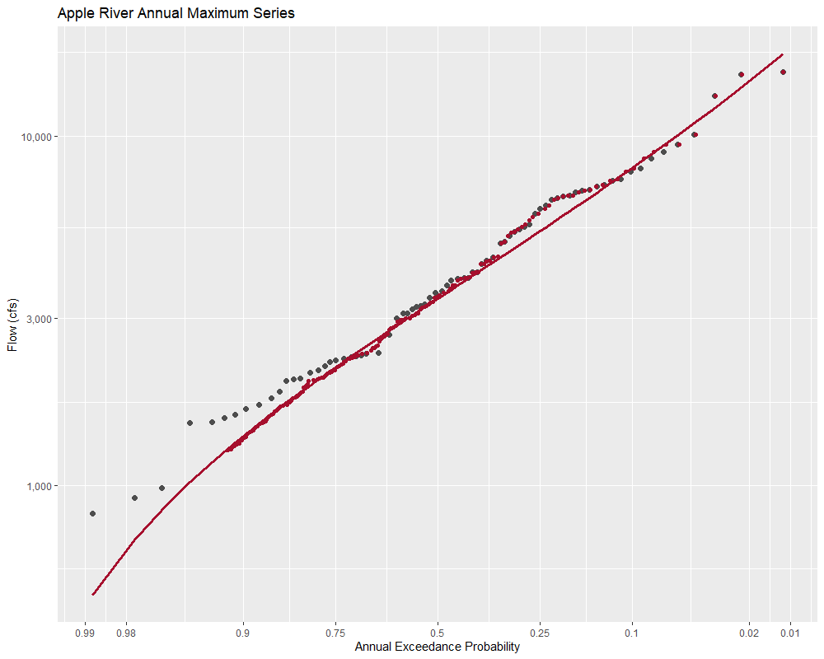
AMS
87 events
PDS
220 events
2.53 / year
PDS plotted at Weibull plotting positions then adjusted with Langbein
(red points)
GPA+Poisson converted to GEV
(red line)
AMS plotted at Weibull plotting positions
(grey points)
PDS threshold = 1,250 cfs

Slide 25
Questions?

