Slide 1
Flood Separation and
Threshold Choice
Partial Duration Workshop
June 2023
Gregory S. Karlovits, P.E., PH, CFM
Statistical Hydrologist
US Army Corps of Engineers
Hydrologic Engineering Center

Slide 2
Purpose
IID is still an important assumption in PDS modeling
Getting POT requires a bit of extra work to meet assumptions

Slide 3
Outline
Inference Assumptions
Flood Separation
Threshold Choice

Slide 4
Inference Assumptions

Slide 5
Inference Assumptions
Sample is representative of population
Sample values are independent
Sample values are identically-distributed
I.I.D.

Slide 6
Representative Sample
High threshold ensures sample made only of floods
Too high of a threshold limits sample size
Violation: model for population doesn’t actually represent it

Slide 7
Independence
Floods you keep should be independent of others
Enough time passes between floods
Hydrograph sufficiently recedes between floods
Violation: we think large floods happen more often than they actually do
Notes:
Independence is the hard part about using peaks over threshold – it’s up to you to determine how to ensure the peaks you get are independent of one another.

Slide 8
Identical Distribution
High threshold ensures sample made only of floods
May still be a mixture of flood-generating mechanisms
Violation: population model misrepresents extremes
Notes:
Remembering the mixed population lecture/workshop we saw the consequence of failing to handle a mixture – our estimates for frequency events over a range of probabilities were low.

Slide 9
Flood Separation

Slide 10
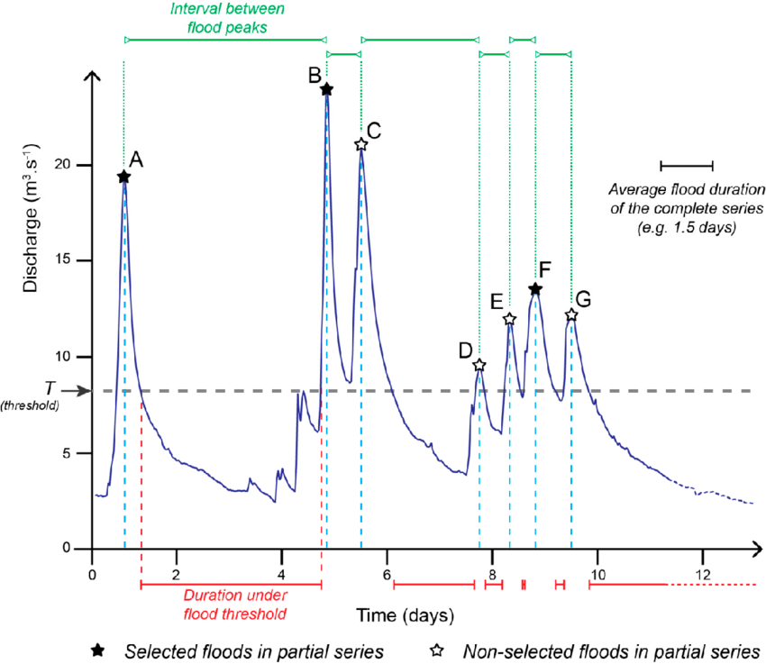
Independence
Are two (or more) flood peaks caused by the same event?
Van Campenhout, et al. (2020)

Slide 11
Things to Consider
Time
  How much time between events?
Recession
  How low should flow get between events?

Slide 12
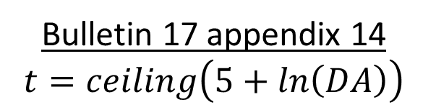
Time Separation
How long does a typical flood last?
How long does it take to return to baseflow?
  Typically related to drainage area
  May also be related to meteorology/climatology
Bulletin 17 appendix 14
$$t=ceiling\left(5+ln\left(DA\right)\right)$$
Notes:
The source of this equation is a mystery, but in my experience it’s a pretty good first estimate especially in drainage areas of a few hundred to few thousand square miles.

Slide 13
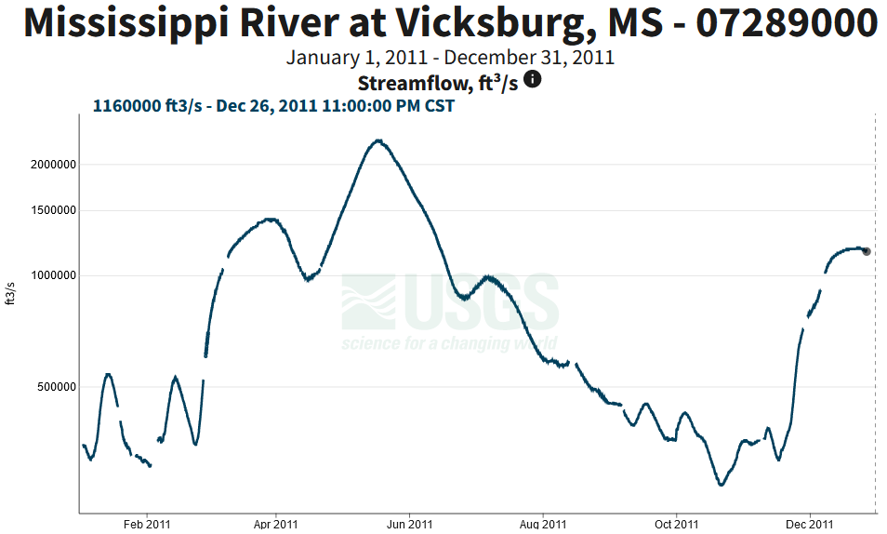
2+ months
Drainage area: 1,144,500 square miles
Notes:
5+ln(DA) gives us 19 days on this one, which is way too low

Slide 14
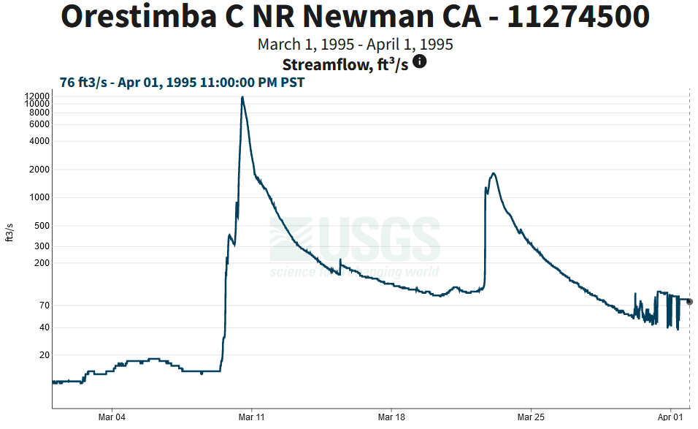
~10 days
Drainage area: 134 square miles
Notes:
5+ln(DA) gives 10 days which is very reasonable here.

Slide 15
Recession Separation
How low does flow have to be to consider a flood “over”?
Alternatively, when do we get back to baseflow?
  Depends on magnitude of floods
Strategies
  Fixed threshold
  Amount lower than higher peak
  Percent of higher peak
  Percent of lower peak
Notes:
The first three strategies are easy to apply using the filtering tools in HEC-SSP. The last one is mentioned in Bulletin 17B appendix 14 but we haven’t really implemented anywhere.

Slide 16
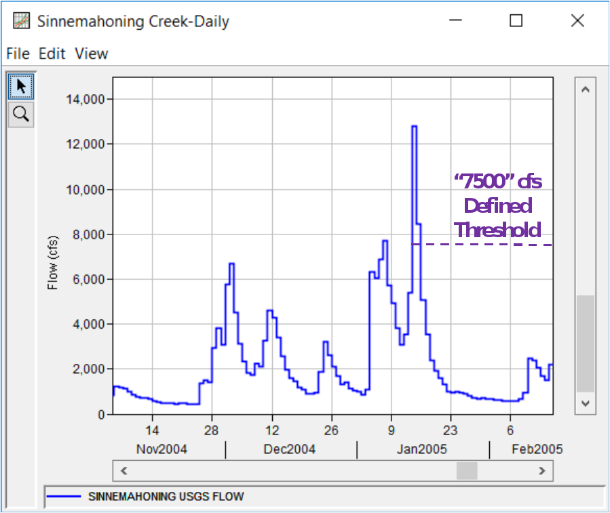
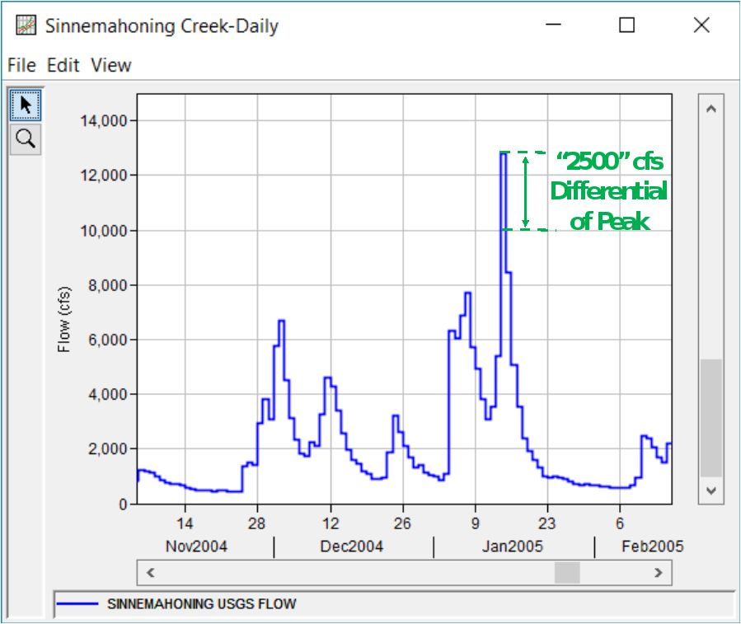
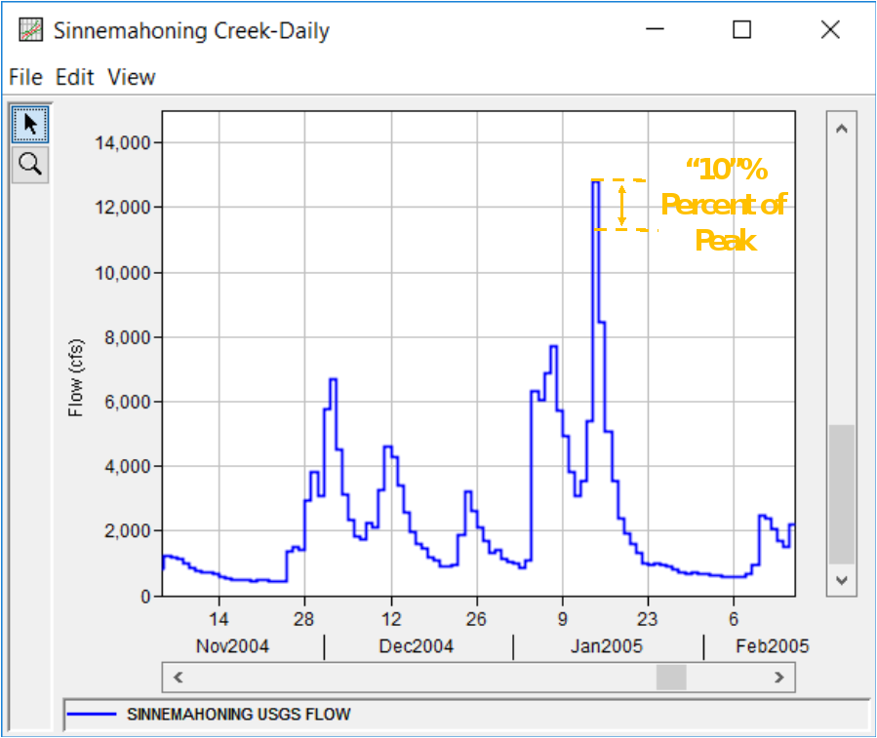
Filtering Peaks

Slide 17
Threshold Choice

Slide 18
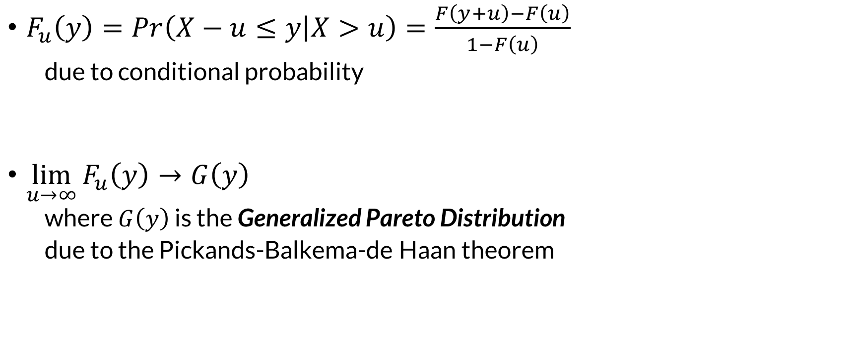
Pickands-Balkema-de Haan Theorem
$F_{u}\left(y\right)=Pr\left(X−u≤y | X>u\right)=\frac{F\left(y+u\right)−F\left(u\right)}{1−F\left(u\right)}$
  due to conditional probability
$\lim_{u→∞}{F_{u}\left(y\right)}→G\left(y\right)$
  where $G\left(y\right)$ is the Generalized Pareto Distribution
  due to the Pickands-Balkema-de Haan theorem
Notes:
The Pickands-Balkema-de Haan theorem, also called the second extreme value theorem, gives us the probability distribution for the values of those excesses.
The bottom line is that if you select a sufficiently high threshold, the values of the excesses will converge to the generalized Pareto distribution. The generalized Pareto distribution is a three-parameter distribution where one parameter is the value of the threshold selected for a PDS analysis.

Slide 19
Threshold Choice
High thresholds
  Better agreement with second extreme value theorem
  More likely to be a collection of floods
  Decreases sample size

Slide 20
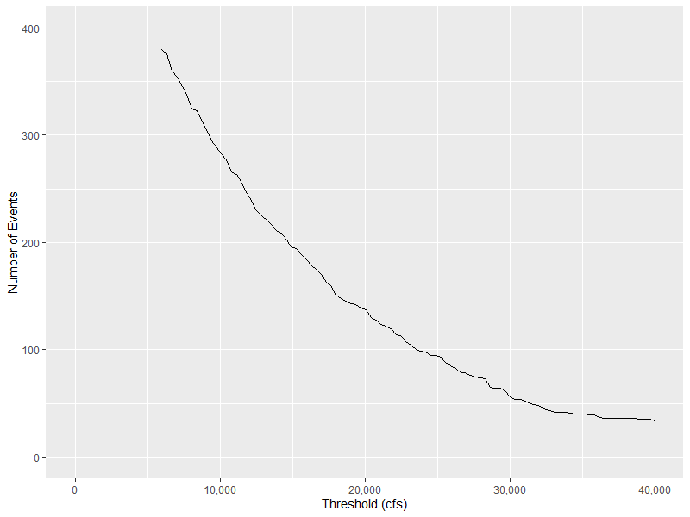
Choosing a Threshold
Sufficiently high threshold necessary
  Helps with assumptions
  Makes our model work
Too high a threshold results in
small sample sizes

Slide 21
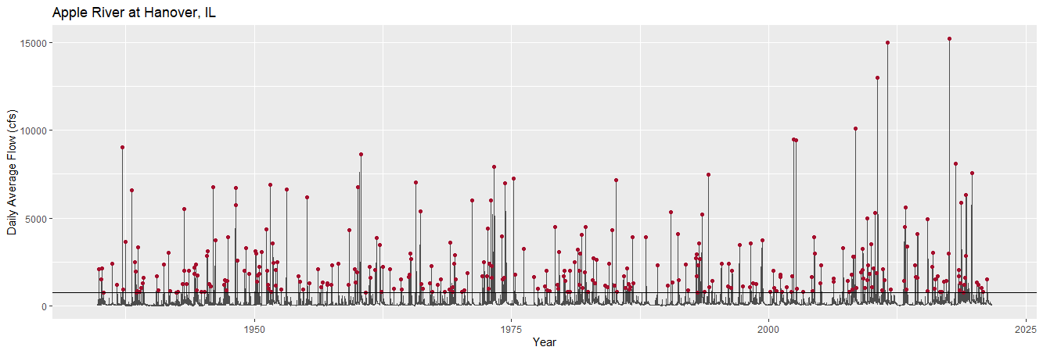
750 cfs
11 days minimum separation
250 cfs minimum recession
318 events

Slide 22
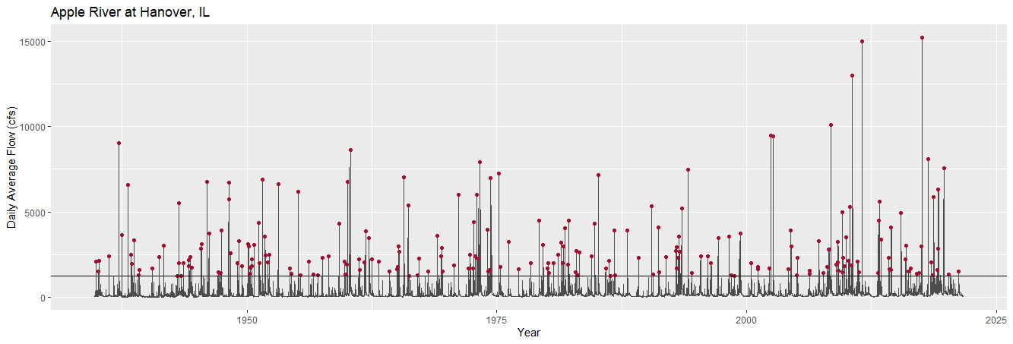
1,250 cfs
11 days minimum separation
250 cfs minimum recession
220 events

Slide 23
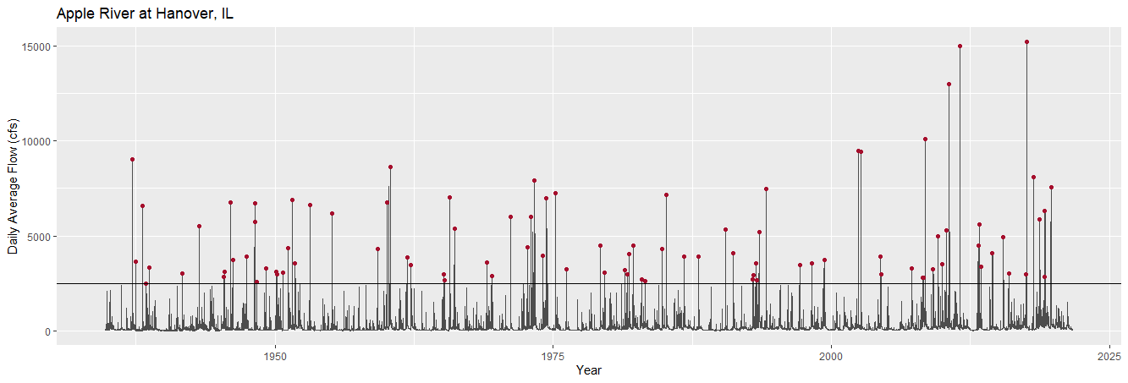
2,500 cfs
11 days minimum separation
250 cfs minimum recession
93 events

Slide 24

Choosing a Threshold: Ideas
Minimum annual maximum value
Bankfull discharge
Mean rate = 1 event / year (# events = # years)
Support with more “advanced” diagnostics
  Pareto shape plot
  Mean excess plot

Slide 25
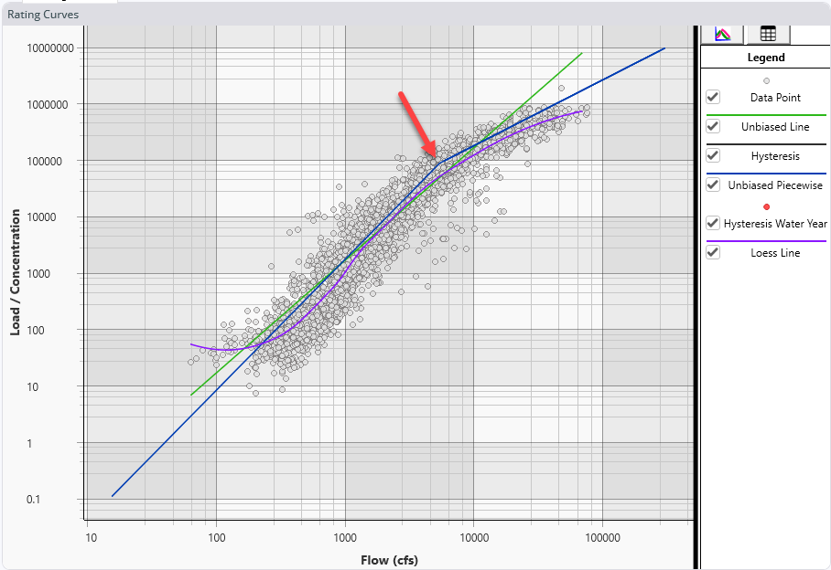
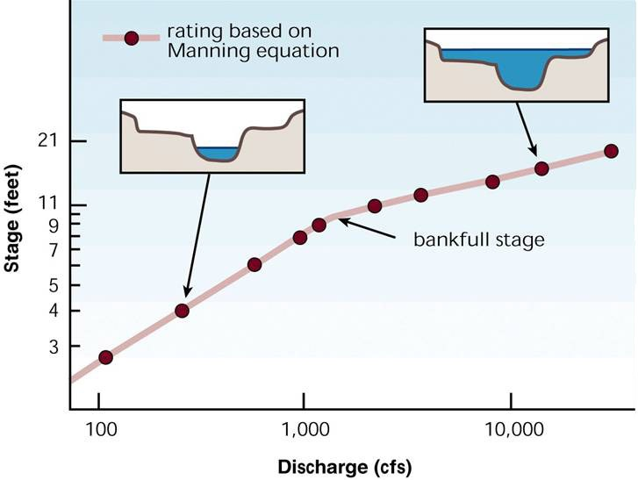
Bankfull Discharge
Cross-section
Geomorphological regression equations
Rating curves
Notes:
In principle I love using bankfull discharge as an estimate for the threshold. If you have a cross-section or a HEC-RAS model for the gage location it can be very easy to extract that value. In places where you can only get flow measurements (e.g. USGS) then you need to try to estimate it from inflection points in the rating curve. Sometimes sediment data (graphic from Stanford Gibson) can be instructive too. Some areas have geomorphic prediction equations that predict the bankfull discharge, but this isn’t common. They may predict other bankfull properties (such as top width, depth, and area) you can attempt to use to estimate the discharge using Manning’s equation. However, this doesn’t always work.

Slide 26
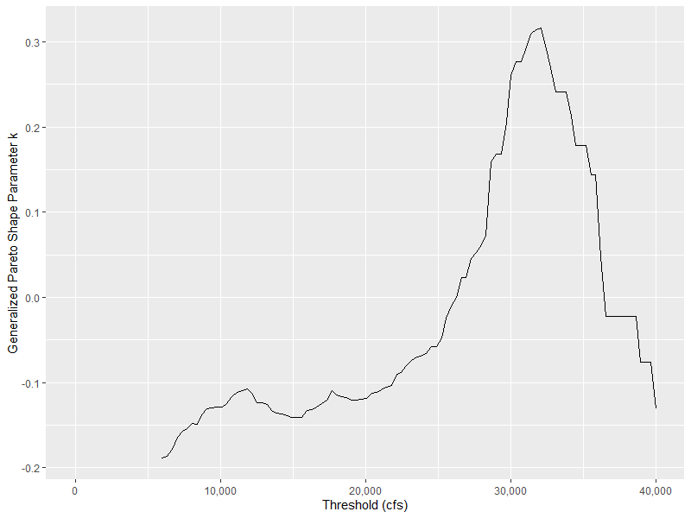
Other Diagnostics: Pareto Shape Plot
Compute PDS for varying thresholds
Fit generalized Pareto distribution to each
Plot threshold vs. Pareto shape parameter
Check for flat spot or change in shape
  Go from high to low
Notes:
We will talk more about the generalized Pareto distribution in Section 2. If you’re uncomfortable with fitting this model and taking its parameter, imagine it is the same procedure as fitting a log-Pearson type III distribution and taking the skew out. It’s like that but a different distribution with different parameters.
This plot is pretty subjective, as is the next one. Here we are looking for the largest threshold value where the shape parameter is stable, creating a modestly flat spot in the plot. Here the plot increases from a low threshold to about 10,000 cfs, and then is relatively flat until about 20,000 cfs, and then starts increasing by a lot. Here I would choose a threshold of about 20,000 cfs.

Slide 27
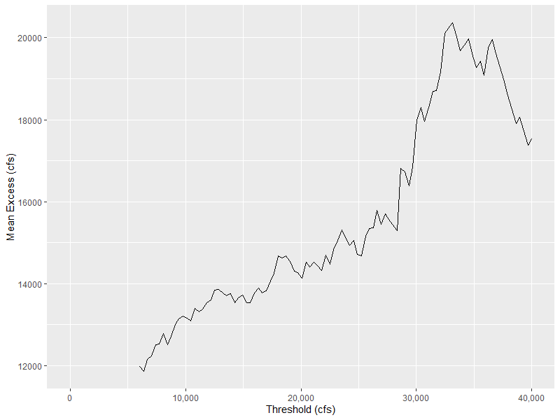
Other Diagnostics: Mean Excess Plot
Compute PDS for varying thresholds
Compute mean amount peaks exceed threshold
Plot threshold vs. mean
Check for linearity or change in shape
  Go from high to low
Notes:
Both of these plots are pretty subjective and don’t always produce easy to interpret results. For this plot, find the (largest) threshold value where the linearity in mean excess stops, and that is your threshold. Here it’s something like 28,000 cfs.

Slide 28
Questions?

