Slide 1

Multivariate Analysis
Part I: Marginal, Conditional, and Joint Probability
Gregory S. Karlovits, P.E., PH, CFM
US Army Corps of Engineers
Hydrologic Engineering Center
Notes:
Hello everyone, I'm Greg Karlovits from the Hydrologic Engineering Center. Welcome to our course on statistical methods in hydrology. This video is part one of three on the topic of multivariate analysis and will discuss marginal, conditional, and joint probability. Let's get started.

Slide 2
Notation: Probability
Marginal
P(A)
Joint
P(A,B) or P(A and B) or P(A ∩ B)
Conditional
P(A|B)
Notes:
In this segment, we will discuss how multiple events and random variables interact with each other. We have seen some of these before, and we will expand on these concepts to build to bigger and more complex multivariate problems. Let’s start by looking at three key distinctions of notation.
In the context of multivariate probability, when we encounter P(A), this is referred to as the marginal probability of A.
When we see any of the following: P(A [comma] B), P(A [and] B), or P(A [intersection] B), these are different notation for the same thing: the joint probability of A and B.
Finally when we see P(A [vertical pipe] B), which is read as “A given B”, this is conditional probability.

Slide 3
Marginal Probability
What is the probability of A occurring irrespective of what happens with B?
Ω
A
B
Notes:
In multivariate probability, when we ask about the probability of one event regardless of any information we have about other variables, this is referred to as marginal probability. P(A) is the marginal probability of event A occurring regardless of any other information.
Imagine the rectangle has an area equal to one. If the area of a circle (less than or equal to 1, greater than or equal to zero) is equal to its probability, then in this case P(A) is the area inside A regardless of whether it’s in B, or an undrawn C, etc.

Slide 4
Joint Probability
What is the probability of A and B occurring together?
Ω
A
B
Notes:
Now imagine that we’re concerned with the region that belongs in both A and B, so that both things have to happen. This is the joint probability of A and B, or the probability of the intersection of A and B. The area of this lens is less than A or B. It can be at most the area of the smaller of the two, assuming it is completely within the other.

Slide 5

Joint Probability
$$P\left(A,B\right)≤min\left(P\left(A\right),P\left(B\right)\right)$$
Ω
A
B
Beware the Conjunction Fallacy
Notes:
Joint probability can be very important in situations like expert elicitations, where expert judgement is used to estimate the probability of something occurring. However, there is one key fallacy that can ruin the validity of these estimates, called the conjunction fallacy.
Tversky and Kahneman in 1983 performed an experiment with a number of statisticians. They gave the following question to the field:
Linda is 31 years old, single, outspoken, and very bright. She majored in philosophy. As a student, she was deeply concerned with issues of discrimination and social justice, and also participated in anti-nuclear demonstrations. Which is more probable?
Linda is a bank teller.
Linda is a bank teller and is active in the feminist movement.
The answer is statement A: Linda is a bank teller. This is because the extra condition imposed by the statement that “Linda is active in the feminist movement” necessarily makes the second statement less likely. It is easy to look at the narrative, and find the likelihood of the statement “Linda is active in the feminist movement” to be high. However, this conclusion suffers from the conjunction fallacy. The only way that the statements could have equal probability is if the probability of Linda being active in the feminist movement is one. If it is anything less than one, then the second statement is less probable.
The largest that the joint probability of two events can be is the smaller of the probability of the two events, and this only occurs if B is completely contained within A; then P(B) = P(A,B). The Venn diagram above shows this situation, where the overlapping area, which is the probability of A and B, is equal to the probability of B.
Why does it suddenly become easier to believe that the government is controlled by lizard people if we also believe there is a massive conspiracy to cover it up involving the entire Federal government?
The sticking power of conspiracy theories arises from the fact that evidence against the first (lizard people) becomes evidence for the second (giant coverup.)

Slide 6
Independence
A and B are independent iff:
P(A,B) = P(A) * P(B)
Then we write A ⊥ B
Not easy to show on a Venn Diagram
Notes:
Independence of two events comes from understanding joint probability. A and B are independent if and only if the probability of A and B is equal to the probability of A times the probability of B. This is written as A “perpendicular” to B, which means that the two events are independent. This is not easy to show on a Venn diagram and has to be constructed so that the overlapping area of two circles is equal to the product of the areas of the circles.

Slide 7
Conditional Probability
Given that B has occurred, what is the probability that A occurs?
Once we have observed that B has occurred, it becomes our “universe”
A
B
Ω
A^{c}
B
A
Notes:
Conditional probability is about adding information. It asks, once we see some event B occurring, what is the probability that event A then occurs? When B occurs, our universe narrows a bit, and we can only then observe outcomes that are dependent on B having occurred first. It transforms our Venn diagram from the figure on the left, into the one on the right. After B has occurred, the possible outcomes are that A occurs, or A does not occur (written as A-complement.) The probability that A occurs given that B has occurred is the area of the overlap between A and B, divided by the whole area of B.

Slide 8
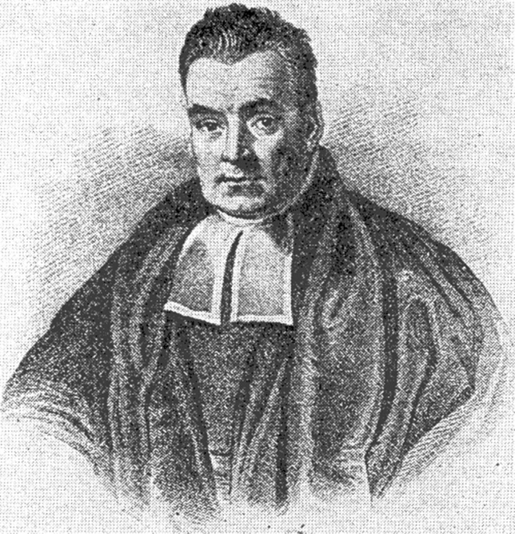


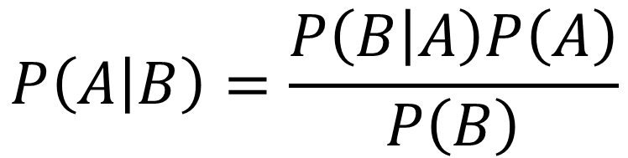
Conditional Probability
$P\left(A | B\right)≠P\left(B | A\right)$ unless $P\left(A\right)=P\left(B\right)$
$$P\left(A | B\right)=\frac{P\left(B | A\right)P\left(A\right)}{P\left(B\right)}$$
Bayes’ Theorem
Notes:
It is important to note that conditional probability is not reversible. The probability of A given B is not equal to the probability of B given A, unless the probability of A and B are equal.
This is due to Bayes’ theorem, which lets us do two important things: one, is to reverse conditional probability, and two, is to update our beliefs with information. The first of these usages is important for working with conditional probability. The second is an entire branch of statistics which unfortunately will not be covered here. Hat tip to Reverend Thomas Bayes.

Slide 9

Relationships
$P\left(A\right)=\int{P\left(A,B\right)dB}$
$P\left(A | B\right)=\frac{P\left(A,B\right)}{P\left(B\right)}$
if A ⊥ B, $P\left(A | B\right)=\frac{P\left(A\right)P\left(B\right)}{P\left(B\right)}↔P\left(A\right)$
Notes:
All three of the flavors of multivariate probability we talked about, marginal, joint, and conditional, are related.
To get the marginal probability for event A from the joint probability of A and B, B is integrated out of the joint probability. This is used most frequently in finding the marginal probability distribution for variable A when what is given is the joint probability distribution of A and B.
An important identity is that the probability of A given B is equal to the joint probability of A and B, divided by the probability of B. To reverse the condition and get the probability of B given A, you would find the quotient P(A and B) divided by P(A) instead.
When A and B are independent, the joint probability of A and B is equal to the products of the probability. This means that the previous identity shows that the probability of A given be is equal to the probability of A. In other words, conditioning doesn’t add any information. If B occurs, it makes it no more or less likely that A will.

Slide 10
Handling the Difference
Joint probabilities can never be larger than marginal
P(A,B) ≤ P(A)
Imposing a condition can vastly change the answer
Large P(A|B) says nothing about P(A)
Ω
A
B
Notes:
Knowing which situation your events are in can be important for interpreting the results. We talked before about the conjunction fallacy, and it is important to remember that joint probabilities can never be larger than marginal. This is important because if you have a situation where the outcome of interest requires a bunch of things happening, and one of those has a very tiny probability, the probability of your outcome of interest is smaller than even that very tiny value (unless all the other events have probability 1).
When a condition is imposed, the event probabilities can change vastly. If the probability we are given for A to occur is dependent on already having seen B, this actually does not give us any information about the marginal probability of A occurring. In the Venn diagram at the bottom, we see a situation where P(A|B) = 1. If B happens, there is no way for A^{c} to happen (A to not happen). But what does that say about the probability of A occurring any time? It can be large but definitely not 1 as in this case. In this case, B occurring only tells us A is certain to happen. But if B doesn’t happen, A seems to still be pretty likely to happen. That’s because P(A)/P(B) is pretty large. This also means that P(B|A) is much smaller than P(A|B). If we see that A has happened, there’s still a pretty good chance that B doesn’t happen.

Slide 11
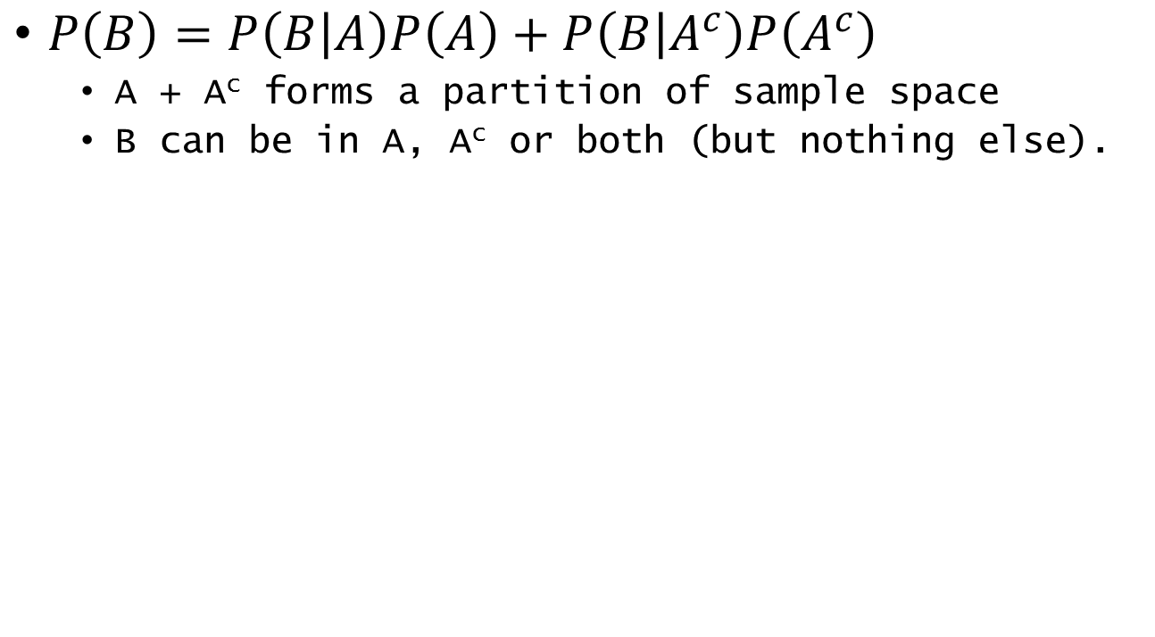
Law of Total Probability
$P\left(B\right)=P\left(B | A\right)P\left(A\right)+P\left(B | A^{c}\right)P\left(A^{c}\right)$
A + A^{c} forms a partition of sample space
B can be in A, A^{c} or both (but nothing else).
A^{c}
A
B
Ω
Notes:
The law of total probability lets us break up problems into discrete elements that may be easier to model. In this simple situation, we observe phenomenon B in the context of event A either happening, or not happening. We can compute the probability of B by attributing its probability to those two situations. The first term after the equals sign gives us the real area of the overlap of A and B, and the second term gives us the real area of the part of B that is not in A. Because A and A-complement are mutually exclusive and exhaustive, B has to be either in A or in A-complement. This means the remainder of the area is in A-complement, and can be computed as the real area of overlap between B and A-complement.
In this case we only see two variables, but the law of total probability extends to arbitrarily many variables, which can be used to break up a problem into parts that are easier to model.

Slide 12
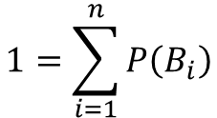
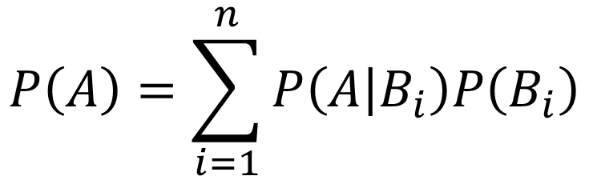

Law of Total Probability
$$1=\sum_{i=1}^{n}{P\left(B_{i}\right)}$$
$$P\left(A\right)=\sum_{i=1}^{n}{P\left(A | B_{i}\right)P\left(B_{i}\right)}$$
$$P\left(B_{i},B_{j}\right)=0 ∀i≠j$$
B₁
B₂
B₃
B₄
A
Ω
Notes:
This is the extension of the law of total probability into arbitrarily many variables. We are interested in the probability of event A, and it is observed after one of the conditions B1 through B4 are observed first.
If we establish the Bs are a partition of the sample space (they do not overlap, and there’s nothing that can happen that’s not in one of the Bs) then we can generalize the equation. This lets us compute the probability of A from an arbitrary number of conditional probabilities.

Slide 13
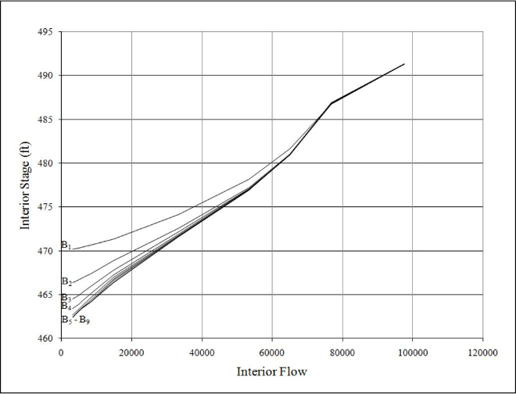
Coincident Frequency Analysis e.g. EM1110-2-1413
A and B have some joint distribution
C = f(A, B)
What is the distribution of C?
Notes:
Coincident frequency analysis gets a lot of mileage out of the law of total probability. This will provide a brief overview of the method, which we will see in more detail later.
In this situation, there is a levee pump station storage basin, and we are interested in the probability of the stage of that storage basin exceeding some values. This is our unknown event C. It is a function of A, which is interior flow to the pump station, and B, which is the exterior flow on the river side of the levee. There is a joint distribution of A and B, and we simulate the response of C for a large number of combinations of A and B. A is treated continuously, and B is broken into a number of discrete cases. Response functions are plotted for each discrete case of B, which are plots of C as a function of A, with a given value of B. The probability of a value of C is computed then as the sum of P(C|B)P(B) for all B.
This process has mainly been replaced by more intuitive techniques involving Monte Carlo simulation that take advantage of modern computing power.

Slide 14
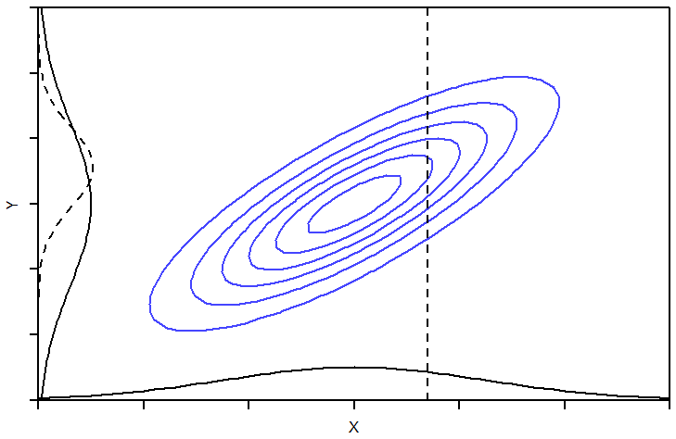
Conditional Moments
Start with a joint distribution of X and Y
Given an observation X = x, what is the behavior of Y?
Notes:
This is a little bit of a preview of the discussion of joint probability distributions that we will see later. However, it ties in very directly to the discussion of the difference between marginal, joint, and conditional probability.
Imagine the joint behavior of variables X and Y are defined by the blue contours in this plot. The contours are lines of constant likelihood. The mode of this distribution is in the oval in the middle of the contours. This is referred to as the joint distribution of X and Y.
The marginal probability distribution for X is the solid curve along the X axis, and the marginal probability distribution for Y is along the Y axis. Remember that marginal refers to the behavior of this variable without regard for any other variables or information.
Now imagine we observe that X takes on some value, shown as the vertical dashed line. The conditional distribution of Y, given that we have observed X take on this value, is shown as the dashed line along the Y axis. Notice that the shape of this distribution is different than the marginal distribution shown along the same axis. The center of this distribution has shifted upwards, and the spread of the distribution seems smaller than the marginal distribution. This conditional distribution of Y has different moments than the marginal distribution for Y. That is to say, it has conditional moments, conditioned on having observed that random variable X has taken on some value.
That vertical line representing the observed value of X makes a slice through the joint probability distribution, and the cross-section that it makes is the conditional distribution of Y. The mean of this conditional distribution is the conditional mean of Y given a value of X, and the variance of this distribution is the conditional variance of Y given a value of X.
With this conditional distribution shown as the dashed curve, we can answer a question like this: “what is the probability that Y is greater than 3, given that X is equal to 0.7?” We would find the dashed curve by taking a vertical slice of the joint distribution at X = 0.7, and then on the dashed curve, find the area of it for the region where it is greater than 3.

Slide 15
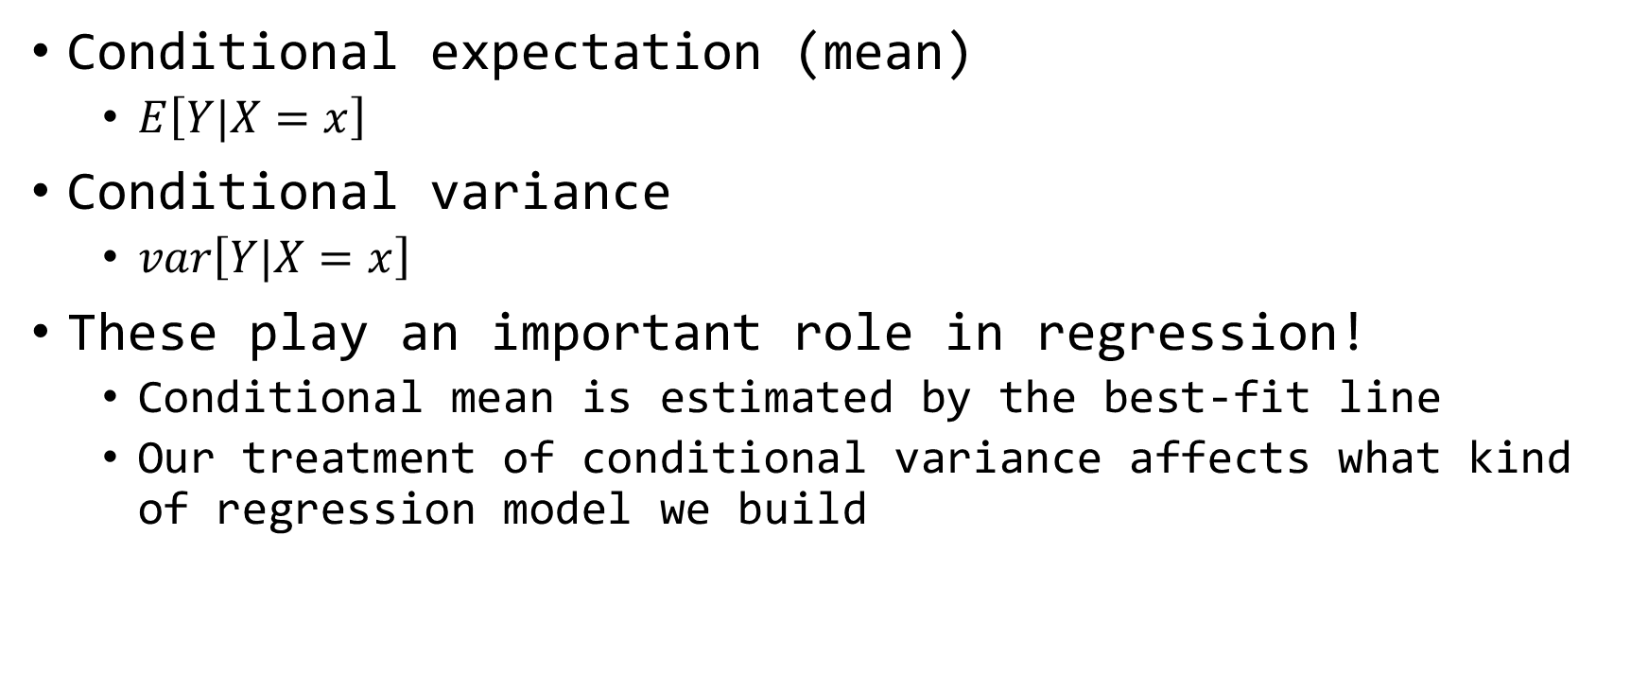
Conditional Moments
Conditional expectation (mean)
$E\left[Y|X=x\right]$
Conditional variance
$var\left[Y|X=x\right]$
These play an important role in regression!
Conditional mean is estimated by the best-fit line
Our treatment of conditional variance affects what kind of regression model we build
Notes:
When we have joint distributions of two variables, we might want to know more about the behavior of one of those variables given that we have information about the other. Linear regression is one of those cases. When we have a linear regression model we are describing the relationship between two variables. Usually we want more information about the response variable Y after we have observed that X is some value. This is how we make predictions about the best estimate for Y based on the regression line, or build confidence and prediction intervals – they are all based on conditional moments.
The regression line itself is the conditional mean of Y at all values of X. X and Y are random variables, but the mean value of Y given any value of X is the regression line.
The variance of Y tells us what kind of regression model we are going to build. We will see in the regression discussion that we assume that the conditional variance of Y given all values of X is constant, and Y has a normal distribution. This is fundamental to simple linear regression. However in the cases where either or both of these assumptions don’t hold, we might build a different kind of regression model.

Slide 16
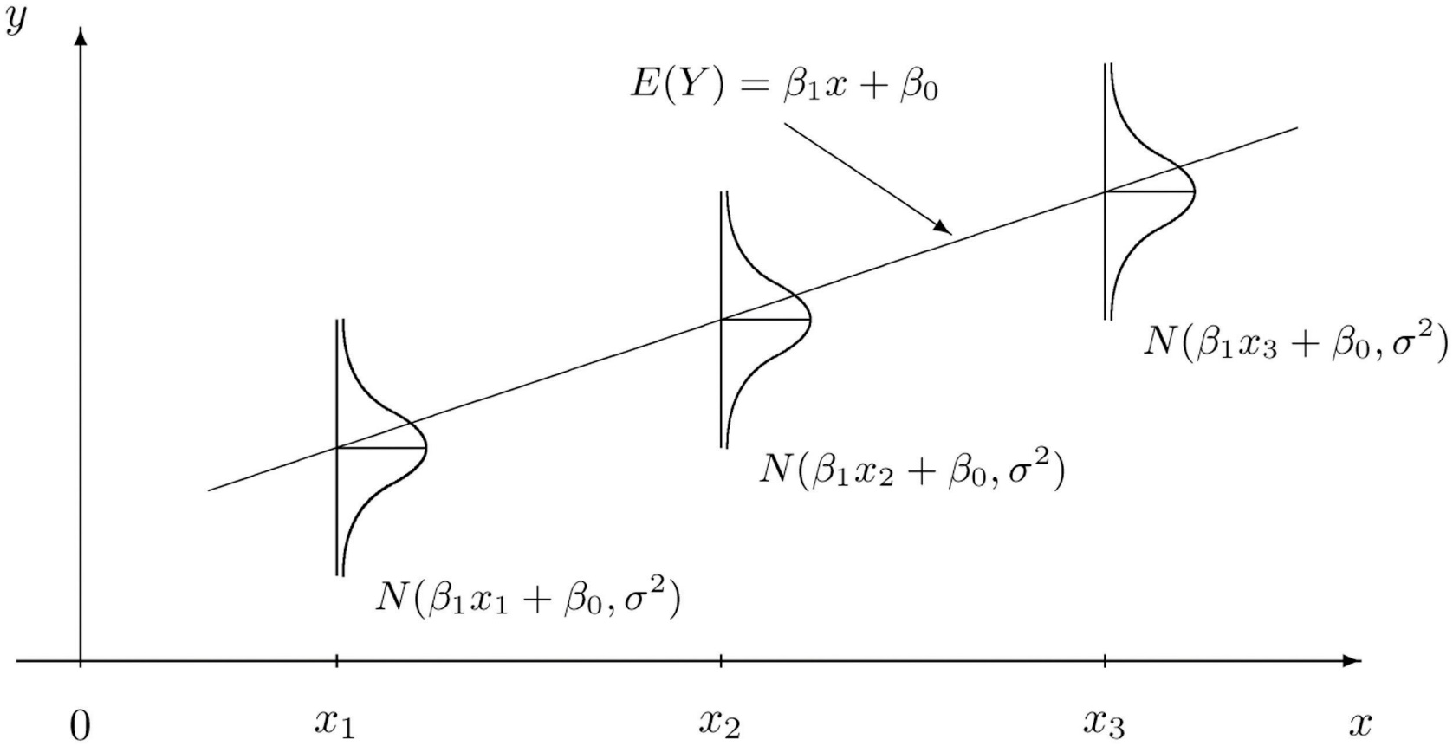

Simple Linear Regression
Response variable is normally-distributed, with:
$E\left[Y|X=x\right]=β_{0}+β_{1}x$ and $var\left[Y|X=x\right]=σ^{2}$
https://saylordotorg.github.io/text_introductory-statistics/s14-03-modelling-linear-relationships.html
Notes:
Here is the simple linear regression example of conditional moments. We see that the conditional mean of Y is the regression line, with beta-naught + beta-one times x determining how the conditional mean varies linearly with x. The plot shows that best fit line going through the middle of the bell-curves that show the conditional distribution for Y. The bell curves all have the same spread, because in simple linear regression we assume that the conditional variance of Y given any value of X is a constant.

Slide 17

Generalized Linear Models
Response variable has any distribution
Parameters or moments a function of the predictors
$E\left[Y|X=x\right]=f\left(x\right)$
$var\left[Y|X=x\right]=g(x)$
Notes:
Generalized linear models help us in the situation where we can’t meet the assumptions in simple linear regression. In generalized linear models, which are a type of regression with more relaxed requirements, the response variable does not need to be normally distributed – it could be any distribution you choose. The parameters or the moments of that distribution become a function of one or more predictor variables, meaning the mean and the variance (and higher moments) are explicitly functions of one ore more predictors. These are very flexible models useful for a variety of situations. Generalized linear models are a more advanced topic and we won’t cover them in this class, but they are good to know about for when your regression analysis calls for them.

Slide 18
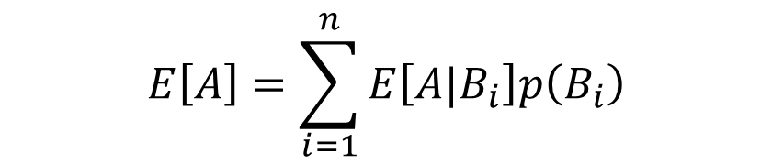
Law of Total Expectation
Weighted average under a number of conditions
As long as B forms a partition of the sample space,
Variance (and covariance) have similar rules.
$$E\left[Y\right]=E\left[E\left[Y|X\right]\right]$$
$$E\left[A\right]=\sum_{i=1}^{n}{E\left[A|B_{i}\right]p\left(B_{i}\right)}$$
Notes:
The law of total expectation, also called the law of iterated expectation, allows us to get the mean of Y when all we have is the conditional distribution of Y given X. This basically says that the mean of all the conditional means of Y is the mean of Y.
Conditional moments have similar properties to conditional probabilities, including a law of total expectation that behaves much like the law of total probability. The second equation is the general case of the first equation. Say you have two cases, B1 and B2, and they are equally likely (that is, they both have probability 0.5.) When B1 occurs, the mean of A is 3. When B2 occurs, the mean of A is 5. Based on this second equation, this means that the mean of A is 4, computed using a weighted average with the weights equal to 0.5.
There are similar rules for variance and covariance that let you compute the variance of a random variable from its conditional distribution.

Slide 19
Summary
Marginal, conditional, and joint probability are used to express the relationship between events
Conditional moments express the behavior of one random variable given information about another
Notes:
In this video, we discussed marginal, conditional, and joint probability. Two key points to take away from this video are:
Marginal, conditional, and joint probability are means for expressing the relationship between two events and their probabilities of occurrence, and
Conditional moments are a way to express the behavior of one random variable, given that we have information about another, related, random variable.
Thanks, and tune into the next video in this series on multivariate analysis to learn about correlation.

Slide 20
Multivariate Analysis
Part II: Correlation
Gregory S. Karlovits, P.E., PH, CFM
US Army Corps of Engineers
Hydrologic Engineering Center
Notes:
Hello everyone, I'm Greg Karlovits from the Hydrologic Engineering Center. Welcome to our course on statistical methods in hydrology. This video is part two of three on the topic of multivariate analysis and will discuss correlation. Let's get started.

Slide 21

Review: Variance
Recall the variance formula:
$s_{x}^{2}=\frac{1}{n−1}\sum_{i=1}^{n}{{\left(x_{i}−\overline{x}\right)}^{2}}$
Notes:
After our review of joint and conditional probability, we can dive more into the relationship between two random variables. These tools further help us quantify and model how two random variables interact and depend on each other.
But first, let’s review the variance formula. Recall that the variance of a variable measures how much the variable spreads out from the mean of that variable. It measures this by finding the average squared distance of each point away from the mean of the sample.

Slide 22
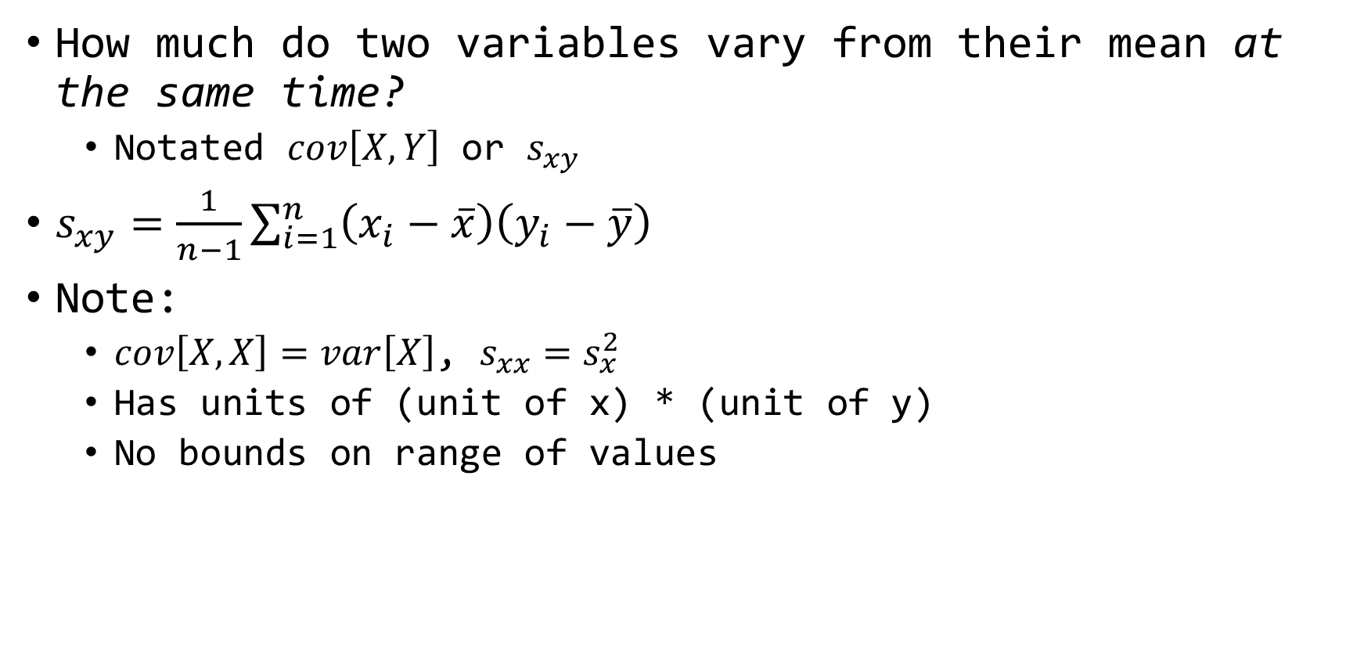
Covariance
How much do two variables vary from their mean at the same time?
Notated $cov\left[X,Y\right]$ or $s_{xy}$
$s_{xy}=\frac{1}{n−1}\sum_{i=1}^{n}{\left(x_{i}−\overline{x}\right)\left(y_{i}−\overline{y}\right)}$
Note:
$cov\left[X,X\right]=var\left[X\right]$, $s_{xx}=s_{x}^{2}$
Has units of (unit of x) * (unit of y)
No bounds on range of values
Notes:
Now, let’s look at covariance, which is a multivariate extension of variance. Instead of measuring in one variable how much it tends to vary away from its mean, we look at how two variables vary away from their mean at the same time. The sample covariance formula looks a lot like the sample variance formula, except instead of squaring the x-i minus x-bar part, we multiply it by y-i minus y bar. So for each point in the sample, we take the x coordinate of the point and subtract of the mean of x, and then do the same for the y coordinate, subtracting off the mean of the y, and multiply the two. Then we add that up for all of the data points in the sample and take the mean. This is the sample covariance of X and Y.
A couple of things to note is that you can take the covariance of a variable and itself, which is simply the variance of that variable. You can see in the covariance formula that if you do that, you are multiplying x-i minus x-bar by itself, giving you x-i minus x-bar squared, which gives you the variance formula back.
The sample covariance of x and y has units of the product of the unit of x and unit of y. That often isn’t very meaningful or helpful. The sample covariance also does not have a range of values, so it is hard to interpret or compare. Standardizing it is much more helpful.

Slide 23
Three Ways to Measure Correlation
Pearson’s product-moment correlation coefficient (r)
Kendall’s rank correlation coefficient (τ)
Spearman’s rank correlation coefficient (ρ)
Range of -1 (perfect negative correlation) to +1 (perfect positive correlation)
Notes:
Correlation and covariance are directly related. Correlation can be thought of as a standardization of covariance that gives the measurement no units, and a range of negative one to one. The fixed range is extremely helpful for comparisons.
The most common way to measure correlation is Pearson’s correlation coefficient, which is a measurement of linear correlation. We will see how Pearson’s correlation directly uses the sample covariance.
Two non-parametric measures of correlation, which tend to be more robust to the linearity requirement, are Kendall’s and Spearman’s rank correlation coefficients.
For all three of these measures, the minimum value of -1 indicates perfect negative correlation and the maximum value of +1 indicates perfect positive correlation. A value of zero indicates no correlation.

Slide 24
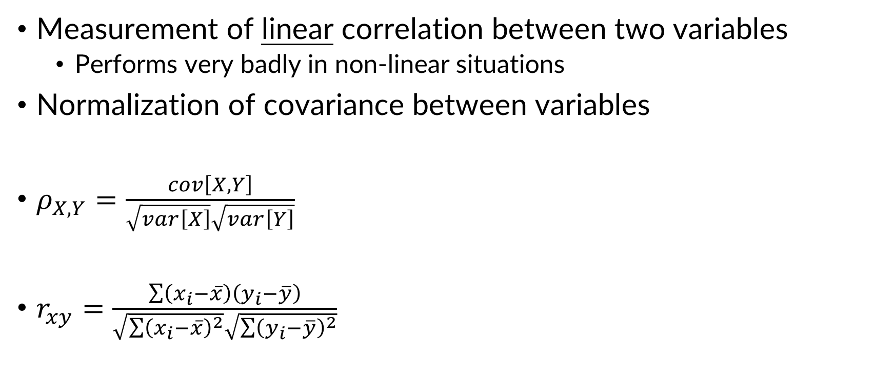
Pearson’s Correlation Coefficient
Measurement of linear correlation between two variables
Performs very badly in non-linear situations
Normalization of covariance between variables
$ρ_{X,Y}=\frac{cov\left[X,Y\right]}{\sqrt{var\left[X\right]}\sqrt{var\left[Y\right]}}$
$r_{xy}=\frac{\sum{\left(x_{i}−\overline{x}\right)\left(y_{i}−\overline{y}\right)}}{\sqrt{\sum{{\left(x_{i}−\overline{x}\right)}^{2}}}\sqrt{\sum{{\left(y_{i}−\overline{y}\right)}^{2}}}}$
R:
cor(x)
x is a data frame with 2 or more columns
Notes:
As we said before, Pearson’s correlation coefficient is the most common way to measure correlation. However, it is highly sensitive to the assumption that the two variables being measured have a linear relationship, and performs badly in situations where X and Y are not linearly related.
Pearson’s correlation coefficient is a normalization of the sample covariance. It normalizes the covariance by taking the product of the standard deviation of x and the standard deviation of Y.
If you were to measure the correlation of a variable with itself, you could plug this into the correlation formula and see that you will always get a value of 1. This is because the covariance of a variable and itself is the variance, and when you compute the normalization factor in the denominator, you wind up with this also being the variance of that variable.
In R it is very easy to compute correlation between two variables using the “cor” function. The default method for computing correlation is Pearson’s coefficient.

Slide 25
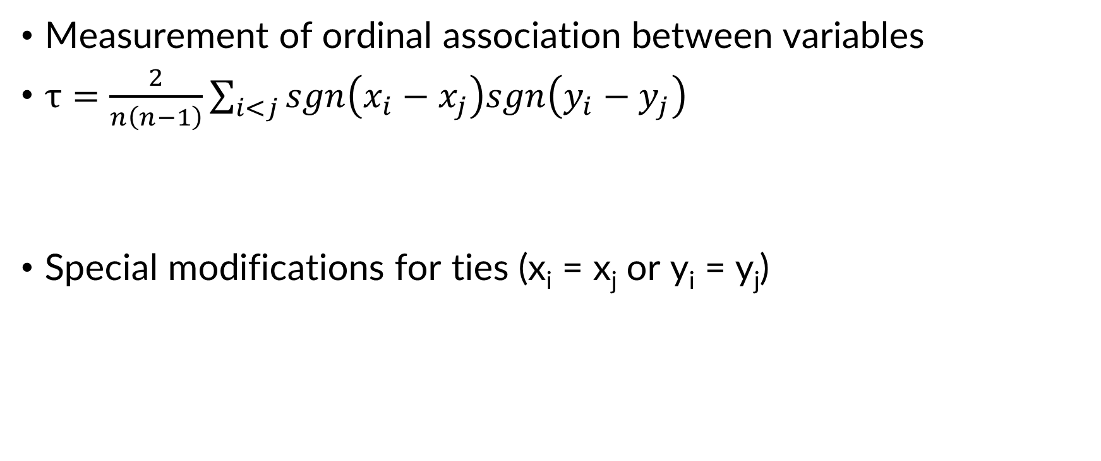
Kendall’s Tau
Measurement of ordinal association between variables
$τ=\frac{2}{n\left(n−1\right)}\sum_{i<j}{sgn\left(x_{i}−x_{j}\right)sgn\left(y_{i}−y_{j}\right)}$
Special modifications for ties (x_{i} = x_{j} or y_{i} = y_{j})
Term is -1 if both x and y do not increase (or decrease), +1 otherwise
R:
cor(x, method = “kendall”)
x is a data frame with 2 or more columns
Notes:
Kendall’s tau is a popular alternative that is less sensitive to non-linearity. Kendall’s tau checks if pair of values in the dataset are increasing in x and y. If both x and y increase between the points, the pair gets a score of +1. If both x and y decrease between the points, the pair gets a score of -1. If they are mixed, they get a score of 0. Then the mean score is computed across all the pairs of points.
In R, setting the method parameter of the “cor” function to “Kendall” will give you Kendall’s tau.

Slide 26
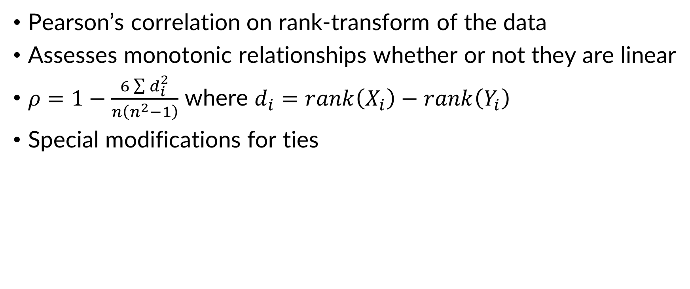
Spearman’s Rho
Pearson’s correlation on rank-transform of the data
Assesses monotonic relationships whether or not they are linear
$ρ=1−\frac{6\sum{d_{i}^{2}}}{n\left(n^{2}−1\right)}$ where $d_{i}=rank\left(X_{i}\right)−rank\left(Y_{i}\right)$
Special modifications for ties
R:
cor(x, method = “spearman”)
x is a data frame with 2 or more columns
Notes:
Spearman’s Rho is also more robust to non-linear situations. It often gives similar performance to Kendall’s tau.
There are two ways to compute it. In either situation, you have to find the rank of each X and Y in your dataset, with 1 being the smallest value and n being the largest value. Because you use a rank transformation on the data, Spearman’s rho is also called the rank correlation coefficient.
The first way to compute Spearman’s rho is to take the Pearson correlation coefficient of the ranks of the data. The second way is to use the formula shown, which is based on the difference in the ranks of the X and Y values for each data point. If all of the ranks are the same, d-i is always zero, so the sum is zero and the correlation is 1.
In R you can set the method parameter of the “cor” function to “spearman” to get Spearman’s rho.

Slide 27
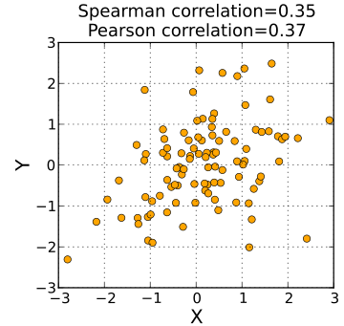
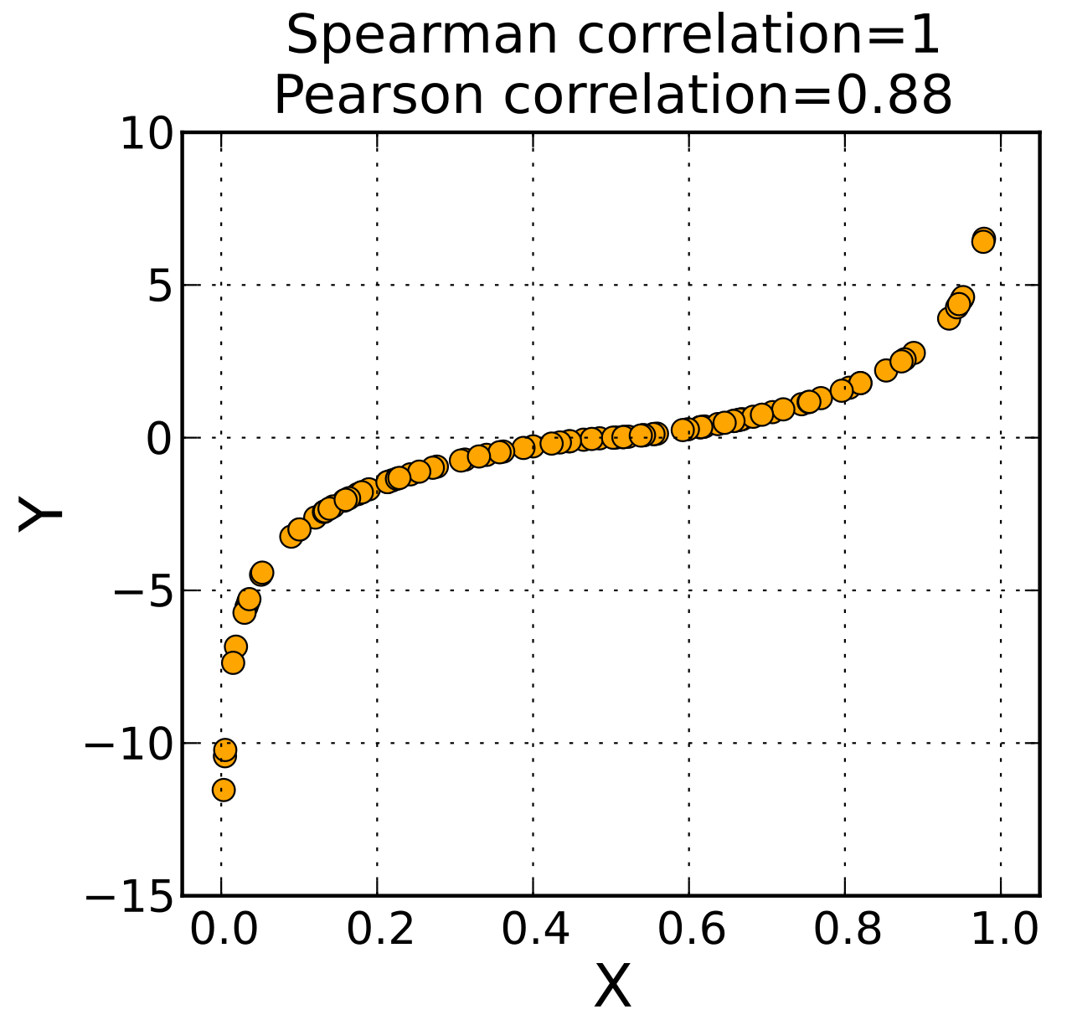
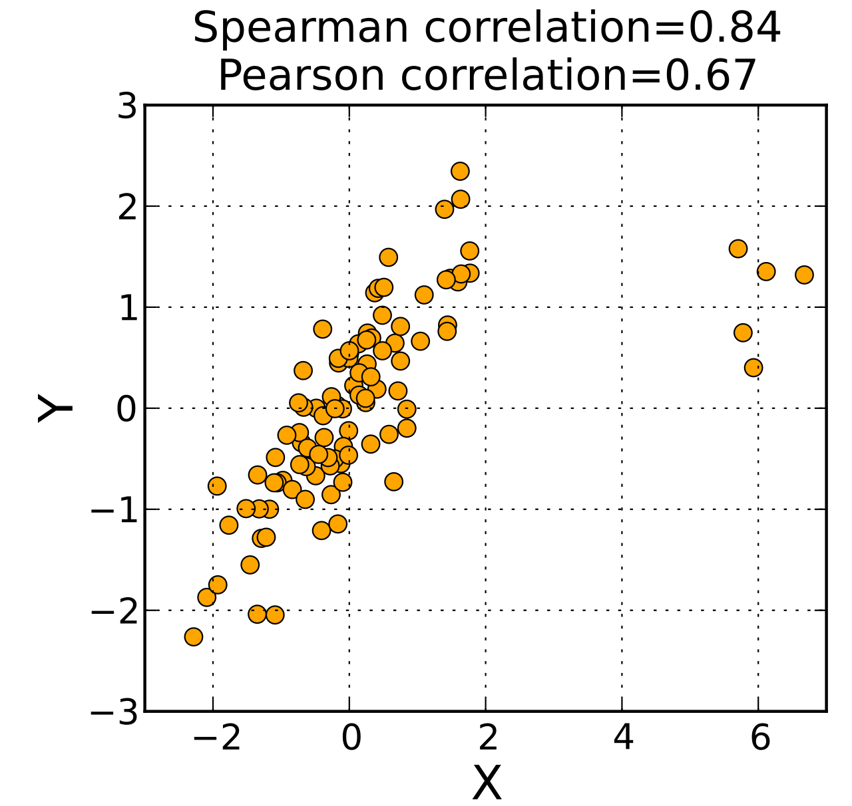
Product-Moment vs Rank Correlation
Monotonic
Non-Linear
Kendall and Spearman have similar performance
Notes:
Let’s see how Pearson’s correlation compares to a non-parametric measure of correlation. These plots show three sets of scattered data, and the associated Spearman and Pearson correlation coefficients for each. Kendall’s tau and Spearman’s rho have similar performance for these data.
In the plot on the left, we see a weakly linear relationship between X and Y, and both of the measures of correlation are small, giving a similar value of 0.35-0.37. There is nothing about the data suggesting that linear and nonlinear correlation should be very different, or that correlation in general should be very strong.
The second plot shows a set of data that are monotonic, but non-linear. In this case, because the relationship is not linear but the data are clearly increasing, the Pearson correlation is high but not perfect. Because the data are monotonic, Spearman’s rho is 1.
The third plot shows a situation where there is a strong linear clustering of points, but five points that do not follow the trend and fall off to the right. Because these extra points break the linear relationship, the Pearson correlation is much smaller than the Spearman correlation. Spearman’s rho is much less sensitive to these few data points and gives much more credit to the strength overall of the trend that larger X values are associated with larger Y values.

Slide 28
Summary
Covariance is a multivariate extension of variance
Correlation is normalized covariance
Pearson’s coeff. measures linear correlation
Kendall/Spearman coeff. are more robust
Notes:
In this video, we discussed correlation. Four key points to take away from this video are:
Covariance is a multivariate extension of variance
Correlation is the normalized version covariance, giving a measure of the relationship between two variables on a -1 to 1 scale
Pearson’s coefficient is a measure of linear correlation, and
Kendall’s and Spearman’s coefficients are more robust measures of correlation that are less sensitive to the linearity assumption.
Thanks, and tune into the next video in this series on multivariate analysis to learn about joint probability distributions and copulas.

Slide 29
Multivariate Analysis
Part III: Joint Probability Distributions and Copulas
Gregory S. Karlovits, P.E., PH, CFM
US Army Corps of Engineers
Hydrologic Engineering Center
Notes:
Hello everyone, I'm Greg Karlovits from the Hydrologic Engineering Center. Welcome to our course on statistical methods in hydrology. This video is part three of three on the topic of multivariate analysis and will discuss joint probability distributions and copulas. Let's get started.

Slide 30
Joint Probability Distributions
Probability distributions for multiple variables are less common
Must describe the behavior of each variable and the relationship between them
A sample of analytical models:
Multivariate normal
Multivariate t
Dirichlet
Wishart
Nobody* uses these
*Except Bayesians
Notes:
Despite there being an endless list of probability distributions for one variable, the list for multiple variables is much shorter and most of them are closely related. In most cases we are going to show examples of bivariate distributions, that is, joint distributions with two variables, but in almost all cases these examples can be extended to arbitrarily many variables.
A joint distribution has to describe two things; the marginal behavior of each variable, and the dependency or relationship between them. For two variables this structure might seem pretty straightforward because the relationship between the variables might be simple. Adding many more variables means accounting for the interaction between all pairs of random variables.
At the bottom is a sample of analytical multivariate models. The first is the multivariate normal, which is by far the most commonly used and easiest to apply. The remainder, including multivariate t, Dirichlet, and Wishart, are very rarely used, except in Bayesian statistics.

Slide 31
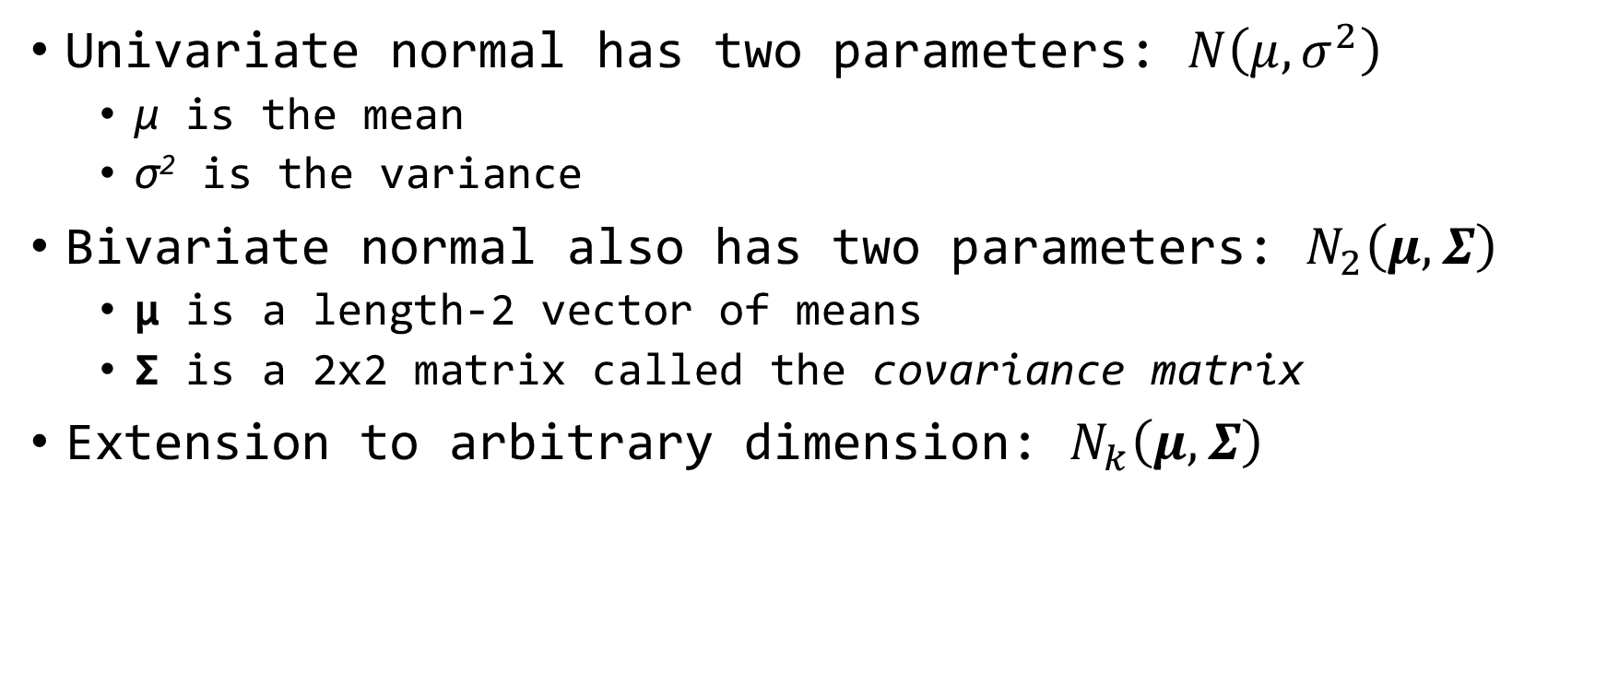
Multivariate Normal
Univariate normal has two parameters: $N\left(μ,σ^{2}\right)$
μ is the mean
σ² is the variance
Bivariate normal also has two parameters: $N_{2}\left(μ,Σ\right)$
μ is a length-2 vector of means
Σ is a 2x2 matrix called the covariance matrix
Extension to arbitrary dimension: $N_{k}\left(μ,Σ\right)$
Notes:
We are going to focus on the multivariate normal for two reasons: one, it is the most common and easy to apply of the multivariate distributions. Two, it can be used as part of a multivariate modeling tool called the Gaussian copula which lets us create a joint distribution of variables that have any marginal distribution we want.
Recall that the univariate normal distribution, the normal distribution we have seen so far, has two parameters; the mean and the variance. These are single values describing the location and scale of the distribution.
When we extend this to a bivariate normal distribution, meaning it is the joint distribution of two variables, we expand the dimension of the parameters. The mean goes from a single value to a vector of length two that describes the mean of each of the two random variables being joined. The single value of the variance becomes a 2x2 covariance matrix, which describes the covariance between each of the variables being joined.
As we extend the bivariate normal to arbitrarily many dimensions, the mu vector has length k, and the covariance matrix is a k by k matrix.

Slide 32
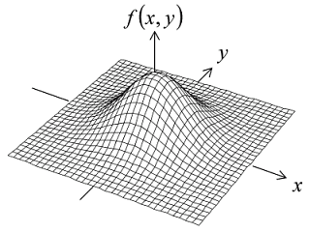









Multivariate Normal
Random samples taken from a k-variate normal are collection of vectors with covariance defined by Σ
$$\left(z_{1},z_{2}\right)$$
$$\left(z_{1},z_{2}\right)$$
$$\left(z_{1},z_{2}\right)$$
$$\left[\overline{z_{1}},\overline{z_{2}}\right]=μ$$
$$\left(z_{1},z_{2}\right)$$
$$cov\left(z_{1},z_{2}\right)=Σ$$
$$\left(z_{1},z_{2}\right)$$
$$\left(z_{1},z_{2}\right)$$
Bivariate Normal
k = 2
$$\left(z_{1},z_{2}\right)$$
Notes:
The lower left shows a 2-d density plot of a bivariate normal distribution. The density shows where combinations of x and y are the most likely as the height of the density. When samples are taken from the bivariate normal, they come out as a list of x,y points. A k-variate normal would be a list of k-length vectors.
For the bivariate case we are showing, each point is a sample from the distribution. The right side shows a list of points sampled from the density on the left. If you take the mean of each column in this list, you get back the mean vector for the bivariate normal. If you compute the covariance between the two columns, you get elements of the covariance matrix back.

Slide 33
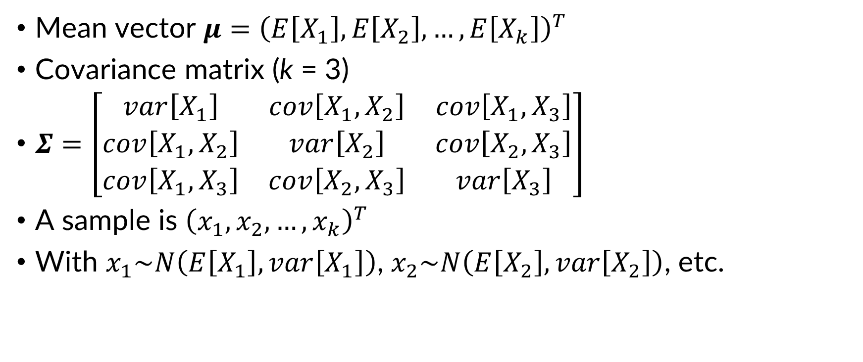
Multivariate Normal
Mean vector $μ={\left(E\left[X_{1}\right],E\left[X_{2}\right],…,E\left[X_{k}\right]\right)}^{T}$
Covariance matrix (k = 3)
$Σ=\left[\begin{matrix}var\left[X_{1}\right] & cov\left[X_{1},X_{2}\right] & cov\left[X_{1},X_{3}\right] \\ cov\left[X_{1},X_{2}\right] & var\left[X_{2}\right] & cov\left[X_{2},X_{3}\right] \\ cov\left[X_{1},X_{3}\right] & cov\left[X_{2},X_{3}\right] & var\left[X_{3}\right]\end{matrix}\right]$
A sample is ${\left(x_{1},x_{2},…,x_{k}\right)}^{T}$
With $x_{1}\sim N\left(E\left[X_{1}\right],var\left[X_{1}\right]\right)$, $x_{2}\sim N\left(E\left[X_{2}\right],var\left[X_{2}\right]\right)$, etc.
symmetrical
Notes:
We introduced the parameters of the multivariate normal before, and here is an expansion of those parameters into matrix notation.
The mean vector is simply a vector that contains the mean of each of the variables in the joint distribution.
The covariance matrix is constructed so that each element is a covariance of a pair of variables. Let’s look at the diagonal first – notice that these are the variances for each of the random variables. This is because as we recall, the covariance of a variable and itself is the variable’s variance.
Now let’s look off-diagonal. We see that for each row and column, that the value is the covariance of two of the variables. In row 1 column 2, it is the covariance of X1 and X2. For row 1 column 3 it is the covariance of X1 and X3, and so on. The matrix is symmetrical, so the value in row 3 column 1 is the same as row 1 column 3.
When a sample is taken from the multivariate normal, it is a k-length vector containing samples from each of the k random variables. Each of the random variables is normally distributed and has a mean defined by the mean vector, and a variance defined by the covariance vector.
The joint distribution behavior becomes apparent only across a large number of samples. A single sample drawn from the distribution simply looks like a collection of normally-distributed variables. Until you look at the covariance or correlation between these variables in a large sample, the joint distribution structure is not apparent.

Slide 34
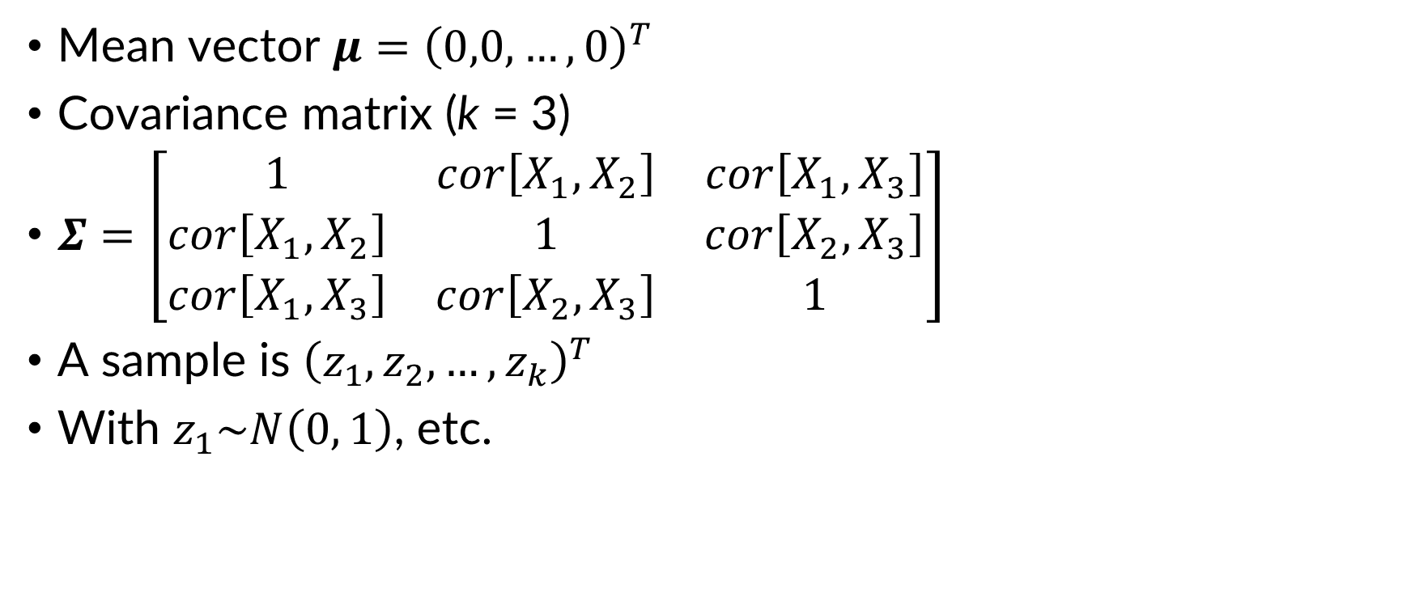
Multivariate Standard Normal
Mean vector $μ={\left(0,0,…,0\right)}^{T}$
Covariance matrix (k = 3)
$Σ=\left[\begin{matrix}1 & cor\left[X_{1},X_{2}\right] & cor\left[X_{1},X_{3}\right] \\ cor\left[X_{1},X_{2}\right] & 1 & cor\left[X_{2},X_{3}\right] \\ cor\left[X_{1},X_{3}\right] & cor\left[X_{2},X_{3}\right] & 1\end{matrix}\right]$
A sample is ${\left(z_{1},z_{2},…,z_{k}\right)}^{T}$
With $z_{1}\sim N\left(0, 1\right)$, etc.
symmetrical
Notes:
Recall that the standard normal distribution is a normal distribution with a mean of zero and a variance of 1. The multivariate normal also has a standard version.
The mean vector of a multivariate standard normal distribution is a k-length vector containing zeros. All of the variables have a mean of zero.
The covariance matrix of the multivariate standard normal has 1s down the diagonal, because each of the variables have a variance of 1. The off-diagonals are the correlation between each of the variables instead of the covariance. The covariance matrix of a multivariate standard normal is also sometimes called a correlation matrix.
A sample from the multivariate standard normal distribution is a k-length vector of standard normal variates. Across a large number of samples, the correlation structure of this distribution becomes apparent.

Slide 35
Others
Multivariate t distribution
Multivariate version of Student’s t distribution
Similar to multivariate normal with extra parameter ν (degrees of freedom)
Dirichlet distribution
Multivariate version of the beta distribution
Wishart distribution
Multivariate version of the gamma distribution
Notes:
We went into a lot of length about the multivariate normal because it is the most common and easy to use.
The other three we mentioned before are the multivariate t, which is a multivariate extension of Student’s t distribution; the Dirichlet distribution which is an extension of the beta distribution, and the Wishart distribution which extends the gamma distribution.
These are not commonly used except in Bayesian statistics.

Slide 36
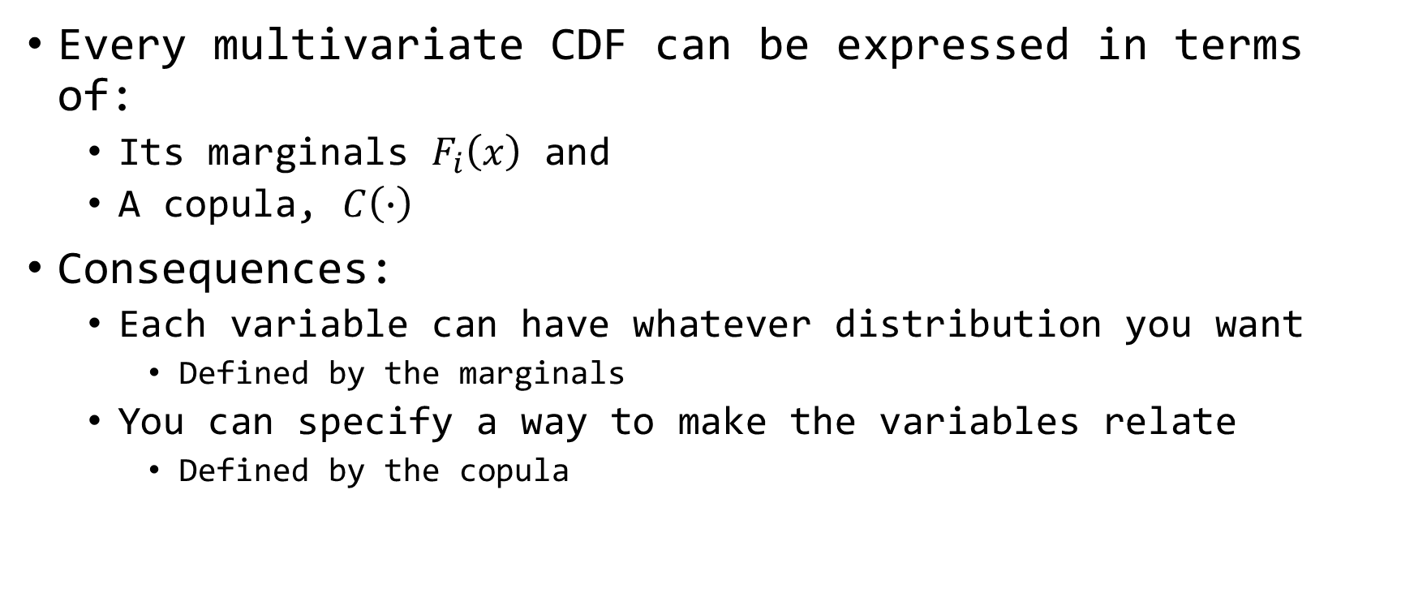
Sklar’s Theorem
Every multivariate CDF can be expressed in terms of:
Its marginals $F_{i}\left(x\right)$ and
A copula, $C\left(∙\right)$
Consequences:
Each variable can have whatever distribution you want
Defined by the marginals
You can specify a way to make the variables relate
Defined by the copula
Notes:
Each of the multivariate distributions can be very restrictive to use. It forces you to define the marginal distribution and joining behavior for each of the variables in a very specific way. Unless all of your variables have the same type of distribution and their joint behavior is easy to define, a multivariate distribution is unlikely to be easy to use.
Sklar’s theorem allows us to define multivariate distributions that have more flexible properties. First, it lets us use any probability distribution for each marginal distribution involved. This means that each variable can have a different marginal distribution. Second, it lets us define how the variables are joined together using a structure called a copula, which is only concerned with the joining structure and not with the marginals at all.
This means that we can join together arbitrarily-distributed variables using a structure that gives us the joint shape we want while preserving the behavior of each of the marginals.

Slide 37
Copulas
Gaussian Copula
Structure uses the multivariate normal distribution
Familiar elliptical shape
Dominantly defined by Pearson’s coefficient
Archimedean Copulas
Other interesting shapes
Single parameter
Definable using Kendall’s tau
Notes:
The two most common families of copulas are the Gaussian copula, which is based on the multivariate normal distribution we spent some time with earlier, and the Archimedean copulas. The Gaussian copula is very straightforward to use because the relationship between variables can be defined using Pearson’s correlation coefficient, and it provides a joint structure that is useful in a number of situations. The Archimedean copulas provide additional interesting shapes for the joining structure of the variables, and the strength of the relationship is usually measured with a single parameter that can be estimated using Kendall’s tau.

Slide 38
Gaussian Copula
Assume underlying structure well-represented with a multivariate normal distribution
However, variables of interest do not have a normal distribution
Generate normal variates with specified correlation
Transform them into the target distributions
HEC-WAT Hydrologic Sampler uses this
Notes:
The Gaussian copula gets a lot of mileage for many usage, including the Hydrologic Sample tool in the HEC-WAT software.
The assumption for the Gaussian copula is that the joining structure looks like a multivariate normal, even when the marginals don’t look normally distributed. It functions by taking random samples from a multivariate standard normal, and converting the sampled marginal values from normal into a different distribution. We will show a demonstration of this sampling next.

Slide 39

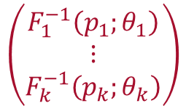



Gaussian Copula
Sampled
Vector
Vector of
U(0, 1)
$$\left(\begin{matrix}Z_{1} \\ ⋮ \\ Z_{k}\end{matrix}\right)$$
$$Φ\left(x\right)$$
$$\left(\begin{matrix}U_{1} \\ ⋮ \\ U_{k}\end{matrix}\right)$$
Standard Normal CDF
$$\left(\begin{matrix}F_{1}^{−1}\left(p_{1};θ_{1}\right) \\ ⋮ \\ F_{k}^{−1}\left(p_{k};θ_{k}\right)\end{matrix}\right)$$
Vector of
Marginal
Quantile
Functions
Next Sample
Multivariate
Standard Normal
$$\left(\begin{matrix}X_{1} \\ ⋮ \\ X_{k}\end{matrix}\right)$$
Vector of
Values with
Desired Target
Distributions
Notes:
The Gaussian copula starts with a multivariate standard normal distribution like the density on the left.
First a sample is taken from this density, resulting in a vector of z-values
Next, each z-value is converted to a probability using the CDF of the standard normal distribution. From the Extreme Value Theory discussion, we know that taking the CDF of a random sample of values from any distribution results in uniform (0, 1) variables.
This vector of uniform (0, 1) random variables is then converted into the target distribution marginals by using the inverse cumulative distribution function (aka the quantile function) on each value. For example, if the first variable has a lognormal distribution with some parameters, you would use the quantile function of a lognormal distribution with those parameters on the uniform (0, 1) values to get a lognormally-distributed value. You would do this for each of the variables in your copula, and they may have different quantile functions. This results in a vector of values with the desired target distributions, and a joining structure defined by the multivariate standard normal.
Then you can repeat this process a number of times to create your random sample. We will see the results of this process in action next.

Slide 40
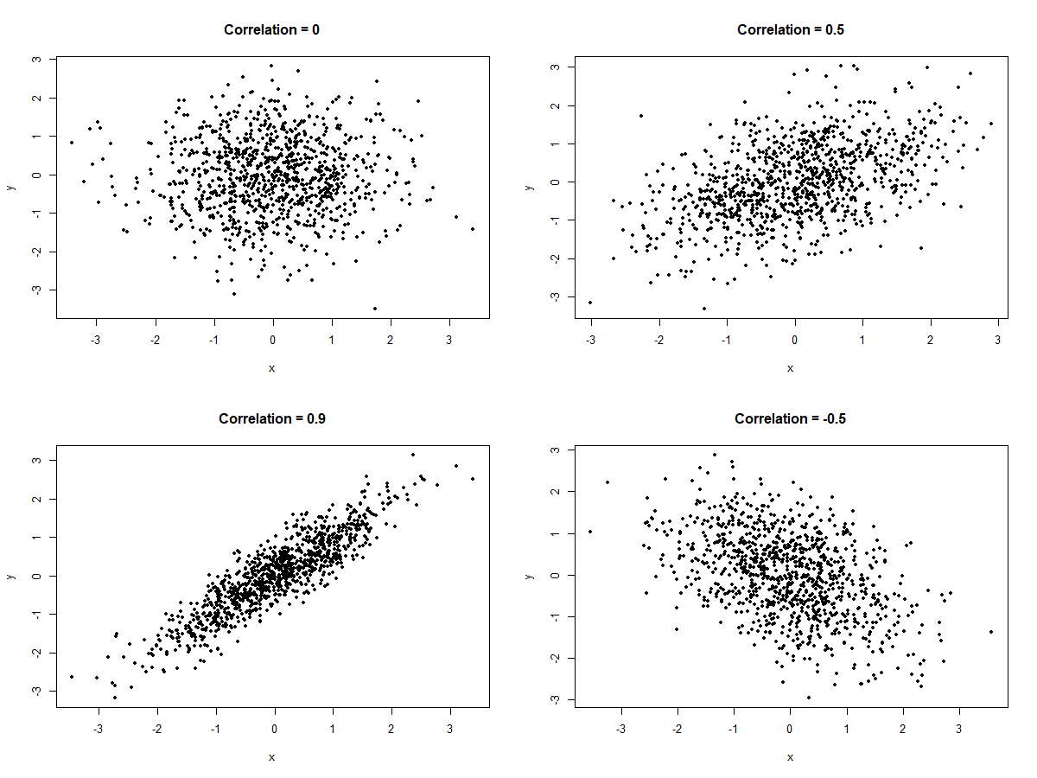
Notes:
Here are four plots of bivariate standard normal noise with varying correlation between the two variables. The upper left has no correlation, upper right is positive 0.5, lower left is positive 0.9, and lower right is negative 0.5. These shapes should be pretty familiar. These same shapes define the joining structure we get from a Gaussian copula, so you can see why these might be useful for a variety of situations.
We will focus on the highly-correlated cloud of points in the lower-left as our copula. Imagine that we have generated 1,000 points from a bivariate standard normal distribution, and the result came out looking like this. This is the first step in using a Gaussian copula.

Slide 41
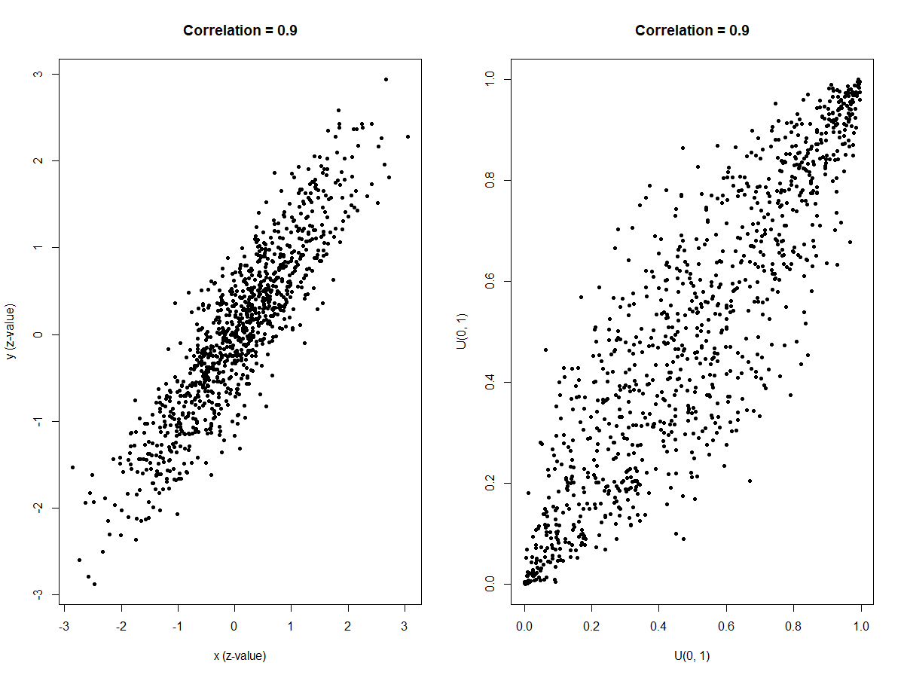

$$Φ\left(x\right)$$
Standard Normal CDF
Notes:
The plot on the left is the same as the Correlation = 0.9 plot on the last slide. Notice that the values of x and y are z-values. We can convert these to probabilities by using the CDF of the standard normal.
The plot on the right is what happens when we take each of the x and y and compute the cumulative probability using the standard normal CDF. Each of the values is now on the range (0, 1) and has a Uniform(0, 1) distribution.

Slide 42
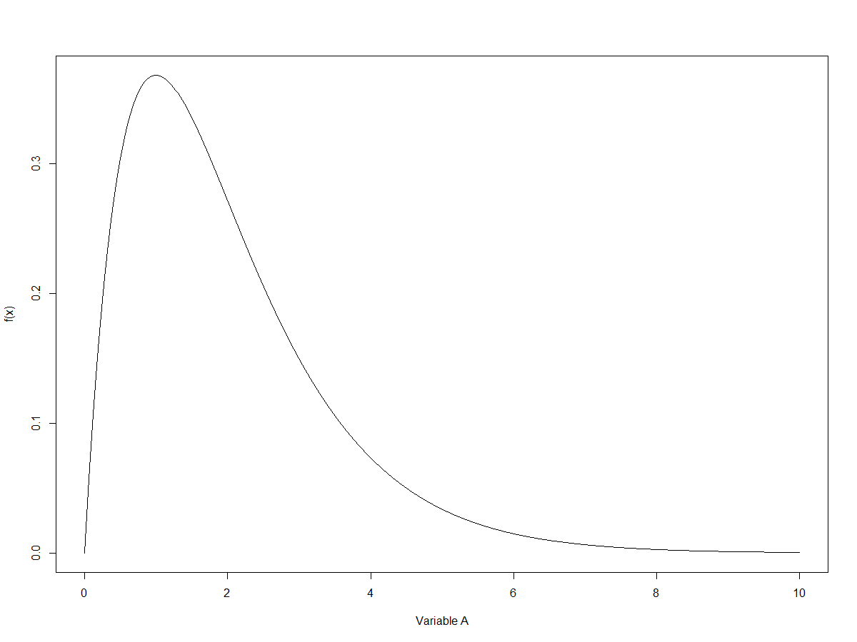
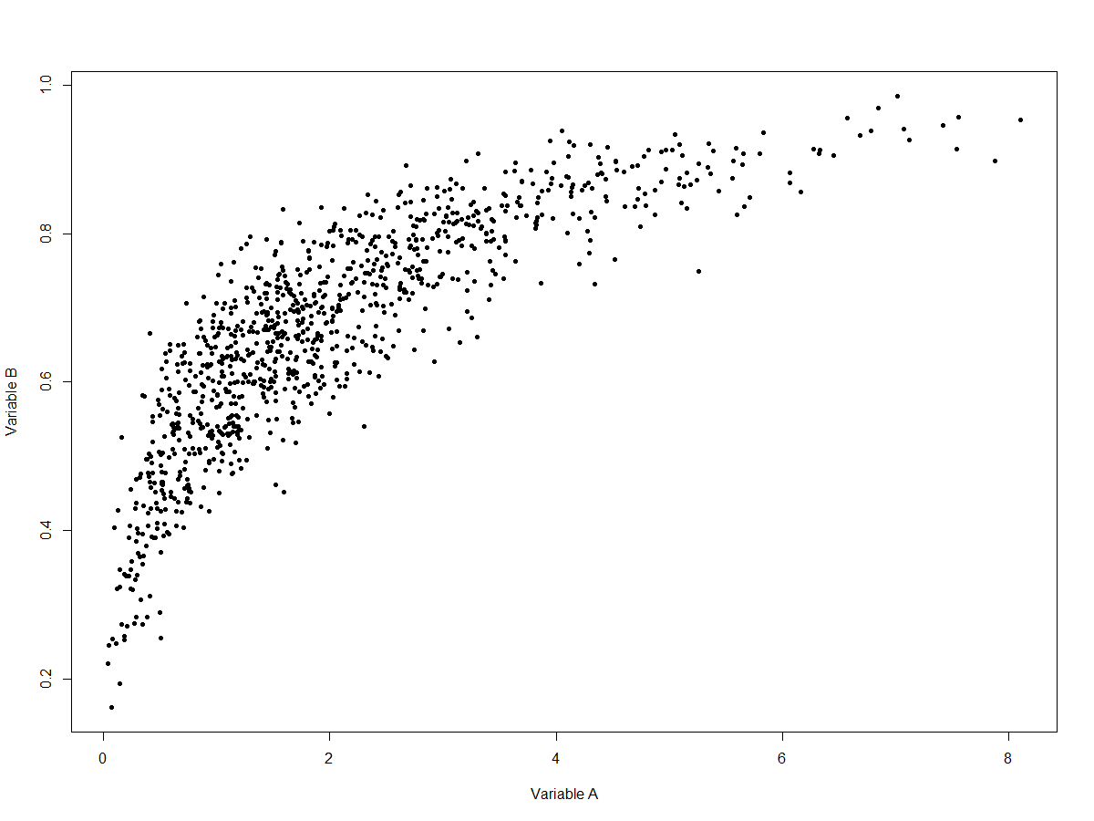
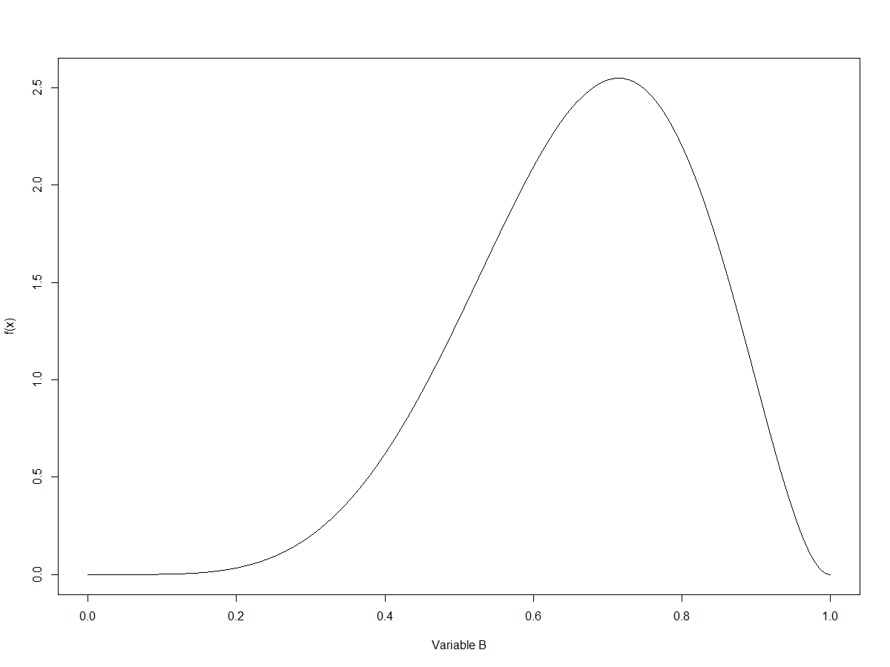
Variable A
Density
B
Variable B
Density
Joint Distribution
Gaussian Copula
r = 0.9
A
Notes:
Let’s define two distributions that we want our output to look like. Here are two density plots.
Variable A is a positively-skewed variable with a lower bound at zero and no upper bound.
Variable B is a negatively-skewed variable with bounds at both zero and one.
For each of these variables, we can turn U(0, 1) random variables into variables with the target distribution using the quantile function (or inverse CDF). This is a property called the “probability inverse transform.” Inverse transform sampling is extremely common in statistical simulation.
The U(0, 1) variables we feed the two quantile functions have been provided by the Gaussian copula, so we know that the underlying structure is bivariate normal with correlation = 0.9.
The resulting joint distribution is on the right. Notice how the density of the scatter for each axis reflects the densities. For x, more points are concentrated on the left than the right. For y, more points are concentrated towards the top (right side of the density) than the bottom (left side of the density.)

Slide 43
Summary
The multivariate normal distribution is the most common multivariate distribution
Copulas let us define a joint distribution made from arbitrary marginals and a joining structure
Notes:
In this video, we discussed joint probability distributions and copulas. Two key points to take away from this video are:
The multivariate normal distribution is the most commonly used multivariate probability distribution, and
Copulas let us define a joint distribution made using arbitrary marginal distributions, and some joining structure that gives us a desired shape for the overall relationship between the variables.
Thanks, and come back soon to learn about other topics in our statistical methods in hydrology course.

