Slide 1
Lecture 16
Coincident Frequency Analysis
Beth Faber, PhD, PE
Statistical Methods in Hydrology
Hydrologic Engineering Center

Slide 2
Coincident Frequency
Coincident Frequency = Joint Probability
A and B have some joint distribution
C = f(A, B) What is the distribution of C?
What’s the probability of a given outcome resulting from several processes (A and B) that all influence a single variable of interest (C)?
Sometimes, a variable of interest is dependent on 2 or more other processes
To estimate probability of the variable of interest, probabilities of each of those processes must be incorporated

Slide 3
Topics
Examples of Coincident Frequency Problems
Theory
  situations and assumptions
  Total Probability Theorem
  when variables are not independent
Using HEC-SSP
Monte Carlo Approach

Slide 4
Problems requiring Coincident Frequency Analysis
Local Runoff
A
C
Tributary
A
Levee
C
Interior Pond
B
B
River
Channel
River
Conduit with
Flap Gate
Interior Flooding
Flooding on Tributary
A = Local Runoff
B = Flow/Stage in the River Channel
C = Pond Stage behind the Levee
A = Flow in the Tributary
B = Stage on the Main Stem
C = Stage on the Tributary
Notes:
These are examples of problems which tend to require coincident frequency analysis. The variable of interest in the analysis is variable C, and it is affected by variables A and B.
Variable A is defined as the more influential, for which we assume the annual maximum is occurring for the highest each year at C. B is the less influential.
For interior flooding, we modeling the runoff interior to the levee (the land side) and the stage in the channel on the exterior. Generally we’re designing an interior pond, with gravity drainage or pumps.
For flooding on a tributary, we’re looking at an event on a tributary with a damage area that experiences backwater from the main step at high flow.

Slide 5
Problems requiring Coincident Frequency Analysis
Ocean or
Lake
A
A
C
C
River
B
Flood Control Storage
B
Stage on Lake Tributary
Peak Reservoir Pool
A = Flow in the River
B = Stage of the Water Body
C = Stage on the River
A = Flood Inflows
B = Initial Reservoir Level
C = Peak Reservoir Pool
Notes:
Stage on a lake tributary is similar to the river tributary, experiencing backwater at the data area when levels are high
Final peak flood pool stage is influenced by the event inflow, and the starting level of the reservoir pool.

Slide 6
Problems requiring Coincident Frequency Analysis
C
B
A
Bridge
C
Runoff
B
ICE
A
Bay or Estuary
River
Ocean
Ice-Affected Flows
Combined Runoff / Storm Surge
A = Conveyance Reduction
Due to Ice
B = Flow in the River
C = River Stage
A = Storm Surge (Wind or Wave Setup) Stage
B = Rainfall Runoff
C = Estuary Stage
Notes:
In an ice jam, the stage at the location of interest in influence by the impact of the ice, and the flow at the site.
Stage in a storm surge situation is influenced by the storm surge stage and the inflow to the estuary.

Slide 7
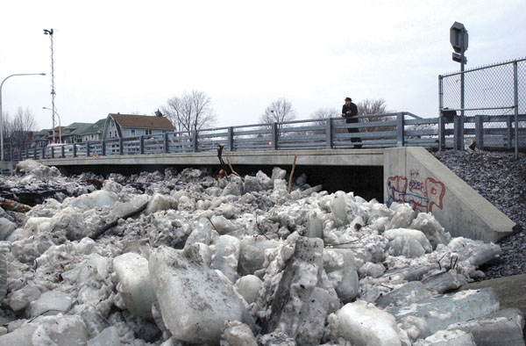
Cazanovia Creek, South Buffalo
Notes:
Here’s an image of an ice jam in South Buffalo.

Slide 8
Example: Tributary Flooding
In this example, the variable of interest, C, is the tributary stage near the confluence with the mainstem.
We’d like a frequency curve for the tributary stage, C.
This stage is a function of BOTH the tributary flow, A and the stage on the mainstem, B (ie, backwater effects.)
A
tributary peak flow
C
tributary stage near confluence
mainstem stage
B
variable C can be computed with backwater analysis, given A and B
Notes:
For this lecture, tributary flooding will be used as the example. We’re interested in the stage C at the damage area, and it is influence by both the tributary flow going by and the backwater from the mainstem.
Variable A is annual maximum flow on the tributary, variable B is the stage on the mainstem that can cause backwater, and variable C is the stage at the damage area.

Slide 9
Example: Tributary Flooding
P(A)
Q₁₀₀
P(C)=?
Q₅
P(B)
Q₁₀₀
A
Q₂₀
tributary channel
Q_{low}
B
C
mainstem channel
Variable A = more influential
Variable B = less influential
Variable C = variable of interest
Notes:
This example demonstrates the effect of the stage on the mainstem on the stage at C. Knowing you have the 100-year flow on the tributary is not enough to define the stage at C if there is backwater.
If we want to model the situation, and define the a flow at A, what should we define as the stage at B? The choice affects the stage at C.

Slide 10
Should we assume worst case for variable B?
In problems like interior flooding, we could just assume the gravity drain is always blocked – worst case
The problem with assuming worst case for variable B is that we lose the probabilistic description we were trying to create.
What appears to be a 1%-chance event no longer has 1% chance, because we’ve attached a “sometimes” condition, so the joint probability is no longer 1%…
So, what assumptions do we make about the flood event on the tributary and the stage on the mainstem?
It depends on whether we see flood events on both at the same time (or, coincident), and how they are related.
Notes:
If we do assume worst case, we ruin out probabilistic descriptions of the resulting damages. A 1% chance has become something with probability other than 1%, because it is combined with another condition that has its own likelihood of occurrence.

Slide 11
Questions to ask
Coincidence: Do notable events (extremes) happen for both variables at the same time?
answer defines probability descriptions
  Flood event or extreme on both A and B
    use annual frequency curve for each variable
    annual max for A, not necessarily annual max for B…
  Flood event on A, but “just another day” on B
    if just another day on B, would use daily duration curve for B
Correlation: If notable events for both variables, are their magnitudes related or independent?
answer defines approach
always AEP for A,
AEP or daily prob for B

Slide 12
5 Possibilities for Tributary & Mainstem Relationship
Always coincident & strong positive correlation (ρ ≈ 1)
  1% tributary event always happens with the 1% mainstem stage.
  the drainage areas are small and similar size (same storm)
Never coincident
  Tributary and mainstem extremes never happen at the same time.
Can be coincident, but not correlated (ρ ≈ 0)
  1% tributary event might happen with any mainstem stage (large or small).
  mainstem drainage area is greater than tributary (different weather)
Usually coincident, but not correlated (ρ ≈ 0).
  1% tributary event happens with mainstem event, but not similar
  Seasonal events, but impacted by different weather patterns
Usually coincident, and correlated (ρ not ±1 or 0)…
Notes:
We must define the relationship between the likelihoods of interior and exterior events. The first 2 descriptions above lead to the simplest analyses. In the first case, we have perfect correlation between interior and exterior events, so when the 1%-chance exceedance event is happening on the interior, we are also experiencing a 1% event on the mainstem channel. This might occur with small and similarly-sized drainage areas. At every likelihood, and interior and exterior event are modeled to define the stage of the same likelihood.
In the second case, a strong negative correlation means flood events never happen on the interior and exterior together. Therefore, we could always assume a low mainstem stage and unblocked gravity drain. This is uncommon.
In the third case, interior and exterior events sometimes occur together, but they are independent, such that large is no more likely to occur with large than small. Correlation is near zero. This state requires a consideration of the separate probabilities of events on the interior and exterior. This relationship might occur when the exterior drainage area is much larger than the interior.
In the forth case, there is some correlation between interior and exterior events, but it is not 1 or -1. Analysis is similar to the third case, but without some simplifying assumptions the third case allows.

Slide 13
Easier Cases conditions (1) or (2)
If we could assume variables A and B are perfectly correlated (ρ ≈ 1)…
  i.e., AEPs match -- 1/N-year flow on tributary always coincides with 1/N-year stage on mainstem
  then the 1/100-year level of variable C could be computed with A₁₀₀ and B₁₀₀
If events A and B never coincident…
  1/100-year flow on tributary, A₁₀₀, always occurs with low mainstem stage, no backwater
easy!
also easy!
Notes:
Case one requires many fewer model runs. Just one for each frequency ordinate using that frequency for both A and B.
Case two also requires fewer model runs, because each frequency ordinate for A is paired with low B.

Slide 14
More Challenging Cases condition (3), (4) or (5)
Variables A and B usually coincident, might have some correlation, though not perfect
3, 4. Little or no correlation, convenient to say A and B INDEPENDENT
  knowing the value of B tells us nothing about the value of A,
    P(A|B) = P(A)
    P(A∩B) = P(A)*P(B), no joint distribution needed!
  difference in 3 and 4 is whether “event” for B (case 4), or “just another day” for B (case 3)
It is easier to assume independence!
hard…
less easy, but OK
Notes:
We’ll defer the more difficult case 4 for later, and discuss case 3 where it is acceptable to assume independence between A and B.

Slide 15
Total Probability Method
(called “Coincident Frequency Analysis” in guidance)
Information needed for analysis:
  variable A, annual peak flows on tributary (more influential)
  variable B (less influential)
    daily mainstem stage, or
    annual peak (or coincident peak) mainstem stage
  Response Function – response at C from A and B
Information we want:
  variable C, frequency curve for stage above confluence (at damage area)
Notes:
An example of combining probabilities using the coincident frequency analysis approach, documented in EM 1110-2-1413 and 1110-2-1415. We define the more influential variable as A, in this case tributary annual peak flood flow, and the less influential variable as B, in this case the mainstem stage. By combining these two variables we will estimate a frequency curve for variable C, the stage at the confluence.
We must define tributary peak flow across all annual exceedance probabilties, and mainstem stages that span the range and are defined by daily % of time exceeded.
For each value of annual peak flow (defined at regular exceedance probabilities) and each chosen mainstem stage, model the maximum resulting confluence stage at C. This run provides variable C, confluence stage, conditioned on variable B, mainstem stage. This resulting stage is given the exceedance probability of A, but conditioned on the associated value of B. The set of these model runs defines a matrix that defines the “response function” – ie, the response of variable C to variables A and B.

Slide 16
Total Probability Method
Input Probability Distributions
more influential
less influential
P(A)
P(B)
limit data to tributary’s flood season
Annual Peak Flow
Mainstem Stage
0.99 0.90 0.50 0.10 0.05 0.01
0.10 0.30 0.50 0.70 0.90
annual exceedance probability of A
% of time B is exceeded
Case 3:
“any given day”
Tributary Annual Peak Flow Frequency Curve for A
using annual extremes
Mainstem Stage Daily Duration Curve for B
using daily stages -- during flood season
NOT assuming peaks/events happen for both variables at the same time
Notes:
We must define tributary peak flow across all annual exceedance probabilties, and mainstem stages that span the range and are defined by daily % of time exceeded.

Slide 17
Total Probability Method
Discretizing the Probability Distributions
more influential
less influential
P(A)
P(b₁)=0.03
P(B)
b₁
b₂
P(b₂)=0.07
Annual Peak Flow
b₃
P(b₃)=0.2
Mainstem Stage
P(b₄)=0.4
A=a_{0.01}
b₄
P(b₅)=0.2
A=a_{0.1}
b₅
P(b₆)=0.1
b₆
A=a_{0.5}
3%
7%
20%
40%
20%
10%
0.99 0.90 0.50 0.10 0.05 0.01
0.10 0.30 0.50 0.70 0.90
annual exceedance probability of A
% of time B is exceeded
Frequency Curve for A, tributary peak flow
Choose quantiles along the curve (flow for each probability) to use in computation – CUMULATIVE PROB
Duration Curve for B, stage on mainstem
Choose index values for B that each represent a portion of the range and probability – INCREMENTAL PROB
Notes:
We choose discrete points for each variable. For variable A, it is the range of frequency ordinates. For variable B, we define a series of index values, and define a portion of the probability range as being represented by each index value.

Slide 18
Computing the “Response Function”
Mainstem Stage, variable B
 | b₁ | b₂ | b₃ | b₄ | b₅ | b₆
a_{0.9} | c_{0.9}|b₁ | c_{0.9}|b₂ | c_{0.9}|b₃ | c_{0.9}|b₄ | c_{0.9}|b₅ | c_{0.9}|b₆
a_{0.5} | c_{0.5}|b₁ | c_{0.5}|b₂ | c_{0.5}|b₃ | c_{0.5}|b₄ | c_{0.5}|b₅ | c_{0.5}|b₆
a_{0.2} | c_{0.2}|b₁ | c_{0.2}|b₂ | c_{0.2}|b₃ | c_{0.2}|b₄ | c_{0.2}|b₅ | c_{0.2}|b₆
a_{0.1} | c_{0.1}|b₁ | c_{0.1}|b₂ | c_{0.1}|b₃ | c_{0.1}|b₄ | c_{0.1}|b₅ | c_{0.1}|b₆
a_{0.05} | c_{0.05}|b₁ | c_{0.05}|b₂ | c_{0.05}|b₃ | c_{0.05}|b₄ | c_{0.05}|b₅ | c_{0.05}|b₆
a_{0.01} | c_{0.01}|b₁ | c_{0.01}|b₂ | c_{0.01}|b₃ | c_{0.01}|b₄ | c_{0.01}|b₅ | c_{0.01}|b₆
a_{High} | c_{H}|b₁ | c_{H}|b₂ | c_{H}|b₃ | c_{H}|b₄ | c_{H}|b₅ | c_{H}|b₆
Tributary Annual Peak Flow,
variable A
Tributary Stages
value of C that has exceedance probability of 5% given B = b₅
Notes:
For each value of annual peak flow (defined at regular exceedance probabilities) and each value of mainstem stage, model the maximum resulting confluence stage at C. This run provides variable C, confluence stage, conditioned on variable B, mainstem stage. This resulting stage is given the exceedance probability of A, but conditioned on the associated value of B. The set of these model runs defines a matrix that defines the “response function” – ie, the response of variable C to variables A and B.
Each column of the matrix is a conditional frequency curve for C, given B.

Slide 19
Total Probability Method
Step 1
P(A)
P(C|B)
B = b₁
B = b₂
Annual Peak Flow
B = b₃
B = b₄
A=a_{0.01}
B = b₅
B = b₆
A=a_{0.1}
Annual Peak Stage at C
C=c_{0.01}|b₆
A=a_{0.5}
C=c_{0.1}|b₆
C=c_{0.5}|b₆
0.99 0.90 0.50 0.10 0.05 0.01
annual exceedance probability of A
0.99 0.90 0.50 0.10 0.05 0.01
annual exceedance probability of C
for each index value of B and various values (and probabilities) of A,
compute variable C.
note that the “response” for C adopts the exceedance probability of A, but is conditioned on B
Notes:
For the confluence stage resulting from a given tributary flow A and mainstem stage B, we assign the tributary stage C exceedance probability, but condition it on the associated exterior stage B.
Each column of the previous slide’s matrix is a conditional frequency curve for C, conditioned on index value bi

Slide 20
Now what?
What do we do with this family of conditional frequency curves for C?
Our interest is in a single (marginal) frequency curve for variable C that is not conditional on B
Make use of the Law of Total Probability
P(C) = Σ_{i} P(C|B_{i}) * P(B_{i})
  ‘prob of C’ equals ‘prob of C given B’ times ‘prob of B’ summed for all B
We just saw the conditional probabilities, P(C|B)
What is the probability of each value of B, P(B)?
  from duration curve – daily “% of time exceeded”
Notes:
The probability of C given B, P(C|B) is the curves we’ve just created. The marginal probability of B is based on the duration curve, and having divided up the probability range among the index values of B.

Slide 21
Basic Relationships
condition
condition
Conditional Probabilities
  Probability that A will occur given that B has occurred
  P(A|B) = P(A ∩ B)
  P(B)
  For an independent event, P(A|B) = P(A)

Slide 22
Venn Diagram, Conditional Probability
A and B
  P(A|B) = P(A ∩ B)
  P(B)
B
A
B
A

Slide 23
Law of Total Probability
Venn Diagram:
area = probability
C is the sum of the 5 intersections with Bi (intersection ∩ means AND)
We have conditional probabilities, C|Bi
C|B1 = C∩B1 / B1
The Law of Total Probability
P_{e}(C) = Σ_{B} P_{e}(C|B) * P(B)
B1
B2
C∩B1
C∩B2
C∩B5
C∩B3
C
B5
C∩B4
B3
B4
Bi are mutually exclusive and exhaustive
Notes:
This example defines the law of total probability more clearly using a Venn Diagram. The “universe” is divided among 5 sections of B. The Bi are mutually exclusive (no overlap) and exhaustive (span the entire universe). C is a part of the universe we are interested in. C can be found by adding together C∩Bi (read “C AND Bi”) for each of the Bi. But the information we have is the conditional “C given Bi” or C|Bi for each of the Bi.
The meaning of the condition-Bi is that we know Bi has occurred, and are now interested in the likelihood of C occurring. The part of C we are looking for is therefore C∩Bi. So once we condition on B1, for example, we no longer have the whole universe, but rather B1 becomes the universe. Since B1 is the universe, it’s likelihood becomes 1. Therefore, to scale C∩Bi up to reflect it’s portion of the new B1 universe, we divide C∩Bi by Bi. This provides the expression C|B1 = C∩B1 / B1
We can convert from the C|Bi that we have to the C∩Bi we want by rearranging into C∩Bi = C|Bi * Bi, therefore scaling back down the reflect it’s portion of the original universe. Having the statement for this intersection for each Bi, we can sum them to get C.

Slide 24
Law of Total Probability
Venn Diagram:
area = probability
C is the sum of the 5 intersections with Bi (intersection ∩ means AND)
We have conditional probabilities, C|Bi
C|B1 = C∩B1 / B1
so C∩B1 = C|B1 * B1
The Law of Total Probability
P_{e}(C) = Σ_{B} P_{e}(C|B) * P(B)
B1
B2
C∩B1
C∩B2
C∩B5
C∩B3
C
B5
C∩B4
B3
B4
Notes:
This example defines the law of total probability more clearly using a Venn Diagram. The “universe” is divided among 5 sections of B. The Bi are mutually exclusive (no overlap) and exhaustive (span the entire universe). C is a part of the universe we are interested in. C can be found by adding together C∩Bi (read “C AND Bi”) for each of the Bi. But the information we have is the conditional “C given Bi” or C|Bi for each of the Bi.
The meaning of the condition-Bi is that we know Bi has occurred, and are now interested in the likelihood of C occurring. The part of C we are looking for is therefore C∩Bi. So once we condition on B1, for example, we no longer have the whole universe, but rather B1 becomes the universe. Since B1 is the universe, it’s likelihood becomes 1. Therefore, to scale C∩Bi up to reflect it’s portion of the new B1 universe, we divide C∩Bi by Bi. This provides the expression C|B1 = C∩B1 / B1
We can convert from the C|Bi that we have to the C∩Bi we want by rearranging into C∩Bi = C|Bi * Bi, therefore scaling back down the reflect it’s portion of the original universe. Having the statement for this intersection for each Bi, we can sum them to get C.

Slide 25
Law of Total Probability
Venn Diagram:
area = probability
C is the sum of the 5 intersections with Bi (intersection ∩ means AND)
We have conditional probabilities, C|Bi
C|B1 = C∩B1 / B1
so C∩B1 = C|B1 * B1
then C = Σi C∩Bi
The Law of Total Probability
P_{e}(C) = Σ_{B} P_{e}(C|B) * P(B)
B1
B2
C∩B1
C∩B2
C∩B5
C∩B3
C
B5
C∩B4
B3
B4
Notes:
This example defines the law of total probability more clearly using a Venn Diagram. The “universe” is divided among 5 sections of B. The Bi are mutually exclusive (no overlap) and exhaustive (span the entire universe). C is a part of the universe we are interested in. C can be found by adding together C∩Bi (read “C AND Bi”) for each of the Bi. But the information we have is the conditional “C given Bi” or C|Bi for each of the Bi.
The meaning of the condition-Bi is that we know Bi has occurred, and are now interested in the likelihood of C occurring. The part of C we are looking for is therefore C∩Bi. So once we condition on B1, for example, we no longer have the whole universe, but rather B1 becomes the universe. Since B1 is the universe, it’s likelihood becomes 1. Therefore, to scale C∩Bi up to reflect it’s portion of the new B1 universe, we divide C∩Bi by Bi. This provides the expression C|B1 = C∩B1 / B1
We can convert from the C|Bi that we have to the C∩Bi we want by rearranging into C∩Bi = C|Bi * Bi, therefore scaling back down the reflect it’s portion of the original universe. Having the statement for this intersection for each Bi, we can sum them to get C.

Slide 26
Law of Total Probability
the Law of Total Probability
P(C) = Σ_{i} P(C|B_{i}) * P(B_{i})
  ‘prob of C’ equals ‘prob of C given B’ times ‘prob of B’ summed for all B
Example:
  if a cold front arrives, there’s a 70% chance of rain
  if not, there’s 10% chance of rain
  What’s the chance of rain?
  Depends on chance of cold front arriving
  if there’s a 20% chance the cold front will arrive…
  prob of rain = (70%)(20%) + (10%)(100%-20%) = 22%
I need to know the probability of my condition….
Notes:
Here’s another example of using the total probability theorem…

Slide 27
Probability of the “Condition” – River Stage
P(B)
P(B)
b₁
b₂
P(b₃)=0.2
Exterior Stage
b₃
Exterior Stage
b₄
b₅
P(b₆)=0.1
b₆
3%
7%
20%
40%
20%
10%
0.10 0.30 0.50 0.70 0.90
0.10 0.30 0.50 0.70 0.90
% of time B is exceeded
% of time B is exceeded
Note, this duration curve is NOT formed from annual peaks. It is daily data, representing daily probability. For Case 3 we are interested in what the stage might be when an interior flood happens, and it might not be the annual peak stage or even an event.
Notes:
This shows where the marginal probability of B, P(B) comes from. The duration curve for B is made from all daily stages, and represents what stage might be on any given day in the future, when an event occurs on the tributary, and not necessarily the annual maximum stage. This choice, made earlier in the example, reflects the fact that the annual maximum doesn’t necessarily happen on the mainstem when it is happening on the tributary.
There are 2 ways to proceed. The probability range for B can be divided up, and an index value chosen to represent each probability segment. Or, a range of relevant index values of B can be chosen, and the probability range divided up to given some amount to each index value. In the end, the probabilities of the index values, Bi, must sum to 1.0.

Slide 28
P(C|B)
B = b₁
P(C)
B = b₂
B = b₃
B = b₄
B = b₅
c₁
B = b₆
c₁
Annual Peak Stage at C
Annual Peak Stage at C
0.99 0.90 0.50 0.10 0.05 0.01
0.99 0.90 0.50 0.10 0.05 0.01
P(c₁|b₂)=0.70
P(c₁|b₅)=0.35
annual exceedance probability of C
annual exceedance probability of C
We can view the single P(C) curve as a probability-weighted average horizontally
Step 2
For every level of C, the exceedance probability given all levels of B can be determined with the
Law of Total Probability:
P(C) = _{ΣB} P(C|B) * P(B)
P(c₁) = [P(c₁|b₁)*P(b₁)] + [P(c₁|b₂)*P(b₂)] + [P(c₁|b₃)*P(b₃)] + [P(c₁|b₄)*P(b₄)] + [P(c₁|b₅)*P(b₅)] + [P(c₁|b₆)*P(b₆)]
P(c₁) = [0.9*0.03] + [0.7*0.07] + [0.65*0.2] + [0.52*0.4] + [0.35*0.2] + [0.2*0.1]
P(c₁) = 0.51
repeat step 2 for all values of C
Notes:
We implement the total probability theorem for a series of values of variable C. We choose a value of Ci, and draw a line across the family of P(C|B) curves, interpolating the exceedance probability of C|B from each of the curves. Then the total probability equation has each of those values of P(C|B) for Ci is multiplied by the associated P(Bi), and summed. The result is the marginal P(Ci) and plots as one point on the P(C) frequency curve. This process is repeated for the full range of C.
For a value of C that is below a frequency curve from the family of curves, P(C|B) is 1.0. For a value of C that is above a frequency curve from the family of curves, P(C|B) is 0. These values must still be included in the total probability equation.

Slide 29
Case 4, Event on A and B
When there is an event on A, we also see an event on B (though not necessarily annual max) - B is not just “ any given day”
….due to locations being close enough to experience the same weather system, or events during a certain season
Replace daily duration curve for B with annual frequency curve for B
  annual max, or
  “coincident events” – sample for B is values of B while A is having each annual max
Discretize frequency curve for B in the same way as the duration curve

Slide 30
Total Probability Method
Initial Probability Distributions
more influential
less influential
P(A)
b₁
P(B)
b₂
P(b₃)=0.2
b₃
Note, annual curve will always be higher, index points higher
Annual Peak Flow
b₄
Mainstem Stage
A=a_{0.01}
b₅
P(b₅)=0.2
b₆
A=a_{0.1}
A=a_{0.5}
7%
20%
40%
20%
10%
3%
0.99 0.90 0.50 0.10 0.05 0.01
0.10 0.30 0.50 0.70 0.90
annual exceedance probability of A
annual exceedance probability of B
Tributary Annual Peak Flow Frequency Curve for A
using annual extremes
Mainstem Stage Annual Frequency curve for B
using either annual extremes, or value of B while A is annual extreme (conditional)
Notes:
We must define tributary peak flow across all annual exceedance probabilties, and mainstem stages that span the range and are defined by daily % of time exceeded.

Slide 31
B = b₁
B = b₂
P(C|B)
B = b₃
P(C)
B = b₄
B = b₅
B = b₆
resulting curve for C is higher
c₁
c₁
Annual Peak Stage at C
Annual Peak Stage at C
0.99 0.90 0.50 0.10 0.05 0.01
0.99 0.90 0.50 0.10 0.05 0.01
P(c₁|b₂)=0.90
P(c₁|b₅)=0.58
annual exceedance probability of C
annual exceedance probability of C
Conditional frequency curves will be higher, because the values of B are higher!
We can view the single P(C) curve as a probability-weighted average horizontally
P(c₁) = [P(c₁|b₁)*P(b₁)] + [P(c₁|b₂)*P(b₂)] + [P(c₁|b₃)*P(b₃)] + [P(c₁|b₄)*P(b₄)] + [P(c₁|b₅)*P(b₅)] + [P(c₁|b₆)*P(b₆)]
Step 2
For every level of C, use the
Law of Total Probability:
P(C) = _{ΣB} P(C|B) * P(B)
P(c₁) = [0.99*0.03] + [0.9*0.07] + [0.82*0.2] + [0.65*0.4] + [0.58*0.2] + [0.45*0.1]
P(c₁) = 0.68
repeat step 2 for all values of C
Notes:
We implement the total probability theorem for a series of values of variable C. We choose a value of Ci, and draw a line across the family of P(C|B) curves, interpolating the exceedance probability of C|B from each of the curves. Then the total probability equation has each of those values of P(C|B) for Ci is multiplied by the associated P(Bi), and summed. The result is the marginal P(Ci) and plots as one point on the P(C) frequency curve. This process is repeated for the full range of C.
For a value of C that is below a frequency curve from the family of curves, P(C|B) is 1.0. For a value of C that is above a frequency curve from the family of curves, P(C|B) is 0. These values must still be included in the total probability equation.

Slide 32
Case 5, Not Independent
Often, A and B are not perfectly correlated, BUT it is not reasonable to assume that they are independent
What if there is some
correlation between
A and B ≠ 0 or 1?
Correlation is too strong to
ignore by assuming
independence
B
A
Notes:
The method just described assumes that A and B are independent. When correlation is close enough to 0, this assumption is fine, but when correlations are above 0.3 or so, independence can’t be assumed. If possible, a continuous simulation approach that provided a time series of variable C would allow a direct frequency analysis on C, and not require coincident frequency analysis. Here, we’ll discuss how tackle the coincident frequency analysis with non-zero correlation.

Slide 33
With Some Correlation
Where before we used the marginal probability of A, (i.e., a single variable)
now we must define a joint (or conditional) probability of A and B
P(A)
P(A|B)
B = b₁
B = b₂
B = b₃
B = b₄
Annual Peak Flow
Annual Peak Flow
B = b₅
A=a_{0.01}
B = b₆
A=a_{0.1}
A=a_{0.01}|b₆
A=a_{0.5}
A=a_{0.1}|b₆
A=a_{0.5}|b₆
0.99 0.90 0.50 0.10 0.05 0.01
0.99 0.90 0.50 0.10 0.05 0.01
annual exceedance probability of A
annual exceedance probability of A
P(A|B) is read as
“probability of A given B”
Notes:
When there is notable correlation between A and B – too much to be ignored – we need a joint distribution between A and B, shown here as a conditional distribution of A given B. This family of conditional curves, one for each index value of B, is used in place of the marginal distribution of A used previously.

Slide 34
Total Probability Method
Discretizing the Probability Distributions
more influential
less influential
P(A|B)
B = b₁
P(B)
B = b₂
b₁
P(b₁)=0.03
B = b₃
B = b₄
b₂
P(b₂)=0.07
B = b₅
b₃
P(b₃)=0.2
Annual Peak Flow
Mainstem Stage
B = b₆
b₄
P(b₅)=0.2
b₅
P(b₆)=0.1
A=a_{0.01}|b₆
b₆
A=a_{0.1}|b₆
3%
7%
20%
40%
20%
10%
A=a_{0.5}|b₆
0.99 0.90 0.50 0.10 0.05 0.01
0.10 0.30 0.50 0.70 0.90
annual exceedance probability of A
annual exceedance probability of B
Frequency Curve for B
Choose index values for B that each represent a portion of the range and probability
Conditional Probability Curves of A given B
Notes:
In addition to the family of conditional curves for P(A|B), we use a frequency curve for B (either annual peak, or values “coincident” with each A peak), divided into probability ranges and index values.

Slide 35
Maintaining Correlation
Using the conditional distribution of A given B
B = b₁
Step 1 is slightly different
P(A|B)
B = b₂
B = b₃
B = b₄
Annual Peak Flow
B = b₅
B = b₆
P(C|B)
B = b₁
B = b₂
A=a_{0.01}|b₆
B = b₃
B = b₄
A=a_{0.5}|b₆
B = b₅
Annual Peak Stage at C
B = b₆
0.99 0.90 0.50 0.10 0.05 0.01
C=c_{0.01}|b₆
annual exceedance probability of A
C=c_{0.5}|b₆
Note that the “response” for C adopts the probability of A, but it’s the conditional probability of A given B.
0.99 0.90 0.50 0.10 0.05 0.01
annual exceedance probability of C
Notes:
When developing the response function for C given A and B, we now use the quantile value of A from each of the curves, along with the index value of B the curve is associated with. In this example of 6 quantiles of A and 6 index values of B, there are still 36 model runs to determine C from A and B, but they now use 36 different values of A, as the 1% quantile of A, for example, now has a different value for each value of Bi.
The computation in the step shown here is the same, however. For each value of A, the value of C that results from combining with the appropriate value of Bi assumes the exceedance probability of A, and remains conditional on Bi.

Slide 36
P(C|B)
B = b₁
B = b₂
B = b₃
correlation between A and B means likely to be high or low together, C will be more extreme
B = b₄
B = b₅
P(C)
B = b₆
Annual Peak Stage at C
c₁
c₁
Annual Peak Stage at C
0.99 0.90 0.50 0.10 0.05 0.01
P(c₁|b₂)=0.90
P(c₁|b₅)=0.30
annual exceedance probability of C
0.99 0.90 0.50 0.10 0.05 0.01
annual exceedance probability of C
Step 2 is exactly the same
For every level of C, the exceedance probability given any level of B can be determined with the
Law of Total Probability:
P(C) = _{ΣB} P(C|B) * P(B)
Available in
HEC-SSP
Notes:
The total probability step is exactly the same as the previous without-correlation description.
Note, the biggest impact of considering the correlation between A and B is that the upper end of the frequency curve is higher. If we acknowledge that large tend to occur at the same time for both variable, it means that larger combined events are more likely.

Slide 37
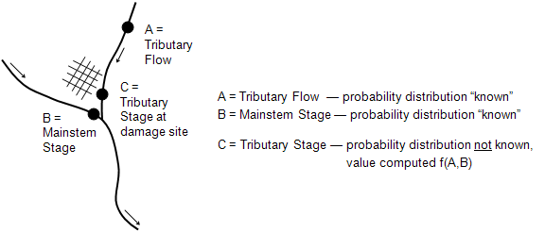
Coincident Frequency Analysis in HEC-SSP
Notes:
A coincident frequency analysis can be performed on any data type, flow, stage, precipitation, wind, etc. The coincident frequency analysis requires both duration and frequency curves. These can be computed by existing analyses in the HEC-SSP study or they can be entered manually in the coincident frequency analysis.
The Coincident Frequency Analysis is designed following guidelines in EM 1110-2-1415. This analysis tool can be used to compute the exceedance frequency relationship for a variable that is a function of two other variables. An example is illustrated above. In this example, the stage at the damage site on the tributary, variable C, is a function of stream flow from the tributary, variable A, and the stage in the mainstem river, variable B.

Slide 38
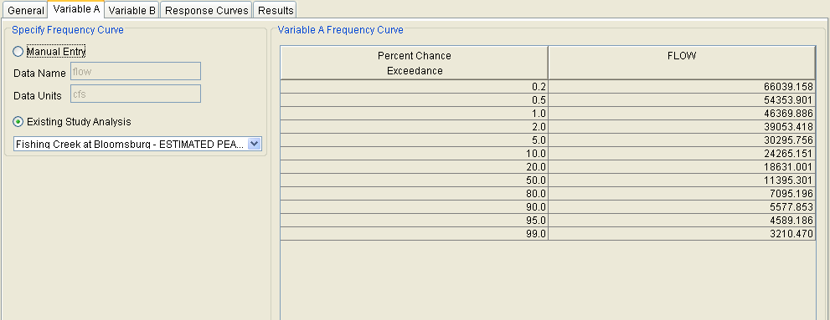
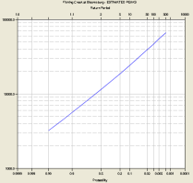
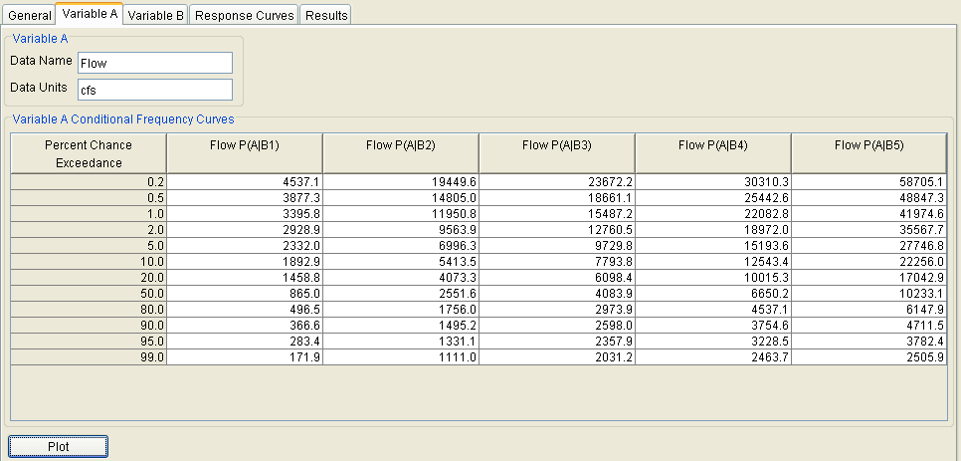
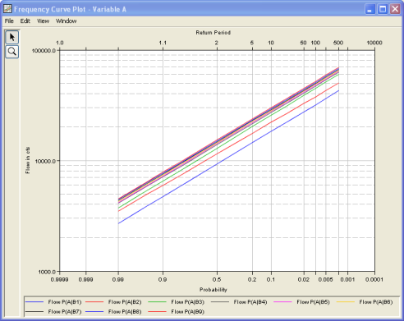
Variable A
If A and B are independent then only 1 frequency curve is needed for Variable A.
  Variable A frequency curve can be imported from existing analyses or entered manually
If A and B are not independent then a conditional frequency curve of Variable A is needed for each Variable B index.
Notes:
The Variable A tab is used to define the frequency curve for variable A. This tab will look different based on the user selection on the General Tab. When the Manual Entry option is selected, the user must define the Data Name and Data Units. Then the user must enter the frequency curve for variable A. A frequency curve value must be defined for each percent chance exceedance ordinate in the table. When the Existing Study Analysis option is selected, the dropdown list will be active and the user can choose any Bulletin 17B or General Frequency analysis in the HEC-SSP study. The variable A frequency curve table will be populated with the frequency curve when an analysis is selected.

Slide 39
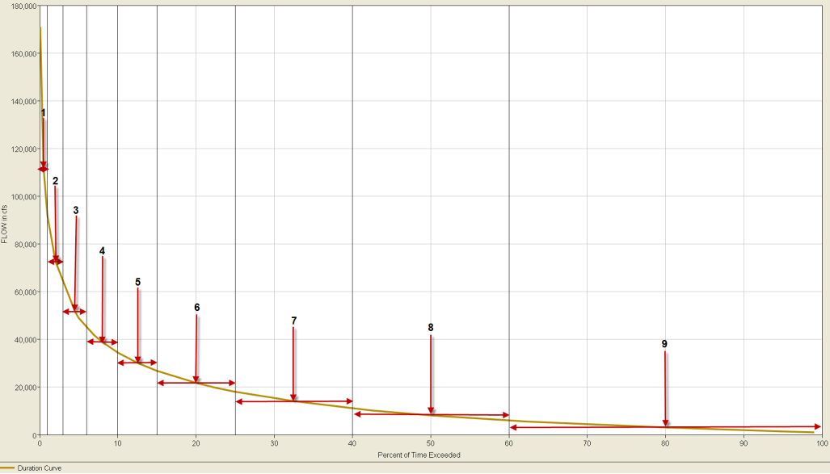
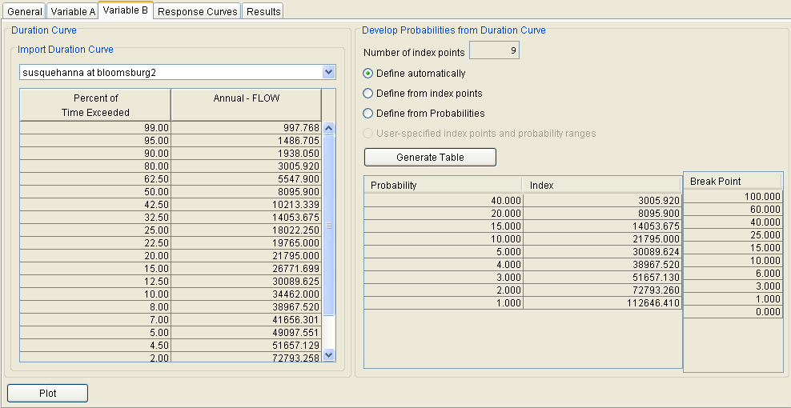
Variable B
The duration curve for Variable B must be imported from an existing Duration Analysis,
But, it can be defined manually in a Duration Analysis.
Then discretize the duration curve to determine index values for variable B.
Notes:
The Variable B tab is used to define the duration curve for variable B and the index points with an associated probability. The index points will be used by the user when developing the response curves (response of variable C to each combination of variables A and B). The associated probability represents the proportion of time we’ve assign to each index point.

Slide 40
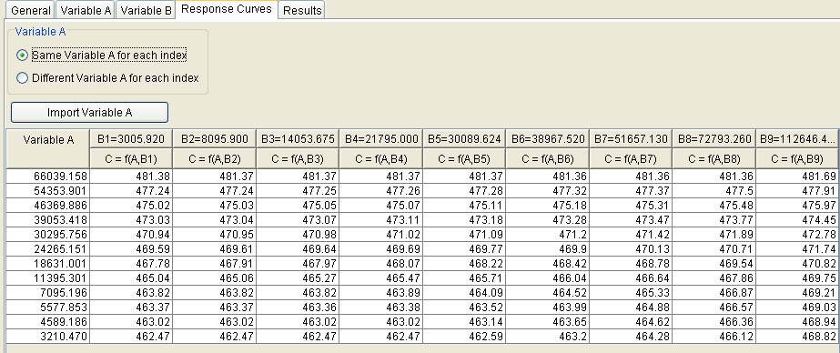
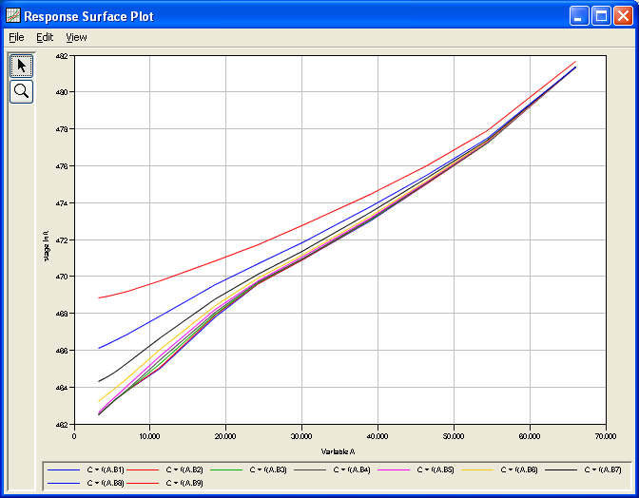
Response Curves
Notes:
The Response Curves tab is used to define the response of variable C to each combination of variable A and variable B. This analysis is performed outside of HEC-SSP. For example, a hydraulics model could be used to apply flow values from the variable A frequency curve to the tributary and the index flow (or stage) from the variable B duration curve would be applied to the mainstem. The hydraulics model would be used to compute the variable C stage at some reference point on the tributary for multiple combinations of variable A and variable B. The peak variable C stage is the value to input into the Response Curves table.
Note the response function table has the rows and columns reversed from what was shown earlier in this lecture.

Slide 41
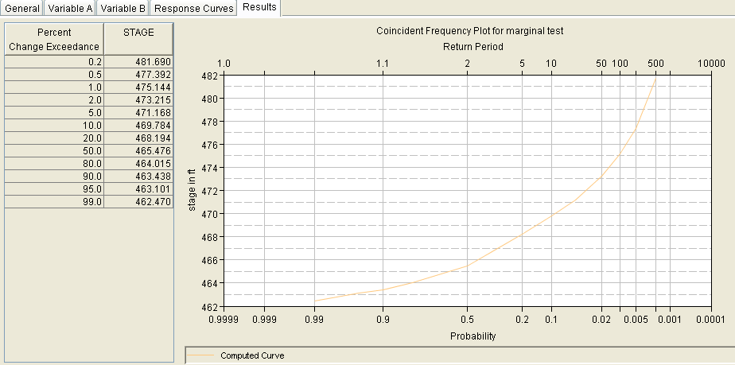

Coincident Frequency Results
Notes:
Once the new analysis has been defined, and the user has all of the information defined on the General, Variable A, Variable B, Response Curves tabs, performing the computations is simply a matter of pressing the Compute button at the bottom of the Coincident Frequency Analysis editor.
The following describes how the variable C coincident frequency curve is computed.
1) The program uses the variable A frequency curve(s) and the variable A values in the response curves table to assign a frequency of exceedance to each variable C value in the response curves table.
2) The program finds the minimum and maximum values of variable C in the response curves table.
3) The program defines 20 evenly spaced values of variable C in between the minimum and maximum values (20 values include the minimum and maximum values).
4) For each variable C from step 3, the program will look-up the exceedance frequency value from each response curve in step 1 and multiply by the corresponding proportion of time (using the probability defined on the Variable B tab) obtained from the variable B index value. These “weighted” values from each response curve are summed to compute the variable C frequency curve.
5) The curve is interpolated to the selected exceedance ordinates defined on the General tab.

Slide 42
Other ways…
Often the assumption of independence is not valid (ie, correlation is too high to ignore).
We need a joint distribution between A and B, but it requires at least an order of magnitude more data
Other options
  Continuous simulation of time-series of A and B to get time-series of C, do frequency analysis for C
  Estimate distributions for A and B, and a correlation, and do correlated random sampling in a Monte Carlo simulation

Slide 43
Monte Carlo Simulation
Replace the probability distributions for A and B with large samples, to create “events” with a value of A and of B
  Use correlated sampling to maintain observed correlation
Evaluate C for each “event” (sampled A and B pair)
  Each pair of A and B produces an output value of C
Resulting output sample of C can be used to infer the distribution of C
Notes:
Another way to incorporate correlation is to use correlated sampling in a Monte Carlo simulation.

Slide 44

To generate Tributary stage frequency Curve
simulate each event to determine stage
B
replace flow-frequency curves with samples…
CDF
Hydraulic Analysis
A
Peak Flow at A & B (cfs)
flows at A and B
C
1
0
choose random probabilities U[0,1] to “generate” event
A
Exceedance Probability
B
Tributary
event
Mainstem
Stage at C (ft)
…end with a sample of stages at C
order the sample as a stage frequency curve:
Relative Frequency
Damage Area Stage (ft)
Corps of Engineers
IWR-HEC
Notes:
The upper left corner shows the two correlated flow frequency curves, one for A and one for B. A correlated pair of values is sampled, and sent to the RAS model on the right side of the screen. Stage at C is computed, in the same way the response surface values were computed in the standard coincident frequency analysis. The Monte Carlo simulation ends with a sample of stages at C in the lower right., which is also shown as a stage frequency curve in the bottom center.

Slide 45
Replacing Flow-Frequency Curve at A with a Large Sample of Peak Flows
1000 events (annual peak flows, or annual max X-duration flows)
PDF form
(histogram)
CDF form (frequency curve)
each point is an “event”
events are ranked and plotted against relative frequency of exceedance (plotting positions for N=1000)
Variable A, flow
Notes:
This is the sample of flows that replaces the flow frequency curve, as a histogram and a frequency plot. There is also a sample of reservoir starting pools to replace the starting pool duration curve, which is not shown.

Slide 46
From each flow A & flow B, compute peak stage C, get sample of stages
1000 event peak stages
Variable C, stage
PDF form
(histogram)
CDF form (frequency curve)
each point is an “event”
Notes:
This is the output sample of peak pool stages, as a histogram and as a peak pool stage frequency curve.

Slide 47
Need to Sample Correlated Values?
If you suspect there is enough correlation between the variables to make independence a poor assumption:
Evaluate coincidence:
  Do A and B experience extremes same time? Annual max or any event?
Study and estimate correlation:
  For flow, consider relationship for log as well as linear
Estimate probability distributions for each variable
Notes:
To determine if need to do correlated sampling…

Slide 48
Two Flow Locations
flows at B are coincident in time with annual max at A
Variable A
Variable B
Notes:
Here is an example of a flow confluence problem. Variable A is the tributary and variable B is the mainstem. It was determined that annual maximums for thse basins coincide. These figures show an annual maximum flow frequency curve of each. Variable B uses the annual maximum distribution when it’s determined that annual maximums coincide.

Slide 49
Make Correlation Plots
Linear Flow, r = 0.74
Log Flow, r = 0.84
B
B
A
A
Notes:
These are correlation plots of A versus B, with linear axes on the left, and log axes on the right. In this case, the relationship between A and B is more linear (ie, have greater linear correlation) with log flow, at r = 0.84. Correlation of flow was only r = 0.74, on the left.

Slide 50
Sample of Correlated Flows
Linear Flow, r = 0.74
Log Flow, r = 0.84
0.74
B
B
1000 pairs
1000 pairs
A
A
Notes:
Correlated random sampling of 1000 pairs of A and B are shown here, with linear axes on the left, and log axes on the right. Note that the point scatter of the samples resembles the point scatter of the actual data on the previous slide.

Slide 51
Sample of Correlated Flows
Variable A
Variable B
1000 flows
1000 flows
Notes:
This shows the 1000 pairs of A and B, each plotted on its frequency plot.

Slide 52
Correlated Sampling
Gaussian Copula
Can generate correlated random values by bringing independent random value through a joint Normal distribution
  Want X ~ MN(0, Σ) multivariate normal
    where Σ is the correlation matrix of the variables
  Generate Z_{i} ~ N[0,1] for Z = (Z₁, Z₂, …, Z_{n})
  Find matrix C such that C^{T}C = Σ
    Can use Cholesky decomposition to get matrix C from Σ
  Then, C^{T}Z ~ MN(0, Σ)
Notes:
Correlated random sampling is performed using a standard multivariate Normal distribution having correlation matrix Sigma. For 2 variables, 2 arrays of independent U[0,1] are generated and transformed to N{[0,1] (Z). The arrays together form the Z matrix. A matrix C is developed such that C transpose times C equals matrix Sigma. Using it, C transpose times Z has a multivariate Normal distribution with correlation Sigma. The two columns of the multivariate Normal matrix are arrays that have the defined correlation.

Slide 53
To generate Tributary stage frequency Curve
simulate each event to determine stage
B
replace flow-frequency curves with samples…
CDF
Hydraulic Analysis
A
Peak Flow at A & B (cfs)
flows at A and B
C
1
0
choose CORRELATED random probabilities U[0,1] to “generate” event
A
Exceedance Probability
B
Tributary
event
Mainstem
…end with a sample of stages at C
Stage at C (ft)
order the sample as a stage frequency curve:
Relative Frequency
Note, sample will have higher highs and lower lows than uncorrelated
Damage Area Stage (ft)
Corps of Engineers
IWR-HEC
Notes:
The upper left corner shows the two correlated flow frequency curves, one for A and one for B. A correlated pair of values is sampled, and sent to the RAS model on the right side of the screen. Stage at C is computed, in the same way the response surface values were computed in the standard coincident frequency analysis. The Monte Carlo simulation ends with a sample of stages at C in the lower right., which is also shown as a stage frequency curve in the bottom center.

Slide 54
To generate Pool Stage Frequency Curve
simulate each event to determine pool stage
replace flow-frequency curve with a sample…
hydrograph
CDF
Reservoir Analysis
Peak Flow (cfs)
another random U[0,1] to sample starting pool
choose random probability U[0,1]
to “generate” event
1
0
event or
sample
member
Exceedance Probability
…end with a sample of Pool Stages
the sample is a pool stage frequency curve:
Peak Stage(i)
peak pool level
Relative Frequency
Corps of Engineers
IWR-HEC
Pool Stage (ft)
Notes:
The upper left corner is the flow frequency curve, and the right side is the starting reservoir pool stage. A random value is chosen for each to create an event, which is simulated in the reservoir model, producing a peak pool stage for each event. The Monte Carlo simulation ends with a large sample of peak pool stages in the lower right.

Slide 55
Knowledge Uncertainty?
What we’ve looked at so far has computed a best estimate of stage frequency curve at C
  The Monte Carlo sampling is only addressing natural variability in flood magnitudes (and initial reservoir level)
It has not yet included uncertainty in the flow distributions, or in the model parameters
Notes:
Thus far, only natural variabilities have been included in this analysis. But knowledge uncertainty is also important.

Slide 56
Natural Variability
Aleatory Uncertainty
Some variables are naturally random in that they change or vary unpredictably through time or space
Examples
  annual peak streamflow
  initial reservoir pool stage
  channel roughness, which can be affected by a flood event
  soil properties (vary in space, not time)
Notes:
When dealing with hydrologic phenomena such as flood events, natural variability tends to be things that vary from flood event to flood event.

Slide 57
Knowledge Uncertainty
Epistemic Uncertainty
The degree to which we are unsure about any parameters and relationships used in computation: economic, hydraulic or statistical
Might be reducible with more information…
Examples
  estimates of probability
  value of structures/contents in flood plain
  channel roughness, which we don’t know precisely
  a model that is too simple
decision metrics often encompass NV, but KU still adds “spread”
Notes:
When dealing with hydrologic phenomena such as flood events, knowledge uncertainties tend to be things that are true across all flood events, but just aren’t known or able to be estimated well.

Slide 58
How do we capture knowledge uncertainty in MC event modeling?
Two-level Nested Monte Carlo:
Sample instances of natural variabilities as flood events, with enough events to capture distributions of flow and starting stage
Sample instances of knowledge uncertainties in model parameters for each realization of the stage distribution, FIRST
inner loop 2 varies natural variability, computes pool-stage-freq
outer loop 1 = a realization
2
1
outer loop 1 varies knowledge uncertainty, computes pool-stage-frequency uncertainty
Corps of Engineers
IWR-HEC
Notes:
A way to incorporate knowledge uncertainty is to do a nested Monte Carlo.
In an outer loop, we sample knowledge uncertainty, and initialize all the models (including frequency curves) with the resulting value(s). Then we do an inner loop in which we sample natural variabilities as flood events. We sample only once in the outer loop, and we sample enough flood events on the inner loop to converge. The combination of once around the outer loop and a converged inner loop is called a realization.
We go back to the outer loop and again sample knowledge uncertainties once and initialize the models again. Then return to the inner loop to do enough flood events to converge.
We do enough outer loops to capture the knowledge uncertainty distributions, doing a full inner loop of natural variabilities for each of them.

Slide 59
sample of peak pool stage at C from one realization
(spans natural variability)
provides 1 estimate of peak pool frequency
2
1
Annual Peak Pool Stage at C (ft)
Peak Stage at C (ft)
sample of frequency curves from all realizations
(spans knowledge uncertainty)
provides distribution peak C pool stage quantiles
Notes:
After an inner loop has converged (one realization), we have a sample of peak stages at C. After all realizations, we have a collection of frequency curve for C, from which we can create confidence intervals.

Slide 60
To generate Pool Stage Frequency Curve
simulate each event to determine pool stage
sample new frequency curve (uncertainty)
hydrograph
CDF
Reservoir Analysis
Peak Flow (cfs)
replace flow-frequency curve with a sample…
another random U[0,1] to sample starting pool
choose random probability U[0,1]
to “generate” event
sample uncertain model parameters
1
0
event or
sample
member
Exceedance Probability
One Realization
…end with a sample of Pool Stages
after many realizations:
Peak Stage(i)
the sample is a pool stage frequency curve:
peak pool level
Relative Frequency
Corps of Engineers
IWR-HEC
Pool Stage (ft)
Notes:
The upper left corner is the flow frequency curve, and the right side is the starting reservoir pool stage. A random value is chosen for each to create an event, which is simulated in the reservoir model, producing a peak pool stage for each event. The Monte Carlo simulation ends with a large sample of peak pool stages in the lower right.

Slide 61
Comparison to Total Probability Theorem Method
We can also estimate a pool stage frequency curve by combining an inflow frequency curve with an initial pool stage frequency (or duration) curve
How does the Monte Carlo (HEC-WAT/FRA) analysis differ?
  Can explicitly incorporate uncertainty in flow frequency curve and other variables
  Can easily capture more random variables than peak flow and initial pool stage if they are relevant, rather than just two.
  Can consider a range of event hydrograph shapes with differing volumes for a given peak magnitude
  Correlation! - can do correlated sampling of marginal distributions

Slide 62
Starting with Precipitation
add rainfall/runoff model w/uncertainty to the sequence
replace precip-frequency curve with a sample…
Rainfall/Runoff Analysis
hyetographs
CDF
Precip (inches)
new randoms U[0,1] to sample infiltration rate, etc
choose random probability U[0,1]
to “generate” event
hydrographs
1
0
Exceedance Probability
event or
sample
member
Reservoir Analysis
new randoms U[0,1] to sample starting pool
…end with a sample of Pool Stages
Relative Frequency
peak pool level
Peak Stage(i)
Damage ($)
Notes:
This slides shows the same sampling and modeling process, but starting the hydrology one step earlier with a precipitation frequency curve and a rainfall/runoff analysis.

Slide 63
Questions?

