Slide 1
Flood Frequency Analysis Using HEC-HMS
Flood Frequency Analysis PROSPECT
May 2024
David Ho, P.H.
Original Slides from:
Gregory S. Karlovits, P.E., PH, CFM
Statistical Hydrologist
US Army Corps of Engineers
Hydrologic Engineering Center

Slide 2
Purpose
Become familiar with HEC-HMS
See how precipitation-frequency data becomes a flow-frequency analysis
Answer these questions:
  How do I set up a rainfall-runoff model and where do I get the data?
  What are the assumptions and modeling decisions to consider?
  How to create AEP/Design hydrographs from frequency curves?
Notes:
We will focus on AEP neutral, deterministic approach to flow frequency.
We will answer these

Slide 3
Outline
Introduction to HEC-HMS
Setting up an HEC-HMS model
Precipitation-frequency data
Modeling hypothetical storm events
Modeling flood frequency with HEC-HMS

Slide 4
Introduction to HEC-HMS
Notes:
Basic overview of HEC-HMS.

Slide 5
Introduction to HEC-HMS
For more information, come to the HMS training classes!
HEC Hydrologic Modeling System
Watershed hydrology model
  “Rainfall-runoff” model
  Event or continuous modeling
User chooses hydrologic process methods/parameters
Driven by user-specified boundary conditions
GIS
Basic HEC-HMS: Nov 18-22, 2024
Advanced HEC-HMS: June 24-28, 2024

Slide 6
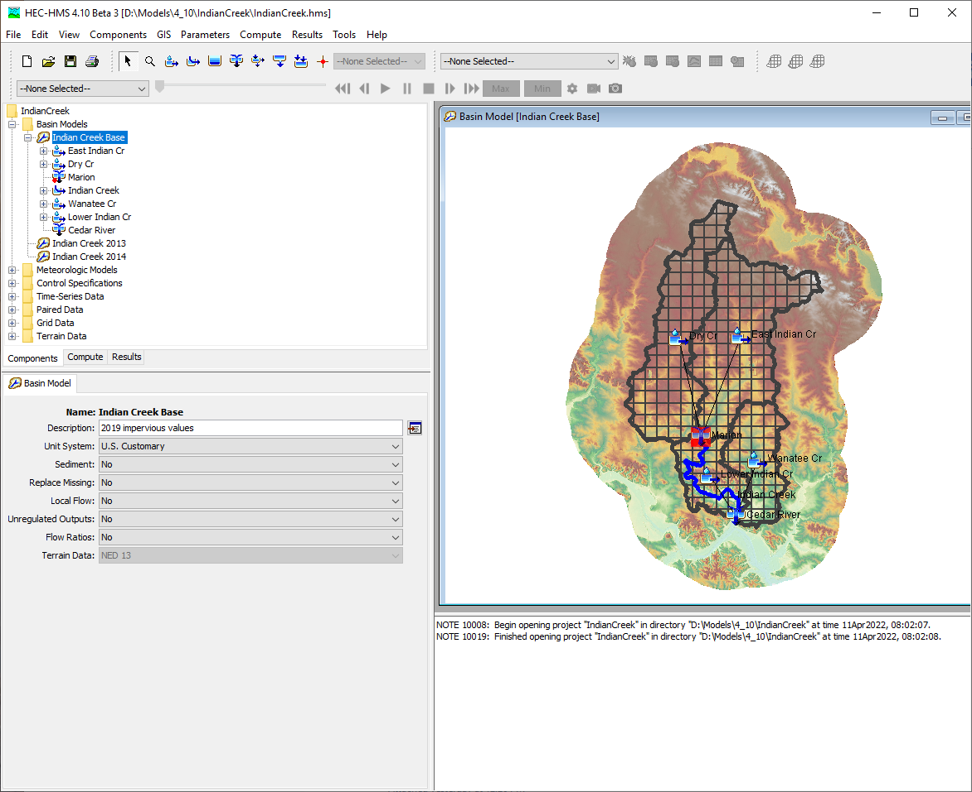
Keys to an HEC-HMS Model
Basin model
Meteorologic model
Compute type
Notes:
These are the three parts to an HMS model that needs to be set up in order to run a simulation. Basin Model and Met Model are the main part of the model that you will spend the most time on.

Slide 7
Basin Model
Representation of surface hydrology in watershed
Seven basin elements:
  Subbasin
  Reach
  Reservoir
  Junction
  Diversion
  Source
  Sink
Notes:
An HMS project can have multiple basin models – usually they represent the same watershed but with different methods and/or parameters set or selected.

Slide 8
Meteorologic Model
Represents atmospheric boundary conditions
Provides meteorologic data to basin model
Shortwave radiation
Longwave radiation
Precipitation
Temperature
Windspeed
Surface pressure
Dew point
Potential evapotranspiration
Notes:
An HMS project will also have several met models – each is used to represent a different set of processes or potentially different periods in time for boundary conditions.

Slide 9
Compute Type
Method for setting model parameters and managing results
Seven compute types:
  Simulation Run
  Optimization Trial
  Forecast Alternative
  Ensemble Analysis
  Depth-Area Analysis
  Uncertainty Analysis
  Frequency Analysis
Notes:
We have different compute types. Method for setting model parameters and managing results and will get you simulated results. These can serve different purposes, Optimization is used for optimizing a parameter value based some maximization or minimization of a given metric. The methods I would point your attention to are the Simulation Run, Uncertainty Analysis, and Frequency Analysis

Slide 10
Data Management
Four main types:
  Time-series data
    Discharge, precipitation, temperature
  Paired data
    Areal reduction, elevation-storage
  Grid data
    Precipitation, CN grid
  Terrain data
    DEM
Re-usable data components
Estimate or set parameters
Provide boundary conditions
Notes:
We have four types of input data: Time-series, Paired data, Grid Data, and Terrain data.

Slide 11
Setting Up an HEC-HMS Model
Notes:
Highlight methods we will be using in the workshop. We tend to recommend these methods as well to users.

Slide 12
Model Inputs for a Basic Model
Basin model
  Subbasin element
Meteorologic model
  Precipitation method
Notes:
Will highlight hydrologic methods and Met methods you will see in the workshop.

Slide 13
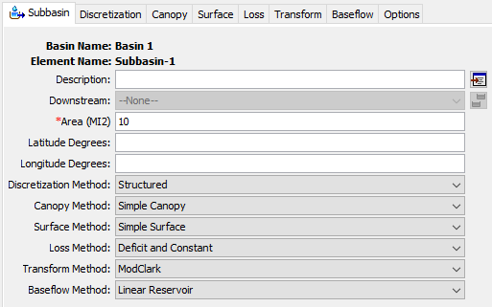
Subbasin Processes
Canopy
Surface
Loss
Transform
Baseflow
Discretization
Notes:
Hydrologic processes

Slide 14
Meteorologic Model
Precipitation
Loss
Transform
Direct Runoff
Baseflow
Interflow
Subbasin Outlet
Baseflow

Slide 15
Loss Methods
Determine how much of the water infiltrates or runs off
  Deficit and Constant (+Gridded)
  Exponential
  Green and Ampt (+Gridded)
  Initial and Constant
  Layered Green Ampt
  SCS Curve Number (+Gridded)
  Smith Parlange
  Soil Moisture Accounting (+Gridded)

Slide 16
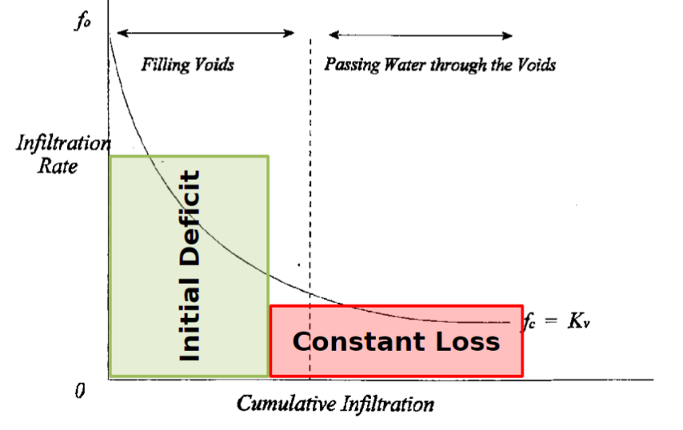
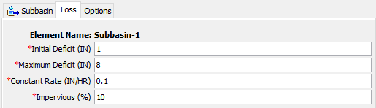
Deficit and Constant Loss
0.1 in/hr
1 in
8 in
0.1 in/hr
Notes:
The goal of a loss method is to partition rainfall (or snowmelt) into infiltrated water in the soil, or to direct runoff that flows along the surface.
Deficit and constant is a flexible method useful for event or continuous modeling. The principle is that there is a certain amount of space in the soil that can hold water (termed a deficit) that can fill up when it rains, or empty when evapotranspiration occurs. At the start of a simulation there is a certain amount of space available – in this example, one inch. As it rains, this deficit reduces to zero as the soil fills up. During that period, no runoff is generated (unless there is impervious area.) Once the deficit is zero, water is infiltrated at a rate equal to the constant rate (here 0.1 inches per hour) and the rest becomes direct runoff. In continuous models where evapotranspiration is computed, plants will pull water from the soil, increasing the deficit up to the maximum value (here, 8 inches.) The impervious area is a reflection of how much of a subbasin has no infiltration at all – these areas are not subject to the deficit or constant rate computations.
The deficit and constant parameters can be estimated from soils data but need to be calibrated to observed events. The impervious area is easy to estimate using the National Land Cover Database data.

Slide 17
Transform Methods
Determine how runoff throughout the watershed becomes streamflow at the watershed outlet
  Clark Unit Hydrograph
  Kinematic Wave
  ModClark
  SCS Unit Hydrograph
  Snyder Unit Hydrograph
  User-Specified S-Graph
  User-Specified Unit Hydrograph
  2D Diffusion Wave

Slide 18
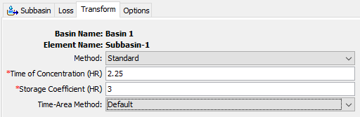
Clark Unit Hydrograph
Notes:
The Clark Unit Hydrograph is a simple but flexible way to describe how the direct runoff in a subbasin gets to the watershed outlet. Without a transform method, direct runoff would arrive at the watershed outlet instantly. It usually takes longer than that for direct runoff to reach the outlet.
The time of concentration is thought of as the maximum travel time of a droplet of direct runoff from where it fell to the outlet. It controls how quickly the outlet hydrograph peaks.
The storage coefficient describes how much attenuation there is in the direct runoff hydrograph – that is, how much the peak of the direct runoff spreads out over time.
There are a number of ways to estimate these values initially, but they almost always require some calibration to observed events.
The method option on the top will come into play when we talk about hypothetical storm modeling because there is a tool that lets us account for how much quicker water reaches the outlet when rainfall intensities are higher.

Slide 19
Baseflow Methods
Determine how infiltrated water returns to the stream at the watershed outlet
  Bounded Recession
  Constant Monthly
  Linear Reservoir
  Nonlinear Boussinesq
  Recession

Slide 20
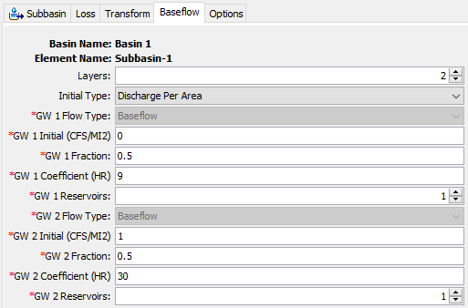
Linear Reservoir Baseflow
Notes:
This looks complicated but I promise it’s not that bad!
Linear reservoir baseflow lets you partition infiltrated water into a number of soil layers that return water to the stream at varying rates. In this example, we have a two-layer model, which is used to model an interflow layer (fast responding, not too deep in the soil) and a regular baseflow layer (slower responding, deeper in the soil.) In some watersheds you might only need one layer, in others you might need to go up to three, it all depends on how complex the flow in the soil is.
Each baseflow layer has 4 parameters.
The first is the initial flow – how much water is exiting the baseflow layer at the start of the simulation? You can set it to a specific value, or use a value normalized to the area of the subbasin.
The second is the fraction – what fraction of the infiltrated water goes into this layer? In this example both layers are getting 50% of the infiltrated water. The fractions don’t have to add up to 100% but they can’t be greater. If the total is less than 100%, it is assumed that the remainder is lost to a deep groundwater aquifer that doesn’t return to the stream. Most of the time 50%-50% is a good first guess.
The groundwater coefficient is the timing parameter – how quickly does this layer respond? This value is often related to the Clark UH time of concentration, with the shallow layer 3-5 times slower than tc, and the deeper layer 10-20 times slower.
The last setting is the number of reservoirs – this can be used to increase attenuation in the layer so that slows down and spreads out the baseflow response.

Slide 21
Precipitation Methods
Frequency Storm
Gage Weights
Gridded Precipitation
HMR52 Storm
Hypothetical Storm
Interpolated Precipitation
Inverse Distance
Specified Hyetograph
Standard Project Storm
Notes:
Transition to Precipitation Methods
The highlighted methods you will see this in the workshop and will talk a little more in detail over these methods.

Slide 22
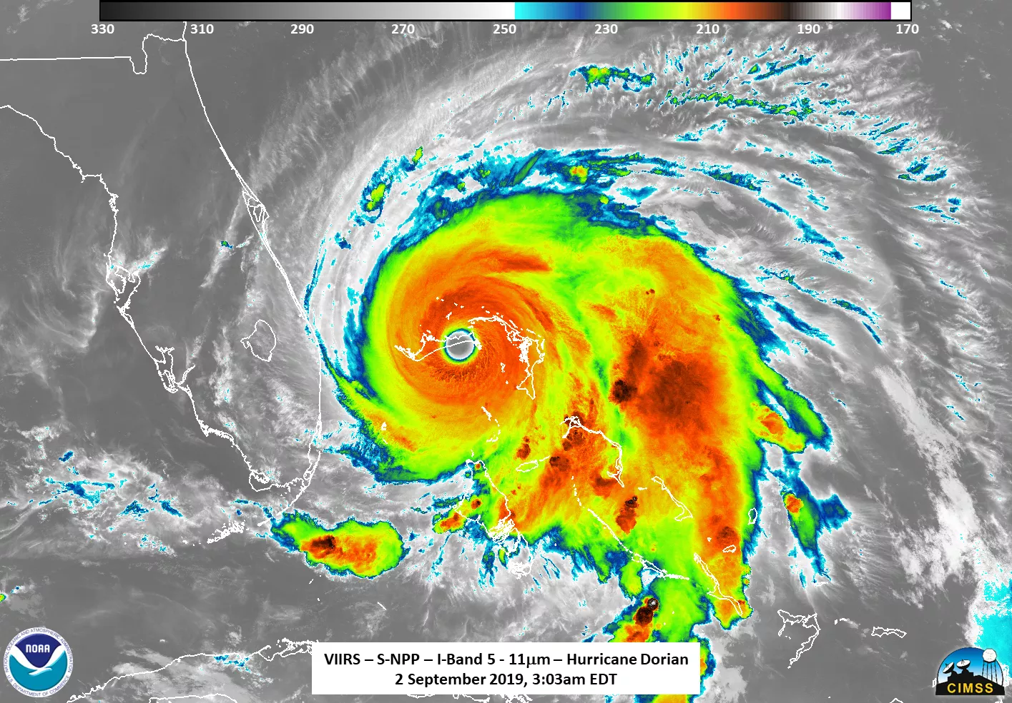
Gridded Precipitation
Observed precipitation input based on precipitation grids
Basin model changes:
  Discretization method
  ModClark transform
Used for:
  Calibration
Notes:
Over the past 5-10 years, gridded datasets are more prevalent and readily available, especially for ingesting into HMS. The advantages of using a gridded dataset is getting a better representation of the spatial values. To take advantage of the gridded precipitation, there are some tweaks we make to the basin model.
We use gridded precipitation for calibrating out model and for forecasting runoff.

Slide 23
Hypothetical Storm
General method for modeling design storms
Specify a number of storm properties:
  Duration
  Precipitation depth
  Time pattern
  Area reduction
Special storm specification methods:
Area-Dependent Pattern
SCS Storms
User-Specified Pattern
Notes:
Moving onto the second Precipitation Method, we have the Hypothetical storm which is a general method for modeling design storms, i.e. 1/100 year. Used to be the SCS Storm method but made it more general.
There are additional options the user needs to specify. We will be using the User Specified Pattern, meaning you need to input the temporal pattern and its applied to the entire basin.

Slide 24
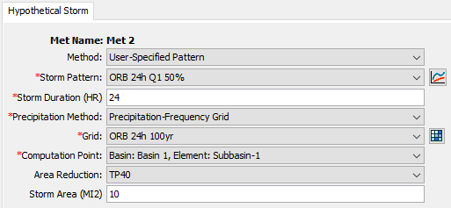
User-Specified Pattern Hypothetical Storm
Notes:
Here is the UI for the user-specified option.

Slide 25
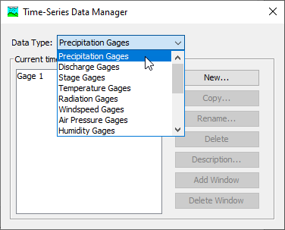
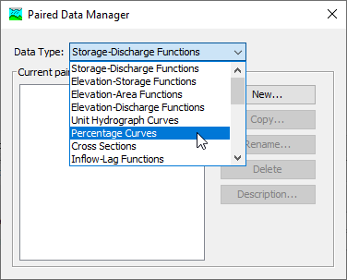
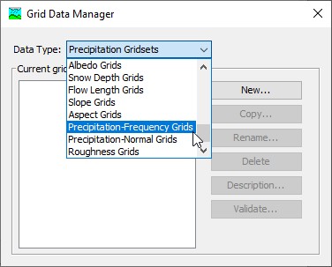
Data
Time-Series Data
  Time-indexed data
Paired Data
  Functional relationship
Grid Data
  Raster format data
Notes:
To parameterize your Hypothetical Storm, you will need to input some additional information into the model. We won’t be dealing with time series data (leave that aside) but we will see Paired Data and Grid Data. Paired Data is defining some functional relationship, given x, you output y. We will see this for the time pattern and area reduction function. You will also use the Grid Data which takes in a raster dataset. In our case, it will be the NOAA Atlas 14 grids we download from Atlas 14.

Slide 26
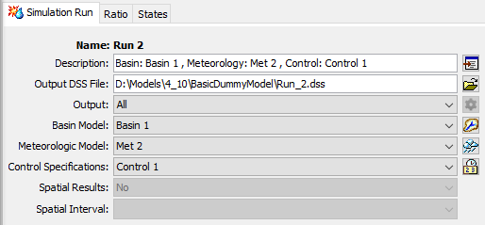
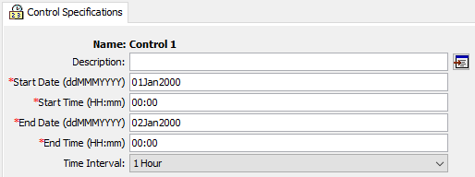
Simulation Run
Basin Model
Meteorologic Model
Control Specification
  Time window
  Time step
Notes:
HMS has multiple Compute Options. The simulation run is the most common method of running an HMS model. Its job is to run the combination of basin model and meteorologic model as-is for a specified time window with a given model timestep. Deterministic, historic rainfall

Slide 27
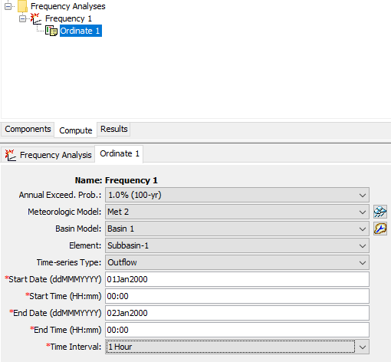
Frequency Analysis Compute
Each ordinate combines:
  AEP
  Meteorologic Model
  Basin Model
Extracts timeseries maximum
Plots as frequency curve
Notes:
For our workshop, we will also use the Frequency Analysis Compute type. This is another Compute Option where you combine AEP, Met Model associated with the AEP, and Basin model. It extracts the time series maximum value and plots the value as a frequency curve. The purpose of this Compute Option is to make it easier to get the peak flow value and assign the value to a quantile to get a compute flow frequency curve.
We will come back to this.

Slide 28
Precipitation-Frequency Data in HEC-HMS
Notes:
So that was a quick overview of HMS. We talked about what is HMS, setting up an HMS model, and now we’re going to discuss the precipitation source in more detail. In HMS, we have the Hypothetical Storm method that we are using to create design storms to get design floods. One of the inputs to the Hypothetical Storm method is rainfall input.

Slide 29
Precipitation-Frequency Data
Precipitation-frequency and data sources (quick review)
Using precipitation-frequency grids in hypothetical storm

Slide 30
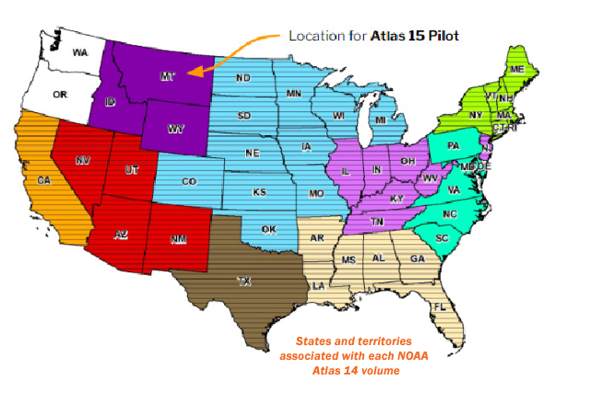
Precipitation-Frequency Data
For most applications, NOAA Atlas 14
Other cases: NOAA Atlas 2/TP-49, custom studies
Input data: isopluvial raster
  Represents a storm depth of a single duration and frequency occurring everywhere
  Not a storm pattern!
Refer back to the “Frequency Curves in Poor Data Environments” lecture!

Slide 31
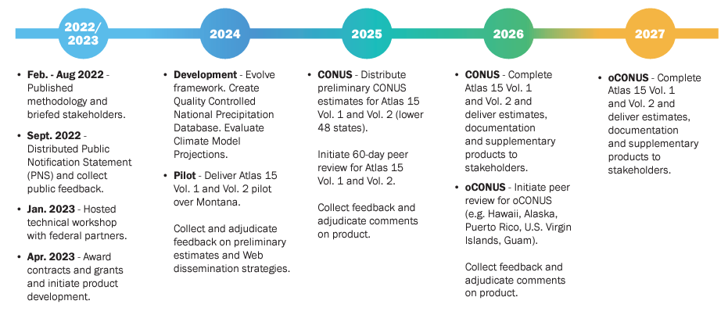
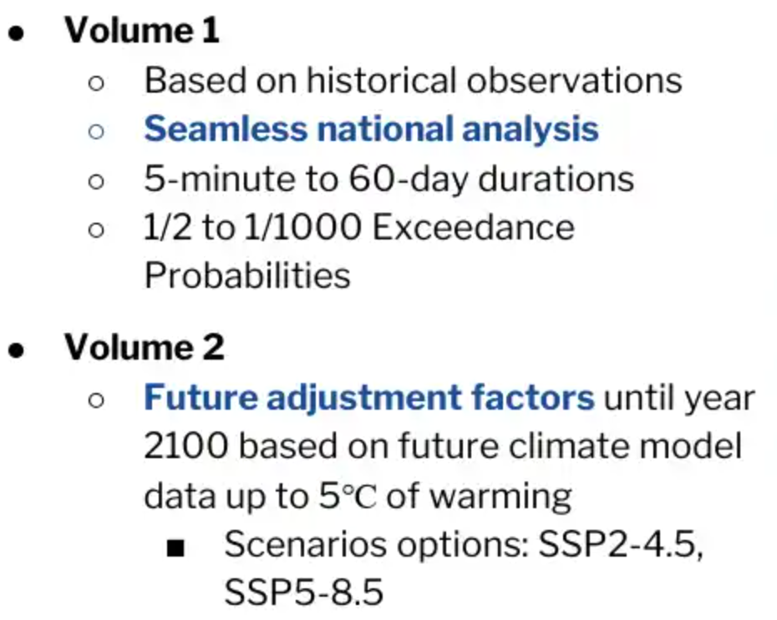
NOAA Atlas 15
https://www.weather.gov/owp/hdsc

Slide 32
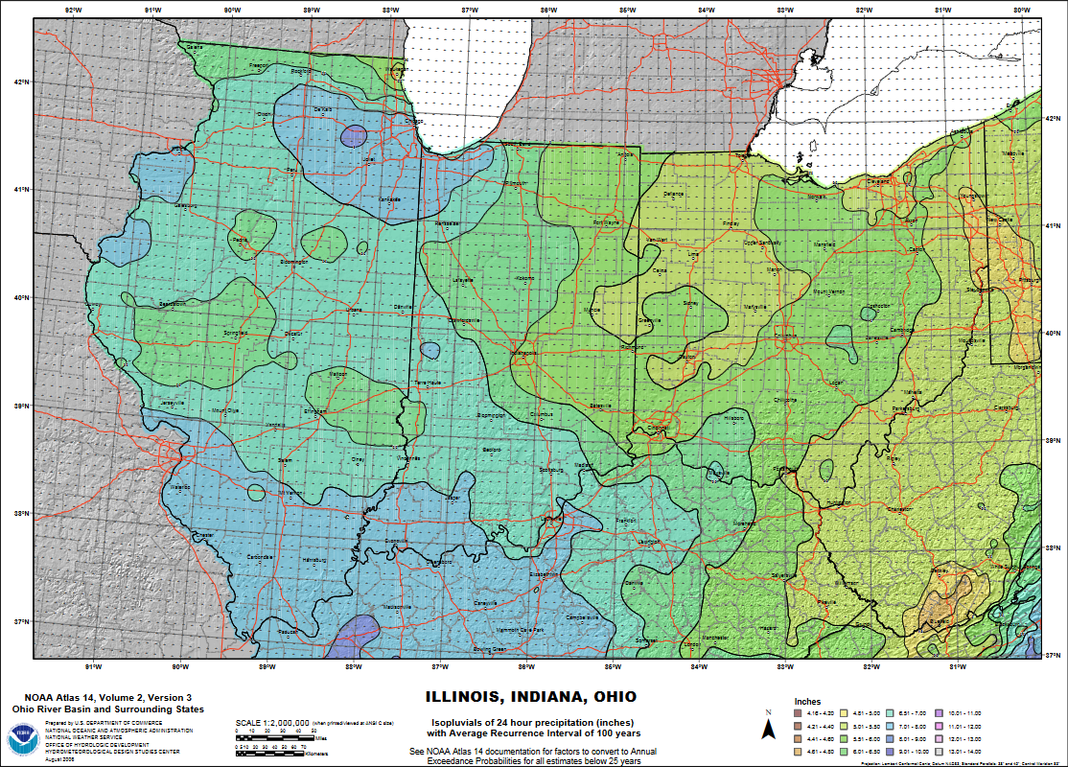
24-hour
1/100 AEP
Notes:
This isopluvial map is rasterized for GIS consumption.

Slide 33
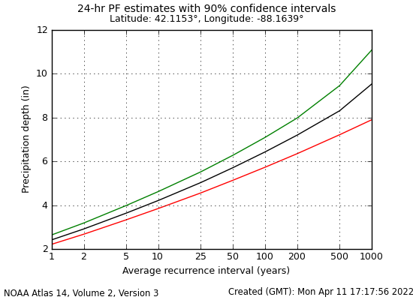
Precipitation-Frequency Curves
Notes:
Each pixel of the raster has a curve like this – to build the raster, go to the same average recurrence interval on the x-axis (for example 100 years) and then read off the value on the black curve.

Slide 34
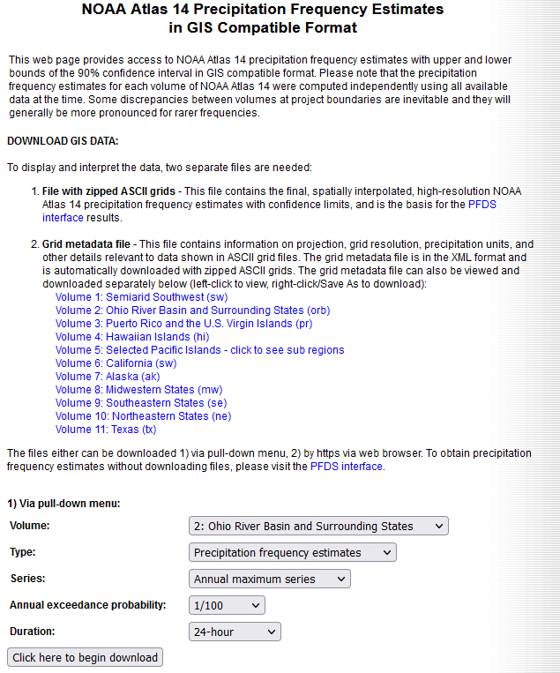
Getting Data
NOAA Precipitation Frequency Data Server (PFDS)
ASC-format rasters for all volumes of A14

Slide 35
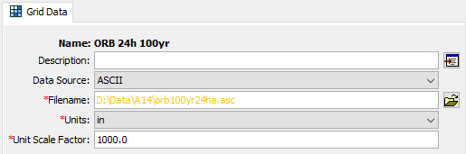
Precipitation-Frequency Grids in HMS
Native support for PF rasters in HMS
Download A14 PFDS rasters and directly plug them in
Data-Specific!
Notes:
Once you download the grids from Atlas 14, HMS can read the files directly. You do not need to convert to dss (other gridded time series data needs dss). You do need to check your units. NOAA Atlas 14 saves its data in 1000 inches for easy storage. This option lets you convert to the proper units.

Slide 36
Hypothetical Storm + PF Grids
Notes:
With Hypothetical storm, you specify one duration and assign the grid for that one duration. In this example, we are assigning the 24 hour depth, 100 year AEP precipitation frequency grid.

Slide 37
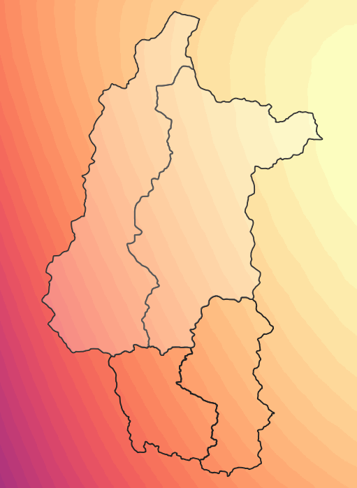
Precipitation Depth
Computed as a watershed-average above the computation point or subbasin
  Spatial Distribution set to Variable by Subbasin or Uniform
NOT the same as area reduction
Average = 7.50 in
Computation Point
Notes:
HMS will average the precip-frequency grid over your watershed area. It will average either by subbasin or above a computation point. Even though we performed an average, the rainfall depths are still “point value”. We’ve simply averaged all of the precip-frequency depths of a given frequency and duration over an area. We have NOT applied area reduction. Atlas 14 does not reflect the depths from a storm pattern

Slide 38
Summary
Intro to HMS
  Basin model and Meteorological Model
  Various compute options: Simulation Run and Frequency Storm option
Setting up HMS model
  Select important Hydrologic Process: Loss, Transform, and Baseflow
  Select Meteorologic Model Method: Gridded Precipitation and Hypothetical Storm
Precipitation-Frequency
  NOAA Atlas 14 gridded data

Slide 39
Modeling Hypothetical Storm Events

Slide 40
Modeling Hypothetical Storm Events
Hydrologic considerations
  How does the watershed respond during a flood?
Meteorologic considerations
  What meteorologic characteristics create a flood?
Notes:
In modeling design storms, there are a number of assumptions you have to make.
When modeling a Hypothetical Storm event, there is the hydrologic considerations and there is the meteorological consideration.
-The hydrologic considerations are looking at the watershed and understanding what processes, initial states, and representative parameters that contribute to generating a flood.
-The meteorological consideration is looking at the storm and understanding what type of storm, i.e. its temporal distribution, its depth, its duration would create a large flood.

Slide 41
Hydrologic Considerations
Model calibration
Initial conditions for flood frequency analysis
Non-linearity of hydrologic response
  Dependency of hydrologic parameters on amount of rainfall
Notes:
To understand what the flood response will be on a basin, we will look at these three points: Model calibration, initial conditions for flood frequency, and the non-linearity of hydrologic response.

Slide 42
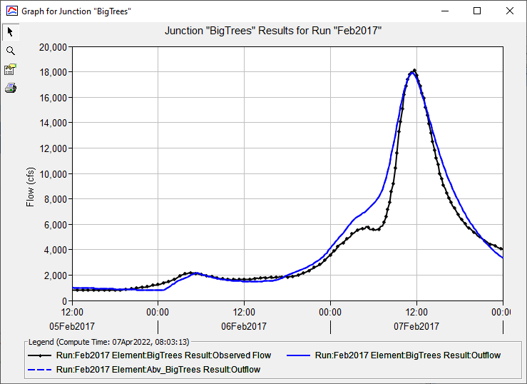
Model Calibration
Watershed model is a stand-in for reality
Set parameters so the model can re-produce real flood events
Notes:
Watershed model is a stand in for reality. We are looking to replicate the flood response given a rainfall boundary condition and there are a lot of different hydrologic processes that can affect the flooding characteristics. In modeling, we have hydrologic methods that attempt to describe hydrologic behavior. For each method, we have parameters. We set parameters so the model can reproduce the flood event. This is what model calibration basically is – adjusting model parameters.

Slide 43
Model Calibration
Calibrate to events of different magnitudes
Identify varying initial conditions (wet vs. dry)
  Loss: initial deficit
  Baseflow: initial baseflow
  Snow, reservoir, reach as needed
Most important parameters:
  Loss: constant loss rate
  Transform: time of concentration, storage coefficient

Slide 44
Ungaged Watersheds
Can’t calibrate without observed streamflow data!
Borrow parameters from neighboring similar watersheds
  Transfer parameters
  Regression equations
Adjust with watershed-specific data
  Compare soils and land-use data
Compare results against
  USGS Regression Equation Quantile estimates
  Regional flow per square mile
Notes:
A situation you will probably find yourself often is performing a flow frequency analysis without any streamflow data. There is no gage to perform a bulletin 17C analysis
-If you were to create a model, you cannot calibrate the model. If you’re lucky, you might be in a situation where the stream gage was discontinued. That is still data you can use. But what about if you have no gage? How do you calibrate your models
-A couple strategies you can consider if you find yourself if this situation:
Borrow parameters from neighboring watersheds that are similar. Transfer the parameters over to your basin. You could also expand your watershed region until you have a gage. Adjust initial parameters to a similar degree to match calibration target.
If regression equations were created for your region, you can borrow those regression parameters. We will commonly see users initialize parameters using TR-55 methods.
Adjust with watershed specific data. This would essentially to spend a longer time during the initial estimate phase.
Once you have your parameters set up and have run your simulation, you can compare your results against usgs regression equations or against regional flow per square mile estimates.

Slide 45
Initial Conditions
Flood severity related to watershed conditions prior to storm
Model should reflect this variation
Factors:
  Soil water storage
  Snow
  Reservoir storage/outflow
  Reach flow
  Baseflow
Notes:
Initial conditions are the starting states for your watershed. For event based simulations, initial conditions are very critical and can affect your results quite drastically. The processes where you will need to set initial conditions are:
Soil water storage, snow, reservoir storage, reach flow, and baseflow.
Snow and reservoir information, and to a lesser extent reaches, are watershed-specific. Not every watershed will need to consider these things.

Slide 46
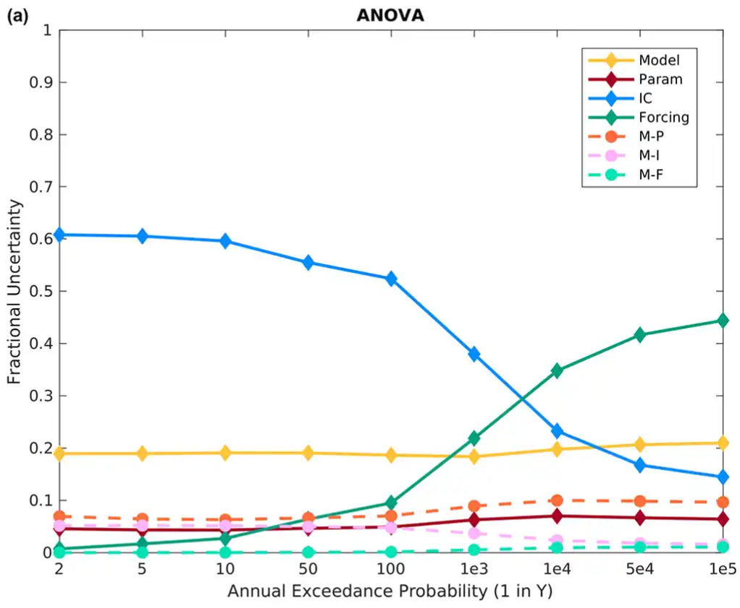
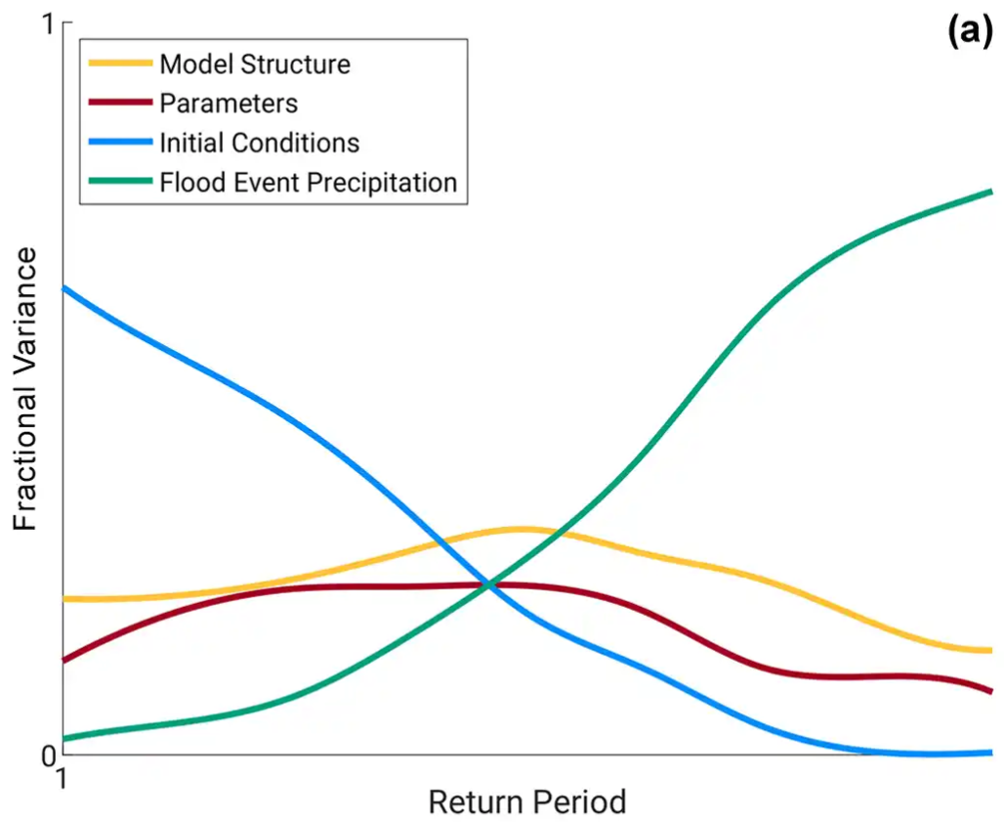
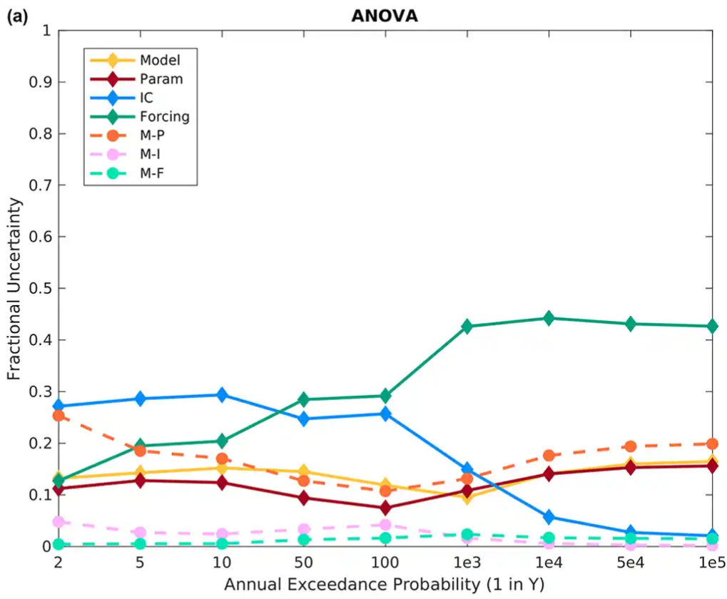
Newman, A. J., Stone, A. G., Saharia, M., Holman, K. D., Addor, N., and Clark, M. P.: Identifying sensitivities in flood frequency analyses using a stochastic hydrologic modeling system, Hydrol. Earth Syst. Sci., 25, 5603–5621, https://doi.org/10.5194/hess-25-5603-2021, 2021.

Slide 47
Non-Linearity in Surface Runoff
Runoff severity can increase with increased precipitation
  Flood wave reaches outlet more quickly
  Less attenuation
Important consideration for peak flows
Notes:
Non-linearity with respects to surface runoff. The runoff severity can increase with increased precipitation. This is referring specifically to our unit hydrograph transform assumption where we scale the hydrograph linearly with increased rainfall depth. In reality, we have quicker runoff and less attenuation of your hydrograph. This is important for capturing peak flows.
If you don’t account for this, your precipitation-based frequency curve is likely to wind up lower and flatter than a streamflow-based one.

Slide 48
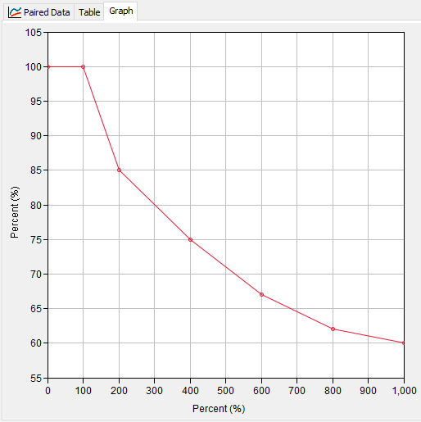
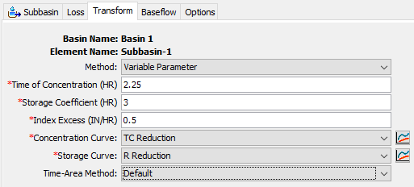
Variable Parameter Clark UH
% of Index Time of Concentration
Index Excess (in/hr)
Notes:
In HMS, we have a way of characterizing the non-linearity of intense rainfall through the Variable Clark UH method. You create concentration and storage curves that adjust the time of concentration and storage based off the excess rainfall intensity.

Slide 49
Meteorologic Considerations
Storm duration
Storm spatial pattern
  Distribution of rainfall
  Area reduction
Storm temporal pattern
Unique for all storms, but we generalize
Notes:
This is getting into how we can create a design storm and we’ve listed three points to consider.
The storm duration – length of storm
Storm spatial pattern
How rainfall is distributed over the basin
Using areal reduction factors
Storm temporal pattern – how the storm depth changes over time

Slide 50
Watershed Response
Peak flow is sensitive to all the hypothetical storm settings
  Time pattern (most sensitive)
  Storm duration
  Area reduction
  Spatial pattern (least sensitive)
Notes:
Peak flow is sensitive to all hypothetical storm settings. What we mean by sensitive is changing any of these can change the peak flow. Some more than others. In general, here is a rank of the most sensitive to least sensitive storm settings when using hypothetical storm.

Slide 51
Storm Duration
Total amount of time of rainfall
Time pattern depends on it
Chosen one of two ways:
  Watershed-based (close to time of concentration)
    If solely interested in peak flow
  Meteorologically-based
    Historically, which storms have produced large floods
Notes:
Storm duration refers to the amount of time it rains. Your pattern needs the storm duration. You can choose the duration either using your watershed time of concentration or from meteorology.

Slide 52
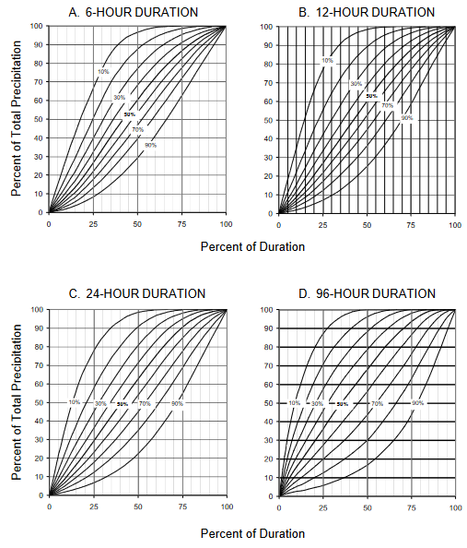
Time Patterns
Dependent on storm duration
  Incorrect pairing will condense or elongate your storm
Two sources:
  Observed storms
  Synthetic patterns
https://hdsc.nws.noaa.gov/pfds/pfds_temporal.html
Notes:
Time patterns are the temporal distribution of the storm and dependent on your storm duration. If you don’t match your duration with your pattern, you can end up elongating your pattern or condensing your pattern and it will affect your peak flow drastically.
Synthetic patterns can be obtained from NOAA, where they analyzed a bunch of storms and divided them into 6-hr, 12-hr, 24-hr and 96-hr durations. For certain states, the distributions are again into regions. For each region, distributions are further divided into 4 quartiles with 9 percentile patterns.
Time pattern usually defines what the most severe increments of rainfall are – they are shown as percents of the total storm duration and total storm depth (cumulative curves)

Slide 53
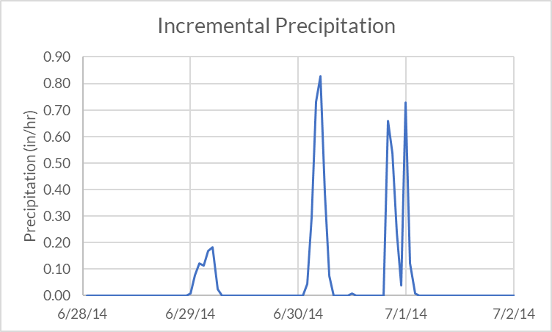
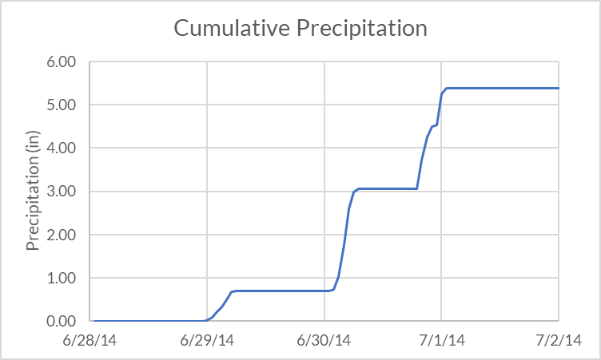
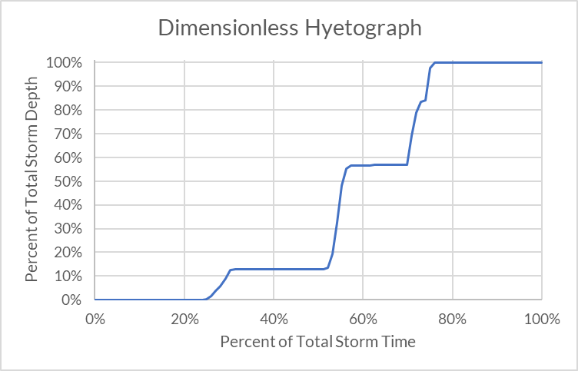
Time Pattern from Observed Storm
Dimensionless %-% cumulative pattern
% of total duration
% of total depth
Input as a Paired Data curve
  Percentage curve

Slide 54
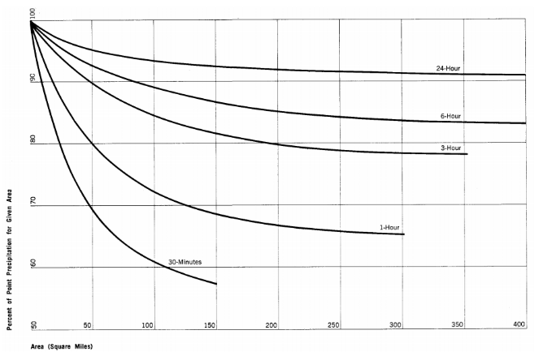

Area Reduction
Precipitation-frequency describes precipitation at a point
Compute area-average from point depths
Area-average reduced from point-average
Area is typically your watershed area
24-hour
6-hour
3-hour
Percent of Point (%)
1-hour
30-min
Area (mi²)
Notes:
Area reduction is where you take your point precipitation value you get from NOAA Atlas and adjust the values so it properly represents an area. Storms depths reduce as you move further away from the storm center. You will overestimate your flows if you do not reduce your precipitation depths. This curve is an example of areal reduction taken from TP-40, as you increase in your area, the depth of your rainfall decreases. In most cases, your area is the watershed area.

Slide 55
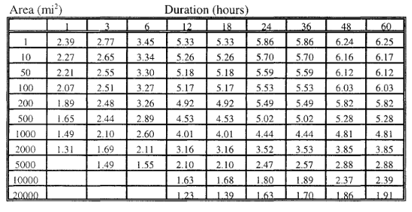
Depth-Area Reduction from Observed Events
Storm information summarized in depth-area-duration table
Notes:
Depth area reduction curves are going to be region specific. TP-40 was actually created for the entire U.S. and it was done back in the 1960 or so it bears updating. There are more recent areal reduction factors you can find from HMR documents.

Slide 56
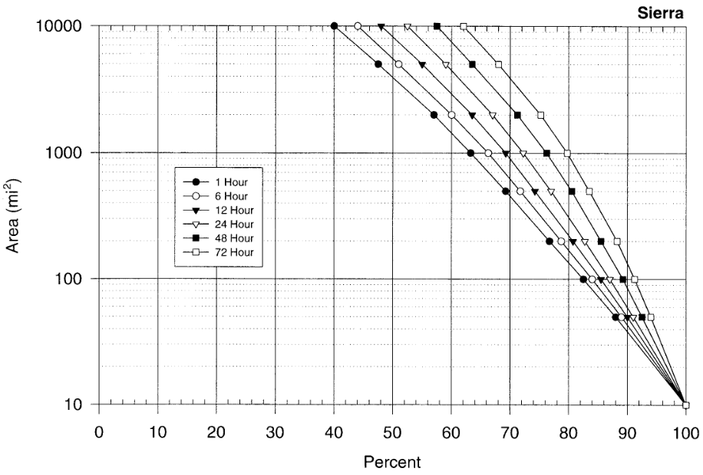
Example from HMR-59
< 10 mi² = 100%
Notes:
Here is an example of a reduction factor for California (HMR-59).

Slide 57
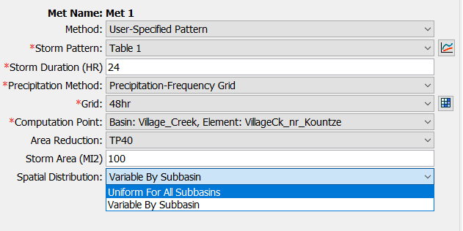
Spatial Pattern
Currently HMS allows both spatially-uniform and variable rainfall above the computation point
  Compute average depths per computation point or by subbasin

Slide 58
Modeling Flood Frequency with HEC-HMS

Slide 59
AEP Neutral Approach
Assumption:
  Precipitation frequency for a particular depth and duration equals the flood frequency
  i.e., 1/100 AEP rainfall causes 1/100 AEP flood
More advanced techniques are required to break free of this assumption
Notes:
A very important assumption we make in flood frequency is AEP neutral. A simplification of our hydrologic modeling. This has been the most common method of applying AEP rainfall in hydrologic models.
The more advanced techniques are beyond the scope of this class but I’m happy to discuss them off-line.

Slide 60
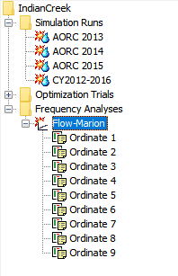
Frequency Analysis Compute
Collection of frequency ordinates (AEPs)
User specifies a basin model and met model combination that represents a specific AEP
HEC-HMS runs each ordinate as a separate simulation
Collects the results
Creates a frequency curve plot

Slide 61
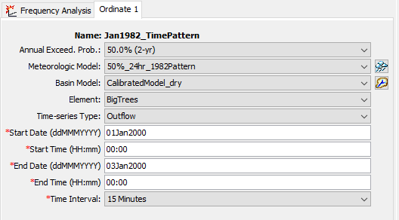
Frequency Analysis Ordinate
Notes:
Here is the interface again for a frequency analysis ordinate. Right now you can only choose AEPs from a list – these are the AEPs used in Atlas 14.
In the simplest of cases, your HMS project might contain one met model for each frequency ordinate, and one total basin model. However, in most situations you will need to create multiple basin models in order to capture initial conditions. To do this, first create a “master” basin model that has all the parameters set that you don’t plan to change. Then, make a number of copies of that master basin model and in the copies change only the parameters you intend to vary (for example initial deficit in a deficit and constant loss model.)

Slide 62
Frequency Analysis Ordinate
Meteorologic model defines the AEP
  Frequency from the precipitation-frequency data
Basin model captures appropriate hydrologic conditions for AEP
  Based on a calibrated model (if data available)
  Initial conditions
  Considerations for non-linearity
Time window
  Make sure window big enough to capture the peak
Notes:
The met model defines the AEP. This is the AEP neutral assumption.
The basin model captures the appropriate hydrologic conditions for the AEP. You try to capture the appropriateness based on a calibrated model. You assume the initial conditions (i.e. dry conditions for common frequency, wet condition for rare frequencies). See if you can include variable Tc and R which changes as a function of rainfall.

Slide 63
Basin Models
Calibrate model across range of events
Choose calibration parameter sets to represent range of conditions
  e.g. “dry”, “average”, “wet”
Create a basin model for each condition set
Decide which AEPs need which conditions
Notes:
Here are some guidelines when performing this type of analysis:
Calibrate your model across a range of events. This means looking at storms that are small, medium, and large
Based on your calibration, choose calibration parameter sets that represent a range of conditions
Create a basin model for each condition set. If you decide to use dry, average, wet, you would have three basin models
Decide which AEPs need which condition. Most likely, you have dry with common AEP and wet with rare AEP.

Slide 64
Meteorologic Models
The Frequency Analysis will use ANY meteorologic model!
You should probably use:
  Hypothetical storm
  Frequency storm
  Specified hyetograph (in specific instances)
Notes:
You can use Frequency Analysis with any meteorologic model but probably use it with Hypothetical Storm, Frequency Storm, or maybe Specified Hyetograph.

Slide 65
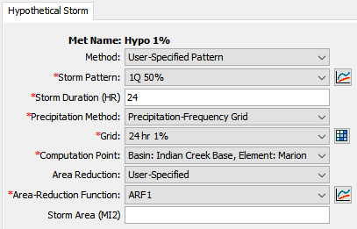
Hypothetical Storm
Paired Data: Percentage Curve
Grid Data: Precipitation-Frequency
Paired Data: Area-Reduction Func.
Notes:
Pro tip: leave the storm area blank to automatically compute it as the drainage area above the computation point!

Slide 66
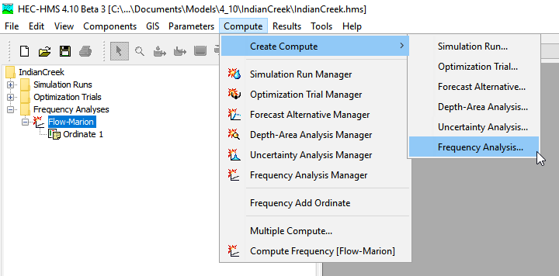
Create Frequency Analysis

Slide 67
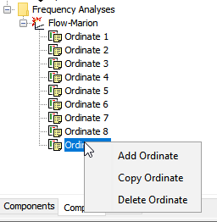
Add/Copy/Delete Ordinates
Right-click menu

Slide 68
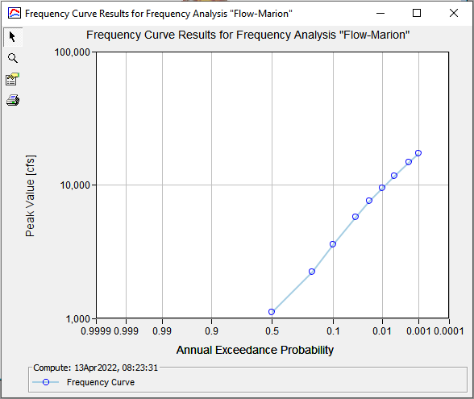
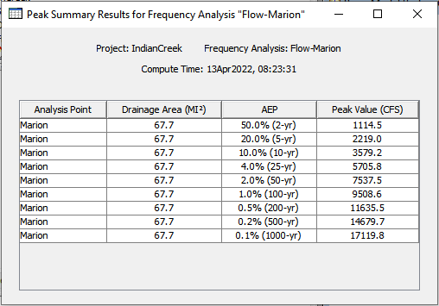
Frequency Analysis
Results

Slide 69
Uncertainty
Copy hypothetical storm met models with varied parameters
  Time patterns
  Area reduction functions
Copy frequency analyses to vary the met models
Notes:
You will do this in your workshop. As I mentioned throughout the presentation, there are different ways to vary the basin model or met model. You can copy the met model and change the time pattern and/or the area reduction functions, create a new frequency analysis compute option and rerun the analysis. You can see the change in your AEP flows base on a different time pattern selection or area reduction selection, or basin model selection.

Slide 70
Summary
Modeling Hypothetical Storm
  Hydrologic Considerations: Calibration, Initial Conditions, and Non-linearity
  Meteorological Considerations: Storm duration, time pattern, areal reduction, spatial pattern
Modeling Flood Frequency Curves in HMS
  AEP Neutral Assumption
  HEC-HMS Flow Frequency Analysis Compute Option
    Select appropriate basin and a met model per ordinate (per AEP storm)
    Consider modeling different met or basin parameters to observe uncertainty

Slide 71
Questions?

Slide 72
GIS
Watershed delineation and parameter estimation framework
Delineate watersheds from DEMs
  Terrain reconditioning
Estimate subbasin parameters
  Raster data
  Impervious area, soil properties, etc.

Slide 73
User-Specified Pattern Hypothetical Storm
Time pattern (dimensionless %-% curve)
Storm duration
Source of precipitation depth (single value or raster)
Basin model computation point
Area reduction function
Storm area

