Slide 1
Graphical Frequency Analysis
& Plotting Positions
Lecture 11
Beth Faber, PhD, PE
May 2024
Flood Frequency Analysis

Slide 2
Goals
Know how a graphical frequency curve differs from an analytical frequency curve
Understand plotting positions, what they estimate, and how they differ from each other
  and that plotting positions are the basis for a graphical frequency curve
Become familiar with the methods of developing graphical frequency curves for regulated flow and stage

Slide 3
Graphical Frequency Analysis
Used for estimating an empirical or just non-analytical frequency curve with no assumed distribution
Used for regulated flows, channel or pool stages, partial duration series

Slide 4
Outline
Graphical Frequency Analysis
Graphical Frequency Analysis
Plotting Positions
  Statistical estimation theory
  Sampling Distributions to define uncertainty
Non-analytic (Graphical) Frequency Curves
  Regulated Flow Frequency Curves
  Stage Frequency Curves
Partial Duration Series (peaks over threshold)
  as graphical, rather than analytical

Slide 5
What Is Graphical Frequency Analysis?
Graphical analysis involves fitting a curve “by hand” to observed data plotted on probability paper (i.e., on a Normal probability axis)
  The horizontal location at which a data point is plotted is based on a selected plotting position — an empirical estimate of exceedance probability
Or, we might form a graphical frequency curve with quantile estimates from another source

Slide 7
Why Use Graphical Analysis?
Plotting the data is a useful visual check on analytical frequency curves (e.g., frequency curves based on LPIII)
Sometimes, plotted frequencies of stage and regulated flow data cannot be adequately described by an analytical distribution such as Normal, or LPIII
  Under these circumstances, we use a graphical frequency curves – also called non-analytic

Slide 8
Plotted Annual Maximum Regulated Flows
1.01
Return Period
2
5
10
20
100
channel capacity
max hydropower
1
0
Annual Exceedance Probability

Slide 9
Does an Analytical Curve Make Sense?
1.01
Return Period
2
5
10
20
100
channel capacity
max hydropower
1
0
Annual Exceedance Probability

Slide 10
Graphical Curve is Better for this
1.01
Return Period
2
5
10
20
100
channel capacity
max hydropower
1
0
Annual Exceedance Probability

Slide 11
Outline
Graphical Frequency Analysis
Plotting Positions
  Statistical estimation theory
  Sampling Distributions to define uncertainty
Non-analytic (Graphical) Frequency Curves
  Regulated Flow Frequency Curves
  Stage Frequency Curves
Partial Duration Series (peaks over threshold)
  as graphical, rather than analytical

Slide 12
Plotting Position – basic idea
A plotting position is an estimate of the exceedance probability for some observation of a random variable, such as flow or stage
For a period of record, plot each observation on the probability axis at the estimate of its exceedance probability based on its relative frequency
Estimated Probability = # of Occurrences
# of Trials → # years
= Relative Frequency

Slide 13
a 30-year record of annual peak flows
1962-1991

Slide 14
Rank the annual events…
1962-1991

Slide 15

Estimate Exceedance Probability by Relative Frequency
exceeded
1 year of 30 ≈ 1/30
≈ .032
exceeded
2 years of 30 ≈ 2/30 ≈ .065
flow vs plotting position
Review from Intro Lecture

Slide 16
Use log(flow) and frequency scale
exceeded
1 year of 30 ≈ 1/30 ≈ .032
exceeded
2 years of 30 ≈ 2/30 ≈ .065
how do we extrapolate?
flow vs plotting position
Review from Intro Lecture

Slide 17
Remember the simple plotting position?
Rank the N observed flows from largest to smallest
The top ranked event has rank m = 1
The second largest event has rank m = 2
...
The smallest event has rank m = N
Estimate cumulative frequency based on the relative frequency of observations within the sample
incremental probability of each 1/N
exceedance probability of each m/N
simple Plotting Position m/N
the rank is the number of times the observation has been equaled or exceeded…
Review from Intro Lecture

Slide 18
A Problem with simple PP = m/N
Probability of exceeding the smallest value is N/N = 1.0
  this is unreasonable
  it also implies a problem with the exceedance probability estimates for other values
Plotting position m/N is therefore statistically biased
Review from Intro Lecture

Slide 19
EXAMPLE:
MILL CREEK, LOS MOLINOS, CALIFORNIA
simple
PLOTTING POSITION m/N

Slide 20
99.5 99 95

Slide 21
Choosing a Plotting Position
How Should a Plotting Position Be Chosen?
Plotting position is an estimator of exceedance probability
  an estimator is generally a function of the data
  two plotting position estimators seen so far are the Median and Weibull plotting positions
Other estimators discussed so far have been for the MEAN, standard deviation and skew
Remember that an estimator for the mean was given as:
Review from Uncertainty Lecture

Slide 22
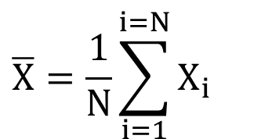
Creating a Sampling Distribution
Review from Uncertainty Lecture
$$\overline{X}=\frac{1}{N}\sum_{i=1}^{i=N}{X_{i}}$$
Consider the sample mean, an unbiased estimator of the pop. mean
Let’s examine properties of estimating the mean from 10 data points
  There exists an actual “population” probability distribution of X
  The distribution of X has a mean μ and standard deviation σ
  As an experiment, we’ll generate 10-member random samples of flow X from the distribution of X above, 100 times
here, distribution of X is Normal
σ
μ
X
Notes:
We’re going to construct the sampling distribution – this is the Monte Carlo simulation. We’re going to generate random samples, compute and estimate of the mean, and see how wrong they are.
The idea of the sampling distribution will be developed by looking at an estimate of the mean from 10 sample members. We can do a statistical experiment with a know distribution to examine the formation and properties of the sampling distribution of this estimator.
The experiment will start with a known distribution, and create random samples of 10 members each.

Slide 23
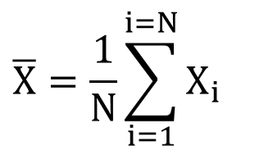
Creating a Sampling Distribution
Review from Uncertainty Lecture
  Generate 100 different 10-member samples of flow X
  Compute an estimate of the mean, X, from each sample of 10
  A frequency analysis of the 100 estimates of X (one from each 10-member sample) would result in this histogram
  the average of 100 X would be close to the population value of the mean, μ
  the histogram of X could be approximated by a Normal distribution
$$\overline{X}=\frac{1}{N}\sum_{i=1}^{i=N}{X_{i}}$$
histogram of X
with N = 10
μ = Population Mean
estimate of X
Notes:
The experiment will start with a known distribution, and create random samples of 10 members each, and estimates the mean (using the sample average) of each sample. Done 100 times, this produces 100 estimates of the mean, each from a sample of size 10. This pink histogram is made up of the 100 estimates of the mean. It will be centered at the population values, because the estimator is unbiased.

Slide 24
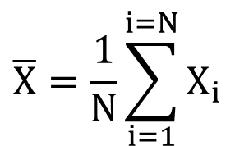
Sampling Distribution for the Mean
Review from Uncertainty Lecture
  CENTRAL LIMIT THEOREM: Since the estimator adds identical RVs, as N becomes very large, the distribution of X is Normal, with mean equal to the population value.
  The pink distribution to the right is the sampling distribution for the sample mean, X
The standard deviation of the distribution-of-sample-means is equal to
$$\overline{X}=\frac{1}{N}\sum_{i=1}^{i=N}{X_{i}}$$
distribution of sample means, X
estimate of X
Notes:
Because the Central Limit Theorem tells us that our sample of sample means is asymptotically Normal, we switch the histogram to a Normal distribution. It is centered on the known mean of the original distribution. It’s variance is equal to sigma-squared/N.

Slide 25
Sampling Distribution for the Mean
Review from Uncertainty Lecture
sampling distribution for X, with N=10
μ
for N = 50
for N = 10
population distribution
of X
X

Slide 26
Sampling Distribution for Plotting Position
sampling distribution for exceedance probability of X₁
The sampling distribution for the estimate of exceedance probability is NOT symmetrical.
exceeded
1 year of 30 ≈ 1/30 ≈ .033
N = 30 ordered events
Not Normal because Central Limit Theorem does not apply. RVs are not summed

Slide 27
What are we uncertain about?
The estimated exceedance probabilities of events in the record are based on rank and the record length
  i.e., the largest event in N=30 years is assigned a likelihood near 1/30, or 0.033 annual likelihood
In what time period is it actually the largest? Longer than N? Shorter?
Can do a sampling experiment to see what the actual exceedance probability might be for the largest event in 30 years….
  Sample 30 years from U[0,1] as the AEP of each event
  Choose the smallest AEP = largest event from each sample
  Repeat for 1,000 samples
Source:
Dave Margo,
USACE / RMC

Slide 28
What’s the real exceedance prob?
Sample 30 “years” as 30 AEPs ~ U[0,1]
Note the smallest AEP
Repeat for 1,000 samples
1 sample of 30 events as AEPs
smallest AEP from 1000 samples size N=30
approx ~U(0, 1)
1
0

Slide 29
What’s the real exceedance prob?
Sample 30 “years” as 30 AEPs ~ U[0,1]
Note the smallest AEP
Repeat for 1,000 samples
back to Linear Probability Axis to see direction of skew
1 sample of 30 events as AEPs
smallest AEP from 1000 samples size N=30
1
Linear Probability Axis
0

Slide 30
Weibull Plotting Position
The Weibull plotting position is the mean of the sampling distribution at X_{m}, which results in an unbiased estimate of the exceedance probability
Return Period of largest event = N + 1
For N=30,
PP₁ = 0.032
Sampling Experiment
Smallest AEP of 30:
average of 1000
samples = 0.031
Sampling Distribution for Exceedance Probability
mean
X_{m}
1
0
Exceedance Probability of X_{m}

Slide 31
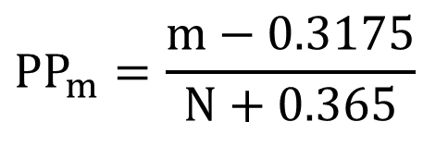
Median Plotting Position
The Median plotting position is the median value of the sampling distribution for estimating the population probability of X_{m}
An approximation for N < 100 is:
Return Period of largest event = 1.5N + 1
$$PP_{m}=\frac{m−0.3175}{N+0.365}$$
For N=30,
PP₁ = 0.023
Sampling Experiment
Smallest AEP of 30:
median of 1000
samples = 0.023
Median Plotting Position
Area = probability = 50%
X_{m}
1
0
Exceedance Probability of X_{m}

Slide 32
Plotting Position Uncertainty, N=30
90% intervals
N=30
Relative frequency of AEP of largest event (smallest AEP) in sample N=30
Plotting Positions versus Rank,
90% confidence interval for largest 3 of 30

Slide 33
Plotting Position Uncertainty, N=62
90% intervals
N=62
Relative frequency of AEP of largest event (smallest AEP) in sample N=62
Plotting Positions versus Rank,
90% confidence interval for largest 3 of 62

Slide 34
Plotting Position Uncertainty, N=100
90% intervals
N=100
Relative frequency of AEP of largest event (smallest AEP) in sample N=100
Plotting Positions versus Rank,
90% confidence interval for largest 3 of 100

Slide 35
Plotting Position Choice
Recommend using Weibull for graphical frequency curves when economic analysis involved
  Calculation of damages requires an expected or mean probability, so use Weibull to estimate graphical a curve
  The Weibull plotting position gives an expected value
Recommend using Median when comparing plotting positions to compute frequency curve such as LP3
Because comparing to a median estimate of LP3

Slide 36
EXAMPLE:
MILL CREEK, LOS MOLINOS, CALIFORNIA
PLOTTING POSITION Comparison

Slide 37
95

Slide 38
Outline
Graphical Frequency Analysis
Plotting Positions
  Statistical estimation theory
  Sampling Distributions to define uncertainty
Non-analytic (Graphical) Frequency Curves
  Regulated Flow Frequency Curves
  Stage Frequency Curves
Partial Duration Series (peaks over threshold)
  as graphical, rather than analytical

Slide 39
Regulated Frequency Curves
Two methods to produce a graphical regulated flow frequency curve:
Estimate a regulated frequency curve with regulated flow data and graphical frequency analysis
Develop unregulated flow frequency curve with LP3 fit. Combine it with reservoir regulation relationship to produce a graphical, regulated flow frequency curve
  Note the added uncertainty in the inflow/outflow relationship

Slide 40
Regulated Frequency Curves
first method: graphical fit to annual peak regulated flow data
Source of regulated flow data:
  Observed data downstream of dam
  Route inflows through dam with reservoir model
    Use period of record inflows
    Estimate inflows from continuous simulation model
Hypothetical events are needed to estimate upper end of frequency curve
  define hypothetical inflow flood events (specified exc prob)
    exceedance probability of outflow assumed same as inflows
    starting water surface elevation is a critical consideration

Slide 41
Unregulated Curve based on 100 years of record
Regulated Curve
Regulated Data

Slide 42
Graphical Curve is Better for this
1.01
Return Period
2
5
10
20
100
200
500
channel capacity
max hydropower
Cumulative Exceedance Probability
42
Notes:
Using synthetic events, we can estimate points higher on the frequency curve, to fill in the gap.

Slide 43
Developing Regulated Flow-Frequency Curve
Second Method:
  Combine UNREGULATED flow-frequency curve with ‘unreg-regulated’ relationship

Slide 44
Historical Reservoir Regulation Data
Regulated-Unregulated Relationship
PMF
250-yr
might instead create this relationship with a reservoir simulation model

Slide 45
Unregulated Curve based on 100 years of record
Regulated Curve

Slide 46
Additional Uncertainties in Regulation
Often, there is incidental flood management provided by reservoir water supply pool
  Reservoir starts with more flood space
  Non-flood reservoirs upstream might reduce peak
There are uncertainties in flood operation
  Real-time flood forecasts are sometimes used, and are contain a great deal of uncertainty
  Releases might be curtailed or diminished due to unforeseen contingencies, not using full capacities.
  Might reduce release to account for runoff below reservoir

Slide 47
Outline
Graphical Frequency Analysis
Plotting Positions
  Statistical estimation theory
  Sampling Distributions to define uncertainty
Non-analytic (Graphical) Frequency Curves
  Regulated Flow Frequency Curves
  Stage Frequency Curves
Partial Duration Series (peaks over threshold)

Slide 48
Stage-Frequency Curves
Two methods to produce a stage-frequency curve:
Estimate stage-frequency curve with stage data and graphical frequency analysis
Develop a flow frequency curve. Combine it with CURRENT flow-stage rating curve to produce stage-frequency curve
  requires a one-to-one relationship between flow and stage, which might not be feasible when complex water systems involved (backwater, tidal)
  better if flow is not regulated, and can use analytical fit

Slide 49
Stage Frequency Analysis
first method, graphical fit to annual peak stage data:
  Use graphical frequency analysis, because analytical curve would smooth out relevant irregularities
  Pay attention to relevant stages: bottom, bankfull, etc
  A linear rather than log-scale is more reasonable
  Source of stage data:
    Observed gaged record (USGS peak flow file)
    Continuous simulation of hydraulic model, based on surrounding longer record gages

Slide 50
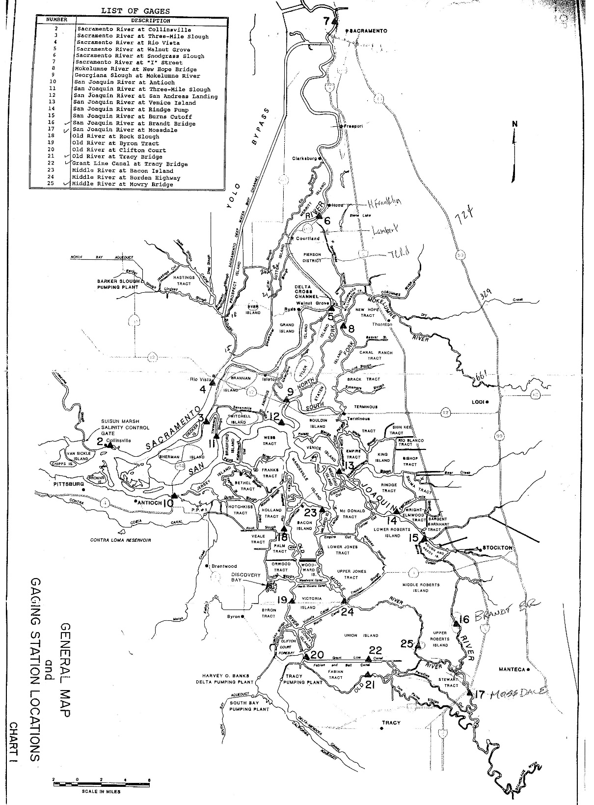
Sacramento River
Sometimes, it is not possible to define a one-to-one relationship between flow and stage
Sacramento-San Joaquin Delta, confluence of Sacramento and San Joaquin Rivers
San Joaquin River

Slide 51
Sacramento River at Walnut Creek, Stage-Frequency
1944 – 1988 annual peak stages
?
?

Slide 52
Sacramento River at Walnut Creek, Stage-Frequency
1944 – 1988 annual peak stages
1944 – 1988 annual peak stages
?
?
90% confidence interval

Slide 53
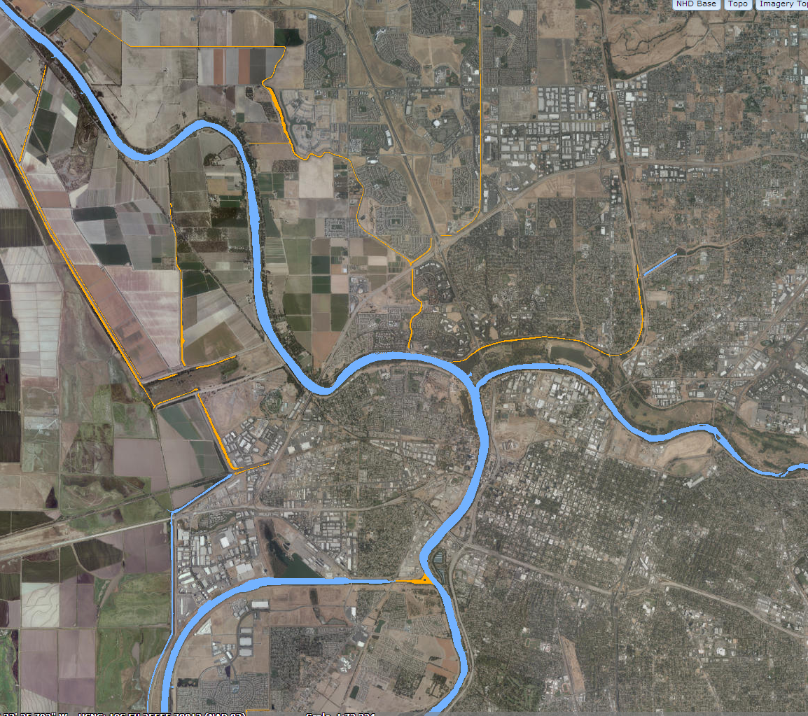
Hydraulic Modeling of the Period of Record
Sacramento River
Sacramento River
Sacramento River
American River
Sacramento Weir
Sacramento Weir
American River
Sacramento
Yolo Bypass
ship channel

Slide 54
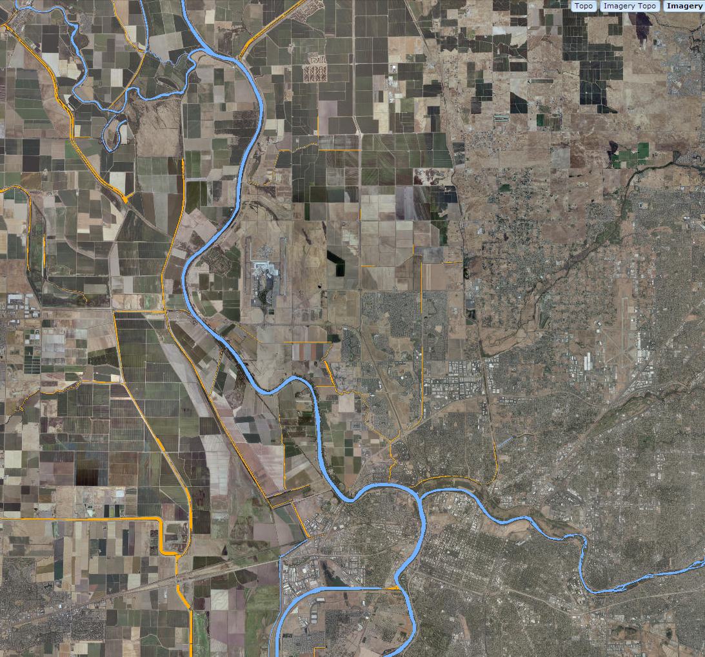
Sutter Bypass
Feather River
Sutter Bypass
Feather River
Fremont Weir
Fremont Weir
Sacramento River
Sacramento River
Yolo Bypass
Sacramento Weir
American River
Sacramento Weir
American River
Sacramento
Yolo Bypass
Delta
Sacramento-SanJoaquin Delta

Slide 55
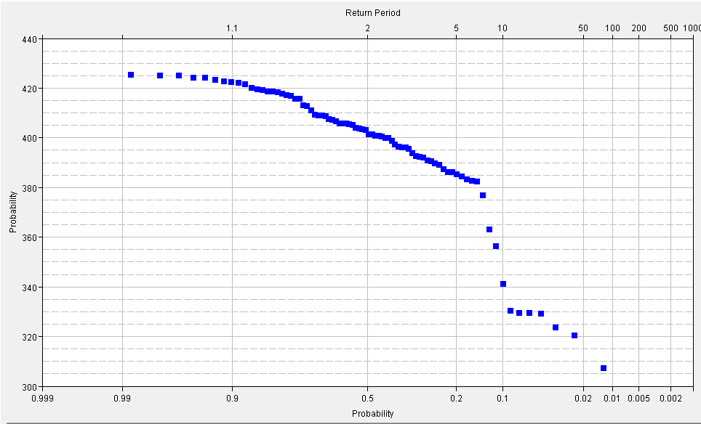
Others: Reservoir Min Stage vs frequency
might be reservoir stage rather than channel stage
boat dock at 385’
Minimum Pool Elevation (ft)
Non-exceedance Probability

Slide 56
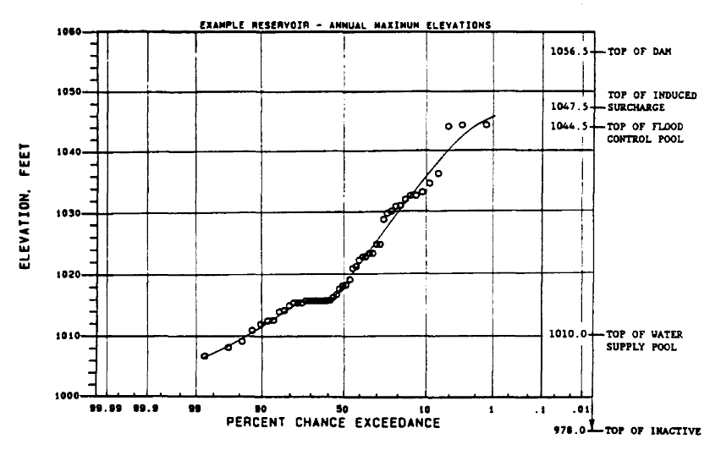
Others: Reservoir Max Stage vs frequency
might be reservoir stage rather than channel stage
Might extend curve with synthetic events and a reservoir model
could do Monte Carlo simulation for many synthetic events!

Slide 57
Developing Stage-Frequency Curve
Second Method:
  Combine flow-frequency curve with flow-stage relationship

Slide 58
Example Stage/Flow Rating Curve

Slide 59
Resulting Stage-Frequency Curve
Flow-Freq Curve based on 100 years of record
What uncertainties must we consider here?
Stage Curve

Slide 60
Outline
Graphical Frequency Analysis
Plotting Positions
  Statistical estimation theory
  Sampling Distributions to define uncertainty
Non-analytic (Graphical) Frequency Curves
  Regulated Flow Frequency Curves
  Stage Frequency Curves
Partial Duration Series (peaks over threshold)
  as graphical, rather than analytical

Slide 61
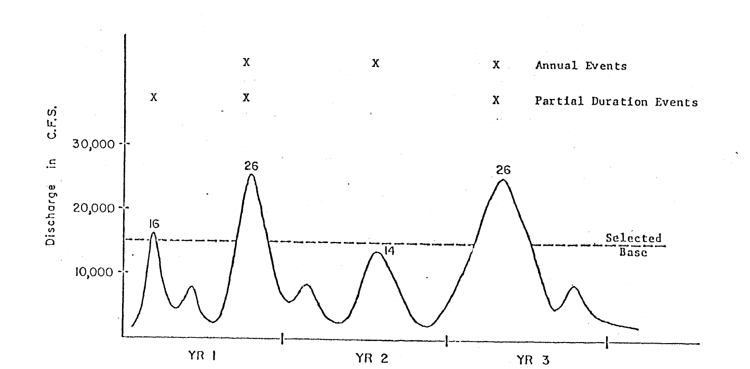
Partial Duration Series
All peak events above a particular threshold
Annual Series vs Partial Duration
Review /preview from other lectures, only graphical

Slide 62
Empirical Partial Duration Series (PDS)
Calculating plotting positions for AEP:
  If there are a total of k events in N years, then the plotting position for the smallest event (rank = k) is based on k/N
    However, if k > N, might be greater than 1.0
    can’t interpret as probability…
    The plotting position for this event is interpreted, not as exceedance probability, but as average of k/N events per year
Review /preview from other lectures, only graphical
  Example
  Smallest event = 4 ft
  k=61, N=42
Then the plotting position estimate states that on the average it is expected that 1.5 events per year will exceed 4 ft
62
Notes:
It is possible to plot partial duration series empirically, with plotting positions. The exceedance probabilities are still interpreted as relative frequencies of equaling or exceeding a value, based on N years. The rank is interpreted the same way, as number of exceedances.
But, rank k might be higher than number-of-years N.
However, it is always possible to interpret as average number of exceedances per year, rather than likelihood of exceedance. This interpretation always makes sense.

Slide 63
Frequency Analysis
Compute estimated probability as
relative frequency = # occurrences greater / # years
Review from other lectures, only graphical
exceeded
2 years of 43 ≈ 2/43 ≈ .046
exceeded
1 year of 43
≈ 1/43 ≈ .023
partial duration series
annual series
Notes:
This is the same chart, with the probability axis changed to a Normal probability scale.

Slide 64
Frequency Analysis
Generally, LP3 distribution does not fit a partial duration series frequency curve. Usually use graphical, or…..
Review from other lectures, only graphical
partial duration series
annual series
Notes:
Generally, an analytical probability distribution will not fit the stage data. Instead, fit a graphical curve to the plotted data. Be careful about extrapolation.

Slide 65
Why use Partial Duration Series?
Estimating expected damage when more than one damaging event per year
Concerned about the low end of the curve, for example for riparian ecosystem restoration studies
Lecture on Thursday!!

Slide 66
Outline
Graphical Frequency Analysis
Plotting Positions
  Statistical estimation theory
  Sampling Distributions to define uncertainty
Non-analytic (Graphical) Frequency Curves
  Regulated Flow Frequency Curves
  Stage Frequency Curves
Partial Duration Series (peaks over threshold)

Slide 67
Plotting Position Uncertainty
0
1
j=1 (largest event) has almost 2 orders of magnitude uncertainty in 90% interval
Plot with Weibull PP
Depiction of plotting position uncertainty for the largest three events
Source:
Dave Margo, USACE / RMC

