Slide 1
Developing Unregulated
Time-Series
Flood Frequency Analysis PROSPECT
May 2024
Melissa Mika, P.E.
US Army Corps of Engineers
Hydrologic Engineering Center

Slide 2
Outline
Purpose of using unregulated data
Identifying appreciable regulation
Methods for developing unregulated time-series

Slide 3
Purpose of Developing Unregulated Data

Slide 4
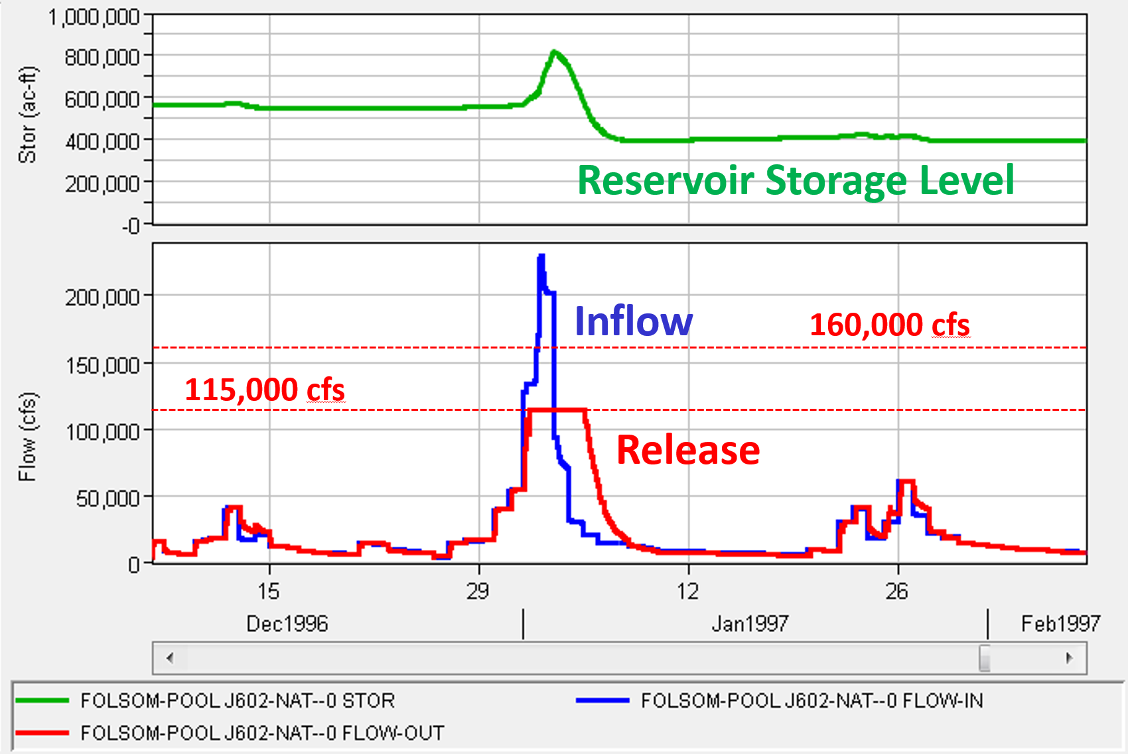
Importance of Using Unregulated Data
Many dams in the USACE portfolio have upstream regulation
Appreciable upstream regulation affects annual maximum series
Regulated data should not be fit to an analytical distribution (in most cases)

Slide 5
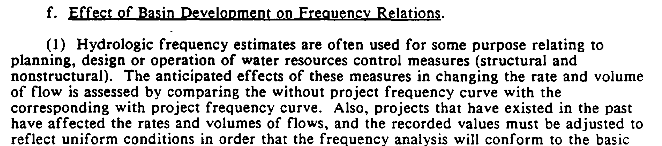
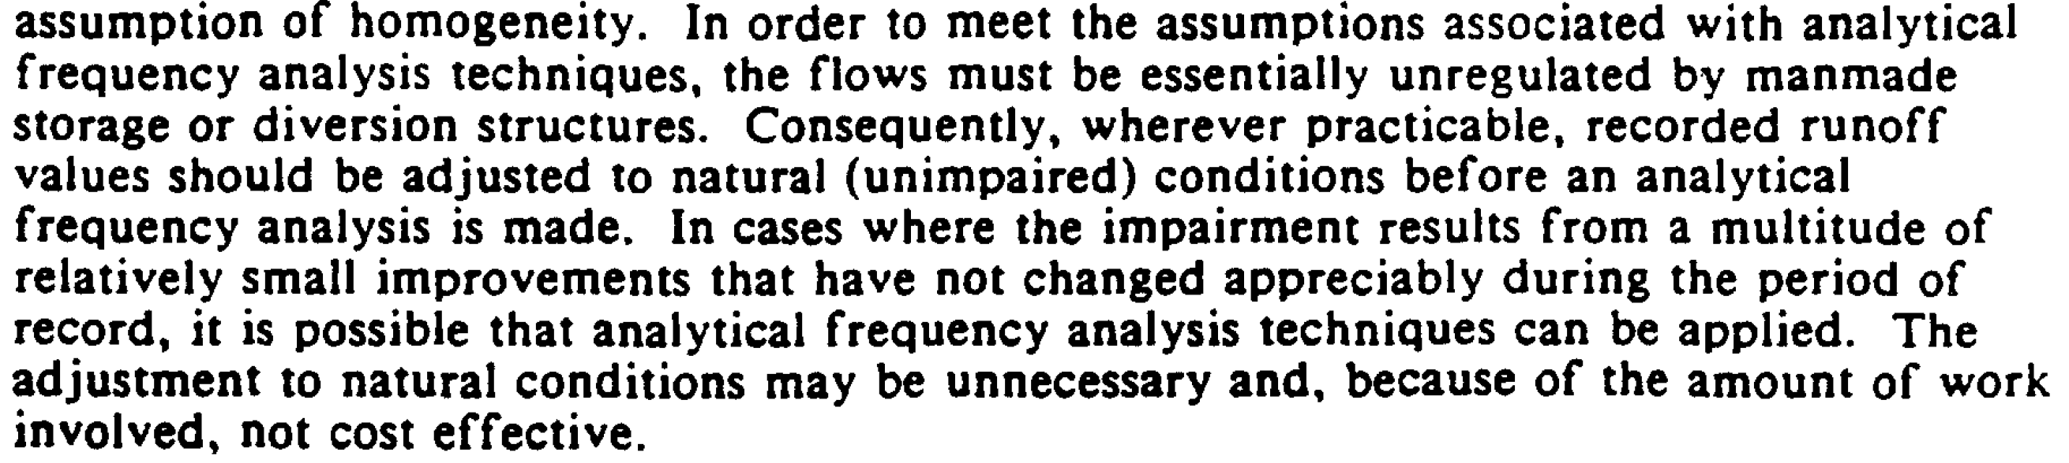
Importance of Using Unregulated Data
EM 1110-2-1415 HYDROLOGIC FREQUENCY ANALYSIS
Runoff should be adjusted to natural (unimpaired) conditions
…unless the regulation effects are not appreciable

Slide 6
Assumptions for Frequency Analysis
Series of annual maximum flows
Random, representative sample from the flood population
IID
  Independent
  Identically distributed (homogeneous/stationary)
Review from Time-Series Analysis Lecture
May be violated by regulated data
Notes:
Regulated flows are better represented by a graphical frequency curve.

Slide 7
Frequency Analysis using Regulated Data
Are the flow data unimpaired (unregulated)?
Is an analytical frequency curve (such as LPIII) needed?
No
No
Yes
Yes
Is the regulation homogeneous across the POR?
Develop analytical frequency curve (LPIII)
Remove effects of regulation
Yes
No
*if all assumptions (IID) are met
Review from Graphical Frequency Analysis Lecture
Develop graphical frequency curve
IID Assumptions Not Met
Notes:
Regulated flows are better represented by a graphical frequency curve.

Slide 8
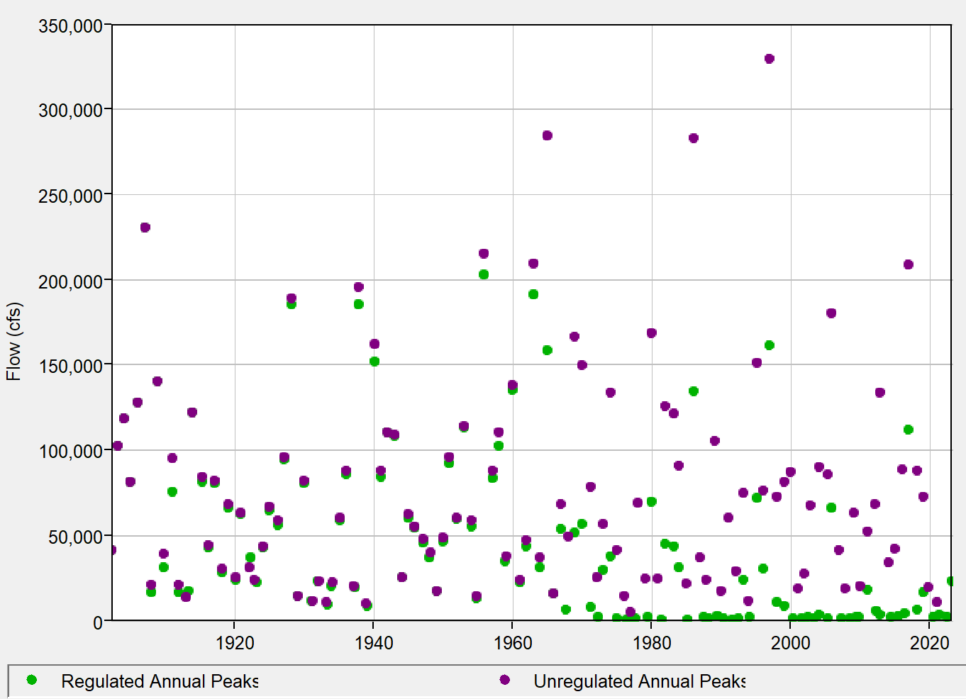
Upstream Regulation Affects AMS
Construction of major flood control dam
Construction of first upstream dam

Slide 9
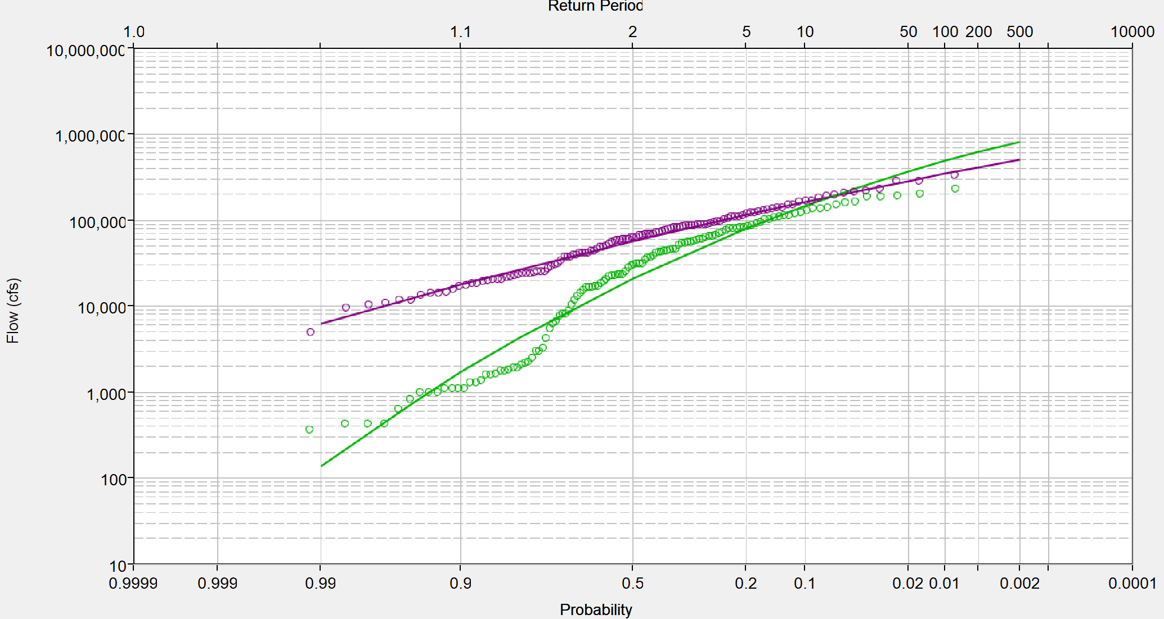
Upstream Regulation Affects AMS
Unregulated
analytical
Review from Graphical Frequency Analysis Lecture
Regulated
analytical
graphical
Notes:
Sometimes, plotted frequencies of stage and regulated flow data cannot be adequately described by an analytical distribution such as Normal, or LPIII.
Under these circumstances, we use a graphical frequency curves – also called non-analytic

Slide 10
Impact of Regulation

Slide 11
Is the Regulation Appreciable?
First, determine if the effects of regulation are appreciable
  If negligible (for entire POR), proceed with analytical frequency analysis
  If appreciable, must remove the effects of regulation
Are the impacts on flow substantial?
  Evaluate regulation impacts (across entire period of record)
  Plot data
  Kolmogorov-Smirnov Test

Slide 12
Evaluate Regulation Impacts
1. What portion of the data is potentially affected by regulation?
2. What percentage of contributing area upstream is regulated?
3. What is the purpose of the upstream reservoir(s) (i.e. flood control, recreation, etc.)?
4. What are the physical components of the upstream reservoirs (i.e. gated or un-gated spillway, etc.)?
5. How are the upstream reservoirs operated?
6. How much of the upstream land is irrigated?
7. How many upstream diversions are present?
8. Are the upstream reservoirs small farm ponds or water supply lakes (or other small storages that may not appreciably affect the flow)?
9. Are inflow and outflow records available for upstream reservoirs?
10. Does using regulated flow data affect the flow-frequency, volume-frequency or stage–frequency at the analysis point of interest?
11. Are different causal mechanisms affecting the record which may cause differentiation in hydrograph peaks and travel time, such as major storms at more than one time of the year (seasonality) or variation in precipitation types (e.g. storm type, rainfall, or snowmelt)?
12. Was regulation uniform over the period of record? If the regulation schedule has changed over time and/or additional projects have been built, a non-uniform regulation schedule may need to be applied to the data to ensure homogeneity.
Etc…
Notes:
These are examples of just some of the questions to ask when investigating the impacts of regulation in a system

Slide 13
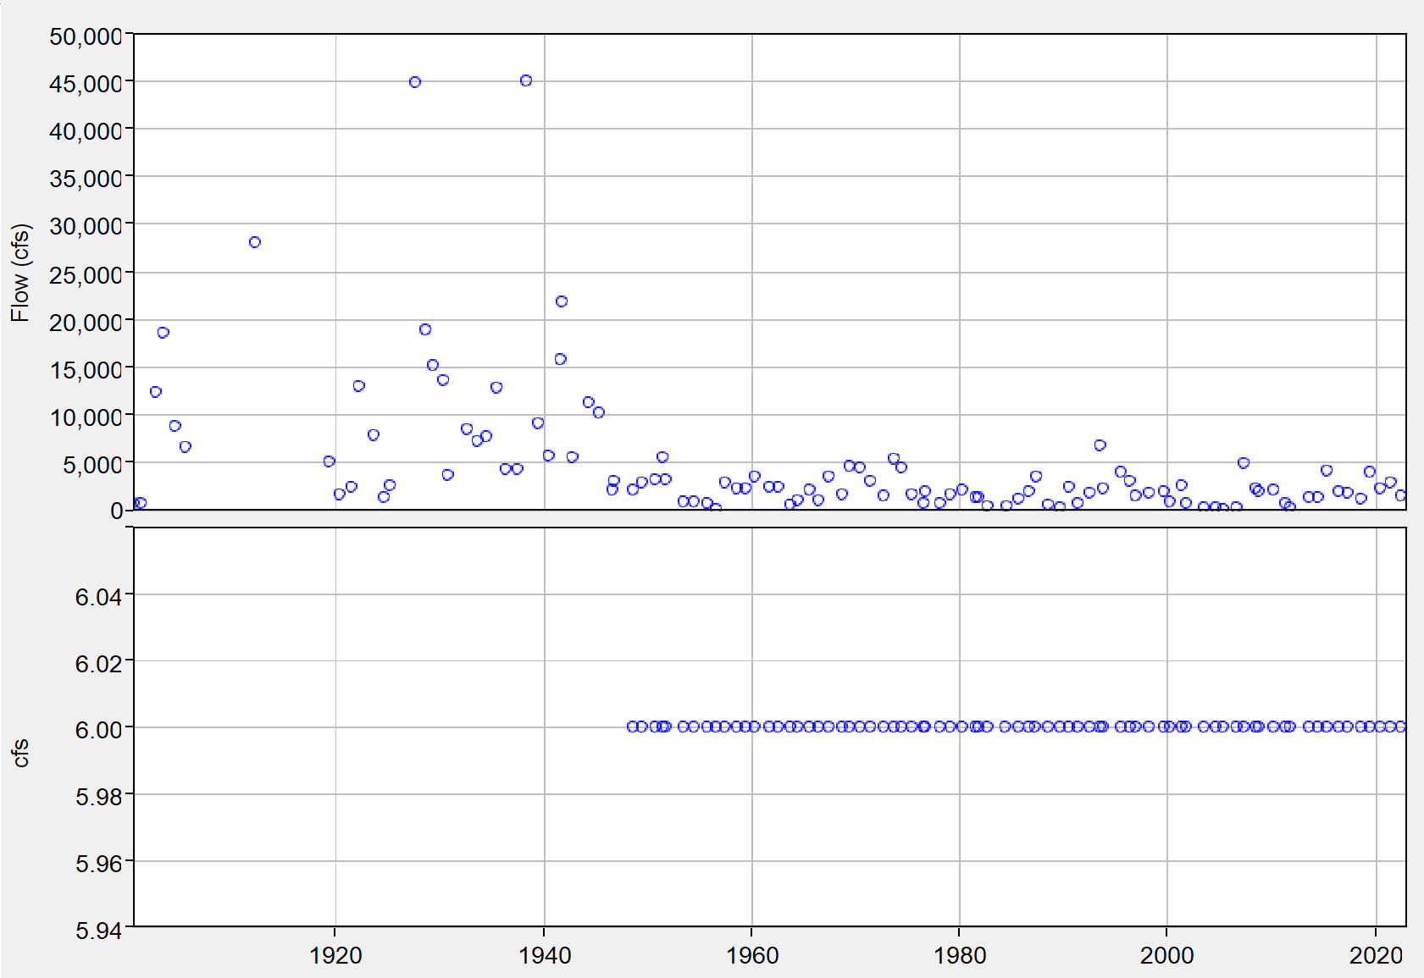
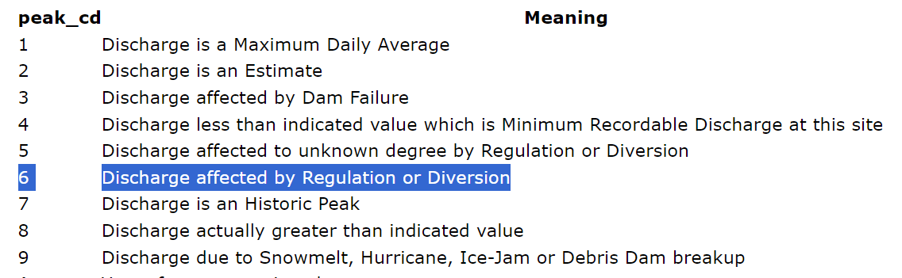
Check Available Data
Plot the annual maximum series
Check for USGS special condition codes

Slide 14
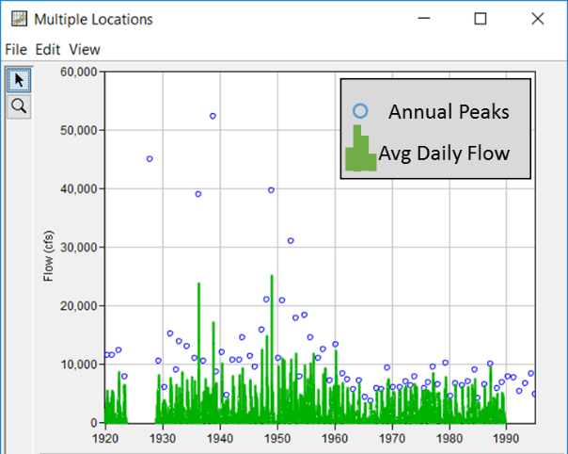
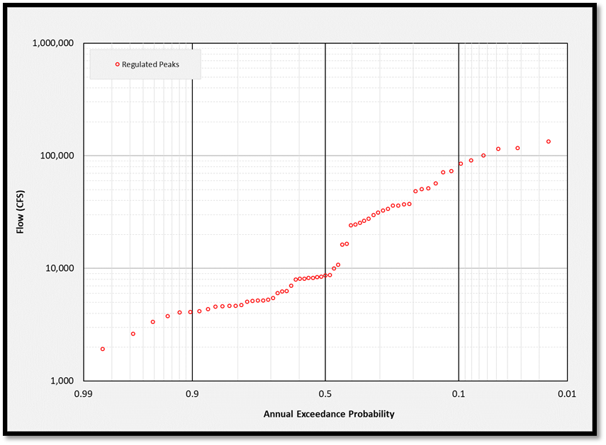
Example 1
Regulation effects are appreciable and should be removed
Notes:
Here is another example of how to examine a reservoir inflow dataset.
This plot displays average daily flows in green, and annual peaks as blue open circles
As you can see, there appears to be a marked change in system behavior starting in the mid 1950’s.
Specifically, notice the lack of large annual peaks in excess of 20,000-cfs after this time period. (click)
This may indicate a change in the upstream system, hinting at a non-homogenous data set.
Also notice the lack of significant differences between annual peak and daily average after the 1950s.
These observations may indicate a change in the upstream system, hinting at a non-homogenous data set.

Slide 15
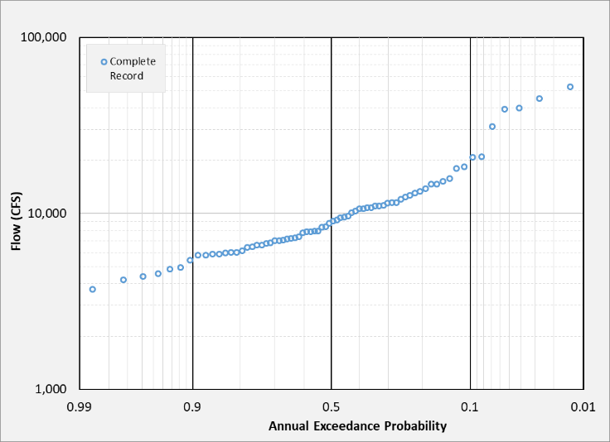
Example 2
Difficult to tell whether there is appreciable regulation from frequency plot alone

Slide 16
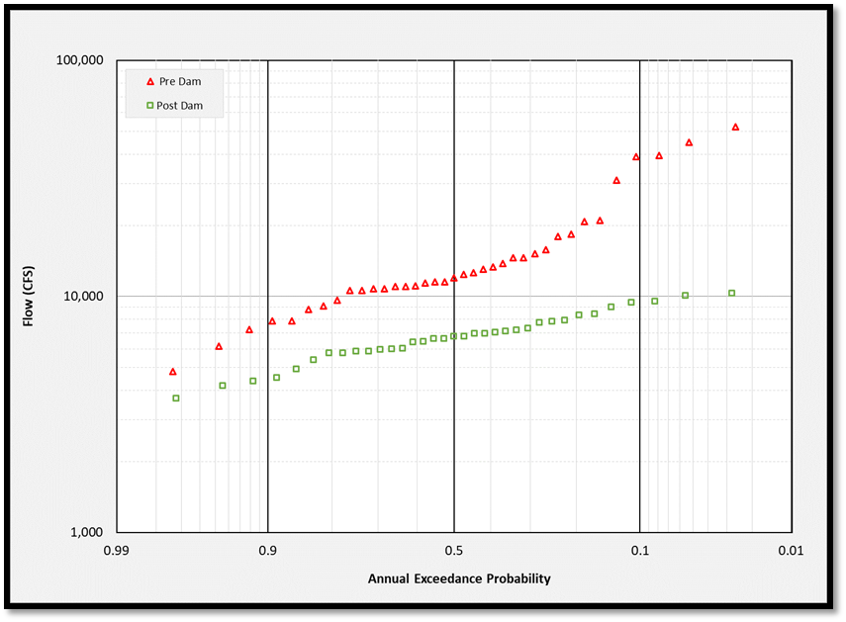
Example 2
Can separate the unregulated and regulation portions and plot them together
Should also investigate the watershed regulation
Pre-Dam (Unregulated)
Post-Dam (Regulated)

Slide 17
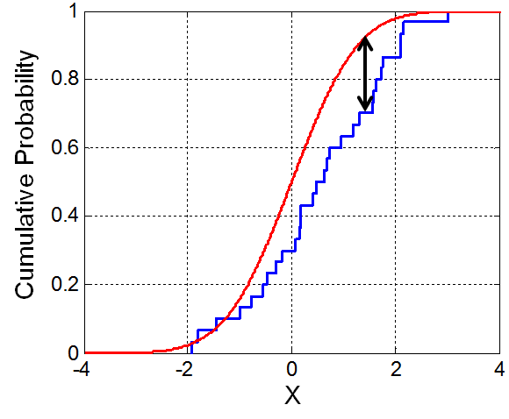

Kolmogorov-Smirnov (K-S) Test
Review from Parametric Modeling Lecture
Nonparametric test of:
  Whether a sample came from a given probability distribution (one-sample K-S test)
  Whether two samples came from the same distribution (two-sample K-S test)
D = critical K-S test value
$$D=\sqrt{−\frac{1}{2}ln⁡({\frac{α}{2}})}\sqrt{\frac{n+m}{nm}}$$
Where α is the significance level,
and n and m are the two sample sizes
Notes:
A quick test can be conducted to assess whether the pre-dam and post-dam data sets come from the same population distribution.
The Kolmogorov-Smirnov (KS) test is used to compare empirical distribution functions of the two samples.
I’ll begin by defining the terms and equations, and then show a few examples of how to compute the KS test.
For sample sizes greater than twelve (12), the critical KS test value (D) can be calculated using this Equation which is a function of the significance level (α) and the size of the two samples (n and m).
We can use a null hypothesis which states that the two samples come from the same population distribution (i.e. the effects of regulation are negligible).

Slide 18
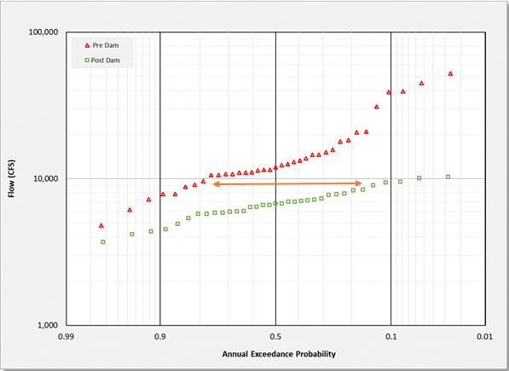
Kolmogorov-Smirnov (K-S) Test
D_{n,m} = Maximum difference between two samples
If D_{n,m} < D,
Accept Null Hypothesis;
Same Population Dist.
If D_{n,m} > D,
Reject Null Hypothesis;
Regulation is appreciable
D_{n,m}
Notes:
The test statistic D_{n,m} (click) is the maximum difference between the empirical distributions for the two samples
In this example: Greatest horizontal difference between unregulated and regulated data is at a flow value of about 9,000 cfs
We will investigate the null hypothesis, which states that the two samples come from the same population distribution (i.e. the effects of regulation are negligible).
(click) If D_{n,m} < D, then accept null hypothesis, which means the two samples DO come from the same distribution. This indicates the effects of regulation are not significant and we can neglect the in our analysis.
(click) If D_{n,m} > D, then reject null hypothesis, which means the two samples DO NOT come from the same distribution – in other words, the effects of regulation are appreciable, and we cannot neglect them.
If we reject the null hypothesis, meaning that the two samples come from different populations, and we must remove the effects of regulation.
More to come on future slides on how to accomplish removing the affects of upstream regulation.

Slide 19
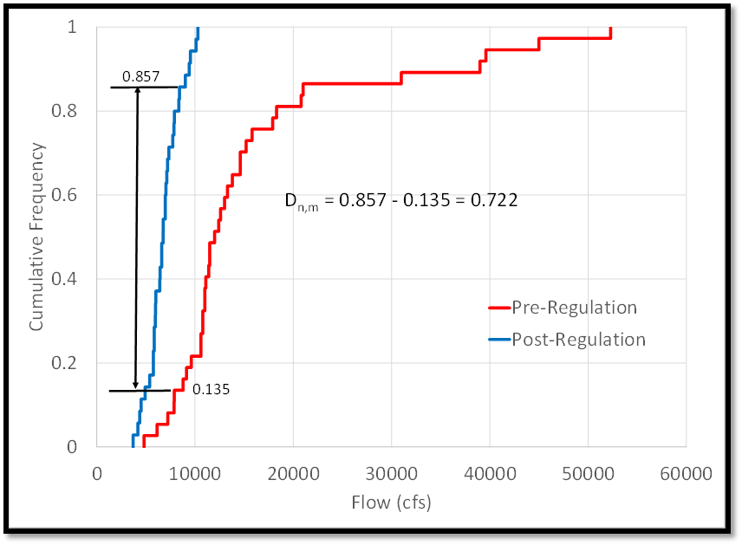
Kolmogorov-Smirnov (K-S) Test
Notes:
The Kolmogorov-Smirnov (KS) test is used to compare empirical distribution functions of the two samples.
Each of the two data sets can be converted to a step-wise function plot: flow vs. cumulative frequency plot, as shown in the Figure by sorting the flow data from small to large and assigning probability based on rank
First, we flip the chart, so now flow is on the horizontal axis and cumulative freq. is on the vertical axis
Convert each of the data sets into a step-wise flow vs. cumulative frequency plot.
Get plotting position by sorting flow data from small to large and assign a probability based on rank (rank/sum of data points).
Then sort from Large to small, and take 1- plotting position
Next, insert intermediate ordinates, and duplicate the flow, so there are steps

Slide 20
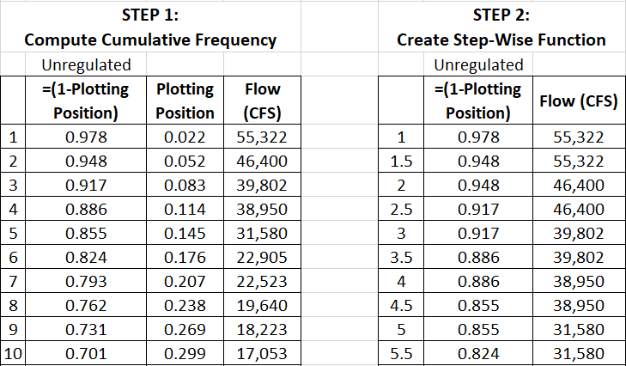
Step-wise Function Example
Notes:
Here is how we develop the step-wise function.
In Step 1, the cumulative frequency is computed by taking 1 minus the plotting position.
In Step 2, a step-wise function is developed by inserting an intermediate ordinate between each ordinate.
To create the step-wise function, the inserted ordinates have the same flow value as the ordinate previous, and have cumulative frequency values the same as the following ordinate

Slide 21
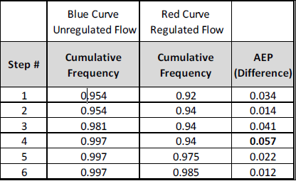
Step-wise Function Example
Notes:
Here we will compare the stepwise functions for the unregulated(blue) and regulated(red) data
For the unregulated and regulated data sets shown in the table, we compare the AEP at each step to discover the location of the greatest vertical distance
In this example, the greatest vertical distance between steps can be observed at location number 4 with a difference in AEP of 0.057.
Recall that the location of greatest vertical difference is where we would want to compute the test statistic for the KS test.

Slide 22
Example 2
Can separate the unregulated and regulation portions and plot them together
Should also investigate the watershed regulation
K-S Test
Pre-Dam (Unregulated)
Post-Dam (Regulated)

Slide 23
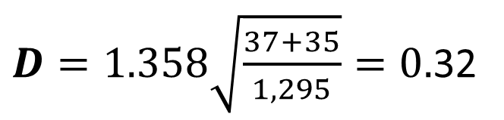
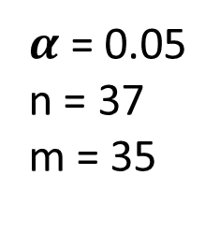
Example 2 Kolmogorov-Smirnov Test
$α$ = 0.05
n = 37
m = 35
$D=1.358\sqrt{\frac{37+35}{1,295}}=0.$32
D_{n,m} (0.72) > D (0.29)
Regulation effects are appreciable and should be removed
Notes:
Now that we know how to develop a step-wise function, we’ll perform the KS test to determine if the regulated and unregulated datasets come from the same population:
In this example, both the unregulated and regulated (pre- and post- dam) datasets were converted to a step-wise flow vs. cumulative frequency plot, as shown in the Figure by sorting the flow data from small to large and assigning probability based on rank
We flip the chart, so now flow is on the horizontal axis and cumulative freq. is on the vertical axis
Next, we Convert each of the data sets into a step-wise flow vs. cumulative frequency plot. Recall, we develop the step-wise function by:
Sorting flow data from small to large and assign a probability based on rank (rank/sum of data points)
Then sort from large to small, and take 1- plotting position
Next, insert intermediate ordinates, and duplicate the flow, so there are steps
For this example, we’ll use (click) significance level of 0.05 for the sample sizes of n=37 pre-dam annual maximums and m=35 post-dam annual maximums.
(click) When we compute the critical KS test value (D), using a significance level of 0.05 for 90% confidence level, we get a value of 0.32.
(click) The test statistic D_{n,m} is the greatest vertical difference in cumulative frequency between the two empirical distributions and was observed at a flow value of approximately 9,000 cfs and computed to have value of (0.857 - 0.135) = 0.722.
The test statistic D_{n,m} (0.72) is greater than the critical KS test value D (0.32) which means that we reject the null hypothesis because there is evidence to support a conclusion that the samples come from different population distributions.
The KS test results support the conclusion that the effects of regulation are significant.

Slide 24
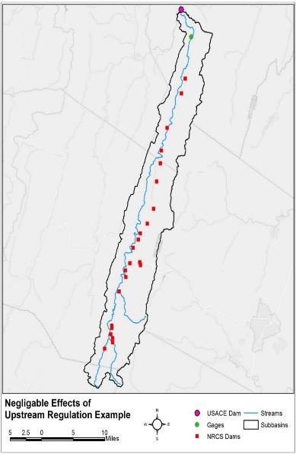
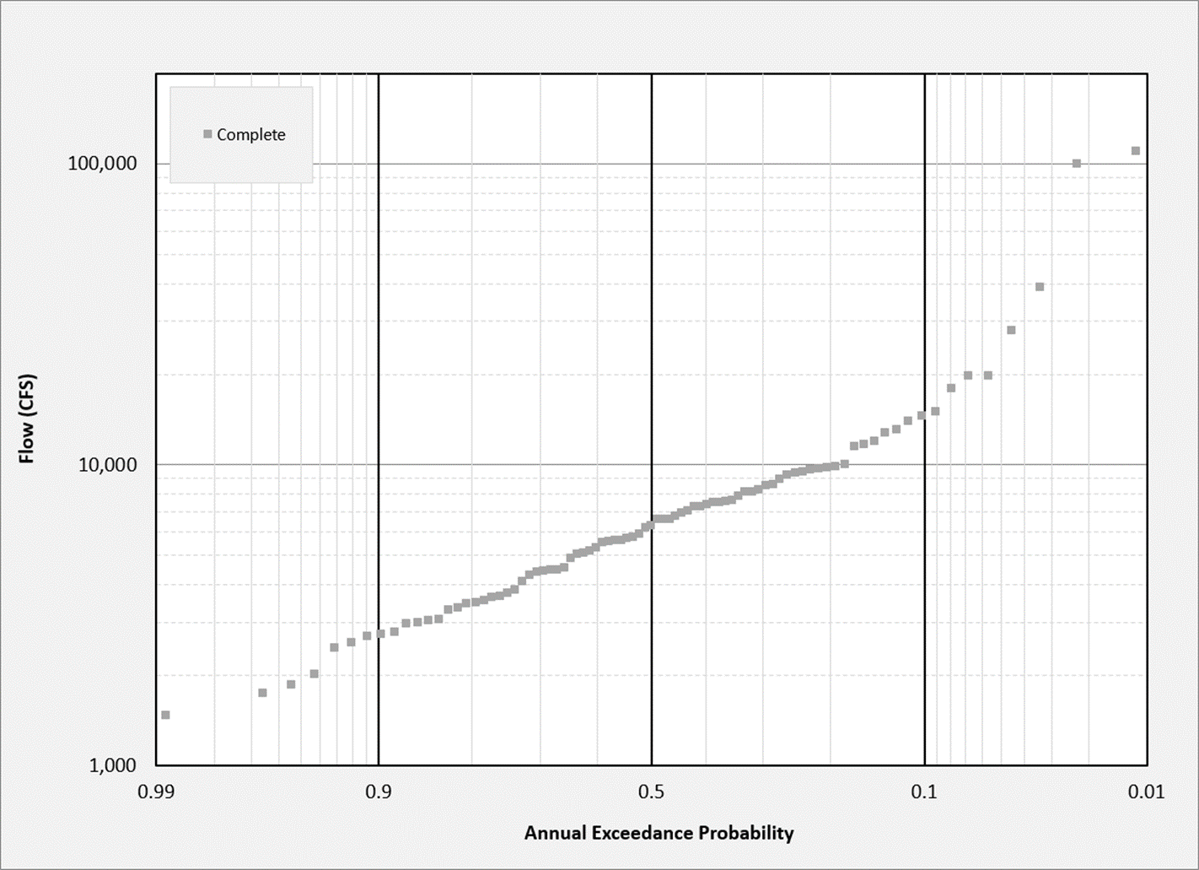
Example 3
Plot the AMS

Slide 25
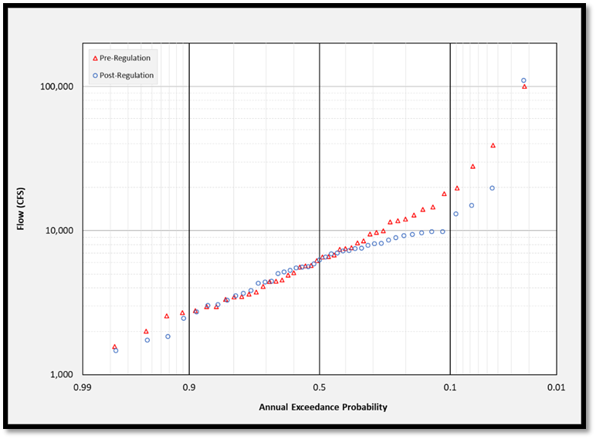
Example 3
Can separate the unregulated and regulation portions and plot them together
Should also investigate the watershed regulation
K-S Test
Pre-Dam (Unregulated)
Post-Dam (Regulated)

Slide 26
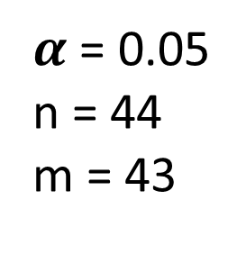
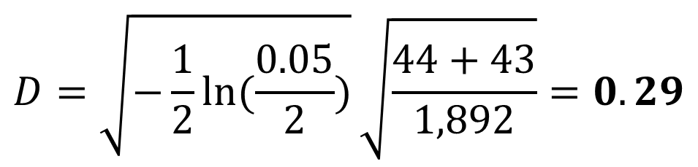
Example 3
Can separate the unregulated and regulation portions and plot them together
Should also investigate the watershed regulation
K-S Test
$α$ = 0.05
n = 44
m = 43
$$D=\sqrt{−\frac{1}{2}\ln{(\frac{0.05}{2})}}\sqrt{\frac{44+43}{1,892}}=0.29$$
D_{n,m} (0.18) < D(0.26)
Regulation effects are negligible

Slide 27
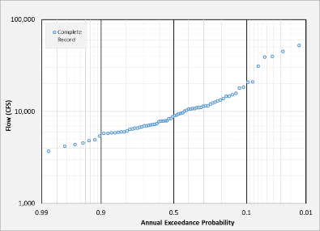
Is the Regulation Appreciable?
Example 1
Example 2
Example 3
Appreciable Regulation
Appreciable Regulation
Negligible Regulation

Slide 28
Methods for Developing Unregulated Time-Series
Notes:
(for use in analytical frequency analysis)

Slide 29
Methods
Complexity
Adopt unregulated portion
Transfer from nearby gage
Calculate reservoir holdouts
Simple hydrologic routing
Complex hydrologic routing
Least preferred
Most common
Highly data intensive

Slide 30
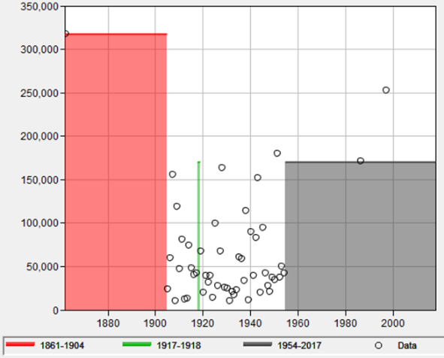
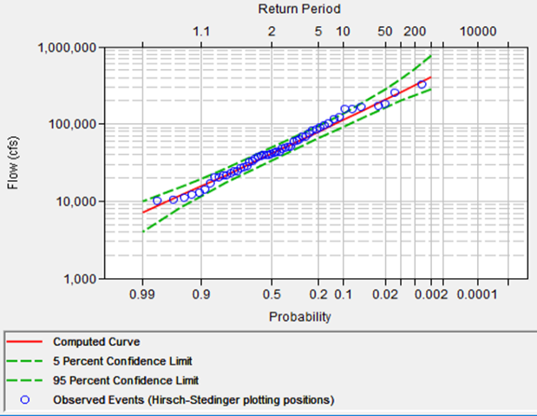


Method 1: Adopt Unregulated Portion
Least preferable
Only if no other options available & at least 50 years of data
Regulated
Portion
Notes:
Adopt pre-dam record

Slide 31
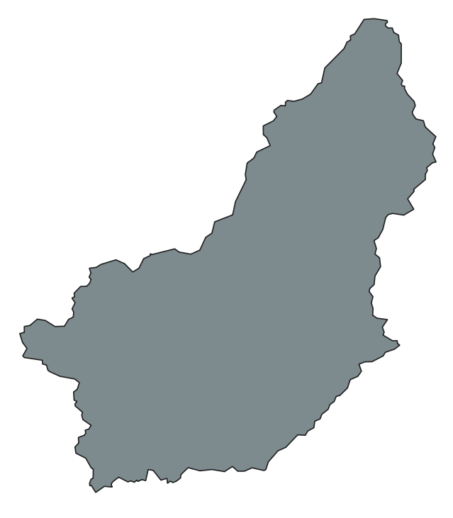
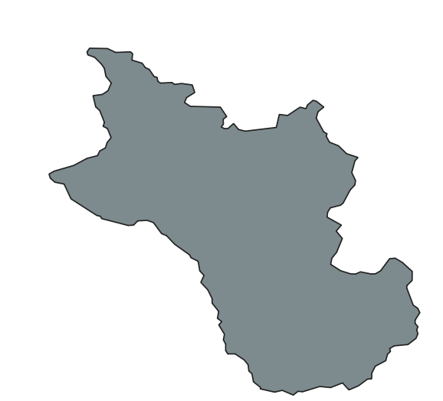
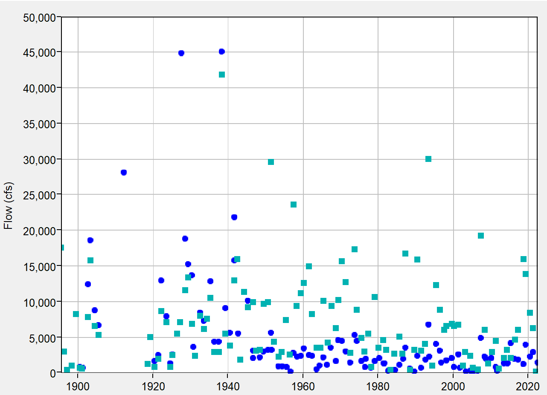
Method 2: Transfer from a Nearby Gage
Treat the regulated period as if it’s missing and perform gage extension following Bulletin 17C procedures
Basin A
Basin B
Dam

Slide 32
Method 3: Calculate Reservoir Holdouts
Requires daily or subdaily data
At minimum: reservoir outflow and reservoir storage
Change in storage (ΔS)
Inflow (I)
Outflow (O)
Regulated stream flow

Slide 33
Method 3: Calculate Reservoir Holdouts
Knowns:
  Reservoir outflow (O)
  Reservoir storage (S)
    Reservoir incremental change in storage (ΔS = S_{t=1} – S_{t=0}), converted to units of CFS (from AC-FT/DAY or AC-FT/HR)
Unknowns:
  Reservoir inflow (I)
Computed Inflow

Slide 34

Method 3: Calculate Reservoir Holdouts
Add incremental change in storage to outflow
  If storage decreases (-ΔS), it means outflow exceeded inflow
  If storage increases (+ΔS), it means the inflow was held back
I = O + ΔS
Change in storage (ΔS)
???
Inflow (I)
Outflow (O)
Regulated stream flow

Slide 35
Method 3: Calculate Reservoir Holdouts
For simple systems (single reservoir), the inflow can be calculated (I = O + ΔS)
  Your District CWMS database probably already does this!
For complex systems (multiple reservoirs), the process is repeated and the flows are lagged to simulate routing time

Slide 36
Method 3: Calculate Reservoir Holdouts
B
A
D
C
E
Observed regulated flow

Slide 37
Method 3: Calculate Reservoir Holdouts
Holdouts (ΔS)
Holdouts (ΔS)
B
Holdouts (ΔS)
A
1 day lag
Holdouts (ΔS)
D
C
1 day lag
1 day lag
2 day lag
E
Holdouts (ΔS)
Observed regulated flow
F(unreg) = F(obs) + H_{A} + H_{B} + H_{C} + H_{D} + H_{E}
No lag
Notes:
This calculation is performed at each time step

Slide 38
Method 3: Calculate Reservoir Holdouts
Flow calculation for complex (multi-reservoir) systems:
  1) Holdouts for upstream reservoirs are calculated
      Holdout = Reservoir Inflow – Reservoir Outflow
      OR
      Holdout = Reservoir Change in Storage
  2) Lag time for each holdout is determined
  3) Unregulated flow at the downstream location is calculated as the observed (regulated) flow plus the lagged upstream holdouts
      Flow(unreg) = Flow(obs) + Holdout₁ + Holdout₂ + …
      Calculated at each time-step
Holdouts may sometimes be negative!

Slide 39
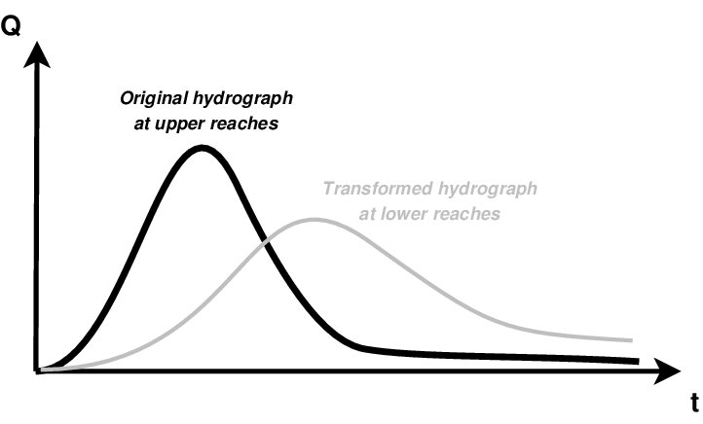
Method 3: Calculate Reservoir Holdouts
Benefits:
  Can be done in a spreadsheet
  Daily reservoir storage data is usually available
Limitations:
  No accounting for local flows
  Poor representation of attenuation

Slide 40
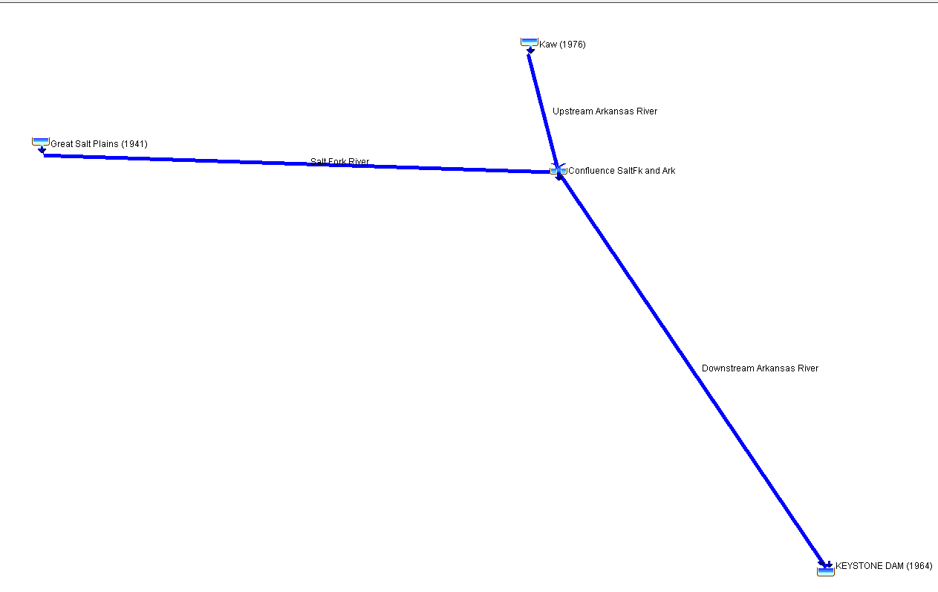
Method 4: Simple Hydrologic Routing
Simple hydrologic routing of reservoir inflows to capture hydrograph attenuation and local flows
  Rainfall-runoff model (HEC-HMS)
  Use existing models where possible

Slide 41
Method 4: Simple Hydrologic Routing
B
A
D
C
E
Observed regulated flow

Slide 42
Method 4: Simple Hydrologic Routing
Inflow (I)
Inflow (I)
B
Inflow (I)
A
Inflow (I)
D
C
Diversions
E
Inflow (I)
Local flows
Observed regulated flow

Slide 43
Method 4: Simple Hydrologic Routing
Route reservoir outflow
Route reservoir inflow
Calculate local flow hydrograph
Calculate unregulated flow hydrograph
Local Flow = Observed Flow – Routed Reservoir Outflow
Unregulated Flow = Local Flow + Routed Reservoir Inflow

Slide 44
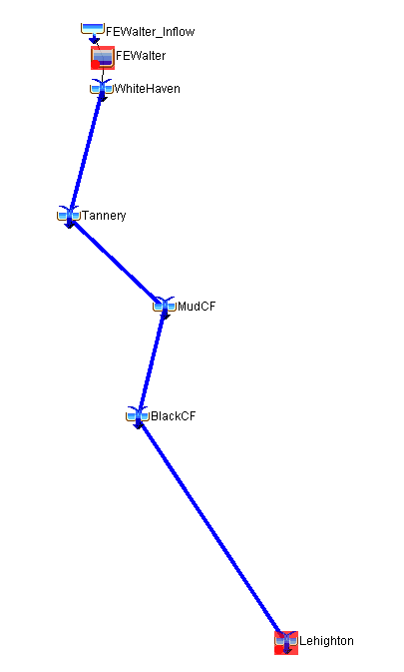
Method 4: Simple Hydrologic Routing
1
Reservoir Outflow (F_{out})
2
Calculated
Inflow (F_{in})
Key:
Gage data
Calculated data
HMS results
Goal
Local Flow (F_{local})
Local Flow (F_{local})
F_{local} = F_{obs} - R_{out}
F_{unreg} = R_{in} + F_{local}
Observed Flow (F_{obs})
Routed
Reservoir
Outflow (R_{out})
Unregulated Flow (F_{unreg})
Routed
Reservoir
Inflow (R_{in})

Slide 45
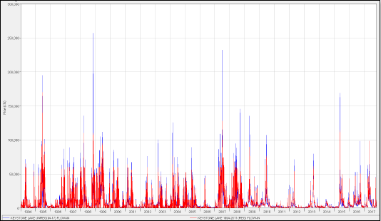
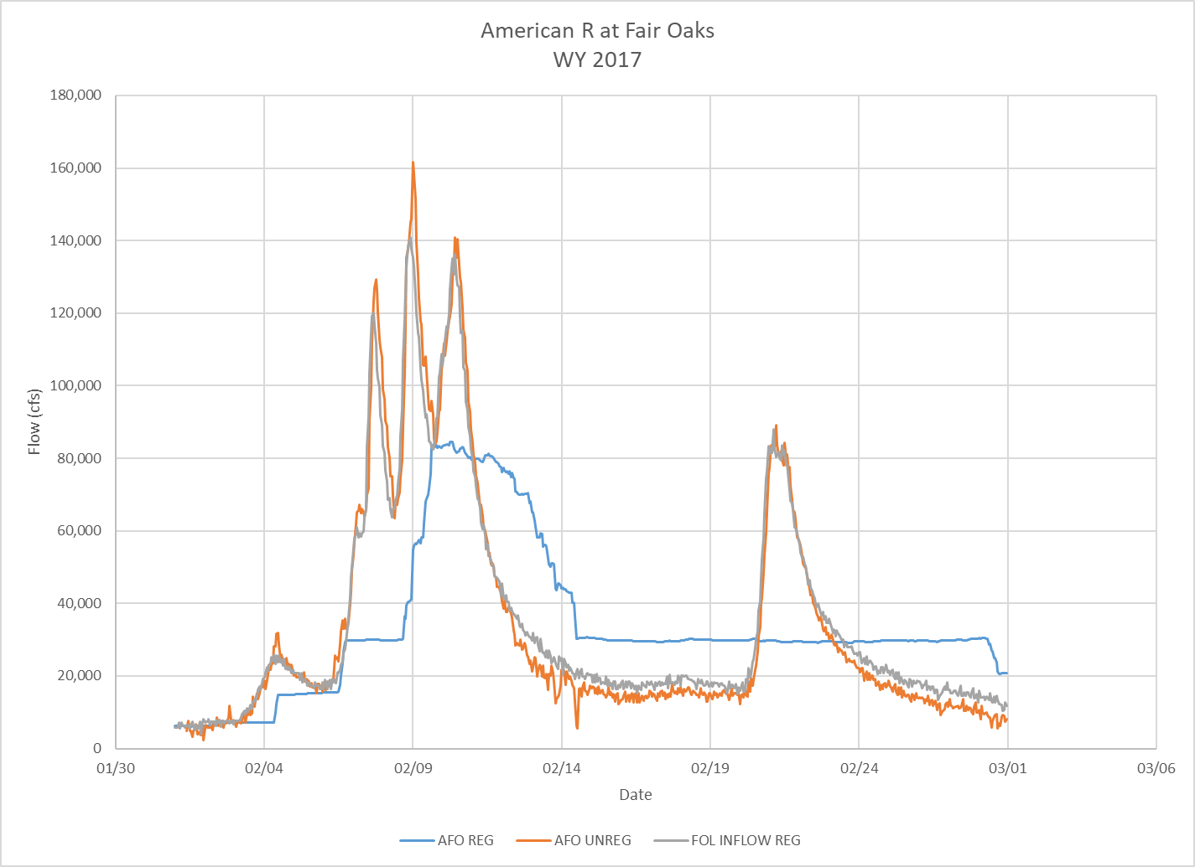
Method 4: Simple Hydrologic Routing
Notes:
This method can be applied to a period-of-record or for individual events

Slide 46
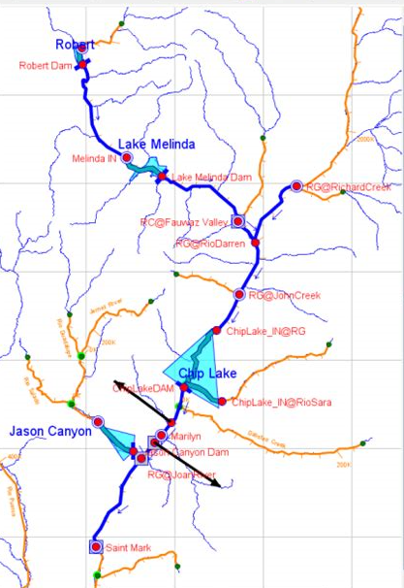
Method 5: Complex Hydrologic Routing
Perform a period-of-record simulation using continuous meteorological forcing data
  Requires a calibrated continuous-simulation model
Can also simulate individual events
Data can be difficult to obtain
Most precise

Slide 47
Summary of Methods
Method | Data Needed | Instantaneous peak unregulated AMS | N-day (1-day, 3-day…) unregulated AMS
1) Adopt unregulated portion | Unregulated AMS >= 50 years | X
2) Gage transfer | Unregulated AMS at nearby gage | X
3) Holdout calculations | Daily reservoir/stream data |  | X
4) Simple modeling | Daily or subdaily reservoir/stream data | X* | X
5) Complex modeling | Continuous meteorological forcing data | X | X
*Only if subdaily data or subdaily disaggregation (such as MetSim) is used
Notes:
Sometimes volume-frequency curves are needed (for n-day durations such as 1-day or 3-day), which cannot be obtained from the first two methods
The limitation for the third method is that it cannot produce instantaneous peak flow-frequency

Slide 48
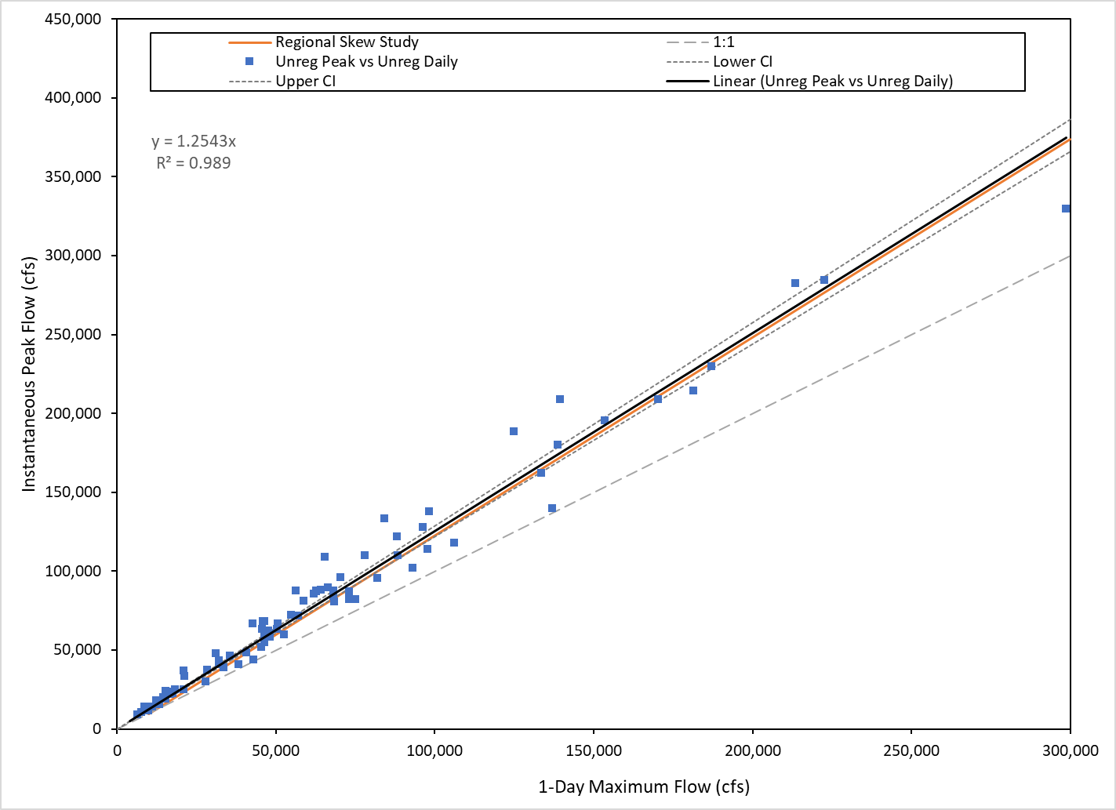
Convert Daily Maximum to Instantaneous Peak
One method of estimating instantaneous peak AMS from daily AMS is through regression
Requires unregulated peak AMS data (pre-dam period) to develop regression
Estimates unregulated peak AMS data for post-dam period

Slide 49
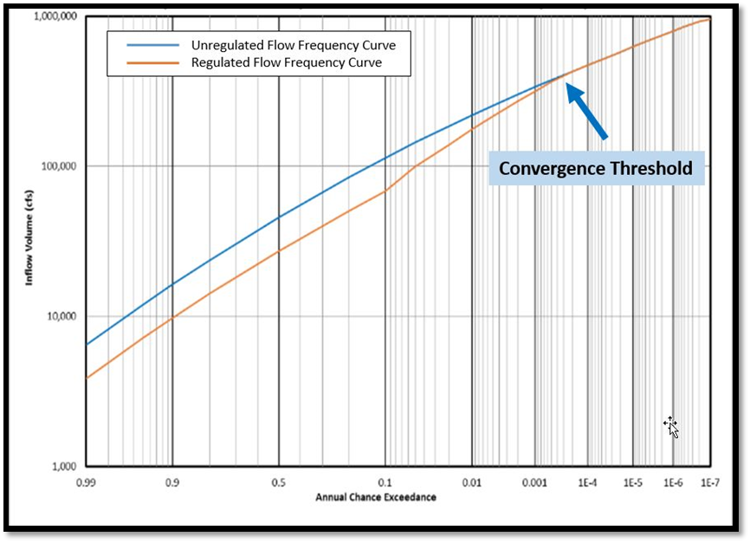
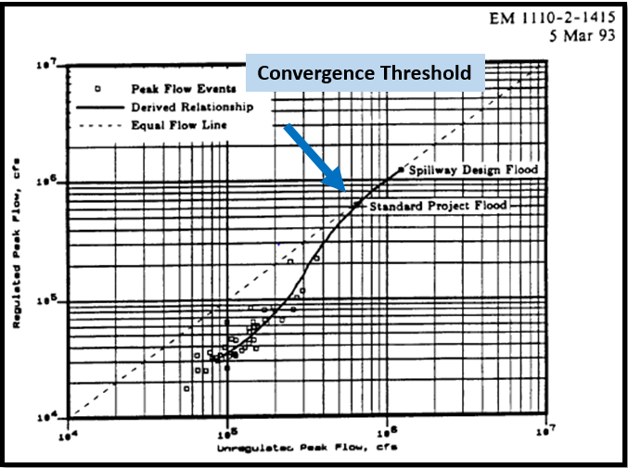
Convergence Value
The point at which the difference between unregulated and regulated flow is negligible
Convergence point
Convergence point
Notes:
The convergence value is defined as the initial flood magnitude at which the difference between regulated and unregulated flows is negligible.
When you have identified the convergence threshold, you can make the assumption that the affects of regulation are negligible
for less frequent AEPs.
When developing the stage freq. curve using an unregulated flow frequency curve, can assume that the upper end of the curve beyond the convergence threshold are applicable to the existing regulated system.
This figure from EM 1110-2-1415 provides an example of a convergence threshold in the context of a flow frequency curve.
In this example, the regulated and unregulated flow frequency curves converge for exceedance probabilities less frequent than approximately 1/4,000 AEP. In this example, the effects of regulation can be considered negligible for extreme flood events with an AEP less than 1 in 4,000.

Slide 50
Summary
Unregulated data are required for analytical flood frequency analysis (if the impacts of regulation are appreciable)
There are many ways for developing unregulated time-series, depending on the availability of data and models

Slide 51
Questions?

