Slide 1
Analyzing Hydrologic Time-Series a potpourri
Lecture 2
Flood Frequency Analysis
Hydrologic Engineering Center
Beth Faber, PhD, PE
Notes:
This lecture is a bit of a review and connect the dots of some material already covered, a preview of a topic that’s coming up, and then some new topics that fit within the theme.

Slide 2
Goals
Review (or preview) some ways we might study a time-series, and what we can learn from it
What information we extract
What assumptions we make
What values or probabilities we can estimate
What type of analysis each requires

Slide 3
Topics
Assumption
Annual Extremes
  annual maximums or minimums
  UNregulated, or regulated
  instantaneous flows or longer duration avg flow/volume
Partial Duration (peaks over threshold, POT)
  graphical (non-analytical)
Daily flows or stages
  Duration Curves
  Summary Hydrographs
Annual Extremes
  annual maximums or minimums
  UNregulated
  instantaneous flows or longer duration avg flow/volume
independence
independence
No independence - persistence
3
Notes:
These are the topics I’ll cover. We divide the time period of the data, and whether we use all the data or isolate the extremes. These choices affect the assumptions we can make about the data set. Isolating annual extremes provides enough time between values that we can assume independence. Using all the data at a daily step, the values are persistent, and can’t assume independence.

Slide 4
Streamflow data, daily flow record
American River at Fair Oaks (unregulated)
108 years of daily unregulated streamflow data
consider each year’s maximum flow
often, annual peaks are instantaneous values
reservoir constructed
Notes:
We extracted an annual max series by selecting the largest flow event in each year, based on some definition of “year,” such as calendar (starting Jan 1) or water (starting Oct 1).

Slide 5
Streamflow data, find annual max
consider each year’s maximum flow
often, annual peaks are instantaneous values
Review from Intro Lecture
Notes:
We extracted an annual max series by selecting the largest flow event in each year, based on some definition of “year,” such as calendar (starting Jan 1) or water (starting Oct 1).

Slide 6
American River, ANNUAL MAX SERIES, AMS
annual maximum values are independent
Review from Intro Lecture
6
Notes:
The data set is now 108 values of annual maximum/peak flows.

Slide 7
Assumptions
What we have: series of annual maximum flows
Treat these flows as a random, representative sample from the flood population of interest
Generally, we assume the sample is IID
  annual peak flows are random and independent
  peak flows are identically distributed – homogeneous data set
  sample is adequately representative of the population
  (estimate of the distribution improves with sample size)
  NOTE, we’re assuming the data is homogeneous, stationary….
Review from Intro Lecture
Notes:
IID = independent and identically distributed. Not so much that they ARE identically distributed as that we assume it is reasonable to fit a single distribution to them. Except when we can’t assume that….

Slide 8
Histogram
divide data range into bins, count number of observations in each bin (frequency), divide by total (relative frequency)
Review from Intro Lecture
switch to log₁₀(flow)
0 25 50 75 100 125 150 175 200 225 250 275
3.2 3.4 3.6 3.8 4.0 4.2 4.4 4.6 4.8 5.0 5.2 5.4 5.6
Log Flow (thousands of CFS)
8
this shape is similar to a PDF, probability density function
Notes:
A histogram gives a good view of probability of the sample.

Slide 9
Definition of PDF and CDF
A Probability Density Function (PDF), f(x), defines the probability of occurrence for a continuous random variable.
area under curve = probability
The Cumulative Distribution Function (CDF), F(x) is the probability the random variable is less than some value
curve = probability
PDF
Review from Intro Lecture
p
X
of Variable X
CDF
p
X
9
of Variable X

Slide 10
Empirical Cumulative Distribution
based on observation
Empirical or Graphical estimate: based on order statistics, using plotting position (estimated [non-]exceedance probability)
  Estimated probability of observation magnitude is based on its position within the sample
  Each observation has an equal incremental prob = 1/N
  m_{i} = rank of ordered observation i (m=1 as smallest value, N as largest) N = total # of observations
Review from Intro Lecture
i.e., relative frequency
m_{i}
N
P[X ≤ x_{i}] =
estimate probability that outcome will be smaller than observation x_{i} by the fraction of the observed sample that is smaller
10
Notes:
Rank is where that sample member is in the line-up of all sample members ordered by magnitude. So, it’s a way of counting the number of events less than or equal to.
Plotting position is the estimate of the cumulative prob of each observation, based on the sample size and the position of each observation within the sample that’s been sorted by magnitude. So, effectively we’re computing the relative frequency of being less than a given observation, based on how many values in the sample were less than that observation – defined by the rank.

Slide 11
Empirical Cumulative Distribution
Weibull plotting position
Year | Rank | Flow | Non-Excdnc Probability |  | Year | Rank | Flow | Non-Excdnc Probability
1997 | 108 | 252431 | 0.99 |  | 1955 | 14 | 10528 | 0.13
1955 | 107 | 189073 | 0.98 |  | 1975 | 13 | 10389 | 0.12
1964 | 106 | 183242 | 0.97 |  | 1972 | 12 | 10046 | 0.11
1986 | 105 | 170960 | 0.96 |  | 2008 | 11 | 9150 | 0.10
2005 | 104 | 161731 | 0.95 |  | 1966 | 10 | 8659 | 0.09
1963 | 103 | 152614 | 0.94 |  | 1939 | 9 | 8500 | 0.08
1950 | 102 | 132000 | 0.94 |  | 1907 | 8 | 8460 | 0.07
1980 | 101 | 124915 | 0.93 |  | 2001 | 7 | 8045 | 0.06
1928 | 100 | 119000 | 0.92 |  | 1931 | 6 | 7920 | 0.06
1982 | 99 | 113126 | 0.91 |  | 1990 | 5 | 7606 | 0.05
1907 | 98 | 105000 | 0.90 |  | 1961 | 4 | 6914 | 0.04
1909 | 97 | 98000 | 0.89 |  | 1988 | 3 | 5447 | 0.03
1970 | 96 | 88316 | 0.88 |  | 1994 | 2 | 5009 | 0.02
1969 | 95 | 83526 | 0.87 |  | 1977 | 1 | 2359 | 0.01
Plotting Position:
General Formula
Weibull: a = 0.0, b = 1.0
Median: a = -0.3175, b = 0.365
Median: a = -0.3, b = 0.4
m + a
N + b
P =
largest 14 values
smallest 14 values
Notes:
These are the largest 14 and smallest 14 values in the 108-year data set.

Slide 12
Empirical Cumulative Distribution
Review from Intro Lecture
CDF = cumulative distribution function
12
Notes:
First, plot in the typical CDF form, with flow on horizontal and cumulative probability on vertical. But, now can plot every observation, rather than every bin.

Slide 13
Empirical Cumulative Distribution
for a Corps frequency curve, we switch axes...
Review from Intro Lecture
annual
13
Notes:
Switch axes to probability on horizontal and probability on vertical. Note, annual probability because one value each year, and computing relative frequency based on years.

Slide 14
Empirical Cumulative Distribution
…also called a frequency curve…
...and adjust axis scales
Review from Intro Lecture
Normal probability scale
0
1
14
annual
Notes:
Switch probability axis from linear to Normal. Note, normal data would plot as a straight line on normal axis.
How to we create a normal axis?
the axis is linear in Zp, the standard normal deviate of probability p.
The axis is based on the normal PDF that you can see as a shadow along the horizontal, so
(2) we plot a given probability where the area under the PDF (from left to right) equals that probability.

Slide 15
Empirical Cumulative Distribution
…also called a frequency curve…
log scale
...and adjust axis scales
Review from Intro Lecture
Normal probability scale
0
1
15
annual
Notes:
Switch vertical axis to log(flow).
Note, the data becomes close to a straight line, so log(flow) is close to Normal, and flow is close to logNormal in this case.

Slide 16
Empirical Cumulative Distribution
…also called a frequency curve…
1.01
Return Period
2
5
10
20
100
log scale
equaled or exceeded 11 times in 108 years ≈ 10%
largest in 108 years, probability ≈ 1/108 ≈ 0.9%
switch to exceedance
Review from Intro Lecture
Normal probability scale
0.9%
1
0
Cumulative Exceedance Probability
16
Annual
Notes:
Switch from non-exceedance to exceedance probability. Note that return period = 1 / (exceedance prob).
Recall the interpretation of the plotting positions. The largest even is explicitly interpreted as equaled or exceeded once in 108 years, etc

Slide 17
Empirical Graphical Cumulative Distribution
1.01
Return Period
2
5
10
20
100
log scale
Normal probability scale
1
0
Cumulative Exceedance Probability
17
Annual
Notes:
With no further assumptions, we have an empirical or graphical curve only.

Slide 18
Analytical Distribution
for unregulated, instantaneous annual maximums
1.01
Return Period
2
5
10
20
100
log scale
Log Pearson III per Bulletin 17B/C
Normal probability scale
1
0
Cumulative Exceedance Probability
18
Annual
Notes:
Or, we can assume an analytical distribution, and estimate its parameters from the 108 member sample of values. This is the log Pearson type 3 distribution recommended in Bulletin 17B/C for unregulated annual maximum values

Slide 19

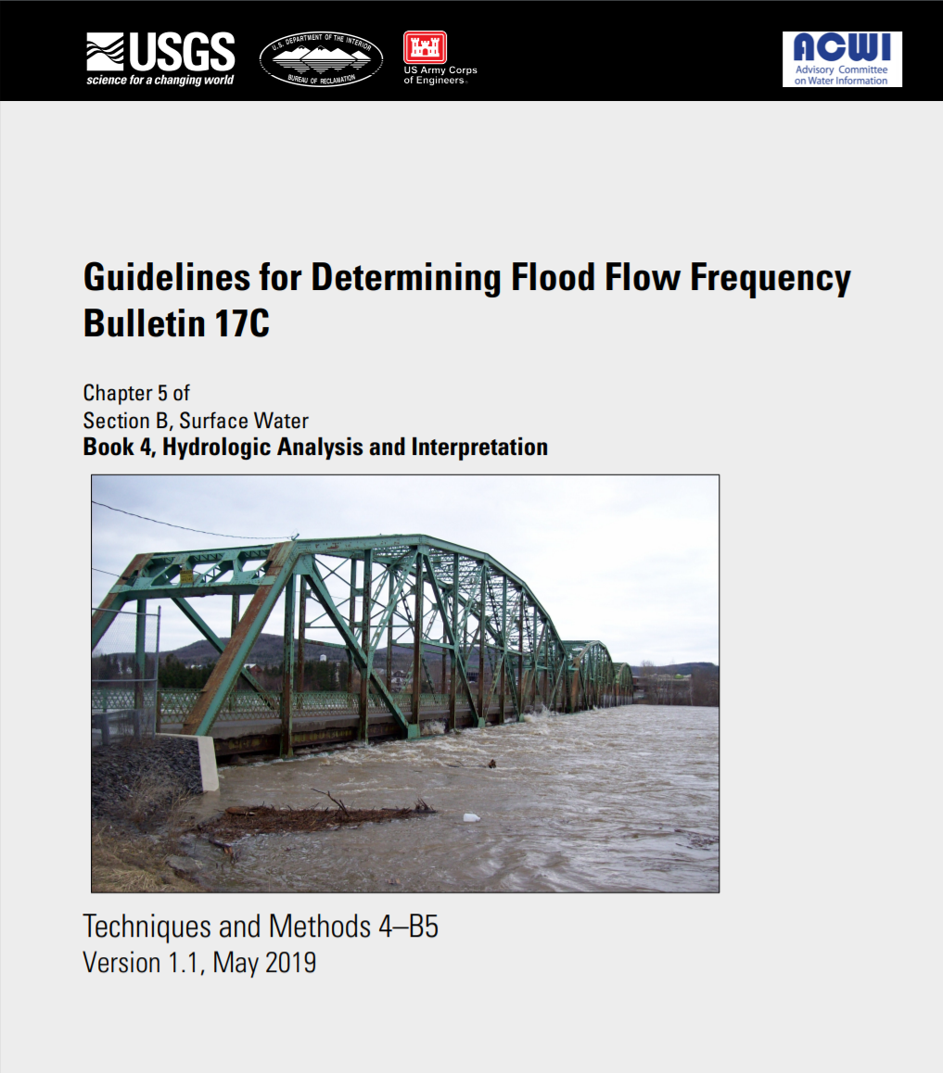
Bulletin 17B
dated March 1982
Bulletin 17C
dated May 2019
19
Notes:
Reference

Slide 20
B17B/C: Frequency Analysis of Annual Peak Flows
Estimate LogPearson III distribution for unregulated annual peak flows
  Method of Moments
Data challenges:
  Missing Flows (Broken or Incomplete Record)
  Low and High Outliers
  Zero Flows
Additional information to improve estimates:
  Historical/Paleo Information
  Regional Skews (use a weighted skew)
  Allowing a longer record site to improve short record estimate
moments of sample used to estimate moments of distribution
many of the methods for handling data challenges and using additional information are improved in Bulletin 17C
20
Notes:
Fitting an LP3 to annual maximums is the primary guidance. But the details are in dealing with difficulties in the data set, and in bringing in additional data that can provide more information.

Slide 21
Analytical Distribution
for unregulated, instantaneous annual maximums
1.01
Return Period
2
5
10
20
100
log scale
Log Pearson III per Bulletin 17B/C
90% confidence interval
Normal probability scale
1
0
Cumulative Exceedance Probability
21
Annual
Notes:
The fit of the LogPearson type 3 distribution (LP3) also includes estimating the 90% confidence interval. The interval can be interpreted simply as meaning there is a 90% change the correct population frequency curve is within this range.

Slide 22
Topics
Assumption
Annual Extremes
  annual maximums or minimums
  UNregulated, or regulated
  instantaneous flows or longer duration avg flow/volume
Partial Duration (peaks over threshold, POT)
  graphical (non-analytical)
Daily flows or stages
  Duration Curves
  Summary Hydrographs
independence
independence
No independence - persistence
22
Notes:
These are the topics I’ll cover. We divide the time period of the data, and whether we use all the data or isolate the extremes. These choices affect the assumptions we can make about the data set. Isolating annual extremes provides enough time between values that we can assume independence. Using all the data at a daily step, the values are persistent, and can’t assume independence.

Slide 23
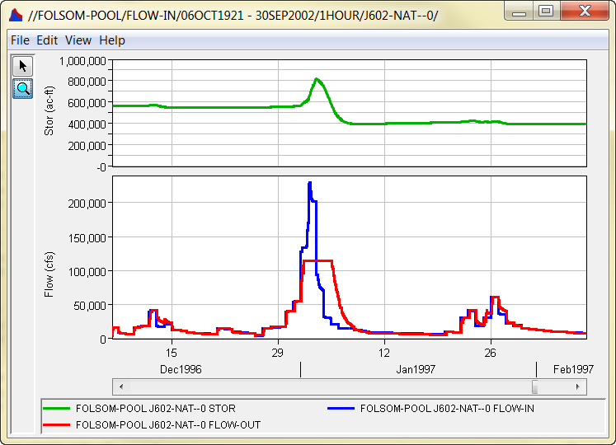
Also Interested in Regulated Flow
Reservoir Storage Level
Inflow
160,000 cfs
115,000 cfs
Release
23
Notes:
This figure shows the regulation of a flood event through a reservoir, where the reservoir stores all of the water volume in excess of the same channel flow or “objective release” and then releases that volume more slowly after the event.

Slide 24
Streamflow data, regulated
period of record 1955 - 2009
homogeneous = identically-distributed = stationary
Is this regulation homogeneous?
reservoir constructed
24
Notes:
The red line is the reservoir outflows, beginning when the reservoir was constructed (1955) and ending in 2005. These are regulated flows.
We can extract an annual maxima series of this data we have 2 issues:
Are we looking at homogeneous data during the regulated period? Was the reservoir regulated the same way during this period? Usually not. Reservoir operations change. Not identically distributed and not stationary.
Record lengths are different: 108 years of unregulated flow vs. 50 yrs of regulated flows
We can route our entire POR of data through our reservoir simulation model to ensure we have homogeneous data (the same and current reservoir operations) and expand data set

Slide 25
Streamflow data, regulated
these are simulated outflows:
HOMOGENEOUS operation
2 benefits:
homogeneous operation, and longer period
25
Notes:
Here, we see the unregulated record simulated with the current operation strategy. So, the operation is homogeneous. Hopefully, the inflow record is, too!
Light blue is modeled regulated record (from reservoir modeling) → plotting positions do not line up since we only simulated 80 years of record.
Longer period of record, same operations

Slide 26
Streamflow data, regulated
consider each year’s maximum flow
regulated annual peaks are often daily values
26
Notes:
Create the annual maximum series (AMS) in the same way we do for unregulated flows.
Note, in this case, the simulated period is not the complete unregulated record. So, the POR is a bit shorter.

Slide 27
Folsom Release, ANNUAL MAX
annual maximum values are independent
27
Notes:
Now we have a record of regulated peaks (81 regulated maxima). Channel capacity is 115000 cfs.
Frequency analysis of regulated flows by sorting them, ranking them, and computing plotting position

Slide 28
Plotted Annual Maximums
1.01
Return Period
2
5
10
20
100
channel capacity
max hydropower
1
0
Cumulative Exceedance Probability
28
Notes:
Hollow diamonds are the unregulated record.
Solid diamonds are the regulated record, plotted in the same way.
Note that there are relevant flow thresholds, such as channel capacity at the upper end, that are horizontal over a range of exceedance probability.
These thresholds are important
Lower threshold of 4,000 cfs is hydropower release
Upper threshold of 115,000 cfs is channel capacity
We see that in our record, there were no events that exceeded the flood pool capacity and required a release above the channel capacity
No regulated flows beyond 115,000 cfs in our record

Slide 29
Does an Analytical Curve Make Sense?
1.01
Return Period
2
5
10
20
100
channel capacity
max hydropower
1
0
Cumulative Exceedance Probability
29
Notes:
An analytical fit to this data would smooth through the important flat areas that represent flow thresholds. This is not what we want since it removes our thresholds!
Sometimes we do want to smooth through sampling error. But, in this case, the flats spots are meaningful.
Regulated flows are better represented by a graphical frequency curve.

Slide 30
Graphical Curve is Better for this
Return Period
1.01
Return Period
1.01
5
5
100
2
100
2
20
10
20
10
channel capacity
how do we extrapolate?
max hydropower
1
1
0
Cumulative Exceedance Probability
Cumulative Exceedance Probability
30
Notes:
It is better to do a graphical fit to this data, so we can capture the thresholds that are relevant, and smooth through the ones that are not.
Problem of extrapolation?

Slide 31
Extending a Regulated Curve
To extend a regulated frequency curve, we can construct synthetic events with a specified frequency, e.g. 100-yr, 200-yr, etc, and regulate them
How?
  Estimate frequency curves for longer duration average flows or volumes (3-day, 7-day, 30-day, etc)
  Construct hydrograph for a given frequency
  Route through operation model to get peak outflow
  NOTE: will assume likelihood of peak release is related to likelihood of peak inflow
31
Notes:
We extrapolate a graphical curve by estimating higher values (lower probability) regulated flows based on unregulated flood events of the desired probability.
Construct events with a particular exceedance probability
Estimate family of frequency curves (longer duration or volumes)
Scale up historical event to the given frequency curve based on longer duration average
Route event through reservoir model
Assumption: probability of peak release is equal to likelihood of peak inflow

Slide 32
Graphical Curve is Better for this
1.01
Return Period
2
5
10
20
100
200
500
channel capacity
max hydropower
1
Cumulative Exceedance Probability
32
Notes:
It is better to do a graphical fit to this data, so we can capture the thresholds that are relevant, and smooth through the ones that are not.
Problem of extrapolation?

Slide 33
Topics
Assumption
Annual Extremes
  annual maximums or minimums
  UNregulated, or regulated
  instantaneous flows or longer duration avg flow/volume
Partial Duration (peaks over threshold, POT)
  graphical (non-analytical)
Daily flows or stages
  Duration Curves
  Summary Hydrographs
independence
independence
No independence - persistence
33
Notes:
We’ll move on to frequency analysis of longer durations of flow, for the purpose of generating scaled synthetic hydrographs.

Slide 34
Longer Durations of Flow/Volume
Volume Frequency Analysis
Create a family of frequency curves for a given site that specify average flow across various durations
  Compute X-day moving average TS for various durations, X
    X might be 1-day, 5-day, 30-day etc.
  Extract annual maximums for each duration
  Perform frequency analysis for each duration
    Similar to Bulletin 17B/C procedure, but not instantaneous peak
    Compute plotting positions and distribution parameters from each period of record sample
34
Notes:
Why are we looking at longer durations? When reservoir are involved for providing flood storage, we’re more interested in the volume of water that will arrive across some period of time than just the highest flow. So we want to estimate the likelihood of flow volumes.

Slide 35
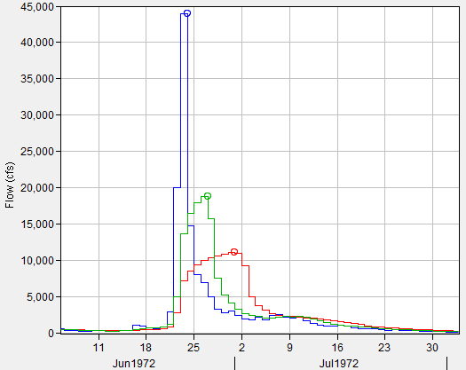
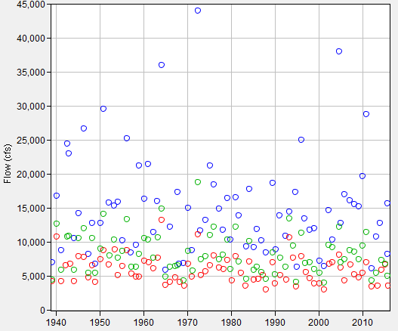
Longer Durations Max Average Flows
1-day Daily Average
5-day Daily Average
10-day Daily Average
1-day AMS
5-day AMS
10-day AMS
35
Notes:
These are rain floods, that are shorter – only a few days. On the left is the time-series of moving X-day averages for 1 event, with the maximum values noted. On the right is the record of annual maximums generated this way across the record.

Slide 36
Longer Duration Max Average Flows
36
Notes:
This is a location where the highest flows are snow-melt floods that last longer than rain floods. It lets us see the annual maximum average flows more easily.

Slide 37
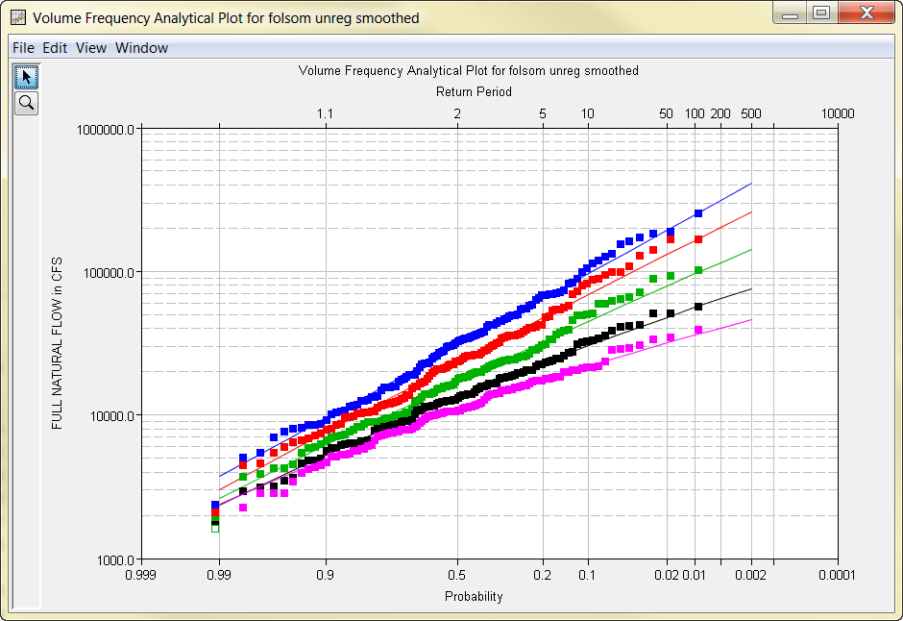
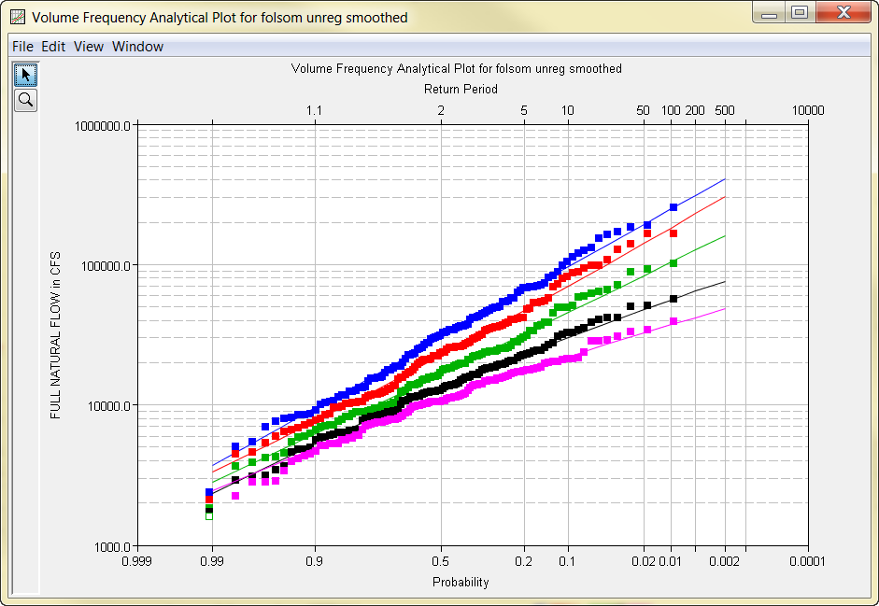
Max Flow at Folsom Volume-Freq Curves
Note: average flow easier to plot than volume – curves are closer
1DAY
3DAY
7DAY
15DAY
Average Flow (cfs)
30DAY
shorter duration (1 day) is more extreme
Percent Chance Exceedance
37
Notes:
This figure has both the sorted and plotted annual maximums, and fitted LP3 curves for each. Note, these are X-day average flows, because X-day volumes would be much higher for longer durations and not plot nicely. Showing average flows let’s us show them all on one plot this way.

Slide 38
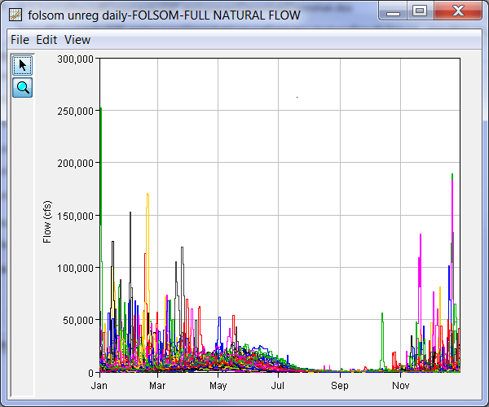
Note: it’s important to define the year
define a year that won’t break up longer high flow averages
what about for low flows?
38
Notes:
It is important to choose a start date that captures all flood events from a certain hydrologic regime. If high flows generally occur between November and May, then the year should not start between these months. This will minimize the possibility that the same flood event is used for consecutive years.

Slide 39
Synthetic Events
Create synthetic, low-frequency event hydrographs to model extremes, or other watershed conditions (e.g. regulated flow)
  perform volume frequency analysis
    produce the family of X-day average flow frequency curves
  choose an historical event as a hydrograph “shape”
  scale the hydrograph to match flow of chosen exceedance probabilities (e.g., the 1% chance event)
    read the average flow for each duration for the chosen exceedance probabilities
    scale the hydrograph up or down to match that avg flow
39

Slide 40
Max Flow at Folsom Volume-Freq Curves
200-year
1DAY
3DAY
7DAY
15DAY
Average Flow (cfs)
30DAY
shorter duration (1 day) is more extreme
Percent Chance Exceedance
40
Notes:
The average flow exceeded with a 0.005 (or, 0.5%) exceedance probability can be read for each curve. This value will allow us to create a synthetic event with that the desired estimated probability.

Slide 41
Rescaling Historical Event
1997 flood event
0.97%
41
Notes:
This is an historical event on the American River, from 1997. The exceedance probabilities of the maximum X-day average flows are noted.

Slide 42
Rescaling Historical Event
1997 flood event, scaled to 3-day 1-in-200%
0.97%
42
Notes:
This is the 1997 flood event scaled to the 0.5% (1 in 200 year) 3-day max average flow.

Slide 43
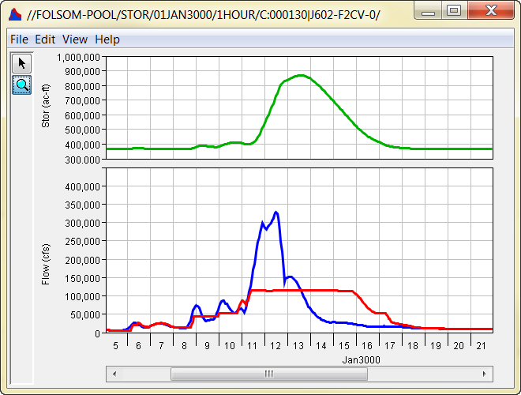
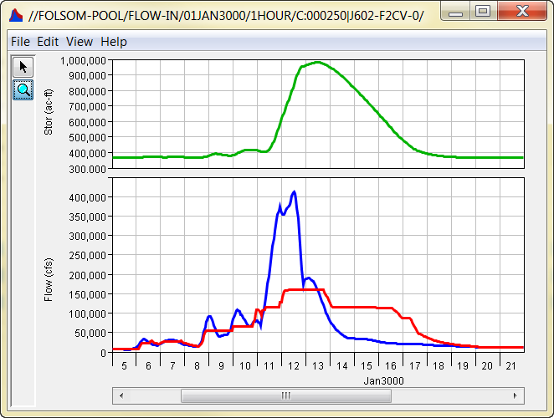
Modeled Operations
Actual 1997 event
Scaled 1/200-year 1997 event
Storage Level
Storage Level
Inflow
160,000 cfs
160,000 cfs
115,000 cfs
Release
115,000 cfs
Release
43
Notes:
Simulating the 1997 event through the reservoir shows it not exceeding the lower objective release.

Slide 44
Graphical Curve is Better for this
1.01
Return Period
2
5
10
20
100
200
500
Cumulative Exceedance Probability

Slide 45
Volume Frequency Analysis
  Sometimes there’s an additional step needed in the volume frequency analysis…
  Check curves for consistency
    Curves should not cross
    Smooth by plotting log moments vs duration, or versus each other
45
Notes:
The curve have to make sense.

Slide 46
When volume-frequency curve require adjustment
Note: average flow easier to plot than volume – curves closer
46
Notes:
The sample for each duration is ranked and plotted separately, with an LP3 curve fitted to each. For high flow data, LP3 fit is generally successful.
The probability axis shows exceedance probability, and so extreme values plot to the right. Shorter durations are more extreme (in this case, higher) than longer durations.
When LP3 parameters are estimated for each separate data set (each duration column), the curves might not form a regular set, might cross. The parameters sometimes need to be adjusted…

Slide 47
To prevent curves
from crossing…
47
Notes:
Here standard deviation is plotted against mean, and smoothed.

Slide 48
Resulting Volume Duration Frequency Curves
Note: average flow easier to plot than volume – curves closer
48
Notes:
The sample for each duration is ranked and plotted separately, with an LP3 curve fitted to each. For high flow data, LP3 fit is generally successful.
The probability axis shows exceedance probability, and so extreme values plot to the right. Shorter durations are more extreme (in this case, higher) than longer durations.
When LP3 parameters are estimated for each separate data set (each duration column), the curves might not form a regular set, might cross. The parameters sometimes need to be adjusted…

Slide 49
Balancing across multiple durations
peak
1-day
3-day
7-day
15-day
30-day
Notes:
Using the 1% chance exceedance values of each duration, create a “balanced” hydrograph that has those flow volumes. Could be scaled from an historical event. Note, this historical event might not be the best model, as the 1% values show a greater difference between peak and 1-day average max flow.

Slide 50
High vs Low Flows
High flows
  Can usually fit an analytical distribution function to unregulated high flows
  Generally not to regulated high flows - need graphical
Low flows
  can be more non-linear (effects of groundwater, etc),
  might only allow graphical (empirical) frequency curve
50
Notes:
So far we have talked about annual maxima (high flows).
We are also interested in low flow frequency, with annual minima.
Unregulated high flows allow us to use a parametric model, or an analytical probability distribution.
Unregulated low flows very rarely fit an analytical distribution. We more often use a graphical frequency curve.

Slide 51
Low Flow Frequency Analysis
Based on annual minimum flows
Estimate the probability that X-day average flow will not exceed a given value:
mQn: m consecutive day average,
n year return period
example: 7Q10, 7-day 10-year low-flow
⇨ There is a 10% chance that the 7-day average low-flow will be less than this value in any year
As the duration increases to months, independence between events becomes less likely (7-day is common)
p
X
Notes:
For low flows, we work with NON-exceedance probabilities.
A metric that’s sometimes used in watershed restoration analysis and low flow regulation is ….

Slide 52
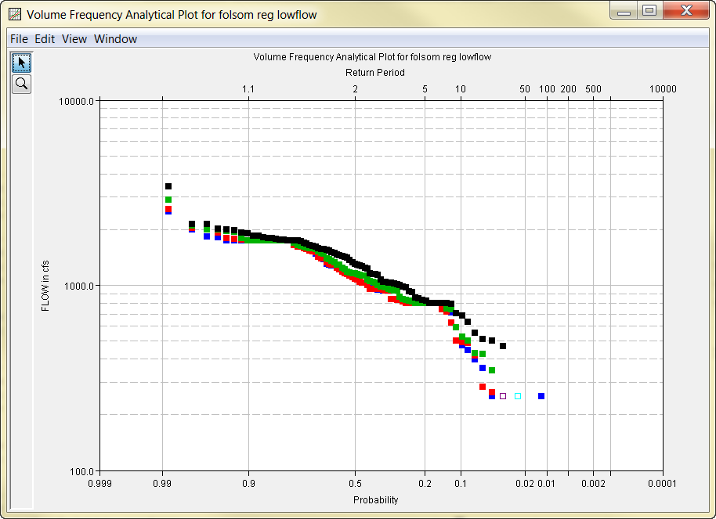
Regulated Low Flow Volume-Freq Curves
note that
low-flow curves are closer...
15DAY
7DAY
3DAY
1DAY
Average Flow (cfs)
7Q10, 7DAY 10YEAR
510
Percent Chance Non-exceedance
Notes:
We’re interested in extremes. So, for annual minimums, we plot the NON-exceedance probability.
We usually keep the extremes on the right. So, zero non-exceedance probability is still on the right. The curves for different X-day average flows are closer, because low flows are not a peaky as high.

Slide 53
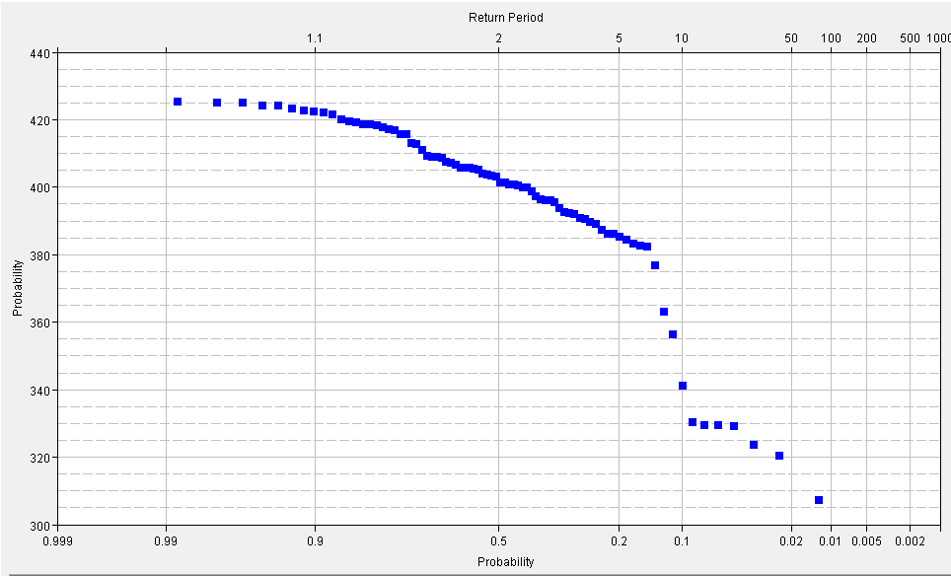
Folsom Minimum Pool Frequency
boat ramp at 385’
Folsom Minimum Pool Elevation (ft)
boat ramp at 320’
Non-exceedance Probability
53
Notes:
Also look at annual minimums (and maximums) for other variables. In this case, minimum reservoir pool.

Slide 54
Topics
Assumption
Annual Extremes
  annual maximums or minimums
  UNregulated, or regulated
  instantaneous flows or longer duration avg flow/volume
Partial Duration (peaks over threshold, POT)
  graphical (non-analytical)
Daily flows or stages
  Duration Curves
  Summary Hydrographs
independence
independence
No independence - persistence
54
Notes:
We’ll take a quick look at partial duration series, or peaks over threshold.

Slide 55
Annual Maximum Series (AMS)

Slide 56
Partial Duration Series (PDS)
Peaks over Threshold
Choose not just the most extreme each year, but all INDEPENDENT events that fall beyond a defined threshold

Slide 57
Empirical Partial Duration Series (PDS)
Calculating plotting positions for AEP:
  If there are a total of k events in N years, then the plotting position for the smallest event (rank = k) is based on k/N
    However, if k > N, might be greater than 1.0
    can’t interpret as probability…
    The plotting position for this event is interpreted, not as exceedance probability, but as average of k/N events per year
  Example
  Smallest event = 1000
  k=50, N=25
Then the plotting position estimate states that on the average it is expected that 2.0 events per year will exceed 1000 cfs
57
Notes:
It is possible to plot partial duration series empirically, with plotting positions. The exceedance probabilities are still interpreted as relative frequencies of equaling or exceeding a value, based on N years. The rank is interpreted the same way, as number of exceedances.
But, rank k might be higher than number-of-years N.
However, it is always possible to interpret as average number of exceedances per year, rather than likelihood of exceedance. This interpretation always makes sense.

Slide 58
Empirical Frequency Curves: American River unreg partial duration vs annual max
can only plot the top N points on a probability axis
N=years
partial duration series
annual peak flow (cfs)
annual maximum series
58
Notes:
AMS and PDS curves are very similar at the top. But, they tend to differ quite a lot below the median, and often start to diverge below 10%.
We use PDS when we care about the lower end of the annual maximum frequency curve.

Slide 59
Topics
Assumption
Annual Extremes
  annual maximums or minimums
  UNregulated, or regulated
  instantaneous flows or longer duration avg flow/volume
Partial Duration (peaks over threshold, POT)
  graphical (non-analytical)
Daily flows or stages
  Duration Curves
  Summary Hydrographs
independence
independence
No independence - persistence
59
Notes:
We’ll take a quick look at partial duration series, or peaks over threshold.

Slide 60
Flow/Stage Duration Curve
Fraction of days exceeding a given value, referred to
as percent of time exceeded
OR
Estimate of the likelihood that a daily flow will exceed a
particular level (refers to future, not soon…)
Graphical display of stream characteristics
Navigation, run-of-river hydropower, water supply
not necessarily the annual extreme...
60
Notes:
When using daily data, we compute percent of time exceeded.

Slide 61
Flow- or Stage-Duration Curves
Plot of Flow vs Percent of time exceeded
(see Maidment, 1992, pg. 8.27, 18.53, 27.40)
Computation
  Rank all the daily flows for period of record from largest to smallest
  Percent of time exceeded for each = rank
  total number of
  days in record
relative frequency!

Slide 62
Starting with a daily flow record…
the REGULATED record
Question: How much of the time can we expect future flows to be between 2,000 and 4,000 cfs?
Interested in hydropower generation
How often were past flows between 2,000 and 4,000 cfs?
62
Notes:
Here’s the daily outflow record from the reservoir simulation we’ve been looking at.

Slide 63
Order the data from low to high, and compute relative frequency of exceedance
More than 4000 cfs is released 19% of the time, and
at least 2000 cfs is released 70% of the time,
so, 51% between 2000 and 4000 cfs
considering all flows, not just annual extremes
… but lost event DURATION
4,000 cfs
4000
2000
2000 cfs
70%
19%
63
Notes:
We can plot every value versus its percent of time exceeded.
Though this is called a “duration curve,” we do not maintain information about the duration of time of each exceedance of a given flow. All days of exceedance are clumped together.

Slide 64
Comparing Unregulated to Regulated
Regulated flows are between 2000 and 4000 cfs 51% of the time,
unregulated flows are in the range 14% of the time.
American River flows, unreg and reg
4,000 cfs
4000
2000
2000 cfs
70%
44%
30%
19%
64
Notes:
The red curve uses the same process of generating a duration curve, but for unregulated flow. By comparing, it’s clear that the reservoir allows release to be within the hydropower generation range much more often than a run-of-river hydropower plant would have.

Slide 65
Flow Duration Analysis Cautions
Data points are not independent, so frequency does not approximate probability in the near term
  Only approximates probability in future
  An estimate of daily probability, not annual
Analytical distributions do not fit data
Need sufficient record length to estimate distribution tails
65

Slide 66
Topics
Assumption
Annual Extremes
  annual maximums or minimums
  UNregulated, or regulated
  instantaneous flows or longer duration avg flow/volume
Partial Duration (peaks over threshold, POT)
  graphical (non-analytical)
Daily flows or stages
  Duration Curves
  Summary Hydrographs
independence
independence
No independence - persistence
66
Notes:
Moving on to summary hydrographs

Slide 67
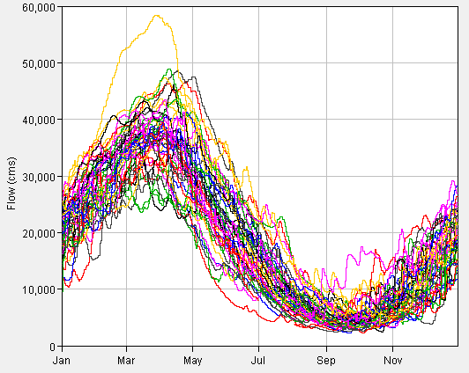
Summary “Hydrographs”
called
“cyclic analysis” in HEC-DSS
Rio Madeira @ Porto Velho, Brazil
1967 - 2005
Sept 1 only
90%
Sept 1 of each year 1967 – 2015
50%
min = 2630
max = 11614
4834
7750
67
Notes:
Summary hydrographs look at day of year, to give an overall summary of flow at a site across seasons. The method does a frequency analysis for each day of the years, and either plots all values, or plots summary values.
This image shows the frequency analysis for Sept 1 on the right, as a histogram and a cumulative histogram.

Slide 68
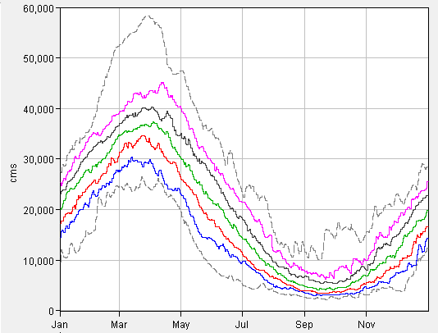
Summary “Hydrographs”
called
“cyclic analysis” in HEC-DSS
Rio Madeira @ Porto Velho, Brazil
1967 - 2005
Sept 1 only
% of time less than
max
90%
75%
50%
25%
10%
min
90%
Sept 1 of each year 1967 – 2015
50%
min = 2630
max = 11614
4834
7750
68
Notes:
Given the frequency analysis for each day, the left plot can show percentiles, rather than all flow years. Note that the curves on the left are not really hydrographs. The daily values do not follow each other.

Slide 69
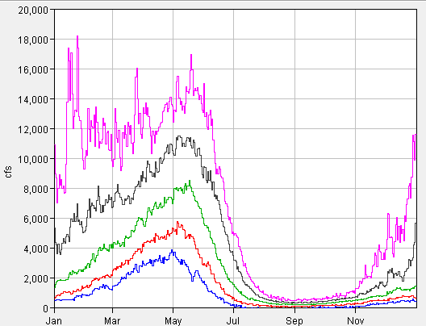
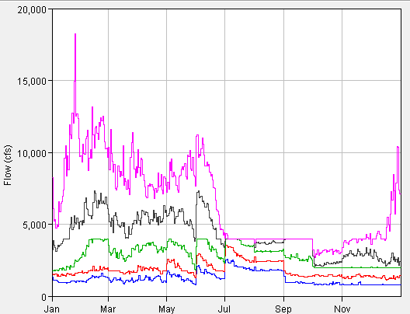
Summary “Hydrographs”
American River blw Folsom
Unregulated Regulated
% of time less than
90%
75%
50%
25%
10%
% of time less than
90%
75%
50%
25%
10%
69
Notes:
Summary “hydrographs” for American River, unregulated and regulated. Note wet winter and dry summer, and how regulated record shows lower high flows, and higher low flows.

Slide 70
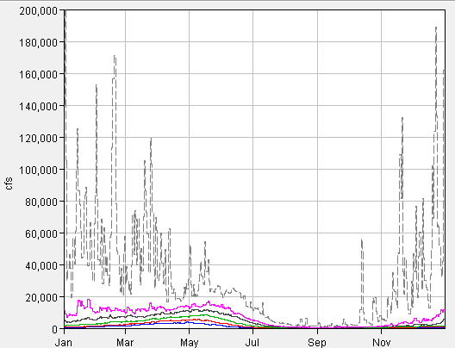
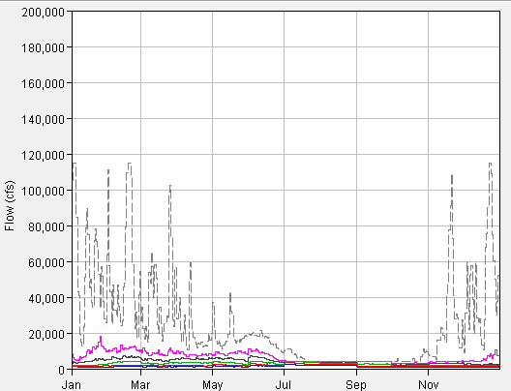
Summary “Hydrographs”
American River blw Folsom
Unregulated Regulated
% of time less than
max
90%
75%
50%
25%
10%
% of time less than
max
90%
75%
50%
25%
10%
70
Notes:
Summary “hydrographs” for American River, unregulated and regulated.
This version includes maximums for each day. Note, we see nearly all winter flood events, because they usually happened on different calendar dates. However, it makes it more clear that the max “hydrograph” doesn’t represent a flow time-series that can occur.
Seeing the maximum flows makes it clear that the reservoir is able to maintain each of the historical events to the channel capacity.

Slide 71
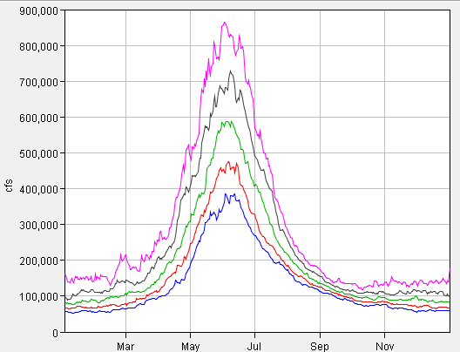
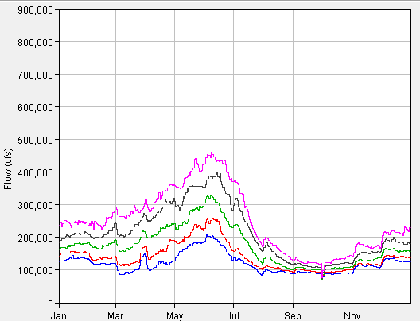
Summary “Hydrographs”
Columbia River at the Dalles
Unregulated Regulated
% of time less than
90%
75%
50%
25%
10%
% of time less than
90%
75%
50%
25%
10%
71
Notes:
Summary “hydrographs” for Columbia River, unregulated and regulated. Note snowmelt in spring, and how regulated record shows a large decrease in the snowmelt flood flow.

Slide 72
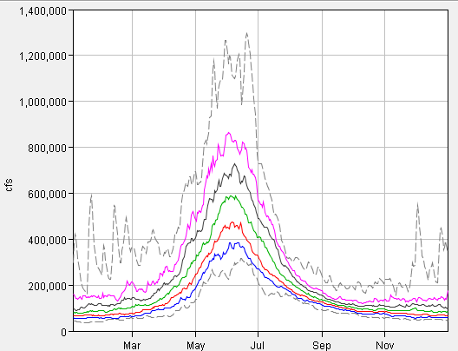
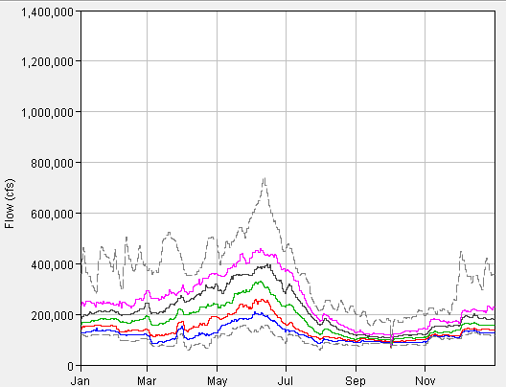
Summary “Hydrographs”
Columbia River at the Dalles
Unregulated Regulated
% of time less than
max
90%
75%
50%
25%
10%
% of time less than
max
90%
75%
50%
25%
10%
72
Notes:
Seeing the maximum flows makes it clear that the reservoir system is able to maintain nearly all of each of the historical events to the channel capacity.

Slide 73
Topics
Assumption
Annual Extremes
  annual maximums or minimums
  UNregulated, or regulated
  instantaneous flows or longer duration avg flow/volume
Partial Duration (peaks over threshold, POT)
  graphical (non-analytical)
Daily flows or stages
  Duration Curves
  Summary Hydrographs
independence
independence
No independence - persistence
73
Notes:
These are the topics I’ll cover. We divide the time period of the data, and whether we use all the data or isolate the extremes. These choices affect the assumptions we can make about the data set. Isolating annual extremes provides enough time between values that we can assume independence. Using all the data at a daily step, the values are persistent, and can’t assume independence.

