Slide 1
Correlation
Flood Frequency Analysis PROSPECT
May 2024
Gregory S. Karlovits, P.E., PH, CFM
Statistical Hydrologist
US Army Corps of Engineers
Hydrologic Engineering Center

Slide 2
Purpose
Understand how to measure the strength of relation between two variables

Slide 3
Outline
Definition/understanding correlation
Measuring correlation
Visualizing correlation, transformations

Slide 4
Defining and Understanding Correlation

Slide 5
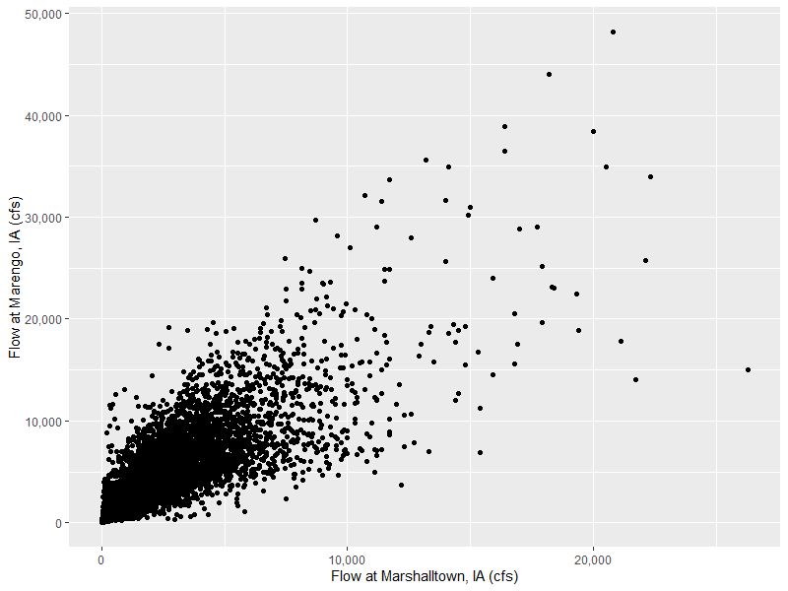
Background
Correlation is a multivariate concept*
Two or more variables
coincident in some way
Each variable has its own
sample of multiple data points
6/13/2008

Slide 6
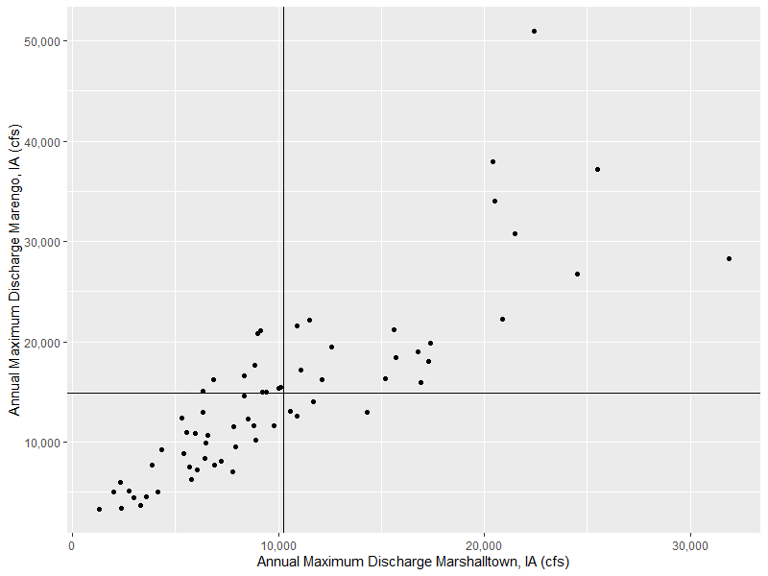
“Co-relation”
When variable X departs from its mean, does variable Y depart from its mean in a similar manner?
X- Y+
X+ Y+
X Mean
Y Mean
X- Y-
X+ Y-

Slide 7
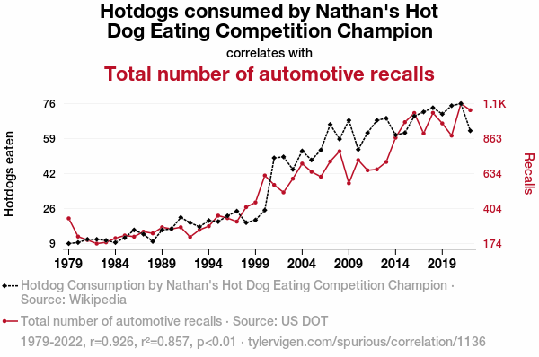
Correlation
Quantifies the strength of a relationship between two variables
Does not imply causation…

Slide 8
Data
WY | Marshalltown | Marengo
1993 | 20400 | 38000
1994 | 6420 | 8350
1995 | 4330 | 9210
1996 | 5970 | 10900
1997 | 8890 | 10200
1998 | 12600 | 19500
1999 | 9790 | 11600
2000 | 5790 | 6290
2001 | 7910 | 9540
2002 | 2750 | 5180
2003 | 5420 | 8880
2004 | 8330 | 14600
2005 | 7240 | 8130
2006 | 3610 | 4580
2007 | 16900 | 15900
2008 | 22400 | 51000
2009 | 10100 | 15500
2010 | 12100 | 16200
2011 | 6480 | 9950
2012 | 2400 | 3430
2013 | 25500 | 37200
2014 | 24500 | 26800
2015 | 14300 | 13000
2016 | 16800 | 19000
2017 | 8510 | 12300
2018 | 9000 | 20800
2019 | 15700 | 18400
2020 | 9250 | 15000
2021 | 2010 | 5040
Two or more variables coincident in some way
Example here: coincident in time
Correlation measured on coincident pairs of data

Slide 9
Computing Correlation

Slide 10
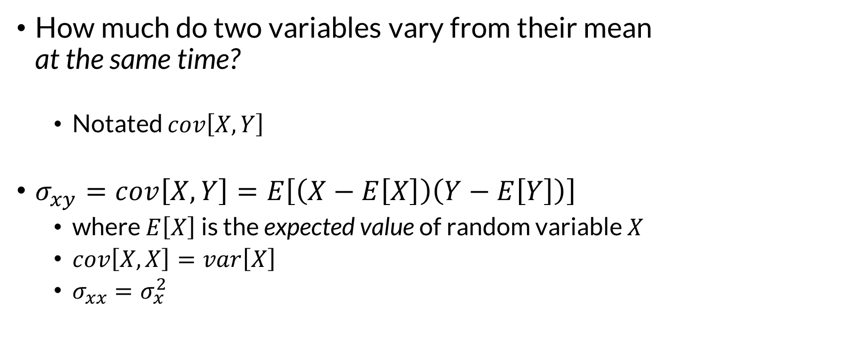
Population Covariance
How much do two variables vary from their mean
at the same time?
  Notated $cov\left[X,Y\right]$
$σ_{xy}=cov\left[X,Y\right]=E\left[\left(X−E\left[X\right]\right)\left(Y−E\left[Y\right]\right)\right]$
  where $E\left[X\right]$ is the expected value of random variable $X$
  $cov\left[X,X\right]=var\left[X\right]$
  $σ_{xx}=σ_{x}^{2}$
Notes:
We have to start a discussion about correlation with a discussion of covariance, which is the foundation for how correlation (particularly linear correlation) works

Slide 11
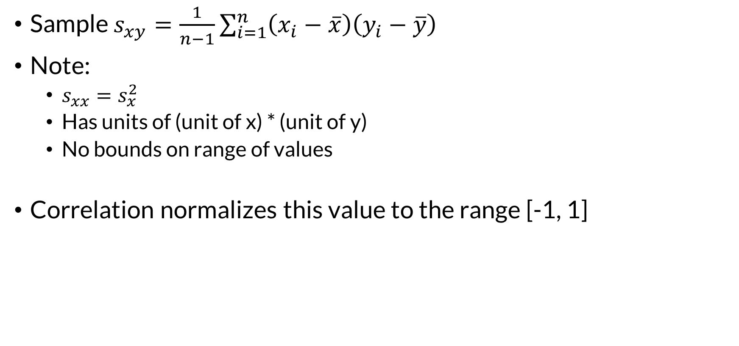

Sample Covariance
Sample Variance
Sample $s_{xy}=\frac{1}{n−1}\sum_{i=1}^{n}{\left(x_{i}−\overline{x}\right)\left(y_{i}−\overline{y}\right)}$
Note:
  $s_{xx}=s_{x}^{2}$
  Has units of (unit of x) * (unit of y)
  No bounds on range of values
Correlation normalizes this value to the range [-1, 1]
$$s_{x}^{2}=\frac{1}{n−1}\sum_{i=1}^{n}{{\left(x_{i}−\overline{x}\right)}^{2}}$$
Notes:
Ever wonder why variance is labeled as s-squared? Here’s why, it’s shorthand.
Because sample covariance doesn’t have a fixed range, it’s not useful for comparing across variables. Standardizing it is much more helpful.

Slide 12
Three Ways to Measure Sample Correlation
Pearson’s product-moment correlation coefficient (r)
Spearman’s rank correlation coefficient (ρ)
Kendall’s rank correlation coefficient (τ)
Notes:
90% or more of the time when someone says “correlation” and provides a value, they’re talking about Pearson’s correlation coefficient

Slide 13
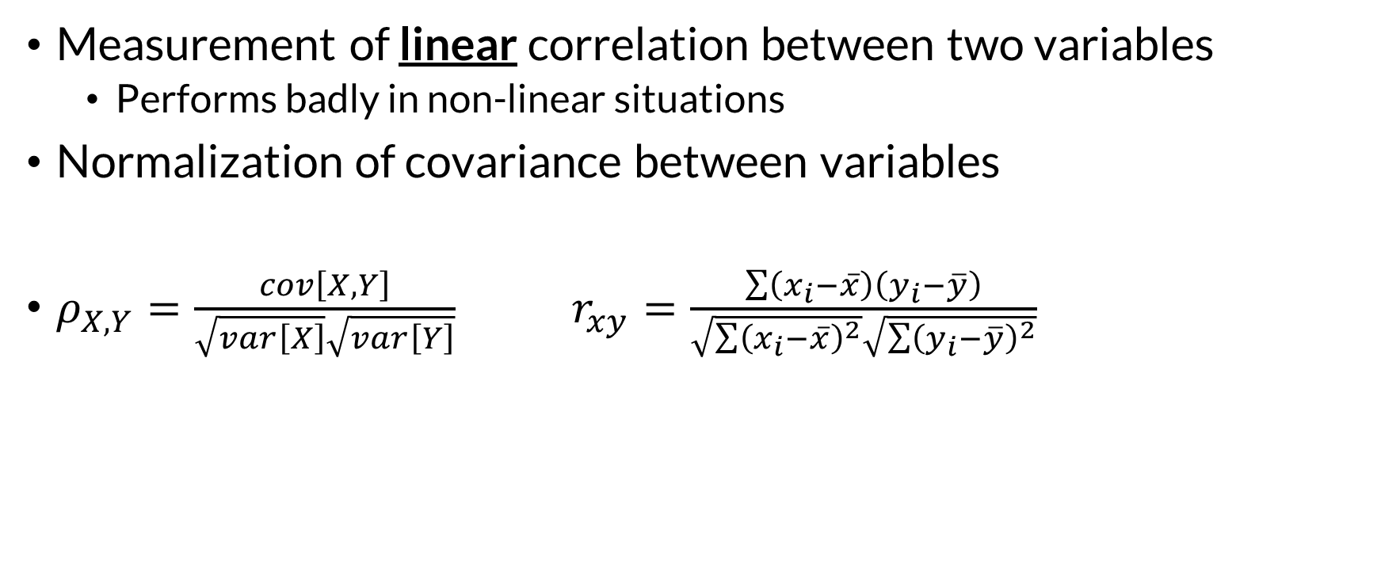
Pearson’s Correlation Coefficient
Measurement of linear correlation between two variables
  Performs badly in non-linear situations
Normalization of covariance between variables
$ρ_{X,Y}=\frac{cov\left[X,Y\right]}{\sqrt{var\left[X\right]}\sqrt{var\left[Y\right]}}$ $r_{xy}=\frac{\sum{\left(x_{i}−\overline{x}\right)\left(y_{i}−\overline{y}\right)}}{\sqrt{\sum{{\left(x_{i}−\overline{x}\right)}^{2}}}\sqrt{\sum{{\left(y_{i}−\overline{y}\right)}^{2}}}}$
Excel:
correl()
R:
cor(x)
Notes:
Pearson correlation is intrinsically linked to linear regression, and if you are using linear regression approaches to make predictions of one variable with another, you will be mostly interested in the values for Pearson correlation.

Slide 14
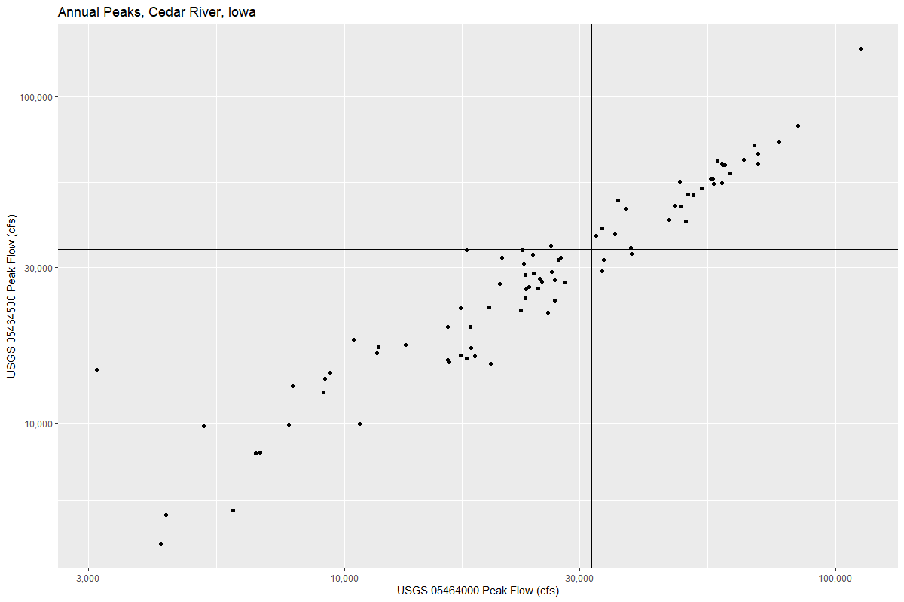
Pearson Correlation
Normalization of covariance
to be on the range [-1, 1]
Sample covariance
457,328,829 (cfs)²
  sd(x) = 21,545 cfs
  sd(y) = 21,895 cfs
r = 0.9695

Slide 15

Pearson Correlation and Simple Linear Regression
$$r_{xy}=\frac{\sum{\left(x_{i}−\overline{x}\right)\left(y_{i}−\overline{y}\right)}}{\sqrt{\sum{{\left(x_{i}−\overline{x}\right)}^{2}}}\sqrt{\sum{{\left(y_{i}−\overline{y}\right)}^{2}}}}$$
$$\hat{β}=\frac{\sum{\left(x_{i}−\overline{x}\right)\left(y_{i}−\overline{y}\right)}}{\sum{{\left(x_{i}−\overline{x}\right)}^{2}}}$$
$$\hat{α}=\overline{y}−\hat{β}\overline{x}$$

Slide 16
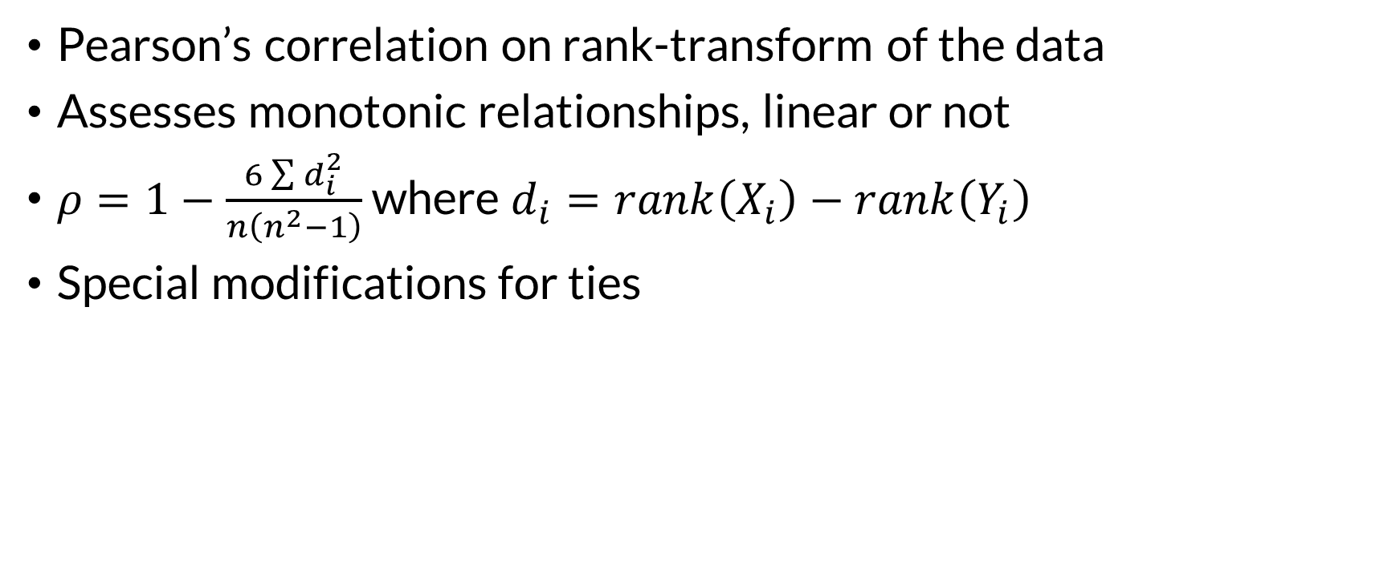
Spearman’s Rho
Pearson’s correlation on rank-transform of the data
Assesses monotonic relationships, linear or not
$ρ=1−\frac{6\sum{d_{i}^{2}}}{n\left(n^{2}−1\right)}$ where $d_{i}=rank\left(X_{i}\right)−rank\left(Y_{i}\right)$
Special modifications for ties
Excel:
Rank transform data
correl(ranks)
R:
cor(x, method = “spearman”)

Slide 17
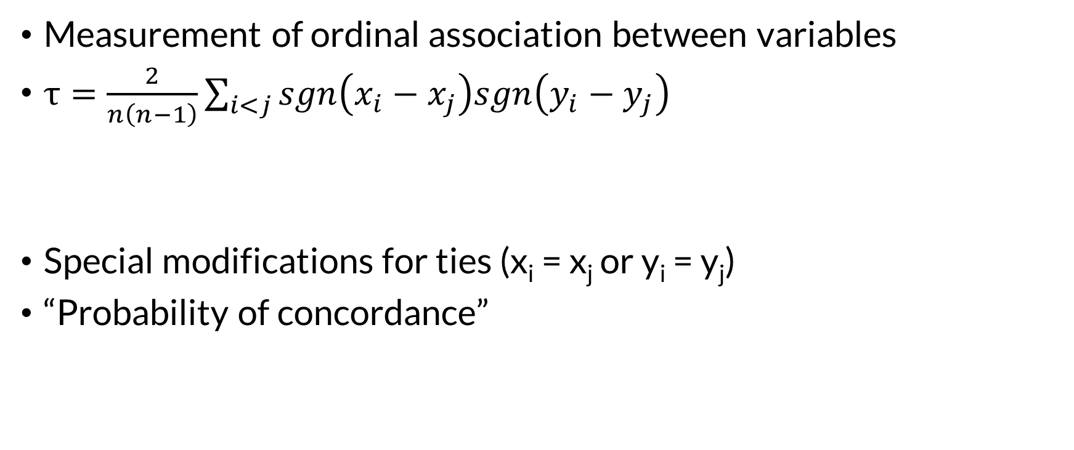
Kendall’s Tau
Measurement of ordinal association between variables
$τ=\frac{2}{n\left(n−1\right)}\sum_{i<j}{sgn\left(x_{i}−x_{j}\right)sgn\left(y_{i}−y_{j}\right)}$
Special modifications for ties (x_{i} = x_{j} or y_{i} = y_{j})
“Probability of concordance”
Term is -1 if both x and y do not increase (or decrease), +1 otherwise
R:
cor(x, method = “kendall”)

Slide 18
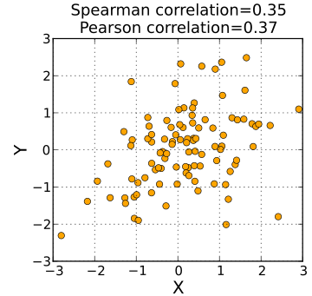
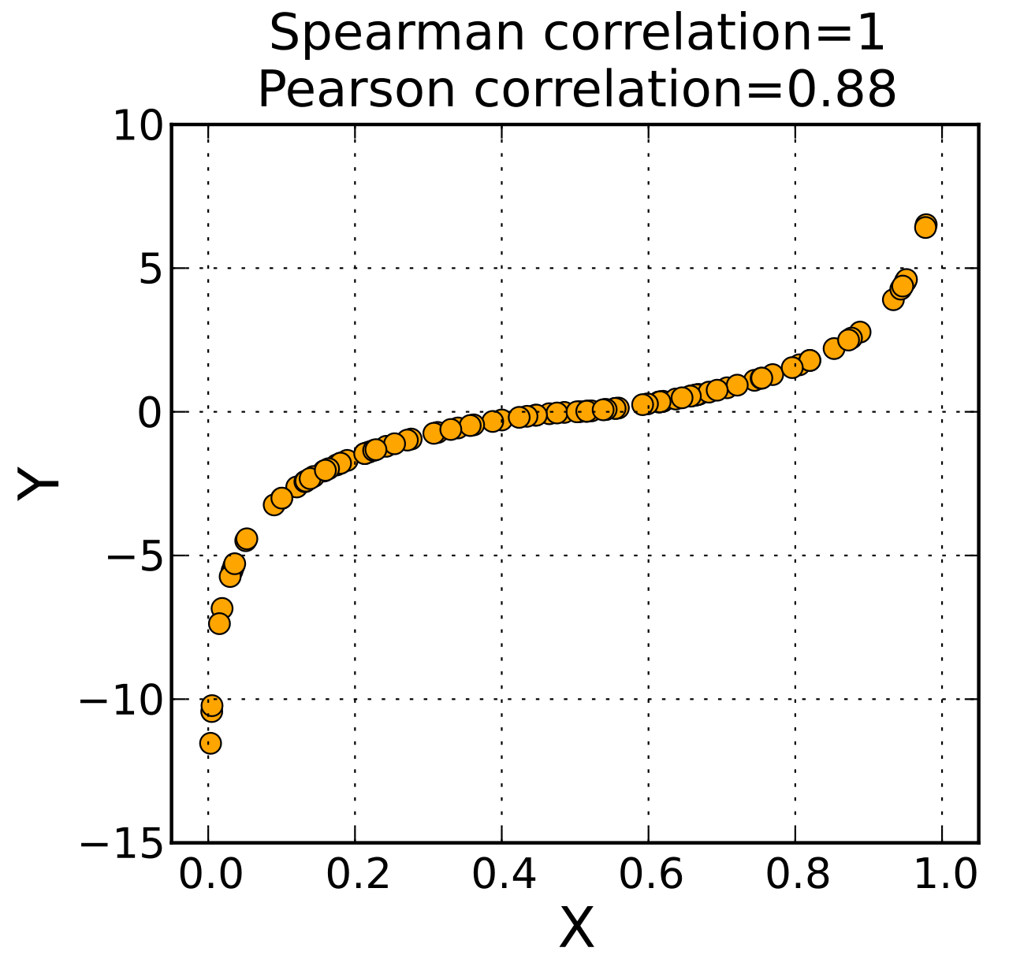
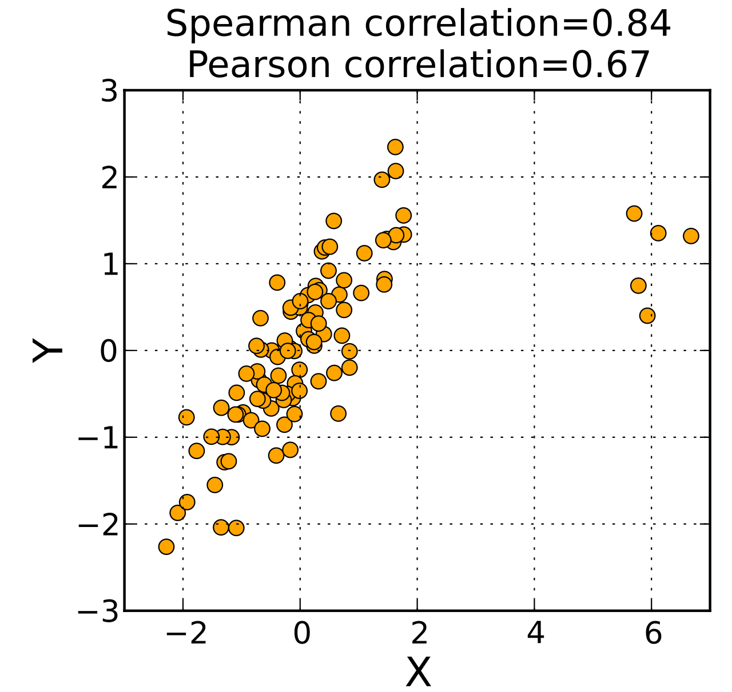
Product-Moment vs Rank Correlation
Notes:
Spearman and Kendall magnitudes are similar for these datasets.

Slide 19
Visualizing Correlation

Slide 20
Visualizing Correlation
Is there a pattern between X and Y?
Is it positive (large X tends with large Y)?
Or is it negative (large X tends with small Y)?
Is it linear?
  Can it be transformed to make it more linear?

Slide 21
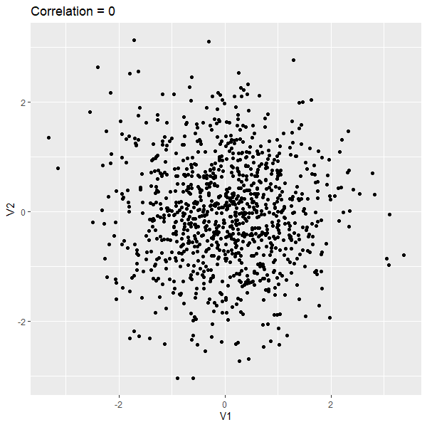
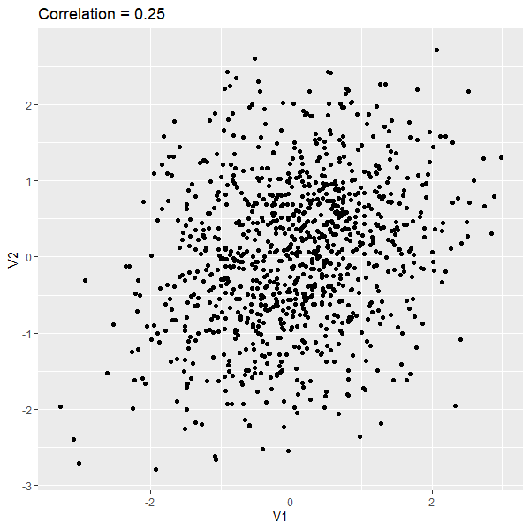

Slide 22
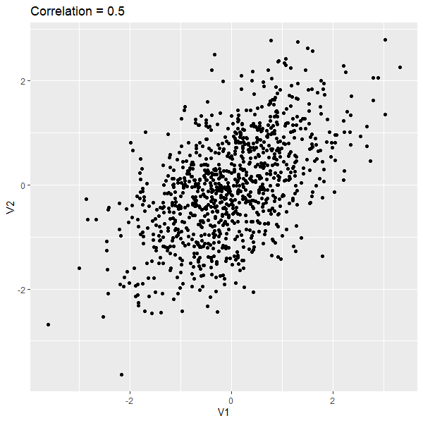
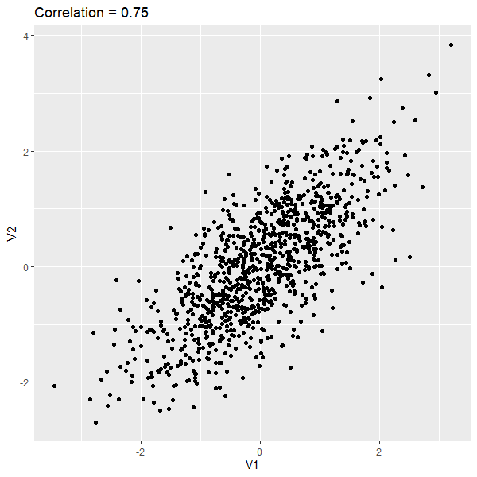

Slide 23
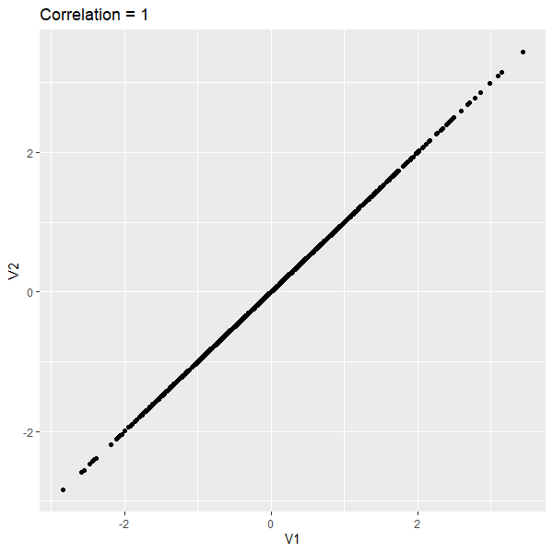
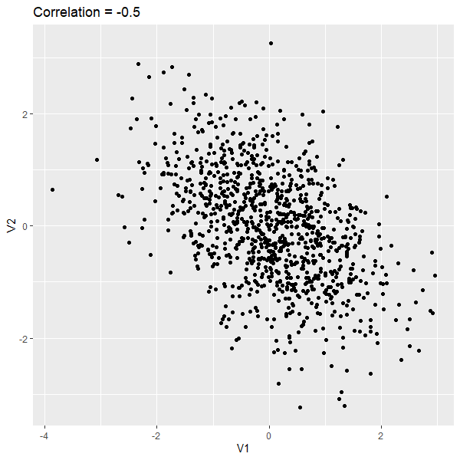

Slide 24
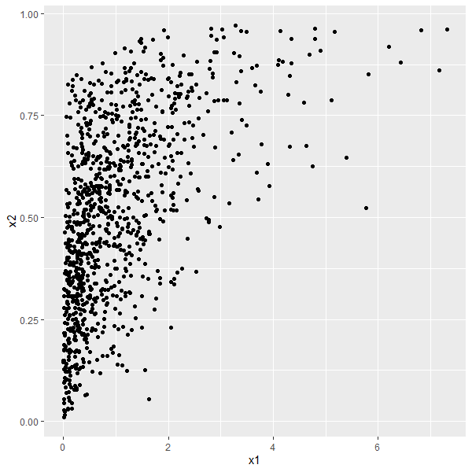
Is this linear?
r (Pearson) = 0.55
ρ (Spearman) = 0.59
Notes:
You can measure the Pearson correlation coefficient on this dataset, but I wouldn’t. Without doing anything else to this dataset I would consider using Spearman rank correlation to measure the relation. But, if we want to use Pearson (there are good reasons for wanting to use that, e.g. if you want to model the dataset with a Gaussian copula) then we can transform the data to get at the underlying structure.

Slide 25

Transformation
Use a monotonic function on the variables to improve linearity
  Only affects Pearson (linear) correlation!
Two common functions:
  Logarithm
  Exceedance probability/standard normal
    (requires a probability distribution)
Notes:
Transformations will only change the value of the Pearson correlation coefficient. The next demonstration will show how monotonic transformations do not affect the Spearman rank correlation.

Slide 26
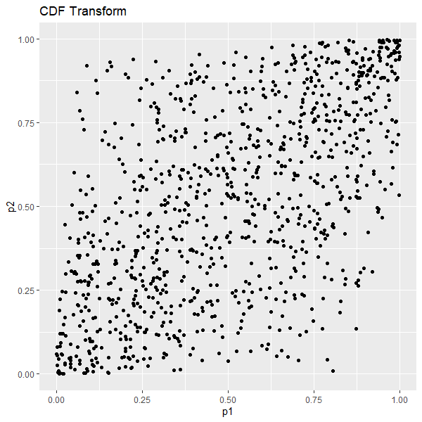


$F\left(x2\right) \sim$Beta(2,2)
r = 0.55
ρ = 0.59
$F\left(x1\right) \sim$Gamma(1,1)
r = 0.59 ρ = 0.59

Slide 27
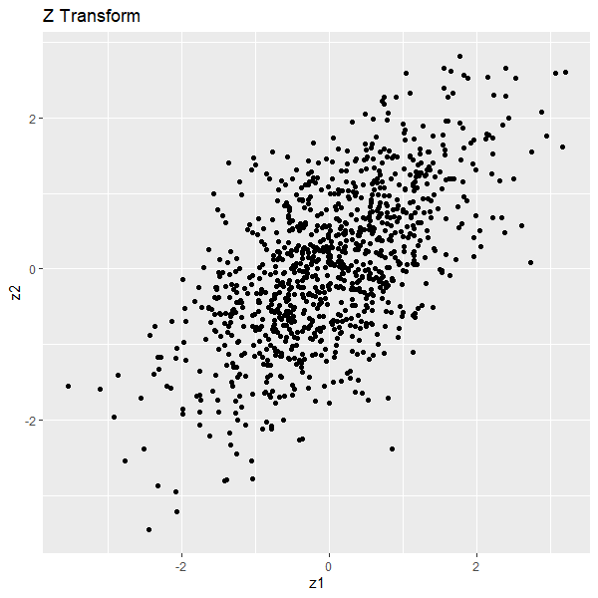




$F\left(x2\right) \sim$Beta(2,2)
$F\left(z2\right) \sim$Normal(0,1)
$F\left(x1\right) \sim$Gamma(1,1)
$F\left(z1\right) \sim$Normal(0,1)
r = 0.59 ρ = 0.59
r = 0.62 ρ = 0.59

Slide 28
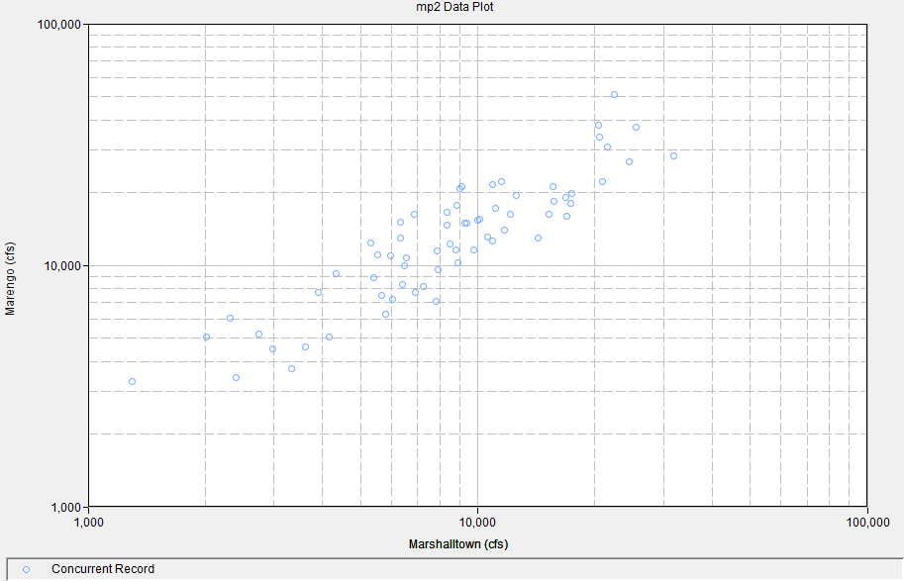
Exceedance Probability Transform
Correlation in two-site peak streamflow?
Start with log transform
Consider exceedance probability transform
  Fitted log-Pearson type III distribution

Slide 29
Questions?

