Slide 1
Introduction to Block Maxima
Flood Frequency Analysis PROSPECT
May 2024
Melissa Mika, P.E.
(slides courtesy of Gregory Karlovits)
US Army Corps of Engineers
Hydrologic Engineering Center

Slide 2
Purpose
Understand a fundamental technique in statistical hydrology

Slide 3
Outline
Block maxima
Annual maximum series

Slide 4
Block Maxima

Slide 5
Block Maxima
Break a sample into equal sized parts
  Parts can’t overlap
Take the largest observation from each part
Sample
1
2
3
Block | Maximum Value
1 | 117.7
2 | 110.9
3 | 112.2
4 | 115.9
5 | 107.3
6 | 122.5
4
5
6

Slide 6
Why?
Helps with the “IID” assumption
  Observations are:
    Independent
    Identically-distributed
Lets us look at behavior of large observations (i.e. floods)
The math is “friendly”

Slide 7
Example
Kindergartners
Class 1
Class 2
Class 3
Class 4
Class 5
Class 6
Each kindergartner has a height of N(42.8, 1.76) inches
20 children / class
Children are randomly assigned to a class
Notes:
I don’t have real class data so I used the CDC growth charts for 5 year olds and created a fake elementary school.

Slide 8
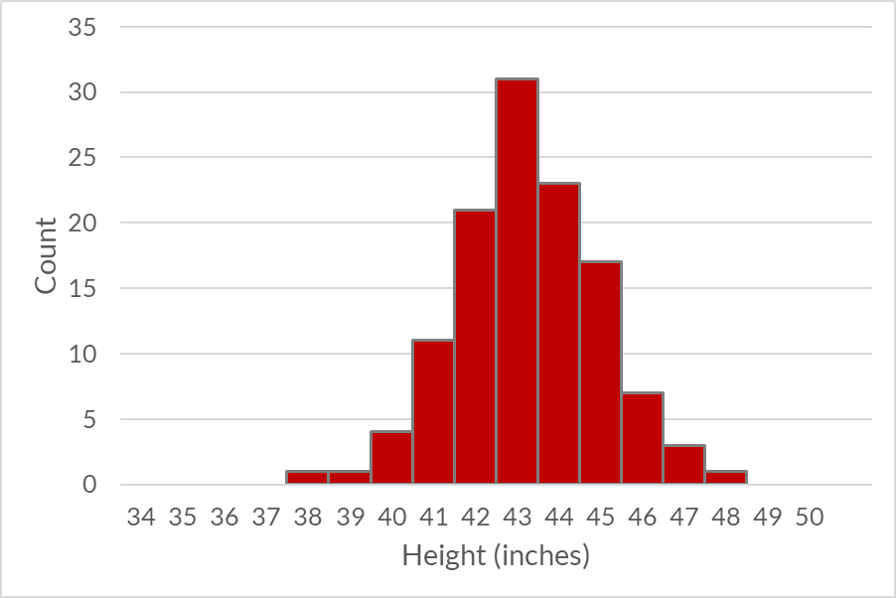
Example
Kindergartners
Class | Max Height (in)
1 | 47.5
2 | 46.2
3 | 46.6
4 | 45.7
5 | 45.9
6 | 46.2

Slide 9
Time Series Block Maxima
Selected block size is a unit of time
Blocks should be homogeneous
  Make sure the largest value in each block means the same thing
  If your process repeats with a regular cycle length, use that as the block size

Slide 10
Annual Maximum Series

Slide 11
Annual Maximum Series
Block maxima where the groups are years
  Water year
  Calendar year
Collect up the maxima and analyze them
1 observation per year

Slide 12
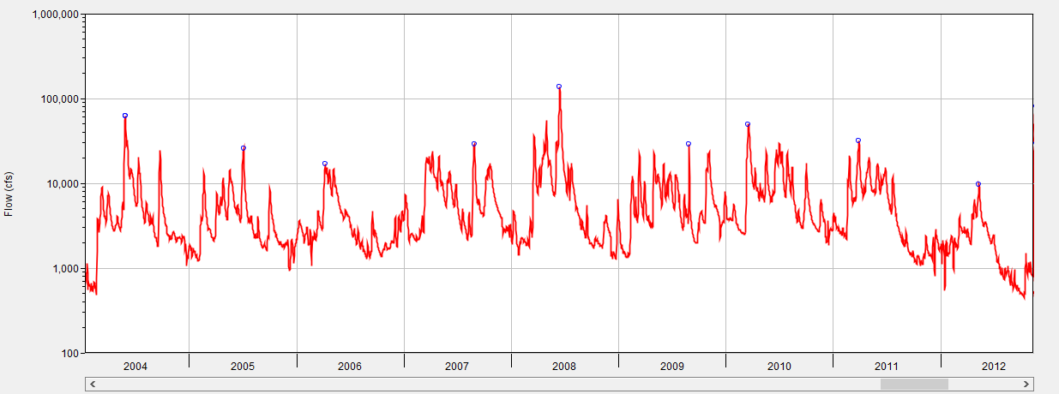

Slide 13
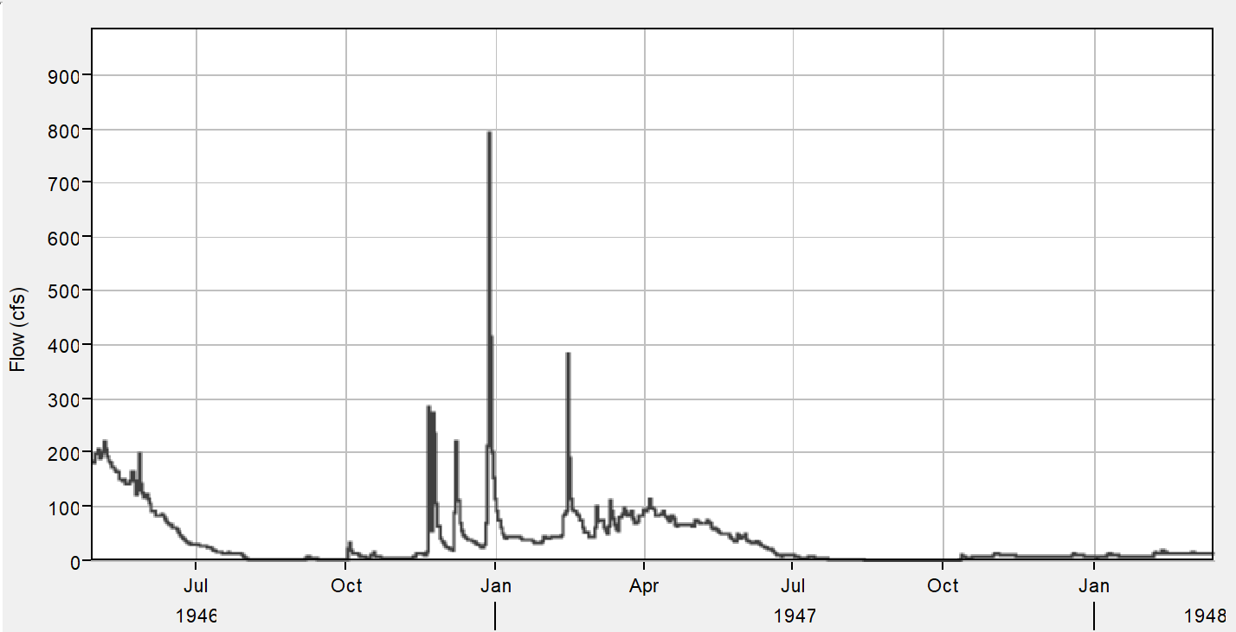
Water Year
Calendar Year
1947
Split the year during the driest part
Make sure one flood event doesn’t create maximum in two years
October 1st is the traditional break point
Check your flow record!
Water Year
1947

Slide 14
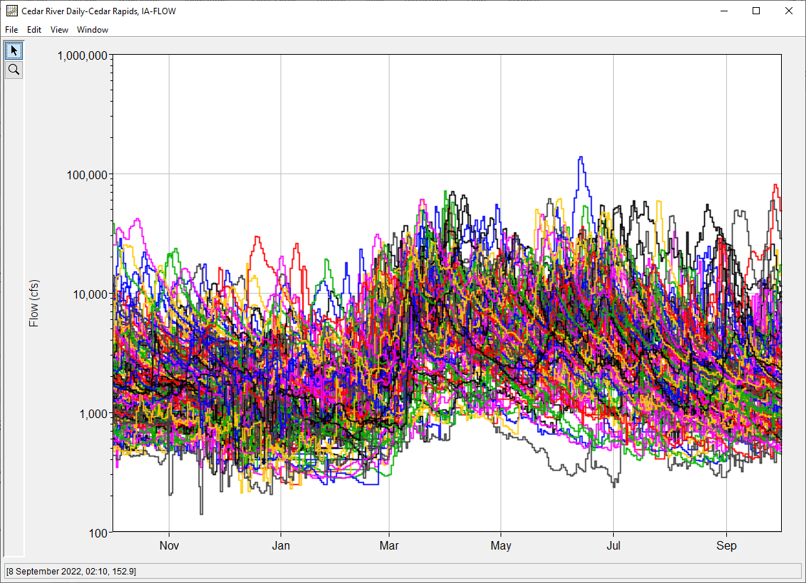
Year-Over-Year Plot

Slide 15
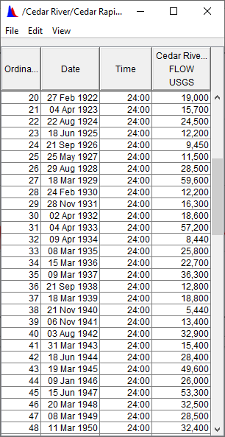
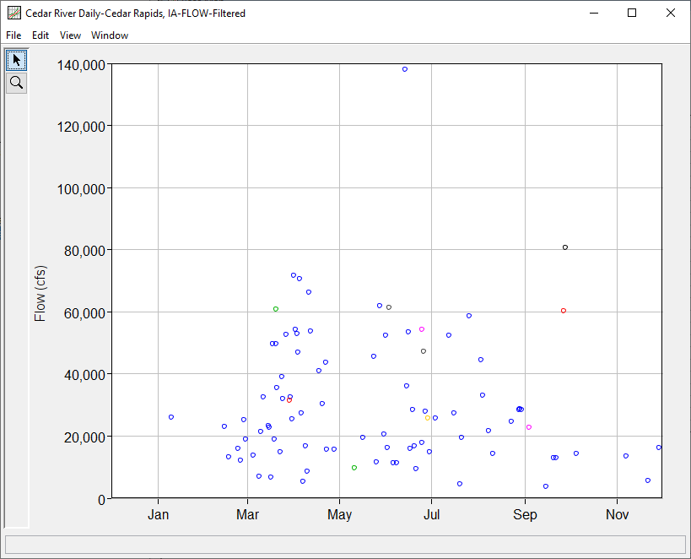
Water Year
01Dec

Slide 16
Limitations
Non-maximum events in a year can be larger than annual maxima
Some small annual maximum events will not be floods
Partial Duration Series is an alternative to Annual Maximum Series that addresses these limitations to some extent

Slide 17
Questions?

