Slide 1
Methods for Extending Streamflow Records
Ryan Cahill, PE USACE, NWP
Beth Faber, PhD, PE USACE, HEC
Chuck Parrett, PH retired, USGS Hydrologist

Slide 2
Outline
Record Extension Basics
Bulletin 17C Flood Frequency Analysis
Common Pitfalls
Other Applications
2

Slide 3
Extending Streamflow Records
Problem: Not much data at a location of interest
Solution: Use a nearby long-term site to extend the record
9 years
104 years
3

Slide 4
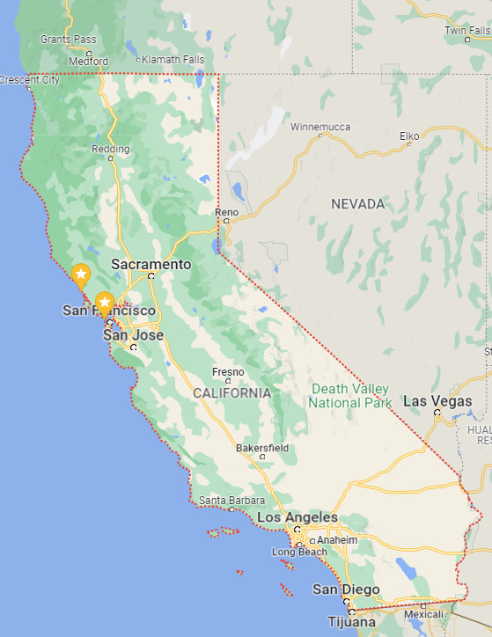
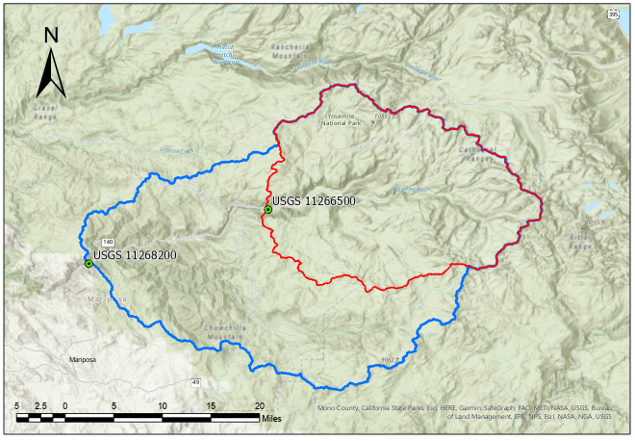
Merced River sites
long record site
short record site
4

Slide 5
Extending Streamflow Records
Using data from a similar long-term site to estimate data (extend the record) at a short-term site
9 years
104 years
5

Slide 6
Extending Streamflow Records
A short record may be missing large (or small) recorded flows that could have a significant effect on a frequency curve
9 years
104 years
6

Slide 7
Basic Regression Concept
Can knowing the value of one variable help predict the value of another variable?
We try to find the “best”
linear equation that relates
one variable to another.
Hydrologic data often
have linear relationships
if we use logs
7

Slide 8
Ordinary Least-Squares (OLS) Regression
The “best” linear relation between variable X and variable Y is one that minimizes the sum of squared errors
error
Y = m X + b
m = slope
b = intercept
8

Slide 9
Record Extension
Developing and Using the Relationship
Step 1:
Develop a linear relationship between X and Y (the long and short record stations) using the concurrent record
Step 2:
Use the linear relationship to estimate values for the short record station for times we only have values for the long record station (non-concurrent)
N₁ = concurrent
N₂ = only long
9

Slide 10
N₂
N₁
N₁ = concurrent record, N₂ = additional record
10

Slide 11
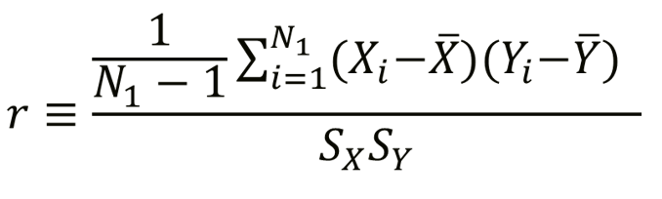

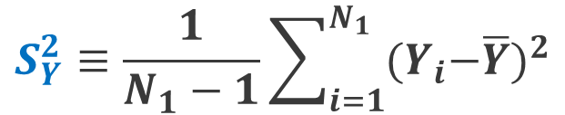
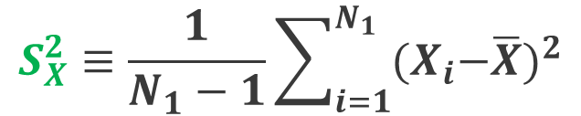

Statistics (based on logs) for Concurrent Record (N₁)
longer record station
shorter record station
$$\overline{X}≡\frac{1}{N_{1}}\sum_{i=1}^{N_{1}}{X_{i}}$$
$$\overline{Y}≡\frac{1}{N_{1}}\sum_{i=1}^{N_{1}}{Y_{i}}$$
mean
mean
variance
StDev²
$$S_{X}^{2}≡\frac{1}{N_{1}−1}\sum_{i=1}^{N_{1}}{{{(X}_{i}−\overline{X})}^{2}}$$
$$S_{Y}^{2}≡\frac{1}{N_{1}−1}\sum_{i=1}^{N_{1}}{{{(Y}_{i}−\overline{Y})}^{2}}$$
variance
StDev²
Pearson’s linear correlation
r
11

Slide 12
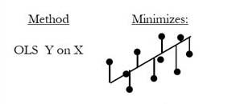
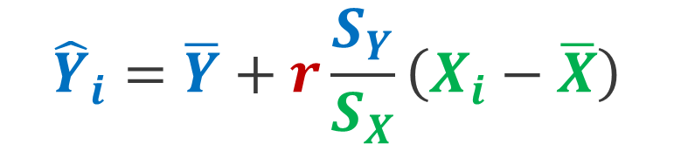
Ordinary Least Squares (OLS) Regression
Basic equation for record extension using statistics from concurrent record
$${\hat{Y}}_{i}=\overline{Y}+r\frac{S_{Y}}{S_{X}}\left(X_{i}−\overline{X}\right)$$
X = Longer station
Y = Shorter station
12

Slide 13
OLS Regression
Assuming the linear model is valid, and that X is measured without error, OLS yields predictions that are:
  Unbiased
  Minimum variance
OLS is the preferred method of predicting a particular value of Y, given a value of X
However, if our purpose is NOT the best single prediction, but rather the description of a relationship between X and Y, then OLS is not appropriate.
13

Slide 14

OLS Regression
If |r| < 1 (nonperfect fit), then variance of predicted values of Y will tend to be less than variance of true values. That is,
Reduced variance for a series of estimates is a major problem for record extension to be used for frequency analysis
$$E\left[S_{\hat{Y}}^{2}\right]<σ_{Y}^{2}$$
14

Slide 15
Reduction in Variance
…variance of estimates is reduced
Estimates of variable Y, when only variable X is available, will follow the regression line
15

Slide 16
Other Methods that Do Not Reduce Variance
OLS Regression Plus Noise
Linear regressions generally termed
Maintenance Of Variance Extension (MOVE)
  MOVE.1
  MOVE.2
  MOVE.3
Two-station comparison used in Bulletin 17B (MOVE.2)
16

Slide 17
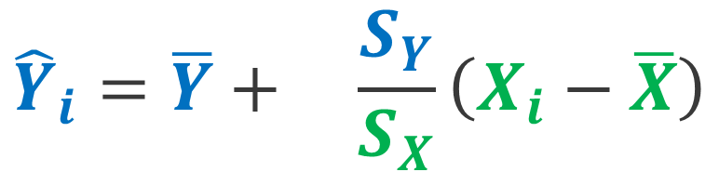
MOVE.1
The equation is only slightly different from the OLS equation:
No “r” term here
$${\hat{Y}}_{i}=\overline{Y}+ \frac{S_{Y}}{S_{X}}\left(X_{i}−\overline{X}\right)$$
X = Longer station
Y = Shorter station
Nearly unbiased variance of estimates …
17

Slide 18
Line of Organic Correlation (LOC)
(Alternatively called MOVE.1)
The LOC is the line that minimizes the sum of squared geometric distances in both the X and Y directions
This method does not reduce variance of predictions
Minimize areas of right
triangles
18

Slide 19
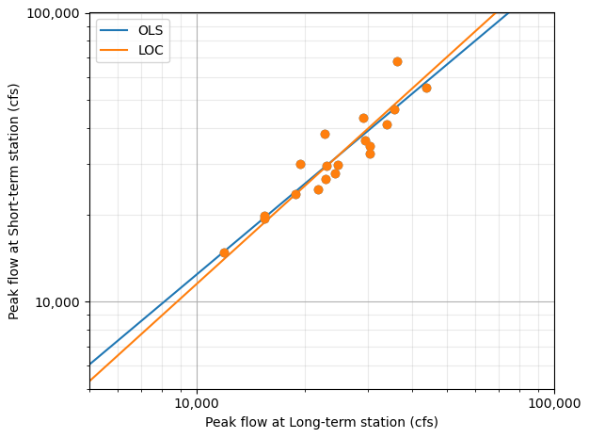
OLS vs MOVE.1 (LOC)
For streamflow record extension applications, LOC produces higher estimates for large flows and lower estimates for small flows
Y
r = 0.93
X
19

Slide 20
Other Methods that Do Not Reduce Variance
OLS Regression Plus Noise
Linear regressions generally termed
Maintenance Of Variance Extension (MOVE)
  MOVE.1
  MOVE.2
  MOVE.3
Two-station comparison used in Bulletin 17B (MOVE.2)
20

Slide 21
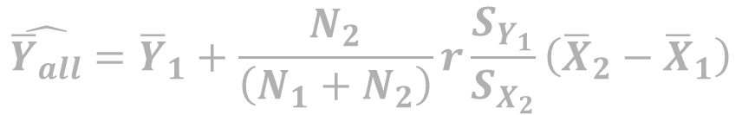
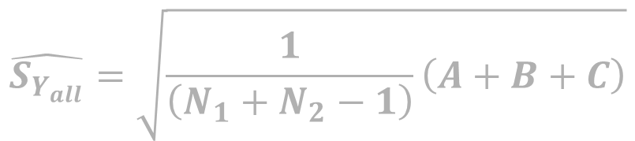
Matalas-Jacobs Estimators
Foundation for MOVE.3 (and MOVE.2)
Updated mean and standard deviation of the shorter station, based on the full record of the longer station.
Sets the target that the record extension is aiming at
Matalas-Jacobs
Estimators
$$\hat{{\overline{Y}}_{all}}={\overline{Y}}_{1}+\frac{N_{2}}{\left(N_{1}+N_{2}\right)}r\frac{S_{Y_{1}}}{S_{X_{2}}}\left({\overline{X}}_{2}−{\overline{X}}_{1}\right)$$
X = Longer station
Y = Shorter station
$$\hat{S_{Y_{all}}}=\sqrt{\frac{1}{\left(N_{1}+N_{2}−1\right)}\left(A+B+C\right)}$$
N₁ = concurrent record, N₂ = additional record
21

Slide 22
MOVE.3
The MOVE.3 method extends the short-term record in a way that assures that the complete extended record will have a mean and variance matching the Matalas-Jacobs estimators.
MOVE.3 variance is unbiased.
Equations for estimating missing record are long.
Variance = standard deviation²
22

Slide 23
Outline
Record Extension Basics
Bulletin 17C Flood Frequency Analysis
Common Pitfalls
Other Applications
23

Slide 24
Record Extension For Flood Frequency
Bulletin 17B, Appendix 7
Two-station comparison: used the Matalas-Jacobs estimators (MOVE.2) to adjust the mean and variance of a short record frequency curve, based on correlation with a long record
Bulletin 17C, Appendix 8
Use MOVE.3 to extend the short record, and perform frequency analysis
Why? PILFs and historical data, regional skew, etc
But, the uncertainty will be too small! We don’t really have N = N₁+N₂
Should extend only a portion of the available long record, n_{e}
24

Slide 25
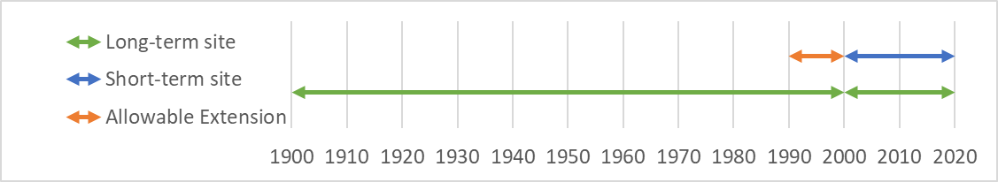
MOVE.3 (Bulletin 17C version)
Original MOVE.3 (1985) allows for extension based on every additional (non-concurrent) value of the long-term site (N₂)
  Provides the best frequency curve, but gives false sense of confidence in estimates at the short-term site
Bulletin 17C version extends only a portion of the record
  Define n_{e} = equivalent record length, and the maximum number of years allowable for extension.
  Higher correlation = higher n_{e}
  Modify MOVE.3 equations for a and b to use n_{e} instead of N₂
But, MJ mean and variance still use N₂
n_{e}
N₂
N₁

Slide 26
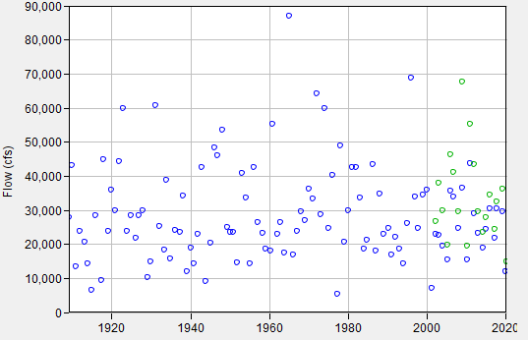
Which n_{e} years to extend?
Only n_{e} years of record extension are recommended
Which years should we pick?
Different year selections….
  will not affect the MJ mean or variance, but
  will affect the skew
Bulletin 17C allows for judgment of the analyst on year selection to ensure the skew isn’t misrepresented
n_{e}?
n_{e}?
n_{e}?
n_{e}?
26

Slide 27
Which n_{e} years to extend?
Default in B17C: use the most recent years.
But if a sequence of unusually big floods or small floods is in n_{e}, may need to adjust:
  Compute the skew using a record extension for the entire period of record (original MOVE.3 technique using N₂, not limited to n_{e})
  Select a sequence of n_{e} years that results in a similar skew value
n_{e}?
n_{e}?
n_{e}?
n_{e}?
27

Slide 28
How Should We Select a Long-Term Site for Record Extension?
Various studies have recommended that the correlation coefficient (r) between short-term and long-term sites for the concurrent record be 0.8 or greater.
Long-term sites with additional flows that are substantially outside the range of those in the concurrent period may provide more information than other potential long-term sites.
Can use more than one long-term site and weight results (perhaps using r or record length) with results from another long-term site.
Can use a correlation analysis to check multiple gages and select the one that produces the highest n_{e}
28

Slide 29
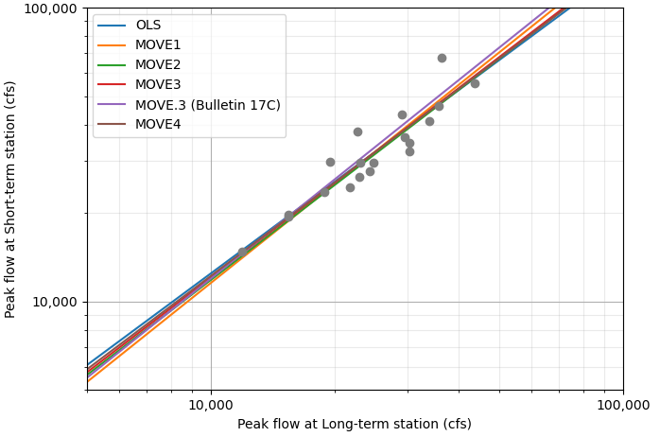
Record Extension Method Comparison
For many real-world datasets, the various record extension techniques produce similar regression lines
Y
X
29

Slide 30
Outline
Record Extension Basics
Bulletin 17C Flood Frequency Analysis
Common Pitfalls
Other Applications
30

Slide 31
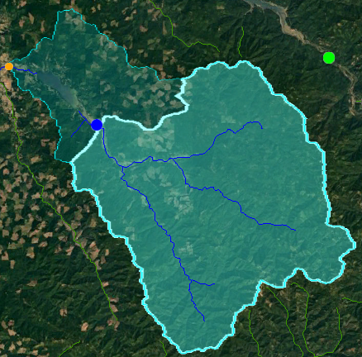

Drainage Area Ratio
Uses a ratio of the drainage area between two locations to estimate periods of missing flow.
$$Y= {X\left(\frac{A_{y}}{A_{x}}\right)}^{\text{ϕ}}$$
Y = flow estimate at missing station
X = known flow at long-term station
Ay = Drainage area of missing station
Ax = Drainage area of long-term station
Φ = 1, unless there is a regional regression
study
Missing station (downstream):
Drainage Area = 270 sq. miles
Long-term station (upstream):
Drainage Area = 211 sq. miles
DAR = 270/211
= 1.28
31

Slide 32
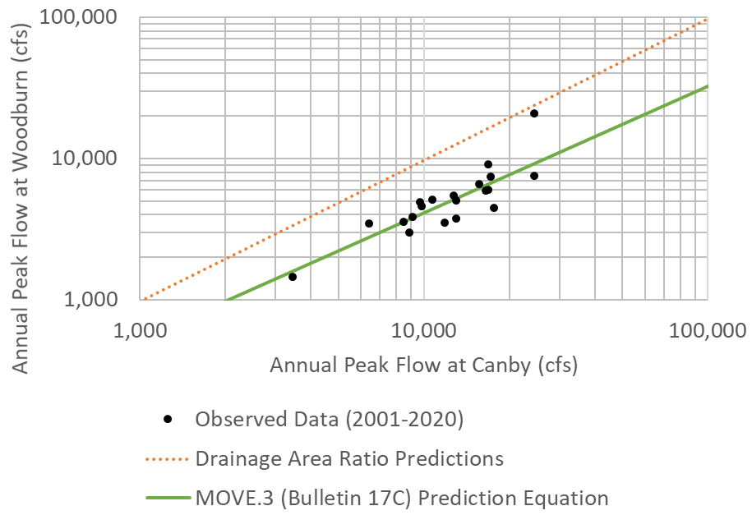
Drainage Area Ratio
Generally works well when two sites are
  on the same river,
  with drainage areas within 50% of each other
Can produce poor results if different streams are used.
Always use a record extension technique (e.g. MOVE.3) instead of a drainage area ratio when concurrent record is available.
32

Slide 33
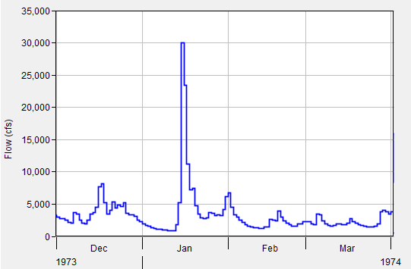
Daily Average Flow Extensions
MOVE.1 or OLS is often used
Why do daily extensions?
  Missing very short periods of time
  Long-term simulations of reservoir operations
  Hydropower modeling
If flood-frequency is the goal, use MOVE.3 from Bulletin 17C instead
33

Slide 34
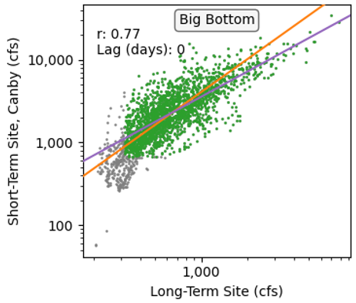
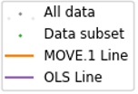
Daily Average Flow Extensions
MOVE.1 was designed to maintain variance.
  Is that really the goal for daily flow extensions?
Usually better to focus regression on the range of flows of most interest for the study
When correlations are low (~0.8), OLS is generally be preferred to MOVE.1 to avoid the consistent bias in high and low flows
34

Slide 35
Outline
Record Extension Basics
Bulletin 17C Flood Frequency Analysis
Common Pitfalls
Other Applications
35

Slide 36
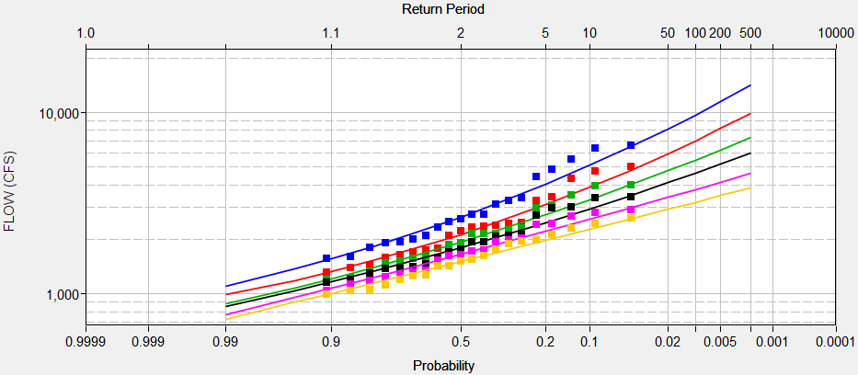
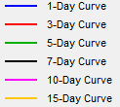
Pitfall: Volume Frequency Curves
Pitfall: Do a MOVE.1 extension on daily data, and then calculate volume-frequency curves directly from this extended record
  Regression is not focused on flood events
  Ignores the concept of limiting the extension by only n_{e} years
Better idea: use a separate MOVE.3 (Bulletin 17C) record extension for each duration.
36

Slide 37
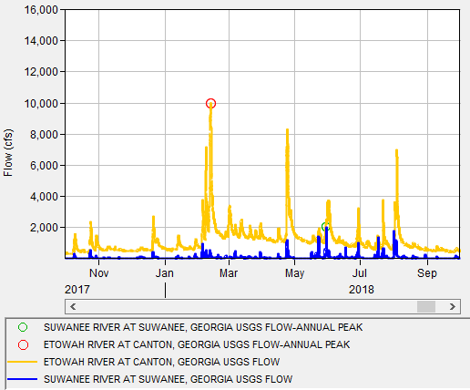
Pitfall: Input Data
Pitfall: Use MOVE.3 record extension with annual peak flow records without examination
  Peak flow may be generated by completely different storms months apart, hydrologically unrelated
37

Slide 38
Pitfall: Input Data
Use max flow value here instead
Better idea: Examine the input data. Ensure the date of peak flow is from the same storm event. Peaks should be within a few days. Can use a correlation analysis in SSP.
What about years with date of peak far apart?
  Ignore the issue (if only a few small years)
  Find a better long-term site
  Drop the year altogether (less preferred)
  Try to find short-interval streamflow data from the same storm event and use it in the regression instead.
38

Slide 39
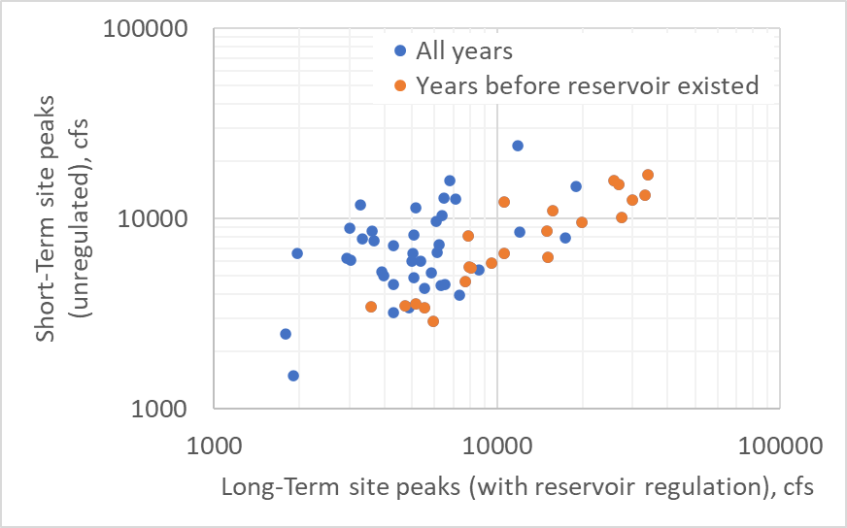
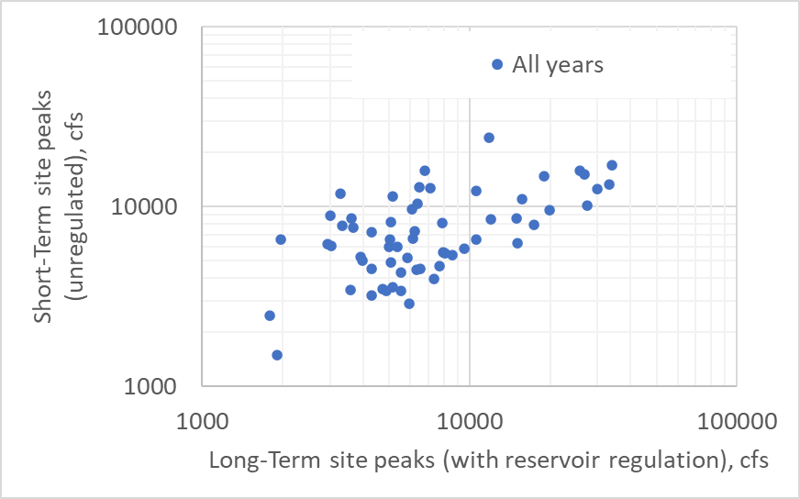
Pitfall: Regulated Data
Pitfall: Use record extension techniques at sites heavily affected by upstream reservoirs
Better idea: Only do record extension on unregulated data (both pre-dam and reconstructed post-dam records)
39

Slide 40
Pitfall: Record Extension as Flow Intervals
The n_{e} years of extended data are input as systematic data to an EMA analysis.
What about the other years?
No information?
N_{e}
40

Slide 41
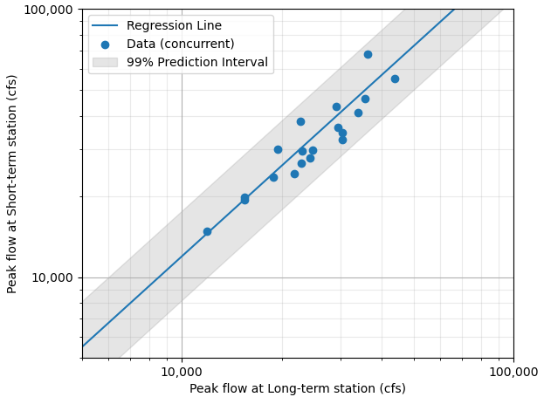
Pitfall: Record Extension as Flow Intervals
Pitfall: Represent them as flow intervals
  Seems appealing, since the selection of which years to use as n_{e} becomes less important
  Uncertainty bounds shrink significantly when this is done, which is inappropriate
  Mean and std deviation also will differ from the Matalas-Jacobs estimators
41

Slide 42
Pitfall: Record Extension as Flow Intervals
Information already included in record extension of N_{e}
N_{e}
42

Slide 43
Pitfall: Record Extension as Flow Intervals
Better Idea: Take care that selection of which n_{e} years to extend matches the skew from an extension using the full record length
Information already included in record extension of N_{e}
N_{e}
43

Slide 44
Summary of Estimation Techniques
Method | Purpose | Uses
Drainage Area Ratio | Approximate analysis is good enough | Two gages are very close together, minimal effort
Ordinary Least Squares (OLS) Regression | Best individual flow estimates, daily flow estimates | Someone wants to get the best estimate peak flow for one particular year
Maintenance of Variance Extension (MOVE.1) | Filling in daily flows in an extended period | Water resources planning and management models; reservoir design and operation
Maintenance of Variance Extension (MOVE.3, Bulletin 17C) | Estimate flood peaks for years with missing data | Flood-Frequency Analysis
44

Slide 45
References
Alley, W. M., and A. W. Burns, 1983. Mixed-station extension of monthly streamflow records, J. Hydraul. Div. Am. Soc. Civ. Eng., 109(10), p. 1271-1284.
Bulletin 17B, 1982. Guidelines for Determining Flow Frequency Analysis: Interagency Advisory Committee on Water Data, USGS, Office of Water Data Collection, Reston, Virginia.
England, J.F. Jr., Cohn, T.A., Faber, B.A., Stedinger, J.R., Thomas, W.O., Jr., Veilleux, A.G., Kiang, J.E., and Mason, R.R., Jr., 2018, Guidelines for determining flood flow frequency—Bulletin 17C: U.S. Geological Survey Techniques and Methods, book 4, chap. B5, 148 p https://doi.org/10.3133/tm4B5.
45

Slide 46
References
Helsel, D.R., and Hirsch, R.M., 2002, Statistical methods in water resources: Techniques of Water-Resources Investigations of the U.S. Geological Survey, Book 4, Chapter A3. , New York, Elsevier, 510 p. https://pubs.usgs.gov/twri/twri4a3/pdf/twri4a3-new.pdf
Hirsch, R.M., 1982, A comparison of four streamflow record extension techniques: Water Resources Research, v. 18, no. 4, p. 1081-1088.
Matalas, N.C. and Jacobs, B., 1964, A correlation procedure for augmenting hydrologic data: U.S. Geological Survey Professional Paper 434-E.
Vogel, R.M., and Stedinger, J.R., 1985. Minimum Variance Streamflow Record Augmentation Procedures: Water Resources Research V21(5), p715-723.
46

