Slide 1
Correlation
Presented by: Richard Nugent, Ph.D.
Senior Economist
Chief, Water Resources Systems Division
US Army Corps of Engineers
Hydrologic Engineering Center
Slides authored by Greg Karlovitz
Notes:
Today is about correlation: a way to describe how strongly two things “move together.”
Discuss why this matters in economics as in civil engineering.

Slide 2
Purpose
Understand how to measure the strength of relation between two variables
Notes:
The goal is simple: learn how to measure the strength of the relationship between two variables.
Think of it like asking: When Site A has a big flood year, does Site B usually have a big flood year too?
In flood frequency work, we often need this when:
comparing peak flows at two gages,
combining information (e.g. record extension, joint probability – e.g. among tributaries or other hazards including surge),
Important for coincident frequency analysis in SSP
or checking whether two variables share the same “big years.”
These statistics are key inputs to copula analysis

Slide 3
Outline
Definition/understanding correlation
Measuring correlation
Visualizing correlation, transformations
Notes:
We’ll do three things:
What correlation means (plain-language interpretation).
How to measure it (three common methods – Pearsons, Spearmans’s Rho, and Kendall’s Tau).
How to see it in plots, and when transformations help.

Slide 4
Defining and Understanding Correlation
Notes:
Before we calculate anything, we need a shared picture of what we’re measuring.

Slide 5
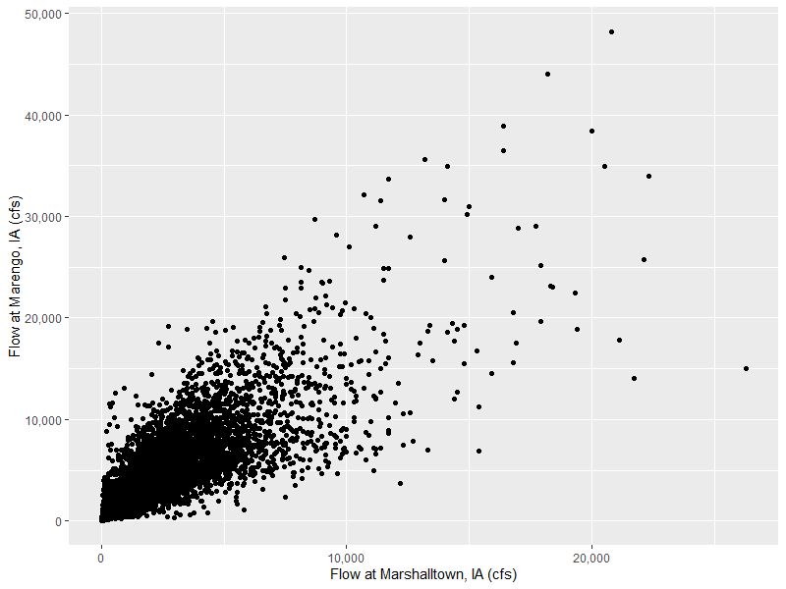
Background
6/13/2008
Correlation is a multivariate concept
Two or more variables coincident in some way
Each variable has its own sample of multiple data points
Notes:
Correlation is a multi-variable idea: it takes at least two variables. The key requirement is that the data are paired in a meaningful way. In this image, we have a scatter plot of CFS by day of year at two different sites on the Iowa River. Marshalltown is upstream of Marengo.
Some questions we can ask about the scatterplot:
First impressions
What story does this plot seem to tell in one sentence?
If you had to guess the sign of the correlation (positive, negative, or near zero), what would you pick and why?
Direction (positive/negative/none)
As values on the x-axis get bigger, do values on the y-axis tend to get bigger, get smaller, or show no consistent change?
Do most points fall more in the “upper-right and lower-left” (moving together) or “upper-left and lower-right” (moving opposite)?
Strength (how tight is the relationship?)
How tightly do the points cluster around an imagined trend line: tightly, moderately, or loosely?
If you cover the axis labels, would you still feel confident predicting whether y is high or low from x?
Are there enough points close to a line that you’d say “knowing x helps a lot,” or does it only help a little?
Shape (linear vs not)
Does a straight line seem like a fair summary, or does the pattern bend (curved), level off, or change slope?
Would a curved line fit much better than a straight one?
Does the relationship look monotonic (generally increasing or generally decreasing), even if it’s not straight?
Outliers and influential points
Are there any points that “don’t belong” with the rest of the cloud?
If you removed the most extreme point, do you think the correlation would change a lot or a little?
Do you see a single unusual event/year that might be dominating the pattern?
Clusters and mixed behavior
Do the points form one cloud, or are there two (or more) clusters?
If there are clusters, do they represent different regimes (e.g., seasons, storm types, regulated vs unregulated periods)?
Is the within-cluster trend different from the overall trend?
Spread (fan shape / changing variability)
Is the scatter roughly the same width across x, or does it “fan out” as x increases?
Are predictions of y from x more reliable at low x than at high x (or the reverse)?
Range and leverage
Is most of the x-range covered, or are we seeing a narrow slice?
Are the “far left” or “far right” points controlling the apparent trend more than the middle points?
Practical interpretation (engineering context)
If x is high, how confident are you that y will also be high?
In real-world terms, what does one point represent (a year, an event, a site pair), and could any points be mismatched pairs?
Would you trust a single correlation number to summarize this plot, or would you want to treat different parts separately?
Method hints (without heavy jargon)
Does the pattern look straight enough that a “line-based” correlation makes sense?
If the pattern is consistently increasing but curved, would a rank-based measure better match what your eyes see?
Would a simple transformation (like a log scale) make the relationship look more like a straight, even cloud?
The standout event of June 13 is an important reminder that extreme events can strongly affect correlation, especially for methods that use the original values. This does not necessarily mean that we jump right to removing outliers, this suggests sensitivity analysis.
Flood story: “If one town is hit by the same storm system as another town downstream, their peak flows often rise together—correlation is our ‘togetherness meter.’”

Slide 6
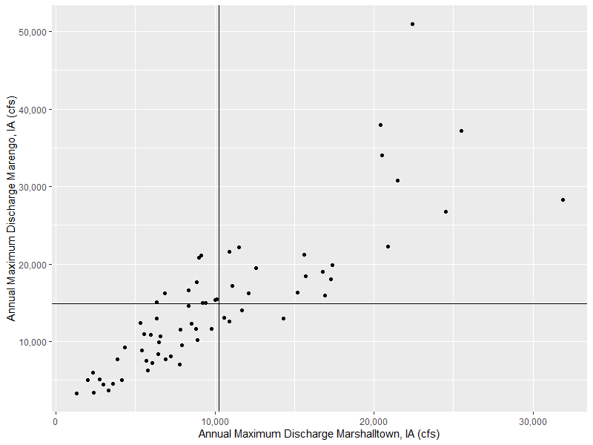
“Co-relation”
When variable X departs from its mean, does variable Y depart from its mean in a similar manner?
X- Y+
X+ Y+
X Mean
Y Mean
X- Y-
X+ Y-
Notes:
Another way to ask the slide’s question: “When X is above its usual value, is Y also above its usual value?” Observe that you can say YES. Also observe that the ranking is not perfect.
In this image, we’re looking at a scatter plot of flows at the same two gauges, but we’re focused on annual maximum discharge rather than observed daily flow.
Upper-right (X+, Y+): both above average (they “agree” in direction)
Lower-left (X-, Y-): both below average (also “agree”)
The other two quadrants are “disagreements.”
How do the two scatter plots (daily versus annual maximum) compare? Why might that be?
The large storms that generate these annual maximums are typically the same. There are localized influences that show up in the daily data that do not show up in the annual maximum data.

Slide 7
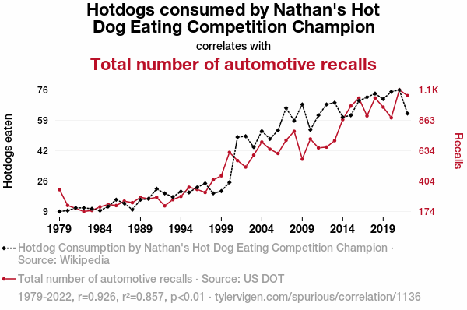
Correlation =/= Causation
Quantifies the strength of a relationship between two variables
Does not imply causation…
Notes:
Emphasize the warning: Correlation only says two things move together, not why.
Funny example on the slide: “These two trends match, but nobody believes hotdogs cause recalls.”
In flood work: two gages can be correlated because of shared storms, regional climate, basin similarity, or regulation effects—not because one gage “causes” the other.
What are some other ENG or non-ENG correlated relationships that don’t necessarily imply causation? Here are some examples.
Traffic volume and crash counts
Roads with higher Average Daily Traffic often show more crashes.
That doesn’t mean traffic causes crashes by itself; crashes also depend on speed, roadway geometry, access density, lighting, weather, driver behavior, enforcement, and reporting practices.
Older infrastructure and higher maintenance cost
Older bridges/pipes/pavements tend to have more repairs and higher O&M spending.
Age correlates with deterioration, but it’s not the only driver: design details, original materials, load history, environment (freeze-thaw, corrosion), construction quality, and maintenance strategy can dominate.
Impervious area and peak runoff (or flood peaks)
More pavement/roofs usually goes with higher, flashier peak flows.
But you can’t assume imperviousness alone “causes” any specific peak at a site: soil type, storm pattern, drainage network, detention/green infrastructure, channel conditions, and upstream controls can change peak flows a lot even at the same impervious percentage.

Slide 8
Data
WY | Marshalltown | Marengo
1993 | 20400 | 38000
1994 | 6420 | 8350
1995 | 4330 | 9210
1996 | 5970 | 10900
1997 | 8890 | 10200
1998 | 12600 | 19500
1999 | 9790 | 11600
2000 | 5790 | 6290
2001 | 7910 | 9540
2002 | 2750 | 5180
2003 | 5420 | 8880
2004 | 8330 | 14600
2005 | 7240 | 8130
2006 | 3610 | 4580
2007 | 16900 | 15900
2008 | 22400 | 51000
2009 | 10100 | 15500
2010 | 12100 | 16200
2011 | 6480 | 9950
2012 | 2400 | 3430
2013 | 25500 | 37200
2014 | 24500 | 26800
2015 | 14300 | 13000
2016 | 16800 | 19000
2017 | 8510 | 12300
2018 | 9000 | 20800
2019 | 15700 | 18400
2020 | 9250 | 15000
2021 | 2010 | 5040
Two or more variables coincident in some way
Example here: coincident in time
Correlation measured on coincident pairs of data
Notes:
This slide is the “pairing” slide:
Correlation is computed on coincident pairs: (Marshalltown peak in 1993, Marengo peak in 1993), etc. Need to be careful about how we choose coincidence.
For record extension, if we’re evaluating
note:
Missing years matter. If one gage is missing 2001, you can’t form a pair for 2001—your correlation uses only overlapping years.
frequency analysis:
We often compare sites to borrow strength (regional info), but only if the relationship is real and stable.
Questions for the crowd
What are other ways two variables can be coincident?
Time and/or space

Slide 9
Computing Correlation

Slide 10
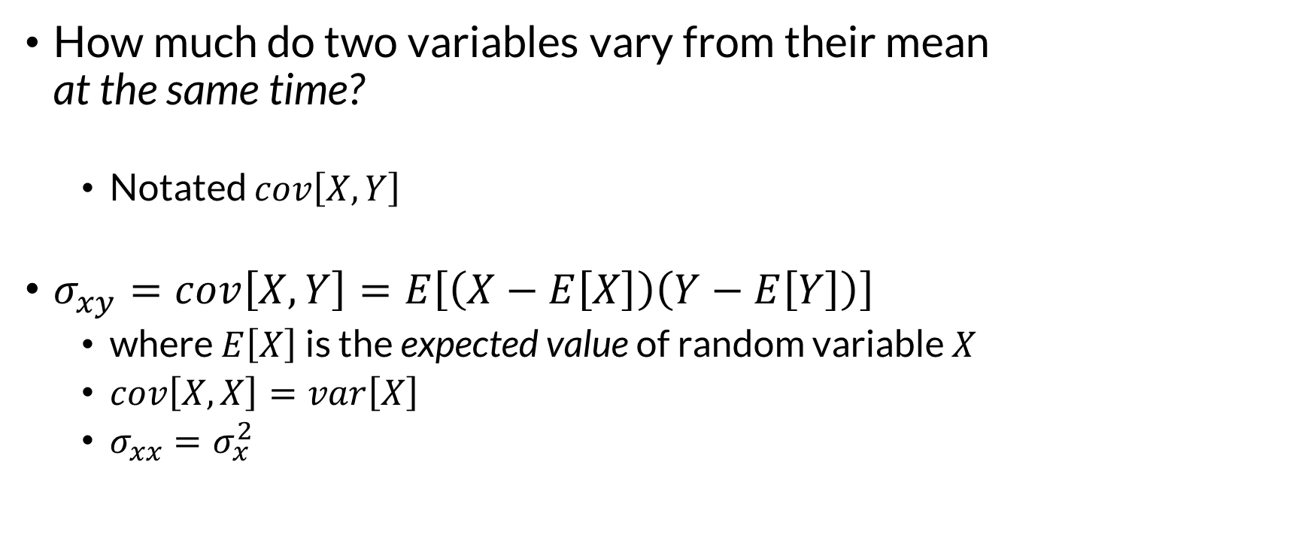
Population Covariance
How much do two variables vary from their mean at the same time?
Notated $cov\left[X,Y\right]$
$σ_{xy}=cov\left[X,Y\right]=E\left[\left(X−E\left[X\right]\right)\left(Y−E\left[Y\right]\right)\right]$
where $E\left[X\right]$ is the expected value of random variable $X$
$cov\left[X,X\right]=var\left[X\right]$
$σ_{xx}=σ_{x}^{2}$
Notes:
We have to start a discussion about correlation with a discussion of covariance, which is the foundation for how correlation (particularly linear correlation) works.
explanation:
Covariance asks: Do X and Y tend to be high together and low together?
interpretation:
Covariance has units (cfs × cfs here), so the raw number is hard to interpret.
The concept of covariance is important for managing the math in a multivariate statistical system. For example, the variance of a distribution of a variable Z which is a linear combination of X and Y depends on the covariance between X and Y.

Slide 11
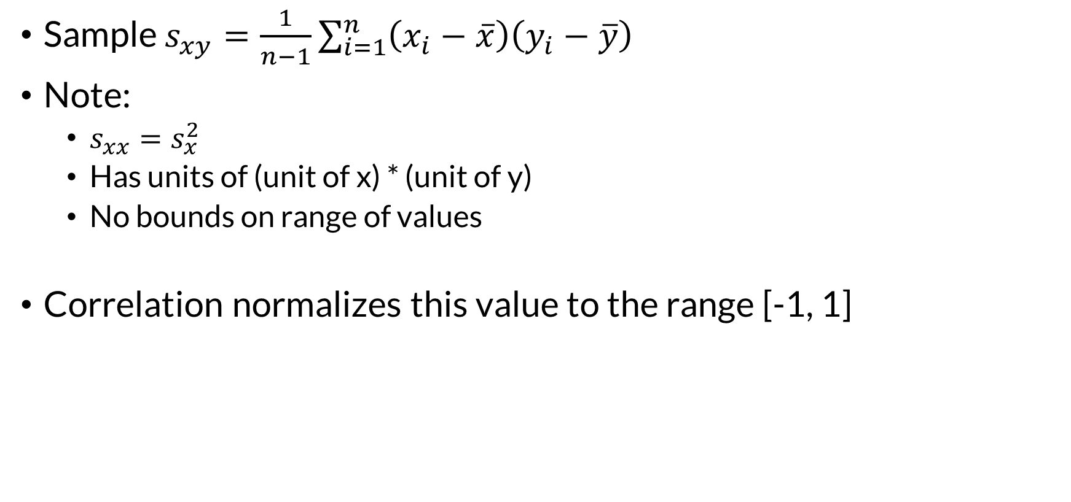

Sample Covariance
Sample Variance
Sample $s_{xy}=\frac{1}{n−1}\sum_{i=1}^{n}{\left(x_{i}−\overline{x}\right)\left(y_{i}−\overline{y}\right)}$
Note:
$s_{xx}=s_{x}^{2}$
Has units of (unit of x) * (unit of y)
No bounds on range of values
Correlation normalizes this value to the range [-1, 1]
$$s_{x}^{2}=\frac{1}{n−1}\sum_{i=1}^{n}{{\left(x_{i}−\overline{x}\right)}^{2}}$$
Excel:
covariance.s()
R:
cov(x)
Notes:
Ever wonder why variance is labeled as s-squared? Here’s why, it’s shorthand.
Because sample covariance doesn’t have a fixed range, it’s not useful for comparing across variables. Standardizing it is much more helpful.
It has units and no fixed range.
That’s why we convert it into correlation, which always lands between -1 and +1.
Analogy:
“Covariance is like total ‘moving togetherness’ measured in awkward units; correlation is the percentage-style version—scaled so we can compare across problems.”

Slide 12
Three Ways to Measure Sample Correlation
Pearson’s product-moment correlation coefficient (r)
Spearman’s rank correlation coefficient (ρ)
Kendall’s rank correlation coefficient (τ)
Notes:
90% or more of the time when someone says “correlation” and provides a value, they’re talking about Pearson’s correlation coefficient
Pearson (r): “Do they line up in a straight-line way?”
Spearman (ρ): “Do they generally move in the same direction, even if the shape is curved?”
Kendall (τ): “How often do the pairs agree on who’s bigger?”
Spearman’s and Kendall’s can be reformulated as special cases of the general correlation coefficient.

Slide 13
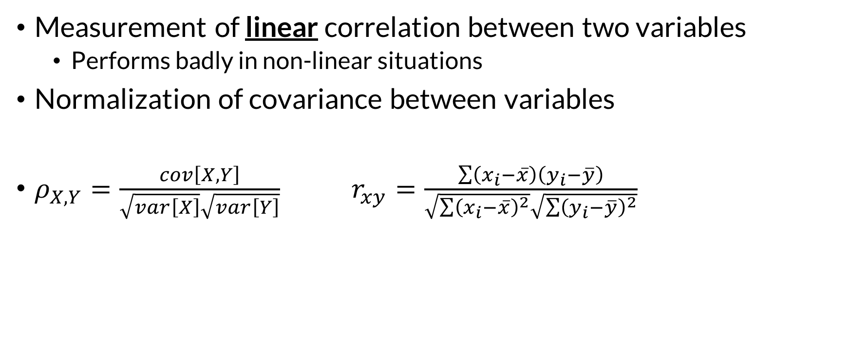
Pearson’s Correlation Coefficient
Measurement of linear correlation between two variables
Performs badly in non-linear situations
Normalization of covariance between variables
$ρ_{X,Y}=\frac{cov\left[X,Y\right]}{\sqrt{var\left[X\right]}\sqrt{var\left[Y\right]}}$ $r_{xy}=\frac{\sum{\left(x_{i}−\overline{x}\right)\left(y_{i}−\overline{y}\right)}}{\sqrt{\sum{{\left(x_{i}−\overline{x}\right)}^{2}}}\sqrt{\sum{{\left(y_{i}−\overline{y}\right)}^{2}}}}$
Excel:
correl()
R:
cor(x)
Notes:
Pearson correlation is intrinsically linked to linear regression, and if you are using linear regression approaches to make predictions of one variable with another, you will be mostly interested in the values for Pearson correlation.
Why it can “perform badly” in nonlinear cases:
If the relationship is curved, Pearson may understate the strength because it only rewards straight-line alignment.
the formula:
It’s covariance divided by the two standard deviations—this is the “normalizing” step.
takeaway:
Pearson is common and useful, but always look at the scatterplot.
Pearson’s correlation coefficient is designed to summarize how well two variables follow a straight-line pattern. It can be sensitive to heteroskedasticity (uneven scatter, like a “fan-shaped” cloud of points) because a single number may hide that the relationship is tight in one range and noisy in another. Pearson’s r is also sensitive to outliers and high-leverage points: a few extreme observations can noticeably increase or decrease r, sometimes making the relationship look stronger or weaker than what most of the data suggest.

Slide 14
Pearson Correlation
Normalization of covariance to be on the range [-1, 1]
Sample covariance 62,516,307 (cfs)²
sd(marshalltown) = 6,567cfs
sd(marengo) = 10,909 cfs
r = 0.8726
Notes:
Annual peak discharge at different locations on the Cedar River in Iowa
r ≈ 0.8726 in plain terms:
“That’s very strong: when one site is high, the other is very often high too.”
what r is not:
It doesn’t say they’re equal; it says they move together strongly.
the scatterplot shown:
The points fall close to an upward slanting line—classic Pearson-friendly picture.

Slide 15

Pearson Correlation and Simple Linear Regression
$$r_{xy}=\frac{\sum{\left(x_{i}−\overline{x}\right)\left(y_{i}−\overline{y}\right)}}{\sqrt{\sum{{\left(x_{i}−\overline{x}\right)}^{2}}}\sqrt{\sum{{\left(y_{i}−\overline{y}\right)}^{2}}}}$$
$$\hat{β}=\frac{\sum{\left(x_{i}−\overline{x}\right)\left(y_{i}−\overline{y}\right)}}{\sum{{\left(x_{i}−\overline{x}\right)}^{2}}}$$
$$\hat{α}=\overline{y}−\hat{β}\overline{x}$$
Notes:
Pearson correlation and the slope in a simple regression are “close cousins” because both come from the same building blocks (mean-centered sums).
“Correlation tells you how tightly the cloud hugs a line; regression tells you what line you’d draw.”
High correlation does not guarantee a good predictive model outside the data range (especially in extremes—our flood world).

Slide 16
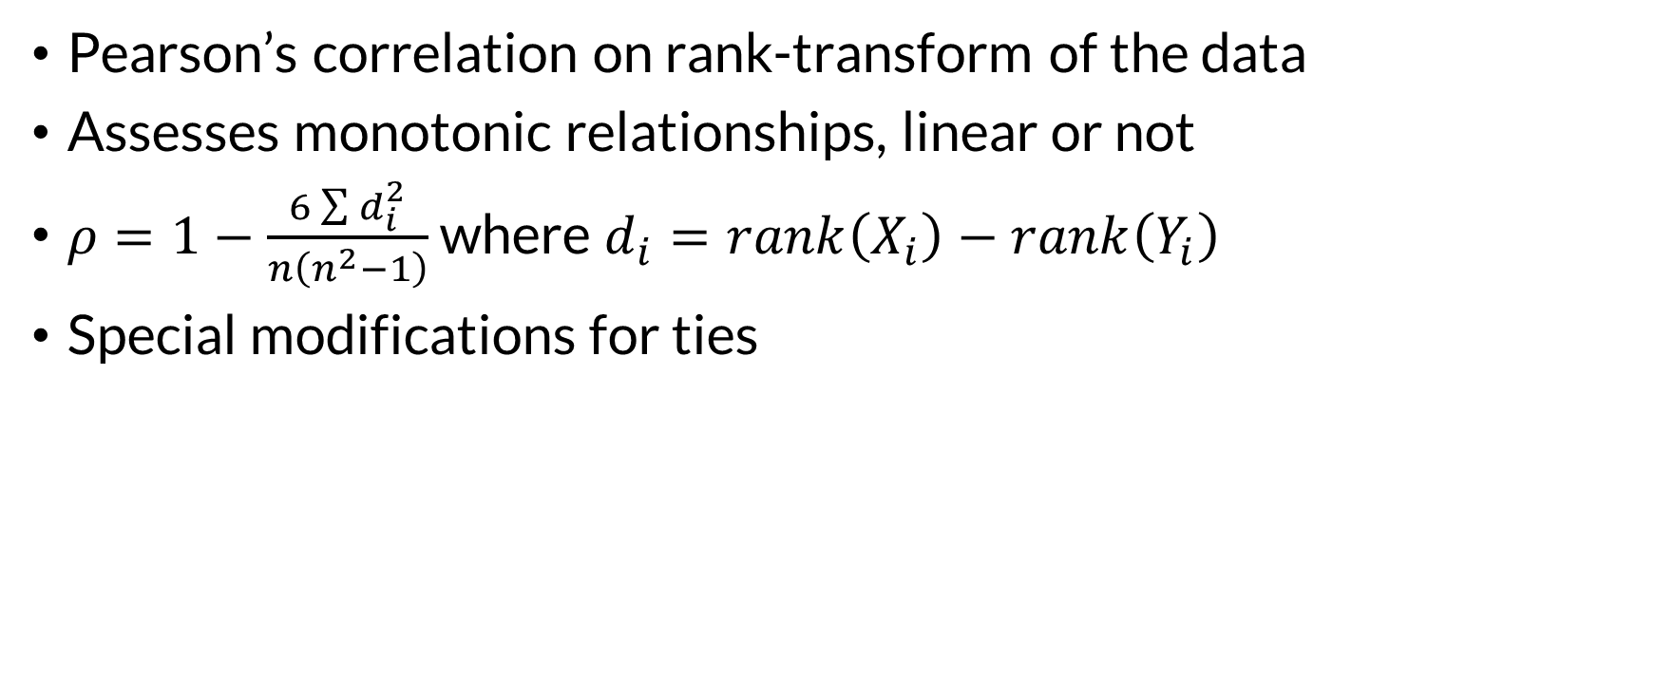
Spearman’s Rho
Pearson’s correlation on rank-transform of the data
Assesses monotonic relationships, linear or not
$ρ=1−\frac{6\sum{d_{i}^{2}}}{n\left(n^{2}−1\right)}$ where $d_{i}=rank\left(X_{i}\right)−rank\left(Y_{i}\right)$
Special modifications for ties
Excel:
Rank transform data
rank.avg(data)
correl(ranks)
Correlation –
Marshalltown & Marengo
ρ = .9246
R:
cor(x, method = “spearman”)
Notes:
Start with the “ranking” story:
“Pretend we throw away the actual cfs values and keep only the ordering: 1st biggest year, 2nd biggest year, etc.”
Then:
Spearman is basically Pearson, but applied to those ranks.
What it’s good for:
If X increases and Y tends to increase too—even in a curved way—Spearman will still show a strong relationship.
Spearman’s and Kendall’s are preferred in many contexts because relationships are typically non-linear. Copulas shine
Simple analogy:
“Spearman doesn’t care about the exact height of the flood, just whether the ‘big years’ tend to be the same big years.”
A pair $\{\left(x_{i} , y_{i}\right),\left(x_{j} , y_{j}\right)\}$ is said to be tied if and only if $x_{i}=x_{j}$ or $y_{i}=y_{j}$; a tied pair is neither concordant nor discordant. When tied pairs arise in the data, the coefficient may be modified in a number of ways to keep it in the range [−1, 1] such as taking the average, as in the excel function example

Slide 17
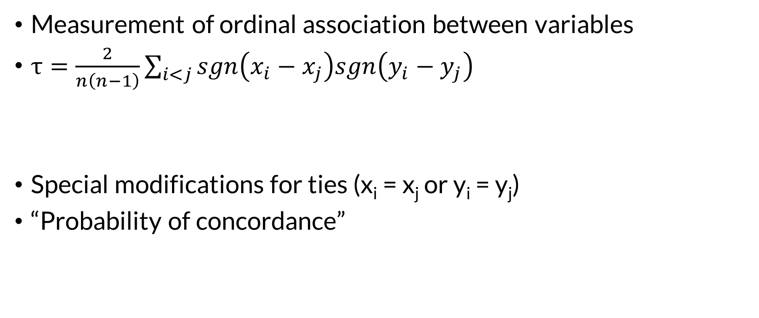

Kendall’s Tau
Measurement of ordinal association between variables
$τ=\frac{2}{n\left(n−1\right)}\sum_{i<j}{sgn\left(x_{i}−x_{j}\right)sgn\left(y_{i}−y_{j}\right)}$
Special modifications for ties (x_{i} = x_{j} or y_{i} = y_{j})
“Probability of concordance”
Term is -1 if both x and y do not increase (or decrease), +1 otherwise
Kendall’s Tau Correlation –
Marshalltown & Marengo
$$τ=.7635$$
statistics.tools
R:
cor(x, method = “kendall”)
Notes:
Kendall’s tau is about pairwise agreement:
Take any two years (i and j).
If Marshalltown is bigger in year i than j, and Marengo is also bigger in year i than j, that pair “agrees.”
If the agreement between the two rankings is perfect (i.e., the two rankings are the same) the coefficient has value 1.
If the disagreement between the two rankings is perfect (i.e., one ranking is the reverse of the other) the coefficient has value −1.
If X and Y are independent random variables and not constant, then the expectation of the coefficient is zero.
Sgn is the mathematical function for sign.
“Probability of concordance” interpretation:
“Tau is closely related to: how often do the sites agree on which year is bigger?”
We are not looking at just adjacent years, we’re looking at many pairs of years
Tau can be more stable with outliers because it relies on ordering comparisons.
Spearman’s rho vs Kendall’s tau
Both are rank-based ways to describe whether two variables tend to move in the same direction.
If higher X usually goes with higher Y, they’re positive.
If higher X usually goes with lower Y, they’re negative.
If there’s no consistent ordering, they’re near zero.
Because they use ranks (order) rather than the original values, both are less thrown off by extreme outliers than Pearson correlation.
How they work (key difference)
Spearman’s rho: “Do the rankings match overall?”
Convert both variables to ranks (1st, 2nd, 3rd, …).
Then check how well those ranks line up.
Plain picture: “If I sort sites/years from smallest to largest for X, do I get almost the same sorted order for Y?”
Good when you want a familiar “correlation-style” number based on how similar the overall ordering is.
Kendall’s tau: “How often do they agree pair-by-pair?”
Look at all pairs of observations.
For any two observations A and B:
If X(A) > X(B) and Y(A) > Y(B), that pair agrees (concordant).
If X(A) > X(B) but Y(A) < Y(B), that pair disagrees (discordant).
Tau is basically: (agreements − disagreements) / (all pairs) (with versions that handle ties).
Plain picture: “If I pick two random years, how often do both variables agree on which year was bigger?”
Interpreting the numbers (why they don’t match)
Both range from -1 to +1, but tau is usually smaller in magnitude than rho for the same dataset.
Intuition: tau is counting concordance across many pairwise comparisons, so it tends to be more conservative.
Although rho of the Marshalltown and marengo data is 0.9246, tau 0.7635—not because the relationship is weaker, but because tau uses a different yardstick.
Sensitivity and robustness Spearman’s rho
Often a bit more sensitive to the overall shape of the ranked relationship.
Can move more when you have a few points that shift rank positions a lot.
Kendall’s tau
Often described as more directly tied to “probability of agreement,” and can feel more stable because it’s based on many pairwise votes.
Has well-known variants for handling ties (common in rounded or discretized data).

Slide 18
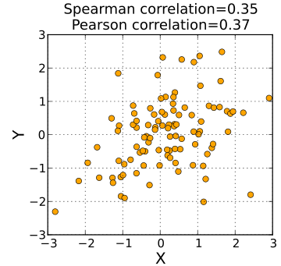
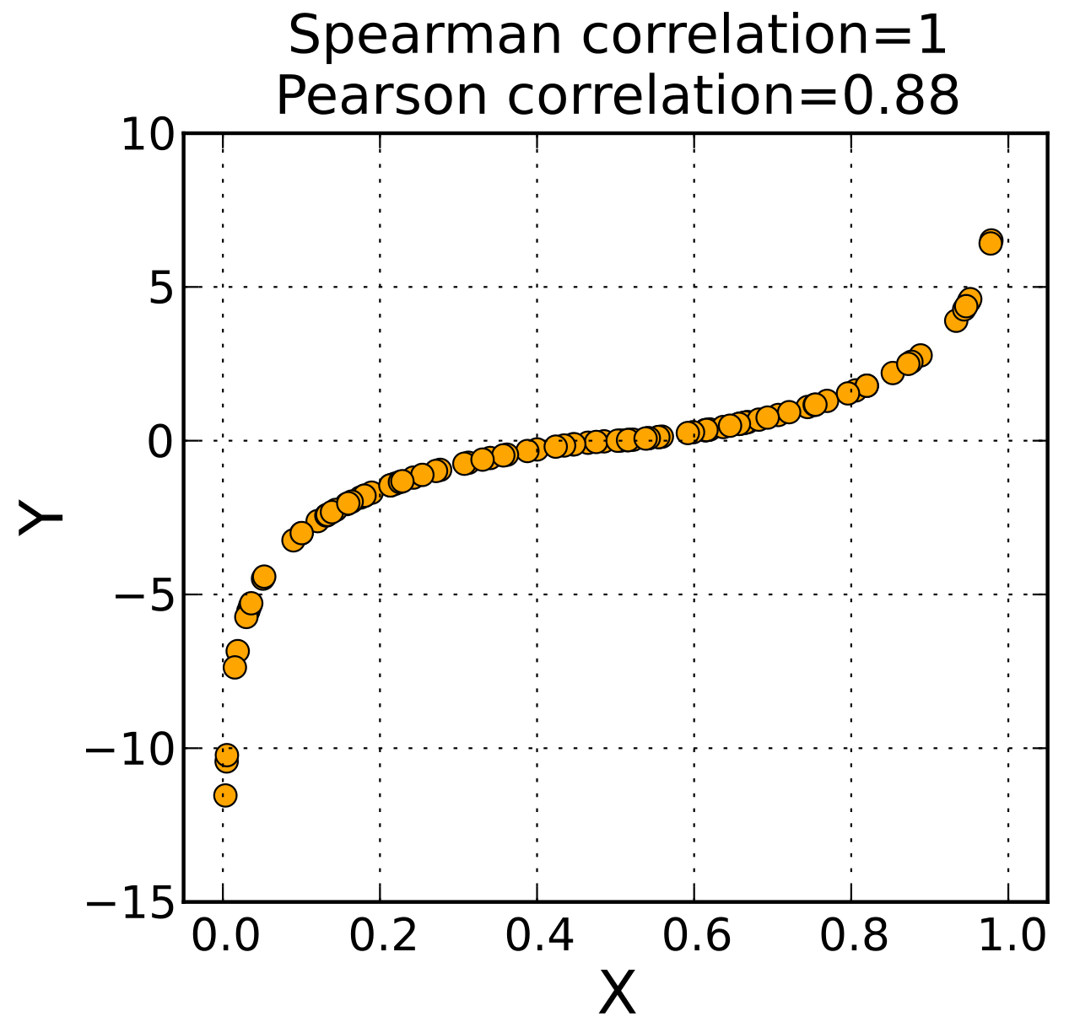
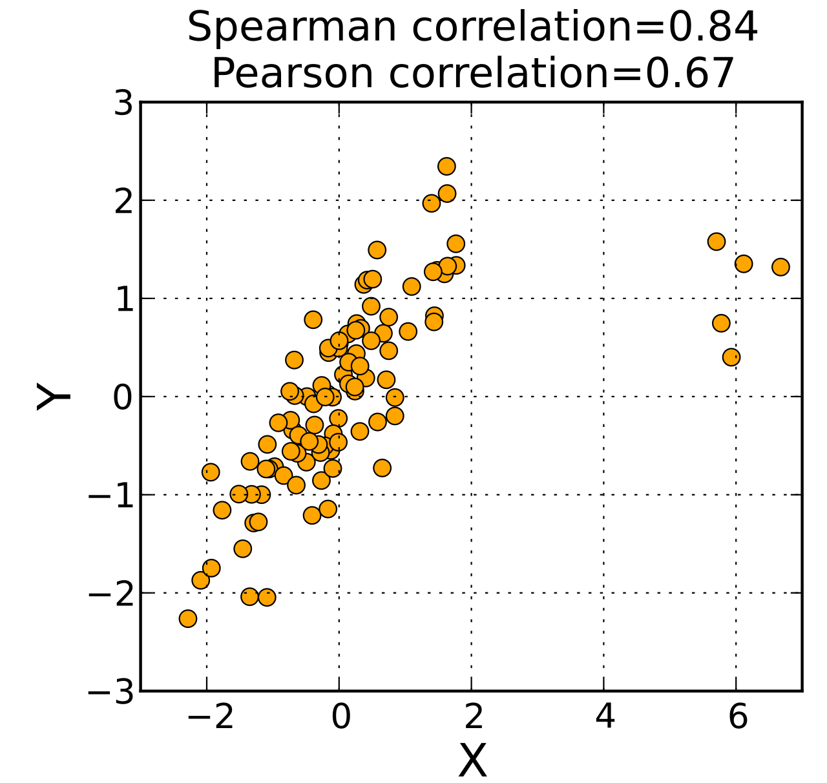
Product-Moment vs Rank Correlation
Notes:
Lets compare the methods for analyzing correlation.
Question you can ask: Has anyone used any of these metrics on their projects?
PLOT REVIEW
Spearman and Kendall magnitudes are similar for these datasets.
Left panel: weak relationship, both Pearson and Spearman small and similar.
Middle panel: clearly curved but consistently increasing.
Spearman = 1 (perfect monotonic ordering)
Pearson < 1 because the relationship isn’t a straight line.
Say it like: “Spearman says ‘the ordering is perfect.’ Pearson says ‘but it’s not straight.’”
Right panel: outliers or uneven spread reduce Pearson more than Spearman.
Spearman stays higher because ranks aren’t as pulled by extreme values.

Slide 19
Visualizing Correlation

Slide 20
Visualizing Correlation
Is there a pattern between X and Y?
Is it positive (large X tends with large Y)?
Or is it negative (large X tends with small Y)?
Is it linear?
Can it be transformed to make it more linear?
Notes:
Use this as a checklist narrative:
“Do we see a pattern, or just a blob?”
“Does it tilt up (positive) or down (negative)?”
“Is a straight line a reasonable summary?”
“If not, can a simple transform make it closer to linear?”
Emphasize:
Plot first, compute second is often the safest workflow.

Slide 21
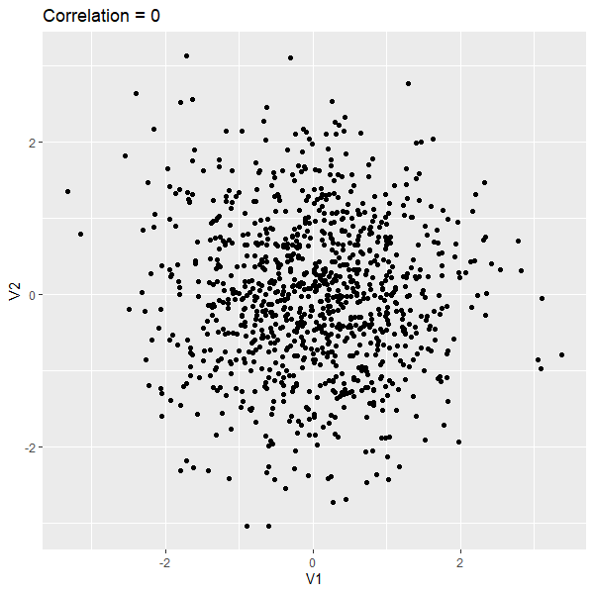
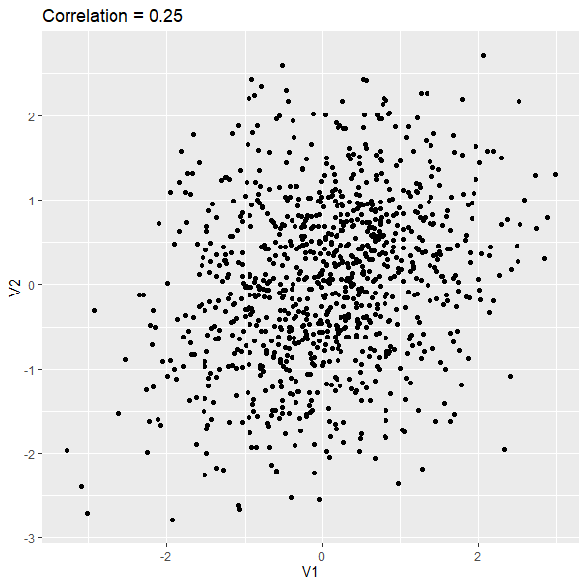
Notes:
0: a symmetric cloud; knowing X doesn’t help guess Y.
0.25: slight tilt; a weak tendency.

Slide 22
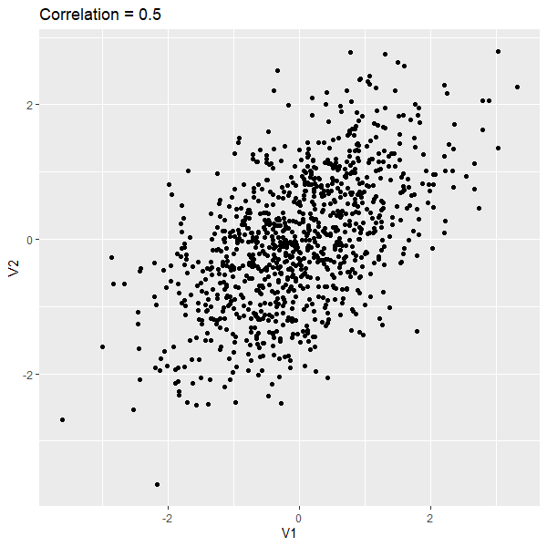
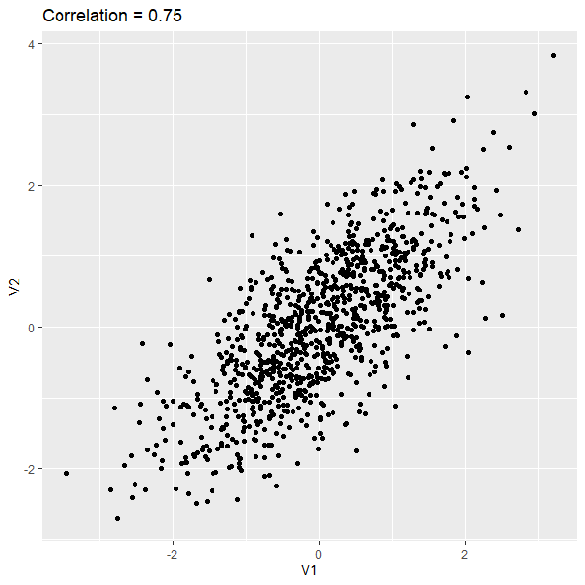
Notes:
0.5: a visible trend, but still lots of scatter.
0.75: strong tilt; much more “cigar-shaped” cloud.

Slide 23
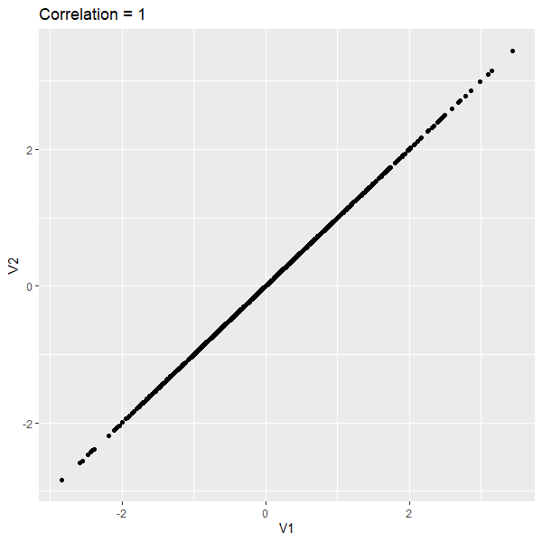
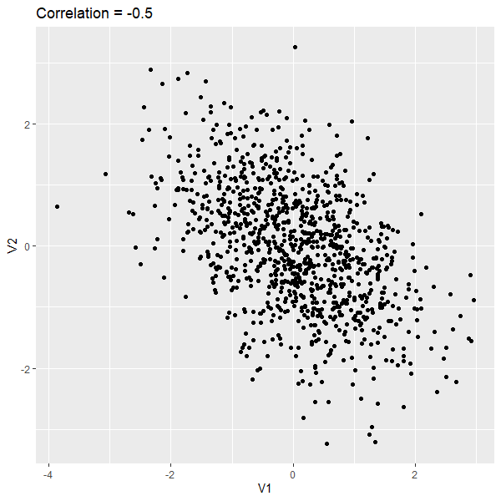
Notes:
1: points fall on a perfect line (rare in real hydrology).
-0.5: as X increases, Y tends to decrease—downward tilt.

Slide 24
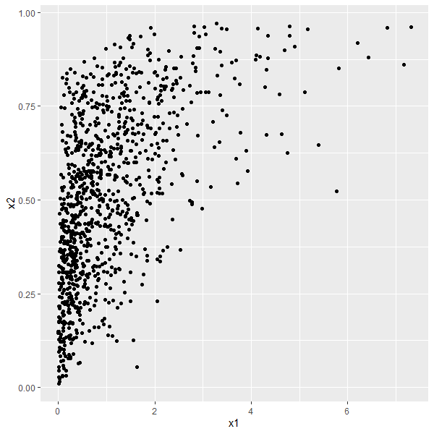
Is this linear?
r (Pearson) = 0.55
ρ (Spearman) = 0.59
Notes:
You can measure the Pearson correlation coefficient on this dataset, but I wouldn’t. Without doing anything else to this dataset I would consider using Spearman rank correlation to measure the relation. But, if we want to use Pearson (there are good reasons for wanting to use that, e.g. if you want to model the dataset with a Gaussian copula) then we can transform the data to get at the underlying structure.
“Pearson is trying to summarize this with one straight line, and it’s struggling a bit.”

Slide 25


Transformation
Use a monotonic function on the variables to improve linearity
Only affects Pearson (linear) correlation!
Two common functions:
Logarithm
Exceedance probability/standard normal
(requires a probability distribution)
Pearson Correlation –
Marshalltown & Marengo Logged Flows
$r=.$9174
Notes:
Transformations will only change the value of the Pearson correlation coefficient. The next demonstration will show how monotonic transformations do not affect the Spearman rank correlation.
Core message: transformations are like changing the camera lens.
Log transform
Often helpful for flows because flood peaks span orders of magnitude.
Logging can turn “fan-shaped” scatter into something closer to a straight-line cloud.
Exceedance probability / standard normal transform
This is a “convert each value to how rare it is” approach.
It requires fitting a distribution – whether normal, log pearson type III, or rely on an empirical approach such as Weibull
Key point from slide:
These transforms mainly matter for Pearson, because Pearson cares about straightness; rank methods mostly don’t change under monotonic transforms.
Source: Pearson is sensitive to linearity and scale; Spearman/Kendall are rank-based:
The image is of a screen shot of SSP for the correlation ana

Slide 26
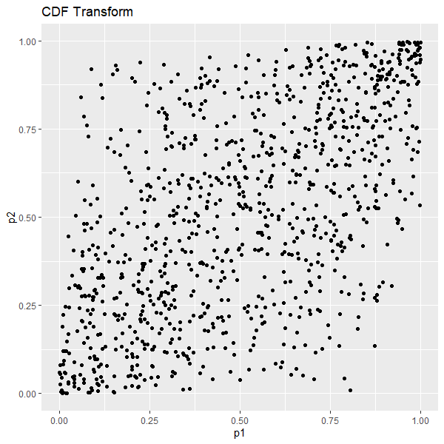


$F\left(x2\right) \sim$Beta(2,2)
r = 0.55
ρ = 0.59
$F\left(x1\right) \sim$Gamma(1,1)
r = 0.59 ρ = 0.59
Notes:
On the left, the raw relationship gives r = 0.55 and ρ = 0.59.
After the CDF transform (right plot), Pearson improves (r = 0.59) while Spearman stays the same (ρ = 0.59).
Intuition:
“We didn’t change the ordering of the points—so rank correlation stays put. But transformed in a way that improved linearity so the cloud looks more line-like—and Pearson improves.”

Slide 27

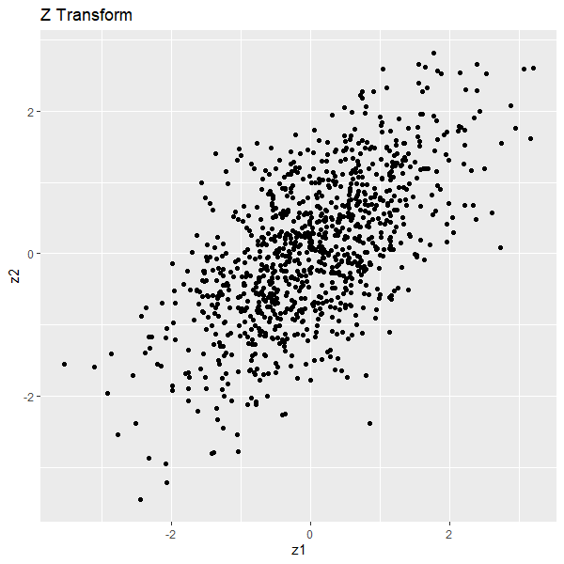



$F\left(x2\right) \sim$Beta(2,2)
$F\left(z2\right) \sim$Normal(0,1)
$F\left(x1\right) \sim$Gamma(1,1)
$F\left(z1\right) \sim$Normal(0,1)
r = 0.59 ρ = 0.59
r = 0.62 ρ = 0.59
Notes:
what “Z transform” means in plain language:
“After mapping values to probabilities, we map probabilities to the standard normal scale—like converting ‘how rare’ into a common yardstick.”
Transormation result:
Pearson rises (r = 0.62) while Spearman stays (ρ = 0.59).

Slide 28
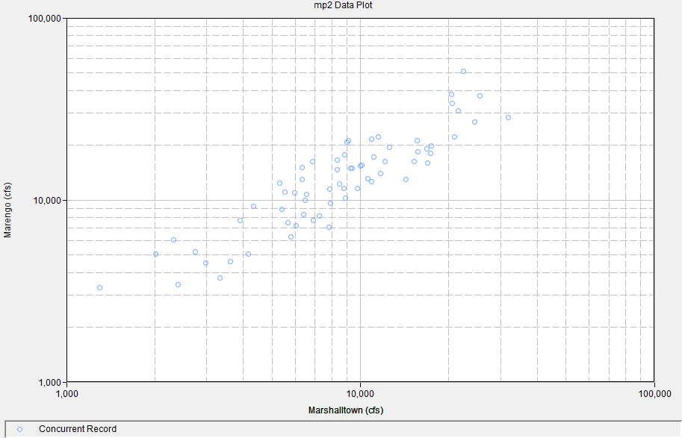
Exceedance Probability Transform
Correlation in two-site peak streamflow?
Start with log transform
Consider exceedance probability transform
Fitted log-Pearson type III distribution
Notes:
flood frequency practice:
Bulletin 17C guidance supports fitting log-Pearson Type III for annual peak flows in U.S. practice.
why this slide matters:
In two-site peak flow correlation, comparing raw cfs can be misleading because sites have different scales and skew.
Turning peaks into exceedance probabilities is like asking:
“Was this year a ‘top 1% year’ at both sites?”
Suggested workflow:
Start with log transform.
Then consider exceedance probability transform using a fitted LP3.

Slide 29
Questions?

