Slide 1
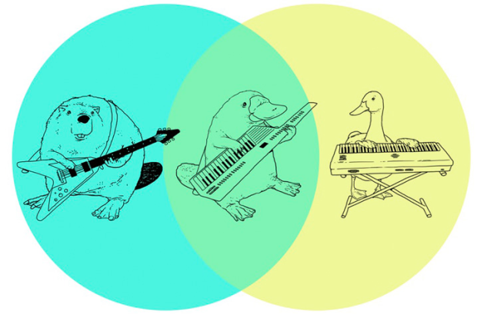
Joint Probability
Flood Frequency Analysis
April 2026
Presented by:
Avital Breverman, P.E.

Slide 2
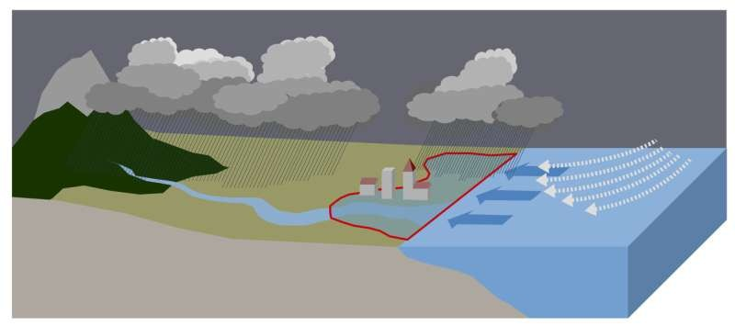

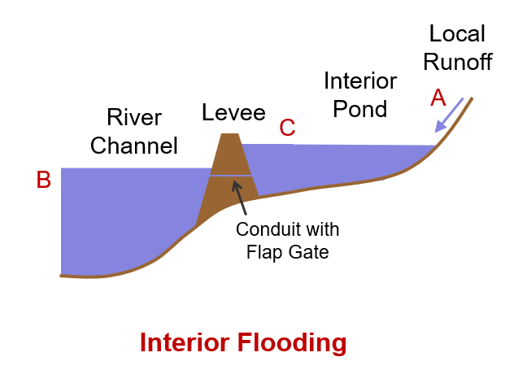
Joint Probability Scenarios
Tributary
Stage
C
A
Coastal compound flooding
B
Tributary
Flow
Hydrologic problems are often multivariate problems!
Mainstem
Flow
Tributary and
mainstem
Ice jams
Interior flooding
Notes:
Here are a few scenarios that require joint probability analysis:
Coastal compound flooding: I want to model the frequency of estuary stages but I don’t have estuary stage data. Estuary stage is a function of precipitation and tidal surge and I have data on both of those variables.
Interior flooding: I have data on river discharge and local runoff (precipitation). I want to estimate the frequency of stage behind the levee.
Ice jams: what happens to river stage when there are ice jams? Channel is restricted so for a given flow, the stage is elevated.
Tributary and mainstem (riverine compound flooding): high mainstem flows can cause backwater on the tributary. How do I determine stage somewhere along the tributary near the confluence with the mainstem?

Slide 3
Objectives
Understand multiple approaches to joint probability
Understand advantages of copulas over traditional coincident frequency approach

Slide 4
Outline
Background
Coincident Frequency
Joint Probability Distributions
Copulas

Slide 5
Background

Slide 6
Notation
Marginal
  P(A)
Joint
  P(A,B) or P(A and B) or P(A ∩ B)
Conditional
  P(A|B)

Slide 7
Marginal Probability
What is the probability of A occurring irrespective of what happens with B?
Ω
A
B
Notes:
Imagine the rectangle has an area equal to one. If the area of a circle (less than or equal to 1, greater than or equal to zero) is equal to its probability, then in this case P(A) is the area inside A regardless of whether it’s in B, or an undrawn C, etc.

Slide 8
Joint Probability
What is the probability of A and B occurring together?
Ω
A
B
Notes:
Now imagine that we’re concerned with the region that belongs in both A and B, so that both things have to happen. The area of this lens is less than A or B. It can be at most the area of the smaller of the two, assuming it is completely within the other.

Slide 9

Joint Probability
$$P\left(A,B\right)≤min\left(P\left(A\right),P\left(B\right)\right)$$
Ω
A
B
Conjunction Fallacy (“Linda the Bank Teller”)
Conspiracy Theories
Notes:
If B is completely contained within A, then P(B) = P(A,B)conjunction
Linda is 31 years old, single, outspoken, and very bright. She majored in philosophy. As a student, she was deeply concerned with issues of discrimination and social justice, and also participated in anti-nuclear demonstrations. Which is more probable?
Linda is a bank teller.
Linda is a bank teller and is active in the feminist movement.
Why does it suddenly become easier to believe that the government is controlled by lizard people if we also believe there is a massive conspiracy to cover it up involving the entire Federal government?
The sticking power of conspiracy theories arises from the fact that evidence against the first (lizard people) becomes evidence for the second (giant coverup.)

Slide 10
Conditional Probability
Given that B has occurred, what is the probability that A occurs?
Once we have observed that B has occurred, it becomes our “universe”
A
B
Ω
A^{c}
B
A
Notes:
P(A|B) is the ratio of P(A and B) to the ratio of P(B) i.e. the platypus playing the keytar to the probability of B.
If A and B are independent, then the occurrence of B has no impact on the occurrence of A: P(A | B) = P(A)

Slide 11
Motivation
Variable C is a function of variables A and B
It is difficult to estimate the distribution of C, F(C), from data
You can get to F(C) from modeling combinations of A and B with probabilities you can compute from f(A, B)
Ω
A
B

Slide 12
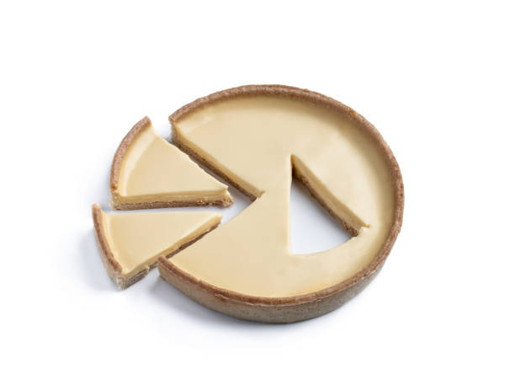

Joint Probability Methods
Discrete
Coincident frequency analysis
Continuous
Joint probability distributions
Copulas
Notes:
We’re going to talk through 3 joint probability models.
The first, coincident frequency analysis, is included in USACE guidance. This is a discrete probability method in that you evaluate joint probability at a countable number of combinations of variables A and B.
We’ll then talk through two continuous joint probability methods and explain why copulas are more flexible than the other two options.

Slide 13
Coincident Frequency

Slide 14
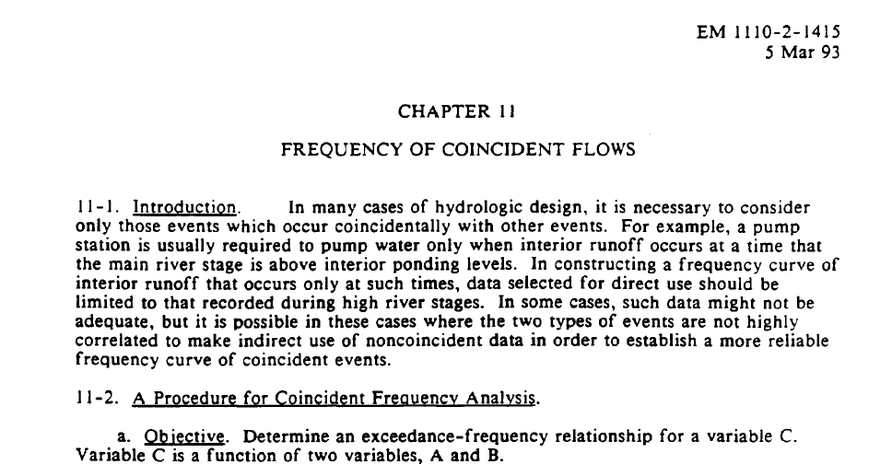
Coincident Frequency Analysis
In USACE guidance:
  Engineer Manual (EM) 1110-2-1415 Hydrologic Frequency Analysis (1993)
  EM 1110-2-1413 Hydrologic Analysis of Interior Areas (2018)
Notes:
Engineer Manual 1110-2-1415 Hydrologic Frequency Analysis
2 pages on coincident frequency
Better explanation in EM 111-2-1413
This is current USACE guidance.
We are working to update 1415, since it has not been updated in ~33 years and our statistical modeling procedures have advanced since then. We’ve learned a lot in the last 3 decades!

Slide 15
Coincident Frequency Analysis
Correlation
  Are the magnitudes of notable events at the two variables related or independent?
  The answer to this dictates how we define probability descriptions
Coincidence
  Do notable events (extremes) happen for both variables at the same time?
  The answer to this defines our approach
Notes:
When performing a coincident frequency analysis, we need to consider two things:
Correlation
Coincidence

Slide 16

Coincidence
Do notable events (extremes) happen for both variables at the same time?
  If there are extreme events at A but “normal” events at B:
    The probability of events at A is described using a frequency curve (AEP)
    The probability of events at B is described using a daily duration curve
  If there are extreme events at both A and B
    The probability of events at A is described using a frequency curve (AEP)
    The probability of events at B is described using a frequency curve (AEP)
Notes:
Variable A is always described by a frequency curve

Slide 17
Coincident Frequency Analysis
Case | Correlation (Magnitude) | Coincidence
1 | Strong positive (ρ ≈ 1) | Always
2 | - | Never
3 | Not correlated (ρ ≈ 0) | Not really
4 | Not correlated (ρ ≈ 0) | Usually
5 | Correlated (ρ not ±1 or 0) | Usually

Slide 18

Case 1: Strong Positive Correlation, Always Coincident
1/100 AEP tributary event always happens with 1/100 AEP mainstem event
Drainage areas are small and similar size and experience the same flood driving events
We can compute the 1/100 AEP event at variable C from the 1/100 AEP events at A and B

Slide 19

Case 2: Never Coincident
Tributary and mainstem events never happen at the same time
1/100 event on the tributary always occurs with low mainstem flow/stage
No backwater
Univariate problem

Slide 20

Cases 3 and 4
Case 3: No correlation, extremes are not really coincident
Case 4: No correlation, extremes are usually coincident
Convenient to assume mainstem and tributary (A and B) are independent (approach)
The difference is in the coincidence
  Case 3: extremes not really coincident → “normal” values at B → duration curve at B
  Case 4: extremes usually coincident → extreme values at B → frequency curve (AEP) at B

Slide 21

Case 5: Usually Coincident, and Correlated
Some correlation: ρ not ±1 or 0
Events at A and B are not independent
Challenging

Slide 22

Total Probability Method
Probability of event A by partitioning it into conditional probabilities across several distinct, exhaustive scenarios $B_{i}:$
$$P\left(A\right)= \sum_{i}{P\left(A | B_{i}\right)} P(B_{i})$$
B₁
B₂
B₃
B₄
A
Ω
Notes:
Recall the Law of Total Probability from Monday. We want to compute the probability of event A and we have information about A conditioned on B. We can extend this. As long as the B parts form a partition, we can compute p(A) from any number of subcases. This can also be used to compute the probability of some third event C, which is a function of A and B.

Slide 23
Input Probability Distributions (Case 3)
Case 3: No correlation, not really coincident
more influential
less influential
P(A)
P(B)
Annual Peak Flow
Mainstem Stage
A=a_{0.01}
A=a_{0.1}
A=a_{0.5}
0.99 0.90 0.50 0.10 0.05 0.01
0.10 0.30 0.50 0.70 0.90
AEP
Percent of Time Exceeded
A: Tributary Flow
Peak Flow Frequency Curve
using annual extremes
B: Mainstem Stage
Daily Duration Curve
using daily stages during flood season
Notes:
Frequency curve: probability of 1 is on the left, probability of 0 is on the right
Duration curve: probability of 0 is on the left, probability of 1 is on the right
We discretize both curves, but in different ways
We discretize the frequency curve by pulling values off the curve at different probabilities (AEPs). We keep these probabilities as exceedance probabilities or cumulative probabilities.

Slide 24
Input Probability Distributions (Case 3)
Case 3: No correlation, not really coincident
P(B)
P(B)
b₁
b₂
P(b₃)=0.2
Mainstem Stage
b₃
Mainstem Stage
b₄
b₅
P(b₆)=0.1
b₆
3%
7%
20%
40%
20%
10%
0.10 0.30 0.50 0.70 0.90
0.10 0.30 0.50 0.70 0.90
Percent of Time Exceeded
Percent of Time Exceeded
Notes:
We discretize the duration curve by dividing the curve into probability ranges. We define an index value for each probability range. The index value is then associated with the incremental probability for that range.

Slide 25
Response Function
B: Mainstem Stage
 | b₁ | b₂ | b₃ | b₄ | b₅ | b₆
a_{0.9} | c_{0.9}|b₁ | c_{0.9}|b₂ | c_{0.9}|b₃ | c_{0.9}|b₄ | c_{0.9}|b₅ | c_{0.9}|b₆
a_{0.5} | c_{0.5}|b₁ | c_{0.5}|b₂ | c_{0.5}|b₃ | c_{0.5}|b₄ | c_{0.5}|b₅ | c_{0.5}|b₆
a_{0.2} | c_{0.2}|b₁ | c_{0.2}|b₂ | c_{0.2}|b₃ | c_{0.2}|b₄ | c_{0.2}|b₅ | c_{0.2}|b₆
a_{0.1} | c_{0.1}|b₁ | c_{0.1}|b₂ | c_{0.1}|b₃ | c_{0.1}|b₄ | c_{0.1}|b₅ | c_{0.1}|b₆
a_{0.05} | c_{0.05}|b₁ | c_{0.05}|b₂ | c_{0.05}|b₃ | c_{0.05}|b₄ | c_{0.05}|b₅ | c_{0.05}|b₆
a_{0.01} | c_{0.01}|b₁ | c_{0.01}|b₂ | c_{0.01}|b₃ | c_{0.01}|b₄ | c_{0.01}|b₅ | c_{0.01}|b₆
A: Tributary Annual Peak Flow
C: Tributary Stages
value of C that has exceedance probability of 5% given B = b₅
Notes:
Next, we develop a response function using hydraulic modeling.
We simulate combinations of A and B (discretized values at A and index values at B). We evaluate the value at C for each of these combinations.
Each column is a conditional exceedance probability for C (conditioned on B, given B = b1, b2, b3, etc.)

Slide 26
Total Probability
P(C|B)
B = b₁
P(C)
B = b₂
B = b₃
B = b₄
B = b₅
c₁
B = b₆
c₁
Annual Peak Stage at C
Annual Peak Stage at C
0.99 0.90 0.50 0.10 0.05 0.01
0.99 0.90 0.50 0.10 0.05 0.01
P(c₁|b₂)=0.70
P(c₁|b₅)=0.35
AEP
AEP
For every level of C, the exceedance probability given all levels of B can be determined with the Law of Total Probability
P(c₁) = [P(c₁|b₁)*P(b₁)] + [P(c₁|b₂)*P(b₂)] + [P(c₁|b₃)*P(b₃)] + [P(c₁|b₄)*P(b₄)] + [P(c₁|b₅)*P(b₅)] + [P(c₁|b₆)*P(b₆)]
Notes:
We get a family of conditional frequency curves for C, conditioned on values of B.
We can view the single P(C) curve as a probability-weighted average horizontally
Law of Total Probability: P(C) = _{ΣB} P(C|B) * P(B)

Slide 27
Input Probability Distributions (Case 4)
Case 4: No correlation, usually coincident
more influential
less influential
P(A)
b₁
P(B)
b₂
P(b₃)=0.2
b₃
Annual Peak Flow
b₄
Mainstem Stage
A=a_{0.01}
b₅
P(b₅)=0.2
b₆
A=a_{0.1}
A=a_{0.5}
7%
20%
40%
20%
10%
3%
0.99 0.90 0.50 0.10 0.05 0.01
0.10 0.30 0.50 0.70 0.90
AEP
AEP
A: Tributary Flow
Peak Flow Frequency Curve
using annual extremes
B: Mainstem Stage
Frequency Curve
Annual maximum frequency curve or
Coincident event frequency curve
Notes:
For variable B, you will develop one of the following:
Annual maximum frequency curve, if the annual maximum at A are coincident with the annual maximum at B
Coincident event frequency curve

Slide 28
Input Probability Distributions (Case 5)
Case 5: Some correlation and coincidence
Joint (or conditional) probability of A and B
P(A|B)
B = b₁
P(C|B)
B = b₁
B = b₂
B = b₂
B = b₃
B = b₃
B = b₄
B = b₄
B = b₅
Annual Peak Flow
B = b₅
Annual Peak Stage at C
B = b₆
B = b₆
C=c_{0.01}|b₆
A=a_{0.01}|b₆
C=c_{0.5}|b₆
A=a_{0.1}|b₆
A=a_{0.5}|b₆
0.99 0.90 0.50 0.10 0.05 0.01
0.99 0.90 0.50 0.10 0.05 0.01
AEP
exceedance probability of C
Notes:
Before, we used a marginal frequency curve of A but now we need the joint (or conditional) distribution of A and B
I’m showing this as a family of conditional probability curves for A. Each curve is conditioned on a value of B.
Conditional probability curves (for joint distribution of A and B) is very difficult to develop
We need significantly more data than just developing marginal frequency curves for A and B separately
Frequency curve for C has a greater variance or standard deviation than Case 3 and 4 due to correlation.

Slide 29
Limitations
We rarely have enough data to fully define the distinct scenarios
We must assume a level of dependence between the variables
We must identify a dominant variable
Does not support quantification of uncertainty
Notes:
Often the assumption of independence is not valid (correlation is too high to ignore)

Slide 30
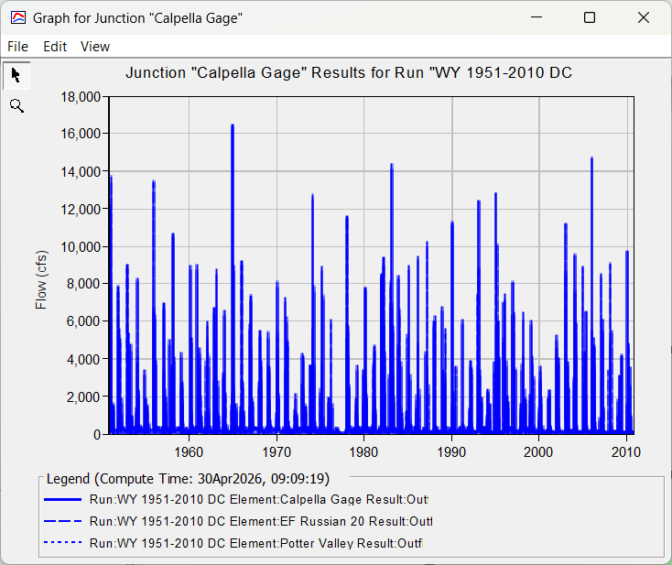
Other Methods
Continuous simulation
Joint probability distributions
Copulas
Notes:
Continuous simulation of time series A and time series C to get time series C. We can then just perform a frequency analysis at C.
Estimate marginal distributions for A and B, and estimate correlation. Then, do correlated random sampling in Monte Carlo analysis.
Copulas

Slide 31
Joint Probability Distributions

Slide 32
Joint Probability Distributions
Probability distributions for multiple variables are less common
Only a few analytical multivariate distributions
  Multivariate normal
  Multivariate t
  Dirichlet
  Wishart
Not common

Slide 33

Multivariate Normal Distribution
Univariate normal has two parameters: $N\left(μ,σ^{2}\right)$
  μ is the mean
  σ² is the variance
Bivariate normal also has two parameters: $N_{2}\left(μ,Σ\right)$
  μ is a length-2 vector of means
  Σ is a 2x2 matrix called the covariance matrix
Extension to arbitrary dimension: $N_{k}\left(μ,Σ\right)$

Slide 34


Bivariate Normal Distribution
$$cov\left[X_{1},X_{2}\right]=cov\left[X_{2},X_{1}\right]$$
Mean vector $μ={\left(E\left[X_{1}\right],E\left[X_{2}\right],…,E\left[X_{k}\right]\right)}^{T}$
Covariance matrix (k = 3)
$Σ=\left[\begin{matrix}var\left[X_{1}\right] & cov\left[X_{1},X_{2}\right] & cov\left[X_{1},X_{3}\right] \\ cov\left[X_{1},X_{2}\right] & var\left[X_{2}\right] & cov\left[X_{2},X_{3}\right] \\ cov\left[X_{1},X_{3}\right] & cov\left[X_{2},X_{3}\right] & var\left[X_{3}\right]\end{matrix}\right]$
A sample is ${\left(x_{1},x_{2},…,x_{k}\right)}^{T}$
With $x_{1}\sim N\left(E\left[X_{1}\right],var\left[X_{1}\right]\right)$, $x_{2}\sim N\left(E\left[X_{2}\right],var\left[X_{2}\right]\right)$, etc.
symmetric

Slide 35
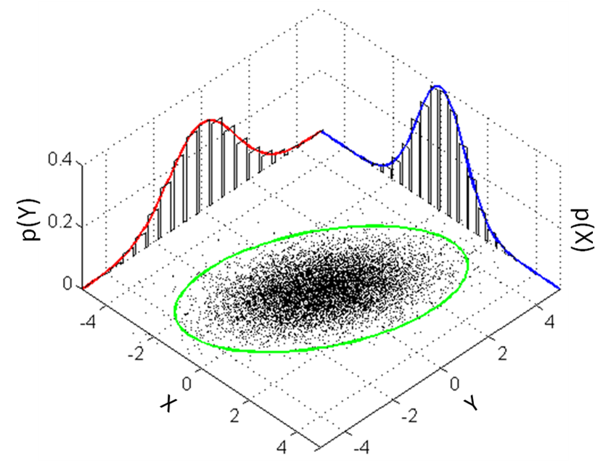
Multivariate Normal Distribution

Slide 36
Other Joint Probability Distributions
Multivariate t distribution
  Multivariate version of Student’s t distribution
  Similar to multivariate normal with extra parameter ν (degrees of freedom)
Dirichlet distribution
  Multivariate version of the beta distribution
Wishart distribution
  Multivariate version of the gamma distribution
Notes:
Dirichlet = dee-rush-lay
Wishart

Slide 37
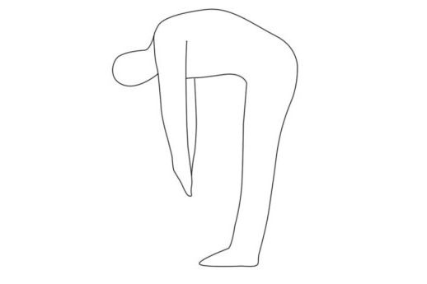
Limitations
Must describe the behavior of each variable (marginal distribution) and the relationship between them (joint probability distribution)
  The marginal distributions in a multivariate normal distribution must also be normal
  Not flexible

Slide 38
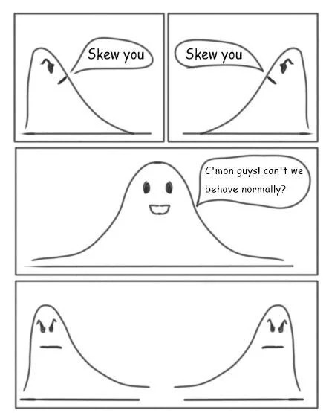
Stretch Break

Slide 39
Copulas

Slide 40
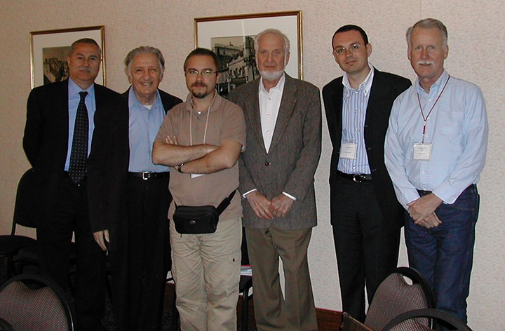

Sklar’s Theorem
Every multivariate CDF can be expressed in terms of:
  Its marginal distributions $F_{i}\left(x\right)$ and
  A copula, $C\left(∙\right)$
Consequences:
  Each variable can have whatever distribution you want
    Defined by the marginals
  You can specify a way to make the variables relate
    Defined by the copula

Slide 41

Definition
$X_{1}$ and $X_{2}$are continuous random variables
Marginal CDFs :
  $F_{i}\left(x\right)$= $P\left(x_{i} ≤x\right)$
Probability integral transform:
  $U_{i}= F_{i}(x)$
$U_{i} \sim Uniform(0, 1)$
Extend beyond bivariate

Slide 42

Probability Integral Transform
$X$ has a continuous distribution
$F\left(x\right)\sim Uniform\left(0, 1\right)$
Notes:
Applying a variable’s CDF to itself yields a transformed variable that is uniformly distributed on [0, 1]

Slide 43
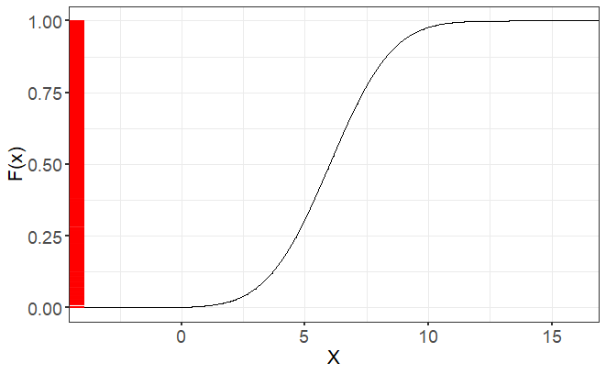
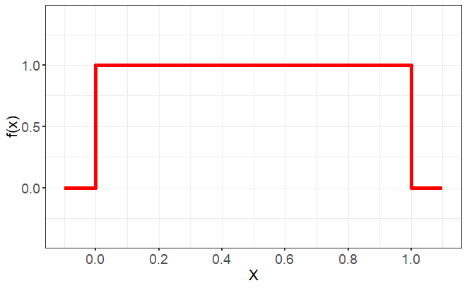
Probability Integral Transform
Notes:
Applying a variable’s CDF to itself yields a transformed variable that is uniformly distributed on [0, 1]

Slide 44
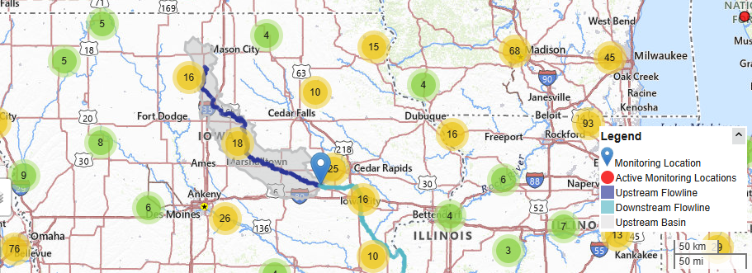
Example: Iowa River

Slide 45
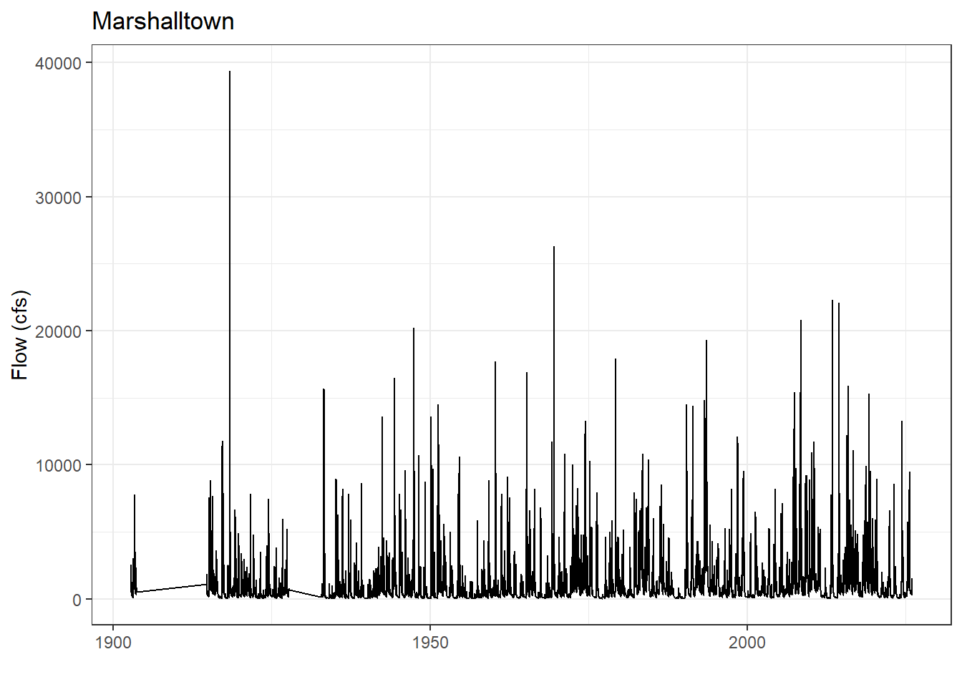
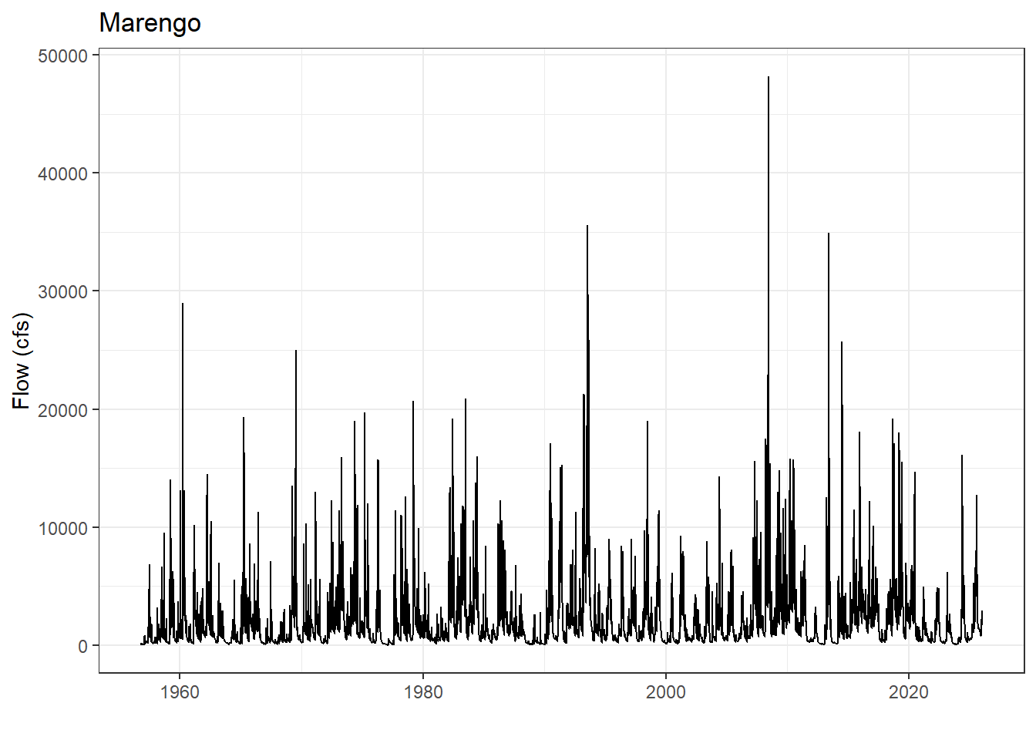
Data
Iowa River at Marshalltown, IA (05451500)
DA: 1532 square miles
Iowa River at Marengo, IA (05453100)
DA: 2794 square miles

Slide 46
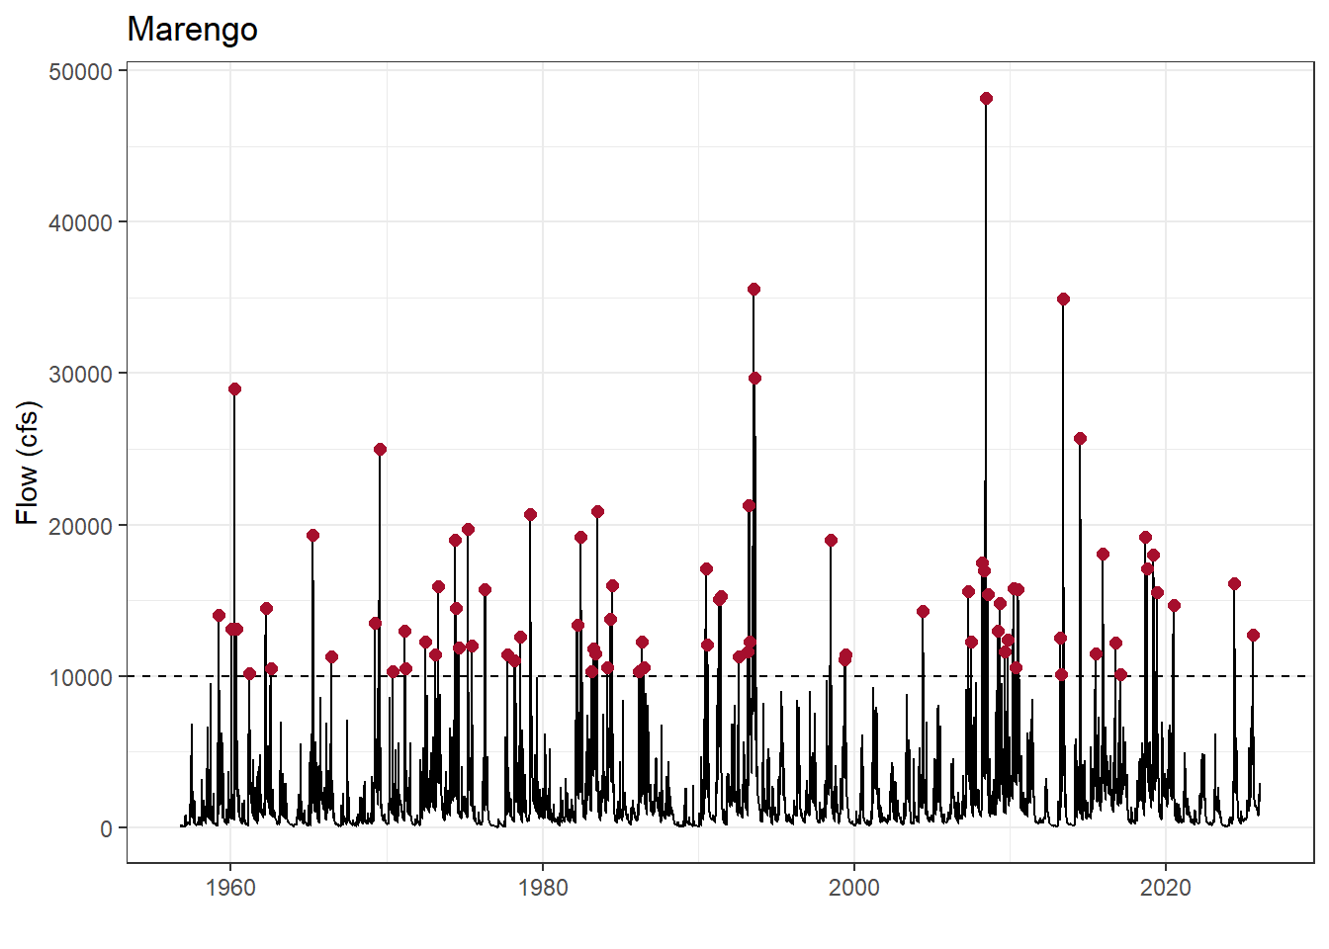
Development of Extremal Events
Annual maximum series (AMS)
Partial duration series (PDS)
Notes:
In general, we will use a PDS to define the extreme events since the overlapping record of the two variables will be short and block maxima can be wasteful.

Slide 47

Kendall’s Tau
Refresher from Correlation lecture
Kendall’s rank correlation
$τ$ = $\frac{2}{n(n−1)} (C−D)$
C = number of concordant pairs
D = number of discordant pairs
n = total number of paired observations
Special modification for ties
Notes:
Tau = 1 indicates perfect positive rank correlation (rankings agree perfectly)
Tau = -1 indicates perfect negative rank correlation (rankings are the exact reverse)
Tau = 0 indicates no correlation or independence between rankings
Scale invariant estimates
Avoids linearity assumption made by Pearson’s correlation coefficient

Slide 48
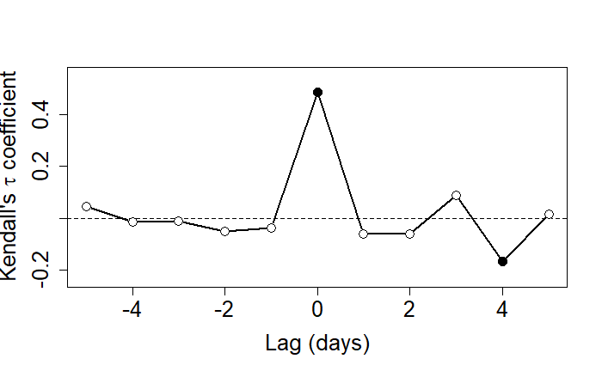
Dependence Assessment
p-value < 0.05
Rank correlation is statistically significant at the 5% level
Notes:
Null hypothesis, $H_{0}$: there is no ordinal association between 2 variables ($τ$ = 0)

Slide 49
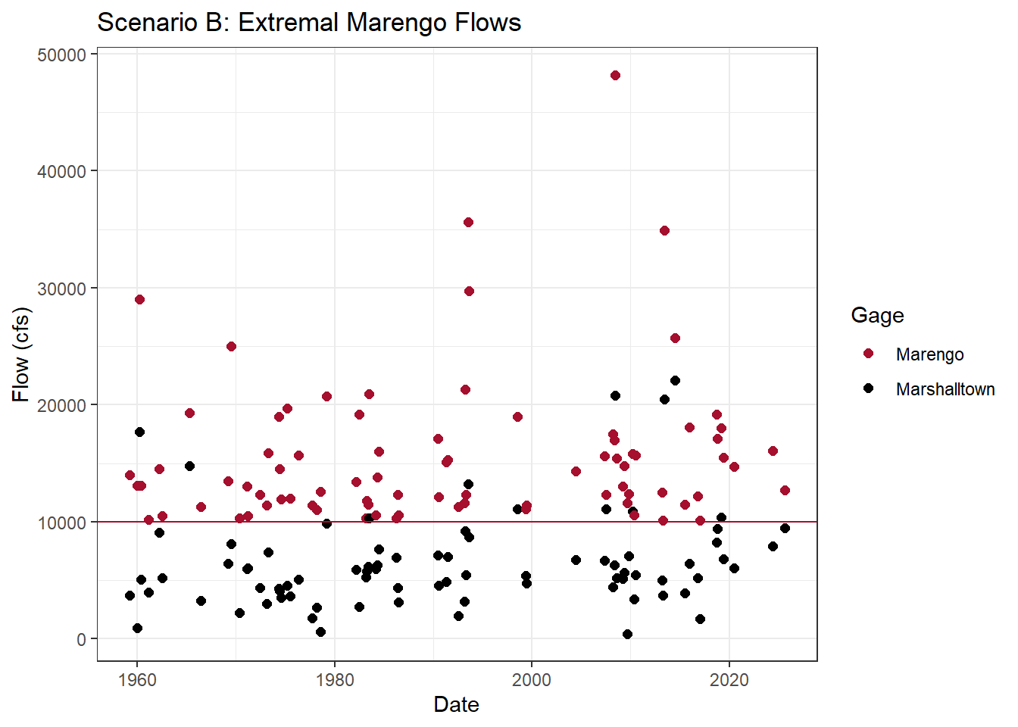
Fit Marginal Distributions
Extreme events at Variable 1
Near coincident events at Variable 2
Extreme events at Variable 2
Near coincident events at Variable 1

Slide 50
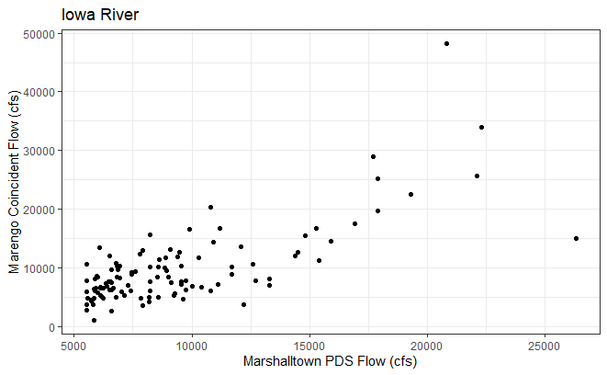
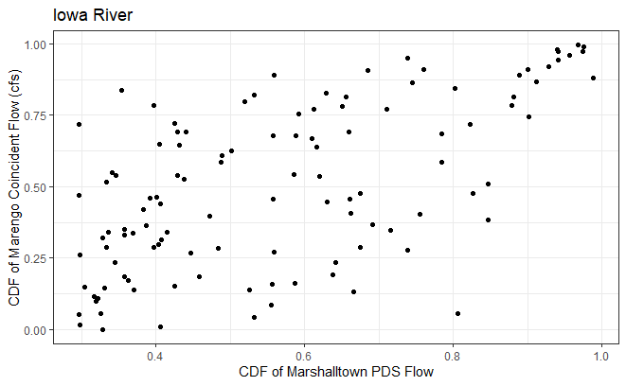
Real Space vs. Unit Space

Slide 51
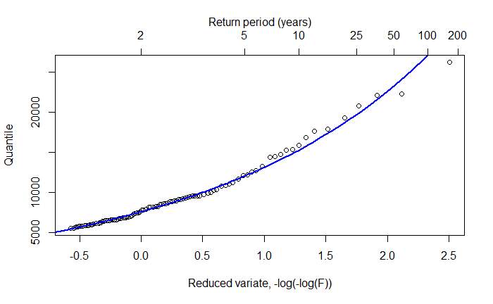
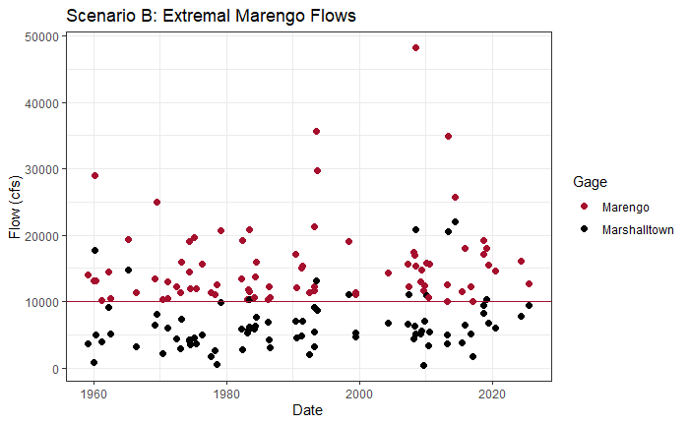
Define Copulas
Copula A
  Extreme events at Variable 1
  Near coincident events at Variable 2
Copula B
  Extreme events at Variable 2
  Near coincident events at Variable 1

Slide 52

Fit Copulas
Akaike Information Criterion (AIC):
$AIC=2k −2ln⁡(\hat{L}$)
k is the number of parameters estimated by the copula
$\hat{L}$ is the maximized value of the likelihood function of the probability model
Can be negative
Lower AIC → better model fit

Slide 53
Copula Families
Elliptical Symmetrical correlation
  Gaussian Copula (derived from multivariate normal)
  t-Copula (derived from multivariate t-distribution)
Archimedean Dependence parameter θ
  Frank
  Joe
  Clayton
  Gumbel (Extreme Value Copula)
These are last names
Notes:
Tail dependence describes how variables correlate at extreme ends (upper and lower corners) of a joint distribution
When you observe high-high values, there is upper tail dependence
When you observe low-low values, there is lower tail dependence
Note here that we are in unit space

Slide 54
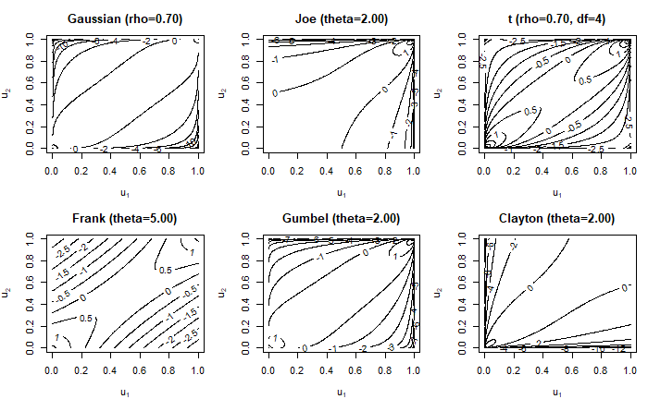
Copula Families
  df → 0: tail dependence increases
  df → ∞: converges to Gaussian copula
No tail dependence
Upper tail dependence
Lower tail dependence
Notes:
Tail dependence describes how variables correlate at extreme ends (upper and lower corners) of a joint distribution
When you observe high-high values, there is upper tail dependence
When you observe low-low values, there is lower tail dependence
Note here that we are in unit space

Slide 55
Advantages
Explicitly represents dependence between variables
Flexible
Adaptable
  Different copula families can capture different types of dependence
Allows for computation of uncertainty
Eliminates the need to assume a primary variable since you can compute a two-sided copula
Notes:
Copulas are flexible. They can handle correlations between 0 and 1. They can also be built off of any marginal distributions.

Slide 56
Limitations
Static dependence structure
  There are ways to model non-stationary dependence
Fitting a copula to limited data can be challenging

Slide 57
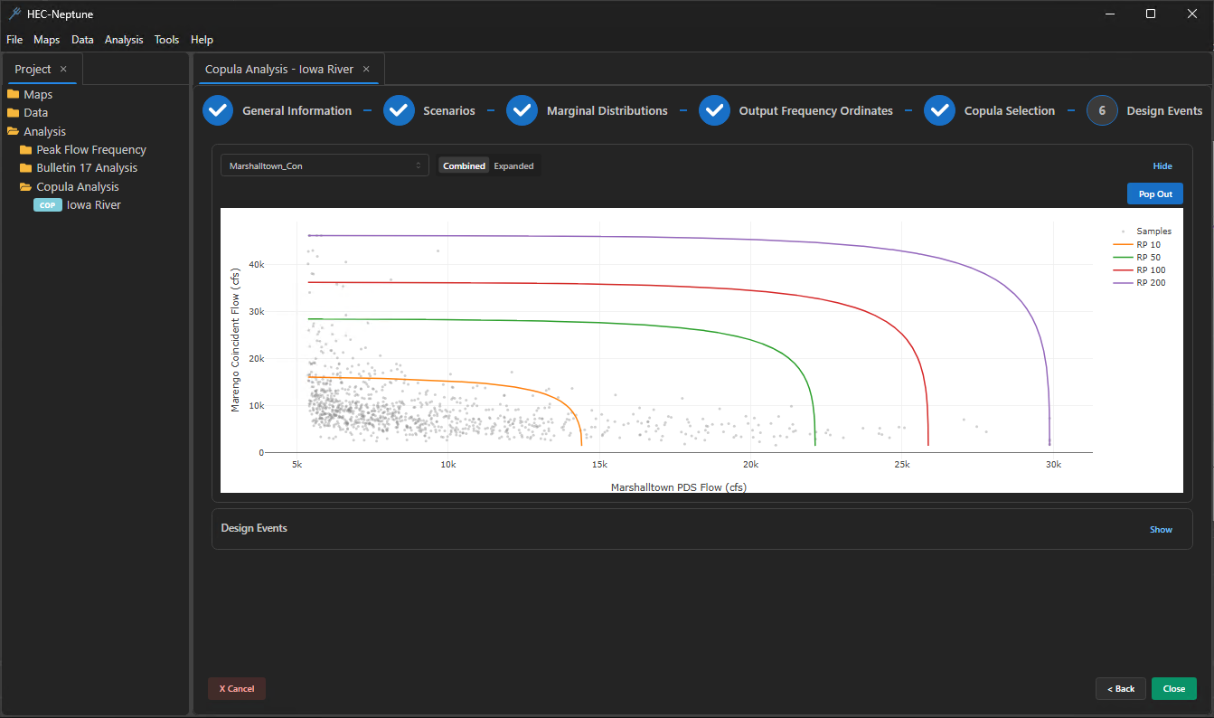
Copula Analysis in HEC-Neptune

Slide 58

Questions?
Check out our Confluence for tutorials, user’s manual, and webinars
Notes:
Confluence of Sacramento and American Rivers in Sacramento, CA

