Slide 1

Probability and Statistics: Events
Flood Frequency Analysis
April 2026
Presented by:
Avital Breverman, P.E.
Slides borrowed from Gregory Karlovits, P.E., PH, CFM

Slide 2
Section Outline
Revisiting the axioms with Venn diagrams
Mutual exclusivity and exhaustivity/partitions
Complements
General additivity
Independence
Joint, marginal, and conditional probability

Slide 3
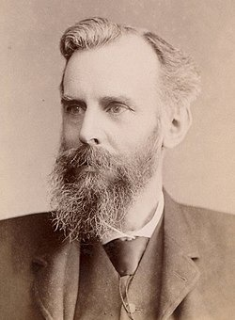
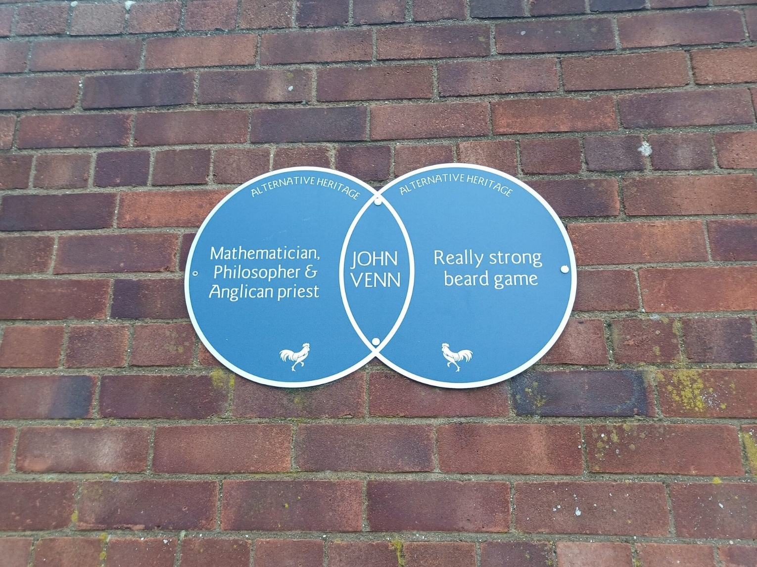
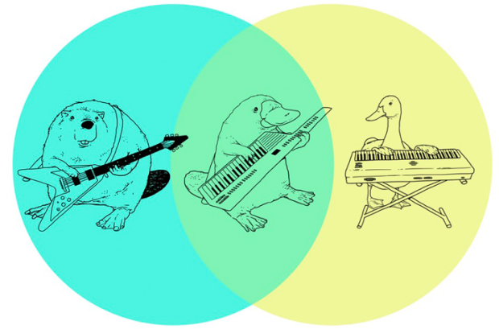
Venn Diagrams
Notes:
Tool for visualizing relationships between sets.
John Venn (1834-1923). Used to teach set theory. Sets are just the collection of objects or events.

Slide 4
Venn Diagrams
Ω
A
B
$$p\left(Ω\right)=1$$
$$p\left(A or B\right)=p\left(A\right)+p\left(B\right)$$
Notes:
Here is a significantly less interesting Venn diagram.
The colored circles are two events, A and B. The rectangle labeled with the omega represents all of the things that can happen. Omega is called the sample space. It is the exhaustive list of all of the things that can happen. We can use these diagrams to illustrate a number of concepts that are important for understanding events.
We discussed the three axioms of probability previously. This is an illustration that shows how two of them work.
If we set the area of each of these objects equal to their probability, this means the rectangle has an area of 1. This is because omega, our sample space, has a probability of 1 – this is the second axiom of probability. Any events we draw inside the box have to stay inside the box, they can’t be bigger than that.
This also helps us understand the third axiom, which is how probabilities can be added. We see here that events A and B have no overlap. This means they are mutually exclusive; that is, they can’t happen at the same time. As a consequence, we can compute the probability of event A or event B happening simply as the sum of their probabilities.

Slide 5

Coin Flip
Mutually exclusive and exhaustive
H
Ω
T
$$p\left(A or B\right)=p\left(A\right)+p\left(B\right)=1$$
Notes:
Returning to the outcomes of our coin flip, we know that because it’s a Bernoulli random variable that there are only two outcomes. Since something has to happen (back to our second axiom) either we get a heads or a tails, and nothing else. This means that our two outcomes fill up the sample space. A list of outcomes are called exhaustive when the list contains everything that can happen. We also know that we can’t get both a heads and a tails at the same time. This means that the outcomes are mutually exclusive, and in our diagram they have no overlap.
When a collection of outcomes are mutually exclusive and exhaustive, they are said to form a partition of the sample space.

Slide 6

Die Roll
1
Ω
2
3
4
5
6
Notes:
First off, what kind of random variable does a die roll represent, and how do you know? ….. It’s a discrete random variable, because there are a finite number of outcomes. It’s not Bernoulli because there are now more than two ways it can shake out. It’s not continuous, because we can count the number of outcomes there are. For a fair die, much like a fair coin, the outcomes are equiprobable; that is, they have the same probability.
Are rolls of a die mutually exclusive? ….. Yes they are! In one roll of a die, you can’t get both a 3 and a 5 at the same time.
Does this Venn diagram show an exhaustive listing of events? ….. Yes! The outcomes 1 through 6 are the only things that can happen, and there are no blank or empty spaces on the diagram.
Do the six outcomes represent a partition? ….. Yes again. Since the rolls are mutually exclusive, and they are exhaustive, the rolls 1 through 6 form a partition.
If this is a fair die and the outcomes are equiprobable, what does that mean the probability of rolling a 1 is? ….. It’s 1/6, because the sum of the probability of events in a partition is 1, and since they all have the same probability, it must be equally spread among the 6 outcomes.
We also know that the probability of rolling a 3 OR a 5 is equal to the probability of rolling a 3 plus the probability of rolling a 5, or 1/3, because we have the probability of two mutually exclusive events.

Slide 7

Complements
All the space in “not A”
A
Ω
A^{c}
$$p\left(A^{c}\right)=p\left(Ω\right)−p\left(A\right)=1−p\left(A\right)$$
Notes:
Complements are more than just flattery. They can make certain kinds of problems much easier.
The complement to A is written A-super-c, or A-complement. It’s any event that can occur when A doesn’t occur. In a simple case like our coin flip, the complement to heads is tails – because the only thing that can happen in “not heads” is tails. For a die roll, the complement to rolling a 1 is rolling a 2, 3, 4, 5 or a 6.
A and A-complement form a partition. This is because either A happens or it doesn’t – nothing else can happen. Also, A and not-A can’t happen at the same time.
One handy relationship results here. If you want to know the probability of A not happening is, you simply have to subtract the probability of A from 1.

Slide 8
When Events Collide – General Additivity
A and B
Ω
A
B
$$p\left(A or B\right)=p\left(A\right)+p\left(B\right)−p\left(A and B\right)$$
Notes:
Events aren’t always mutually exclusive, so if we want a general way to be able to add probabilities together, we have to deal with the overlapping area on the Venn diagram, where our platypus playing a keytar lives. Remember that the area of the rectangle labeled omega is equal to 1. The area of the events A and B are then equal to the probability of each event. When these two events overlap, we get a little lens shape in between them. The area of this space is equal to the probability of event A AND event B occurring at the same time. The equation at the bottom makes sure that we don’t double count that little lens space when we add together the probabilities.

Slide 9
Two Coins
H1
Ω
T1
Ω
H2
T2
Notes:
Let’s extend our coin flip example to the flip of two fair coins now. The figure on the left represents the outcomes from flipping our first coin, and the figure on the right represents the outcomes from our second coin. Both coins are fair, and both are Bernoulli random variables. We draw the diagrams slightly differently so that we can look at what happens when we combine the two.

Slide 10
Two Coins
H2
H1
Ω
T1
T2
$$p\left(H1 or H2\right)=p\left(H1\right)+p\left(H2\right)−p\left(H1 and H2\right)$$
Notes:
We’re going to muddy up the diagram for a second by overlaying the two. Now we see four distinct regions in here with slightly different colors. This is because in two coin flips, there are four outcomes. By flipping two coins, we’ve gone from a Bernoulli random variable to a discrete random variable for our outcomes. Looking at the diagram we get HH, TH, HT, and TT.
If we wanted to compute the probability of flipping two coins and getting a heads on either one, we can use our general adding rule. We know the probability of a heads on both coins is ½, but now since we can have overlapping events, we have to account for that overlap. The trick is in computing that right hand quantity – what is the probability of getting a heads on both the first and second coin?

Slide 11
Two Coins
Ω
HH
TH
HT
TT
$$p\left(H1 and H2\right)=p\left(H1\right)∗p(H2)$$
$$p\left(H1 or H2\right)=p\left(H1\right)+p\left(H2\right)−p\left(H1\right)∗p(H2)$$
Only because H1 and H2 are independent!
Notes:
Let’s rearrange the diagram a little bit so that the four outcomes that can result from the two coin flip are clear. Here we label the rectangle in the upper left HH because the first and the second coin were both heads, the upper right is TH because the first was tails and the second heads, and so on.
We can see how the four flips create a partition of the sample space. For both coins, heads and tails are equiprobable. So that means the width of these rectangles, which comes from the probability of getting heads or tails on the first flip, is equal to ½. The height of the rectangles works the same way – we get it from the probability of getting heads or tails on the second flip, and is also equal to ½. This means that the area of all four of these outcomes is ¼. Plugging that back into our previous equation, we find that the probability of getting a heads on either coin is 0.5 + 0.5 – 0.25 = 0.75.
We can solve this using complementation as well. Of the four equiprobable outcomes that are up there, only one doesn’t contain at least one heads – the lower right, which is TT. This means that the probability of getting at least one heads is equal to 1 minus the probability of getting no heads, which is the probability of outcome TT. This is 1 minus ¼, or 0.75.
There is an important hitch – in order for this to work, the events we’re considering have to be independent. The outcome of our first coin flip has no bearing on our second coin flip. If for example flipping a heads on our first coin made it more likely to get a heads on our second coin, these flips would NOT be independent, and these equations wouldn’t work! In our situation, when you flip the first coin, no matter what it comes up as, the second coin still has a 50-50 shot at coming up heads.

Slide 12

Independence
Joint probability of A and B
$$p\left(A and B\right)=p\left(A\right)∗p\left(B\right)$$
  iff $A⏊B$
Marginal probability of B
Marginal probability of A
Notes:
Here’s the lowdown on independence. If and only if events A and B are independent (written sometimes as A perpendicular to B) then the probability of A and B occurring is equal to the product of their individual probabilities. This statement is reversible. If the probability of A and B jointly occurring is equal to the product of their probabilities, then A and B are independent.
While we’re at it let’s add a couple important definitions. When we see the probability of A And B written, this is also called the joint probability of A and B. Anytime we talk about a variable without any other condition or information, such as the statements p(A) or p(B) in the equation here, this is referred to as the marginal probability of A or marginal probability of B. We will illustrate these next.

Slide 13
Marginal Probability
What is the probability of A occurring irrespective of what happens with B?
Ω
A
B
Notes:
This is an illustration of marginal probability on the Venn diagram. We ask the question, what is the probability of A occurring irrespective of what happens with B? This probability is the area of the red circle. Most of the time when we’re talking about the probability of some event, we’re just dealing with the simple case of marginal probability.

Slide 14

Joint Probability
What is the probability of A and B occurring together?
$$p\left(A and B\right)$$
Ω
Ω
A
A
B
B
Notes:
Now imagine that we’re concerned with the region that belongs in both A and B, so that both things have to happen. Here are a couple of interesting cases.
On the left we have two overlapping events. The probability of A and B happening at the same time is the area of that red lens in the overlap. Notice how it is smaller than the marginal probability of either A or B.
On the right we have total overlap of A and B – there is no way for B to happen if A doesn’t happen. The joint probability is then equal to the probability of the smaller of the two events, so in this case the joint probability is equal to the probability of B. This is important – remember that anytime you add variables to a joint probability statement, the joint probability can be AT LARGEST the probability of the least probable event.
Let’s look at this another way, if B happens, A is certain to happen. We can rephrase that and say that “given that B has occurred, A is certain to occur.” This is because there is no part of B outside of A: if B occurs, then A has to as well.
The statement we made: “given that B has occurred“ is a statement of conditional probability. Conditional and joint probability are tightly linked.

Slide 15

Conditional Probability
Given that B has occurred, what is the probability that A occurs?
Once we have observed that B has occurred, it becomes our “universe”
$$p\left(A | B\right)$$
A
B
Ω
A^{c}
B
A
Notes:
Conditional probability is extremely useful in statistics. Conditioning adds information. This is because we start with a statement of knowledge, generally saying “given that…” In our diagram here, we know that B has already occurred. This means that we only have to look at what happens inside of event B. We go from the diagram on the left to the one on the right. Inside of B are two events – A (which is the part that overlaps with the other circle) and A-complement, all of B that is not also in A.
The rectangles are the same size for these two figures. Notice how the area for A in red is larger than it was before – the conditional probability of A occurring, given that B has occurred, is larger than the marginal probability of A occurring. We write the conditional probability of A given B has occurred as p of A pipe B.

Slide 16

Conditional and Joint Probability
A
B
A^{c}
$$p\left(A | B\right)=\frac{p\left(A and B\right)}{p\left(B\right)}$$
  if A $⏊$ B,
  $p\left(A | B\right)=\frac{p\left(A\right)∗p\left(B\right)}{p\left(B\right)}=p\left(A\right)$
Notes:
Remember how I said conditional and joint probability are tightly linked? Their definitions are closely related. The first line gives us the means for going between conditional and joint probability of some events. This statement can be shown by the second figure from the last slide. The area of the large rectangle is equal to p(B). The rectangle B is split into two parts – the red part is the area corresponding to where A and B both occur, and the blue are is where A-complement and B both occur. This means that the area of that red rectangle represents p(A and B). Dividing that area by the area of rectangle B gives us p(A|B).
In the case where events A and B are independent, we know that the probability of A and B is equal to the product of the marginal probabilities. This leads to p(B) completely dropping out of the formula – the result is that p(A|B) is equal to p(A). What does that mean? It means that conditioning on the occurrence of B does not add any new information! Just as we said in our definition for independence, the probability of A occurring is the same regardless of what happens with B.

Slide 17

Total Probability
$P\left(B\right)=P\left(B | A\right)P\left(A\right)+P\left(B | A^{c}\right)P\left(A^{c}\right)$
  A + A^{c} forms a partition of sample space
  B can be in A, A^{c} or both (but nothing else).
A^{c}
A
B
Ω
Notes:
The Law of Total Probability, also called the Total Probability Theorem, used to play an important role in US Army Corps of Engineers guidance when doing coincident frequency analysis. It is still applied when doing these analyses, but many coincident frequency analyses have been simplified by using newer simulation techniques.
Total Probability is a way to compute the probability of an event when it might only be measurable piecewise. In this case, we are interested in the probability of event B. It can be computed by looking at how much of B is inside of A, and how much of it is outside of A, and taking a weighted average of the two. We compute the total probability of B as the probability of B given A times the probability of A, plus the probability of B given A complement times the probability of A complement.
Next I’ll show an example that illustrates this important formula.

Slide 18

Total Probability Example
I have two bags that each contain 100 marbles. In the first I have 75 red and 25 blue marbles. In the second I have 60 red and 40 blue marbles. I choose one of the bags at random (with equal probability) and then pick a marble from that bag. What is the probability that I choose a red marble?
0.75
0.6
$$p\left(red\right)=0.75∗0.5+0.6∗0.5$$
$$p\left(red\right)=0.675$$
0.5
0.5
Notes:
I have two bags that each contain 100 marbles. In the first I have 75 red and 25 blue marbles. In the second I have 60 red and 40 blue marbles. I choose one of the bags at random (with equal probability) and then pick a marble from that bag. What is the probability that I choose a red marble?
You have a 75% chance of picking a red marble given you select the first bag. You have a 60% chance of selecting a red marble if you pick the second bag. The chance of picking either bag is 0.5. This means that the probability of picking a red marble is the simple average of the two probabilities, with the result being 0.675.

Slide 19
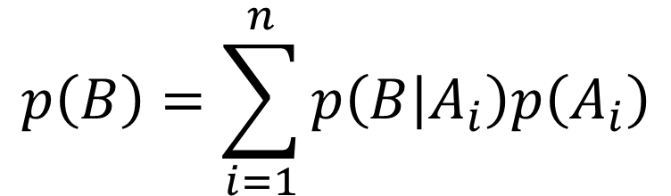
Total Probability
$$p\left(B\right)=\sum_{i=1}^{n}{p\left(B | A_{i}\right)p\left(A_{i}\right)}$$
A₁
A₂
A₃
A₄
B
Ω
Notes:
The equation extends to any number of subcases that build our example. As long as the A parts form a partition, we can compute p(B) from any number of subcases. This is the form that you will generally see in USACE guidance. This can also be used to compute the probability of some third event C, which is a function of A and B.

Slide 20
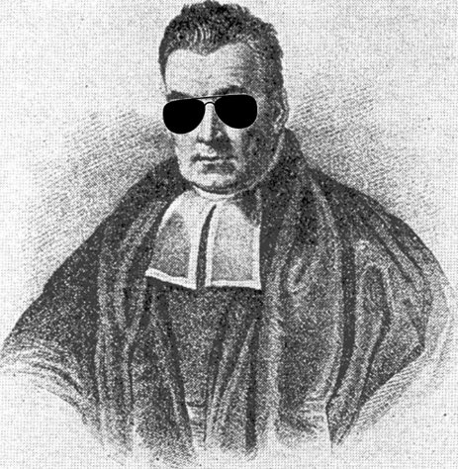

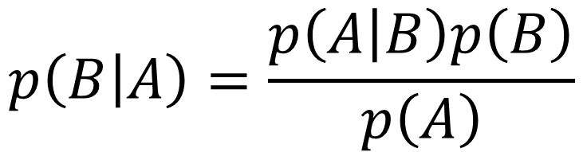
Bayes’ Theorem
$p\left(A | B\right)≠p\left(B | A\right)$ unless $p\left(A\right)=p\left(B\right)$
Reversible using Bayes’ Theorem
Prior
$$p\left(B | A\right)=\frac{p\left(A | B\right)p\left(B\right)}{p\left(A\right)}$$
Can also be called a prior
Notes:
Conditional probabilities aren’t reversible – that is, p(A|B) doesn’t equal p(B|A) unless the marginal probabilities are equal. In order to reverse the condition it requires Bayes’ Theorem.
There are a lot of uses for Bayes’ Theorem. This equation established an entire field of statistics called Bayesian Statistics which is only starting to gain traction in the hydrologic sciences.

Slide 21

Bayes’ Theorem Example

Slide 22


Bayes’ Theorem Example
How likely is Han Solo to successfully navigate an asteroid field?
$p\left(survivor\right)$= 0.99 because he is Han Solo (prior)
$p\left(asterod field | survivor\right)$= 0.10
$p\left(asteroid field | {survivor}^{c}\right)$= 0.80
$p\left(survivor | asteroid field\right)$= ?
$$p\left(survivor | asteroid field\right)=\frac{p\left(asterod field | survivor\right)p\left(survivor\right)}{p\left(asterod field | survivor\right)p\left(survivor\right)+ p\left(asteroid field | {survivor}^{c}\right)p\left({survivor}^{c}\right)}$$
$=\frac{0.10 ∗0.99}{0.10 ∗0.99+0.80 ∗0.01}$
= 0.925

Slide 23
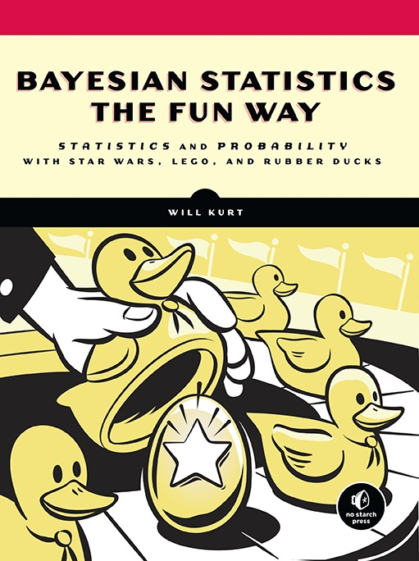

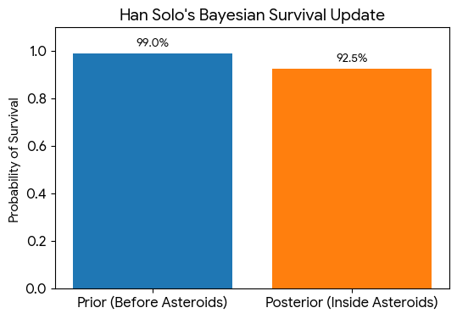

Bayes’ Theorem Example
How likely is Han Solo to successfully navigate an asteroid field?
Frequentist
"The odds of successfully navigating an asteroid field are approximately 3,720 to 1!“
P(survivor | asteroid field) = 1/3271 = 0.00027
Bayesian
Notes:
https://www.countbayesie.com/blog/2015/2/18/hans-solo-and-bayesian-priors

Slide 24

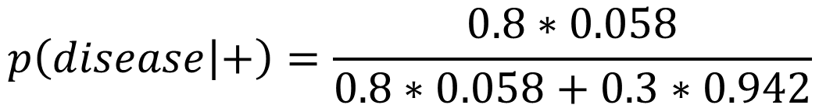
Bayes’ Theorem Example
How likely am I to have a disease, given a positive test for that result?
Sensitivity = 80%, specificity = 70%, prevalence = 5.8%.
$$p\left(disease | +\right)=\frac{p\left(+ | disease\right)p\left(disease\right)}{p\left(+ | disease\right)p\left(disease\right)+p\left(+ | no disease\right)p\left(no disease\right)}$$
$$p\left(disease | +\right)=\frac{0.8∗0.058}{0.8∗0.058+0.3∗0.942}$$
$$p\left(disease | +\right)=0.14$$
Notes:
Let’s try an example. Imagine there is a medical test that detects a specific disease. We label a positive test with the plus sign, and note the situations where the disease is or is not present with “disease” or “no disease.”
The sensitivity of the test, which defines the probability of finding the disease when it is present, is p(+|disease) and is equal to 80%.
The specificity of the test, which defines the probability of getting a negative result when there is no disease, is p(-|no disease) and is equal to 70%. To plug this term into our equation we will need the false-positive rate p(+|no disease) which is the complement of the specificity, and is 30%.
The prevalence of the disease, which defines the fraction of the population that has the disease, is p(disease), and is equal to 5.8%. We will also need the complement to this term p(no disease), which is 94.2%.
First, I am going to re-write Bayes’ Theorem expanding out the denominator using the Law of Total Probability. This will let us put our sensitivity and specificity into the equation correctly. The entire term in the denominator is just taking the marginal probability of getting a positive test, which isn’t easily known, and translating it into things we know. It comes from properties of the test, and the base rate of the disease. In this format, the math is very straightforward.
The numerator is the sensitivity times the prevalence. The denominator is the sum of the sensitivity times the prevalence and the false positive rate times the rate of no disease.
What we see is that despite a positive test in this case, the probability of having the disease is still quite small. This is because the overall probability of having the disease in the general population is quite small. Ignoring the small disease prevalence is a phenomenon called the base rate fallacy and is important to be aware of.

Slide 25
Events
Revisiting the axioms with Venn diagrams
Mutual exclusivity and exhaustivity/partitions
Complements
General additivity
Independence
Joint, Marginal, and Conditional Probability
Notes:
Alright, we got through the heavy machinery of probability. Hopefully after that you feel more comfortable with working with various kinds of events, and computing probability of events described in a number of ways. A number of these tools will be referenced later in this lecture, so if you need to go back and re-watch some of these concepts, it may be worth your time.

Slide 26

Questions?
Check out our Confluence for tutorials, user’s manual, and webinars

