Slide 1
Graphical Frequency Analysis
& Plotting Positions
Will Lehman
May 2026
Flood Frequency Analysis

Slide 2
Goals
Know how a graphical frequency curve differs from an analytical frequency curve
Understand plotting positions, what they estimate, and how they differ from each other
  and that plotting positions are the basis for a graphical frequency curve
Become familiar with the methods of developing graphical frequency curves for regulated flow and stage

Slide 3
Graphical Frequency Analysis
Used for estimating an empirical or just non-analytical frequency curve with no assumed distribution
Used for regulated flows, channel or pool stages, partial duration series

Slide 4
Outline
Graphical Frequency Analysis
Graphical Frequency Analysis
Plotting Positions
  Statistical estimation theory
  Sampling Distributions to define uncertainty
Non-analytic (Graphical) Frequency Curves
  Regulated Flow Frequency Curves
  Stage Frequency Curves

Slide 5
What Is Graphical Frequency Analysis?
Graphical analysis involves fitting a curve to data plotted on probability paper
  The horizontal location at which a data point is plotted is based on a selected plotting position — an empirical estimate of exceedance probability

Slide 6
Natural Variability
large
Value
Aleatory
small
frequent
Probability
infrequent

Slide 7
Maximum Streamflow Naturally varies annualy
Notes:
To support evaluation of the Hazard, it is necessary to evaluate the likelihood of loading. To do this we generally use flow frequency analysis of annual peak data. This example uses historic gage data with 83 years of recorded flows.

Slide 8
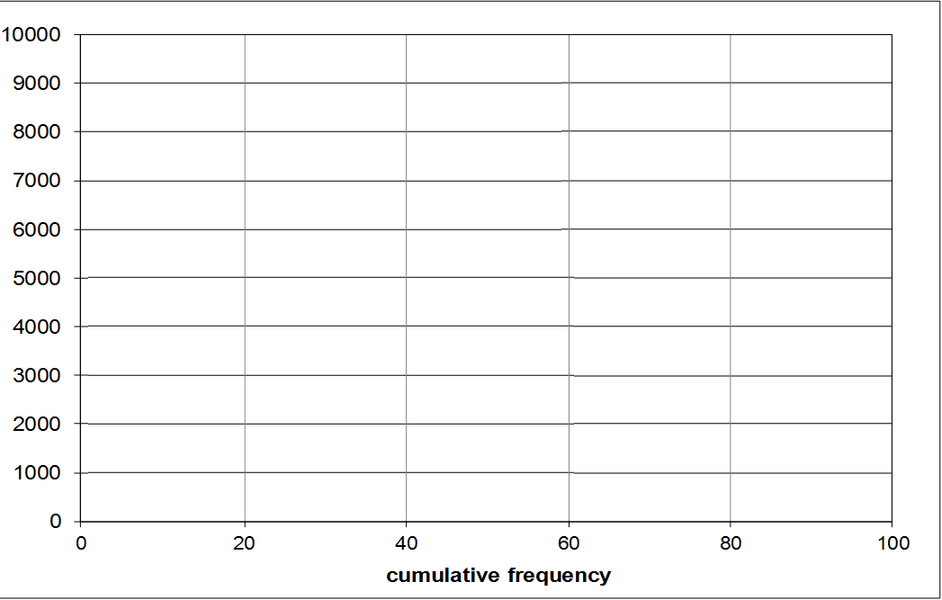
Establish Flow Frequency
Frequency = 1/(N) => 1/83
Frequency = 38/(N) => 38/83
Notes:
The second step in creating a frequency curve is to rank the data and define a probability of exceedance for each event based on the ranked data.

Slide 9
Why Use Graphical Analysis?
Plotting the data is a useful visual check on analytical frequency curves (e.g., frequency curves based on LPIII)
Sometimes, plotted frequencies of stage and regulated flow data cannot be adequately described by an analytical distribution such as Normal, or LPIII
  Under these circumstances, we use a graphical frequency curves – also called non-analytic

Slide 10
Plotted Annual Maximum Regulated Flows
1.01
Return Period
2
5
10
20
100
channel capacity
max hydropower
1
0
Annual Exceedance Probability

Slide 11
Does an Analytical Curve Make Sense?
1.01
Return Period
2
5
10
20
100
channel capacity
max hydropower
1
0
Annual Exceedance Probability

Slide 12
Graphical Curve is Better for this
1.01
Return Period
2
5
10
20
100
channel capacity
max hydropower
1
0
Annual Exceedance Probability

Slide 13
Outline
Graphical Frequency Analysis
Plotting Positions
  Statistical estimation theory
  Sampling Distributions to define uncertainty
Non-analytic (Graphical) Frequency Curves
  Regulated Flow Frequency Curves
  Stage Frequency Curves

Slide 14
Plotting Position – basic idea
A plotting position is an estimate of the exceedance probability for some observation of a random variable, such as flow or stage
For a period of record, plot each observation on the probability axis at the estimate of its exceedance probability based on its relative frequency
Estimated Probability = # of Occurrences
# of Trials → # years
= Relative Frequency

Slide 15
a 30-year record of annual peak flows
1962-1991

Slide 16
Rank the annual events…
1962-1991

Slide 17

Estimate Exceedance Probability by Relative Frequency
exceeded
1 year of 30 ≈ 1/30
≈ .032
exceeded
2 years of 30 ≈ 2/30 ≈ .065
flow vs plotting position

Slide 18
Remember the simple plotting position?
Rank the N observed flows from largest to smallest
The top ranked event has rank m = 1
The second largest event has rank m = 2
...
The smallest event has rank m = N
Estimate cumulative frequency based on the relative frequency of observations within the sample
incremental probability of each 1/N
exceedance probability of each m/N
simple Plotting Position m/N
the rank is the number of times the observation has been equaled or exceeded…

Slide 19
A Problem with simple PP = m/N
Probability of exceeding the smallest value is N/N = 1.0
  this is unreasonable
  it also implies a problem with the exceedance probability estimates for other values
Plotting position m/N is therefore statistically biased

Slide 20
99.5 99 95

Slide 21
Choosing a Plotting Position
How Should a Plotting Position Be Chosen?
Plotting position is an estimator of exceedance probability
  an estimator is generally a function of the data
  two plotting position estimators seen so far are the Median and Weibull plotting positions
Other estimators discussed so far have been for the MEAN, standard deviation and skew

Slide 22
Plotting Position
Standard formula = (m-a)/(n+1-2a)
  Weibull: a= 0.0 => m/(n+1)
  Median: a=0.3175 => (m-0.3175)/(n+0.365)
  Hazen: a=0.5 => (m-0.5)/(n)

Slide 23
Sampling Distribution for Plotting Position
sampling distribution for exceedance probability of X₁
The sampling distribution for the estimate of exceedance probability is NOT symmetrical.
exceeded
1 year of 30 ≈ 1/30 ≈ .033
N = 30 ordered events
Not Normal because Central Limit Theorem does not apply. RVs are not summed

Slide 24
What are we uncertain about?
The estimated exceedance probabilities of events in the record are based on rank and the record length
  i.e., the largest event in N=30 years is assigned a likelihood near 1/30, or 0.033 annual likelihood
In what time period is it actually the largest? Longer than N? Shorter?
Can do a sampling experiment to see what the actual exceedance probability might be for the largest event in 30 years….
  Sample 30 years from U[0,1] as the AEP of each event
  Choose the smallest AEP = largest event from each sample
  Repeat for 1,000 samples
Source:
Dave Margo,
USACE / RMC

Slide 25
What’s the real exceedance prob?
Sample 30 “years” as 30 AEPs ~ U[0,1]
Note the smallest AEP
Repeat for 1,000 samples
1 sample of 30 events as AEPs
smallest AEP from 1000 samples size N=30
approx ~U(0, 1)
1
0

Slide 26
Weibull Plotting Position
The Weibull plotting position is the mean of the sampling distribution at X_{m}, which results in an unbiased estimate of the exceedance probability
Return Period of largest event = N + 1
For N=30,
PP₁ = 0.032
Sampling Experiment
Smallest AEP of 30:
average of 1000
samples = 0.031
Sampling Distribution for Exceedance Probability
mean
X_{m}
1
0
Exceedance Probability of X_{m}

Slide 27
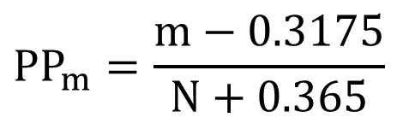
Median Plotting Position
The Median plotting position is the median value of the sampling distribution for estimating the population probability of X_{m}
An approximation for N < 100 is:
Return Period of largest event = 1.5N + 1
$$PP_{m}=\frac{m−0.3175}{N+0.365}$$
For N=30,
PP₁ = 0.023
Sampling Experiment
Smallest AEP of 30:
median of 1000
samples = 0.023
Median Plotting Position
Area = probability = 50%
X_{m}
1
0
Exceedance Probability of X_{m}

Slide 28
Plotting Position Uncertainty, N=30
90% intervals
N=30
Relative frequency of AEP of largest event (smallest AEP) in sample N=30
Plotting Positions versus Rank,
90% confidence interval for largest 3 of 30

Slide 29
Plotting Position Uncertainty, N=62
90% intervals
N=62
Relative frequency of AEP of largest event (smallest AEP) in sample N=62
Plotting Positions versus Rank,
90% confidence interval for largest 3 of 62

Slide 30
Plotting Position Uncertainty, N=100
90% intervals
N=100
Relative frequency of AEP of largest event (smallest AEP) in sample N=100
Plotting Positions versus Rank,
90% confidence interval for largest 3 of 100

Slide 31
Plotting Position Choice
Recommend using Weibull for graphical frequency curves when economic analysis involved
  Calculation of damages requires an expected or mean probability, so use Weibull to estimate graphical a curve
  The Weibull plotting position gives an expected value
Recommend using Median when comparing plotting positions to compute frequency curve such as LP3
Because comparing to a median estimate of LP3

Slide 32
EXAMPLE:
MILL CREEK, LOS MOLINOS, CALIFORNIA
PLOTTING POSITION Comparison

Slide 33
95

Slide 34
Use log(flow) and frequency scale
exceeded
1 year of 30 ≈ 1/30 ≈ .032
exceeded
2 years of 30 ≈ 2/30 ≈ .065
how do we extrapolate?
flow vs plotting position

Slide 35
TIME CHECK – PROCEED IF AVITAL SAYS OK.

Slide 36
Outline
Graphical Frequency Analysis
Plotting Positions
  Statistical estimation theory
  Sampling Distributions to define uncertainty
Non-analytic (Graphical) Frequency Curves
  Regulated Flow Frequency Curves
  Stage Frequency Curves

Slide 37
Regulated Frequency Curves
Two methods to produce a graphical regulated flow frequency curve:
Estimate a regulated frequency curve with regulated flow data and graphical frequency analysis
Develop unregulated flow frequency curve with LP3 fit. Combine it with reservoir regulation relationship to produce a graphical, regulated flow frequency curve
  Note the added uncertainty in the inflow/outflow relationship

Slide 38
Regulated Frequency Curves
first method: graphical fit to annual peak regulated flow data
Source of regulated flow data:
  Observed data downstream of dam
  Route inflows through dam with reservoir model
    Use period of record inflows
    Estimate inflows from continuous simulation model

Slide 39
How do we extrapolate?!
Unregulated Curve based on 100 years of record
Regulated Curve
Regulated Data

Slide 40
Streamflow data, regulated
period of record 1955 - 2009
homogeneous = identically-distributed = stationary
Is this regulation homogeneous?
reservoir constructed
Notes:
The red line is the reservoir outflows, beginning when the reservoir was constructed (1955) and ending in 2005. These are regulated flows.
We can extract an annual maxima series of this data we have 2 issues:
Are we looking at homogeneous data during the regulated period? Was the reservoir regulated the same way during this period? Usually not. Reservoir operations change. Not identically distributed and not stationary.
Record lengths are different: 108 years of unregulated flow vs. 50 yrs of regulated flows
We can route our entire POR of data through our reservoir simulation model to ensure we have homogeneous data (the same and current reservoir operations) and expand data set

Slide 41
Developing Regulated Flow-Frequency Curve
Second Method:
  Combine UNREGULATED flow-frequency curve with ‘unreg-regulated’ relationship

Slide 42
Historical Reservoir Regulation Data
Regulated-Unregulated Relationship
PMF
250-yr
might instead create this relationship with a reservoir simulation model

Slide 43
Unregulated Curve based on 100 years of record
Regulated Curve

Slide 44
Additional Uncertainties in Regulation
Often, there is incidental flood management provided by reservoir water supply pool
  Reservoir starts with more flood space
  Non-flood reservoirs upstream might reduce peak
There are uncertainties in flood operation
  Real-time flood forecasts are sometimes used, and are contain a great deal of uncertainty
  Releases might be curtailed or diminished due to unforeseen contingencies, not using full capacities.
  Might reduce release to account for runoff below reservoir

Slide 45
Outline
Graphical Frequency Analysis
Plotting Positions
  Statistical estimation theory
  Sampling Distributions to define uncertainty
Non-analytic (Graphical) Frequency Curves
  Regulated Flow Frequency Curves
  Stage Frequency Curves

Slide 46
Stage-Frequency Curves
Two methods to produce a stage-frequency curve:
Estimate stage-frequency curve with stage data and graphical frequency analysis
Develop a flow frequency curve. Combine it with CURRENT flow-stage rating curve to produce stage-frequency curve
  requires a one-to-one relationship between flow and stage, which might not be feasible when complex water systems involved (backwater, tidal)
  better if flow is not regulated, and can use analytical fit

Slide 47
Stage Frequency Analysis
first method, graphical fit to annual peak stage data:
  Use graphical frequency analysis, because analytical curve would smooth out relevant irregularities
  Pay attention to relevant stages: bottom, bankfull, etc
  A linear rather than log-scale is more reasonable
  Source of stage data:
    Observed gaged record (USGS peak flow file)
    Continuous simulation of hydraulic model, based on surrounding longer record gages

Slide 48
Sacramento River at Walnut Creek, Stage-Frequency
1944 – 1988 annual peak stages
?
?

Slide 49
Developing Stage-Frequency Curve
Second Method:
  Combine flow-frequency curve with flow-stage relationship

Slide 50
Example Stage/Flow Rating Curve

Slide 51
Resulting Stage-Frequency Curve
Flow-Freq Curve based on 100 years of record
What uncertainties must we consider here?
Stage Curve

Slide 52
Developing Stage-Frequency Curve
Magical Method three:
  Combine flow-frequency curve with hydraulic simulation to create simulated record

Slide 53
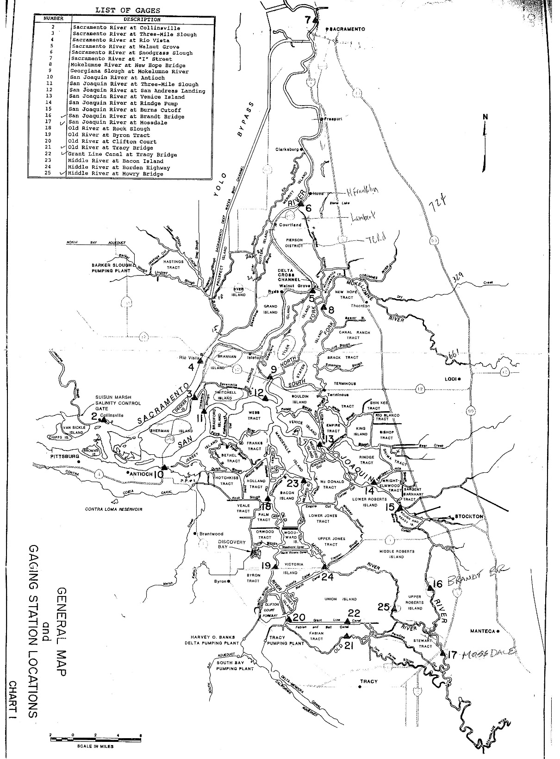
Sacramento River
Sometimes, it is not possible to define a one-to-one relationship between flow and stage
Sacramento-San Joaquin Delta, confluence of Sacramento and San Joaquin Rivers
San Joaquin River

Slide 54
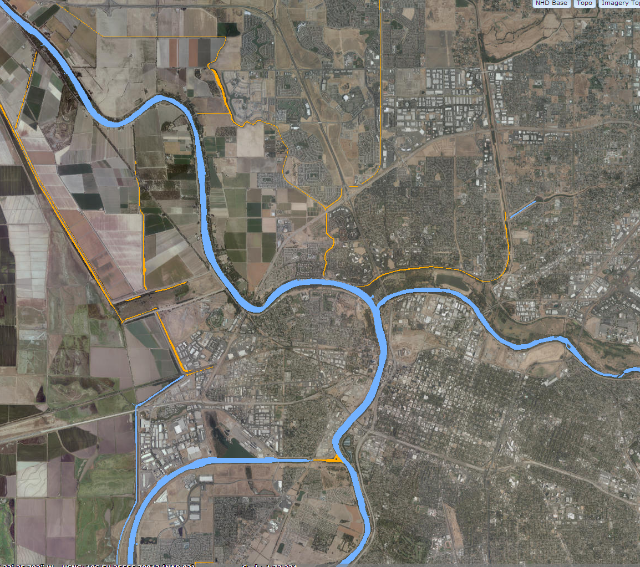
Hydraulic Modeling of the Period of Record
Sacramento River
Sacramento River
Sacramento River
American River
Sacramento Weir
Sacramento Weir
American River
Sacramento
Yolo Bypass
ship channel

Slide 55
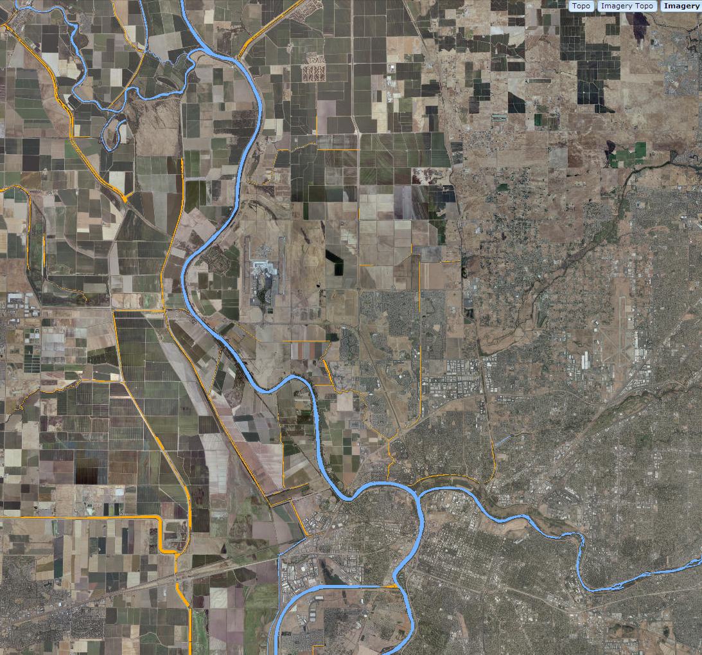
Sutter Bypass
Feather River
Sutter Bypass
Feather River
Fremont Weir
Fremont Weir
Sacramento River
Sacramento River
Yolo Bypass
Sacramento Weir
American River
Sacramento Weir
American River
Sacramento
Yolo Bypass
Delta
Sacramento-SanJoaquin Delta

Slide 56
Outline
Graphical Frequency Analysis
Plotting Positions
  Statistical estimation theory
  Sampling Distributions to define uncertainty
Non-analytic (Graphical) Frequency Curves
  Regulated Flow Frequency Curves
  Stage Frequency Curves

