Slide 1
U.S. Army corps of engineers
Streamflow Record Extension
05 May 2022
Ryan Cahill, Portland District
(with much source material from Beth Faber and Chuck Parrett)

Slide 2
Outline
Problem statement
Regression basics
Annual Peak extension
Continuous extension (e.g. daily)
Common pitfalls

Slide 3
Problem Statement
Problem: Not much data at a location of interest
Solution: Use a nearby long-term site to extend the record

Slide 4
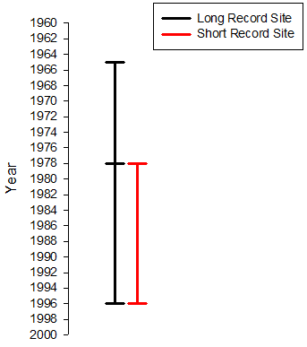
Another view
Use the relationship to fill in missing record at the short-term site (N₂=13)
Develop a relationship from the concurrent record (N₁=18)

Slide 5
Outline
Problem statement
Regression basics
Annual Peak extension
Continuous extension (e.g. daily)
Common pitfalls

Slide 6
Basic Regression Concept
Can knowing the value of one variable help predict the value of another variable?

Slide 7
Basic Regression Concept
If there is no relationship, the best prediction of variable Y is simply the mean of variable Y…

Slide 8
Basic Regression Concept
If there is no relationship, the best prediction of variable Y is simply the mean of variable Y…
error

Slide 9
Basic Regression Concept
If variable X has some ability to help predict variable Y, we seek a relationship between the two

Slide 10
Basic Regression Concept
If variable X has some ability to help predict variable Y, we seek a relationship between the two
error

Slide 11
Ordinary Least-Squares Regression
In OLS, the “best” relationship between variable X and variable Y is one the minimizes the sum of squared errors
Y = m X + b
m = slope
b = intercept

Slide 12
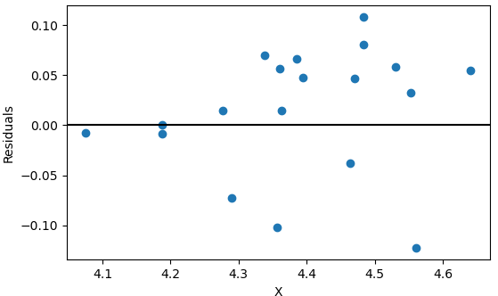
Quality and Assumptions
Goodness-of-fit metrics:
R² = squared correlation
  % of the variability in Y explained by the variability in X
standard error = square root of the sum of squared errors
Assumptions:
errors are homoscedastic = evenly distributed across X
errors are normally distributed

Slide 13
Correlation
correlation = 0 correlation = 0.7 correlation = 1.0
correlation = -0.6 correlation = -1.0

Slide 14
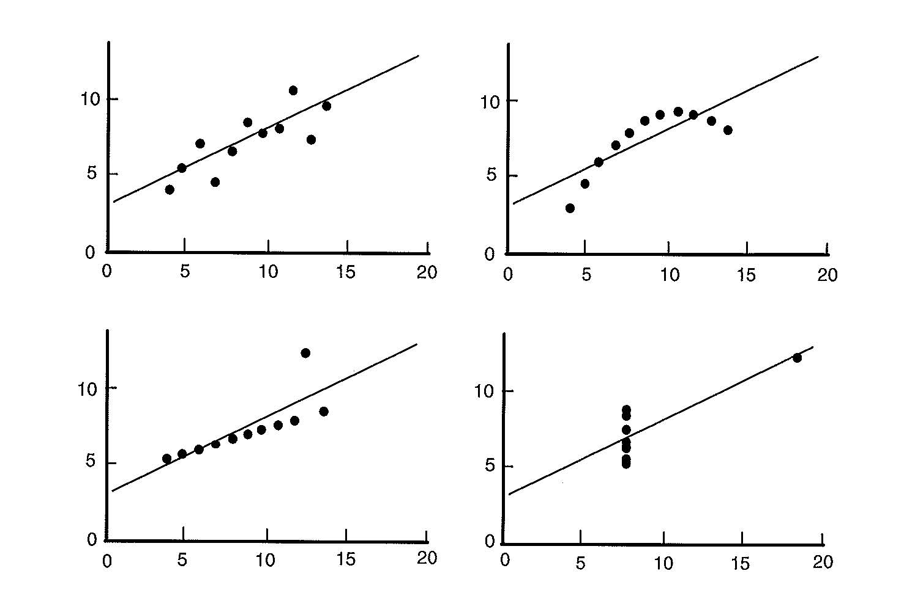
Regression Diagnostics
R² and Standard Error can be misleading
Plot the data
Same R² and SE on all graphs (Anscombe 1973)

Slide 15
Why least-squares?
Other measures of “closeness” could be used (e.g. absolute value of errors)
It is mathematically convenient—there is no analytical solution to the absolute value method

Slide 16
Basic Regression Concept
Estimates of variable Y, when only Variable X is available, will follow the regression line
Y = m X + b
m = slope
b = intercept

Slide 17

OLS Regression
OLS is preferred method of predicting a particular value of Y given a value of X
But…
If |r| < 1 (nonperfect fit), then variance of predicted values of Y will tend to be less than variance of true values. That is,
Reduced variance for a series of estimates is a problem for record extension
$$E\left[S_{\hat{Y}}^{2}\right]<σ_{Y}^{2}$$

Slide 18
Line of Organic Correlation (LOC)
The LOC is the line that minimizes the sum of squared geometric distances in both the X and Y direction
This method does not reduce variance of predictions
Used for MOVE.1 record extension technique
Minimize areas of right
triangles
Notes:
Symmetric regression

Slide 19
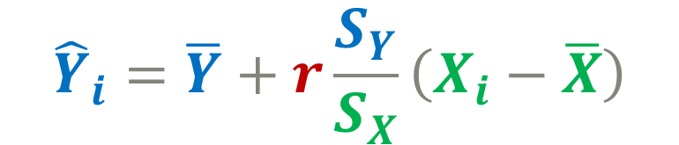
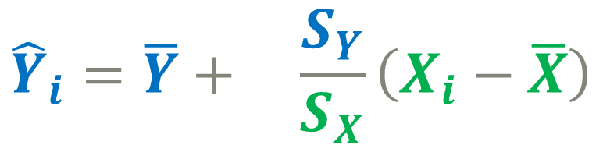
Regression Equations
OLS:
LOC:
$${\hat{Y}}_{i}=\overline{Y}+r\frac{S_{Y}}{S_{X}}\left(X_{i}−\overline{X}\right)$$
$${\hat{Y}}_{i}=\overline{Y}+ \frac{S_{Y}}{S_{X}}\left(X_{i}−\overline{X}\right)$$
No “r” term here

Slide 20
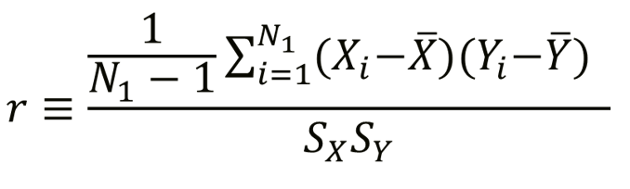

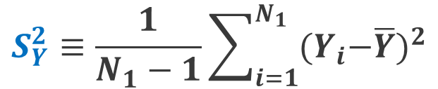
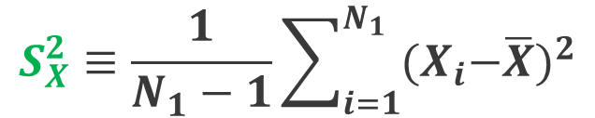

Statistics (based on logs) for Concurrent Record (N₁)
longer record station
shorter record station
$$\overline{X}≡\frac{1}{N_{1}}\sum_{i=1}^{N_{1}}{X_{i}}$$
$$\overline{Y}≡\frac{1}{N_{1}}\sum_{i=1}^{N_{1}}{Y_{i}}$$
$$S_{X}^{2}≡\frac{1}{N_{1}−1}\sum_{i=1}^{N_{1}}{{{(X}_{i}−\overline{X})}^{2}}$$
$$S_{Y}^{2}≡\frac{1}{N_{1}−1}\sum_{i=1}^{N_{1}}{{{(Y}_{i}−\overline{Y})}^{2}}$$

Slide 21
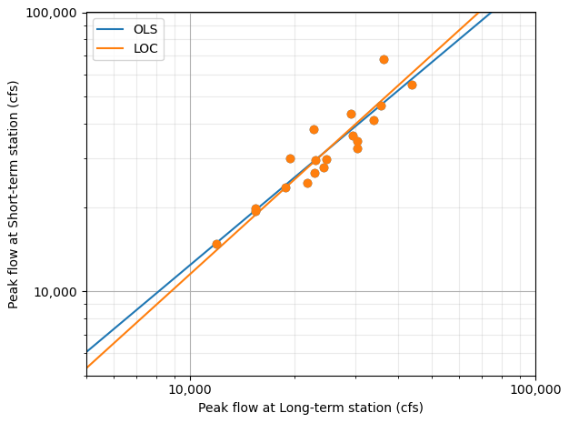
OLS vs LOC
For streamflow record extension applications, LOC produces higher estimates for large flows and lower estimates for small flows
r = 0.93

Slide 22
Outline
Problem statement
Regression basics
Annual Peak extension
Continuous extension (e.g. daily)
Common pitfalls

Slide 23
Annual Peak Flow Extension
Goal is typically a Bulletin 17C analysis
All record extension techniques use logarithm of flow
Step 1: Develop a linear relationship between X and Y (the long and short record stations) using the concurrent record
Step 2: Use the relationship to estimate values for the short record station for times we only have values for the long record station (non-concurrent)
Step 3: Perform a frequency analysis on the extended dataset using the Expected Moments Algorithm

Slide 24
How Should We Select a Long-Term Site for Record Extension?
Various studies have recommended that the correlation coefficient (r) between short-term and long-term sites for the concurrent record be 0.8 or greater.
Long-term sites with flow values in the non-concurrent record period that are substantially outside the range of values in the concurrent period may provide more information than other potential long-term sites.
More than one long-term site can be used and results weighted (perhaps using r or record length) with results from another long-term site.
Long-term sites should be near the short-term site with similar basin characteristics

Slide 25
Past Methods
Methods not typically used in current practice for annual peak extension:
OLS Regression Plus Noise (RPN)
Maintenance of Variance Extension (MOVE)
  MOVE.1
  MOVE.2
  MOVE.3 (as originally formulated in Vogel and Stedinger 1985)
  MOVE.4
  GMOVE
Two-station comparison used in Bulletin 17B (MOVE.2)

Slide 26
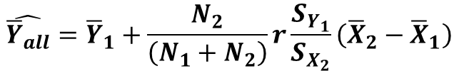
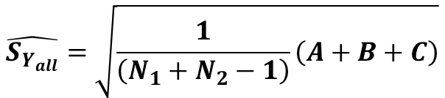
Matalas-Jacobs Estimators
Updated mean and standard deviation of the shorter station, based on the full record of the longer station.
Used in both MOVE.2 (two-station comparison in Bulletin 17B) and MOVE.3
X = Longer station
Y = Shorter station
$$\hat{{\overline{Y}}_{all}}={\overline{Y}}_{1}+\frac{N_{2}}{\left(N_{1}+N_{2}\right)}r\frac{S_{Y_{1}}}{S_{X_{2}}}\left({\overline{X}}_{2}−{\overline{X}}_{1}\right)$$
Matalas-Jacobs
Estimators
$$\hat{S_{Y_{all}}}=\sqrt{\frac{1}{\left(N_{1}+N_{2}−1\right)}\left(A+B+C\right)}$$
N₁ = concurrent record, N₂ = additional record

Slide 27

Current Method
Appendix 8 of Bulletin 17C contains guidance on record extension
  Make sure to use Version 1.1 of Bulletin 17C, not the original published version
Bulletin 17C recommends the MOVE.3 technique, but with a twist

Slide 28
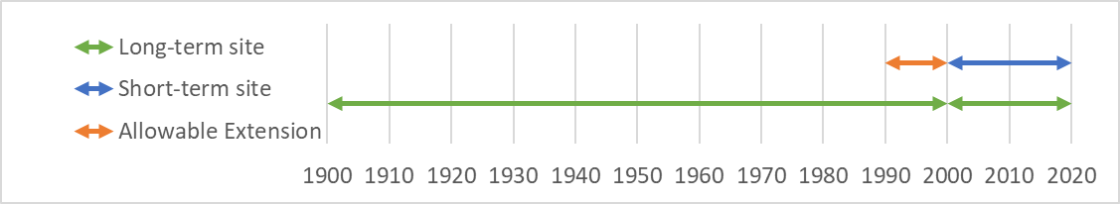
MOVE.3 (Bulletin 17C version)
Original MOVE.3 allows for extension to be performed for every non-concurrent value of the long-term site (N₂)
If the long-term site has many more years than the short-term site, we would get a false sense of confidence in our estimates at the short-term site
The “twist” adopted by Bulletin 17C:
  Define n_{e}: the maximum number of years allowable for record extension.
  Higher correlation = higher n_{e}
  Modify MOVE.3 equations to use n_{e} instead of N₂
n_{e}
N₂
N₁

Slide 29
MOVE.3 (Bulletin 17C version)
n_{e} is calculated twice in Bulletin 17C:
  Max allowable n_{e} for the mean
  Max allowable n_{e} for the variance
#2 is always smaller than #1, so it governs

Slide 30
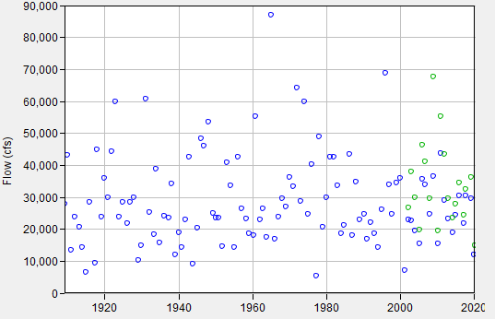
Which years to extend?
Only n_{e} years of record extension are allowed.
Which years should we pick?
Different year selections will not affect the mean or variance, but will affect the skew
Bulletin 17C allows for judgment of the analyst on year selection to ensure the skew isn’t misrepresented
N_{e}?
N_{e}?
N_{e}?
N_{e}?

Slide 31
Which years to extend?
Default: use the most recent years. Usually just fine
But if a sequence of unusually big floods or small floods is in n_{e}, may need to adjust:
  Compute the skew using a record extension for the entire period of record (original MOVE.3 technique using N₂, not limited to n_{e})
  Select a sequence of n_{e} years that results in a similar skew value
N_{e}?
N_{e}?
N_{e}?
N_{e}?

Slide 32
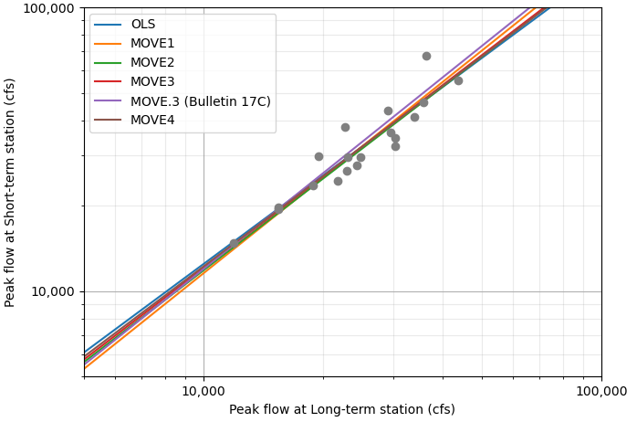
Record Extension Method Comparison
For many real-world datasets, the various record extension techniques produce similar regression lines

Slide 33


MOVE.3 Line (Bulletin 17C)
Refer to Bulletin 17C for the full equations
X = Longer station
Y = Shorter station
$${\hat{Y}}_{i }=a+b(X_{i}−{\overline{X}}_{e})$$
$$a=\frac{\left(N_{1}+N_{e}\right)\hat{{\overline{Y}}_{all}}−N_{1}{\overline{Y}}_{1}}{N_{e}}$$
N₁ = concurrent record, N_{e} = additional record
$$b^{2}=\frac{\left(N_{1}+N_{e}−1\right)\hat{S_{Y_{all}}^{2}}−{(N}_{1}−1)S_{Y_{1}}^{2}−N_{1}({\overline{Y}}_{1}{− \hat{{\overline{Y}}_{all}})}^{2}−N_{e}(a−\hat{{\overline{Y}}_{all}})}{\left[(N_{e}−1)S_{X_{2}}^{2}\right]}$$

Slide 34
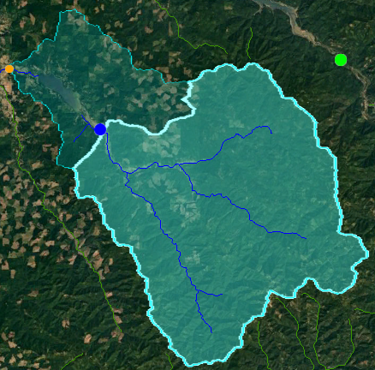

Sidebar: Drainage Area Ratio
Uses a ratio of the drainage area between two locations to estimate periods of missing flow.
$$Y= {X\left(\frac{A_{y}}{A_{x}}\right)}^{\text{ϕ}}$$
Y = flow estimate at missing station
X = known flow at long-term station
Ay = Drainage area of missing station
Ax = Drainage area of long-term station
Φ = 1, unless there is a regional regression study
Missing station (downstream):
Drainage Area = 270 sq. miles
DAR = 270/211
= 1.28
Long-term station (upstream):
Drainage Area = 211 sq. miles

Slide 35
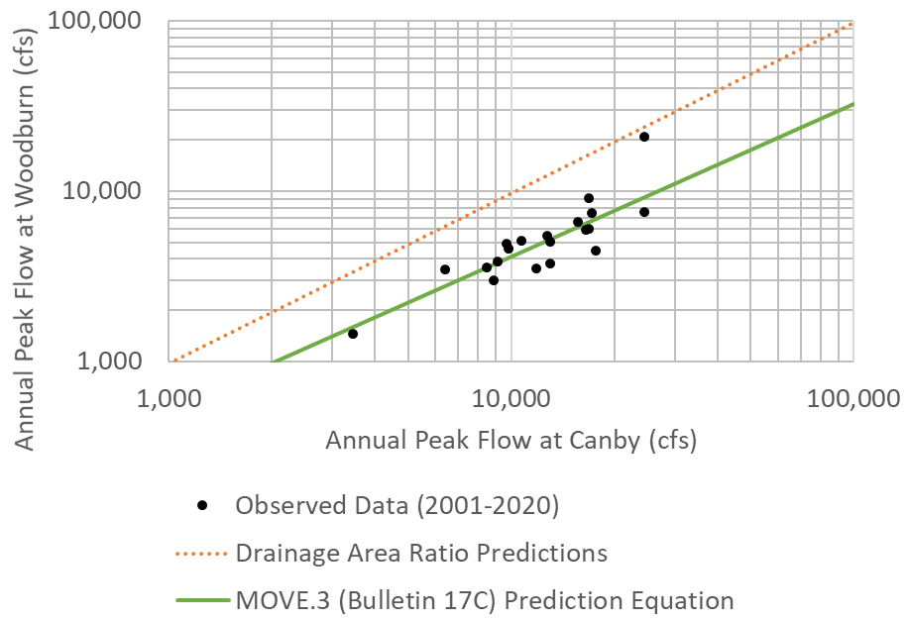
Sidebar: drainage Area Ratio
Generally works well when two sites are on the same river, with drainage areas within 50% of each other
Always use a record extension technique (e.g. MOVE.3) instead of a drainage area ratio when concurrent record is available.
Can produce poor results if different streams are used.

Slide 36
Outline
Problem statement
Regression basics
Annual Peak extension
Continuous extension (e.g. daily)
Common pitfalls

Slide 37
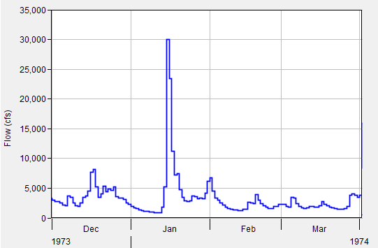
Daily record extension
MOVE.1 is usually used (Line of Organic Correlation)
Why do daily extensions?
  Missing very short periods of time
  Long-term simulations of reservoir operations
  Hydropower modeling
If flood-frequency is the goal, use MOVE.3 from Bulletin 17C instead

Slide 38
Serial correlation
In the context of time series, the error in a period may influence the error in a subsequent period
If there are factors (other than the independent variables) making the observation at some point in time larger than expected, (i.e., a positive error), those same factors may linger, creating a positive bias in the error term of a subsequent period.
Known as positive first-order serial correlation

Slide 39
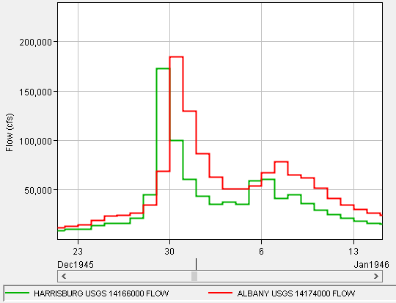
Dealing with serial correlation
Test it, using Durbin-Watson
Break the regression up seasonally
Can route/lag the data before doing the regression to account for routing effects

Slide 40
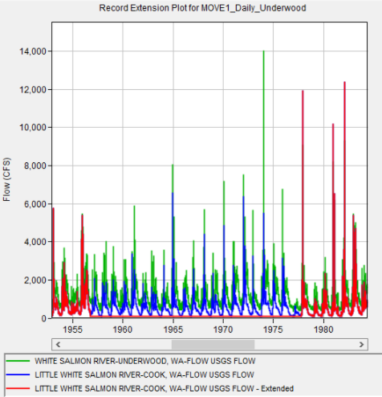
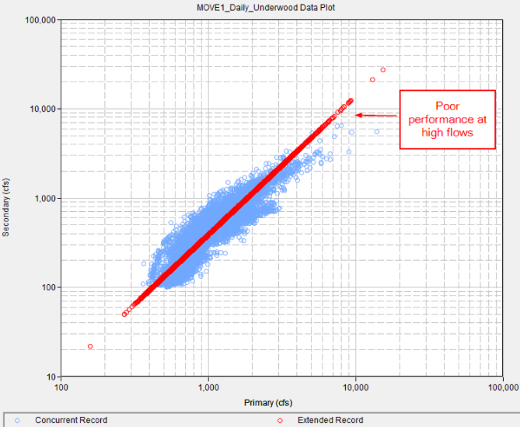
Daily Flow Extension Example

Slide 41
Outline
Problem statement
Regression basics
Annual Peak extension
Continuous extension (e.g. daily)
Common pitfalls

Slide 42
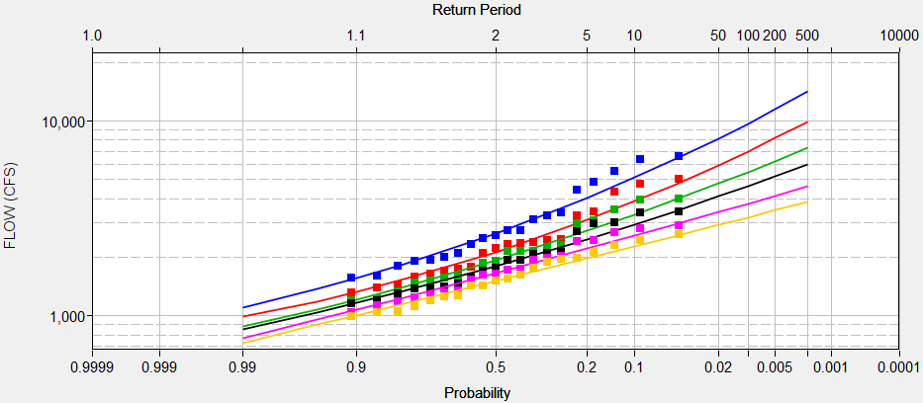
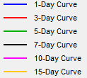
Pitfall: Volume Frequency Curves
Pitfall: Do a MOVE.1 extension on daily data, and then calculate volume-frequency curves directly from this extended record
  Regression is not focused on flood events
  Ignores the concept of limiting the extension by only n_{e} years
Better idea: use a separate MOVE.3 (Bulletin 17C) record extension for each duration.

Slide 43
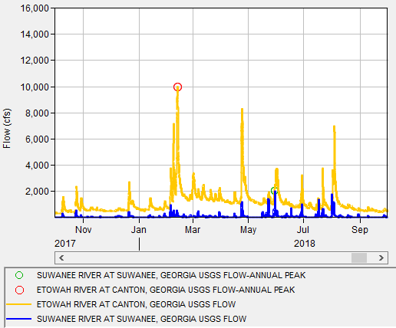
Pitfall: Input Data
Pitfall: Use MOVE.3 record extension with annual peak flow records without examination
  Peak flow may be generated by completely different storms months apart, hydrologically unrelated

Slide 44
Pitfall: Input Data
Better idea: Examine the input data. Ensure the date of peak flow is from the same storm event. Peaks should be within a few days. Can use a correlation analysis in SSP.
What about years with date of peak far apart? Can either:
  Drop the year altogether (less preferred)
  Try to find short-interval streamflow data from the same storm event and use it in the regression instead.
Use max flow value here instead

Slide 45
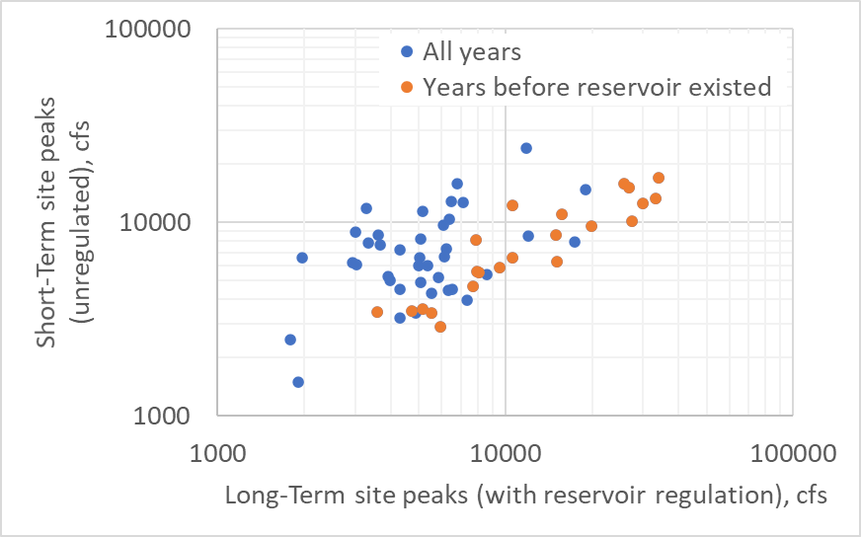
Pitfall: Regulated Data
Pitfall: Use record extension techniques at sites heavily affected by upstream reservoirs
Better idea: Only do record extension on unregulated data (both pre-dam and reconstructed post-dam records)

Slide 46
Pitfall: Record Extension as flow intervals
The n_{e} years of extended data are input as systematic data to an EMA analysis.
What about the other years?
No information?
N_{e}

Slide 47
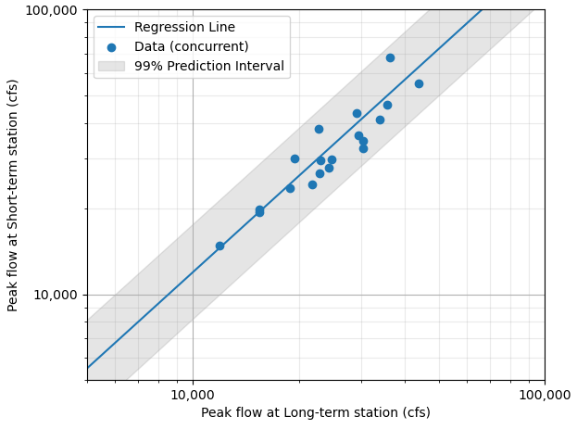
Pitfall: Record Extension as flow intervals
Pitfall: Represent them as flow intervals
  Seems appealing, since the selection of which years to use as n_{e} becomes less important
  Uncertainty bounds shrink significantly when this is done, which is inappropriate
  Mean and std deviation also will differ from the Matalas-Jacobs estimators

Slide 48
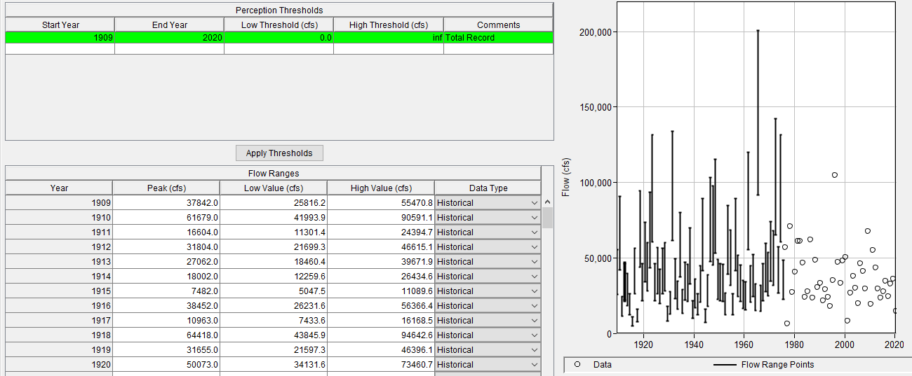
Pitfall: Record Extension as flow intervals
N_{e}
Lower/Upper bounds of 99% prediction interval

Slide 49
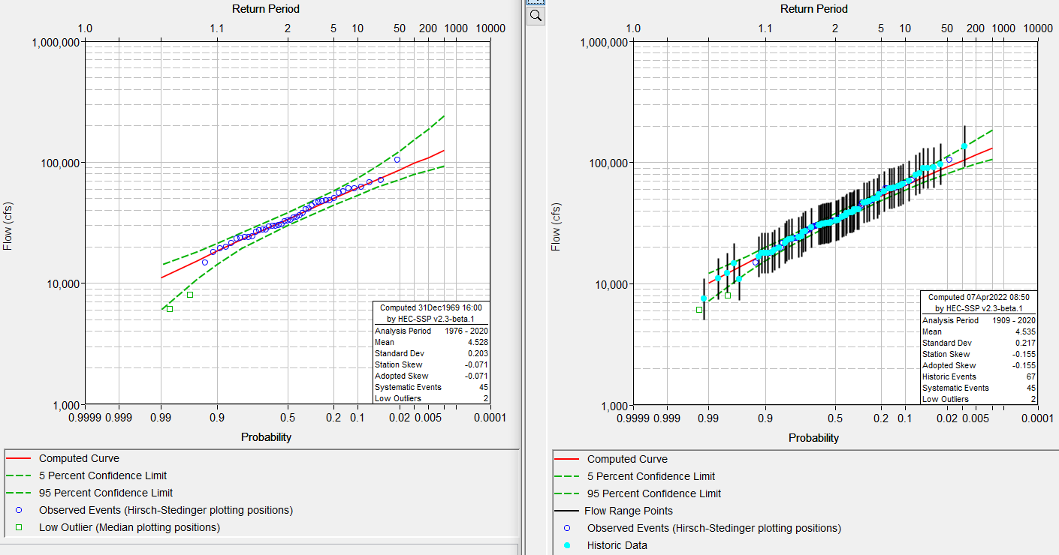
Pitfall: Record Extension as flow intervals
Using only n_{e} years of extension
Using n_{e} years of extension + flow intervals

Slide 50
Pitfall: Record Extension as flow intervals
Better idea: take care that selection of which n_{e} years to extend matches the skew from an extension using the full record length
No information?
N_{e}

Slide 51
Summary of Estimation Techniques
Method | Purpose | Uses
Drainage Area Ratio | Approximate analysis is good enough | Two gages are very close together, minimal effort
Ordinary Least Squares (OLS) Regression | Best individual flow estimates | Someone wants to get the best estimate peak flow for one particular year
Maintenance of Variance Extension (MOVE.1) | Filling in daily flows in an extended period | Water resources planning and management models; reservoir design and operation
Maintenance of Variance Extension (MOVE.3, Bulletin 17C) | Estimate flood peaks for years with missing data | Flood-Frequency Analysis

Slide 52
Questions

Slide 53
References
Alley, W. M., and A. W. Burns, 1983. Mixed-station extension of monthly streamflow records, J. Hydraul. Div. Am. Soc. Civ. Eng., 109(10), p. 1271-1284.
Bulletin 17b, 1982. Guidelines for Determining Flow Frequency Analysis: Interagency Advisory Committee on Water Data, USGS, Office of Water Data Collection, Reston, Virginia.
England, J.F. Jr., Cohn, T.A., Faber, B.A., Stedinger, J.R., Thomas, W.O., Jr., Veilleux, A.G., Kiang, J.E., and Mason, R.R., Jr., 2018, Guidelines for determining flood flow frequency—Bulletin 17C: U.S. Geological Survey Techniques and Methods, book 4, chap. B5, 148 p https://doi.org/10.3133/tm4B5.

Slide 54
References
Granato, G. 2008, Streamflow Record Extension Facilitator (SREF), USGS Open-File Report 2008–1362.
Helsel, D.R., and Hirsch, R.M., 2002, Statistical methods in water resources: Techniques of Water-Resources Investigations of the U.S. Geological Survey, Book 4, Chapter A3. , New York, Elsevier, 510 p. https://pubs.usgs.gov/twri/twri4a3/pdf/twri4a3-new.pdf
Hirsch, R.M., 1982, A comparison of four streamflow record extension techniques: Water Resources Research, v. 18, no. 4, p. 1081-1088.
Matalas, N.C. and Jacobs, B., 1964, A correlation procedure for augmenting hydrologic data: U.S. Geological Survey Professional Paper 434-E.

Slide 55
References
Parrett, Charles, and others, 2011, Regional skew for California, and flood frequency for selected sites in the Sacramento–San Joaquin River Basin, based on data through water year 2006, Appendix A: U.S. Geological Survey Scientific Investigations Report 2010–5260, p. 41-85.
Stedinger, J.R., and Tasker, G.D., 1985, Regional hydrologic analysis 1—Ordinary, weighted, and generalized least squares compared: Water Resources Research, v. 21, no. 9, p. 1,421-1,432. [with correction , in Stedinger, J.R., and Tasker, G.D., 1986, Water Resources Research, v. 22, no. 5, p. 844].
Vogel, R.M., and Stedinger, J.R., 1985. Minimum Variance Streamflow Record Augmentation Procedures: Water Resources Research V21(5), p715-723.

